Slide 1
RASCAL Beginner Training
Sam Hanson, PhD
January 27, 2026
0930-1200 ET

Slide 2

RASCAL Team
RAMP
U.S. NRC Office of Regulatory Research (RES)
RASCAL Primary User
U.S. NRC Office of Nuclear Security and Incident Response (NSIR)
Rigel Flora
Health Physicist, RASCAL Project Manager
Sam Edwards
Computer Scientist
Stephanie Bush-Goddard, PhD
RAMP Manager
Sam Hanson, PhD
Health Physicist

Slide 3
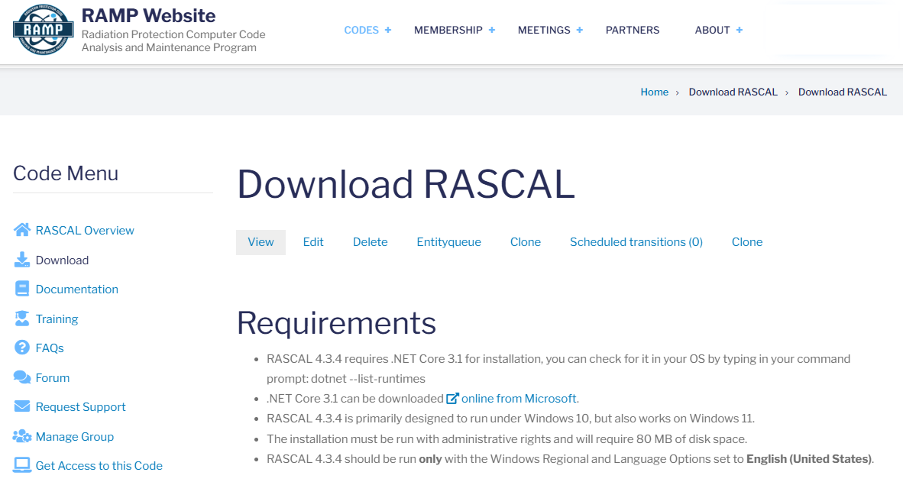
Training and support at ramp.nrc-gateway.gov
Need Account to Access
Non-Disclosure Agreement (NDA)
Fed/State/Local/International/Private
Code Distribution
Technical Support
Technical documentation (NUREGs)
Training
FAQs & Forums

Slide 4
RASCAL Resources
NUREG-1887 for RASCAL 3
NUREG-1940 for RASCAL 4
NUREG-1465 for LOCA
SOARCA for SBO
Aviationweather.gov for meteorology (U.S.)

Slide 5


RASCAL Slide
Every time we ask you to use RASCAL, you’ll see one of these blue slides.
It will include information needed to complete the steps.

Slide 6
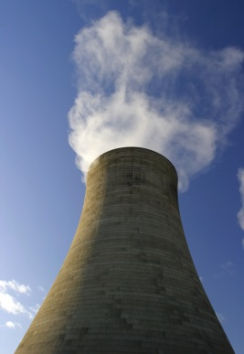
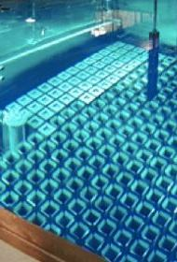
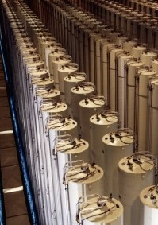
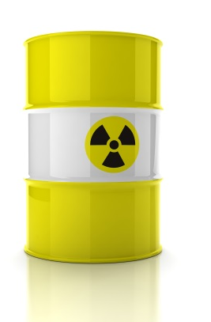
Technology Review
Nuclear Power Plant
Spent Fuel
Fuel Cycle
Other Material

Slide 7
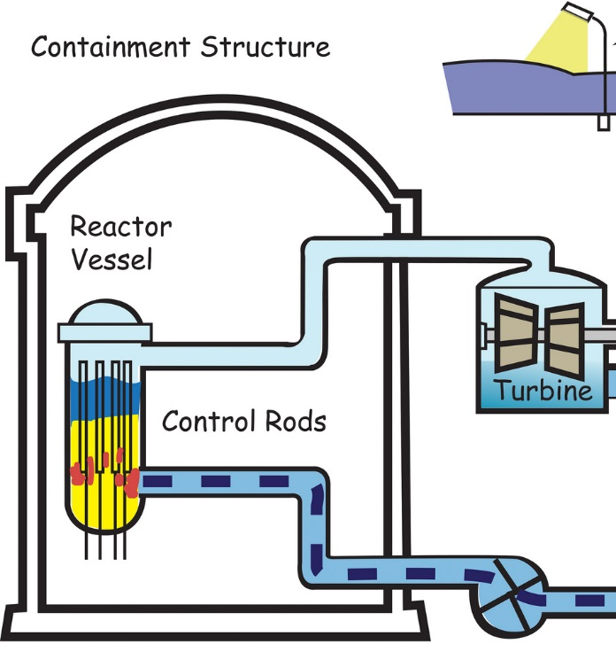
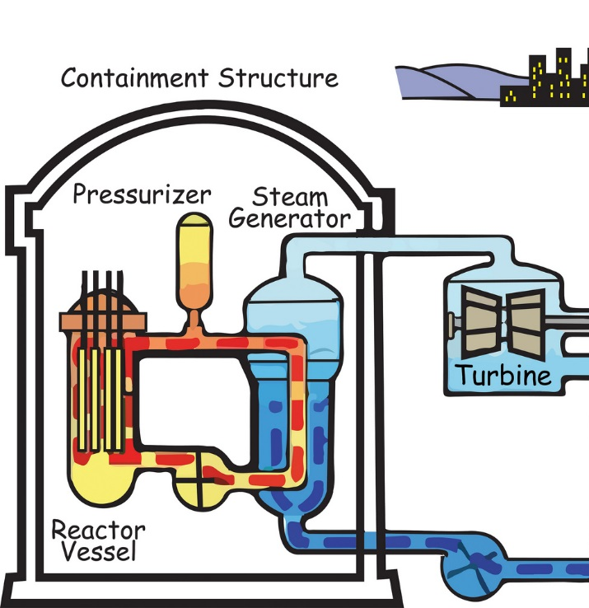
Reactor Types
Core inside reactor vessel creates heat, steam is created (main loop in BWR, secondary loop in PWR), steam turns turbine, which produces electricity
Boiling Water Reactor (BWR)
Pressurized Water Reactor (PWR)

Slide 8
Large releases will come from major fuel damage, only caused from lack of cooling
No heat removal leads to fuel cladding failure and fuel melt
Eventual RCS overpressure / leakage
Possible containment overpressure / leakage
Defense in Depth
Notes:
Defense In Depth

Slide 9
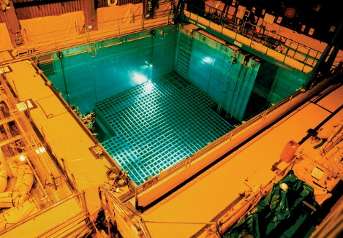
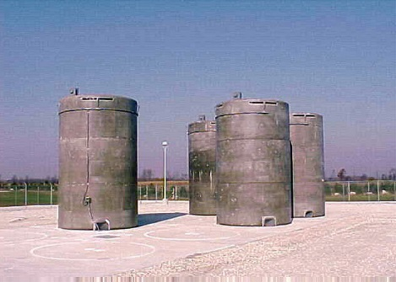
Spent Fuel
Every 12-24 months, a fraction of reactor core is replaced and moved to a pool to cool.
5-10 years later, cooler fuel moved to dry cask

Slide 10
Fuel Cycle
Fuel cycle facilities convert, enrich, and fabricate mined material into reactor fuel
RASCAL Supports these accident types:
UF₆ Cylinders
Criticality
Fire/Explosions involving Uranium Oxide

Slide 11
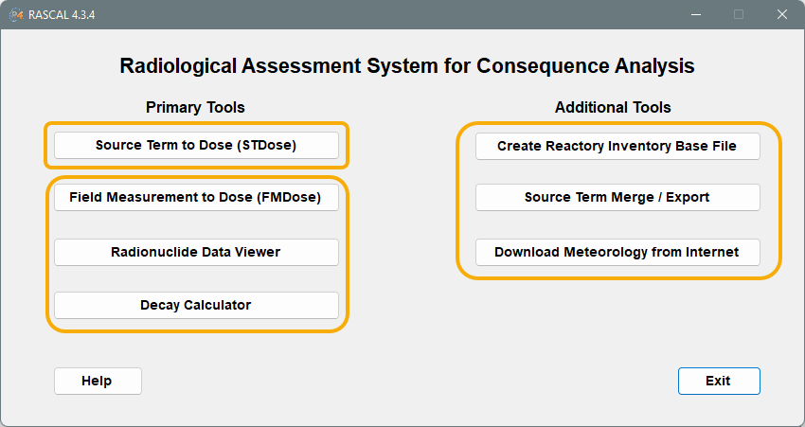
There are 4 primary tools and 3 additional tools on the RASCAL Home Page.

Slide 12
Where does RASCAL fit in the phases of a radiological emergency?
Pre-release
Plume (early)
Intermediate
Ingestion
RASCAL (STDose)
RASCAL (FMDose)
Turbo FRMAC

Slide 13
Our Training Will Focus on STDose
Source Term to Dose module creates an atmospheric source term, processes weather data, and calculates doses
Wind
Atmospheric Source Term
Plume
Generation of Source Material
Dose/Concentration

Slide 14
RASCAL Defines Atmospheric Source Term
Determines radionuclides available for release
May be single nuclide or complex core damage
Time-dependent isotopes and activity
Source material may be filtered, reduced, or decayed
Wind
Atmospheric Source Term
Plume
Generation of Source Material
Dose/Concentration

Slide 15
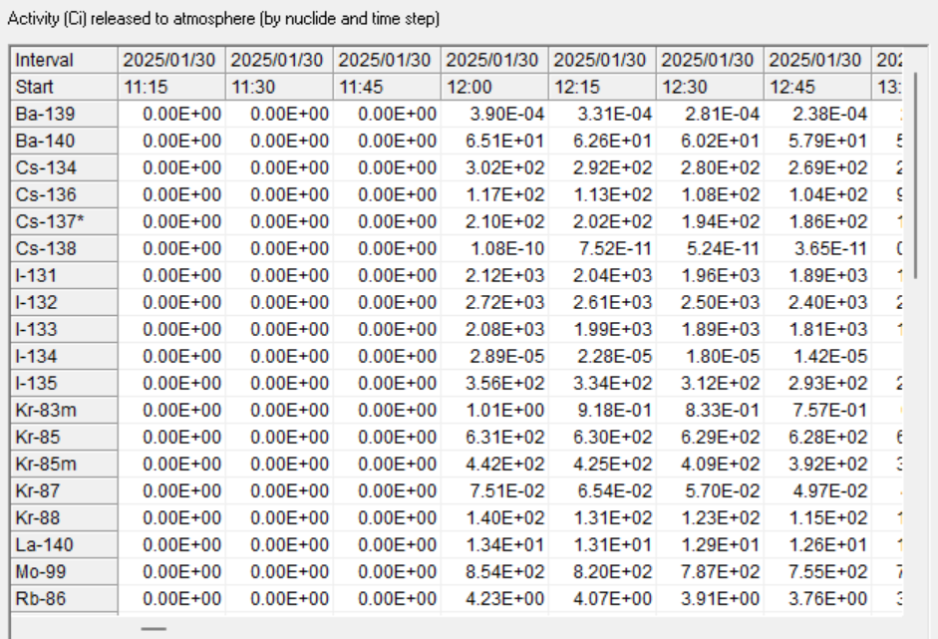
Result is Radionuclides Released to Environment Over Time (Atmospheric Source Term)
Isotopic activity over time (15 min)
Wind
Atmospheric Source Term
Plume
Generation of Source Material
Dose/Concentration

Slide 16
Atmospheric Source Term is Moved using ATD Models
Atmospheric Transport and Dispersion Models
Transport material based on weather conditions
Track material to where it falls/washes on ground
Accounts for dry/wet processes and particle size
Wind
Atmospheric Source Term
Plume
Generation of Source Material
Dose/Concentration

Slide 17
Final Calculations Provide Doses and Concentrations over Calculation Area
Dose calculation accounts for multiple pathways
External (Groundshine + cloudshine)
Internal (Inhalation + ingestion)
Results includes other display/calculation options
Wind
Atmospheric Source Term
Plume
Generation of Source Material
Dose/Concentration

Slide 18
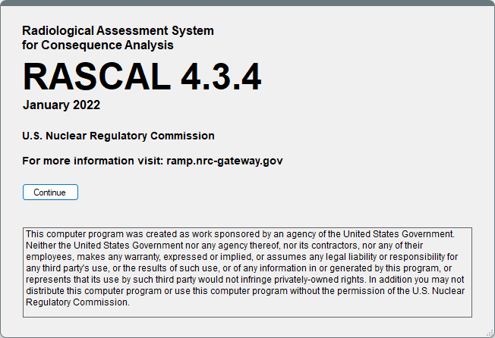
Walkthrough
Let’s step through a RASCAL run together
Watch our discussion slides without using your RASCAL (screenshots may not match)
At each blue slide, you will input information into RASCAL

Slide 19
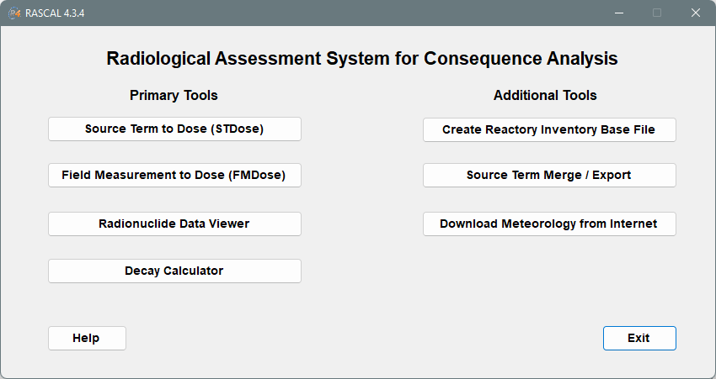
Select STDose
Most of what you will be using RASCAL for (dose assessment) will be done with Source Term to Dose (STDose).

Slide 20
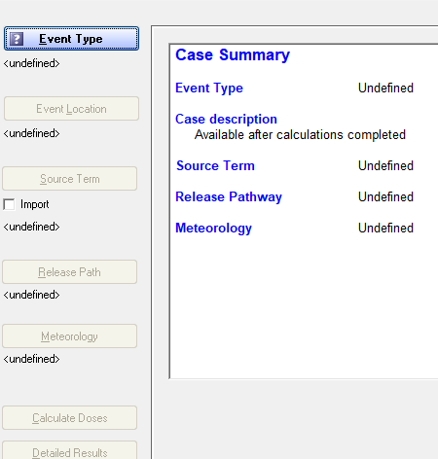
Using STDose
Input information on the buttons on left, from top to bottom
Meteorology can be input once a location is selected
Translate available data into RASCAL inputs
Some data is “static”; enter once
Some data is “dynamic” and changes with time as more communications are established and as conditions evolve

Slide 21
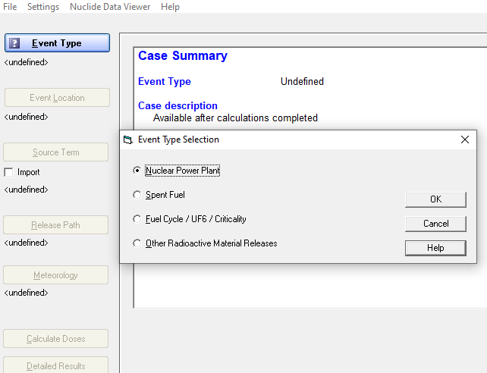
Start by Clicking Event Type
RASCAL breaks up locations and models into 4 types:
NPP
Spent Fuel
Fuel Cycle
Other/Materials

Slide 22
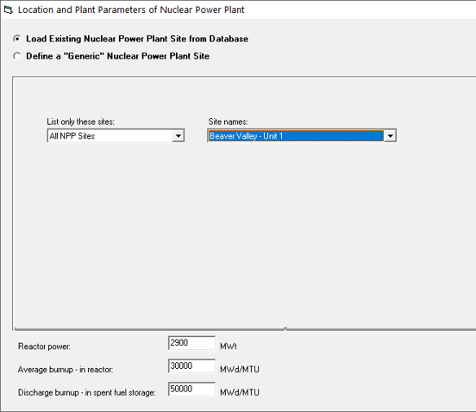
Next, Click Event Location
Select from a list of predefined sites
All U.S. facilities (NPPs, Fuel Cycle, Materials)
International NPPs including: Mexico, South Africa, Taiwan, and UAE
Or, define a custom site
Need Latitude/Longitude coordinates
Does not build in roughness or topography

Slide 23
At the Bottom of Location, Check Reactor Power
Units of megawatts thermal (MWt) and is a direct measure of the energy produced by fission. This number is used by the model to determine the fission product inventory in the core.
The facility database contains the power level at which the reactor is allowed to operate.
Since reactors generally try to operate at 100% power, this value should rarely be changed.

Slide 24
Also Check Burnup
Fuel burnup has units of megawatt-days per metric ton of uranium (MWd/MTU) and is a measure of how much fission energy has been produced by the fuel elements that are currently in the core.
RASCAL uses burnup to adjust core inventory for long-lived radionuclides in the core fuel. A mid-life core value is used as default instead of site-specific values
If you have a burnup value – use it, otherwise the default is OK.

Slide 25
Your Turn to Use RASCAL
Start the RASCAL program & select STDose
Click Event Type
Select Nuclear Power Plant
Click OK
Click Event Location
Select Beaver Valley, Unit 1
Click OK

Slide 26

Let’s walk through together

Slide 27
Knowledge Check
The RASCAL STDose model supports which of the following radiological emergency phases? [select all that apply]
Pre-release
Plume (early)
Intermediate
Ingestion
T or F, RASCAL can model releases from sites not in its facility database?
True
False

Slide 28
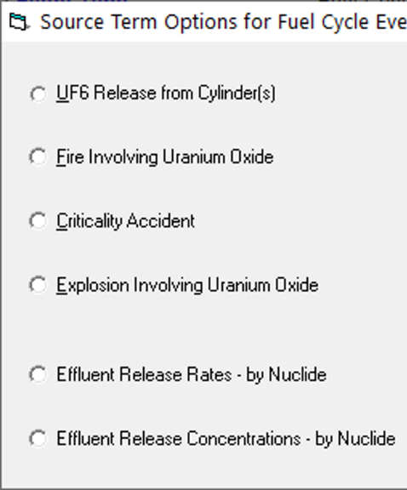
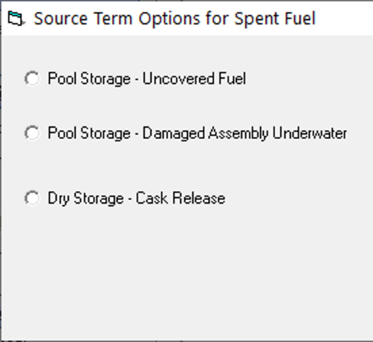
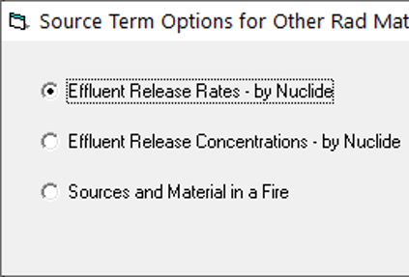
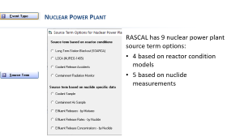
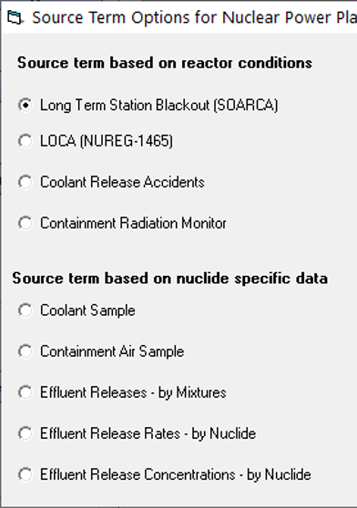
Source Term
Source term models calculate material that can be released
Pick the best model; may have multiple options
Available choices depend on Event Type
Nuclear Power Plant
Spent Fuel
Fuel Cycle
Other Materials

Slide 29
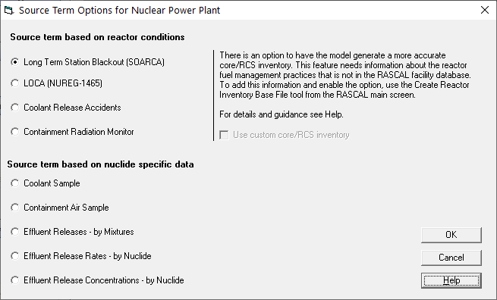
Nuclear Power Plant
RASCAL has 9 nuclear power plant source term options:
4 based on reactor condition models
5 based on nuclide measurements

Slide 30
Nuclear Power Plant
Long Term Station Blackout
Without onsite & offsite AC power and other cooling methods, could lead to core melt
User inputs event timing

Slide 31
Nuclear Power Plant
Loss of Coolant Accident (LOCA)
Loss of reactor coolant, leads to core uncovery and fuel melt
User inputs event timing

Slide 32
Nuclear Power Plant
Coolant Release Accident
Loss of reactor coolant where only coolant is released, no core melt expected
Very small releases

Slide 33
Nuclear Power Plant
Containment Radiation Monitor
Estimates core damage based on containment rad monitor

Slide 34
Nuclear Power Plant
Coolant or Containment Air Sample
User inputs entire source term by nuclide
RASCAL does not extrapolate source term from subset of nuclides
Not expected to have data during event

Slide 35
Nuclear Power Plant
Effluent Releases - Mixtures
User inputs activity rates of:
Noble Gas
Iodines
Particulates
RASCAL fractionates by nuclide based on core inventory
Often based on utility conversion or calculation

Slide 36
Nuclear Power Plant
Effluent Release Rates/Concentration
User inputs entire atmospheric source term by nuclide
RASCAL does not extrapolate source term from subset of nuclides
Can be used to manually define source term, including small/custom releases

Slide 37
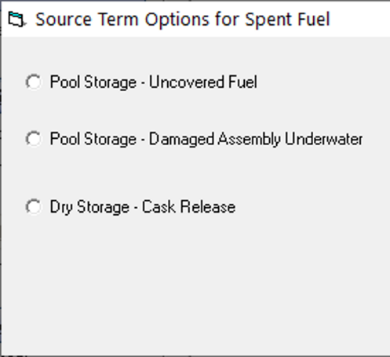
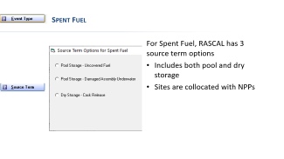
Source Term
Source term models calculate material that can be released
Pick the best model; may have multiple options
Available choices depend on Event Type
Nuclear Power Plant
Spent Fuel
Fuel Cycle
Other Materials

Slide 38
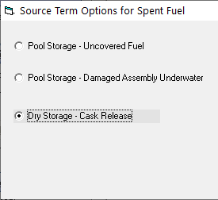
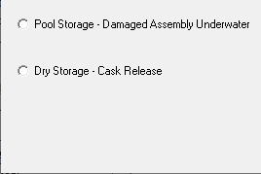
Spent Fuel
For Spent Fuel, RASCAL has 3 source term options
Includes both pool and dry storage
Sites are collocated with NPPs

Slide 39
Spent Fuel
Pool - Uncovered Fuel
Models clad/zirconium fire whether possible or not
User inputs fuel pool inventory and fire start/end times

Slide 40
Spent Fuel
Pool - Damaged Underwater
For fuel handling accidents
Very small releases
User inputs amount of fuel damaged

Slide 41
Spent Fuel
Dry - Cask Release
4 damage options
Small to zero release
User defines inventory of fuel and damage type

Slide 42
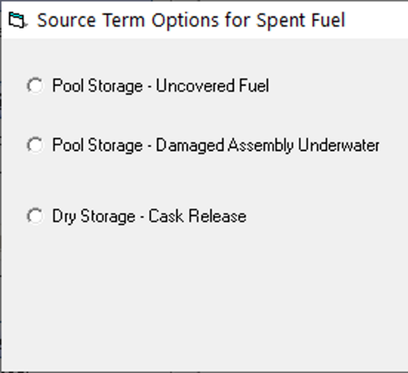
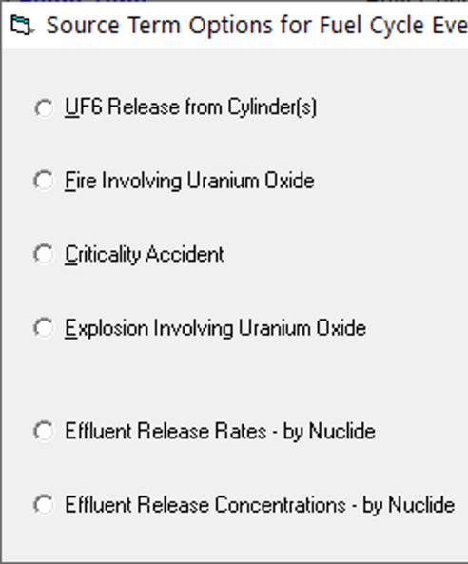
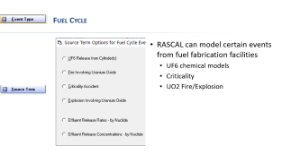
Source Term
Source term models calculate material that can be released
Pick the best model; may have multiple options
Available choices depend on Event Type
Nuclear Power Plant
Spent Fuel
Fuel Cycle
Other Materials

Slide 43
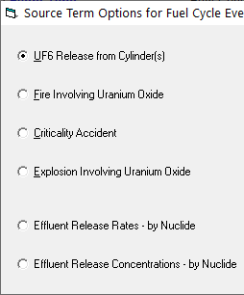
Fuel Cycle
RASCAL can model certain events from fuel fabrication facilities
UF6 chemical models
Criticality
UO2 Fire/Explosion

Slide 44
Fuel Cycle
UF6 Release from Cylinder
Gaseous UF6 released
Special plume model with chemical conversion process
More chemically dangerous than radiological

Slide 45
Fuel Cycle
Fire or Explosion involving Uranium Oxide
Small amounts of material put into atmosphere from event
User inputs material at risk and release fractions / rates

Slide 46
Fuel Cycle
Criticality
Mainly focused on direct shine from criticality event
Very small amount of activated material put into atmosphere

Slide 47
Fuel Cycle
Effluent Release Rates/Concentration
User inputs entire atmospheric source term by nuclide
RASCAL does not extrapolate source term from subset of nuclides
Can be used to manually define source term, including small/custom releases

Slide 48
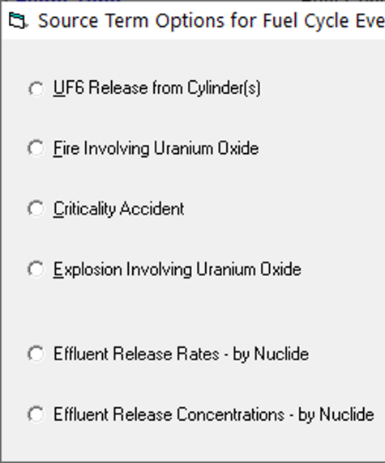
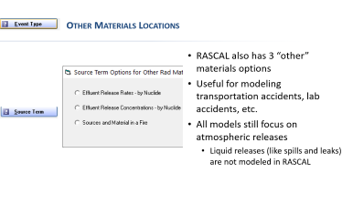
Source Term
Source term models calculate material that can be released
Pick the best model; may have multiple options
Available choices depend on Event Type
Nuclear Power Plant
Spent Fuel
Fuel Cycle
Other Materials

Slide 49
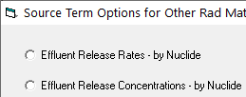
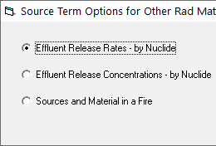
Other Materials Locations
RASCAL also has 3 “other” materials options
Useful for modeling transportation accidents, lab accidents, etc.
All models still focus on atmospheric releases
Liquid releases (like spills and leaks) are not modeled in RASCAL

Slide 50
Other Materials Locations
Effluent Release Rates/Concentration
User inputs entire atmospheric source term by nuclide
RASCAL does not extrapolate source term from subset of nuclides
Can be used to manually define source term, including small/custom releases

Slide 51
Other Materials Locations
Sources and Material in a Fire
Small amounts of material put into atmosphere from a fire
User inputs material at risk and release fractions / rates

Slide 52
Source Term
Source term models calculate material that can be released
Pick the best model; may have multiple options
Available choices depend on Event Type
Nuclear Power Plant
Spent Fuel
Fuel Cycle
Other Materials

Slide 53
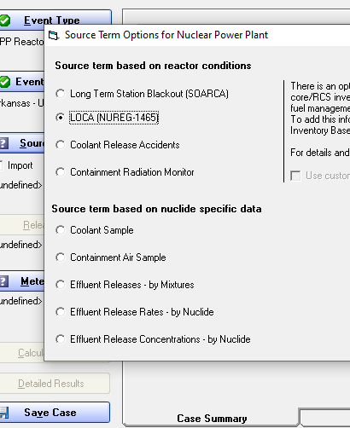
Pick a Source Term
For this scenario, the most appropriate model would be the LOCA model

Slide 54
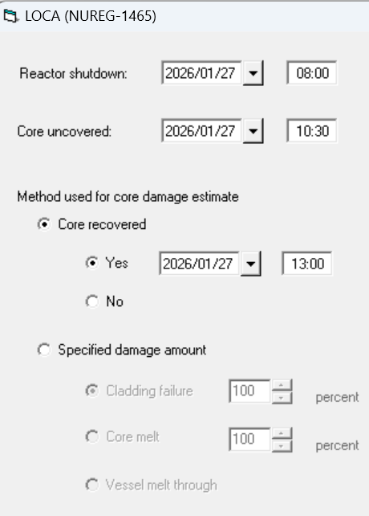
Enter Source Term Details
Each model requires additional details like timing or measurements
For the LOCA model:
Time of reactor shutdown
Starts the decay of all nuclides in the core (they’re in equilibrium before)
Time core was uncovered
When NUREG-1465 models start, starting with 30 min of gap activity, then fuel melt
Is the core recovered?
Additional material stops being generated after the core becomes recovered
All times entered with 24-hour clock

Slide 55

Your Turn to Use RASCAL
Click Source Term
Select Loss of Coolant Accident (LOCA)
Click OK
Input timing sequence numbers
Shutdown Time - 0800
Time of Core Uncovery – 1030
Select Yes for Core Recovered, Time – 1300
Click OK

Slide 56
Let’s walk through together

Slide 57
Knowledge Check
Why is it important to enter the reactor shutdown time?
That is when the radionuclide decay calculation starts
That is when the release starts
That is when the damage to the reactor fuel begins
If the core is recovered, will there still be a release to the atmosphere?
Maybe, it depends on the release pathway and leak rate
Yes, that just stops further damage to the core
No

Slide 58
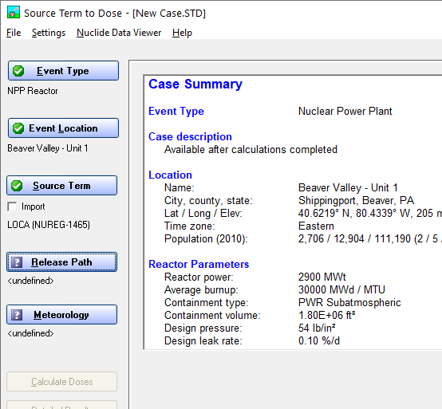
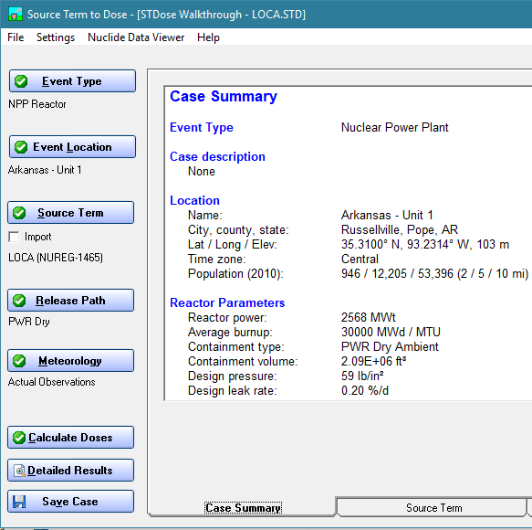
As you can see, the Case Summary tab updates as information is added
As each step is completed, the input information is added to the case summary displayed.

Slide 59
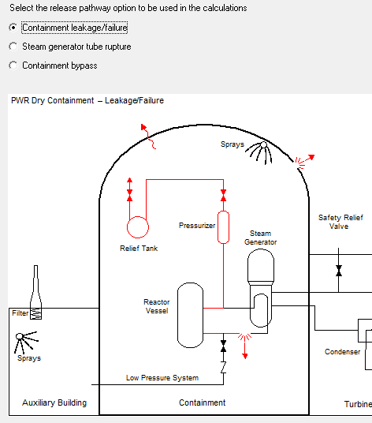
Now We’ll look at Release Pathway
RASCAL needs information on how generated material is released to the atmosphere
Pathway
Height
Wind speeds change with height
Reduction
Amount of material reduced by decay, holdup, filter, sprays
Timing
Release rates, start and stop
We’ll start by selecting the Pathway

Slide 60
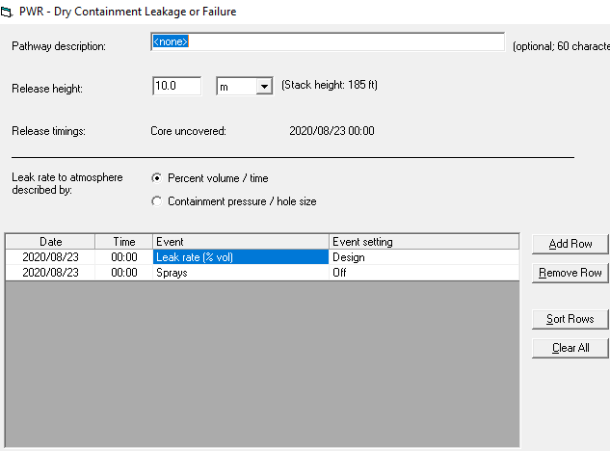
For this Release Pathway option, We’ll need to input:
Release Height
10m is minimum height allowed (ground release)
Select leak rate type
Percent Volume / Time (e.g., 3%/hour)
Containment pressure / Hole Size (e.g., 30 psi/2 cm²)
Define release timeline
Used for leak rate and additional conditions
Need to review/set initial conditions, then can add rows as needed
Don’t copy this data. For discussion purposes only.

Slide 61
Your Turn to Use RASCAL
Click Release Path
Select Containment leakage/failure, Click OK
Ensure release height is set to 10m
Change the initial leak rate (at 10:30) to 5% / day
Keep sprays off
Add row and enter
Time: 18:00 Event Type = Leak rate Setting = 0.0 %/d
Click OK

Slide 62
Let’s walk through together

Slide 63
Knowledge Check
For a LOCA accident, RASCAL can model the release of material to the atmosphere through which of the following pathways? [select all that apply]
Containment
Steam generator
Bypass of containment via other systems
Direct from the reactor vessel
T or F, in RASCAL a release height of 10m is considered ground level?
True
False

Slide 64
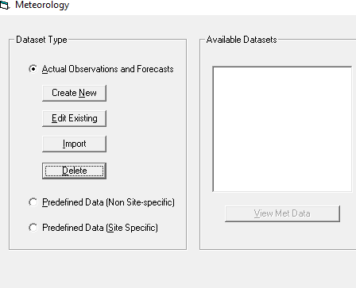
Moving onto Meteorology
Actual
Enter station observations/forecasts
Manual entry or internet download
Pre-defined (non site-specific)
Simple static weather conditions
Easy/fast if no meteorological data known, but doesn’t include topo/roughness
Predefined (site-specific)
Allows custom creation of likely conditions

Slide 65
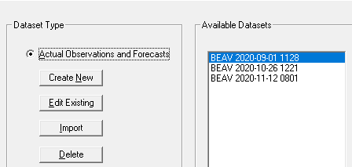
We’ll Mostly Use Actual for Exercises/Events
We won’t use pre-defined except in training
For actual conditions, weather data is managed as site-dependent files
Create New / Edit
View any previously saved weather files
Usable as long as times support scenario

Slide 66
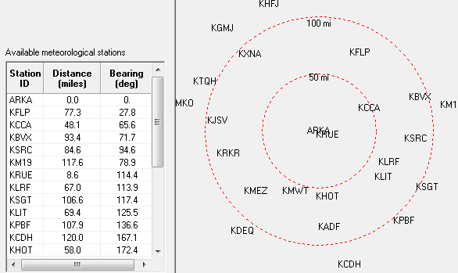
Each Site contains predefined weather stations
Table and map show site and surrounding weather stations
Select stations with plume direction in mind

Slide 67
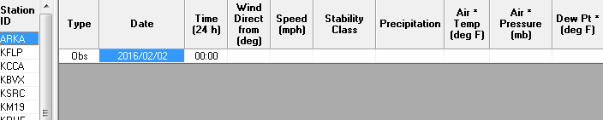
Inputting Weather Data
Select weather station on the left to input its data on the right:
Type
Date/Time
Wind Direction/Speed
Stability
Precipitation

Slide 68

RASCAL uses observed and/or forecast weather data
Current Time
Observations
Forecasts
Release 1
Release 2
Release 3
RASCAL can model releases in the past (all observations), in the future (all forecasts), or that span both.

Slide 69

RASCAL Can Run with a Single Weather Datapoint
2 hours
Release 1
Release 2
Release 3
However, the initial meteorological data must fall within 2 hours before the start of the release to the atmosphere. (Release starts at 10:30; must have some meteorology defined within the 8:30 to 10:30 window)

Slide 70
Although Single Datapoint Weather is possible, More Data is Preferred
Release 1
Release 2
Important when the release may start in the future or may continue for some period of time. You will likely need both observed and forecast data.
However, our scenario doesn’t have additional info like forecasts yet.

Slide 71
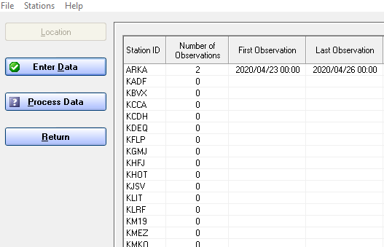
Process Data
Click Process Data to compile all the weather data into a form that the models can use.

Slide 72
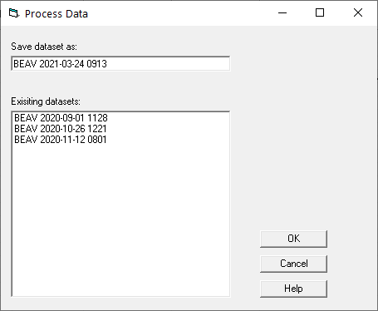
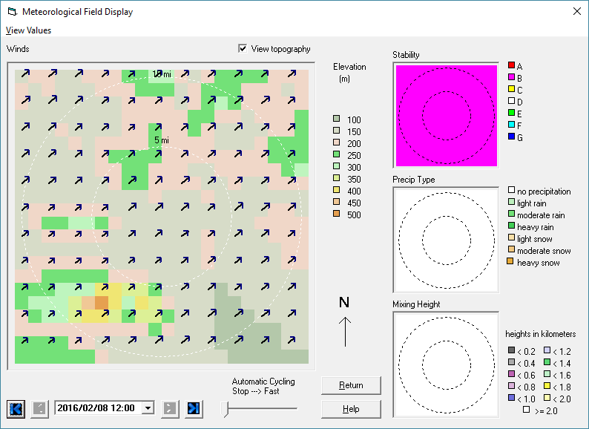
RASCAL processes all entered data into a merged gridded field that changes over time
This named file will show on the main met screen
Weather details can be viewed if needed (View dataset)

Slide 73
Finally, Select Which Weather File You Want RASCAL to Use
RASCAL will return to the main Meteorology screen
Highlight the desired weather data

Slide 74
Your Turn to Use RASCAL
Click Meteorology
Select option for Actual Observations and Forecasts
Click Create New button
Click Enter Data button
For the BEAV station enter the following:
Time = 10:00
Winds = from 45 deg at 2 mph
Stability class = B
Precipitation = None
Click OK
Click Process Data button then click OK
Click the Return button
Make sure your newly created file is selected in blue in the list of available datasets. Click OK

Slide 75
Let’s walk through together

Slide 76
Knowledge Check
T or F, pre-defined weather conditions are acceptable to use in a real event?
True
False
T or F, RASCAL requires at least some weather data to drive the ATD models?
True
False
T or F, RASCAL allows you to enter weather data that varies in both space and time?
True
False
T or F, RASCAL can model a release that may occur in the future?
True
False

Slide 77
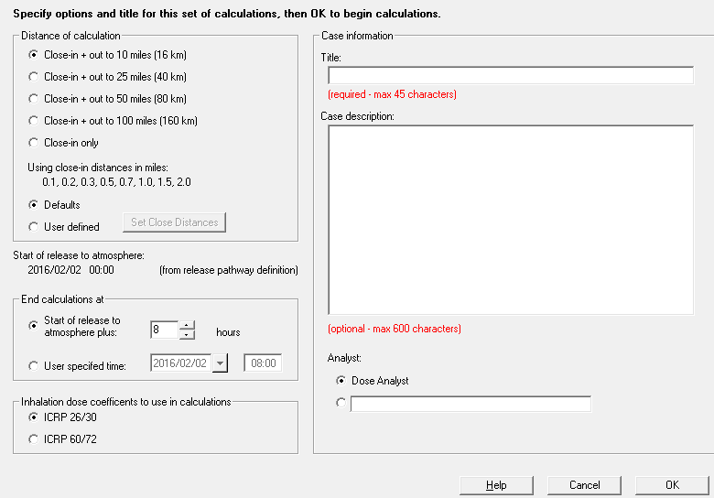
Calculate Doses
Nothing has been calculated at this point
With a few additional parameters, RASCAL will perform all its calculations

Slide 78
Pick a distance to set the calculation area
Shorter distances provide higher resolution
Rule of Thumb – start on the 10 mile distance. If doses are high at the 10 mile edge, go to 25 miles

Slide 79
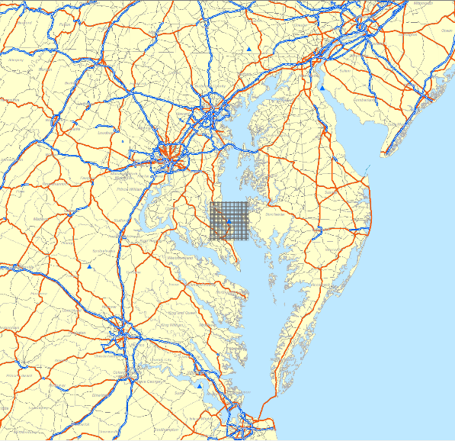
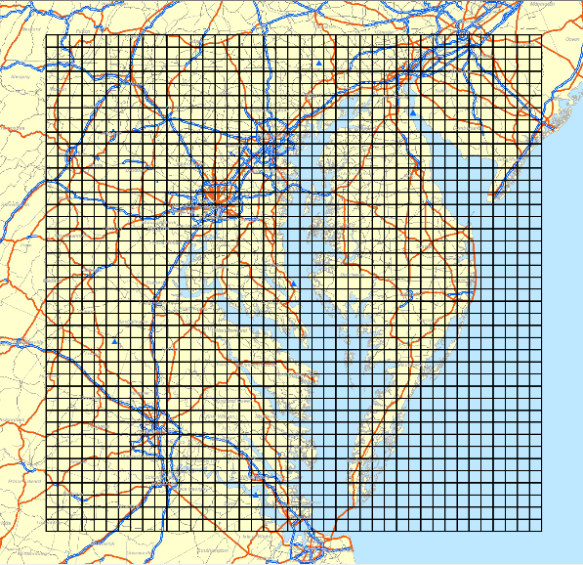
Closer calc distances provide better resolution if you don’t need to see further out
10 mile grid – cells are .5 mile wide
100 mile grid – cells are 5 miles wide

Slide 80
Define a Calculation Time
Duration after the first release to atmosphere that RASCAL terminates the release, plume movement and dose calculations
If time is set too short, dose may be missed; no disadvantage to going long (except runtime)

Slide 81
Set calculation duration to allow for trailing plume edge to reach set distance
Trailing edge, released at t=8.
Leading Edge, released at t=0.
10 mi
Wind speed determines when trailing edge reaches 10 miles
10 mi

Slide 82

There is a rule-of-thumb for estimating the calculation duration
Calculation Distance
“Release Duration”
10 mi
For our problem, 7.5 hr release with 2 mph winds, calculate a duration for a 10-mile grid.
7.5 hours + (10 miles / 2 mph) = 12.5 hours
Add 10% to get 13.75, then round up to the nearest hour (14)

Slide 83
Select the inhalation dose coefficients to be used
ICRP 26/30 vs 60/72
Currently, NRC and most States use 26/30
New EPA PAG Manual uses 60/72
Differences are inclusion of child thyroid CEDE and some minor dose values changes

Slide 84
Enter the case information
RASCAL requires a case title
Description used for justification or special notes; don’t need to repeat case info
Select and/or define an analyst name

Slide 85
What happens when the OK button is clicked?
RASCAL calculates the atmospheric source term and runs the ATD models with the given weather
You cannot interrupt the calculations
Once complete, view results tabs at the bottom
Case Summary
Source Term
Maximum Dose Values

Slide 86
Your Turn to Use RASCAL
Click Calculate Doses
Leave Distance of Calculation at 10 miles
Set End Calculations at:
Start of release to atmosphere plus: 14h
Click OK to start the calculations

Slide 87
Let’s walk through together

Slide 88
Knowledge Check
Which calculation grid has the better resolution?
50-mile
10-mile
They have the same resolution
What would you set as the calculation duration with a 7-hour release with 5 mph winds on a 10-mile grid?
8 hours (RASCAL default)
9 hours
10 hours or more
96 hours (RASCAL max)

Slide 89

RASCAL Results
When RASCAL is finished calculating, it shows this screen, which is just 1 of 3 tabs at the bottom
They each contain different information and have a different purpose, let’s go through them
Your results will be different than screenshot. For discussion purposes only.

Slide 90

Case Summary Tab Shows Inputs
The Case Summary tab has been populating as we added info
You can use it as a great way to check your inputs all at once or compare inputs against other dose assessors
Your results will be different than screenshot. For discussion purposes only.

Slide 91

Source Term Tab Shows Details for Release to Atmosphere
Summary window
View Balance
Where nuclides are at the end of the simulation
View Importance
What nuclides are contributing the most to dose
Release vs. Time
Displays amount of each nuclide released each 15 minute time step
Can be exported
Your results will be different than screenshot. For discussion purposes only.

Slide 92
Max Values Table Shows dose snapshot
Summary window
Doses important for protective actions (TEDE, Thyroid)
Underlines doses exceeding PAGs
Select distance
Close in vs selected “far out” model distance
Does not show direction
Your results will be different than screenshot. For discussion purposes only.

Slide 93

For Additional Result Information, Click Detailed Results
Provides additional graphical and tabular outputs
Result types at top
Dose-related
Deposition/Measurements
Acute doses
Settings on the bottom
Time - cumulative or rate
Map/Table; Close-in or Further Out
Units

Slide 94


Difference between Footprint and Table
Footprint provides celled results on map
Table provides numeric values
Both can be exported, map can be queried, table can be filtered
Footprint
Table

Slide 95


Difference between “close in” and “Far Out”
Two ATD models are used in the calculations
Resolution advantages
Overlap may not line up exactly
Plume Model
Puff Model

Slide 96
Your Turn to Use RASCAL
Examine the results
Maximum Dose Values tab shows some doses at selected distances
Source Term tab show details about the atmospheric release
Click Details Results to see options for looking at dose on a map

Slide 97
Let’s walk through together

Slide 98
Knowledge Check
What is the projected TEDE (rem) at 5 miles?
1.4E+00
1.7E+00
3.2E+01
None of the above values
What percentage of the release to the atmosphere is iodines?
0.6%
12.9%
16.4%
None of the above values
What direction is the plume projected to travel?
Northeast
East
Southeast
Southwest

Slide 99
This concludes our intro walkthrough
You should now be able to click through RASCAL start to finish.
Remember that resources & training can be found at: https://ramp.nrc-gateway.gov/

Slide 100
Available topics for future
Nuclear Power Plant Accidents
Long-Term Station Blackout
Monitored Effluent Mixtures
Containment Rad Monitor
Steam Generator Tube Rupture
Other Radiological Accidents
Spent Fuel Pool
Fuel Cycle
Other Materials Accident
Transportation Accident
RASCAL features
Multi-Unit Assessment
Comparing with Field Measurements
Field Team Dosimetry & DRDs
Download Met from Internet (MetFetch)
Special Receptors

