Slide 1
IMBA Intermediate Training
Charlotte Rose
Research Scientist
Corvallis OR
charlotte.rose@rcdsoftware.com

Slide 2
OUTLINE
Bioassay Calculations
Predictions based on hypothetical intake
Intake -> Bioassay
Tritium Occupational Exposure
Cesium Contaminated milk in population
Estimations from Bioassay Data
Bioassay -> Intake
¹²⁵I Inhalation
⁶⁰Co Unknown Route
Historical Continuous Uranium Inhalation
B. Questions

Slide 3
BIOASSAY PREDICTIONS

Slide 4
Bioassay Predictions
Based on predicted exposure, will provide the user with an estimate of bioassay results for any of the bioassay types.
Single Intake or multiple intakes/continuous intake
Single or multiple bioassay measurements

Slide 5
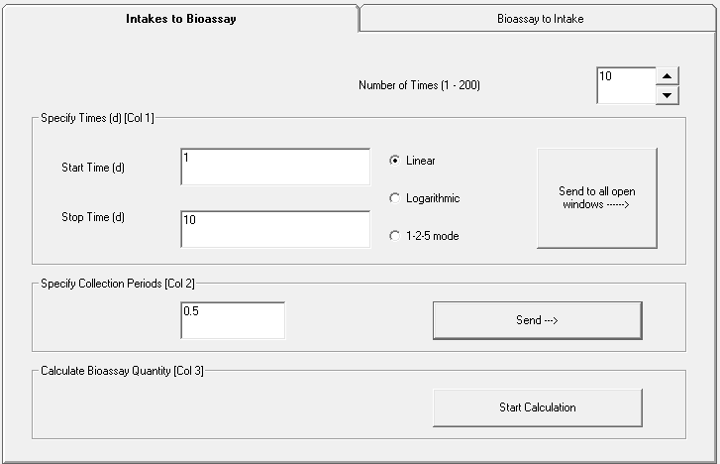
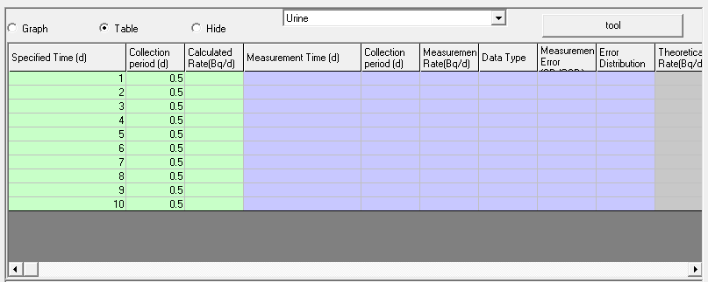

Slide 6
Example 1
First, recall finding an EDE with the dose calculator in IMBA

Slide 7
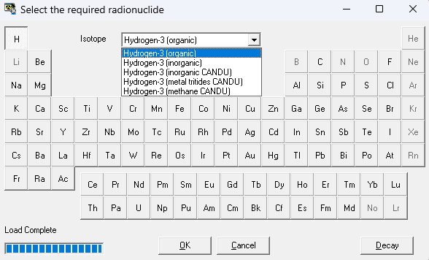
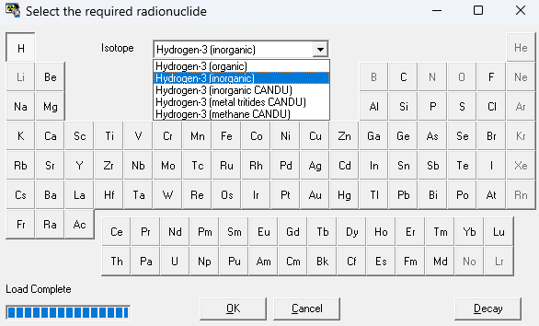
Examples for organic & inorganic tritium
Committed effective dose calculation

Slide 8
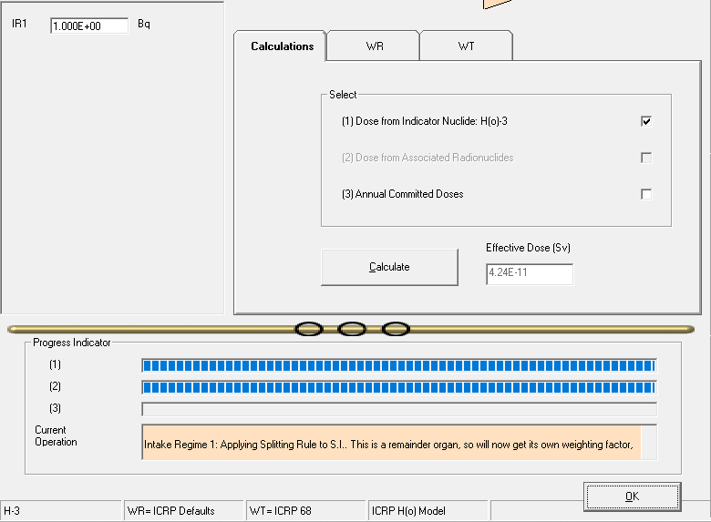
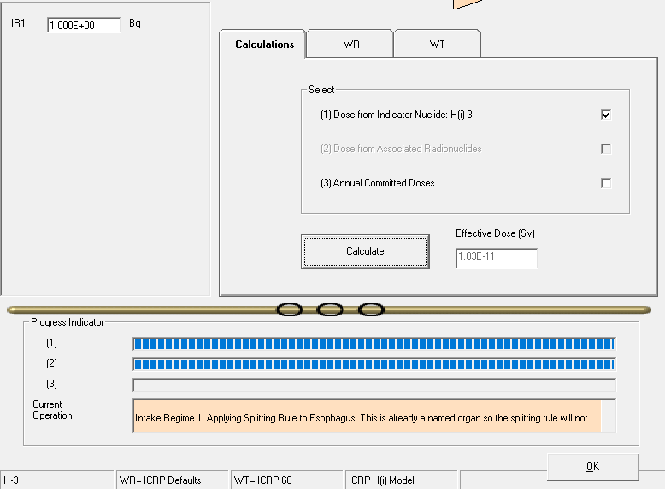
Organically bound
Committed effective doses from tritium ingestion
Tritiated water
Result for unit activity intake
Result for unit activity intake

Slide 9
Tritium (water) Ingestion
EDE for tritiated water
${1.8x10}^{11}\frac{Sv}{Bq}$
Regulatory limit of 0.05 Sv/year (USNRC and CNSC)
ALI is 3 GBq

Slide 10
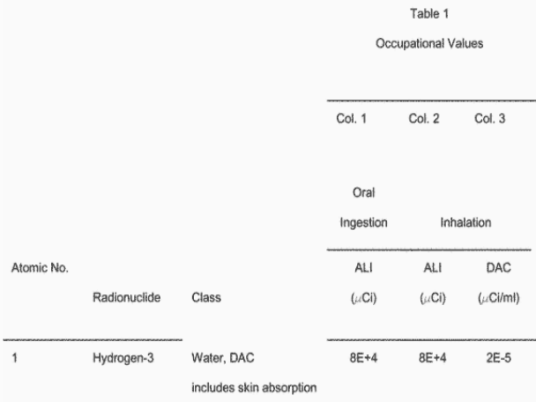
Tritiated water limits
10 CFR Part 20
Annual limits on intake
Tritium ingestion ALI
0.08 Ci ≈ 3 GBq
Same ALI for inhalation

Slide 11
What bioassay results indicate that worker exposure and intakes must be reduced to avoid exceeding the regulatory limit?
Hypothetical worker exposure to tritiated water
Continuous occupational intake possible
Work tasking anticipated for 300 days
Bioassay planned: Urine collection & tritium activity measurements
Example Problem 1

Slide 12
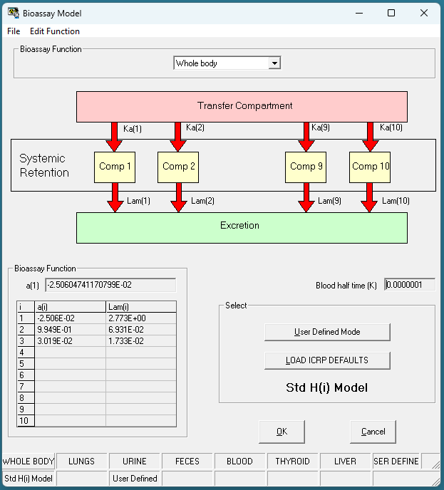
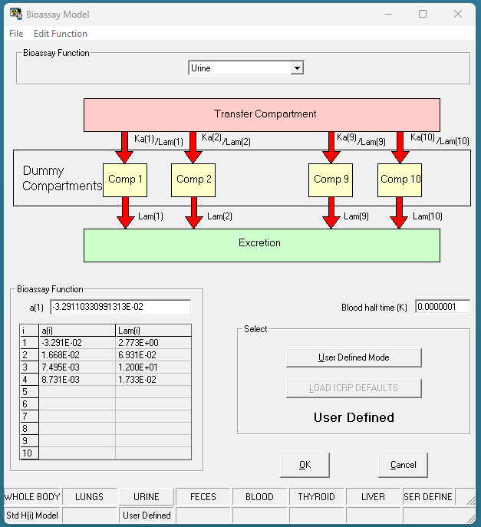

Slide 13
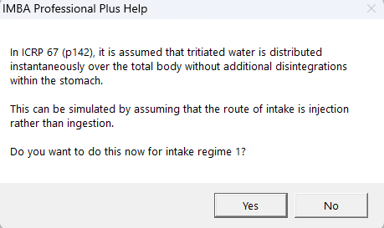
IMBA invites user to accept ICRP modeling

Slide 14
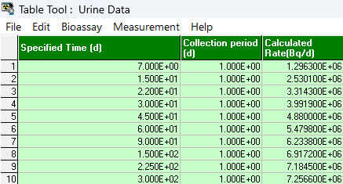
Example IMBA bioassay results
Assumed maximum continuous intake yields 1 ALI during entire work task
IMBA calculates maximum tritium activities in urine at different bioassay times (right)
IMBA provides basis for operational restrictions or corrective actions before regulatory limit is exceeded
Notes:
10 GBq/d over 300 days is 3 MBq, which is the approximate regularoty limit for a year.

Slide 15
Using Bioassay Predictions to find Dose

Slide 16
Cesium Ingestion in Milk
Consider a contamination event where Cs deposition resulted in contaminated feed. What would be the bioassay results, and the estimated doses to the public?
Chronic vs Acute
(living vs visiting)
300 pCi/L in milk
Assuming 1 L consumed per day (conservative for drinking, cheese, butter, etc)
Assume single Celebration/Visit ingestion of 0.03 μCi

Slide 17
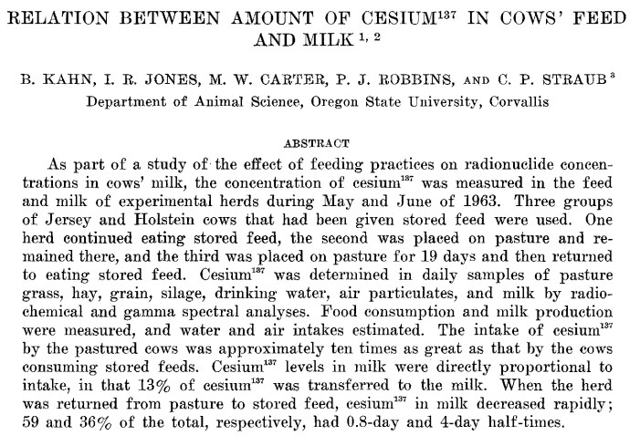

Slide 18
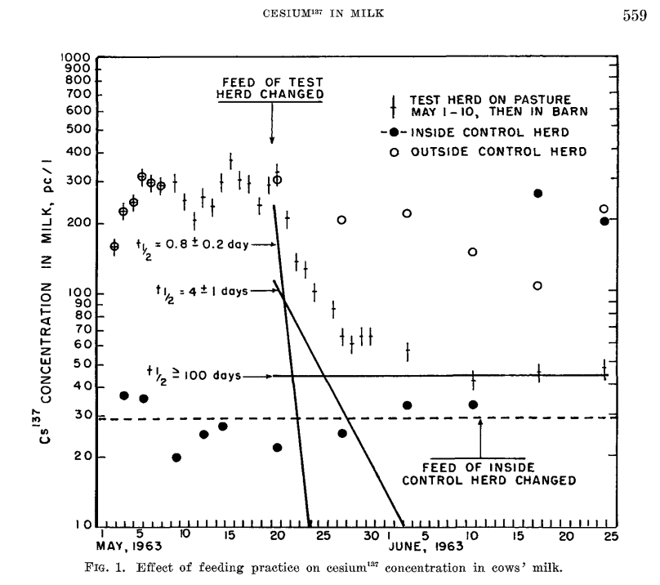

Slide 19
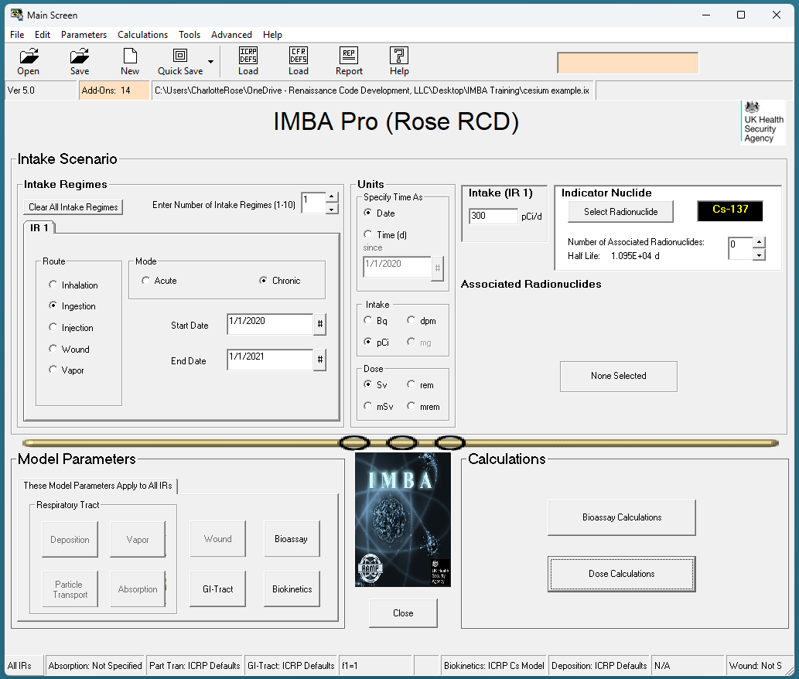
Select Radionuclide
Select chronic intake of 1 year
Ingestion Route
Intake regime 1 is 30 pCi/d
ICRP Defaults

Slide 20
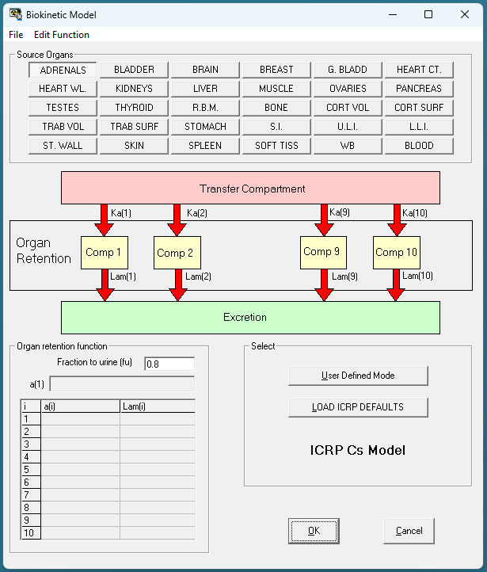
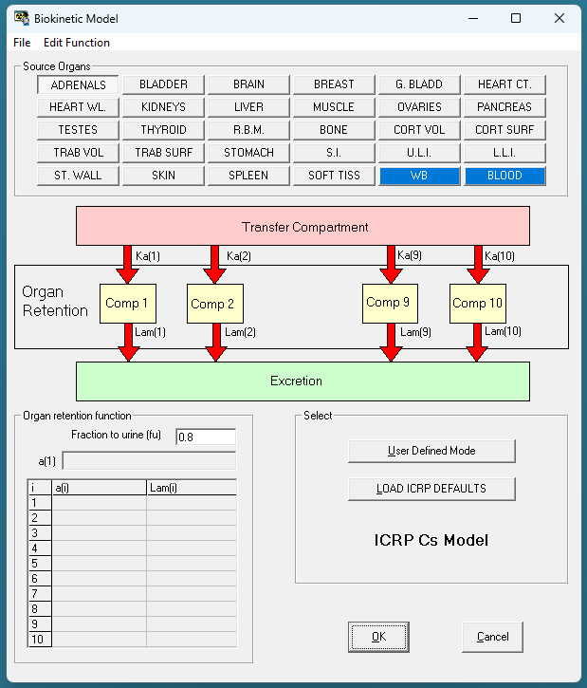

Slide 21
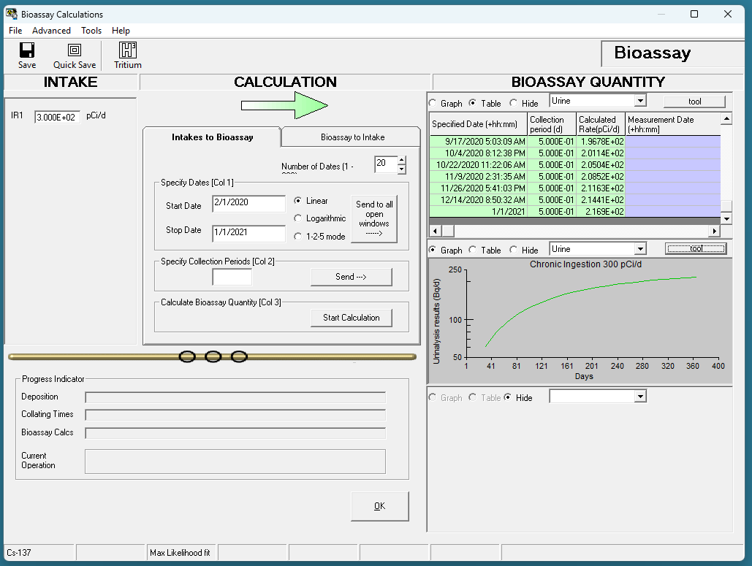
Notes:
Notice the collection period is one half day

Slide 22
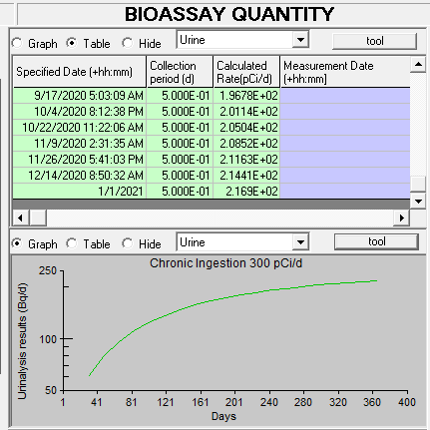
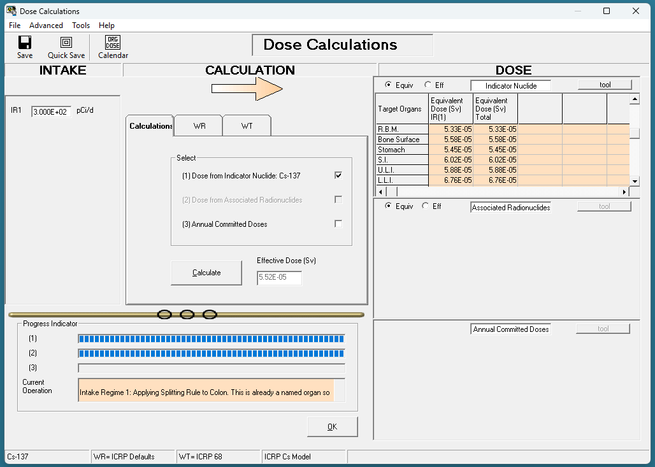
Notes:
Annual limit on intake for public is 1 mSv per year. How much in each scenario would be the maximum amount of intake per year, and what would a urinalysis show?

Slide 23
