Slide 1
IMBA Intermediate Training
Charlotte Rose
Research Scientist
Corvallis OR
charlotte.rose@rcdsoftware.com

Slide 2
OUTLINE
Bioassay Calculations
Predictions based on hypothetical intake
Intake -> Bioassay
Tritium Occupational Exposure
Cesium Contaminated milk in population
Estimations from Bioassay Data
Bioassay -> Intake
¹²⁵I Inhalation
⁶⁰Co Unknown Route
Historical Continuous Uranium Inhalation
B. Questions

Slide 3
Historical Uranium Bioassay Data

Slide 4
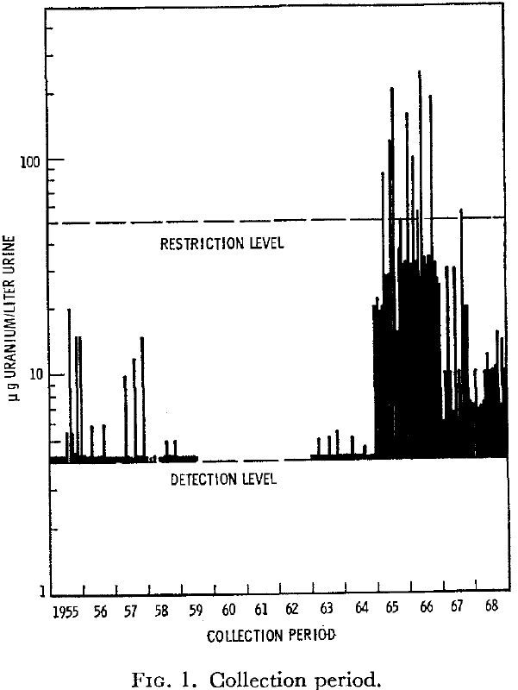
Worker receives a chronic exposure to airborne U-natural during a 4-year period

Slide 5
Measurement time (d) | Collection Period (d) | Measurement Value (mg/d) | Data type
1-Feb-63 | 0.5 | 5.00E-03 | Real
1-Jun-63 | 0.5 | 5.10E-03 | Real
1-Sep-63 | 0.5 | 5.20E-03 | Real
1-Feb-64 | 0.5 | 5.10E-03 | Real
1-Aug-64 | 0.5 | 4.30E-03 | Real
1-Jan-65 | 0.5 | 2.05E-02 | Real
1-Mar-65 | 0.5 | 3.00E-02 | Real
1-Jan-66 | 0.5 | 3.10E-02 | Real
1-Jun-66 | 0.5 | 3.30E-02 | Real
1-Nov-66 | 0.5 | 3.20E-02 | Real
Notes:
Assumption on dates
Assumption on data
Assumption on collection period
Make a text file that is tab delimited; easy to do with data in an excel file that is copy and pasted into a blank text editor and saved. Or save the tab in excel as a tab delimited file (or comma, whatever). The only issue with that is that you will have the extra header when you import the information, which we will see later ☺

Slide 6
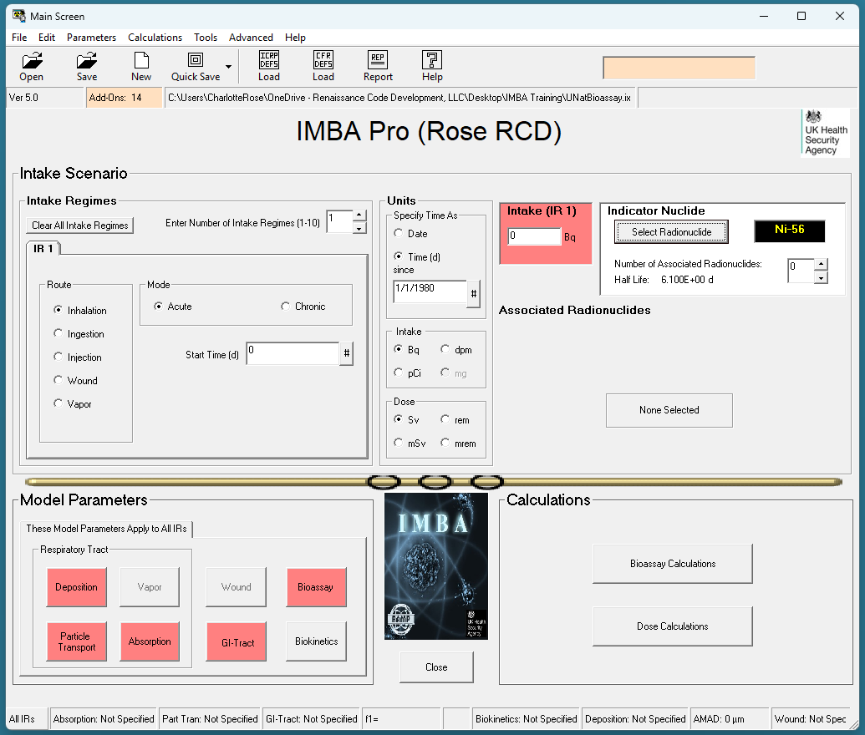
All Red Highlights; chose ICRP Defaults

Slide 7
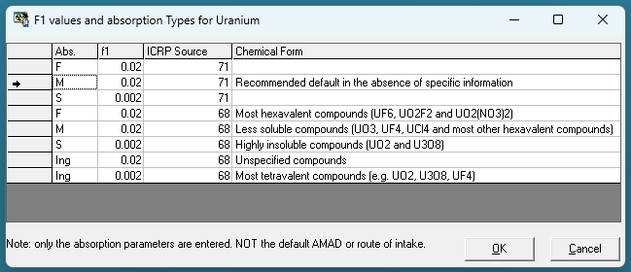
Notes:
Click ok to select the recommended absorption types and f1 values for Uranium mixtures. Note that choosing ICRP 71 or 68 results in the same values for F1

Slide 8
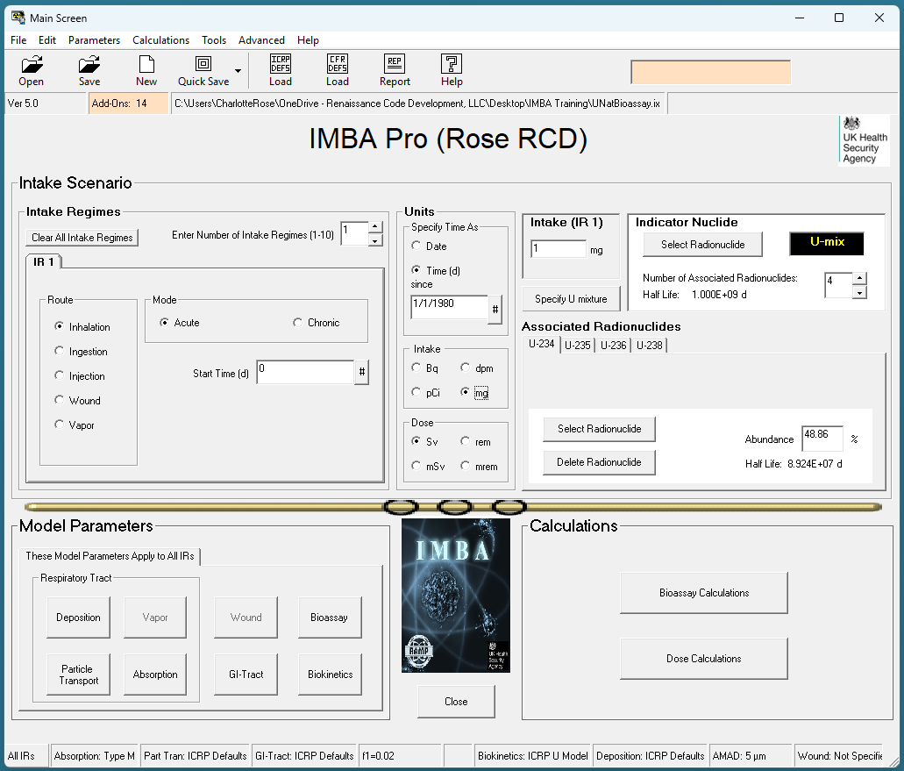
Notes:
Now we can see that all of the required fields are filled out. Giving all of the fields a good read through; you can see the absorption type, defaults, f1, biokinetics, deposition amad and wound information is as expected in the bottom ribbon.
However, we missed the intake day. Lets change that!

Slide 9
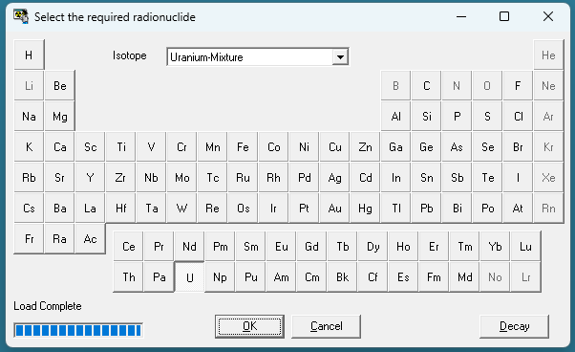
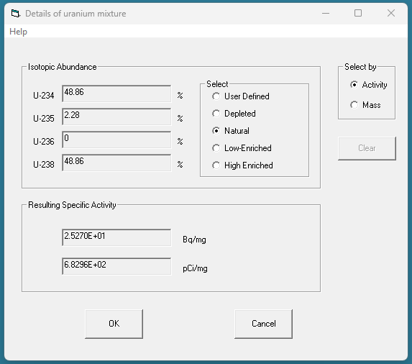
Select radionuclide
U –mix
Specify U mix – nat

Slide 10
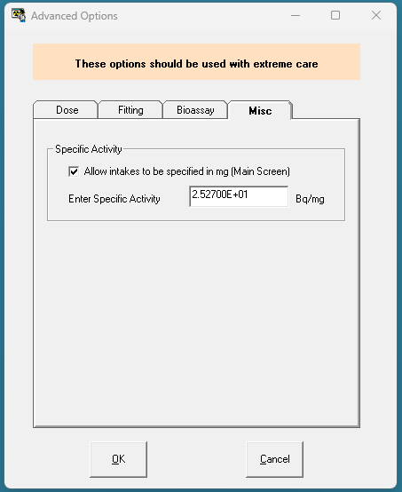
Advanced Options
Advanced options – misc – allow intakes specified in mg
Notes:
Allowing intakes to be specified in mg will require you to enter the specific activity.
Then you can select mg as the intake type. This will align with the bioassay type, which is in micrograms of uranium per liter of urine.

Slide 11
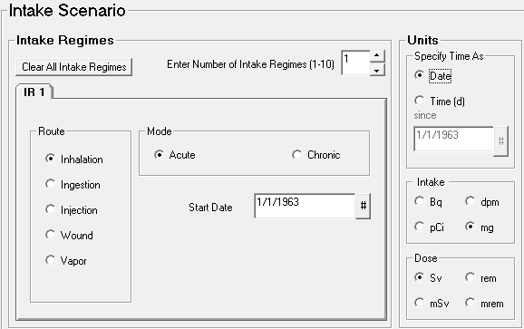
Notes:
Lets assume the intake was on January 1, 1963. Specify time as Date so that our imported file matches the format of IMBAs time units.
Now we can check and see that we are dealing with an inhalation scenario, it was ONE acute exposure that occurred on Jan 1 1963 and our Start date is highlighted as a date and not a “days after exposure”. Our intake is in mg, which matches our data, and the dose we will eventually calculate will be in Sv.
I like to save as I go so I don’t lose any of my work.

Slide 12
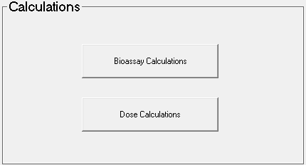
Notes:
Lets Go to the bioassay screen!

Slide 13
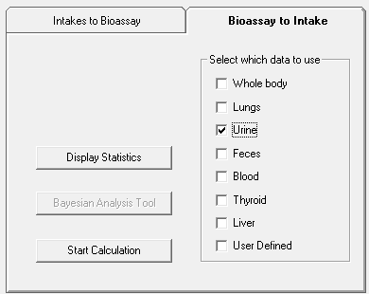
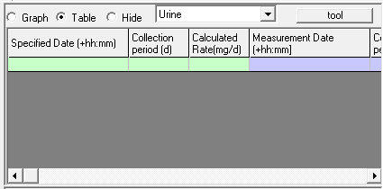

Slide 14
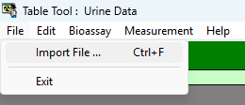
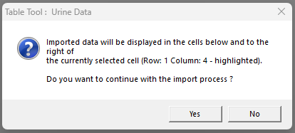
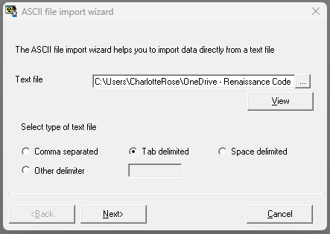
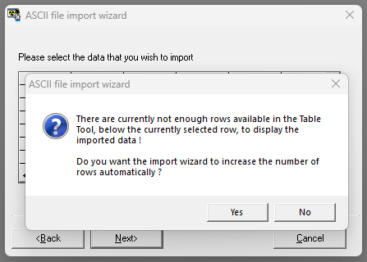

Slide 15
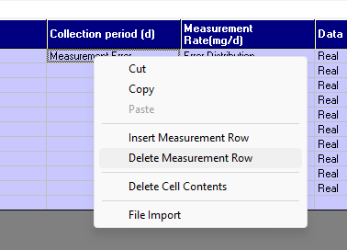
Notes:
Youll have to remove the row that has header information (right click and select

Slide 16
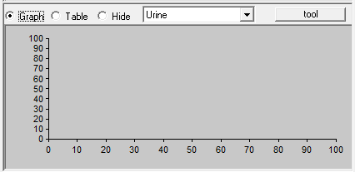
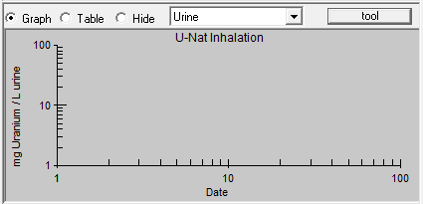

Slide 17
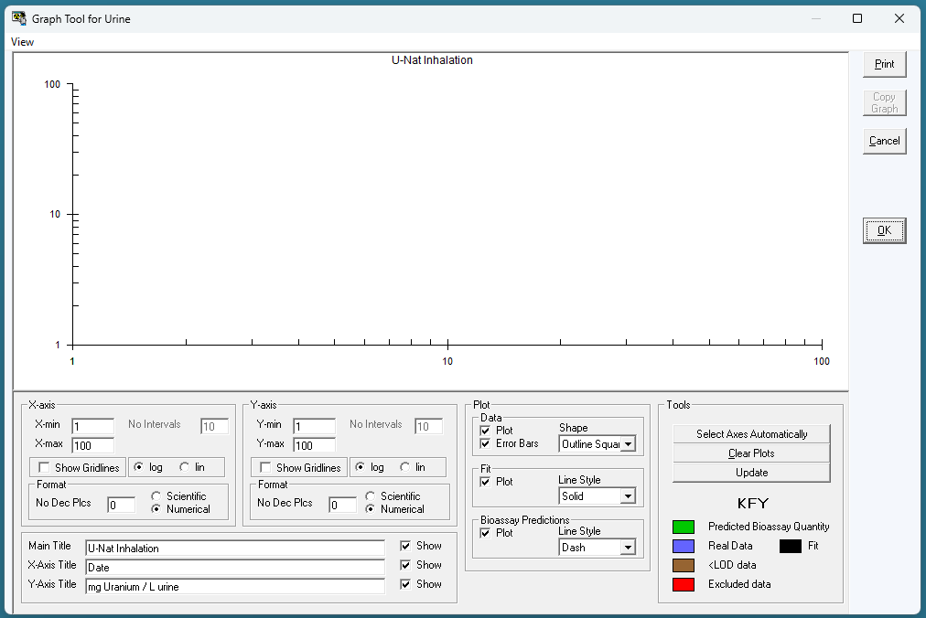
Notes:
To be able to select log axies, you must first change x and y mins from 0 to 1
Name your axes
Select the plot types, fit, and bioassay predictions.
Click Update for the plot to update

Slide 18
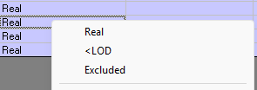
Data Type
Real: good data point
<LOD: below level of detection
Excluded: if you feel the data point is a significant outlier
Notes:
Right click

Slide 19
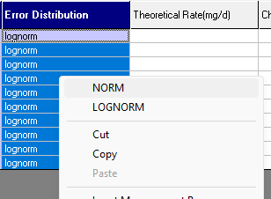
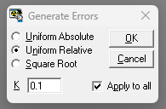
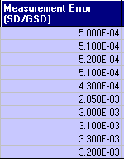
Notes:
Select all of the error distribution column and select norm or lognorm error distribution

Slide 20
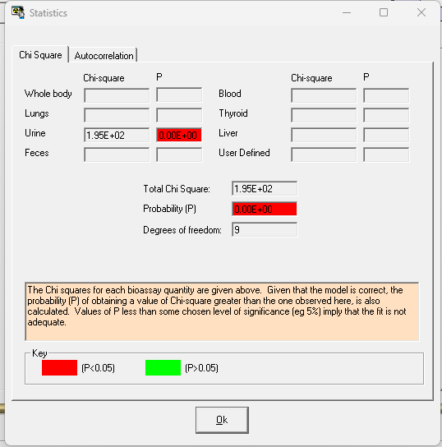
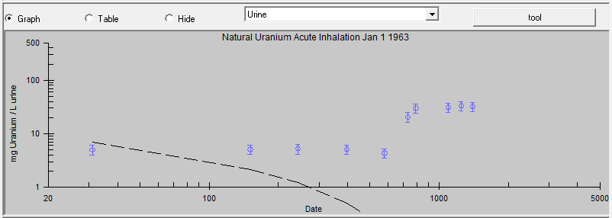
Notes:
This fit really doesn’t look right, so lets exclude some data and try just the first year’s fit.

Slide 21
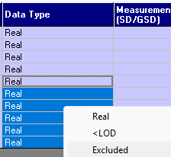
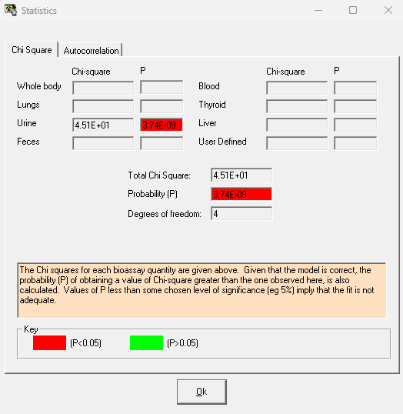
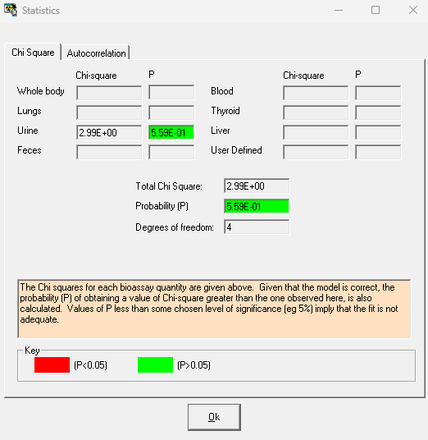
Notes:
Slightly better, but the error distribution is too small, so let’s look at something more realistic. Time was not on our side and we don’t have data about collection, so lets open up that error distribution
Setting the error distribution to a lognormal gives us a higher likelihood that our fit is better. This relates to an error within one order of magnitude.

Slide 22
Notes:
However, we know this might still need some work. This might be a chronic exposure and not acute, so lets change that parameter.

Slide 23
Try some different parameters
Selecting a second exposure
Inhalation and wound
Inhalation

Slide 24
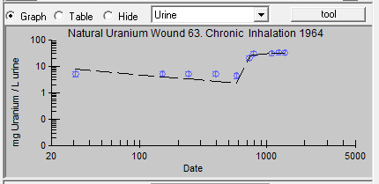
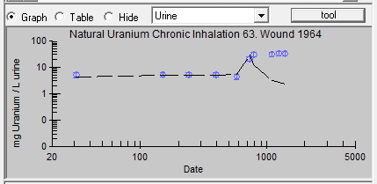

Slide 25
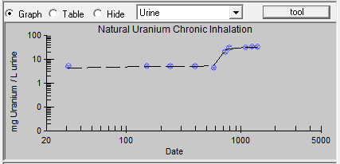
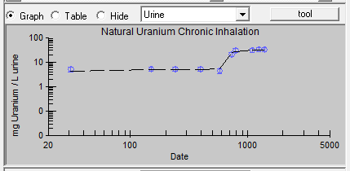
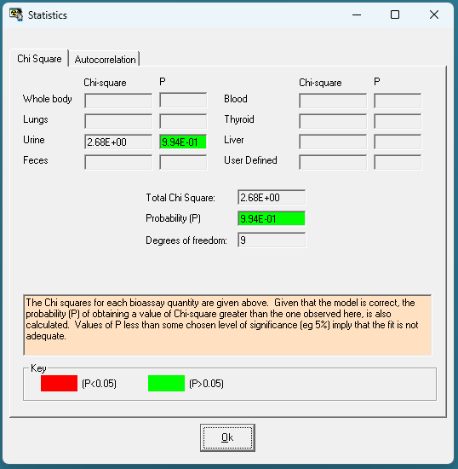
Notes:
These graphs do not follow a pattern of a single exposure, or even 2 single exposures. What looks more likely is that there is a chronic exposure that increases in intensity in 1964. Changing the parameters to reflect this results in this type of graph with a probability near 100% and an autocorrelation that is also within the 5% probability.
Changing the relative error from 10% to 20% also gives us a much better fit – which makes sense considering the age of the data and collection technology.

Slide 26
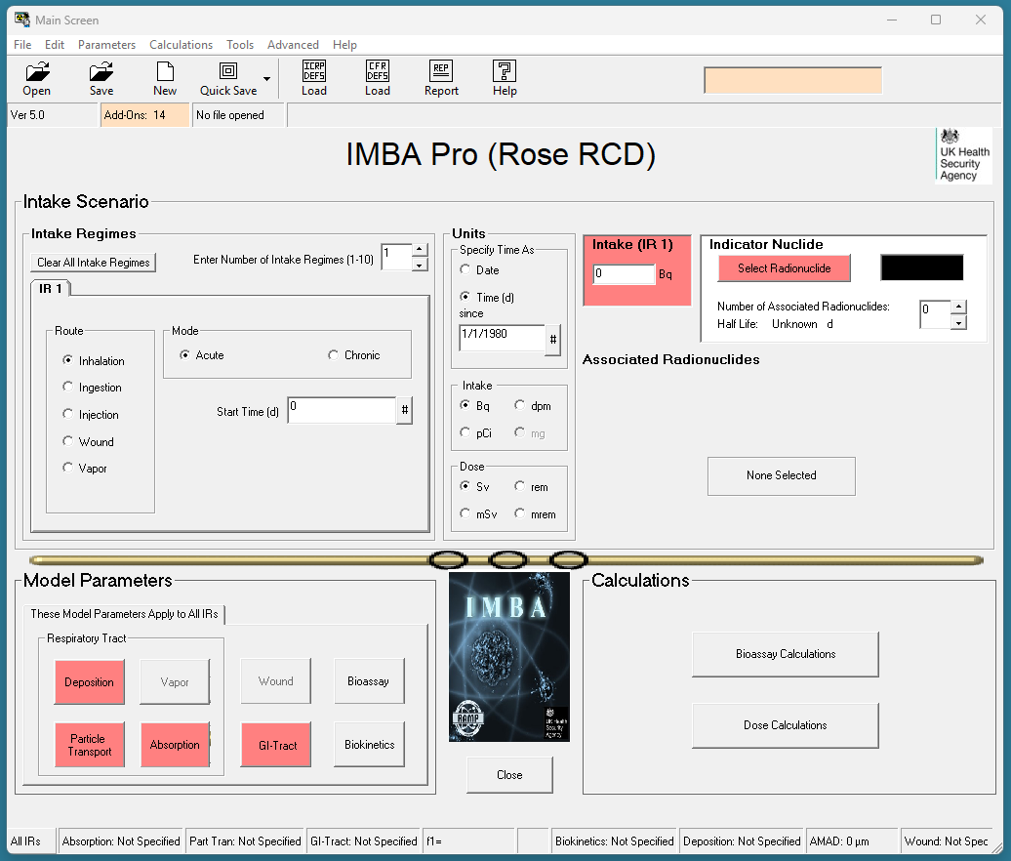

Slide 27
I-125 Inhalation
A lab worker working with an I‐125 radiolabeling solution gets sprayed on her arm from a leak in a syringe‐to‐needle fitting. The liquid is reportedly deposited on the lab coat above her gloves. The solution penetrates the coat and contaminates the skin.
The skin is decontaminated, and no signal can be detected at the thyroid with a handheld monitor during the rest of day of the incident
The chemical composition of the I‐125 solution is unknown
Very few urine spot samples (25 ml) were taken
The spill happens at 11:00 on 8/5/2015

Slide 28
I-125 Inhalation
What would be some likely routes of intake? We can use IMBA to evaluate what would like likely path be
Start with Inhalation
Measurement Date | Bioassay (Bq/l) | Bioassay (Bq/d)
8/5/2015 17:00 | 406.6 | 569.2
8/7/2015 12:00 | 18.7 | 26.2
9/2/2015 12:00 | <4.5 [LOD] | <6.3
Assumed daily urine production of 1.40 liters
Collection period is 25ml/1400ml or 0.018

Slide 29
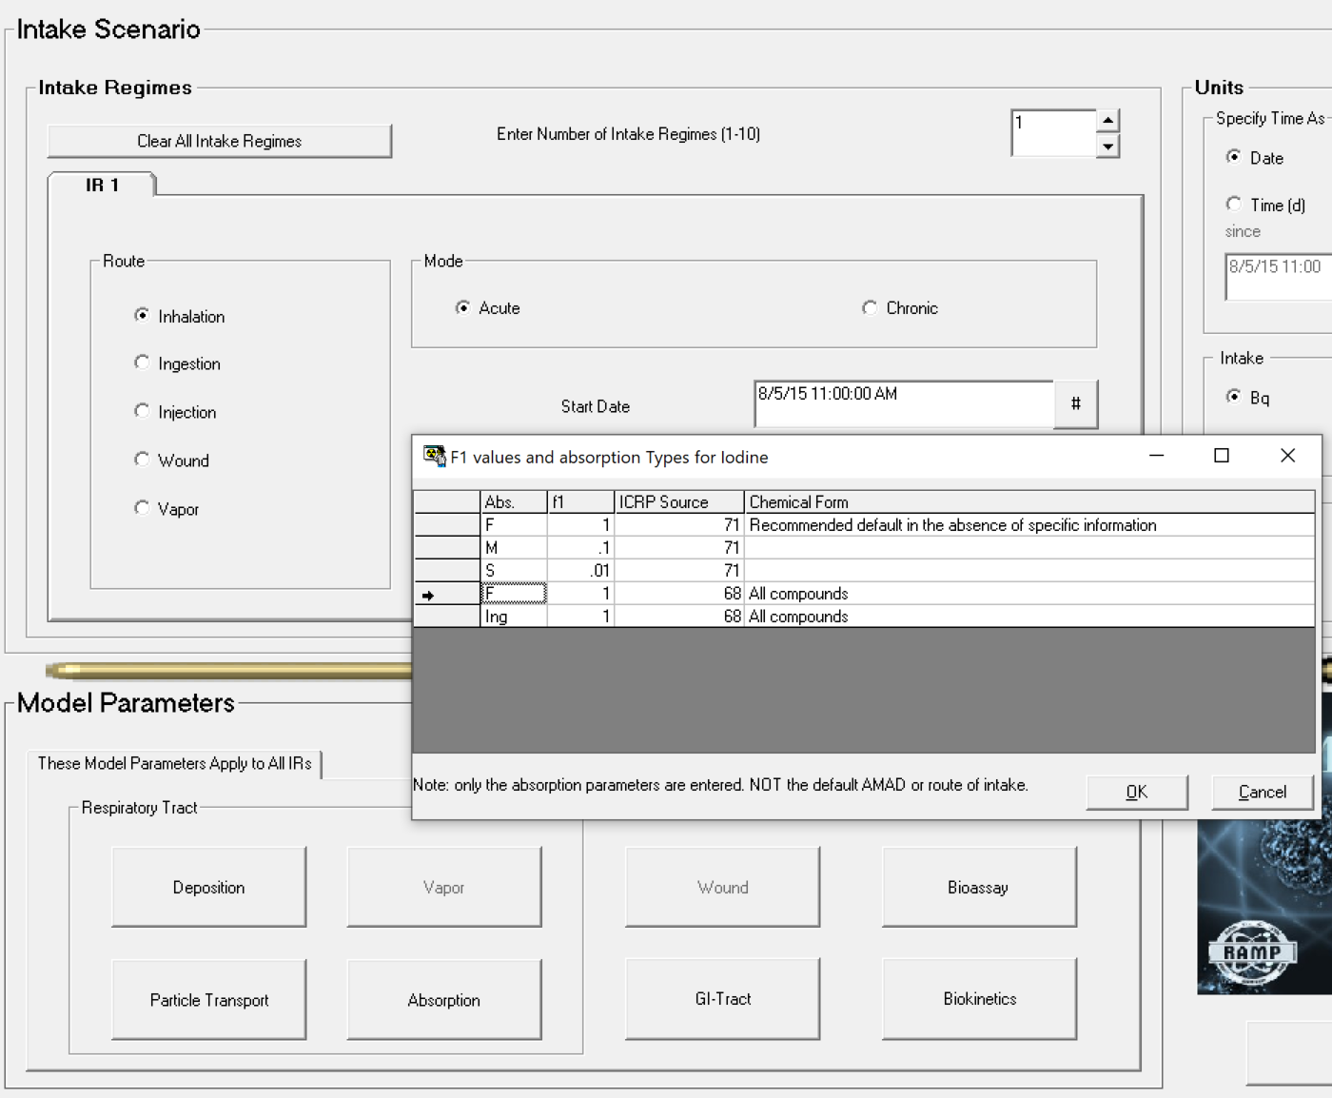
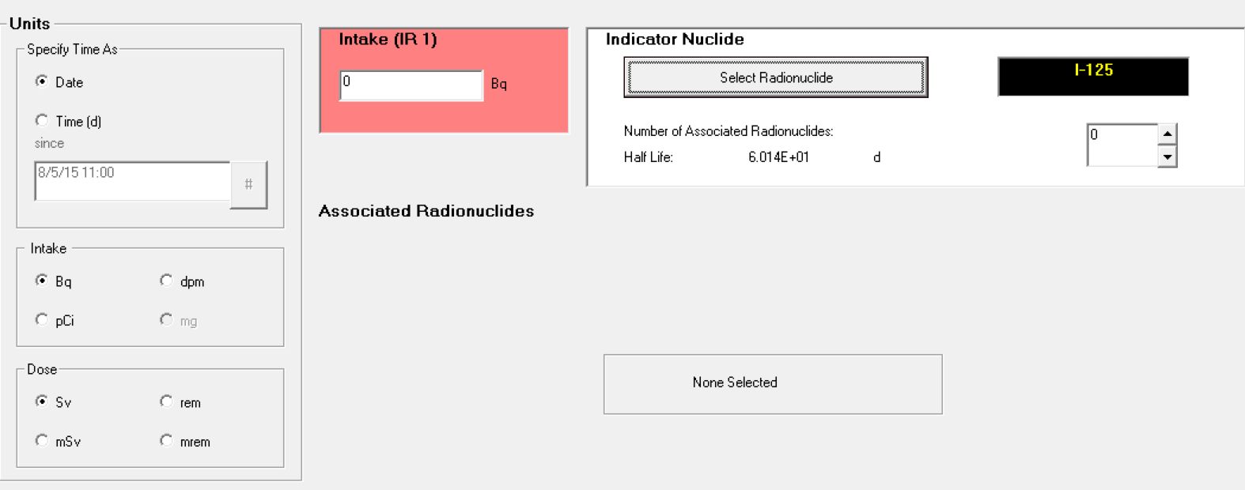
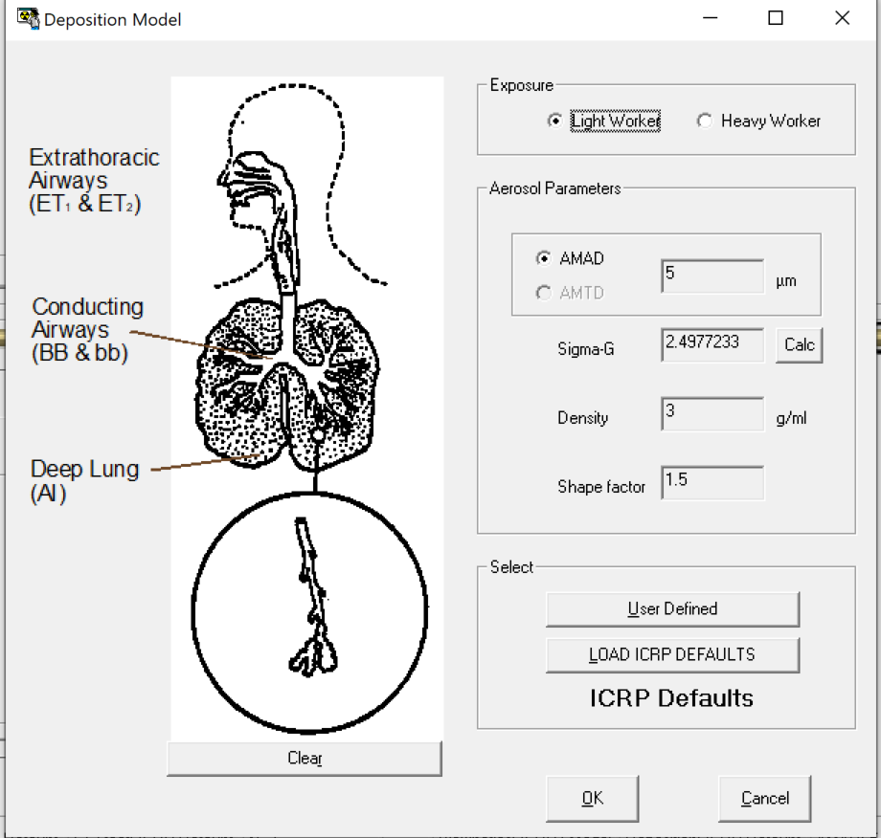
I-125 Inhalation
Notes:
Do not need the intake activity; that’s what we’re looking for!
Use the help function to find the F1 values
Assume an AMAD of 5 micrometers (ICRP defaults)
Enter in the dates

Slide 30
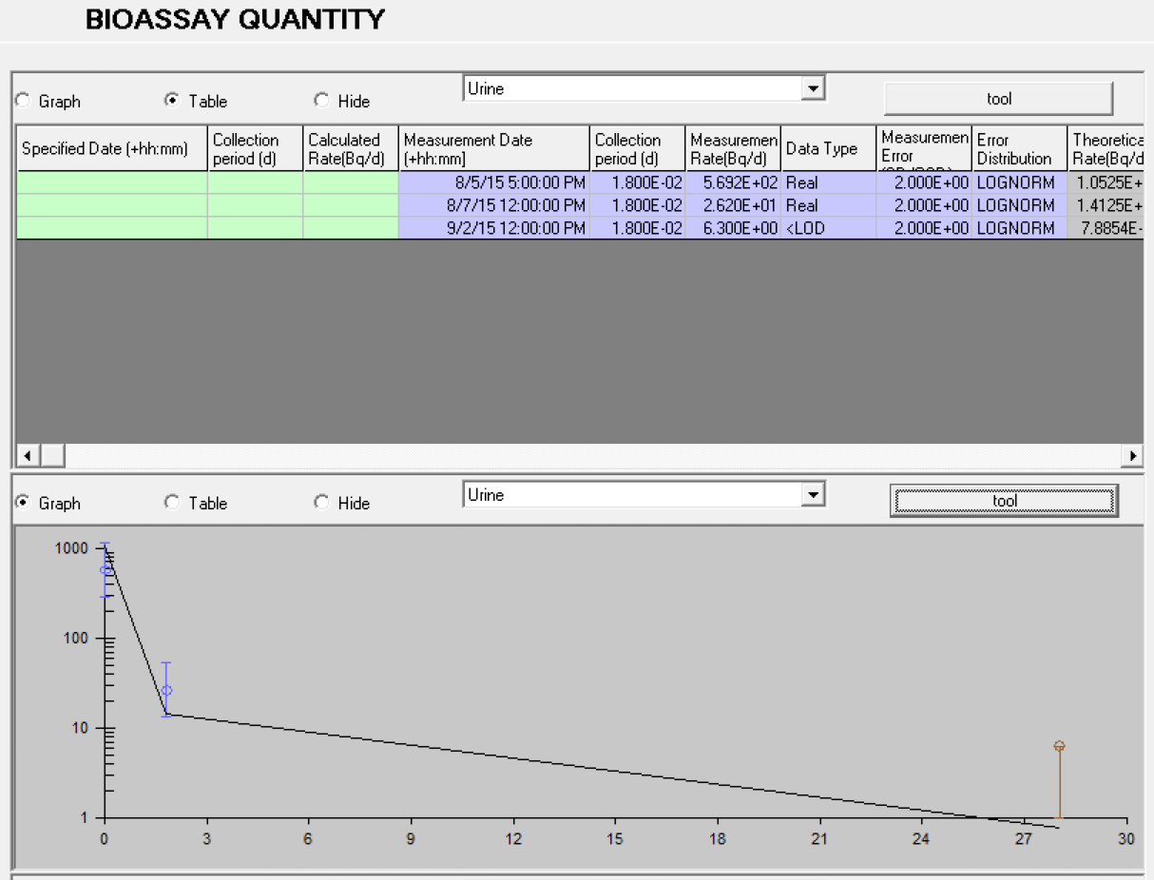
I-125 Inhalation
Notes:
We can enter in the information in the tool for the urine table. Right clicking on any field gives options

Slide 31
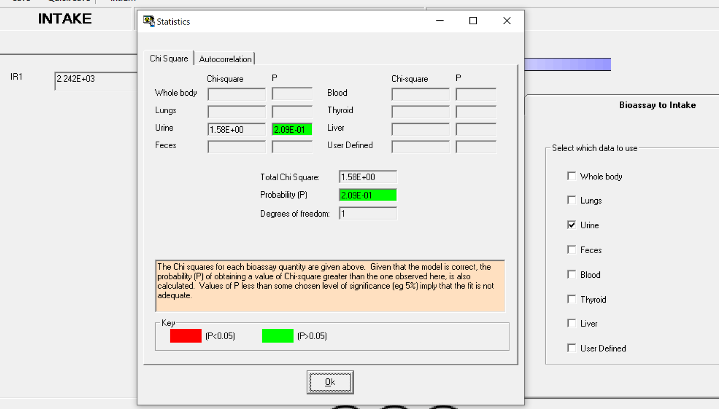
Notes:
We can see here that ther eis a 20% chance that the intake was 2242 Bq inhalation.

Slide 32
I-125 Inhalation
Determine acute inhalation intake from urine samples
2.242E+03 Bq (P = 2.09E-01)
Intake as a vapor?
Measurement Date | Bioassay (Bq/l) | Bioassay (Bq/d)
8/5/2015 17:00 | 406.6 | 569.2
8/7/2015 12:00 | 18.7 | 26.2
9/2/2015 12:00 | <4.5 [LOD] | <6.3
Assumed daily urine production of 1.40 liters
Collection period is 25ml/1400ml or 0.018

Slide 33
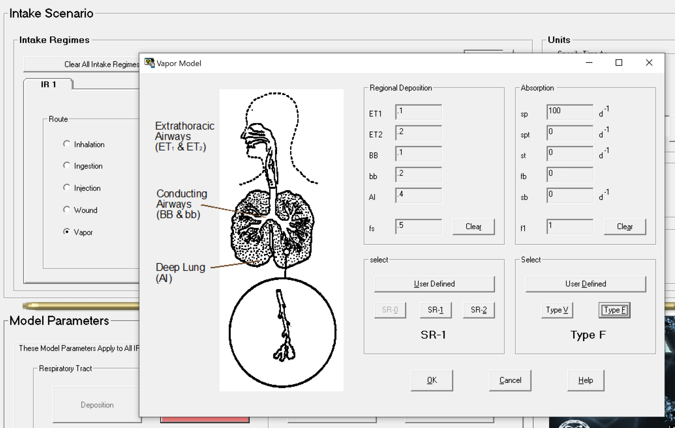
I-125 Inhalation: Vapor
Notes:
Sr-1: Solubility and Reactivity class: Different combinations of solubility and reactivity of gases and vapours result in partial uptake by airway tissues. The simplest definition of uptake is the fraction of the gas or vapour retained in the respiratory tract during steady breathing (fi). The region where the retention is distributed depends on the dynamics of mass transport in the airways, the mucus, and the airway tissue.
Type F is fast.

Slide 34
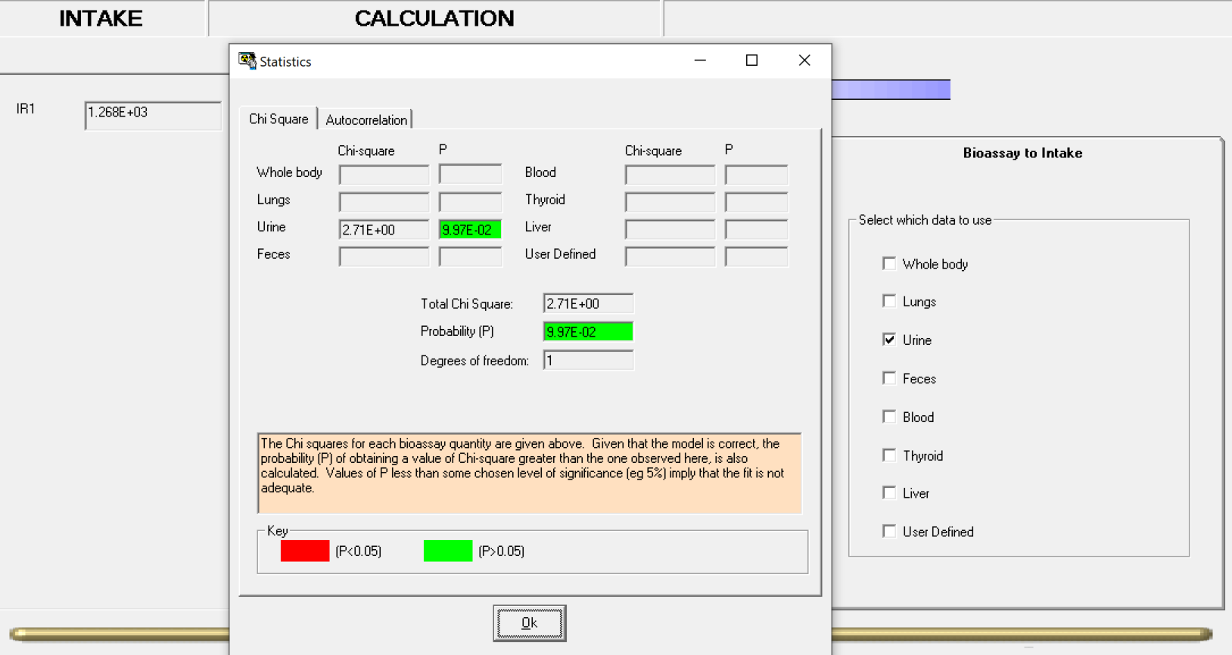
I-125 Inhalation: Vapor
Notes:
Keeping the same information will give you the following results: an intake of 1268Bq with 9.97% probability

Slide 35
I-125 Inhalation
Determine acute inhalation intake from urine samples
2.242E+03 Bq (P = 2.09E-01)
Intake as a vapor?
1.268E+03 Bq (P = 9.97E-02)
Intake as wound?
Measurement Date | Bioassay (Bq/l) | Bioassay (Bq/d)
8/5/2015 17:00 | 406.6 | 569.2
8/7/2015 12:00 | 18.7 | 26.2
9/2/2015 12:00 | <4.5 [LOD] | <6.3
Assumed daily urine production of 1.40 liters
Collection period is 25ml/1400ml or 0.018

Slide 36
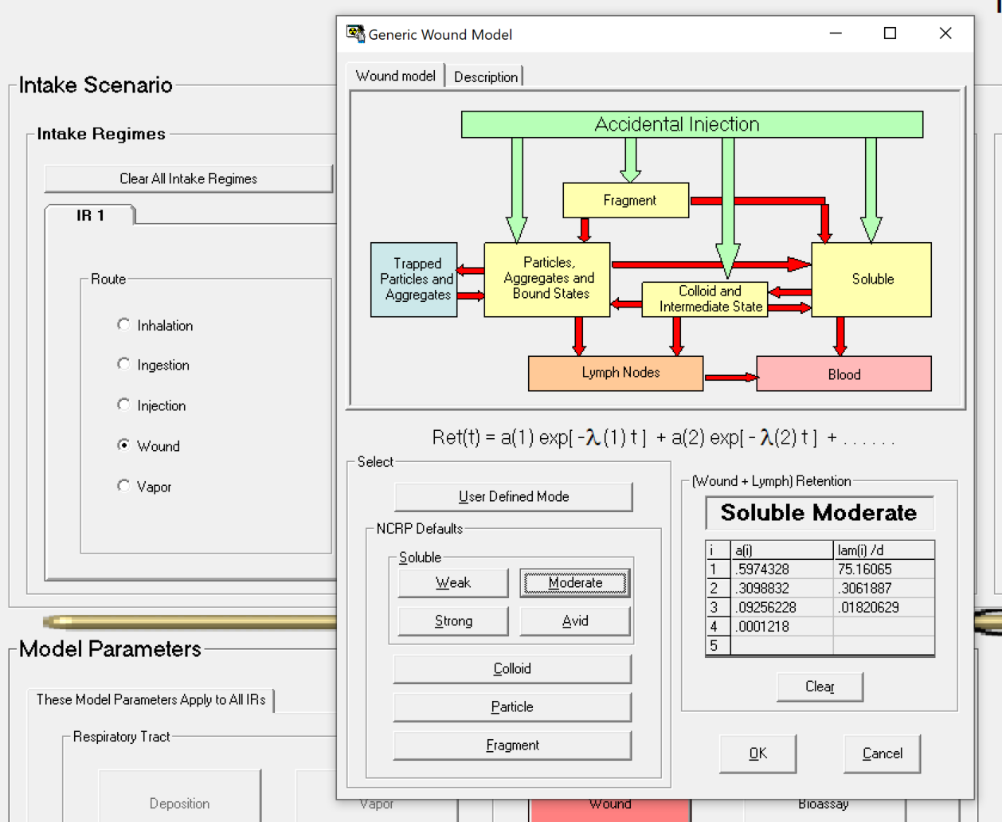
I-125 Inhalation: Wound

Slide 37
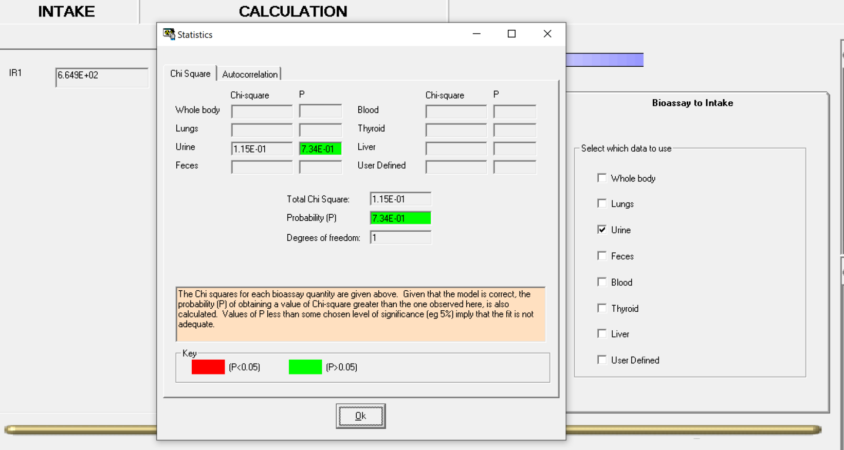
I-125 Inhalation: Wound
Notes:
665 Bq with 73.4% probability

Slide 38
I-125 Inhalation
Determine acute inhalation intake from urine samples
2.242E+03 Bq (P = 2.09E-01)
Intake as a vapor?
1.268E+03 Bq (P = 9.97E-02)
Intake via wound model?
6.649E+02 Bq (P = 7.34E-01)
Wound intake AND acute inhalation?
Measurement Date | Bioassay (Bq/l) | Bioassay (Bq/d)
8/5/2015 17:00 | 406.6 | 569.2
8/7/2015 12:00 | 18.7 | 26.2
9/2/2015 12:00 | <4.5 [LOD] | <6.3
Assumed daily urine production of 1.40 liters
Collection period is 25ml/1400ml or 0.018

Slide 39
Intake via Two Routes
Make sure that you are applying info to all IRs

Slide 40
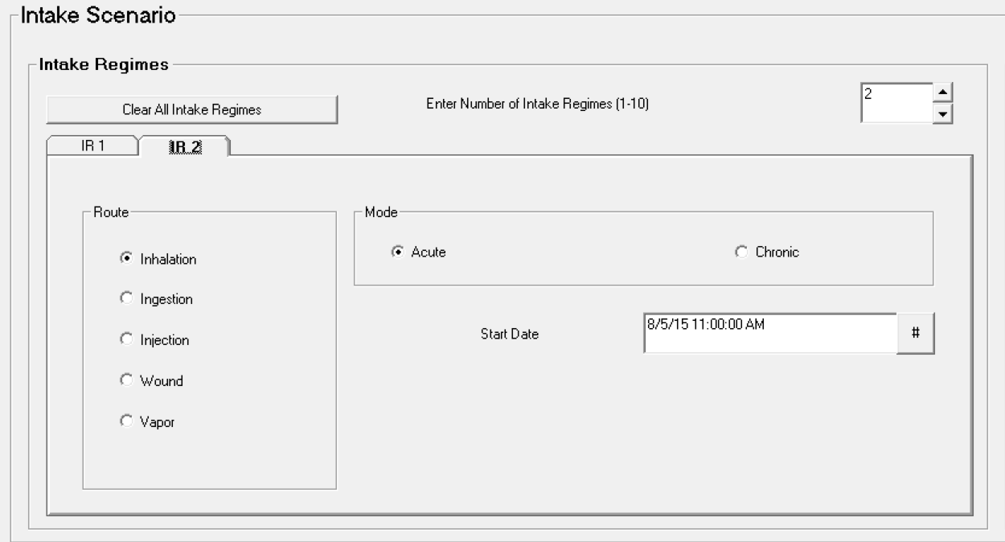
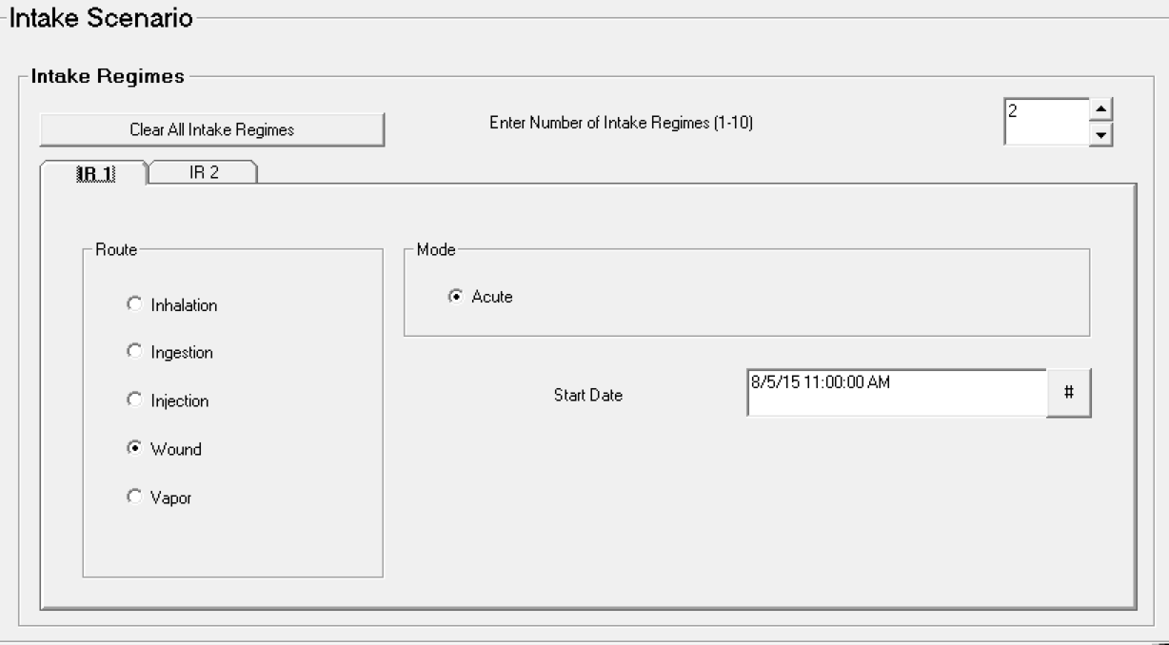
I-125 Inhalation: Wound and Acute

Slide 41
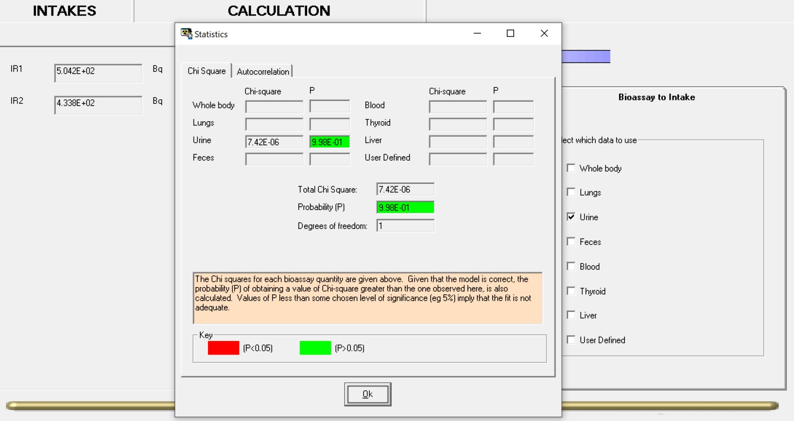
I-125 Inhalation: Wound and Acute
Notes:
This results in 2 intakes; 50 Bq via wound, and 43 Bq via inhalation for a total of 94 Bq with 99.8% probability.

Slide 42
I-125 Inhalation
Determine acute inhalation intake from urine samples
2.242E+03 Bq (P = 2.09E-01)
Intake as a vapor?
1.268E+03 Bq (P = 9.97E-02)
Intake via wound model?
6.649E+02 Bq (P = 7.34E-01)
Wound intake AND acute inhalation?
5.042E+02 Bq – wound
4.338E+02 Bq – inhalation
9.380E+02 Bq – total (P = 9.98E-01)
Measurement Date | Bioassay (Bq/l) | Bioassay (Bq/d)
8/5/2015 17:00 | 406.6 | 569.2
8/7/2015 12:00 | 18.7 | 26.2
9/2/2015 12:00 | <4.5 [LOD] | <6.3
Assumed daily urine production of 1.40 liters
Collection period is 25ml/1400ml or 0.018

Slide 43
Co-60 Inhalation: Urine samples coupled with whole body counting
Worker inhalation of fine dust containing Co-60 (acute intake)
After the incident, the worker followed up with internal monitoring and it was decided to collect urine samples and perform whole body counting
Urine samples had a 1-day collection period
Assume 10% relative uncertainty in bioassay data
There are no earlier known intakes
Assume moderate (M) clearance and 5 um AMAD

Slide 44
Co-60 Inhalation: 2 bioassay datasets
Whole Body Urine
Time after intake (d) | Bioassay (Bq)
1 | 9.76E+05
2 | 5.07E+05
3 | 2.90E+05
4 | 2.01E+05
5 | 1.65E+05
6 | 1.49E+05
8 | 1.38E+05
10 | 1.32E+05
13 | 1.26E+05
16 | 1.21E+05
Time after intake (d) | Bioassay (Bq/d)
1 | 2.09E+04
2 | 9.82E+03
3 | 3.95E+03
4 | 2.33E+03
5 | 1.79E+03
6 | 1.55E+03
8 | 1.27E+03
10 | 1.06E+03
13 | 8.22E+02
16 | 6.53E+02
Estimate acute inhalation intake
One intake, type M
1.261E+06 Bq (P = 0.00E+00)
One intake, type S
2.401E+06 Bq (P = 0.00E+00)
Type M and S combined
1.275E+06 Bq (S)
6.908E+05 Bq (M)
1.966E+06 Bq (total) (P = 1.00E+00)

Slide 45
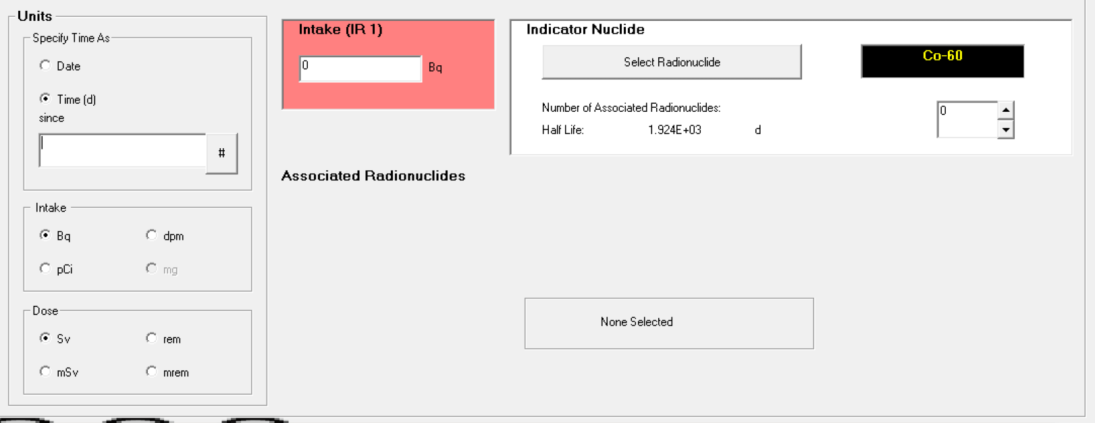
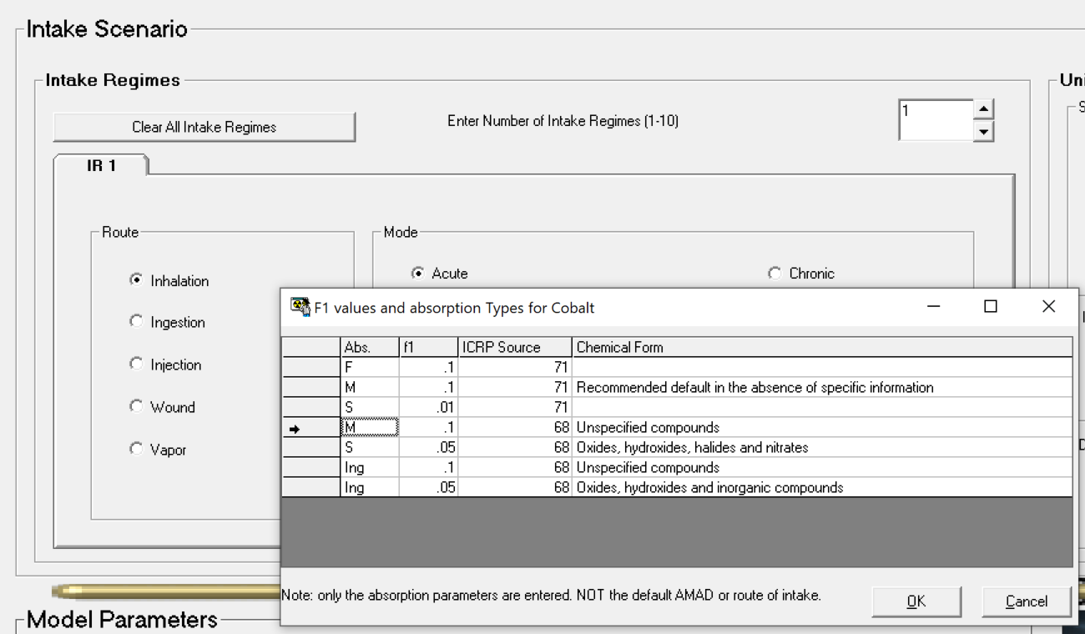
Co-60 Inhalation

Slide 46
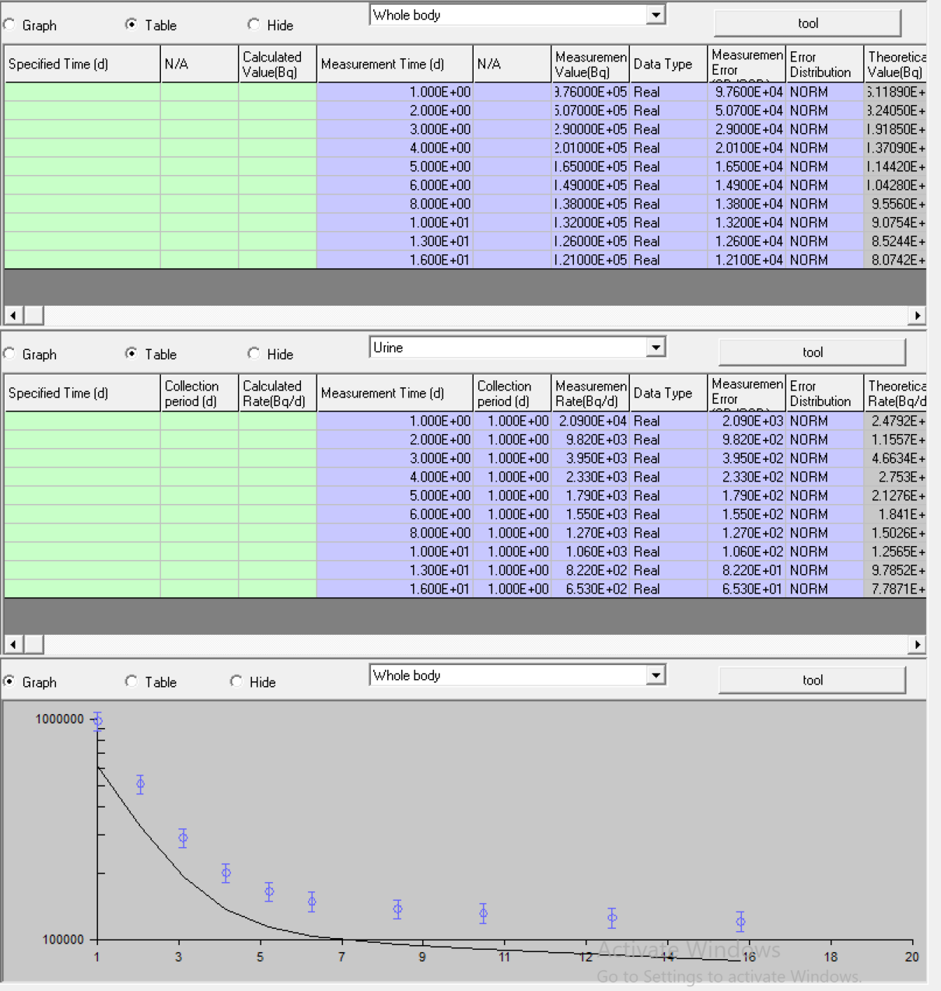
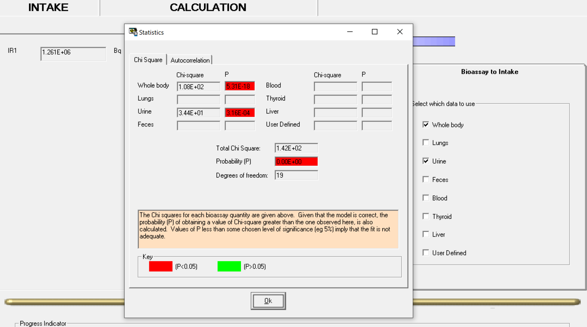
Co-60 Inhalation

Slide 47
Co-60 Inhalation: 2 bioassay datasets
Whole Body Urine
Time after intake (d) | Bioassay (Bq)
1 | 9.76E+05
2 | 5.07E+05
3 | 2.90E+05
4 | 2.01E+05
5 | 1.65E+05
6 | 1.49E+05
8 | 1.38E+05
10 | 1.32E+05
13 | 1.26E+05
16 | 1.21E+05
Time after intake (d) | Bioassay (Bq/d)
1 | 2.09E+04
2 | 9.82E+03
3 | 3.95E+03
4 | 2.33E+03
5 | 1.79E+03
6 | 1.55E+03
8 | 1.27E+03
10 | 1.06E+03
13 | 8.22E+02
16 | 6.53E+02
Estimate acute inhalation intake
One intake, type M
1.261E+06 Bq (P = 0.00E+00)
One intake, type S
2.401E+06 Bq (P = 0.00E+00)
Type M and S combined
1.275E+06 Bq (S)
6.908E+05 Bq (M)
1.966E+06 Bq (total) (P = 1.00E+00)

Slide 48
Co-60 Inhalation: Type S

Slide 49
Co-60 Inhalation: 2 bioassay datasets
Whole Body Urine
Time after intake (d) | Bioassay (Bq)
1 | 9.76E+05
2 | 5.07E+05
3 | 2.90E+05
4 | 2.01E+05
5 | 1.65E+05
6 | 1.49E+05
8 | 1.38E+05
10 | 1.32E+05
13 | 1.26E+05
16 | 1.21E+05
Time after intake (d) | Bioassay (Bq/d)
1 | 2.09E+04
2 | 9.82E+03
3 | 3.95E+03
4 | 2.33E+03
5 | 1.79E+03
6 | 1.55E+03
8 | 1.27E+03
10 | 1.06E+03
13 | 8.22E+02
16 | 6.53E+02
Estimate acute inhalation intake
One intake, type M
1.261E+06 Bq (P = 0.00E+00)
One intake, type S
2.401E+06 Bq (P = 0.00E+00)
Type M and S combined
1.275E+06 Bq (S)
6.908E+05 Bq (M)
1.966E+06 Bq (total) (P = 1.00E+00)

Slide 50
Co-60 Inhalation: Type M and Type S

Slide 51
Co-60 Inhalation: Type M and Type S

Slide 52
Co-60 Inhalation: 2 bioassay datasets
Whole Body Urine
Time after intake (d) | Bioassay (Bq)
1 | 9.76E+05
2 | 5.07E+05
3 | 2.90E+05
4 | 2.01E+05
5 | 1.65E+05
6 | 1.49E+05
8 | 1.38E+05
10 | 1.32E+05
13 | 1.26E+05
16 | 1.21E+05
Time after intake (d) | Bioassay (Bq/d)
1 | 2.09E+04
2 | 9.82E+03
3 | 3.95E+03
4 | 2.33E+03
5 | 1.79E+03
6 | 1.55E+03
8 | 1.27E+03
10 | 1.06E+03
13 | 8.22E+02
16 | 6.53E+02
Estimate acute inhalation intake
One intake, type M
1.261E+06 Bq (P = 0.00E+00)
One intake, type S
2.401E+06 Bq (P = 0.00E+00)
Type M and S combined
1.275E+06 Bq (S)
6.908E+05 Bq (M)
1.966E+06 Bq (total) (P = 1.00E+00)

Slide 53
Main Takeaways when estimating intakes
Understand the ICRP biokinetic models before you use IMBA!
Use realistic assumptions with biokinetic models
Don’t always assume “one size fits all” with bioassay data
Avoid “this fits best mentality”

