Slide 1
IMBA Beginner Training
Charlotte Rose
Research Scientist
Corvallis OR
charlotte.rose@rcdsoftware.com

Slide 2
OUTLINE
A. Overview
What is IMBA
Two main directions for IMBA calculations
B. Main Window
C. Reproduce effective dose coefficients for inhalation & ingestion for selected radionuclides
D. Example dose calculations without bioassay data
CEDE and CDE to Lung for acute inhalation of natural uranium (U-nat)
²³⁸Pu inhalation scenario

Slide 3
²³⁸PuO₂ INHALATION EXAMPLE

Slide 4
Due to year-round facility operation with plutonium oxide, a potential exists for chronic inhalation of ²³⁸Pu by workers.
Calculate the committed effective dose equivalent & committed dose equivalent to the lung for a chronic intake at the annual limit on intake (ALI).

Slide 5
Annual limit on intake (ALI) for workers
10 CFR 20 Appendix B
ICRP-66 (1994)
Element | Type | f₁ | Compounds
Plutonium | M | 5.0x10-4 | Unspecified Compounds
 | S | 1.0X10-5 | Insoluble Oxides
IMBA uses ICRP-66 (1994):
Human Respiratory Tract Model & Absorption Types
PuO₂ inhalation ALI is 0.02 μCi = 740 Bq (2.0 Bq per day)
Notes:
Class W – weeks
Class Y years
Type M (moderate) 10 min (10%); 140 d (90%)
Type S (slow) 10 min (0.1%); 7000d (99.9%) (ICRP 68 p 8)

Slide 6
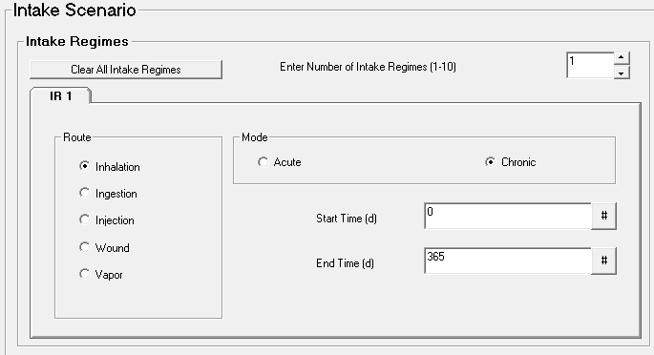
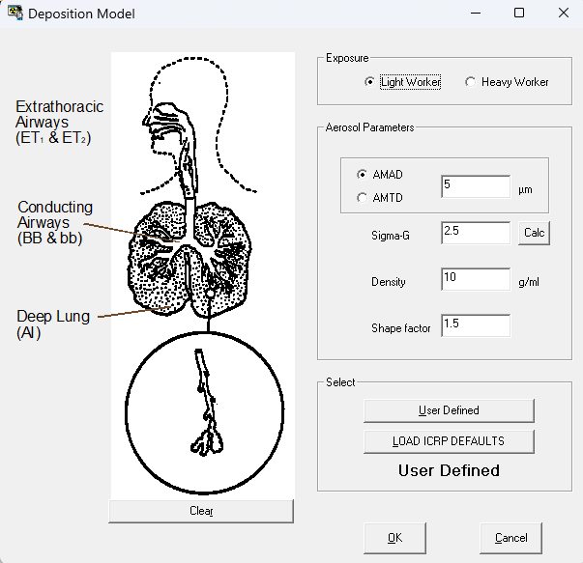
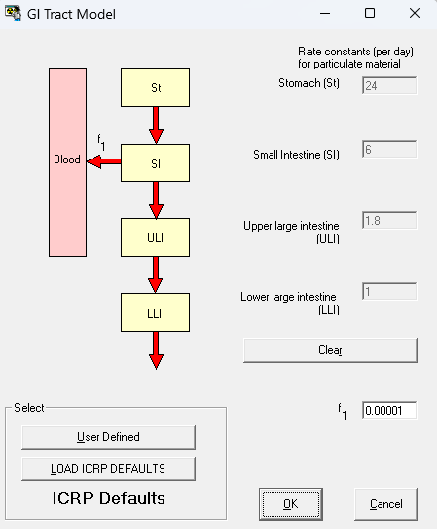
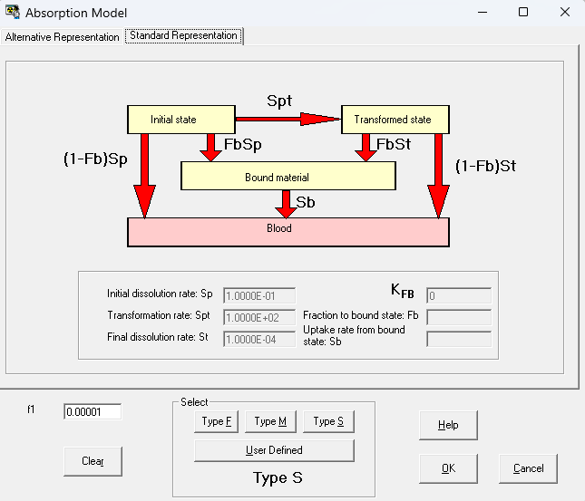
IMBA data input

Slide 7
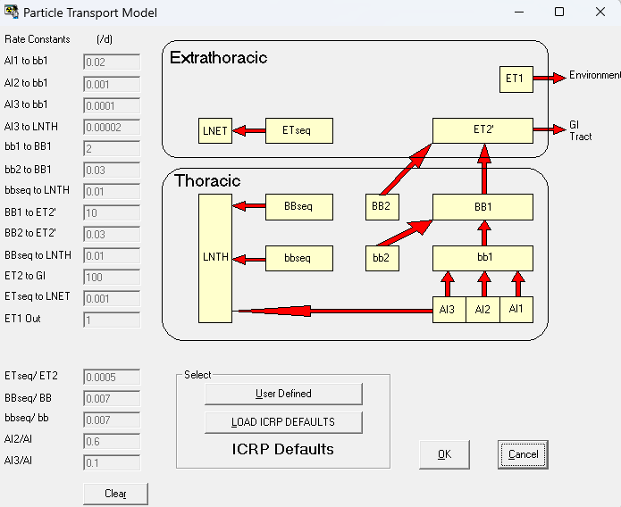
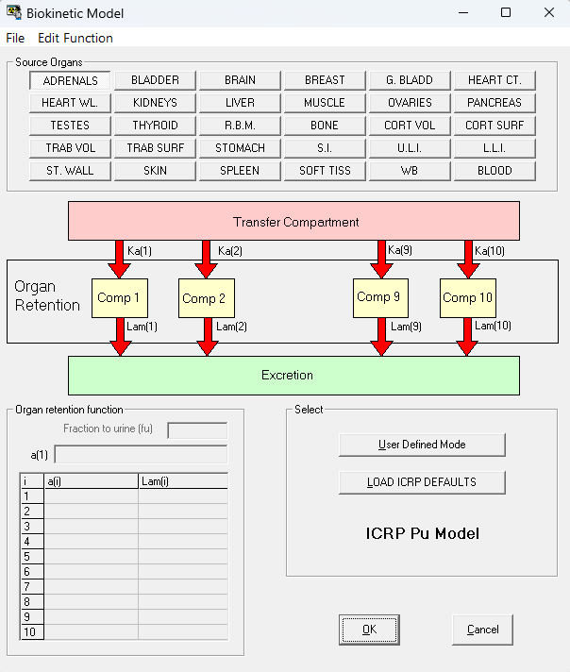
IMBA default selections

Slide 8
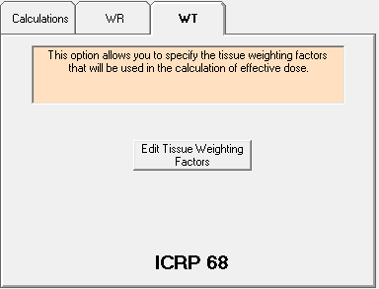
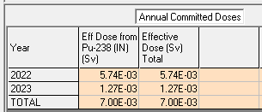
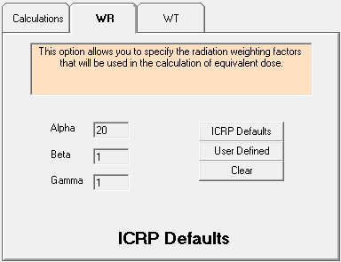
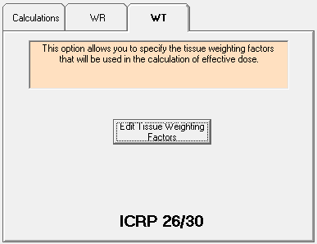
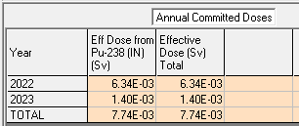
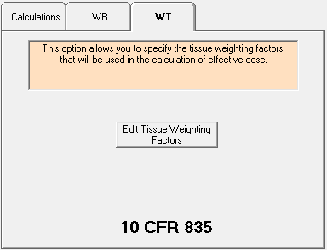
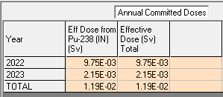
Weighting factors & AMAD affect effective dose
5-μm AMAD
1-μm AMAD

Slide 9
AMAD affects lung dose equivalent
5-μm AMAD
1-μm AMAD

Slide 11
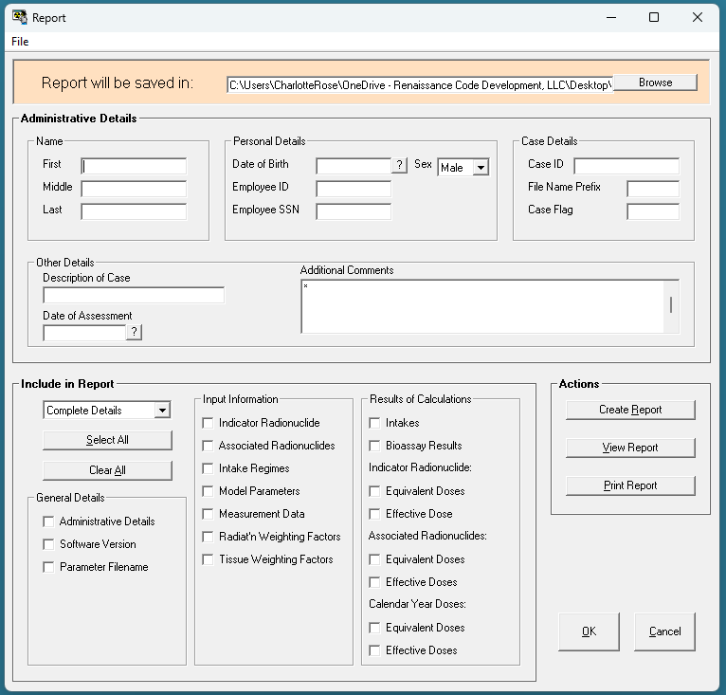
Creating A Report
Select the location to save the report
Enter in details
Select the data to include in the report
Create/View/Print report
Hit “OK”

Slide 12
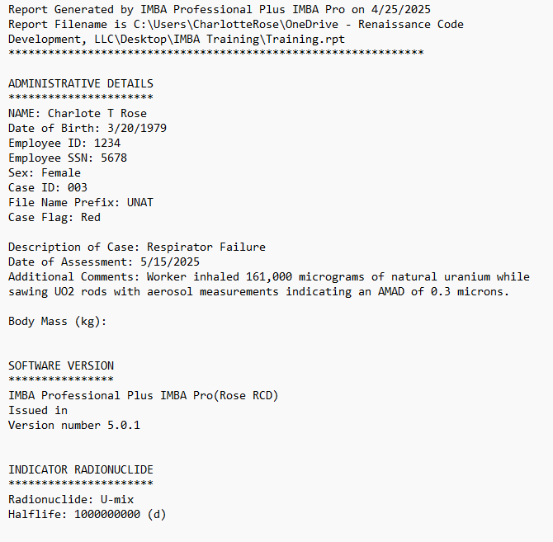

Slide 13
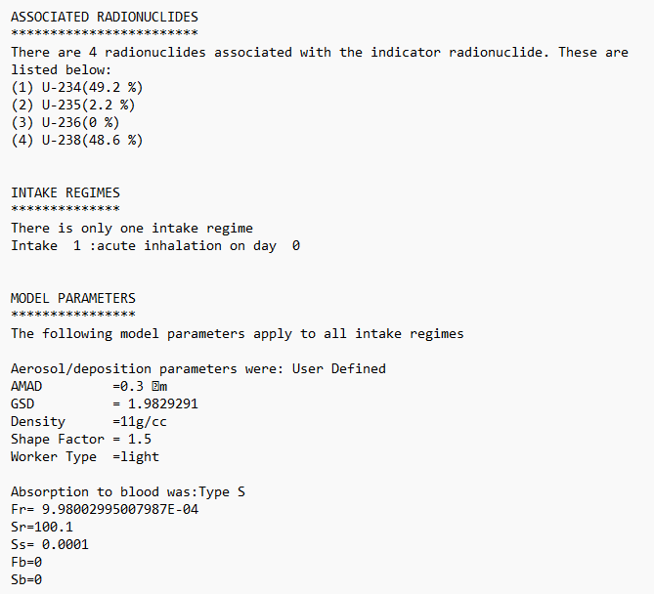

Slide 14
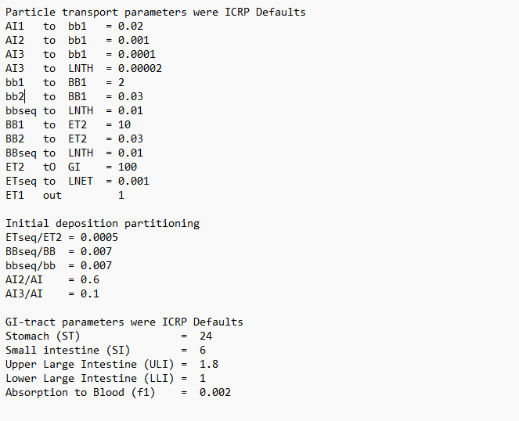

Slide 15
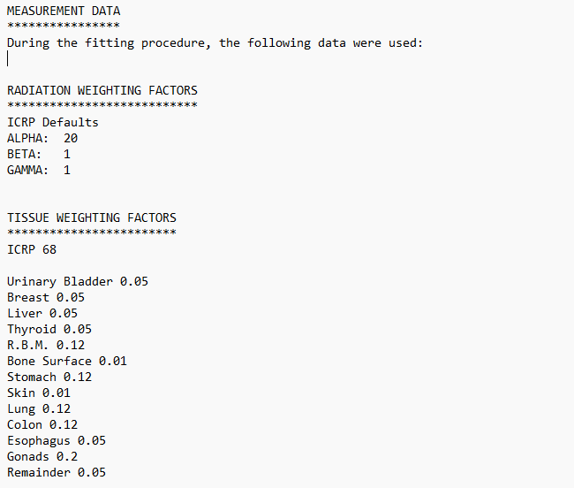

Slide 16
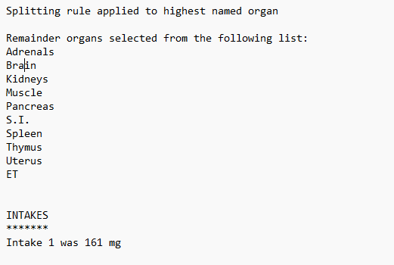

Slide 17
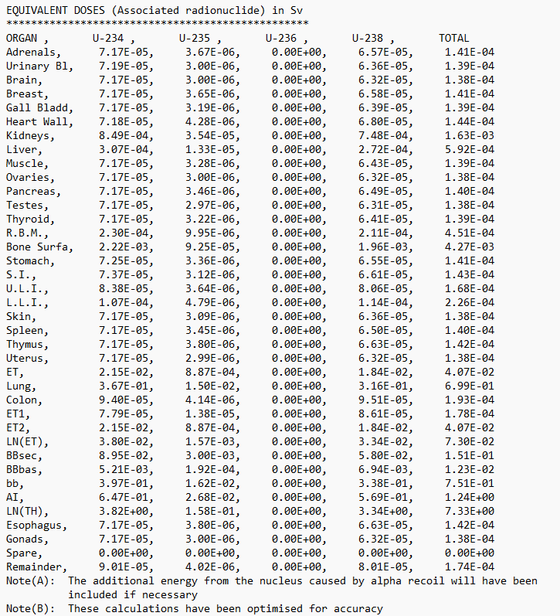

Slide 18
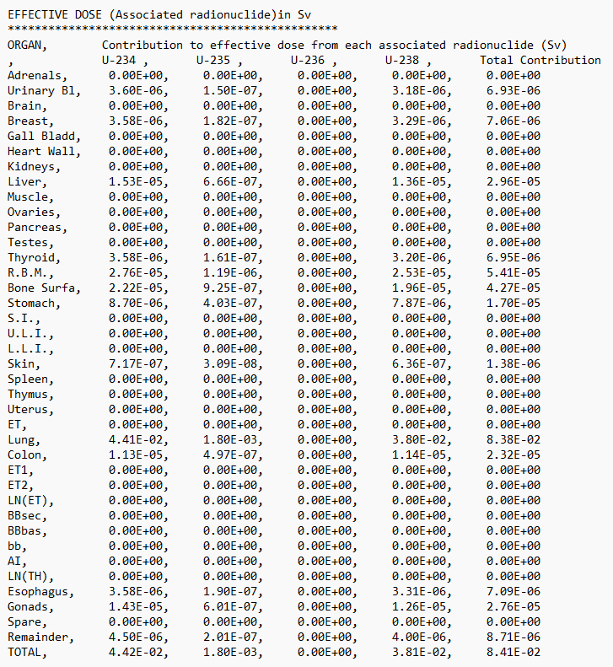

Slide 19
