Slide 1
IMBA Beginner Training
Charlotte Rose
Research Scientist
Corvallis OR
charlotte.rose@rcdsoftware.com

Slide 2
NATURAL URANIUM INHALATION EXAMPLE

Slide 3
A facility worker inhales 161,000 μg of natural uranium while sawing UO₂ rods with aerosol measurements indicating an AMAD of 0.3 μm.
Calculate the committed effective dose equivalent & committed dose equivalent to the lung for this intake.

Slide 4
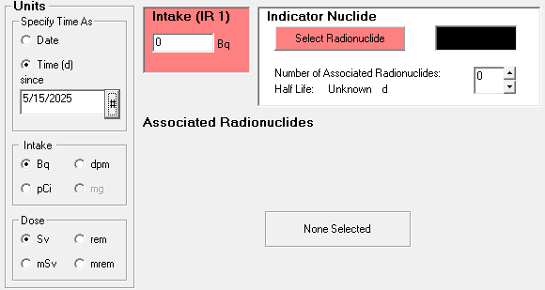
Intake
Starting with a blank screen, we can see what we need to enter, as they are marked in red
First, select the radionuclide
Notes:
This will bring up the

Slide 5
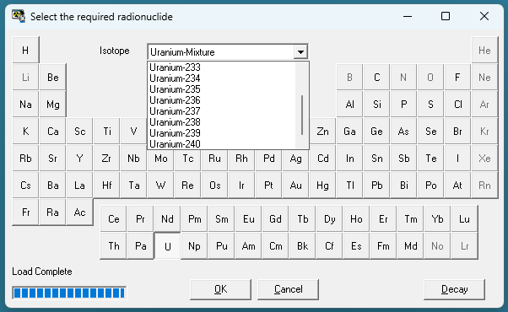
Selecting the Radionuclide
Selecting Uranium gives us the option of choosing a specific nuclide, or a natural mix
Once a mix is selected, a new red buttons is shown to select the U mixture.

Slide 6
Specify the abundance from predetermined list, or user defined.
You can select abundance by activity or mass
Either way, pay attention to the resulting specific activity and write it down for later.

Slide 7
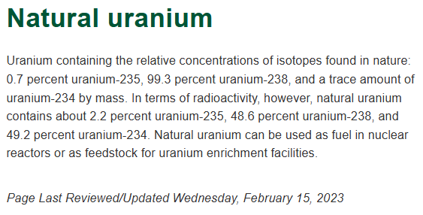
U-NAT EXAMPLE (Cont’d)
Natural uranium comprises
49.2 % ²³⁴U
2.2 % ²³⁵U
48.6 % ²³⁸U
Notes:
We can see that the presets in IMBA do not match the natural uranium definition from the NRC. For this example, we will edit them manually

Slide 9
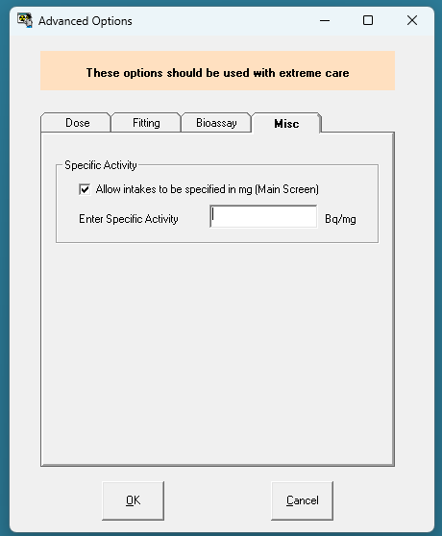
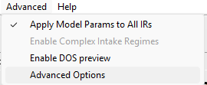

Slide 11
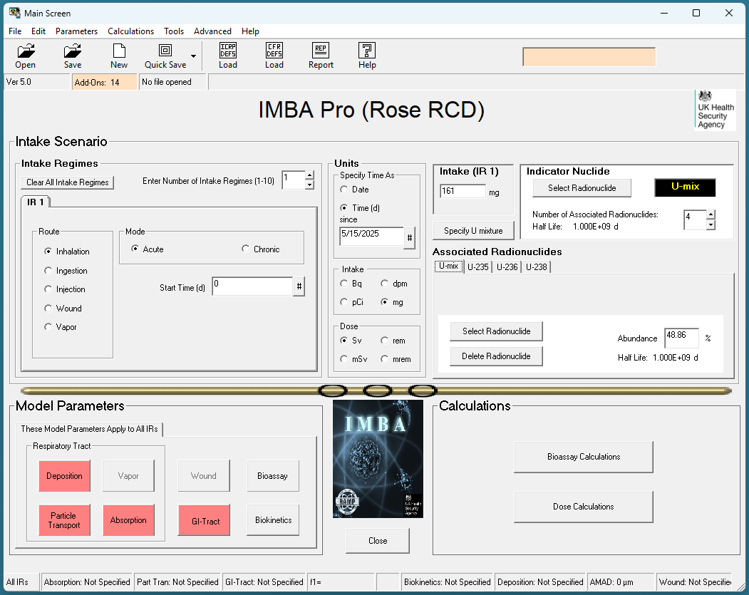
Notes:
Now you can see that we have the option of entering in mass of uranium in stead of activity. However, all reports will provide details about masses, rather than activity, so chose wisely ☺
If you use mg as intake instead of Bq, it will not show the activity anywhere, even on the report.
Same as if you use Bq as intake, it will not show mass of intake anywhere, even on the report.

Slide 12
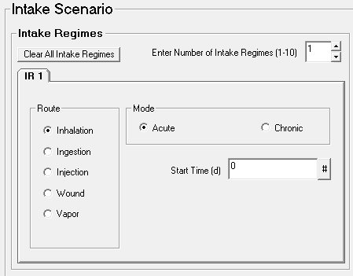
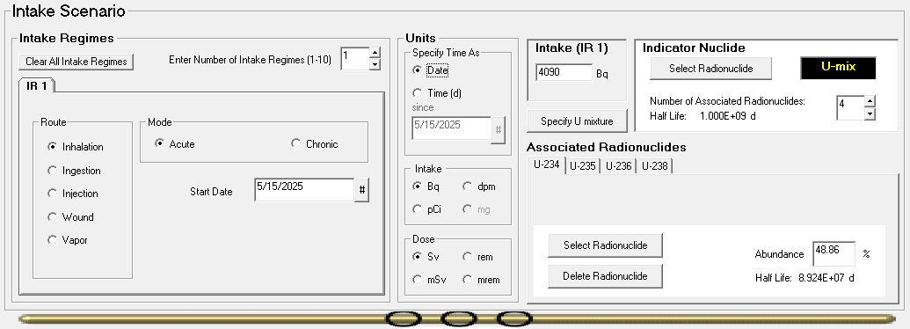
Confirm intake regime
Enter intake
Select the mode of start time in “Specify Time As”
Notes:
This only really matters if you are selecting a chronic intake.

Slide 13
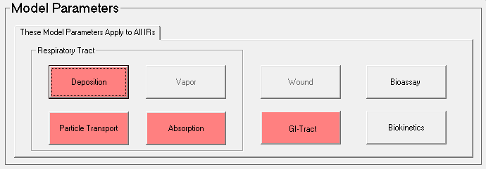
U-NAT EXAMPLE (Cont’d)
Address modeling parameters

Slide 14
Deposition
Notes:
This is a pictoral view of the pathways of the lung model from ICRP 66. Each of the pathways is given an acronym; “ET Extrathoracic, referring to the area above the trachea. Below which is the main bronchus (BB), and the bronchioles, which are the smaller of the airways. Hence the large/capital letters and small/lower case letters. The deep lungh is AI for alveolar/interstitial. Theses are the small sacs that inflate with air and transfer gas (and in our interests, potential particles) into the blood stream. This area is highly vascular and optimized for gas exchange.
The extrathoracic airways have an abundance of cilia which are for the trapping and removal of foreign natter; so in many cases large particles, like those more than 5 micrometers in diameter will be trapped here and either swallowed, or sneexed out. Either way, in most cases, the size of the particle will determine the likelihood of it passing through to the next section of the lung model.

Slide 15
ICRP66 Recommendation
(181) In the absence of specific information about the physical characteristics […], the following default values are recommended:
AMAD = 5 μm (σ_{g} = 2.5) for workplace exposures
AMAD = 1 μm (σ_{g} = 2.47) for indoor or outdoor exposures of general public
particle density, ρ = 3 g/cm³
particle shape factor, χ= 1.5
(170) […] To derive reference values of regional deposition for aerosols of intermediate size, it is assumed that σ_{g} is defined by:
σ_{g}= 1+1.5[1-(100 AMTD^{1.5}+1)⁻¹]
Notes:
Click user defined to be able to fill parameters. The Calculate button automatically uses the geometric standard deviation equation for you.
If you change the size of the AMAD, you can use Calc to derive the reference value with the equation from paragraph 170 in ICPR 66.
(181) In the absence of specific information about the physical characteristics of the aerosol to which a subject is exposed, the following default values are recommended (see Annex D, Section D. 13):
AMAD = 5 μm (σ_{g} = 2.5) for workplace exposures
AMAD = 1 μm (σ_{g} = 2.47) for indoor or outdoor exposures of general public
particle density, ρ = 3 g/cm³
particle shape factor, χ= 1.5
( 170) The geometric standard deviation (σ_{g}) in particle size is approximately unity for vapors in the atomic size range (0.0005 μm in diameter). For unimodal aerosols with a median particle size on the order of 1 μm or larger, σ_{g} is likely to be about 2.5. To derive reference values of regional deposition for aerosols of intermediate size, it is assumed that σ_{g} is defined by Eq. (16):
σ_{g}= 1+1.5[1-(100 AMTD^{1.5}+1)⁻¹]
where AMTD (in μm) is the activity median thermodynamic diameter of the aerosol considered. This assumed variation of σ_{g} with median particle size is discussed in Annex D.

Slide 16
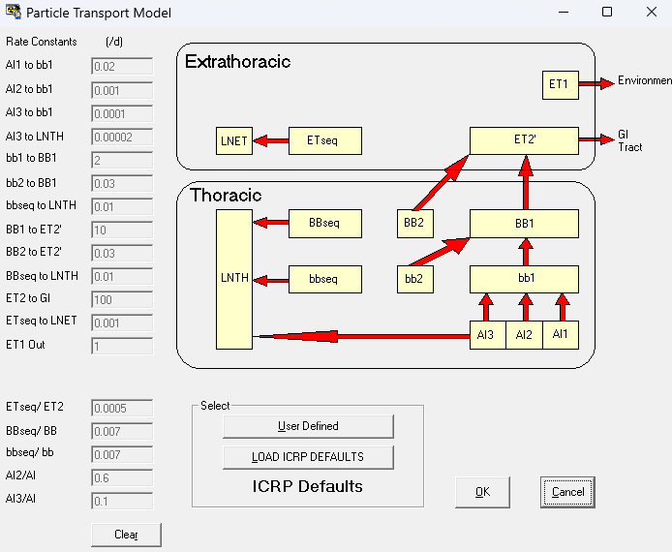
Particle Transport
ICRP default for compartment transfer rates
Notes:
Go through what this is/
Seq is sequestered in tissue
LN=lymph nodes (extrathoracic and thoracic)

Slide 17
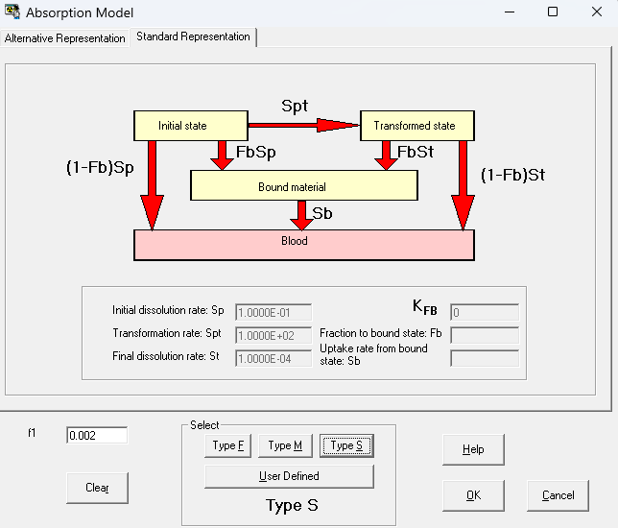
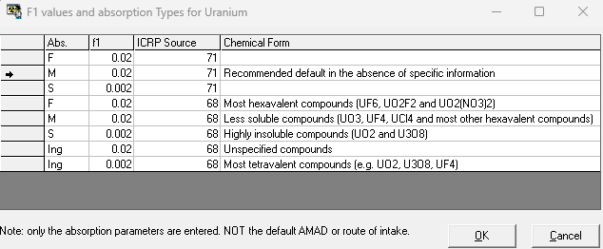
Absorption
For uranium oxides, ICRP-71 (1995) suggests
Absorption Class Y (Corresponding to Slow, or “S”)
f₁ = 0.002
Notes:
Clicking on Help gives the ICRP recommendations
Note the F1 value – this carries over to the GI settings
Absorption Parameter: Both representations of the particle dissolution and material absorption processes have their practical uses. The Standard Representation is helpful when a physical process (such as particle fragmentation) leads to the gradual transformation of deposited particles into a more soluble form, i.e., in cases where the overall absorption rate increases with time - see Technical Basis for an example of this. The Alternative Representation is useful for the more general situation, where the overall absorption rate decreases with time. For example, in vitro solubility studies are usually interpreted in terms of "fast" and "slow" dissolution fractions, with their associated dissolution rates. Such results can be substituted directly in the Alternative Representation

Slide 18
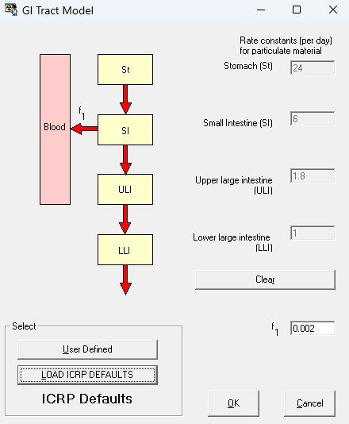
For this inhalation example, ICRP defaults selected for GI tract modeling.
Notes:
F1 will automatically load from Absorption selection
The gi tract model captures the fraction of inhaled particulates that get stuck in the upper airways and are swallowed.

Slide 19
U-NAT EXAMPLE (Cont’d)
With model parameters addressed, indicated by the removal of the red highlighting, we are ready to advance to the Dose Calculation.

Slide 20
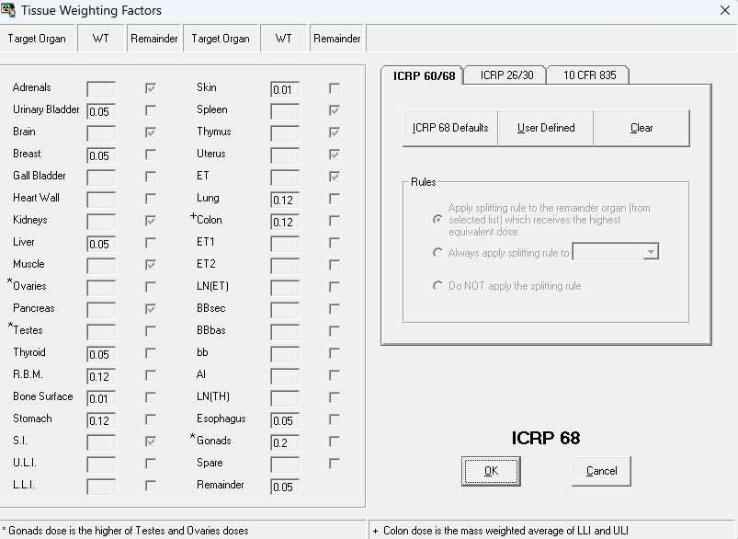
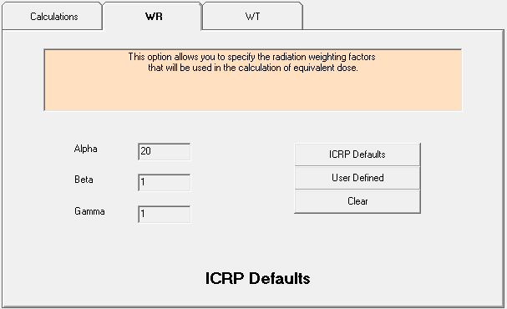
U-NAT EXAMPLE (Cont’d)
Dose Calculation requires
radiation weighting factors
tissue weighting factors

Slide 21
U-NAT EXAMPLE RESULTS
Committed dose equivalent to lung
Committed effective dose equivalent (CEDE)

