Slide 1
IMBA Beginner Training
Charlotte Rose
Research Scientist
Corvallis OR
charlotte.rose@rcdsoftware.com

Slide 2
OUTLINE
A. Overview
What is IMBA
Two main directions for IMBA calculations
B. Main Window
C. Reproduce effective dose coefficients for inhalation & ingestion for selected radionuclides
D. Example dose calculations without bioassay data
CEDE and CDE to Lung for acute inhalation of natural uranium (U-nat)
²³⁸Pu inhalation scenario

Slide 3
Using IMBA to calculate effective dose coefficients for ingested and inhaled particulates for workers (ICRP 119)

Slide 4
Carbon
From ICRP 119 Table A.1 Effective Dose coefficients (e) for ingested particulates for workers
 | f₁ | e (Sv/Bq)
C-11 | 1.0 | 2.4E-11
C-14 | 1.0 | 5.8E-10

Slide 6
Carbon
From ICRP 119 Table A.1 Effective Dose coefficients (e) for ingested particulates for workers
 | f₁ | e (Sv/Bq)
C-11 | 1.0 | 2.4E-11
C-14 | 1.0 | 5.8E-10

Slide 7
Fluorine (F-18) From ICRP 119 Table A.1 Effective Dose coefficients (e) for inhaled particulates for workers
 | f₁ | e (Sv/Bq) (5μm)
F | 1.0 | 5.4E-11
M | 1.0 | 8.9E-11
S | 1.0 | 9.3E-11

Slide 9
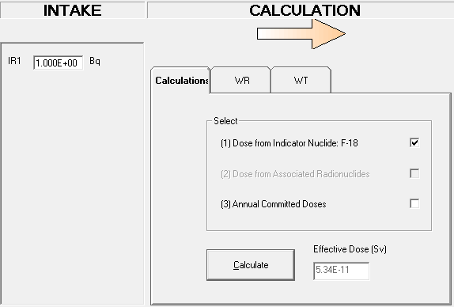
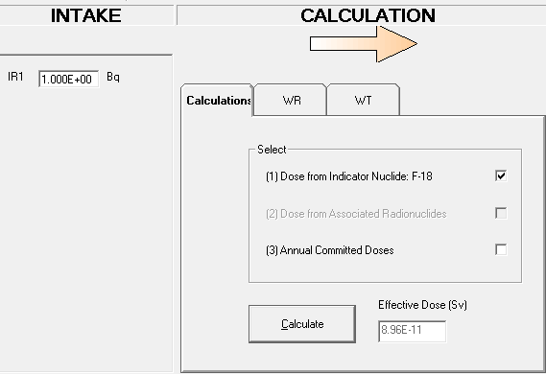
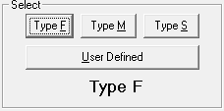
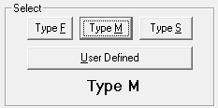
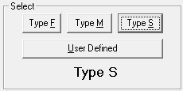
Fluorine (F-18) From ICRP 119 Table A.1 Effective Dose coefficients (e) for inhaled particulates for workers
 | f₁ | e (Sv/Bq) (5μm)
F | 1.0 | 5.4E-11
M | 1.0 | 8.9E-11
S | 1.0 | 9.3E-11

