Slide 1
IMBA Beginner Training
Charlotte Rose
Research Scientist
Corvallis OR
charlotte.rose@rcdsoftware.com

Slide 2
OUTLINE
A. Overview
What is IMBA
Two main directions for IMBA calculations
B. Main Window
C. Reproduce effective dose coefficients for inhalation & ingestion for selected radionuclides
D. Example dose calculations without bioassay data
CEDE and CDE to Lung for acute inhalation of natural uranium (U-nat)
²³⁸Pu inhalation scenario

Slide 3
Purpose
The IMBA code is a collection of software modules designed to calculate the amount of radiation absorbed by different tissues and organs after one has been exposed to radioactive materials.
The IMBA code implements respiratory tract, GI-tract, tissue dosimetry, biokinetic and bioassay models as recommended by the International Commission on Radiological Protection (ICRP 68 and 71)
The code allows users to customize calculations with different parameters, making it a versatile tool for internal dosimetry studies.

Slide 4
Dose Calculations
Dose Calculations are performed on the indicator nuclide over the intake period for all intake regimes (if applicable)
Estimates single or multiple intakes of different radionuclides and calculates resulting doses in the body for the ICRP 68 Reference Worker ​
Dose consequences are listed for each organ, and as a calculated effective dose equivalent based on the ICRP method chosen.
Notes:
ICRP 26/30, ICRP 60/68 and 10CFR 835. 10 CFR 835 is based on ICRP 26/30, but offers more organs to be available to calculate remainder doses. Put in a slide that has specifications for this.

Slide 5
Bioassay Calculations
This module allows you to estimate an intake given bioassay results.
Depending on the level of knowns the user has, a fit is selected with a probability of event.

Slide 6
A Bit of History
Mid 1980’s codes to evaluate bioassay data and calculate internal doses
GENMOD, INDOS, REMEDY, and CINDY… based on ICRP 26/30
Mid 1980’s these codes couldn’t use new ICRP 66 HRTM
IMBA was born in 1997
British Nuclear Fuels
Westlakes Research Institute
UK National Radiological Protection Board (NRPB) (absorbed into UK Health Protection Agency)
Fast forward to today…
IMBA 5.0.1: developed by UK HPA and licensed by RAMP

Slide 7
IMBA Lite
The base unit is the core of IMBA Professional Plus and enables the user to perform basic internal dosimetry calculations (e.g., calculating doses from a specified intake, estimating an intake from bioassay measurements and calculating bioassay quantities from a given intake)
Includes 75 radionuclides
Additional Radionuclides Pack 1 and 2 adding ~665 more
Assess an intake from either inhalation, ingestion, or direct injection
Full access to ICRP 60/68 and ICRP 26/30 models and parameters

Slide 8
IMBA Plus Ad-Ons
All IMBA Lite functionality
(1) Multiple Intake Regimes
(2) Multiple Bioassay Types
(3) Associated Radionuclides
(4) Uranium Mixtures
(5) Uptake from Wounds

Slide 9
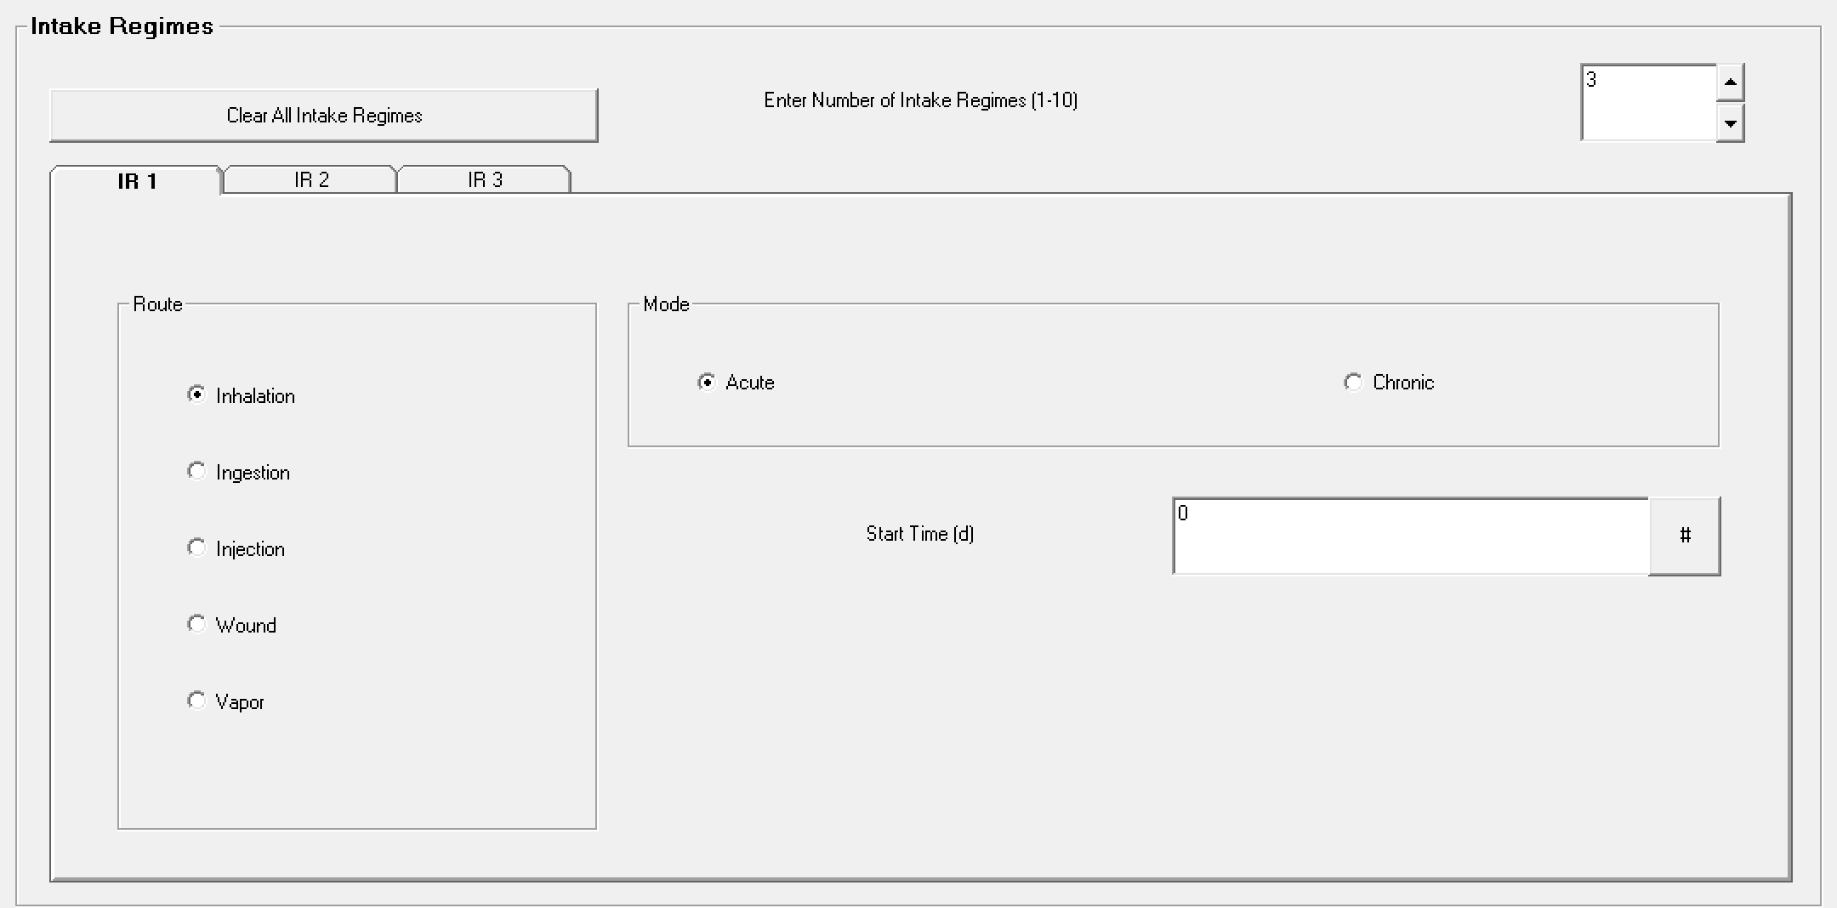
Multiple Intake Regimes (#1)
Up to 10
Contributions from each included in bioassay and dose calculations
Different model parameters assigned to each

Slide 10
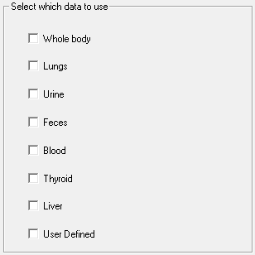
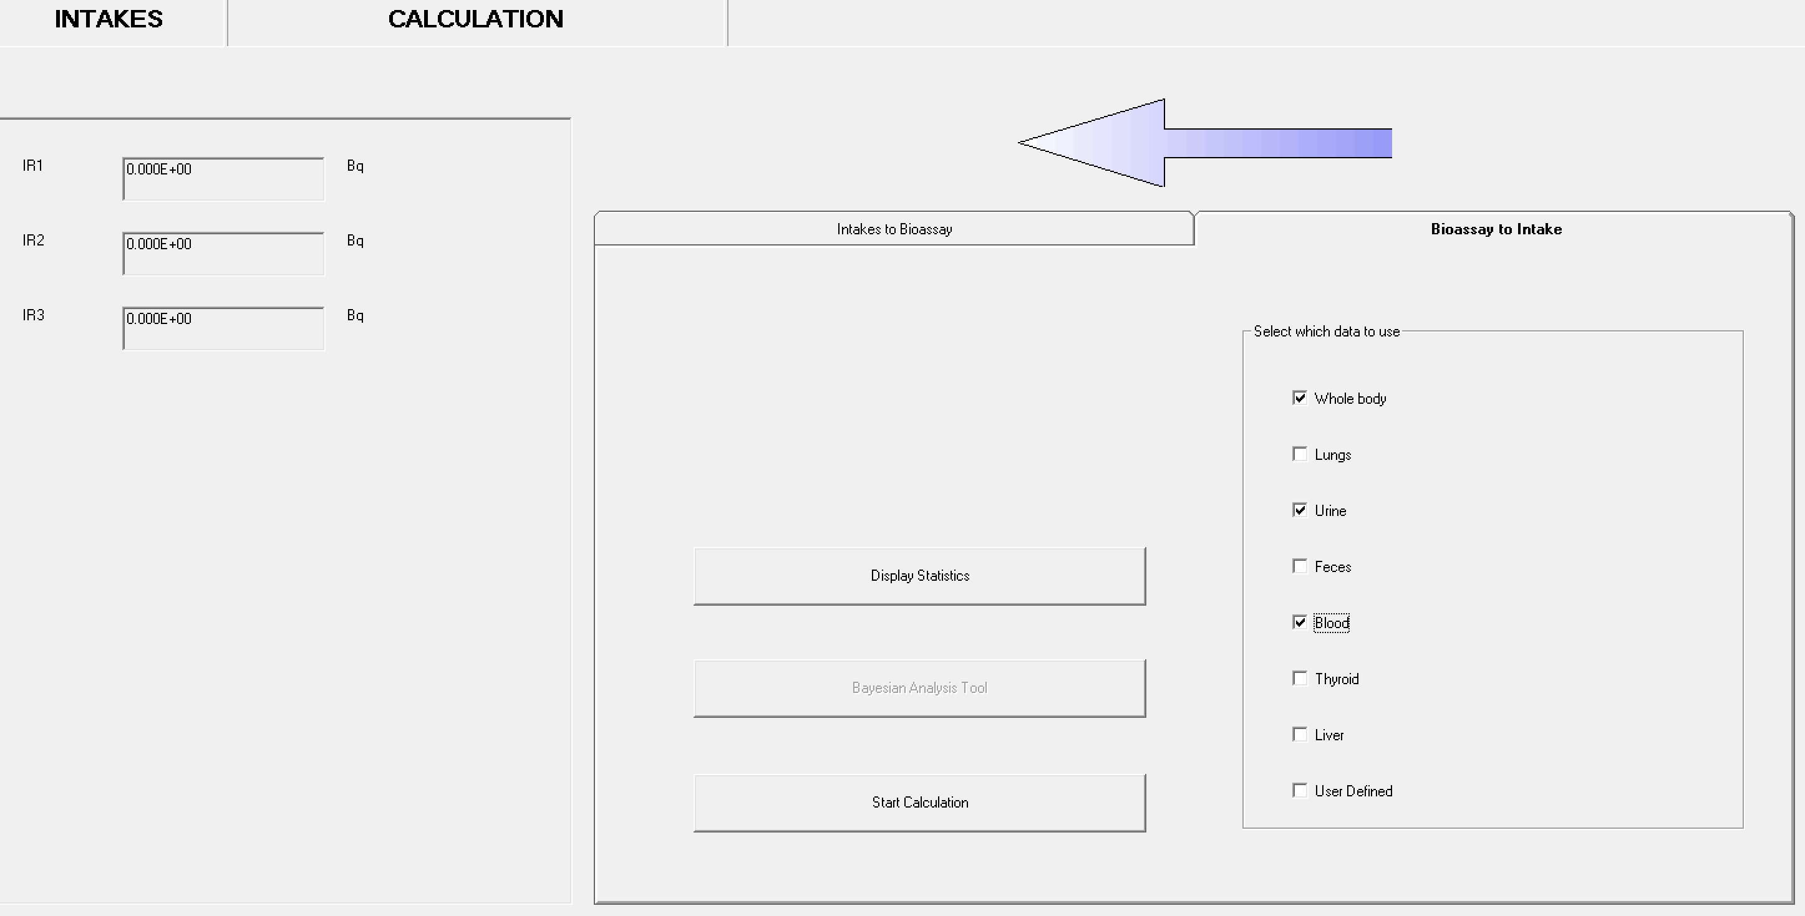
Multiple Bioassay Types (#2)
8 different bioassay quantities
This allows user to fit the intake to different bioassay types simultaneously
This Add-On also works with Add-On 1 to enable multiple intakes to be fitted to multiple bioassay data types simultaneously

Slide 11
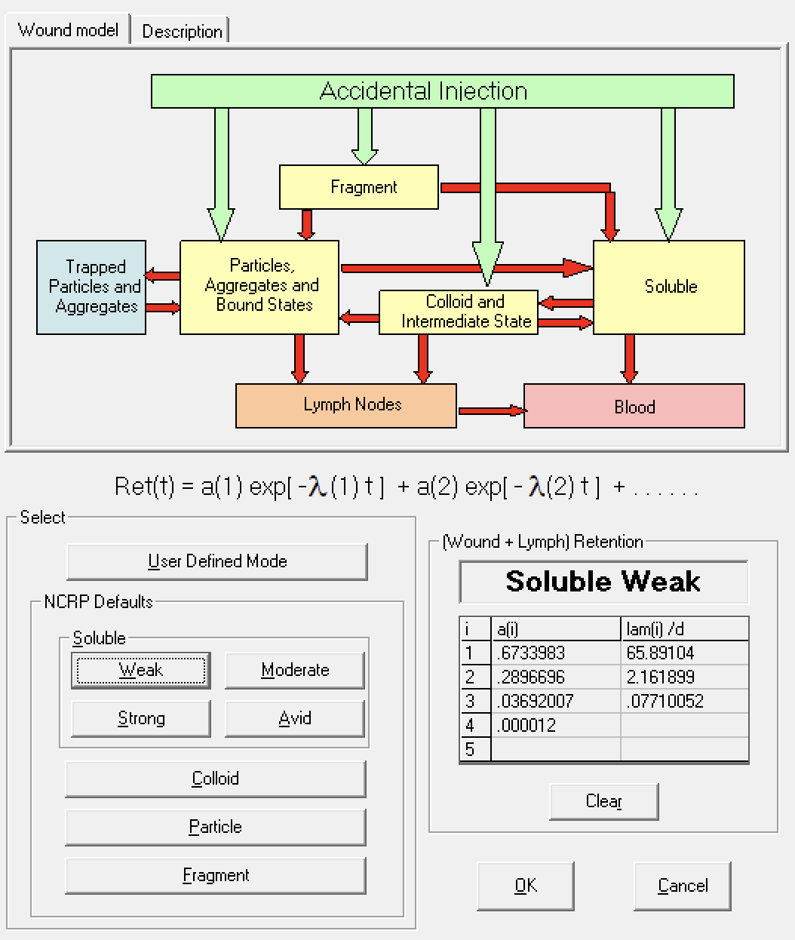
Uptake from a Wound (#5)
Enables the user to specify how the activity reaches the blood following a wound contamination
Implements NCRP No. 156 wound model
Choose one of the "NCRP Defaults" wound categories: Soluble, Colloid, Particle or Fragment.
Users may enter their own values for the retention function as a sum of exponentials (User Defined Mode)

Slide 12
IMBA Pro
All IMBA Plus functionality
(6) Errors on Intake
(7) Bayes Implementation
(8) Tritium Tool
(9) Compensation Type Calculations
(10) Ingrowth of Americium
(11) Statistics Package

Slide 13
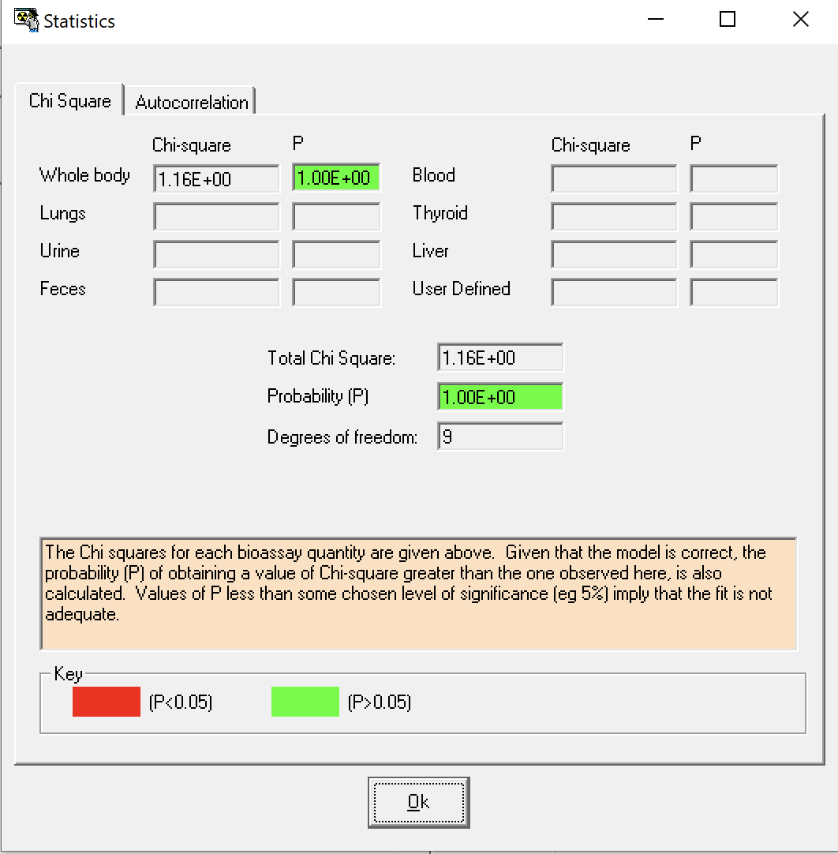
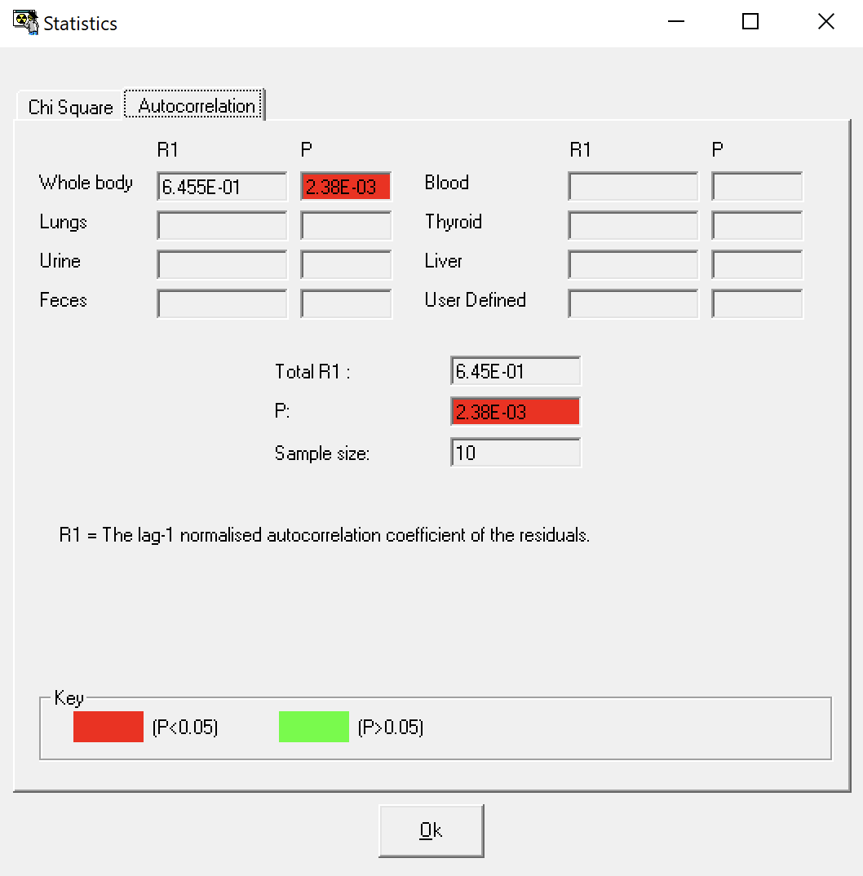
Statistics Package (#11)
Allows the user to examine useful statistical information immediately after fitting intakes to measurement data

Slide 14
Welcome to IMBA
Much like many applications, the main screen contains:
File menu
Tool buttons
Graphical user interface/ main screen

Slide 15
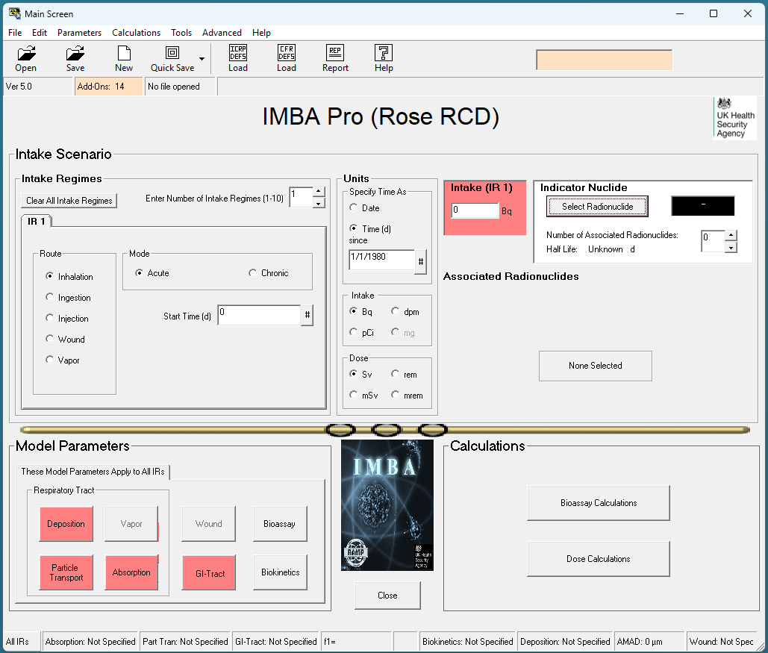
Main Screen
Almost all file menu items are also buttons except intake scenario
Notes:
This means that any of the buttons also have corresponding file menu selections. This includes “file” “edit”, “model parameters” and “calculations”

Slide 16
File Menu Ribbon
File
Edit
Parameters
Calculations
Tools
Advanced
Help
Notes:
Each of these file menu items (with only a few exceptions) are also buttons on the GUI - a bit of redundancy for you to choose the way that you best interact with IMBA. You can do so with keyboard shortcuts if that is your preference, or with a mouse and entrance. Using help mode deactivates most of the buttons, so you can still use this mode with the file menu if you are just beginning. Tools gives a quick way to access likely apps, like your your computer’s calculator and text editor as well as the menu option for setting ICRP and CRF defaults.

Slide 17
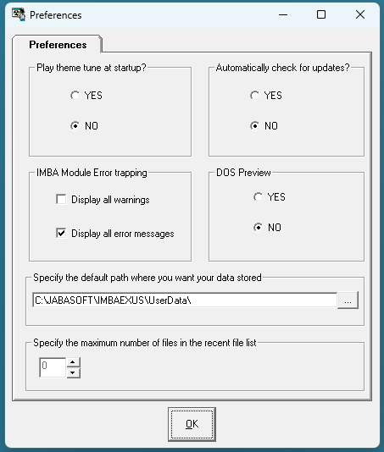
Preferences
Change the default working directory

Slide 18
Main Screen
Red fields indicate necessary inputs to proceed to calculations

Slide 19
Main Screen
As you fill in parameters, they appear in the bottom ribbon

Slide 20
DOS preview
Notes:
DOS preview is not as useful for quick calculations, but when there is a lot of computation it can sometimes be difficult to know if the program has crashed/frozen or if it is taking some time on a calculation. This mode can allow you to see which one of these events is occurring.
“Disk operating system” kind of like operating in terminal mode.

Slide 21
Notes:
Same calculation with no DOS preview.

Slide 22
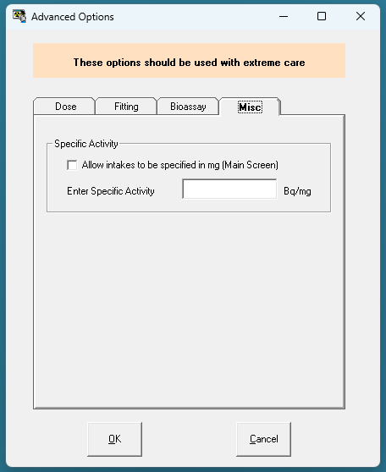
Advanced Options
Dose
Fitting
Bioassay
Misc

Slide 23
Tool Buttons
Open
Save
Load Defaults
Report
Help
Notes:
How is save different from quick save?

Slide 24
GUI- minimizing screens
Minimizing screens show up in bottom of your main screen. This could be different than where your IMBA main screen is depending on if you moved it using multi monitor setups
Check for a small minimized window
IMBA will not let you advance, or even exit if you’ve minimized a screen, so its good to get used to finding it when you do
It does not show up in the usual places like hovering over program windows.
It does not show up on top of windows, will always be lowest level

Slide 25
Help Mode
Notes:
This is what happens when you put it in help mode.

Slide 27
Defaults
If you move your mouse pointer over the "CFR DEFS Load " button in the Tool Bar, the " CFR DEFS" symbol will change color - to purple (Figure 3.87). Clicking the button will then display the "F1 values " window (as shown in Figure 3.84, above) - from which you can again select the row with your required combination of ICRP -DEFAULT Absorption Type and f1 value. When you then click "OK", IMBA Professional will load ALL of the ICRP -DEFAULT Biokinetic Model AND Bioassay Model parameters. However , the loaded radiation weighting factors (wR), tissue weighting factors (wT), and remainder tissue rules will be those prescribed by the 10-CFR-835 Regulation (as currently used in the U.S).

Slide 28
Selecting an Indicator Nuclide
Notes:
When you select a radionuclide, a small periodic table will pop up where you can choose the element, and then a drop down menu will appear allowing you to select a specific nuclide. Once you have a nuclide selected, you can either hit “ok” to load that nuclide, or you can seek out some information. Clicking on decay will bring up the decay chain of that nuclide. Here, Mo99 is a small decay chain, but some like uranium will fill the whole page. You can change the units of half life from hours, to days to years and you will see the numbers under the nuclide square change. When you are hovering over one of the nuclides, it will give you the option to see the nuclide properties or decay products. Properties shows you information like half life, yields, atomic information decay modes, if there is none you will get this error. Decay products gives you information on the energy of decay and the yields.

