Slide 1
Closing Ceremony
Verena Sesin, CNSC RAMP Point of Contact
Stephanie Bush-Goddard, NRC RAMP Program Manager
May 15

Slide 2
Closing Ceremony
Insights from this Meeting
Stephanie Bush-Goddard, RAMP Program Manager
Verena Sesin, CNSC RAMP Point of Contact
Closing Remarks
David Moroz, Director General DSS
Dana Beaton, Director General DERPA
Thank you and reminders
Cake! & Closing celebration

Slide 3
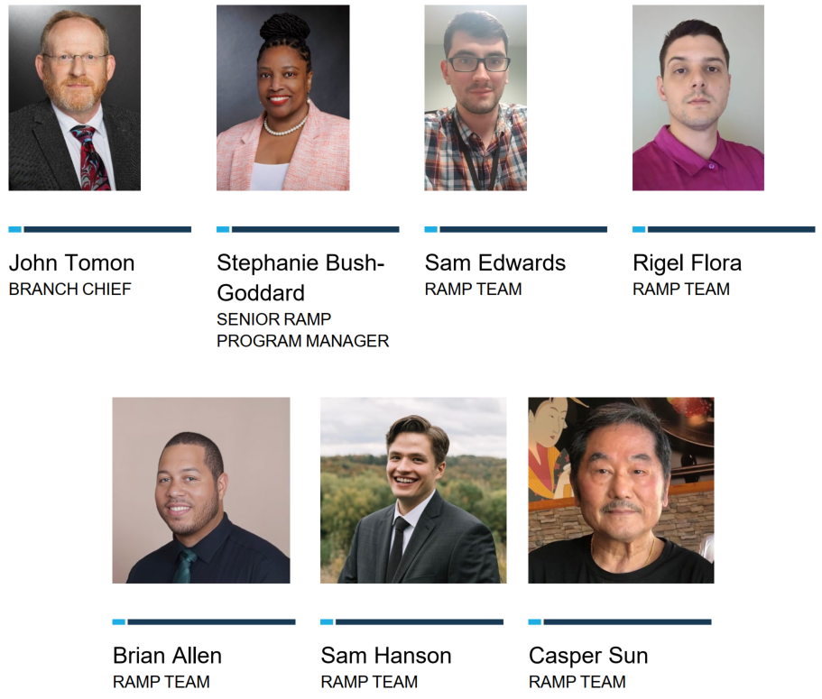
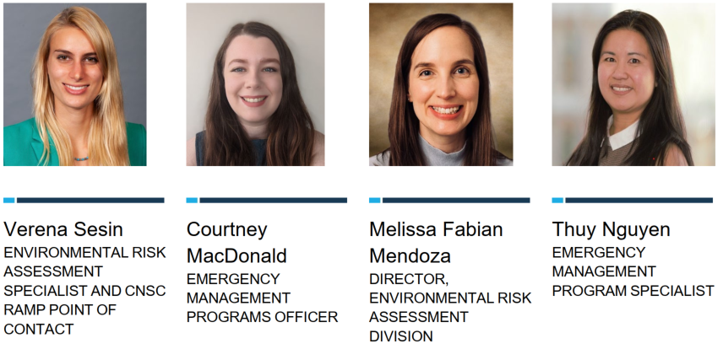
THANK YOU
To the CNSC and US NRC Organizing Teams

Slide 4
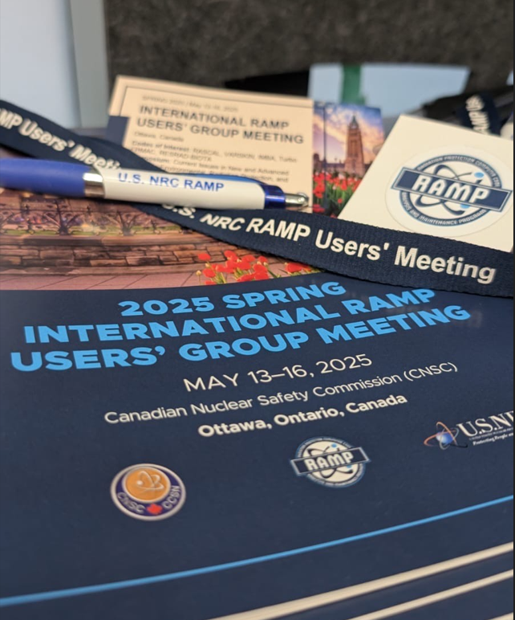
THANK YOU to everyone
We are glad that you:
were here,
participated actively, and
shared your insights!
We are grateful that together, we are enhancing radiation protection and nuclear safety!
We hope that you:
built networks,
strengthened collaborations, and
enjoyed Ottawa!

Slide 5
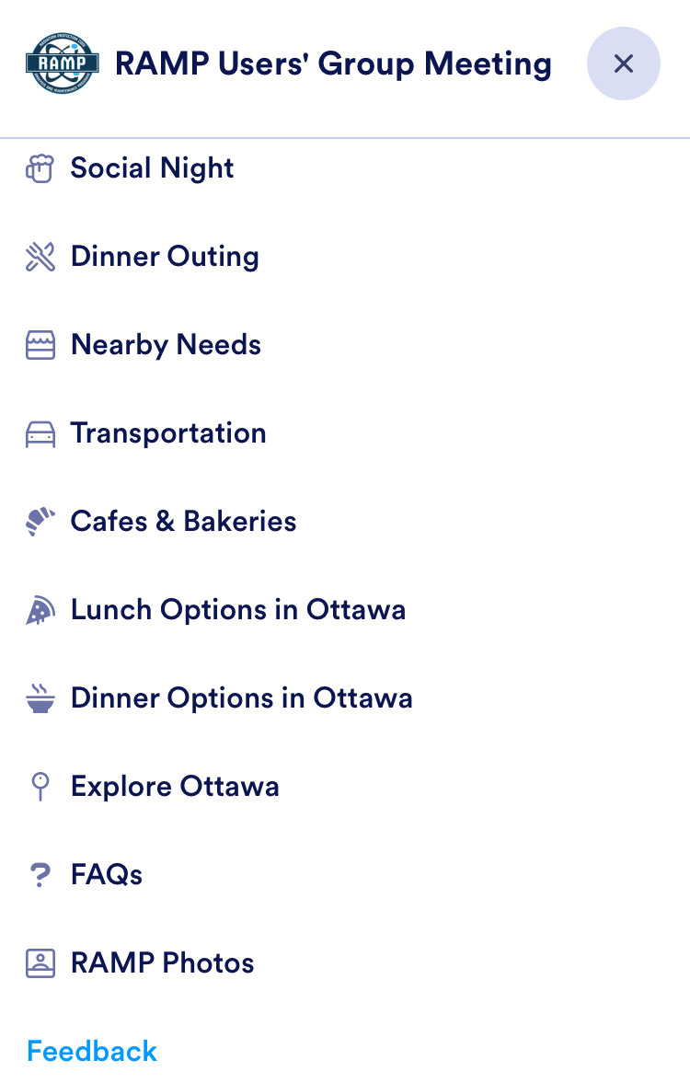
Reminders
Who will be here tomorrow, Friday, May 16?
Please raise your hand!
Please fill out the feedback form through the App or paper copy
Recordings will be available on the RAMP website in ~4 weeks
https://ramp.nrc-gateway.gov

Slide 6
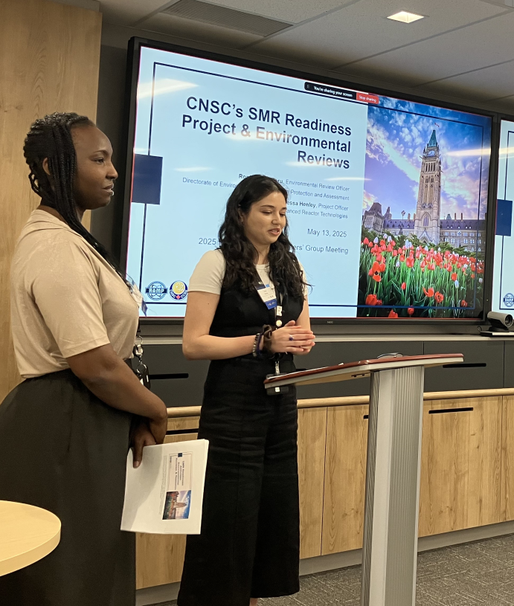
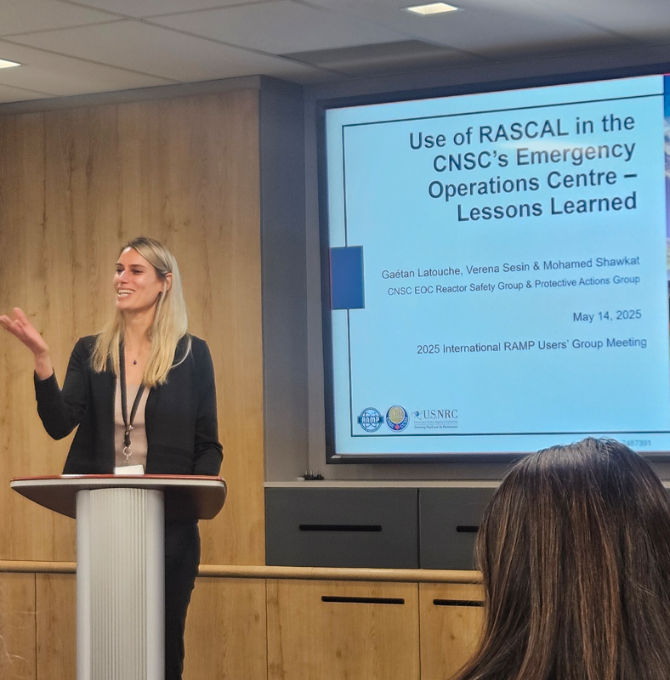
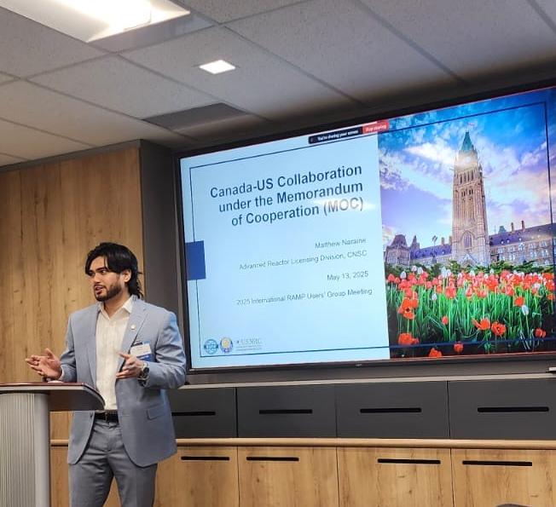
Photos from 2025 Spring Meeting: Symposium
Presentations during the Technical Symposium on Current Issues in New and Advanced Reactors

Slide 7
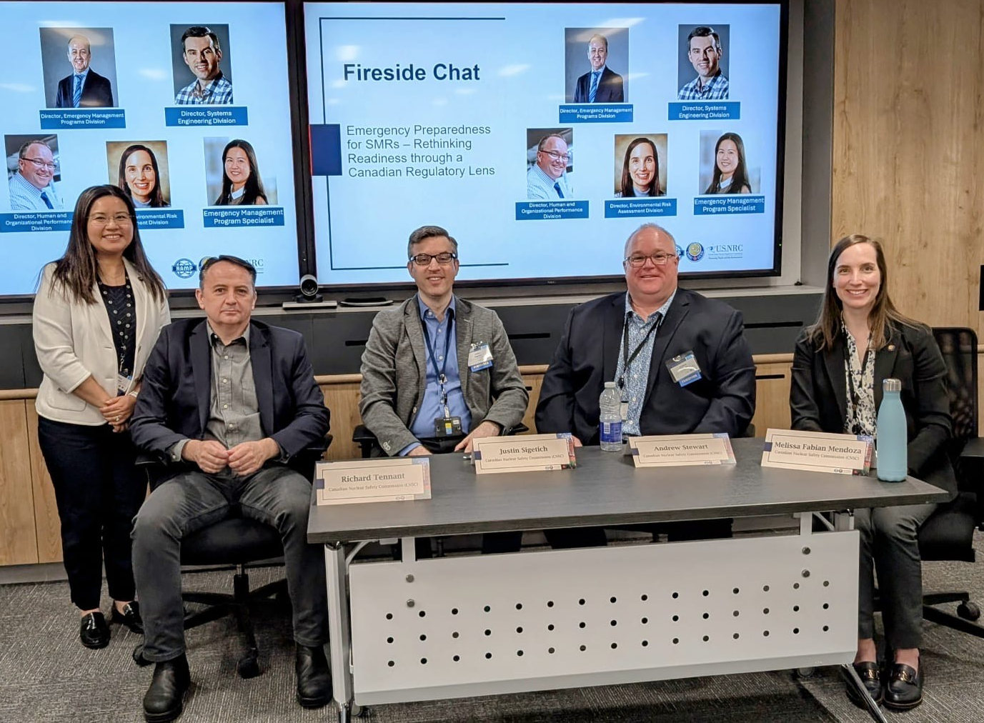
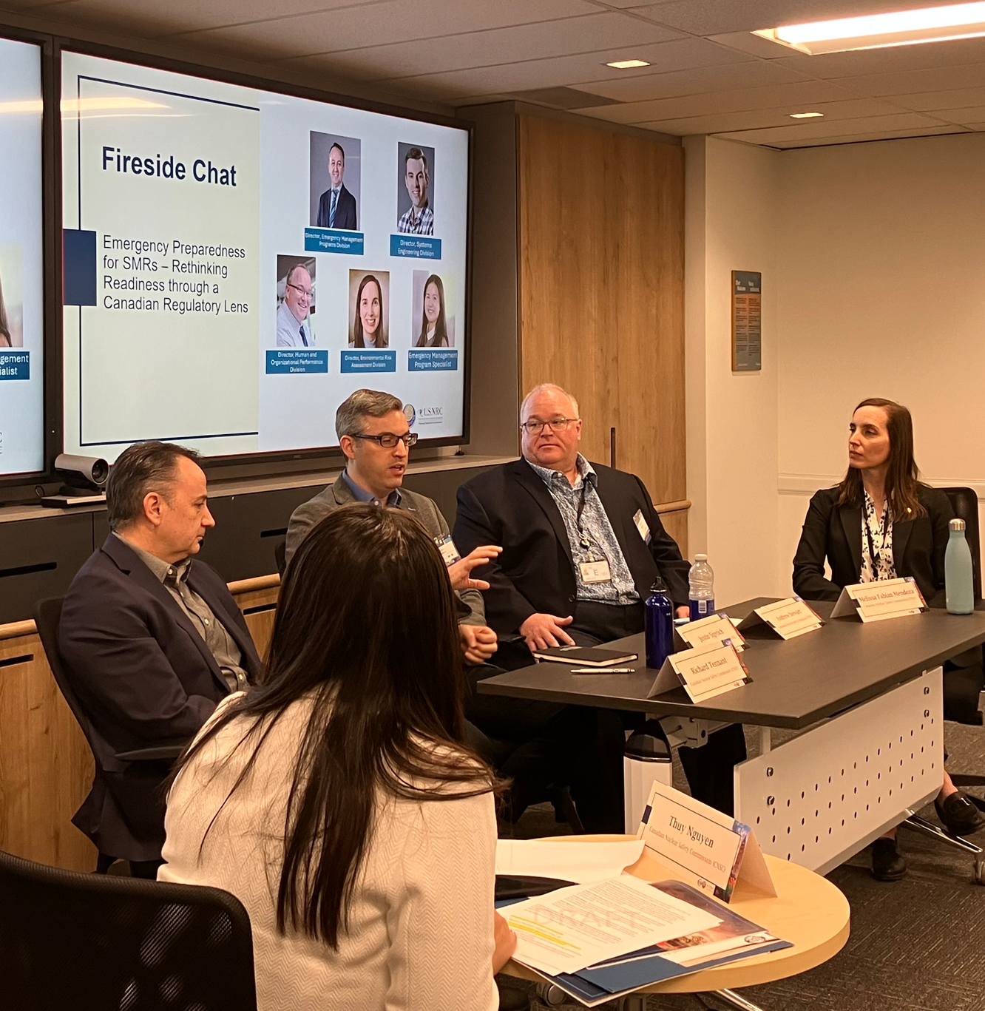
Photos from 2025 Spring Meeting: Fireside Chat
Fireside Chat on Emergency Preparedness for SMRs

Slide 8
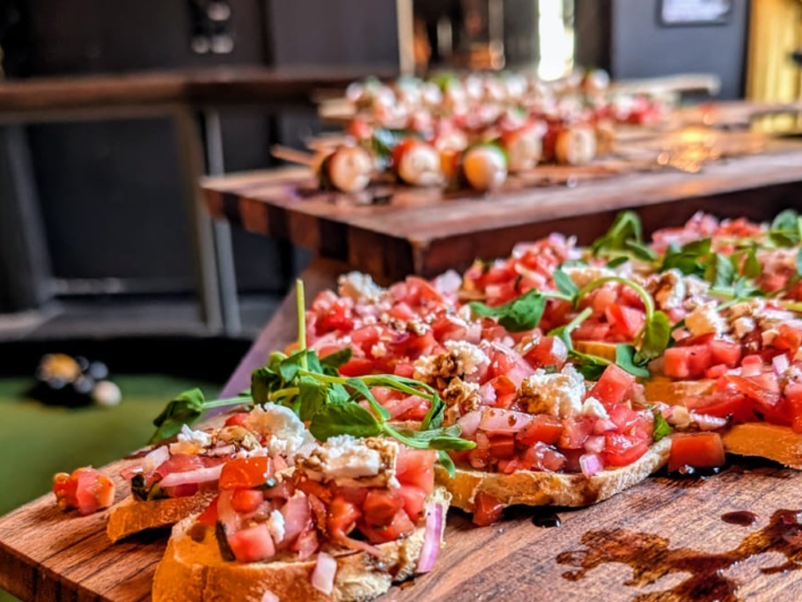
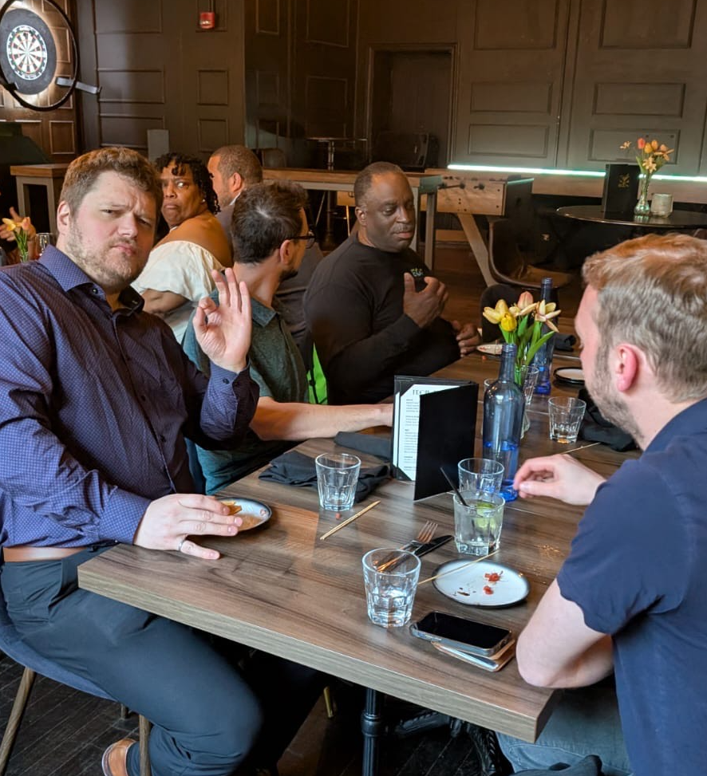
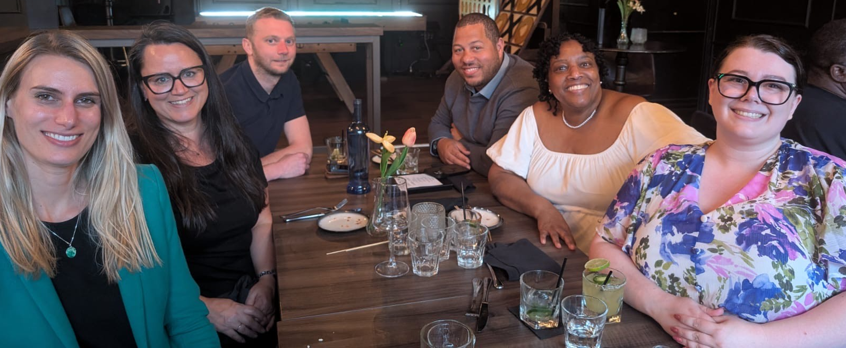
Photos from 2025 Spring Meeting: Social Hour

Slide 9
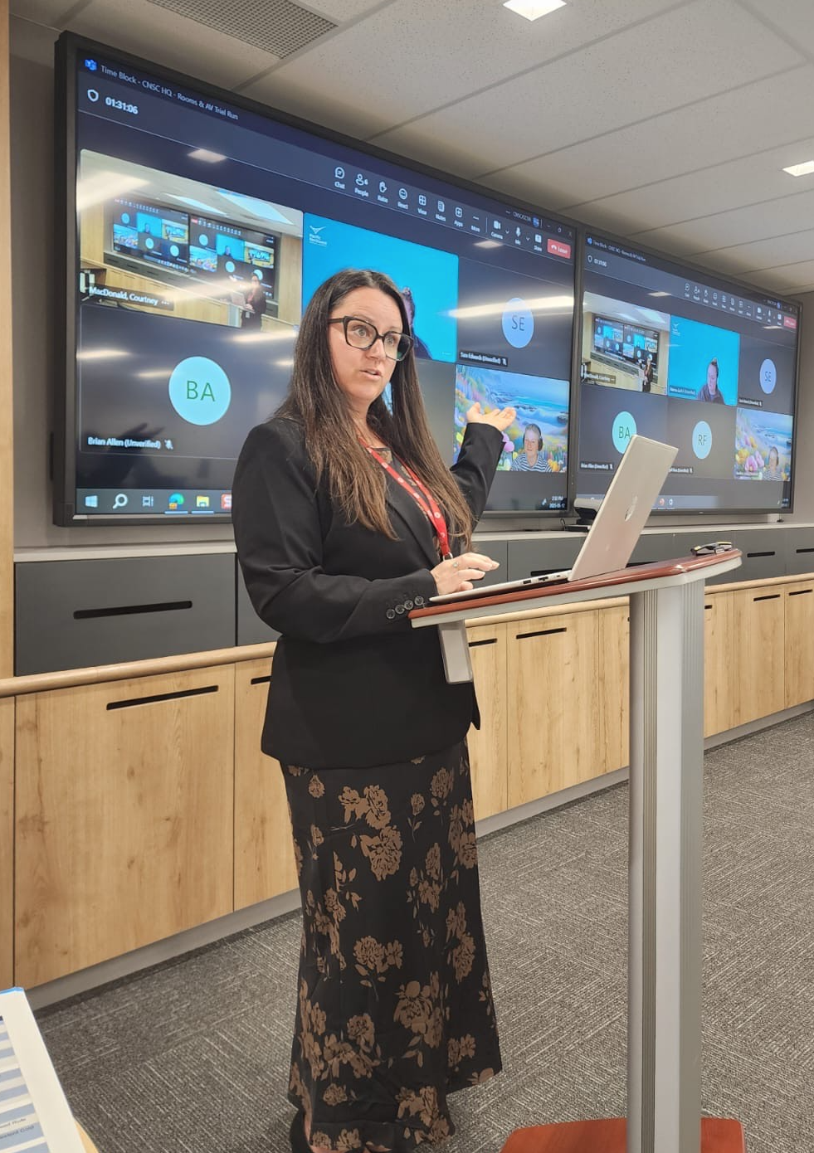
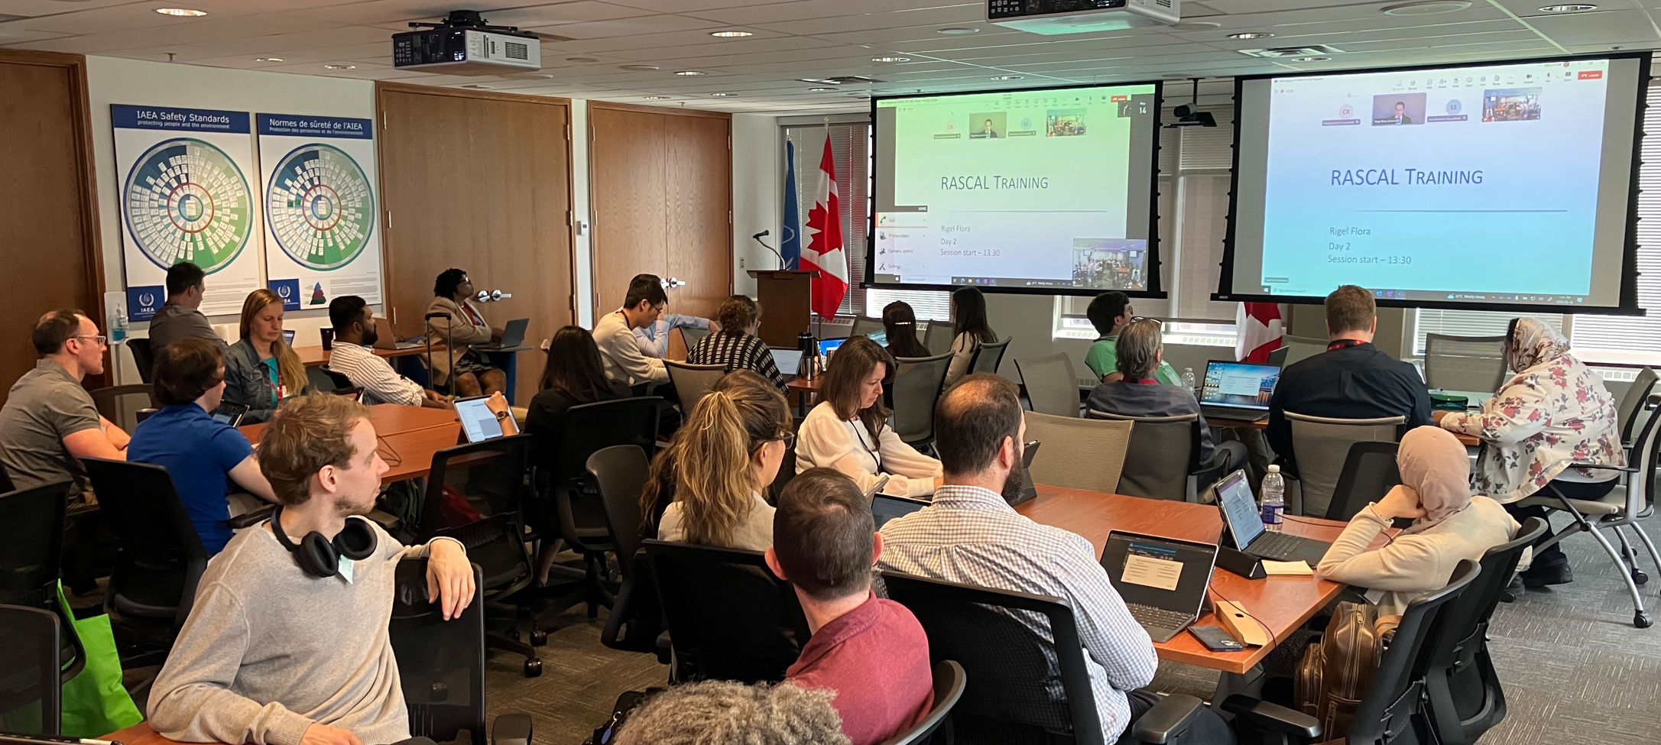
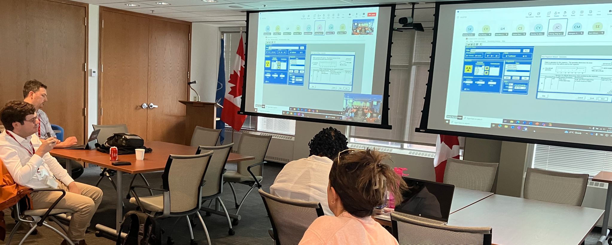
Photos from 2025 Spring Meeting: Training

Slide 10
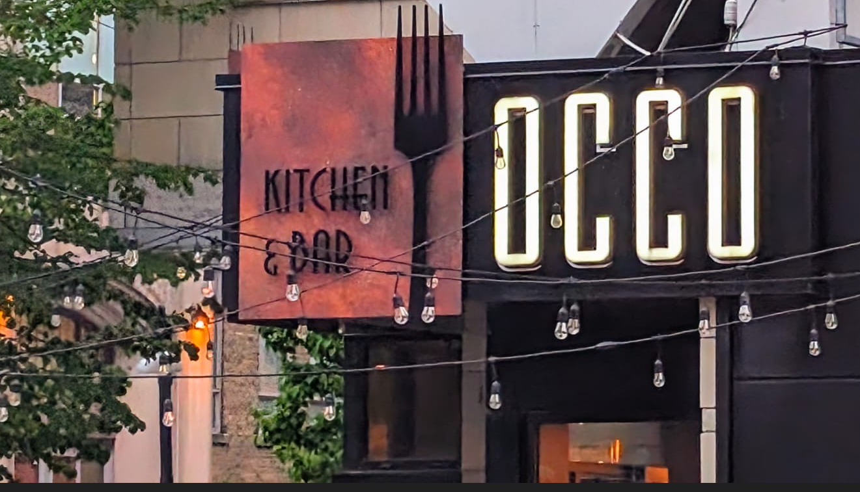
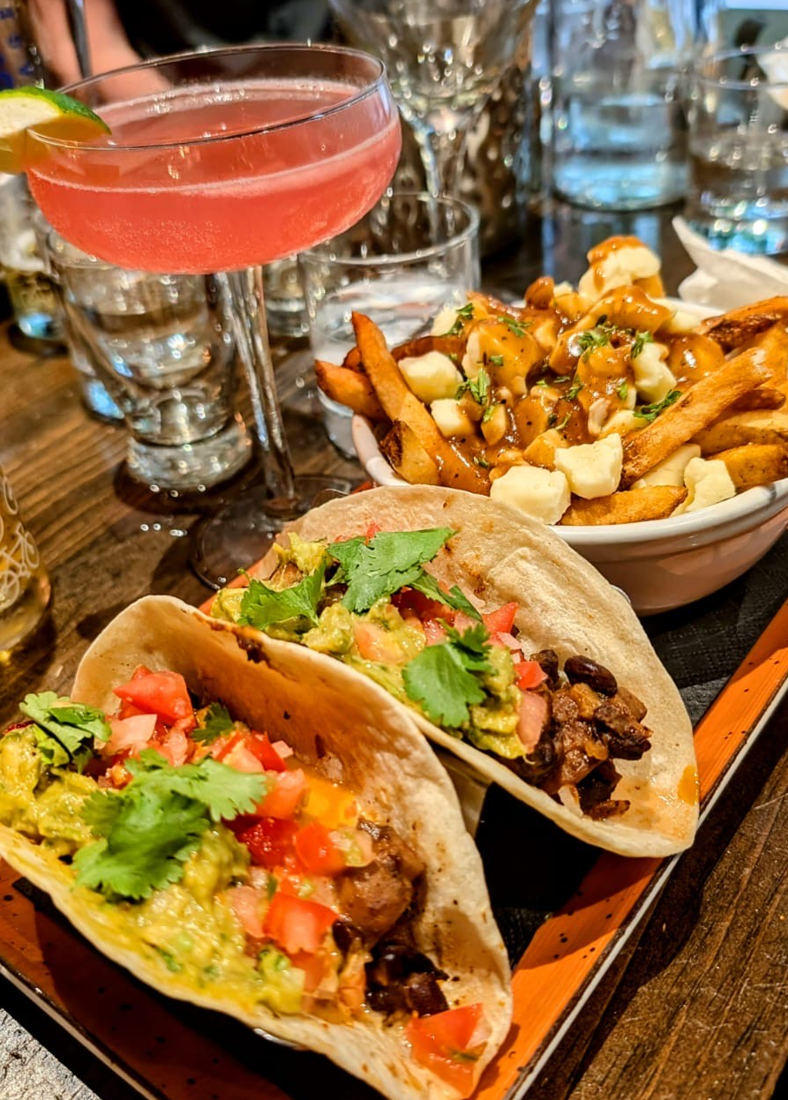
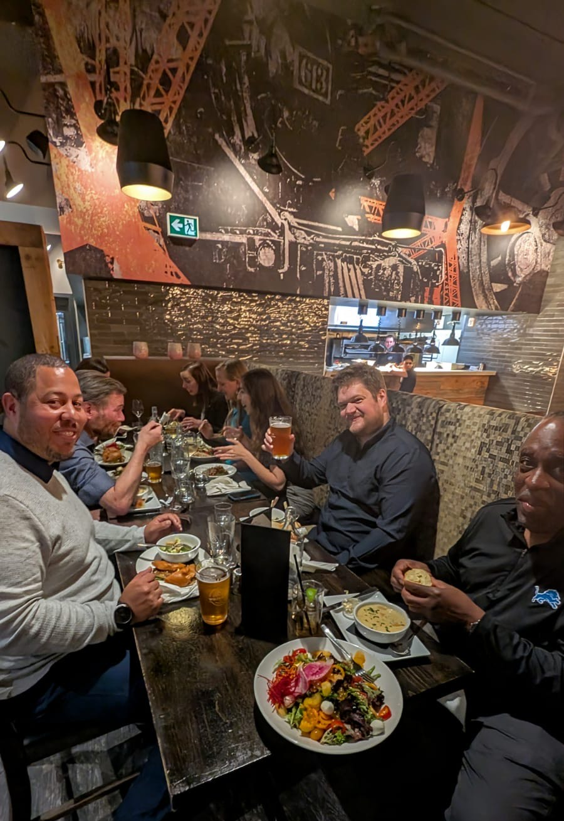
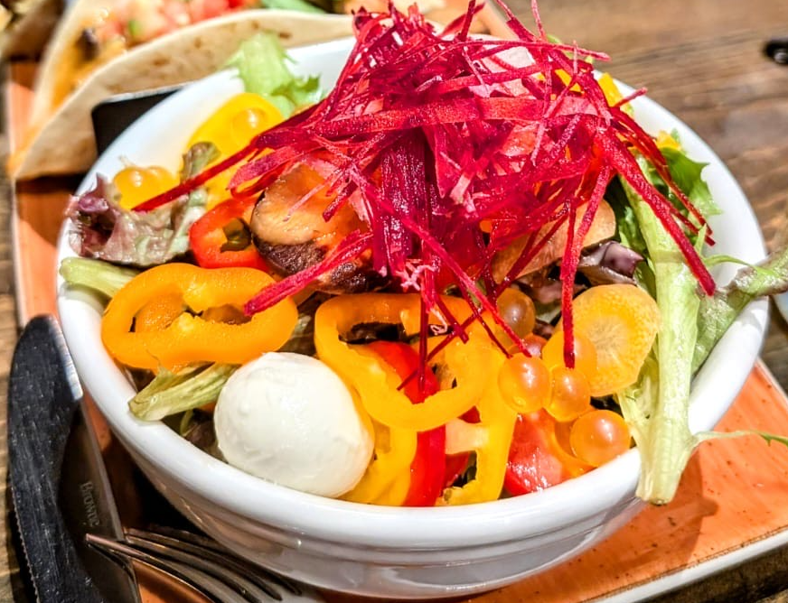
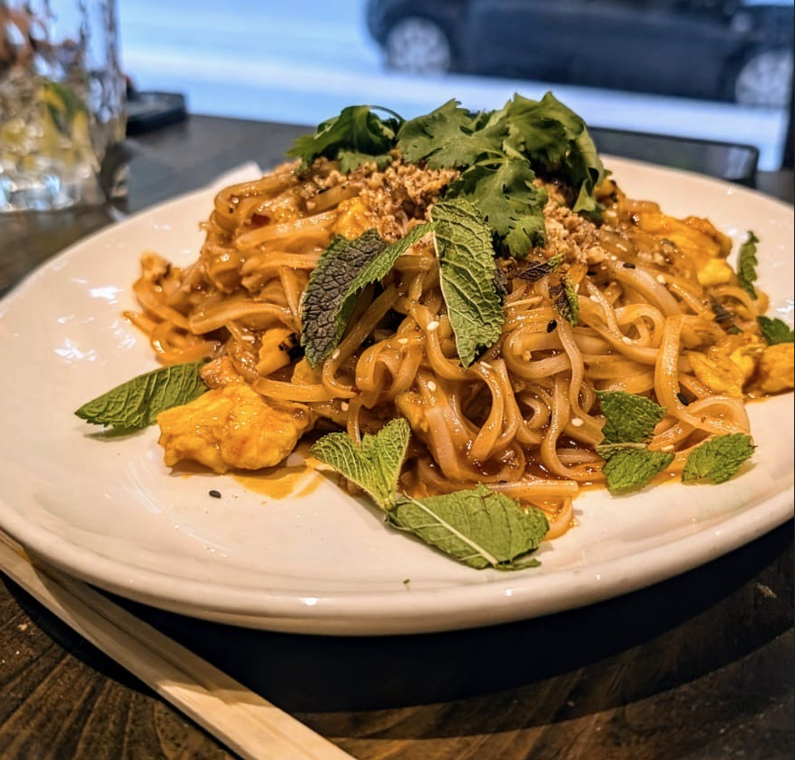
Photos from 2025 Spring Meeting: No-Host Dinner

Slide 11
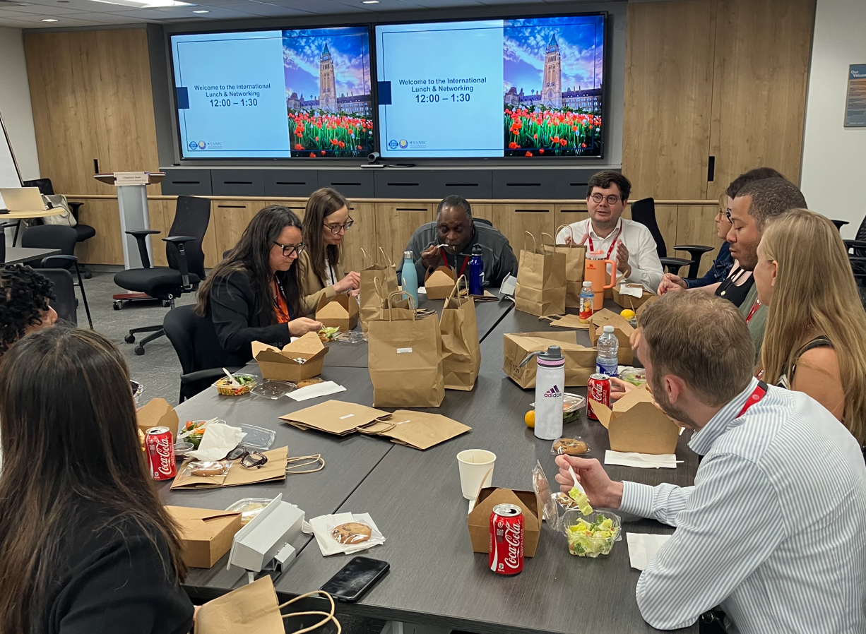
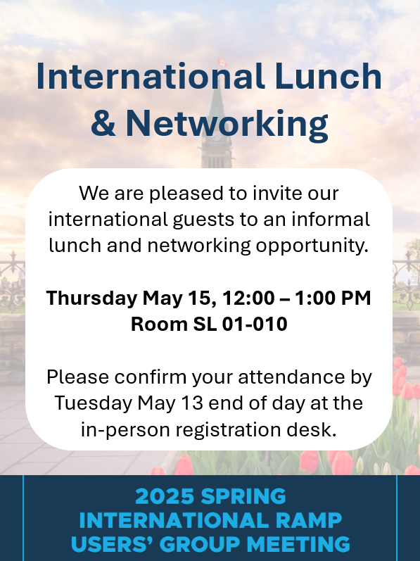
Photos from 2025 Spring Meeting: International Lunch

Slide 12
Upcoming RAMP Users’ Group Meeting
More information to come!

Slide 13
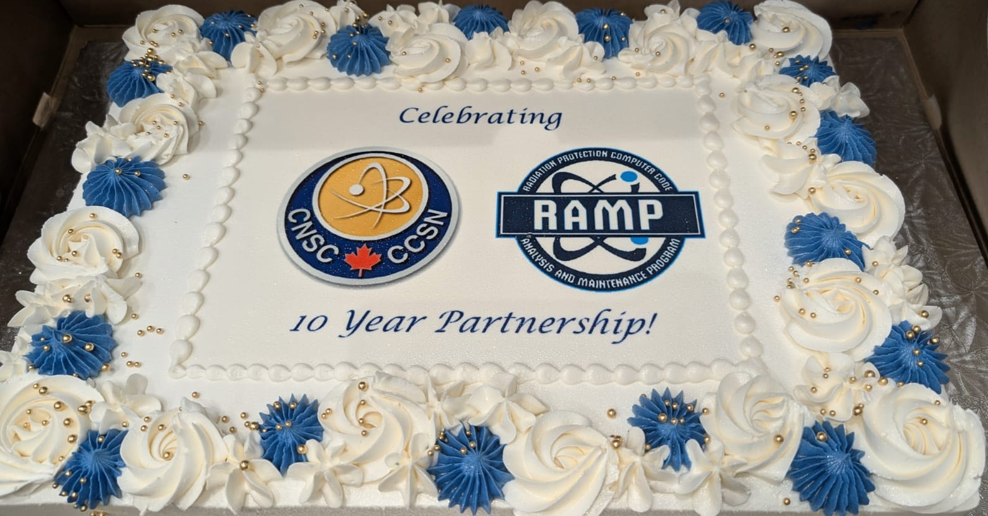
Thank you! Let’s celebrate and enjoy the cake!

