Slide 1
Introduction to Turbo FRMAC
Autumn Kalinowski, Brian Hunt
2025 Spring RAMP Users Group Ottawa, Canada

Slide 2
Outline
Introductions
Turbo FRMAC introduction
Basics of Assessment Science
Basics of Turbo FRMAC
Examples
Web-based training opportunities
If Time:
*Administration of Potassium Iodide (KI)
*Projected Public Dose

Slide 3
Introductions
Training Coordinator:
Autumn Kalinowski, MS, Assessment Scientist
For any questions, contact Autumn with at: aekalin@sandia.gov

Slide 4
Introduction

Slide 5
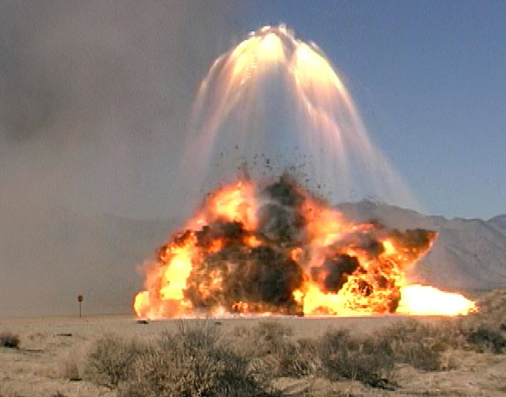
Introduction
Sandia National Laboratories (SNL), located in Albuquerque, New Mexico, USA
Government owned, contractor operated
Provide research and technical solutions, expert analysis, and highly trained emergency response professionals to support the U.S. government’s response to a nuclear or radiological accident

Slide 6
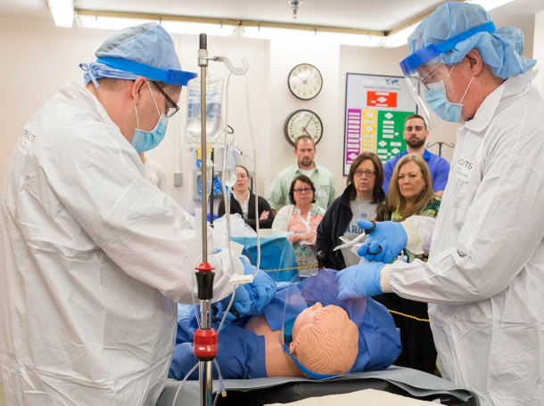
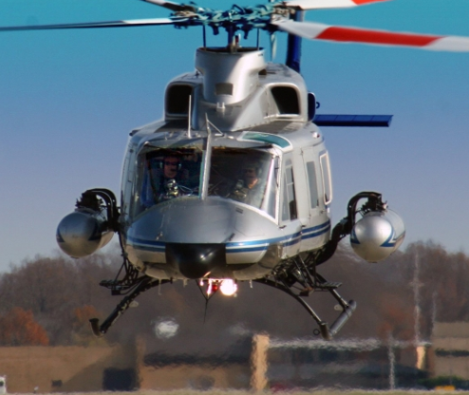
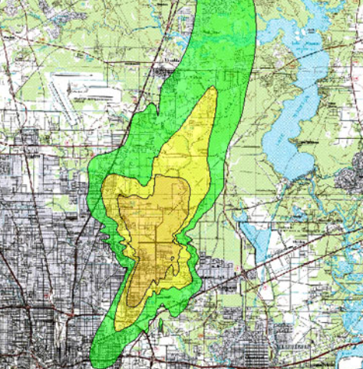
DOE/NNSA Consequence Management Program
Consequence Management Mission
The mission of the National Nuclear Security Administration’s Consequence Management Program is to reduce casualties and protect lives, property, and the environment in response to a nuclear or radiological incident.
MODEL | MEASURE| ASSESS | INTERPRET | ADVISE
TIMELY | ACTIONABLE | SCIENTIFICALLY DEFENSIBLE
NATIONAL NUCLEAR SECURITY ADMINISTRATION
OFFICE OF COUNTERTERRORISM AND COUNTERPROLIFERATION

Slide 7
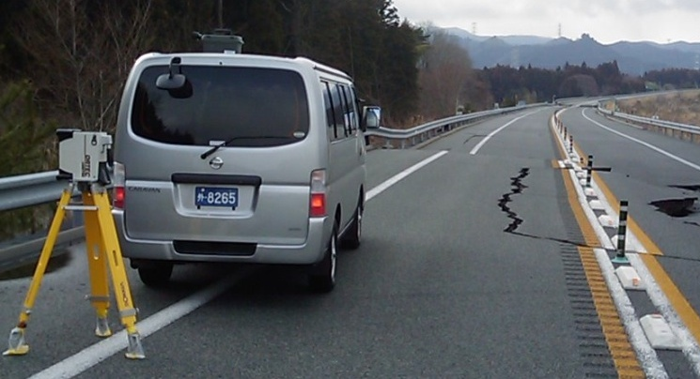
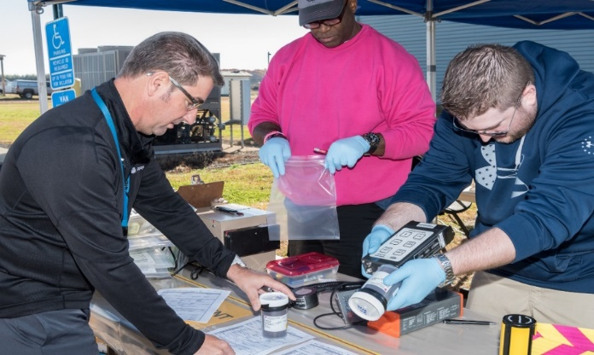
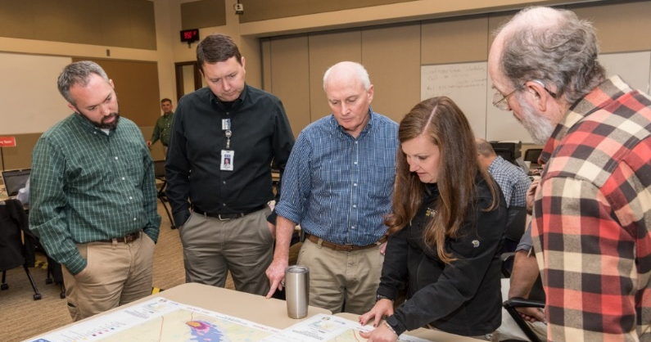
Federal Radiological Monitoring and Assessment Center (FRMAC)
Mission: Provide timely, high-quality predictions, measurements, analyses, and assessments to promote efficient and effective emergency response for the protection of the public from the consequences of nuclear or radiological incidents
Aerial Measurements
Sample Control and Analysis
Field Monitoring
Data Assessment

Slide 8
FRMAC Participation
Department of Agriculture (USDA)
Department of Defense (DoD)
Department of Energy (DOE)/National Nuclear Security Administration (NNSA)
Department of Health & Human Services (DHHS)/Food & Drug Administration (FDA) and Centers for Disease Control & Prevention (CDC)
Department of Homeland Security (DHS)/Federal Emergency Management Agency (FEMA)
Environmental Protection Agency (EPA)
Nuclear Regulatory Commission (NRC)
Law Enforcement (FBI)
State/Local/Tribal/Territorial agencies

Slide 9
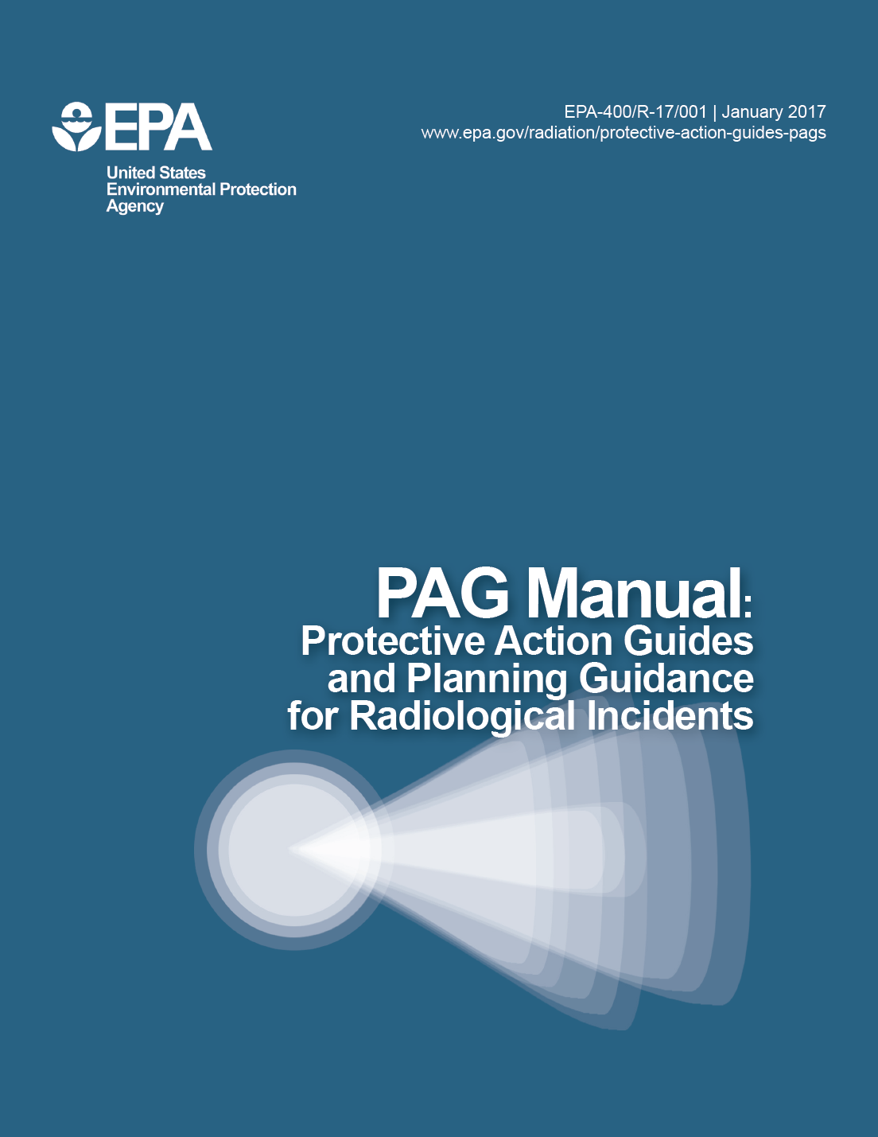
U.S. Protective Action Guidance
Environmental Protection Agency (EPA) Protective Action Guide (PAG) Manual
PAGs are based on 3 principles:
1. Prevent acute effects
2. Reduce risk of chronic effects
3. Balance protection with other factors and ensure that actions result in more benefit than harm
PAGs are predetermined for use in emergencies for a general population without regard to the magnitude or type of radiological release
Decision makers may implement protective actions at higher or lower levels than the recommended PAGs

Slide 10
PAG Manual Guidance
PAGs are not dose limits or strict numeric criteria
NOTE: Decision Makers may implement protective actions at higher or lower levels than the recommended PAGs
PAGs do not:
Establish an acceptable level of risk for normal, nonemergency conditions
Represent the boundary between safe and unsafe conditions
Represent legally binding regulations or standards
Supersede environmental laws
Notes:
Emphasize the NOTE. This is where the Assmt Sci will have to have discussions with FRMAC leaders to determine what the local decision makers wish to implement.

Slide 11
Ingestion PAGs - Water
Drinking water PAG is for use during an emergency and is not a substitute for compliance with EPA’s drinking water regulations under the Safe Drinking Water Act
EPA expects actions will be taken to return drinking water system to compliance with the regulatory levels by the earliest feasible time
FDA Food PAGs and EPA Water PAGs are considered separately
EPA recommends the use of the Sum of Fraction rule if multiple radionuclides are present
EPA allows a water system to blend uncontaminated water with contaminated water to minimize radiation doses

Slide 12
Ingestion PAGs - Food
FDA Ingestion PAG Manual: ACCIDENTAL RADIOACTIVE CONTAMINATION
OF HUMAN FOOD AND ANIMAL FEEDS:
RECOMMENDATIONS FOR STATE AND LOCAL AGENCIES
Sets limits on the radionuclide concentration(s) permitted in human food distributed in commerce
Does not set limits on the radionuclide concentration(s) permitted in animal feeds
PAGs are based on limiting the lifetime total cancer mortality in the general population
PAGs assume a lifetime dose based the consumption of contaminated food for the 1st year following the accident
PAGs are based on the entire diet and assume 30% of the total dietary intake is contaminated

Slide 13
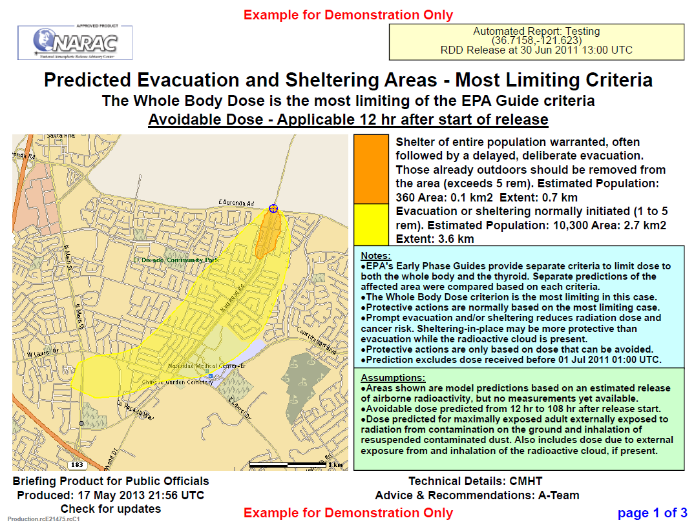
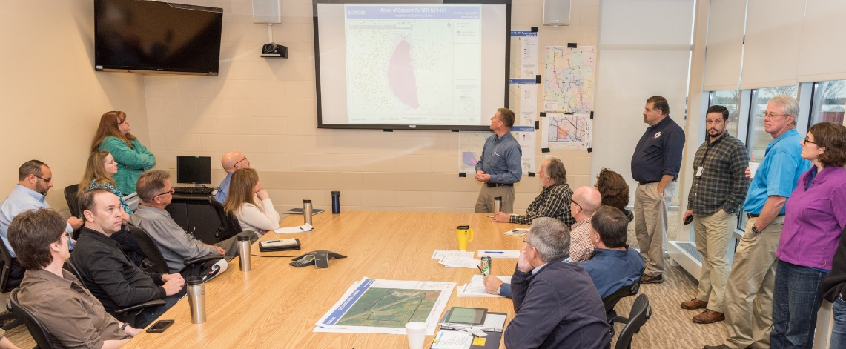
Assessment Capability
Analyze models and data available to develop an understanding of the radiological environment
Provide decision makers with radiological information that can be used to issue protective actions

Slide 14
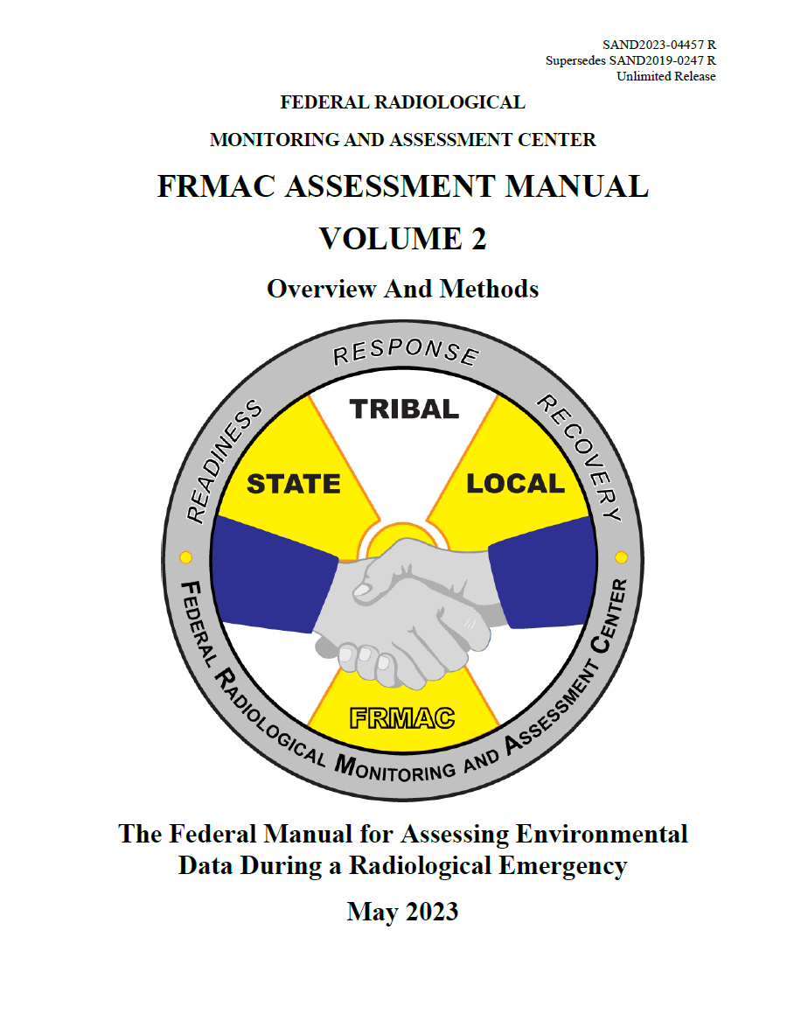
FRMAC Assessment Manual
The technical consensus of multiple U.S. federal agencies with expertise in and authority over aspects of radiological emergency response
Defines the standard dose assessment methods for responding to nuclear or radiological incidents
Serves as the scientific basis for Turbo FRMAC
SNL leads development of this manual
https://www.nnss.gov/pages/programs/FRMAC/FRMAC_DocumentsManuals.html

Slide 15
Turbo FRMAC
Turbo FRMAC, developed and maintained by Sandia National Laboratories is designed to help the decision maker in a radiological emergency understand the significance of the field sample results and modeling information, so that proper response actions can be implemented. It is intended to aid the leadership in identifying the proper action needed in order to appropriately protect the public.

Slide 16
Turbo FRMAC
Software performs complex calculations to quickly evaluate radiological hazards during an emergency response by assessing impacts to the public, workers, and the food supply
Automates FRMAC Assessment Manual methods
Eliminates most human errors
Deployable software application developed by SNL
Does not require internet connection
Updated periodically to implement new and revised methods
NOT a replacement for health physics knowledge and experience

Slide 17
Question Answered by Turbo FRMAC
Do radiation values exceed regulatory or guidance limits?
Should crops be destroyed or can they be utilized?
Should animal products be destroyed or can they be utilized?
Do residents need to be evacuated, sheltered in place, or should another action be taken?
How long can emergency workers work in a given area?

Slide 18
Field-Observable Values
TF generates field-observable values specific to the radiological event that can be used to determine:
How long an emergency worker can work in the contaminated area during a radiological emergency?
The dose received from drinking contaminated water or milk.
The dose from eating contaminated food.
The dose expected up- or down-wind of a given field sample.
Other similar radiological health values

Slide 19
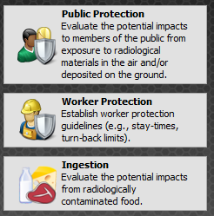
Turbo FRMAC Purpose
Results are used to support protective action decisions, such as:
Should a population be sheltered, evacuated, or relocated?
When can a relocated population return home?
What field measurements would indicate that a protective action is warranted?
How long can a worker remain in a contaminated area?
Might a food crop in an area need to be considered for removal from commerce?
When can a crop be planted so as not to exceed food contamination guidelines?

Slide 20
Initial Assessment Process
Determine initial source term
Calculate DRL
Run atmospheric dispersion models and contour DRL
Collect field measurements and use to refine source term
Potential data sources include regulatory agencies, intel, models, and measurements
Turbo FRMAC is used to calculate DRLs
Resulting map products are used by local officials to decide where to take protective actions
DRLs can also be calculated for specific areas and compared to field measurements
Notes:
Contouring contamination levels from atmospheric dispersion and deposition models
Setting data quality objectives for measurement collection
Determining detection requirements for laboratory analysis of collected samples
Determining if Protective Action Guides might be exceeded in areas where measurement and/or sample results are available

Slide 21
Model Limitations
Turbo FRMAC is not an atmospheric dispersion model, so assumptions are used to estimate the relative radionuclide activities in the air and on the ground
FRMAC atmospheric dispersion modeling is handled by the National Atmospheric Release Advisory Center (NARAC) at Lawrence Livermore National Laboratory in Livermore, CA
However, monitoring and sampling, and atmospheric dispersion model data can be entered to improve the accuracy of dose projections and DRLs
Because Turbo FRMAC does not perform atmospheric dispersion, DRLs are calculated for a single radionuclide mixture that does not account for spatial variance

Slide 22
NARAC
NARAC is a national support and resource center for emergency planning, real-time assessment, emergency response, and detailed studies of atmospheric releases of nuclear, radiological, chemical, biological, and hazardous natural materials. NARAC provides timely and accurate plume predictions to aid emergency preparedness and response efforts in protecting the public and the environment.

Slide 23
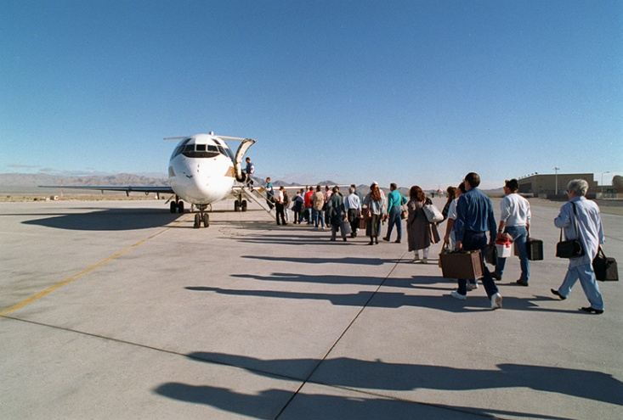
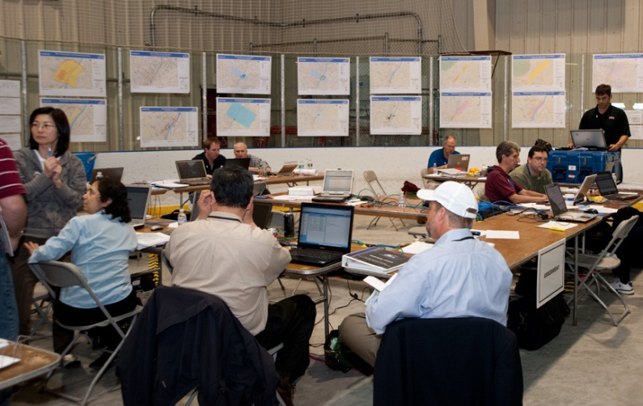
Examples of Turbo FRMAC Use
Turbo FRMAC has proved to be a valuable tool to guide protective action decisions following real-world releases including the 2011 Fukushima Daiichi Nuclear Power Plant incident and other accidental releases.
Turbo FRMAC is also used during planning and preparedness activities at all levels of U.S. government.

Slide 24
Basics of Assessment Science

Slide 25
Overview
FRMAC Assessment Concepts
Public Protection
Ingestion
Calculation Examples in Turbo FRMAC

Slide 26
Public Protection Calculation Concepts

Slide 27
Public Protection Assessment Concepts
Dose Pathways
Mixture & Deposition Time
Time Phases
Evaluation Time
Avoidable Dose
Weathering
Breathing Rate
Lung Clearance Type
Resuspension
Integrated Air Activity
Deposition Velocity
Particle Size Distribution
Radionuclides with Different Chemical/Physical Forms
Decay Chain Truncation
Equilibrium Rules
Occupancy & Sheltering

Slide 28
Commonly-Used Terms
Protective Action - An activity conducted in response to an incident or potential incident to avoid or reduce radiation dose to members of the public
Protective Action Guide (PAG) - A projected dose to an individual from released radioactive material at which a specific protective action to reduce or avoid that dose is recommended
Projected Dose - The prediction of the dose that a population or individual might receive
Derived Response Level (DRL) - A level of radioactivity in an environmental medium that would be expected to produce a dose equal to the corresponding PAG

Slide 29
Time
FRMAC Assessment Manual defines the following:
Release Time (t₀) – The start time of the event/incident/release; Corresponds to the “Time of Deposition”
Start Time (t₁) – The start of the Time Phase (integration period) under consideration
End Time (t₂) – The end of the Time Phase (integration period) under consideration

Slide 30
Default FRMAC Time Phases
*Outlined Time Phases correspond to EPA PAG Manual definitions.
Time Phase | Time Phase Start | Time Phase End | Dose Pathways Included | Comments
Early Phase (Total Dose) | 0 | 96 hr | Plume and Ground | Protective Actions can be implemented before arrival of plume.
Early Phase (Avoidable Dose) | 12 hr | 108 hr | Ground | Protective Actions CAN NOT be implemented before arrival of plume.
First Year | 12 hr | 8772 hr | Ground | Plume pathways not included regardless of when Protective Actions can be implemented.
Second Year | 365 day | 730 day | Ground
Plume Pathways: Inhalation of plume-borne material and Submersion Ground Pathways: Inhalation of resuspended material and Groundshine

Slide 31
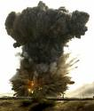
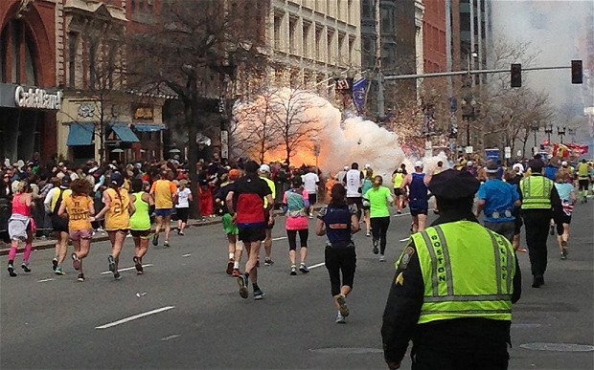
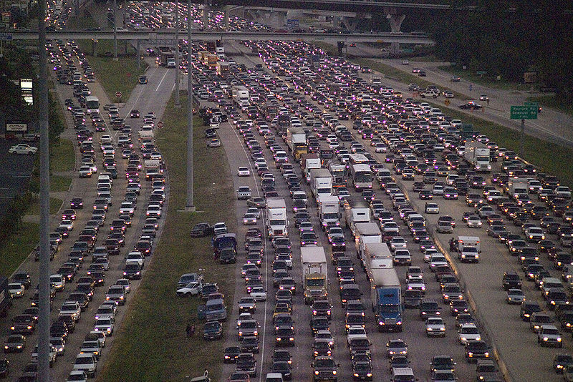
Time Phases – Early Phase
Begins with the radiological release
May last hours to days; Generally considered 4 days (~96 hours)
Protective Actions: Evacuation and/or Shelter in Place

Slide 32
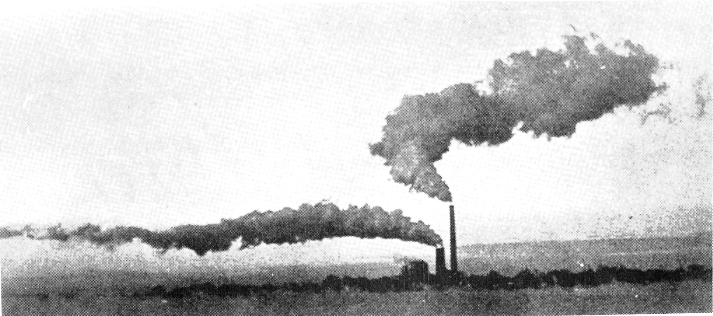
Time Phases - Intermediate Phase
Release under control or terminated
May overlap the Early and Late phases and could last weeks to months
Includes the 1st and subsequent years
Protective Action: Relocation

Slide 33
Intermediate Phase PAGs
Note: Relocation PAGs are treated separately from food and water ingestion.
Projection of intermediate phase doses should not include these ingestion pathways.
In some instances, however, where withdrawal of food and/or water from use would, in itself, create a health risk, relocation may be an appropriate alternative protective action.
In this case, the ingestion dose should be considered along with the projected dose from deposited radionuclides via other pathways, for decisions on relocation.

Slide 34
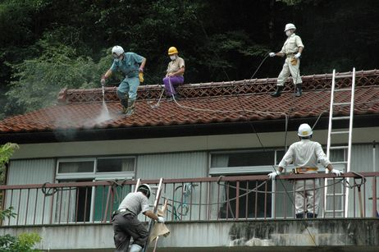
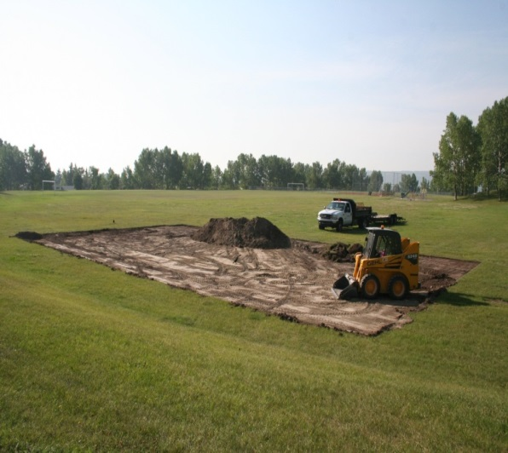
Time Phases – Late Phase
Begins after the Intermediate Phase and proceeds independently of Intermediate Phase Protective Actions
May last months to years
Transition from strategies driven by urgency, to strategies aimed at reducing longer-term exposures and improving living conditions
PAGs will not be used to guide restoration and recovery
Protective Action – Relocation, potentially permanently. Decontamination and/or condemnation of structures

Slide 35
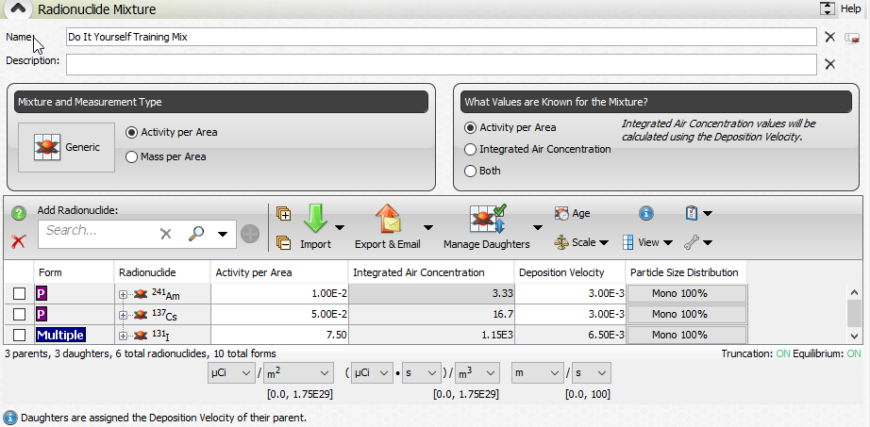
Mixture and Deposition Time
Mixture is assumed to be deposited at t₀ (release time)
FRMAC Assessment Manual methods and Turbo FRMAC use mixture deposited at t₀
A mixture at any other time must be back-decayed and back-weathered to t₀ to calculate appropriate dose for the specified time phase

Slide 36
Evaluation Time
Evaluation Time (t_{n}) – The point in time, relative to the start of the event, for which the calculation, measurement, or prediction is valid
Evaluation Time (t_{n}) is generally set to the start of the time phase (t_{n} = t₁), but may be set to any time (before, during, or after the time phase).
Atmospheric modeling software requires a set duration to model the transport and deposition of plume particulate. For dose assessment to remain consistent with initial atmospheric modeling assumptions, the default t_{n} is set to 12 hours.
For most incident types, 12 hours is sufficient for total plume content deposition
If the plume will not be completely deposited by 12 hours, work with atmospheric modelers to choose an appropriate t_{n}

Slide 37
Avoidable Dose
The decision to implement protective actions should be based on the projected dose that would be avoided if the protective actions were implemented (EPA 2017). This is called the Avoidable Dose.
Unavoidable dose incurred before the implementation of protective action should be excluded when evaluating the need for those protective actions, unless specifically requested by the decision maker.
To exclude the Unavoidable Dose from a dose assessment, start the Time Phase(s) at some time after the start of the exposure period and ONLY include those dose pathways appropriate to the selected Time Phase(s)
Example: A release has occurred but Decision Makers know it will take 12 hours to initiate Protective Actions. The Unavoidable Dose will be excluded if the Assessment Scientist sets the Time Phase to begin at 12 hours after the release and does not include the Plume Pathways (unless the plume is ongoing).

Slide 38
Avoidable and Unavoidable Dose
Protective Actions Initiated
Avoidable Dose
Time Phase
Release
t₀
t₁
t₂
Time

Slide 39
Weathering and Resuspension
Weathering – The adjustment for the decrease that occurs over time as the deposited material migrates deeper into the soil column from deposition (t₀) to evaluation time (t_{n})
Resuspension – The fraction of radioactive material transferred from the surface to the breathing zone at given time after initial deposition
Notes:
Also removed by other natural phenomenon such as wind and rain.

Slide 40
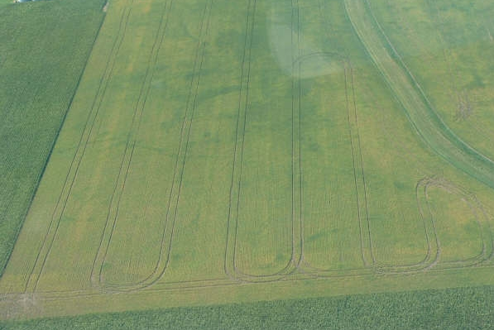
Resuspension Options
Resuspension (K) may be:
A time varying equation
A constant value (e.g., 1.00E-06 m⁻¹), or
The ratio of air concentration to ground concentration (determined from samples)
For Example:
Air sample = 1.6E-09 μCi/m³
Ground sample = 4.5E-03 μCi/m²
Calculated Resuspension valid only for a specific location and a specific time

Slide 41
Breathing Rate
Age Group | Activity |  |  |  |  |  |  |  | Total Volume | Activity Avg. Rate
 | Sleeping |  | Sitting |  | Light Exercise |  | Heavy Exercise
 | Rate m³/hr | Time hr/day | Rate m³/hr | Time hr/day | Rate m³/hr | Time hr/day | Rate m³/hr | Time hr/day | m³/day | m³/hr
Newborn (3 month) | 0.09 | 17.0 | NA | NA | 0.19 | 7.0 | NA | NA | 2.86 | 0.12
Infant (1 year) | 0.15 | 14.0 | 0.22 | 3.33 | 0.35 | 6.67 | NA | NA | 5.20 | 0.22
5 yr old | 0.24 | 12.0 | 0.32 | 4.0 | 0.57 | 8.0 | NA | NA | 8.76 | 0.37
10 yr old | 0.31 | 10.0 | 0.38 | 4.67 | 1.12 | 9.33 | NA | NA | 15.28 | 0.64
15 yr old (m) | 0.42 | 10.0 | 0.48 | 5.5 | 1.38 | 7.5 | 2.92 | 1.0 | 20.10 | 0.84
15 yr old (f) | 0.35 | 10.0 | 0.4 | 7.0 | 1.3 | 6.75 | 2.57 | 0.25 | 15.72 | 0.66
Adult (m) (Sedentary) | 0.45 | 8.5 | 0.54 | 5.5 | 1.5 | 9.75 | 3.0 | 0.25 | 22.18 | 0.92
Adult (f) (Sedentary) | 0.32 | 8.5 | 0.39 | 5.5 | 1.25 | 9.75 | 2.7 | 0.25 | 17.68 | 0.74
See ICRP 66, Tables 8, B.16A, and B.16B for methods to calculate breathing rates.
FRMAC default calculations use these two.

Slide 42
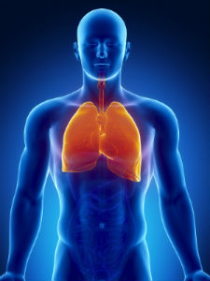
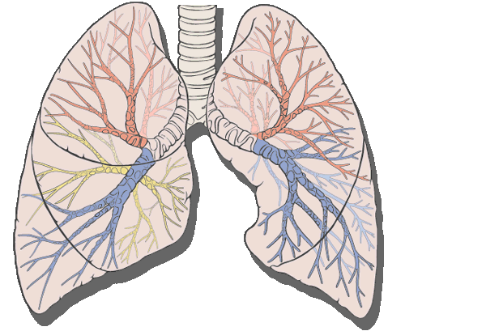
Lung Clearance Type
FRMAC’s default Lung Clearance Type (LCT) is ICRP Recommended
Certain radionuclides have specific LCTs that should be used instead of the default when more appropriate information is available
Notes:
Note the difference between what we use and what NRC uses

Slide 43
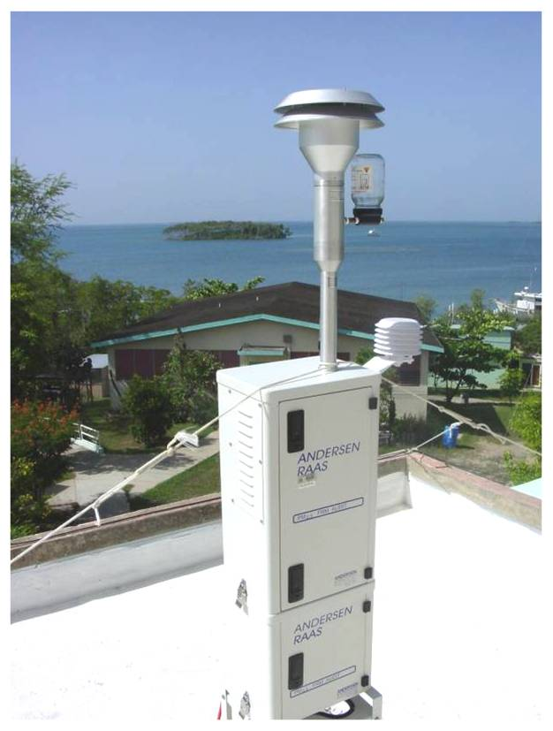
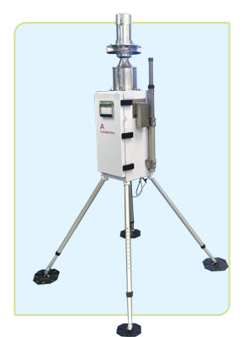
Integrated Air Activity
Radiological assessments that include the dose from plume passage require Integrated Air Activity (µCi·s/m³)
Integrated Air Activity is the concentration of a radionuclide in air integrated over the plume passage time
Integrated Air Activity results are obtained from Environmental Continuous Air Monitors (ECAMs)
Notes:
Or Integrated Air Activity can be “inferred” from deposited activity using deposition velocities

Slide 44
Integrated Air Activity
3 sec
10 μCi/m³

Slide 45
Integrated Air Activity
15 sec
10 μCi/m³

Slide 46
Integrated Air Activity
3 sec
50 μCi/m³

Slide 47
Deposition Velocity
Deposition velocity (V_{d}, units of m · s⁻¹ ) is defined as the ratio of the dry deposition flux (g · s⁻¹ · m⁻² ) to the air concentration (g · m⁻³ ) of particulate matter or gases.
Deposition Velocity (V_{d}) is used to convert between Integrated Air Activity (Ã_{i}) and Areal Activity (Deposition, Dp_{i}) when only one type of data is available
Complex process and depends upon many variables including meteorological conditions (e.g., wind speed, washout) and physical properties (e.g., particle size, gas, vapor, and aerosol)
FRMAC default deposition velocities are based on dry deposition conditions

Slide 48
Deposition Velocity
Wet deposition (washout) is not considered by FRMAC because:
washout is likely to affect only part of the area impacted by the incident (i.e., only where it rains or snows during plume passage)
washout effects are highly dependent on variables for which FRMAC is unlikely to have data (e.g., raindrop size)
However, if data is available to determine specific wet deposition, the Assessment Scientist can modify the default deposition velocity to include wet deposition in assessment calculations

Slide 49
Deposition Velocity
FRMAC’s default Deposition Velocities (V_{d})
FRMAC’s default Deposition Velocities (V_{d}) are “Effective” values that are in good agreement with NARAC and NRC (RASCAL) models
Chemical/Physical Form | V_{d} (m/s)
Particulates | 3.0E-03
Iodine Particulates | 6.5E-03
Reactive Iodine Gas (I₂) | 6.4E-03
Non-Reactive Iodine Gas (CH₃I) | 0.0
Noble Gases | 0.0
Notes:
Need to emphasise that we use the same Vd as RASCAL/NRC

Slide 50
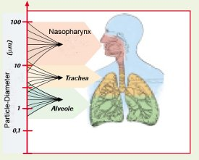
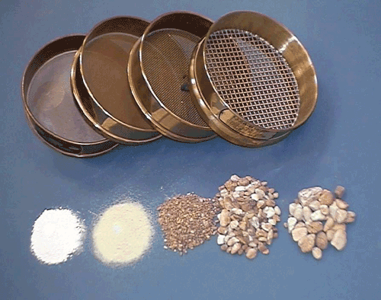
Particle Size Distribution
FRMAC’s default approach considers all radionuclides to be in the “particulate” chemical/physical form
FRMAC’s default Particle Size is 1 micron Activity Median Aerodynamic Diameter (AMAD)
Note: Separate particle size distributions can be entered for plume particles and resuspension particles.
Notes:
Advanced Topic – For typical RDD and nuclear weapon source terms alternate particle size assumptions may be appropriate.
Alternate particle size applies only to airborne plume and not to resuspended material. All resuspended material is still assumed to be 1 micron AMAD.

Slide 51
Radionuclides with Different Chemical/Physical Forms
In addition to particulate form, certain radionuclides may exist in gas or vapor form
These radionuclides can be partitioned into their multiple forms when this information is known
Carbon | Carbon Monoxide (CO) Carbone Dioxide (CO₂)
Hydrogen | Tritiated Water Vapor (HTO) Elemental Tritium (HT) Organically Bound Tritium
Iodine | Iodine Vapor Methyl Iodide (CH₃I)
Mercury | Mercury Vapor
Nickel | Nickel Vapor
Ruthenium | Ruthenium Vapor
Sulfur | Sulfur Dioxide (SO₂) Carbon Disulfide (CS₂)
Tellurium | Tellurium Vapor

Slide 52
Radionuclides with Different Chemical/Physical Forms
Iodine released from a nuclear power plant (NPP) under accident conditions is partitioned as follows in order to be consistent with NRC calculations
Particulate | 25%
I₂ | 30%
CH₃I | 45%
Notes:
DCFs for I-131
Particulate 5.44E2
I2 1.45E3
CH3I 1.14E3

Slide 53
Decay Chain Truncation
To increase calculation speed, we have established a set of rules for truncating daughters when the daughters’ contribution to dose will be negligible.
The first daughter is always included in calculations.
Truncation is enabled by default in Turbo FRMAC calculations

Slide 54
Decay Chain Truncation
Decay Chains are Truncated according to the following:
Include the parent and first daughter regardless of half-life
Analyze first daughter half-life
If first daughter half-life is ≥ 5000 yrs, truncate chain (i.e. do not include remaining radionuclides in decay chain)
If first daughter half-life is < 5000 yrs, include next radionuclide in chain
Analyze second and subsequent daughter half-lives according to the above rule until decay chain is truncated or entire chain has been included
Truncation is enabled by default in Turbo FRMAC

Slide 55
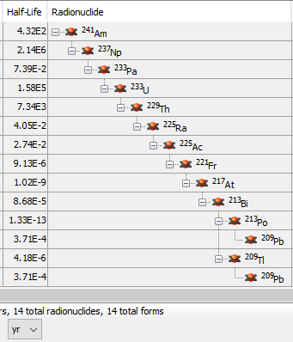
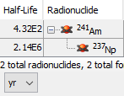
Decay Chain Truncation
Example of Decay Chain Truncation
Decay Chain Truncation Enabled Decay Chain Truncation Disabled
Notes:
DCFs for I-131
Particulate 5.44E2
I2 1.45E3
CH3I 1.14E3

Slide 56
Equilibrium Rules
The following Equilibrium Rules apply to the Mixture:
Daughter radionuclides are considered to be in equilibrium (secular, or transient when the branching ratio ≠ 1) with the Parent at deposition (t = 0) if;
Daughter’s half-life is less than the half-life of the ultimate parent (i.e., first parent in decay series), and
Daughter’s half-life is less than 1.5 years
Daughter radionuclides meeting the above rules are assigned the Parent’s half-life and decay constants for calculations
Equilibrium Rules are applied after Truncation
Equilibrium Rules are enabled by default in Turbo FRMAC, unless importing a mixture from the RASCAL software

Slide 57
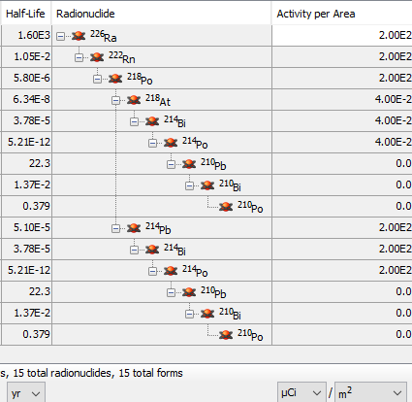
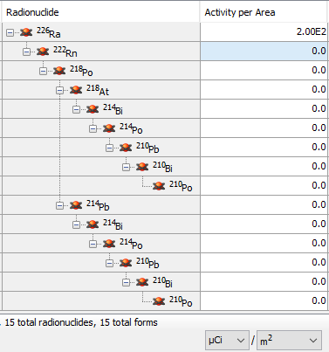
Equilibrium Rules
Example of Equilibrium Rule
Equilibrium Rules Enabled Equilibrium Rules Disabled
Notes:
DCFs for I-131
Particulate 5.44E2
I2 1.45E3
CH3I 1.14E3

Slide 58
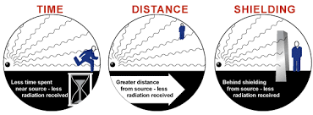
Occupancy and Sheltering
FRMAC’s default approach assumes that the receptor is outside in the contaminated area continuously during the time phase without any protective measures

Slide 59
Occupancy and Sheltering
Occupancy Factors account for the fact that receptors may be:
Unsheltered in the contaminated area for a portion of the Time Phase
Sheltered inside a structure in the contaminated area for a portion of the Time Phase
Absent from the contaminated area for a portion of the Time Phase
Building Protection Factors account for the fact that being sheltered inside a structure reduces the dose to an individual in an area of contamination
Notes:
In the Manual but not yet in TF

Slide 60
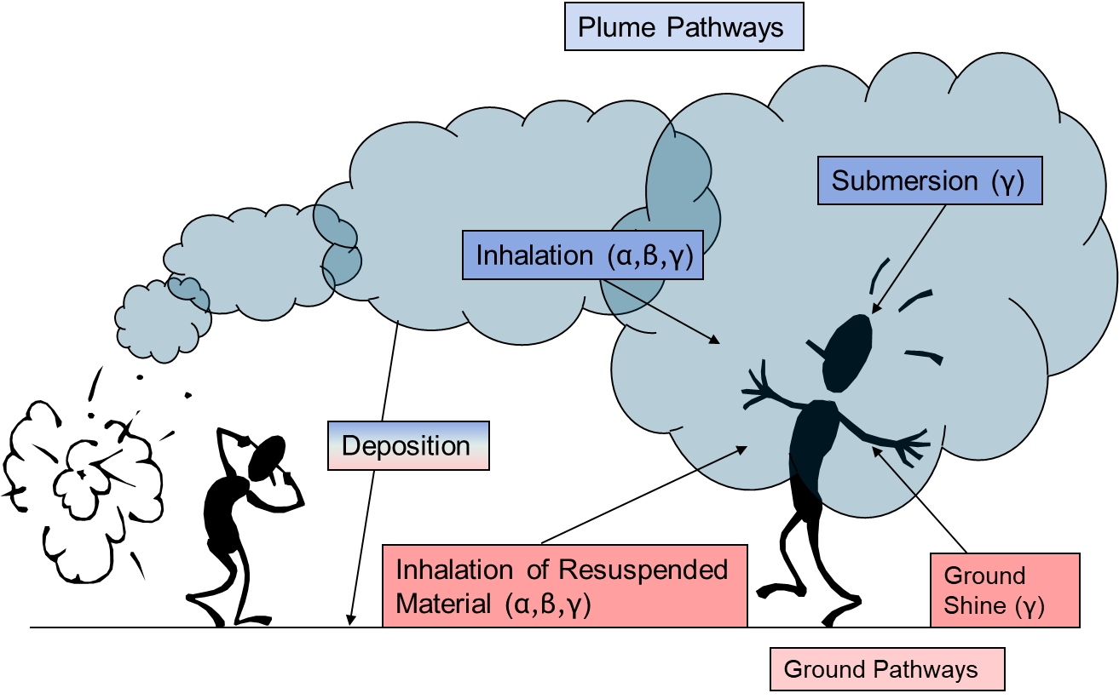
How are public protection doses calculated in Turbo FRMAC?
Public protection calculations include four exposure pathways:
Plume Inhalation
Plume Submersion
Resuspension Inhalation
Groundshine
Ingestion exposure pathway is handled separately
Dose is integrated over a user-specified time period

Slide 61
Types of Public Protection Calculations
Derived Response Level (DRL)
Administration of Potassium Iodide (KI)
Projected Public Dose (PPD)
Dose Parameters

Slide 62
Types of Derived Response Levels (DRL)
DRLs can be both calculated and measurable quantities that are used to generate contours on dispersion models to project areas where Protective Actions should be considered
Integrated Air DRLs - The integrated air activity of a radionuclide at which the total dose from all radionuclides in a release would equal the PAG over the time phase under consideration
Deposition DRLs - The areal activity at a specific evaluation time of a radionuclide at which the total dose from all radionuclides in a release would equal the PAG over the time phase under consideration
Dose Rate/Exposure Rate DRLs - The external dose or exposure rate from all radionuclides in a release that would produce a dose equal to the PAG over the time phase under consideration
Which flavor of DRL to use depends on the question being asked

Slide 63
DRLs and Evaluation Time
DRL(t_{n})
DRL(t_{n})
Measurement
DRL(t_{n})
PAG
t₀
t_{n}
t₁
t_{n}
t₂
t_{n}
Time

Slide 64
FRMAC Default Assumptions
Adult receptor, Whole Body (Effective) dose
The receptor is outside and unprotected
The plume is in contact with the ground
Airborne noble gases are not deposited
Deposition is immediate
Deposition is assumed to be dry particulates with a default particle size of 1-micron Activity Median Aerodynamic Diameter (AMAD)
ICRP Recommended Lung Clearance Type
ICRP 60 based dose coefficients and breathing rates
Maxwell and Anspaugh (2011) resuspension model¹
Anspaugh (2002) weathering model²
Turbo FRMAC settings can be adjusted to use different models or event-specific data
¹ Maxwell, R. and Anspaugh, L., “An Improved Model for Prediction of Resuspension” in Health Physics, Vol. 101, pp. 722-730, December 2011
² Anspaugh, L., et al., “Movement of Radionuclides in Terrestrial Ecosystems by Physical Processes” in Health Physics, Vol. 82, pp. 670-679, April 2002

Slide 65
Public Protection Calculation Example

Slide 66
Setting the Stage
We have a request:
The local decision maker wants to know if they should order a Relocation for their downwind population
You must calculate the 1st Year DRL values.
Are the 1st year DRLs exceeded?
What is the 1st Year PAG?
Which Pathways should we use?
Assume the following Mixture
Radionuclide | Activity per Area (µCi/m²)
⁶⁰Co | 2
¹⁴⁸Gd | 1
⁹⁰Sr | 3
⁹⁰Yª | 3
^{a 90}Y included as a daughter in equilibrium
Notes:
TF automatically adds daughters in equilibrium with the parent. Y-90 should appear once Sr-90 is entered into the mix.

Slide 67
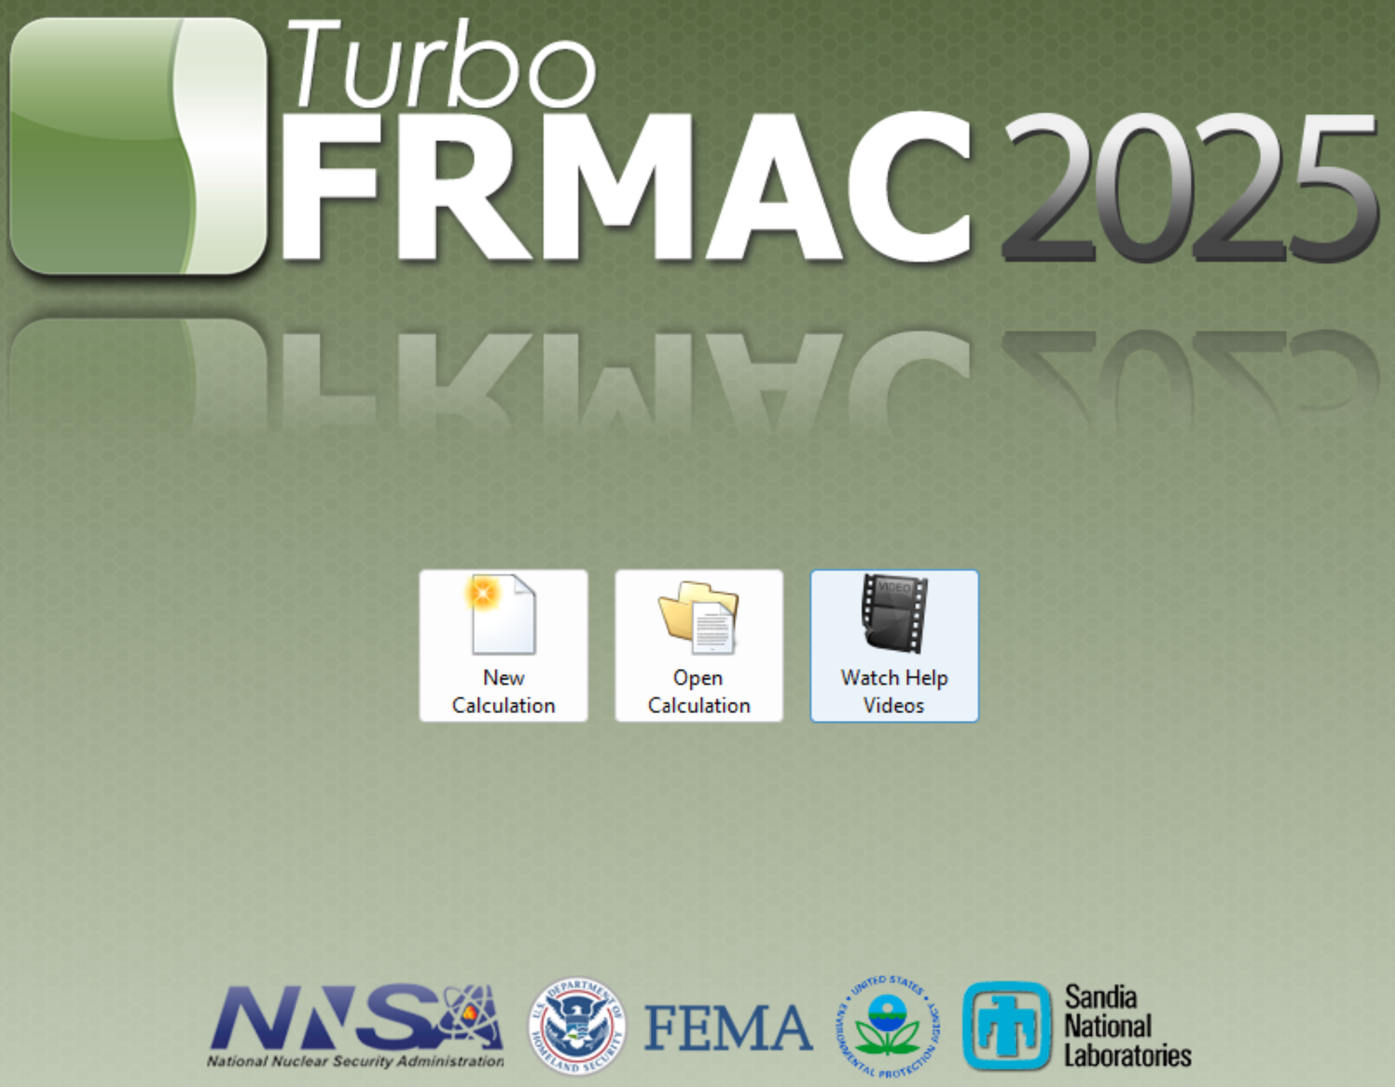
Open Turbo FRMAC
Select New Calculation

Slide 68
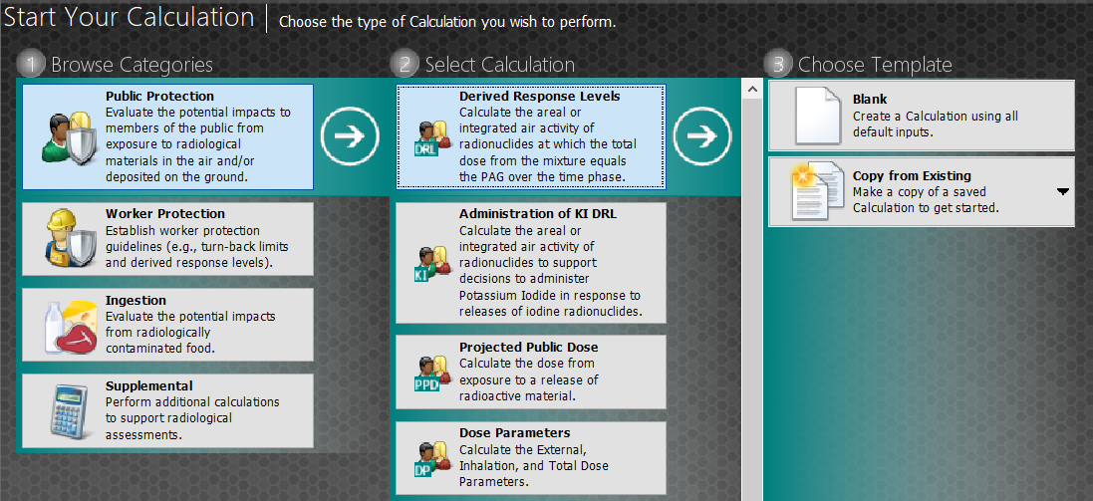
Select New Calculation
Select Public Protection, then Derived Response Level, then Blank

Slide 69
Name and Describe Calculation
Click on Name and Description Button
Type in a Name and Description for the calculation

Slide 70
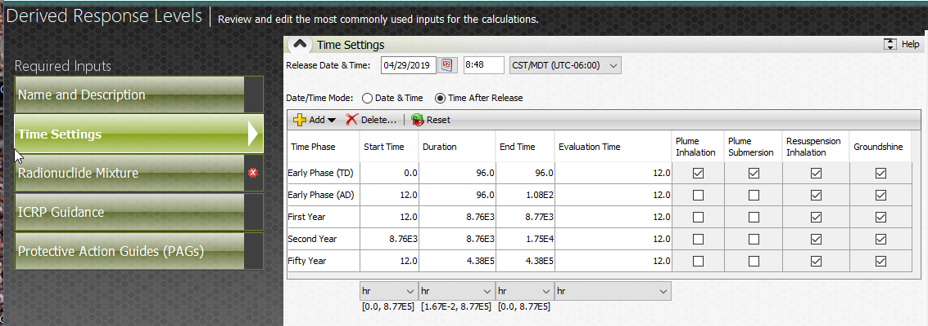
Verify Time Phases and Evaluation Time
Click on Time Settings Button
Verify Time Phases, Evaluation Time and Pathways are correct
What pathways are chosen for the 1st year?
Notes:
TF assumes that all TPs will be calculated. Demo how to delete TPs that are not used.

Slide 71
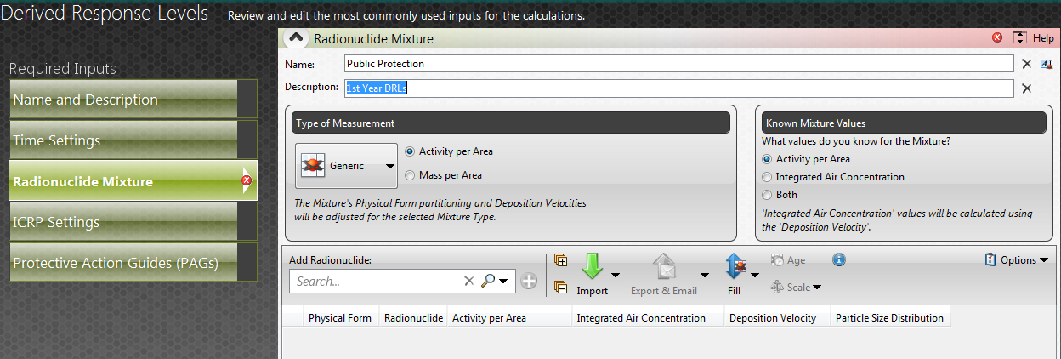
Build Radionuclide Mixture
Click on Radionuclide Mixture Button
Type in a Name and Description for the Radionuclide Mixture

Slide 72
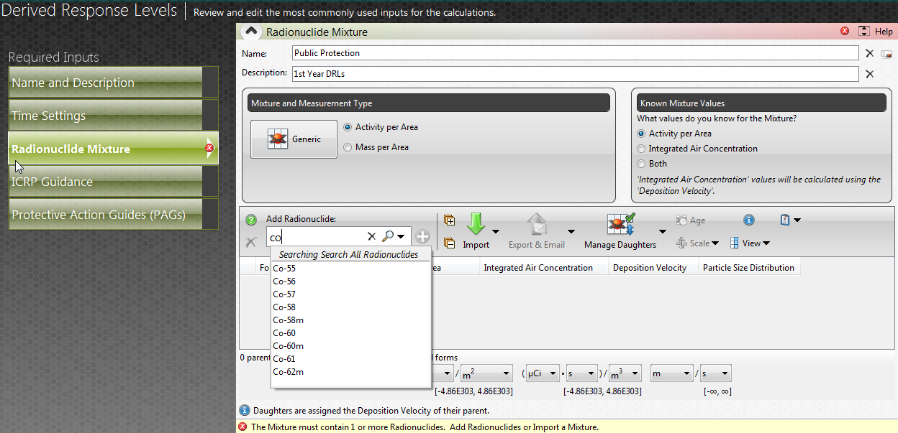
Build Radionuclide Mixture
Click on Search and begin to populate Radionuclides

Slide 73
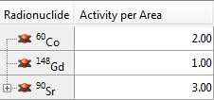
Build Radionuclide Mixture
Enter each Radionuclide in the mix and enter the Activity Concentration

Slide 74
Export and Save Radionuclide Mixture
Select Export & Email then select To Mixture Manager
Notes:
We need to make sure to go over this here, because saving isn’t mentioned previously in the lecture.

Slide 75
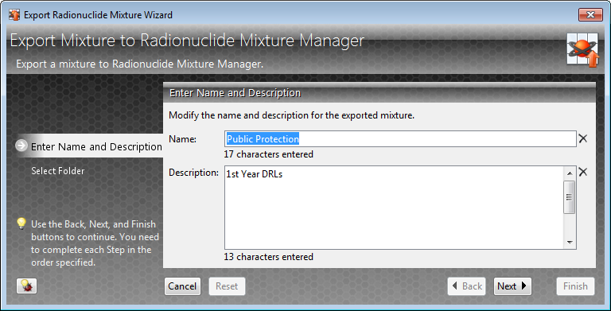
Export and Save Radionuclide Mixture
Verify Name and Description are correct
Click Next

Slide 76
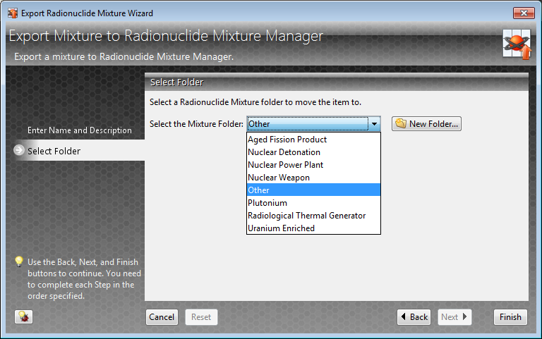
Export and Save Radionuclide Mixture
Select the Mixture Folder “Other”
Click Finish

Slide 77
What is the PAG for this calculation?
Select Protective Action Guides to see what the default PAGs are for this calculation. The user may alter the PAGs here, if need be.

Slide 78
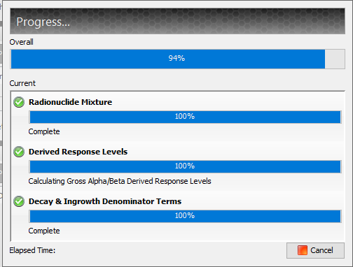
Run Calculation
Click the Deposition button

Slide 79
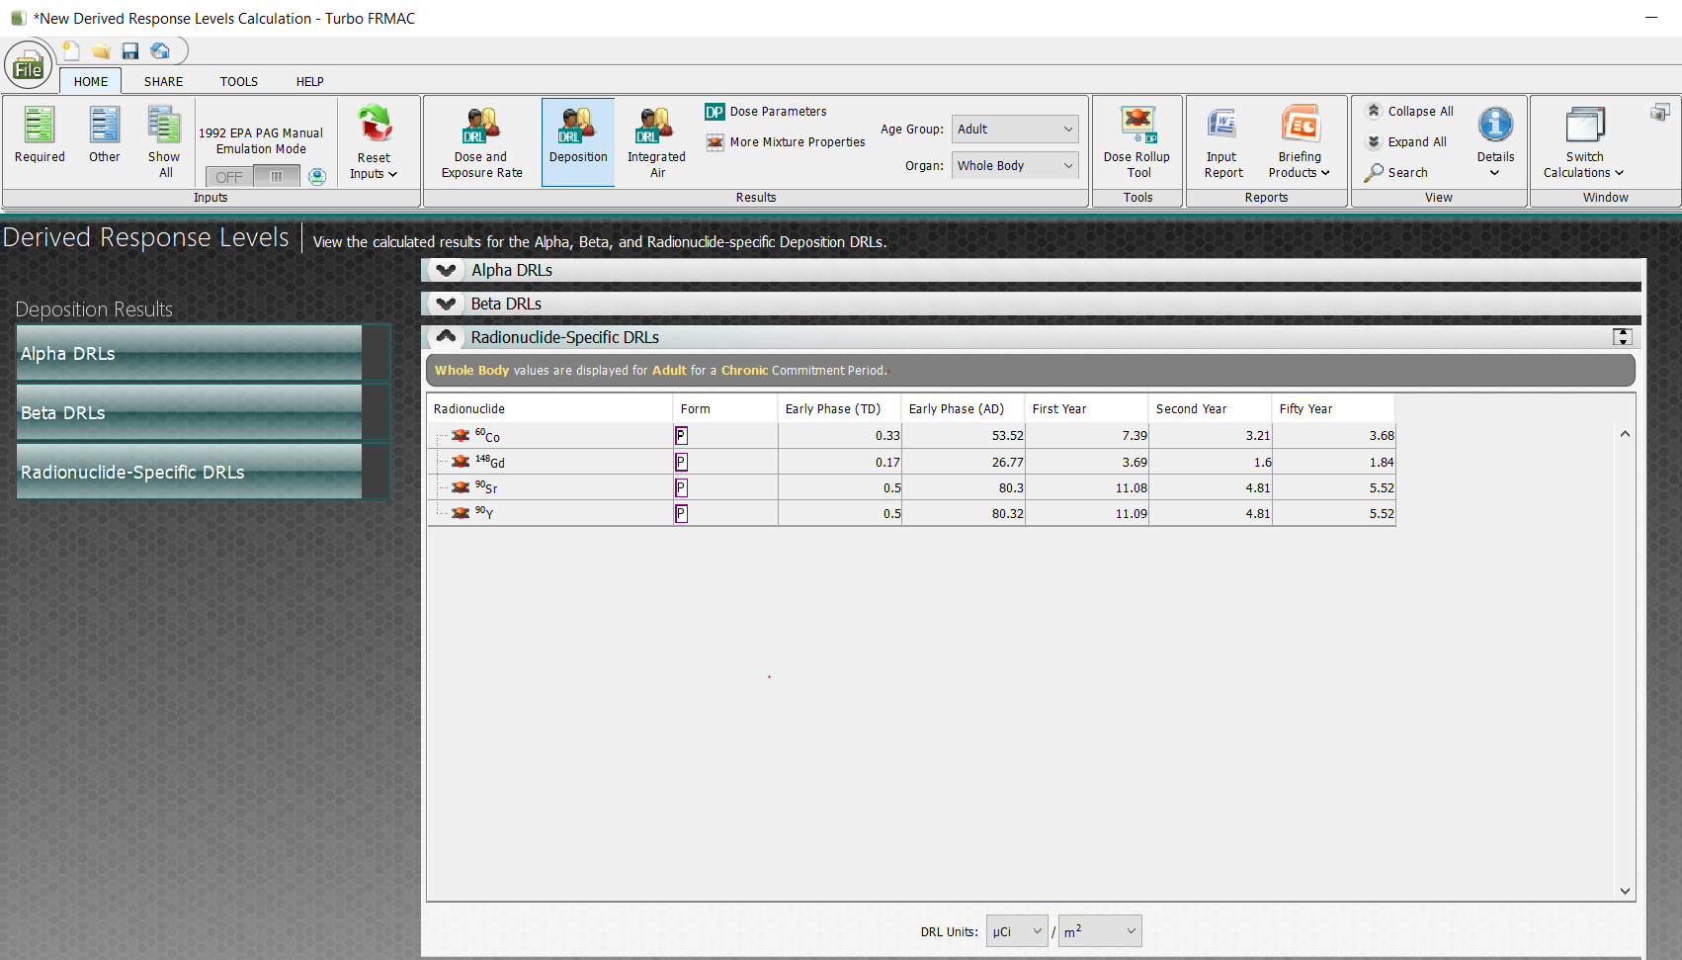
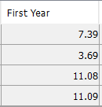
New Deposition DRL Created
Final Results displayed

Slide 80
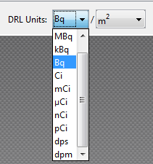
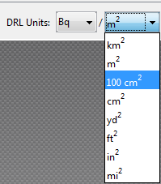
New Deposition DRL Created
Change Units

Slide 81
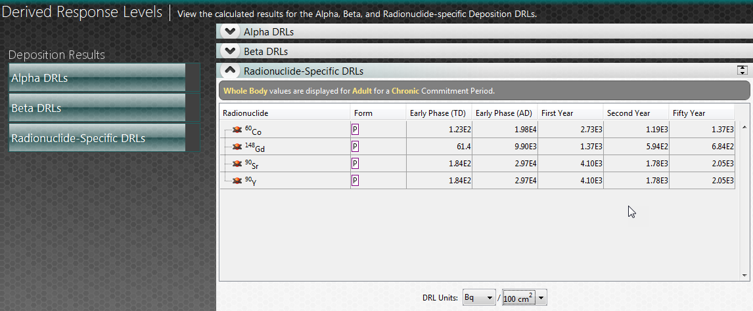
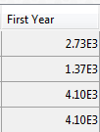
New Deposition DRL Created
Final Results displayed

Slide 82
Dose Parameters
Find the Dose Parameter Rollup Tool button at the top right of the ribbon
Click the Dose Parameter Rollup Tool button

Slide 83
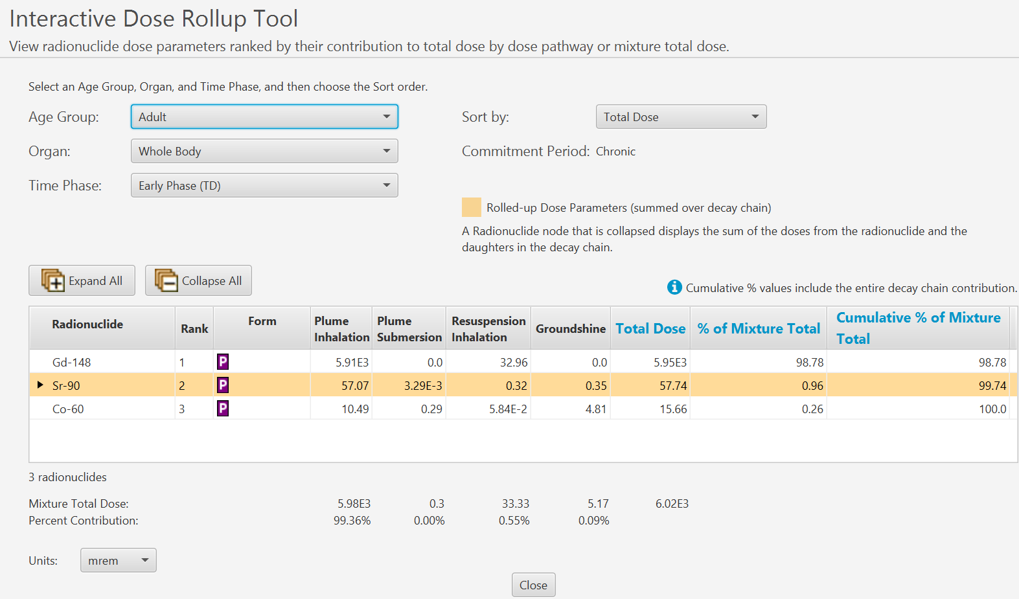
Dose Parameters
The interactive window allows the user to select age group, organ, and time phase of interest

Slide 84
Dose Parameters
Select the First Year Time Phase from the drop down.

Slide 85
1st year Dose Parameters
The 1st Year Dose Parameters are listed by order of percent contribution to the total dose.
Yellow highlighted rows indicate the dose is “rolled up” (combined) with the dose from the daughters.
This can be expanded out to show individual contributions from each daughter.

Slide 86
Dose Parameters
Select First Year Dose Parameter button
Dose Parameter panel comes into view
Dose Parameters indicate dose contribution from each radionuclide

Slide 87
Dose Rate/Exposure Rate DRL
Select Dose and Exposure - Final Results Displayed

Slide 88
1st Year Integrated Air Concentration DRL Created
Select Integrated Air - Final Results Displayed

Slide 89
Summary of Results – Deposition DRLs
None of the activities per area exceed the calculated DRLs. Therefore, Protective Actions in the 1st year may not be necessary
Radionuclide | Activity per Area (µCi/m²) | Deposition DRL (µCi/m²)
⁶⁰Co | 2 | 7.36
¹⁴⁸Gd | 1 | 3.69
⁹⁰Sr | 3 | 11.08
⁹⁰Y ª | 3 | 11.09
^{a 90}Y included as a daughter in equilibrium

Slide 90
Summary of Results – Integrated Air Activity DRLs
None of the integrated air activities exceed the calculated DRLs. Therefore, Protective Actions in the 1st year may not be necessary
Radionuclide | Integrated Air Activity (µCi·s/m³) | Integrated Air DRL (µCi·s/m³)
⁶⁰Co | 6.67E2 | 2.46E3
¹⁴⁸Gd | 3.33E2 | 1.23E3
⁹⁰Sr | 1.00E3 | 3.70E3
⁹⁰Y ª | 1.00E3 | 3.70E3
^{a 90}Y included as a daughter in equilibrium

Slide 91
Ingestion Calculation Concepts

Slide 92
Ingestion Assessment Concepts
Parent/Daughter Dose
All radionuclides present at consumption are treated as parents for ingestion calculations
Ingestion Dose Coefficients account for daughter ingrowth that occurs after consumption
Average Annual Intake
Ingestion calculations are based on the average annual intake of all dietary components (including tap water used for drinking)
Calculations DO NOT apply to determining restrictions on Drinking Water – EPA has separate Drinking Water restrictions.

Slide 93
Ingestion Assessment Concepts
Age Groups
Annual intake varies by Age Group
ICRP provides Ingestion Dose Coefficients based on the following Age Groups: 3 months, 1 year, 5 years, 10 years, 15 years, Adult
Fraction of Diet Contaminated
Assumed to be 0.3
Exceptions: ¹³²Te, ¹³¹I, ¹³³I and ²³⁹Np in the Infant (3-month and 1 year old) diet where it is assumed to be 1.0

Slide 94
Ingestion Intervention Level
An Ingestion Intervention Level is a radionuclide concentration in food that, when consumed, could result in an individual receiving an Ingestion Dose (to the most sensitive age group/organ) equal an FDA Ingestion PAG
Derived Intervention Levels (DILs) were recommended by the FDA in 1998 as the radionuclide activity concentration in food at which point protective actions should be considered. The FDA established DILs for a list of 24 radionuclides and three groups of radionuclides.

Slide 95
FDA DILs
Principle Radionuclide/Group | FDA DIL (μCi/kg_{wet})
⁹⁰Sr | 4.3E-03
¹³¹I | 4.6E-03
¹³⁴Cs + ¹³⁷Cs | 3.2E-02
¹³⁴Cs | 2.5E-02
¹³⁷Cs | 3.7E-02
²³⁸Pu + ²³⁹Pu + ²⁴¹Am | 5.4E-05
²³⁸Pu | 6.8E-05
²³⁹Pu | 6.0E-05
²⁴¹Am | 5.4E-05
¹⁰³Ru + ¹⁰⁶Ru | (¹⁰³Ru/0.18) + (¹⁰⁶Ru/0.012) < 1
¹⁰³Ru | 1.8E-01
¹⁰⁶Ru | 1.2E-02
Secondary Radionuclides | FDA DIL (μCi/kg_{wet})
⁸⁹Sr | 3.8E-02
⁹¹Y | 3.2E-02
⁹⁵Zr | 0.11
⁹⁵Nb | 0.32
¹³²Te | 0.12
¹²⁹I | 1.5E-03
¹³³I | 0.19
¹⁴⁰Ba | 0.19
¹⁴¹Ce | 0.19
¹⁴⁴Ce | 1.4E-02
²³⁷Np | 1.1E-04
²³⁹Np | 0.76
²⁴¹Pu | 3.2E-03
²⁴²Cm | 5.1E-04
²⁴⁴Cm | 5.4E-05

Slide 96
How is a Ingestion Intervention Level used?
A food must first be sampled and analyzed
Radionuclide concentration in food is compared to an Ingestion Intervention Level (DIL or FIL)
If the sample exceeds the Ingestion Intervention Level then consumption of the food may result in an Ingestion Dose greater than the FDA PAG

Slide 97
FRMAC Intervention Levels
FRMAC has developed the FRMAC Intervention Level (FIL) to calculate values analogous to the FDA DILs for radionuclides not listed by the FDA
FDA has directed FRMAC to use the DIL and applicable age group/organ for all FDA Radionuclides as listed in the FDA PAG Manual
FRMAC will calculate FILs for all radionuclides not listed by the FDA

Slide 98
Applying Intervention Levels
Intervention Levels are applicable to foods as prepared for consumption or (generally) “wet”
FDA allows FRMAC to exclude the 3-month old age group for Non-FDA Radionuclides because calculation assumptions are questionable for that age group
When the 3-month old is the limiting age group, discuss with the FDA representative on the A-Team
Determine the next most limiting age group and exclude the 3-month old
Notes:
Consumption period is over a year, so the 3mo will leave that age group over the consumption period
Some intakes assumptions don’t make physical sense

Slide 99
Ingestion Intervention Level Assumptions
FDA DILs apply to individual radionuclides or FDA-specified groups
FRMAC FILs apply only to individual radionuclides
Both DILs and FILs apply only during the first year after an incident
Both are based on the most sensitive age group/organ determined from Dose Coefficients and Ingestion Rates
DILs for FDA radionuclides use ICRP 56 and the National Radiological Protection Board (NRPB) GS7 publication
FILs for non FDA-listed radionuclides use the ICRP 60+ dosimetry model
Annual intake is adjusted to account for radioactive decay
DIL: Effective Days of Intake (EDI)
FIL: Integrated Decay
Notes:
DIL modifies the effective days of intake to account for decay over the consumption period. EDI = time to decay to 1% of original value
FIL integrates radioactive decay over the consumption period

Slide 100
Ingestion Dose
The Dose from consumption of contaminated food based on measured radionuclide concentration
Compared to the FDA PAGs to determine whether protective actions are warranted

Slide 101
Ingestion Dose Assumptions
Calculations take in to account:
Radioactive decay
Fraction of diet contaminated
Daily food intake rate
Consumption period (usually one year)
FDA has established Food PAGs, but does not provide method(s) for calculating Ingestion Dose
There is no specific guidance on the time period to use for calculating the Ingestion Dose, use one year as default

Slide 102
Ingestion Dose Food Groups
Food Types fall into 4 groups (shown with subgroups)
Meat/Fish
Beef, Pork, Poultry, Fin Fish, Shell Fish, Other Meat
Crop/Produce
Leafy, Other Produce, Breads, Cereals, Other Grains, Exposed, Protected
Milk
Fresh Cow’s Milk, Other Dairy, Eggs
Beverages
Tap Water, Water-Based Drinks, Soups, Other Beverages

Slide 103
Ingestion Dose Example

Slide 104
Setting the Stage
Calculate the Crop Ingestion DRL for ⁶⁰Co in lettuce for an evaluation time of 7 days after deposition and a 90 day time to harvest

Slide 105
Open Turbo FRMAC
Select New Calculation

Slide 106
Select New Calculation
Select Ingestion, then Crop DRLs, then Blank

Slide 107
Name and Describe Calculation
Click on Name and Description Button
Type in a Name and Description for the calculation

Slide 108
Human Intake Rate
Click on Human Intake Rates Button
Default FDA Ingestion Rates are listed

Slide 109
Build Radionuclide Mixture
Click on the Radionuclide Mixture Button
Click the Search box
Type in Co and select Co-60

Slide 110
Crop Pathway Settings
Click on the Crop Pathway Settings Button
Set Evaluation Time to 7 Days
Set Time to Harvest to 90 Days

Slide 111
ICRP and FDA Settings
Click on the ICRP and FDA Settings Button
Notice the FDA Options box is checked

Slide 112
Run Calculation
Click the Crop DRL button

Slide 113
New Crop DRL Created
Final Results displayed

Slide 114
Web-based Training Opportunities

Slide 115
Nuclear Incident Response Self-Paced Learning Opportunities
AS-100: Introduction to Assessment Science
24 ABHP CECs
22 module course covering FRMAC Assessment methods for public protection, worker protection, and ingestion pathway PNNS-KDXC
Turbo FRMAC Advanced Methods
1 ABHP CEC each
Administration of Potassium Iodide Derived Response Level Calculation OMXL-NMBV
Analytical Action Level Calculation HZAK-EWAX
LA-050: Support Laboratory Briefing CMOT-EKHS
What labs should expect when called to help FRMAC
Gamma Spectroscopy ERXF-ZREQ
Detector Calibration Methods
Sample Analysis
Software Functions
Mathematical Instrument Calibration
True Coincidence Summing Corrections
In-Situ Gamma Spectrometry
LA-075: Laboratory Data Reporting (Coming Soon)
Detailed walkdown of data reporting in CBRNResponder
Sandia and partners have developed free, online training!
Learn more: https://snl.matrixlms.com/

Slide 116
Thank you!
Questions?

Slide 117
Supplemental Slides

Slide 118
Admin of KI
The EPA has provided an Early Phase PAG for the issuance of KI
This method was developed to calculate Integrated Air, Deposition, Dose Rate and Exposure Rate DRLs to support decisions to administer KI in response to releases of iodine radionuclides
DRLs are calculated as shown in Equations 1.1-1 and 1.1-2 from Method 1.1 and Equation 1.2-1 from Method 1.2 and will not be covered here
This method differs from the standard DRL calculations in that only the dose to the thyroid from iodine radionuclides is included

Slide 119
Early Phase PAGs
Protective Action Recommendation | PAG (Projected Dose) | Comments
Sheltering-in-place or Evacuation of the publicª | 1-5 rem over 4 days^{b} | Evacuation (or, for some situations, sheltering-in-place) should be initiated when projected dose is 1 rem
Supplementary administration of prophylactic drugs – KI^{c} | 5 rem to child (1 Year Old) thyroid from iodine exposure^{d} | KI is most effective if taken prior to exposure. May require approval of state medical officials (or in accordance with established emergency plans). FDA recommends that KI be administered to both children and adults at the lowest intervention threshold
ª Should begin at 1 rem except when practical or safety considerations warrant using 5 rem; take whichever action (or combination of actions) that results in the lowest exposure for the majority of the population. Sheltering may begin at lower levels if advantageous. ^{b} Calculated dose is the projected sum of the effective dose from external radiation exposure (i.e., groundshine) and the committed effective dose from inhaled radioactive material. ^{c} Provides thyroid protection from radioactive iodines only. ^{d} Thyroid equivalent dose

Slide 120
Assumptions
Receptor of interest is the 1 yr old child
Organ of interest is the Thyroid
Time Phase of interest is Early Phase Total Dose (TD) (0 – 96 hrs)
Only considers the two inhalation pathways (Plume & Resuspension)
Only considers the dose to the receptor’s thyroid from iodine radionuclides
Most likely release of iodines is from a Nuclear Power Plant (NPP)
Accidental release of airborne iodine from a NPP is typically partitioned as follows in order to be consistent with NRC calculations
NOTE: DRLs may be calculated for any radionuclide present in the release, including non-iodine radionuclides. This can be useful when other radionuclides may be easier to detect than iodine radionuclides (e.g., Cs-137) and can be used as a “marker” to indicate how much iodine is present.

Slide 121
Admin of KI Example
Select New Calculation

Slide 122
Select a New Calculation
Select Public Protection, then Administration of KI DRL, then Blank

Slide 123
Name and Describe Calculation
Click on Name and Description Button
Type in a Name and Description for the calculation

Slide 124
Verify Time Phases and Evaluation Time
Click on Time Settings Button
Notice only one Time Phase is available
Verify Time Phases, Evaluation Time and Pathways are correct

Slide 125
Build Radionuclide Mixture
Click on Radionuclide Mixture Button
Click the Integrated Air Concentration button

Slide 126
Build Radionuclide Mixture
Click on Search and begin to populate Radionuclides

Slide 127
Build Radionuclide Mixture
Enter each Radionuclide in the mix and enter the Integrated Air concentration

Slide 128
KI Protection Factors
This calculation allows the user to add a protection factor for administration of KI

Slide 129
Run Calculation
Click the Integrated Air button

Slide 130
New Integrated Air DRL Created
Final Results displayed

Slide 131
New Integrated Air DRL Created
Final Results display DRLs for each of the different chemical/physical forms

Slide 132
Run Calculation
Click the Deposition button

Slide 133
New Deposition DRL Created
Final Results displayed

Slide 134
New Deposition DRL Created
Final Results display DRLs but because the calculation is for Deposition, only the particulate form results are appropriate

Slide 135
Run Calculation
Click the Dose and Exposure Rate button

Slide 136
New Dose and Exposure Rate DRL Created
Final Results displayed.

Slide 137
Using Administration of KI DRLs

Slide 138
Example Problem
Calculate the KI Administration Deposition DRLs for the Early Phase (TD) Time Phase for the Mixture below with an Evaluation Time (t_{n}) of 72 hours and Airborne Partition as indicated
Radionuclide | Integrated Air Activity (µCi•s/m³)
I-131 | 1.0E-01
Chemical/Physical Form | Airborne Partition
Particulate | 0.75
I₂ | 0.20
CH₃I | 0.05
Notes:
TF automatically adds daughters in equilibrium with the parent. Y-90 should appear once Sr-90 is entered into the mix.

Slide 139
Select New Calculation
Select Public Protection, then Administration of KI DRL, then Blank

Slide 140
Name and Describe Calculation
Click on Name and Description Button
Type in a Name and Description for the calculation

Slide 141
Verify Time Phases and Evaluation Time
Click on Time Settings Button
Change Evaluation Time to 72 hr
Notes:
TF assumes that all TPs will be calculated. Demo how to delete TPs that are not used.

Slide 142
Build Radionuclide Mixture
Click on Radionuclide Mixture Button
Click the Integrated Air Concentration button

Slide 143
Build Radionuclide Mixture
Click on Search and begin to populate Radionuclides

Slide 144
Build Radionuclide Mixture
Enter the Radionuclide and the Integrated Air Concentration
Notice the “Multiple” button under the Form column is highlighted – Double Click that button

Slide 145
Build Radionuclide Mixture
A supplement box opens providing the user with the editable values for Airborne Partition
Change these as specified
Click Save with done

Slide 146
Run Calculation
Click the Deposition button

Slide 147
New Deposition DRL Created
Final Results displayed

Slide 148
Interpreting the Results
A Deposition DRL of 35.43 µCi/m² measured at 72 hrs after the release indicates that the Protective Action Guide (PAG) of 5 rem to the 1 yr old thyroid for the Early Phase (TD) time phase is met or exceeded
This data would provide the Decision Makers the information needed to take some protective action such as issuance of KI and advise as to administration
Also this data is provided to NARAC for plotting on a map to determine the potential impacted area that protective actions should be implemented
Notes:
TF automatically adds daughters in equilibrium with the parent. Y-90 should appear once Sr-90 is entered into the mix.

