Slide 1
NRC-RADTRAN Version 1.0
Jonathan Napier, PhD
Health Physicist
May 15, 2025
PNNL-SA-211169

Slide 2
Outline
Introduction
NRC-RADTRAN Concepts
NRC-RADTRAN Use
NRC-RADTRAN Updates

Slide 3
Introduction
NRC – Radioactive Material Transport (NRC-RADTRAN)
Risk and consequence analysis of radioactive material transportation
Modes of transportation: rail, truck, barge, aircraft
First released in 1977 (SNL)
6 versions released to date
GUI compatibility added to RADTRAN 6.02.1 → NRC-RADTRAN v1.0

Slide 4
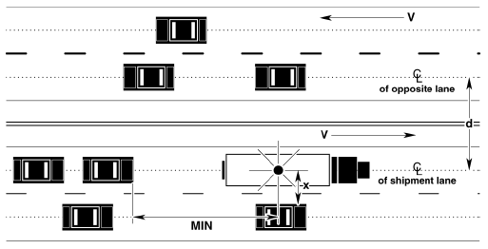
NRC-RADTRAN Concepts
Calculations
With traffic
Opposing traffic
Population
Treats shipment as a stationary object
Relative velocity used for all calculations

Slide 5
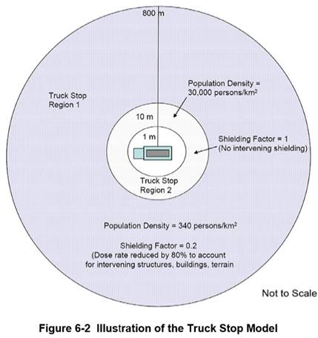
NRC-RADTRAN Concepts
Example Truck Route Stop Figure from page 6-29 of U.S. NRC Environmental Impact Statement for an Early Site Permit (ESP) at the Clinch River Nuclear Site
NUREG-2226, Vol. 1

Slide 6
NRC-RADTRAN Concepts
Two types of accident exposures modeled:
Direct exposure from loss of shielding
Exposure associated with release of particulates, gases, volatiles, and crud; several pathways:
Inhalation
Cloudshine
Resuspension
Groundshine

Slide 7
NRC-RADTRAN Concepts
Accident doses are calculated and summed for all appropriate exposure pathways for all isotopes in each material for the shipment(s) being analyzed and for all downwind isopleths for each accident severity to yield a consequence (total dose) per accident of each severity
Probability of occurrence of each accident severity class is calculated from input values for accident rate, fractional occurrence, and distance traveled
Total Dose is multiplied by probability of occurrence for each accident severity to yield Dose-Risk
Results and intermediate calculations are included in the output file

Slide 8
NRC-RADTRAN Concepts
Changes in RADTRAN 6
Command line is no longer used for any functionalities
RadCat is no longer maintained, distributed, or used
NRC-RADTRAN 1.0 is current version
Runs RADTRAN 6.02.1
New Graphic User Interface for Inputs
RADTRAN/RadCat 6 User Guide and Technical Manual are still valid references

Slide 9
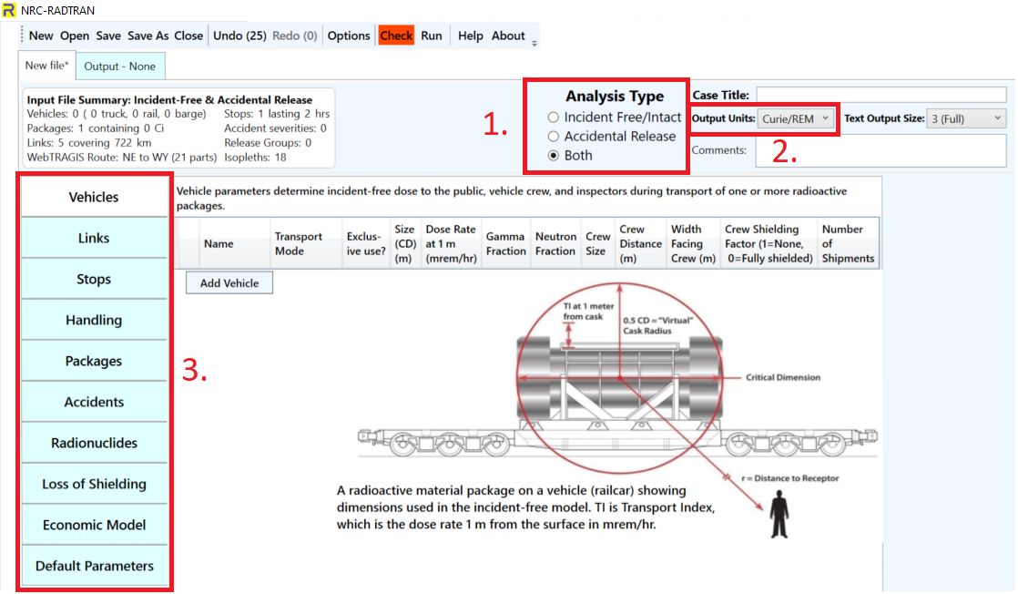
NRC-RADTRAN Use
Defining the problem:
Type of Analysis
Units
Curies/ Rem
Bq/Sv
Analysis type dictates available input panels

Slide 10
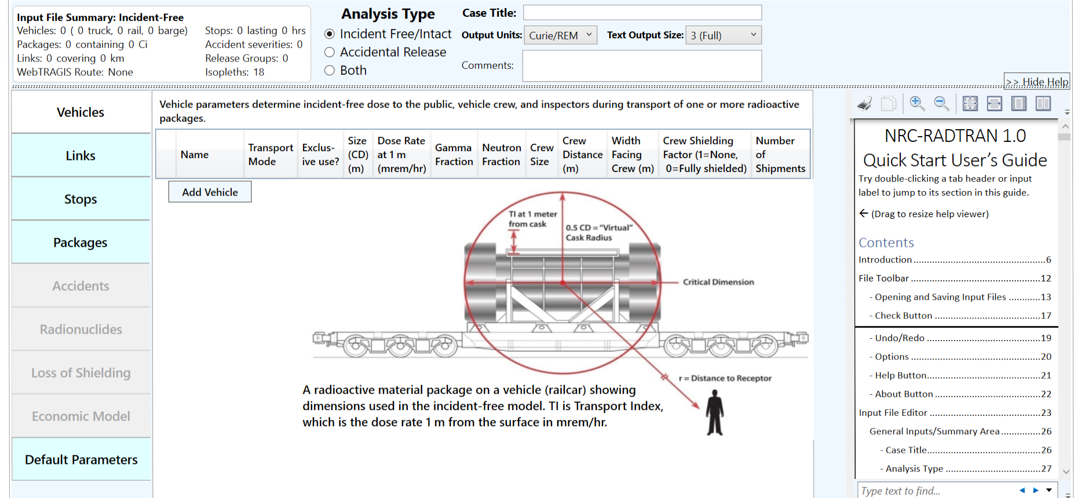
NRC-RADTRAN Use
Basic functions: opening, closing, and saving files
Undo/ Redo: maintains list of prior 99 actions
Options: display, file, open/save, and other legacy options
Check: Indicates any file errors (errors, warnings)
Help/About: opens the viewer and provides basic information about NRC-RADTRAN
Help Viewer

Slide 11
NRC-RADTRAN Use (Vehicles)
Crew Distance: Average distance of crew to nearest radioactive package
Width Facing Crew: largest dimension of the cargo facing crew
Crew Shielding Factor: fraction of radiation exposed to the crew
Number of Shipments: values calculated for single shipment and multiplied
Transport Mode: highway, rail, waterway
Size (CD): Largest dimension of package (max. 9 m)
Gamma/ Neutron Fraction: split between gamma and neutron external package dose (must add to unity)

Slide 12
NRC-RADTRAN Use (Links)
Mode: highway, secondary road/ non road. Do not select unknown
Adjacent Vehicle Occupants: average number in vehicles
Traffic: number of vehicles travelling per hour on the link
Traffic, Accidents per km, and Deaths per accident are user defined
Population Type: Either rural, suburban or urban. Affects shielding factors and dose to pedestrians
Farm fraction if rural: fraction of surrounding area used for agriculture (only for rural)

Slide 13
NRC-RADTRAN Use (Links)
Creation of Links using WebTRAGIS
Limited to contiguous 48 states
May expand to all of North America
Requires US Government Sponsorship
Populations are not currently being updated
Manual Entry

Slide 14
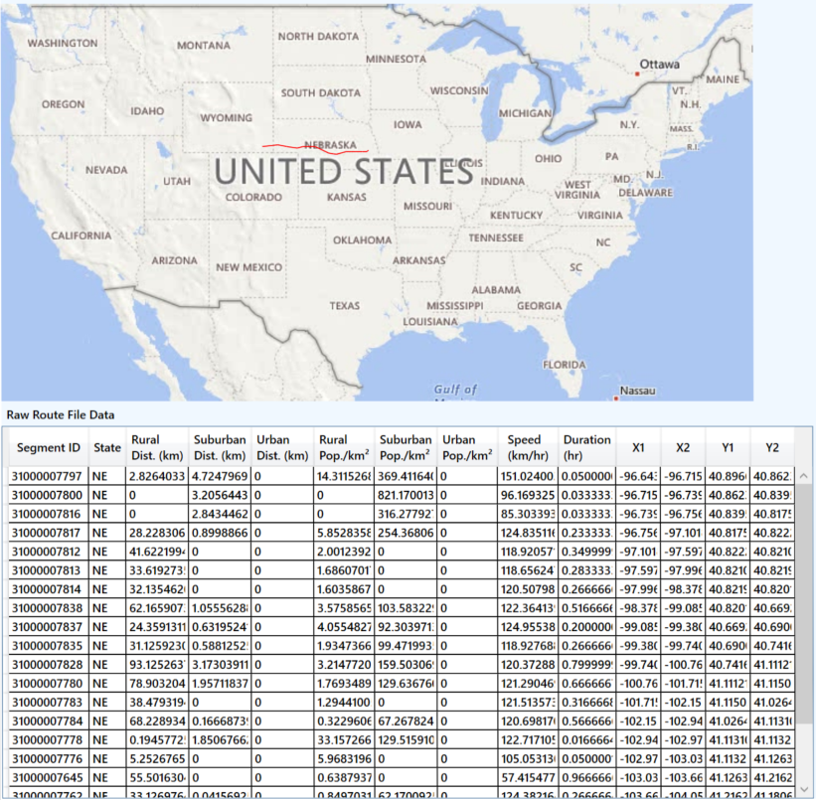
NRC-RADTRAN Use (Links)
WebTRAGIS information is intersection based
Each link is the distance between two intersections and uses defined:
Population density
Distance
Speed
Time of transit

Slide 15
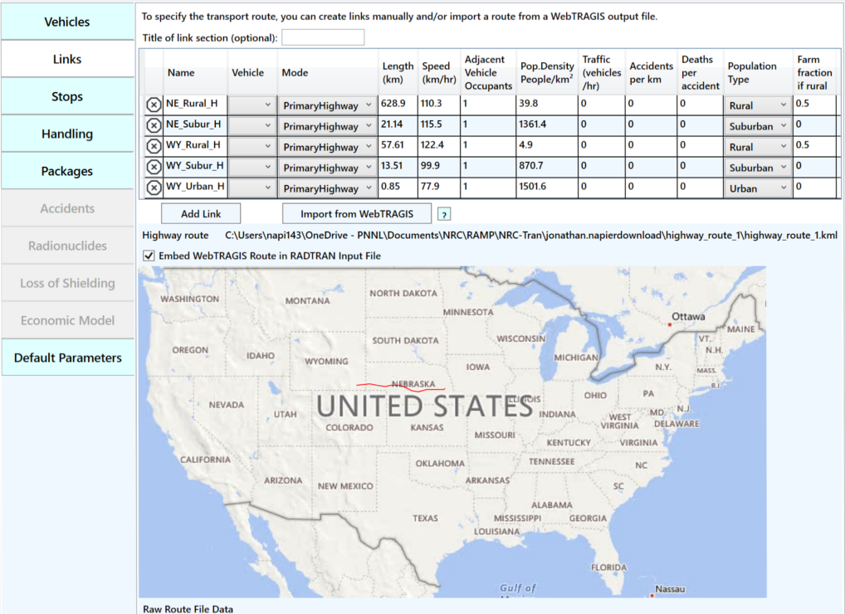
NRC-RADTRAN Use (Links)
Summarized into three links per state
Rural
Urban
Suburban

Slide 16
NRC-RADTRAN Use (Stops)
Vehicle: select any vehicle defined in the vehicles tab
Population Density: the population density in # per km2
Inner Radius: minimum distance from where dose to public is calculated
Outer Radius: maximum distance till where dose to public is calculated
Shielding Factor: used for dose calculations during a stop
Duration: time period for a given stop in hours

Slide 17
NRC-RADTRAN Use (Packages)
Optional for incident free analysis
Required for accident analysis
Enter the critical dimension in meters
Package Dimensions greater than 9 m should not be used
Enter dose at 1 m from surface and gamma/ neutron fraction
Enter number of packages of given type in each vehicle

Slide 18
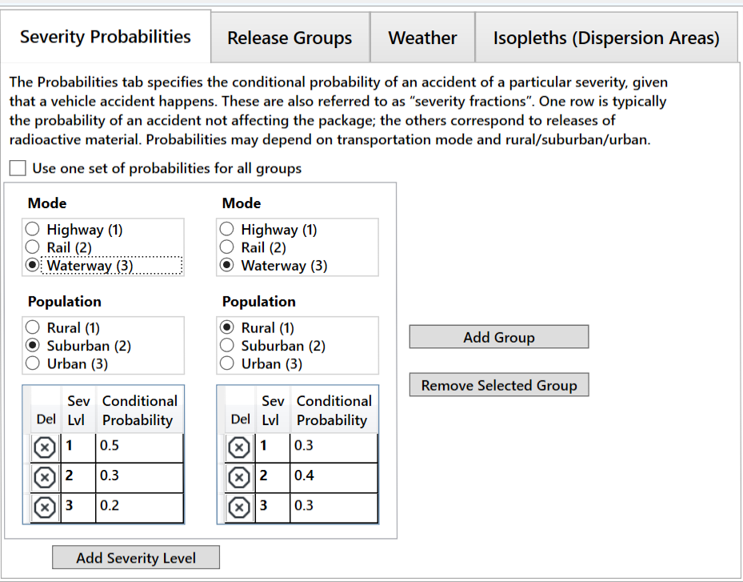
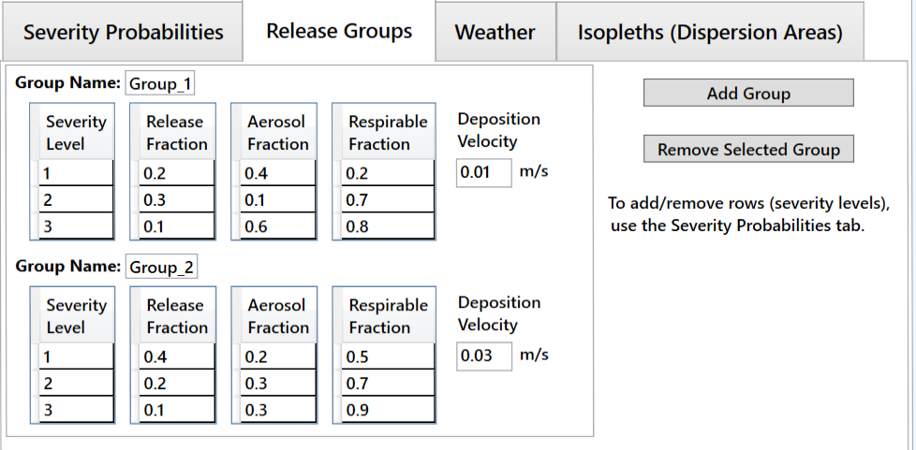
NRC-RADTRAN Use (Accidents)
Define Release Fractions → Aerosol Fractions → Respirable Fraction
Enter Deposition Velocity:
Above 0.384 m/s (error)
Above 0.1 m/s (warning)
Select the mode of transportation and population type
Add probability of each severity level (must sum to unity)

Slide 19
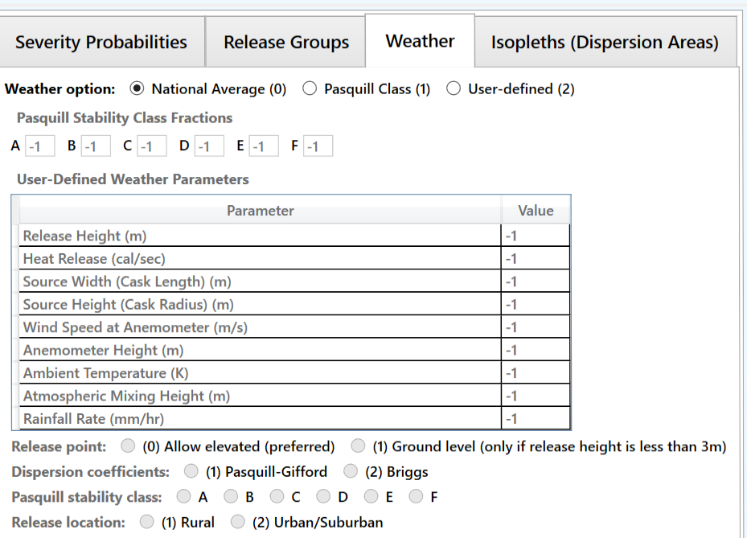
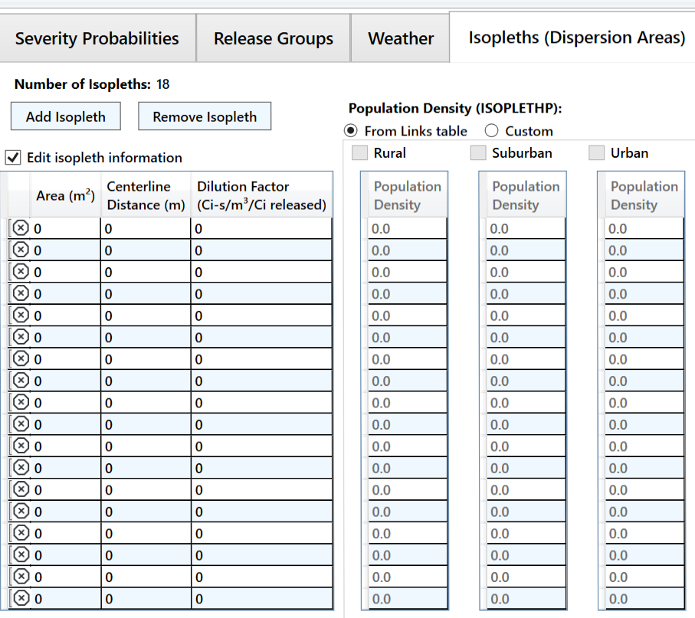
NRC-RADTRAN Use (Accidents)
Define area, centerline distance, and dilution factor of each isopleth (max. number of isopleths: 18)
NOTE: if population density is being used, first two isopleths shall have same population density
National Average (0): simplest and requires no inputs
Pasquill Class (1): requires values for each Pasquill stability class
User-Defined (2): allows more detailed analysis

Slide 20
NRC-RADTRAN Use (Radionuclides)
Radionuclide inventory can be defined for package
Isotope inventory assigned according to release group
Each package has independent isotope inventory
User-defined radionuclides can also be defined
Half-lives, energies, and Dose Conversion Factors (DCFs) are required to be specified

Slide 21
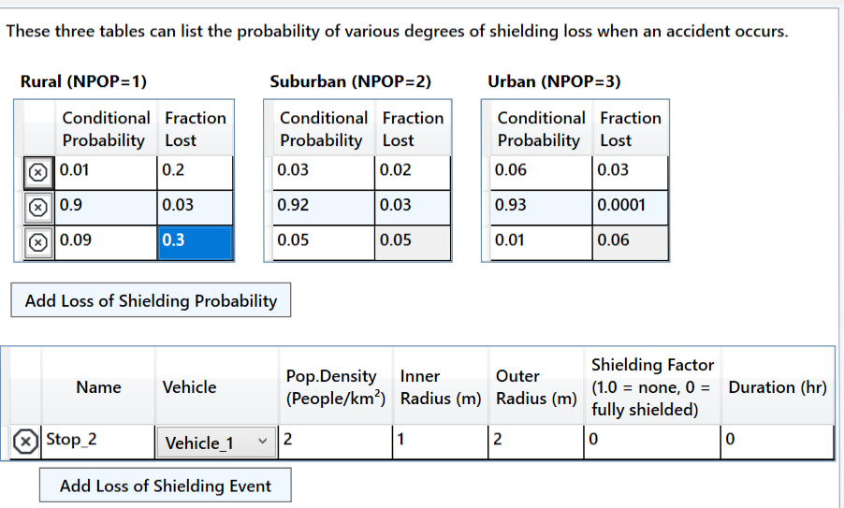
NRC-RADTRAN Use (Loss of Shielding)
Conditional Probability and Fractional Loss are defined
Probability for all scenarios shall sum to unity
Parameters for stop are defined

Slide 22
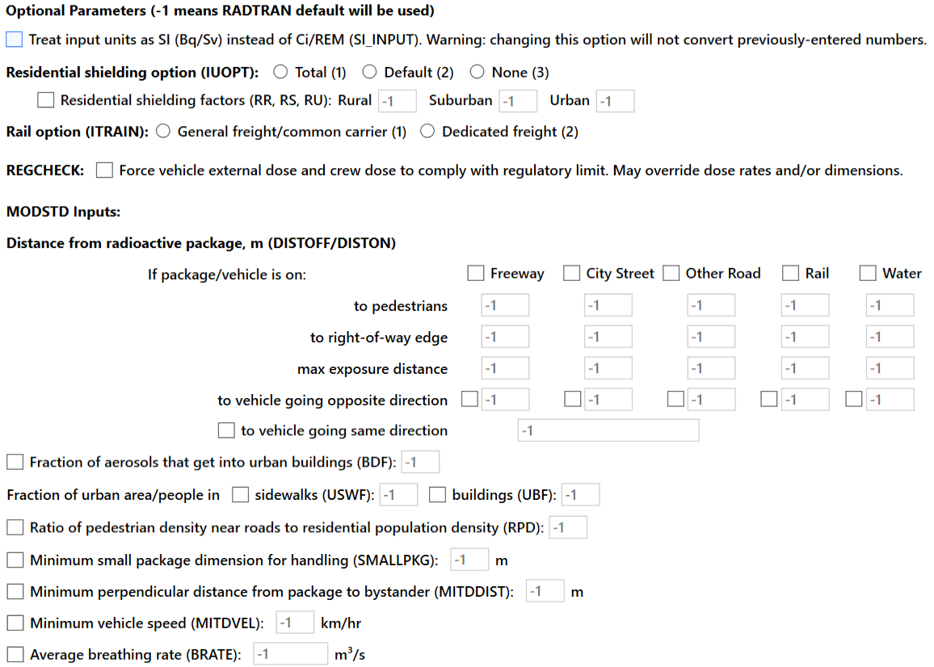
NRC-RADTRAN Use (Defaults)
Values of “-1” mean NRC-RADTRAN defaults shall be used
Potential user defined options include:
Residential shielding factors
Distance from radioactive packages
Dispersion options
Transfer coefficients
REGCHECK: used to force regulatory limits for external dose and crew dose

Slide 23
NRC-RADTRAN Use
Click the Run button
Output window will populate
Input Echo – text version of all inputs into the GUI
NRC-RADTRAN Output – standard text output also viewable in spreadsheet form
Non-rad incident summary
Exposure Summary for links and Rural, Suburban, Urban transit zones
Input sensitivity analysis (effect of 1% change of input value)
Automatically saves each run in a new output file

Slide 24
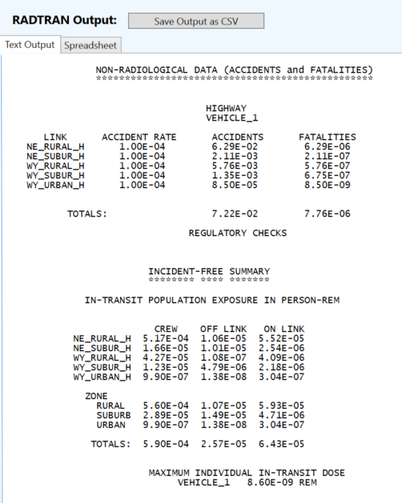
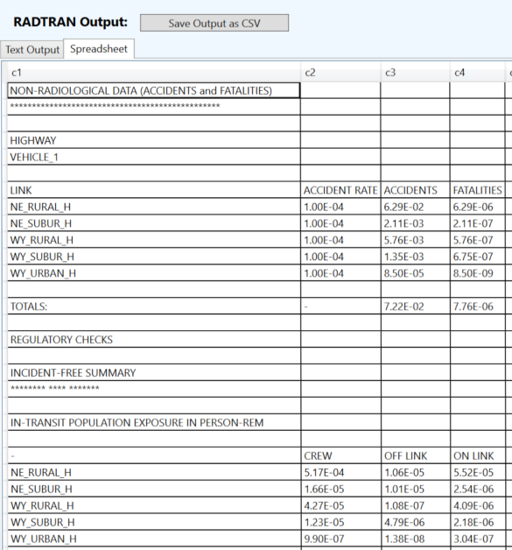
NRC-RADTRAN Outputs

Slide 25
NRC-RADTRAN Version 1.0 User Awareness
Shielding Factors: two runs should be completed using 100% neutron or 100% gamma emissions and the results ratioed externally
Incident-Free Off-Link Neutron Doses: hand-calculated MEI results do not match NRC-RADTRAN results. Until this issue is investigated and resolved, it is recommended that NRC-RADTRAN should be used to estimate incident-free off-link doses through gamma radiation only
Rail Crew Doses: for the rail crew gamma and neutron doses calculating a stop with duration of transit will provide a more representative crew dose estimate
MEI In-Transit Doses: the MEI in-transit doses estimated by NRC-RADTRAN cannot be duplicated using spreadsheet calculations. In addition, gamma and neutron MEI in-transit doses are estimated using the same equations. For this reason, it is recommended that the MEI in-transit doses not be used currently

Slide 26
NRC-RADTRAN Version 1.0 User Awareness
The LOS model was developed for gamma radiation exposures and does not consider neutron radiation exposures
The LOS model was based on modeling simulations performed for a generic 5.21-meter-long steel-lead-steel spent nuclear fuel truck transportation cask, and Dennis et al. (2009) states that the model should only be applied to truck transportation casks
For the inhalation, resuspension, and immersion pathways, NRC-RADTRAN calculates doses using the geometric mean of the depleted atmospheric dilution factors (χ/Qs). For the groundshine pathway, NRC-RADTRAN calculates doses using the depleted χ/Qs, not the geometric mean of the depleted χ/Qs
For accident risks, NRC-RADTRAN output does not provide totals for the expected values of population risks across all links, and users must sum these quantities externally

Slide 27
NRC-RADTRAN Version 1.1 (coming soon)
Updates to the GUI
Added access to all routing options on the Vehicles tab
Corrected WebTRAGIS importation
Added a .csv file import button with example highway and rail .csv files
Updates to calculational Fortran
Implemented a correction for ALL neutron calculations
(i.e., we think we fixed neutrons)
Corrected MEI in transit dose calculations
Added a summation of link risk so it no longer needs to be completed outside of the code
General code maintenance

Slide 28
Thank you

