Slide 1
VARSKIN+ 2.0
Charlotte Rose
Research Scientist
Corvallis OR
charlotte.rose@rcdsoftware.com

Slide 2
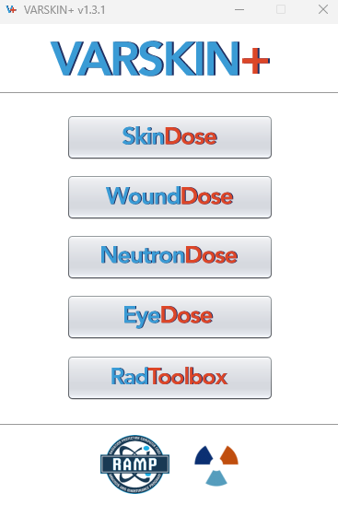
OUTLINE
Source Geometry
Depth Dose profiles
Air Gaps
Progeny Calculations
Decay Correction

Slide 3
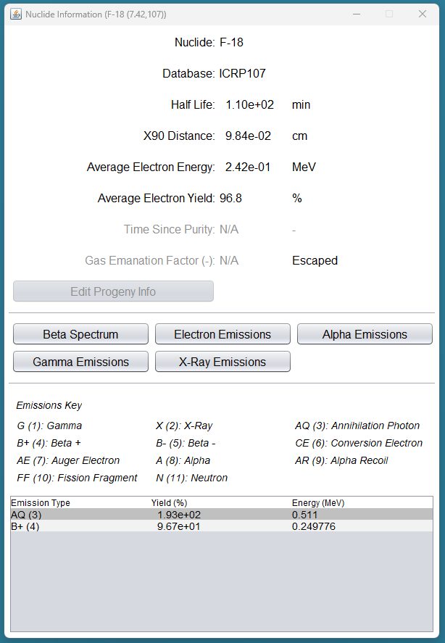
Depth Dose Profiles
Calculate the dose from F-18 at various depths

Slide 4
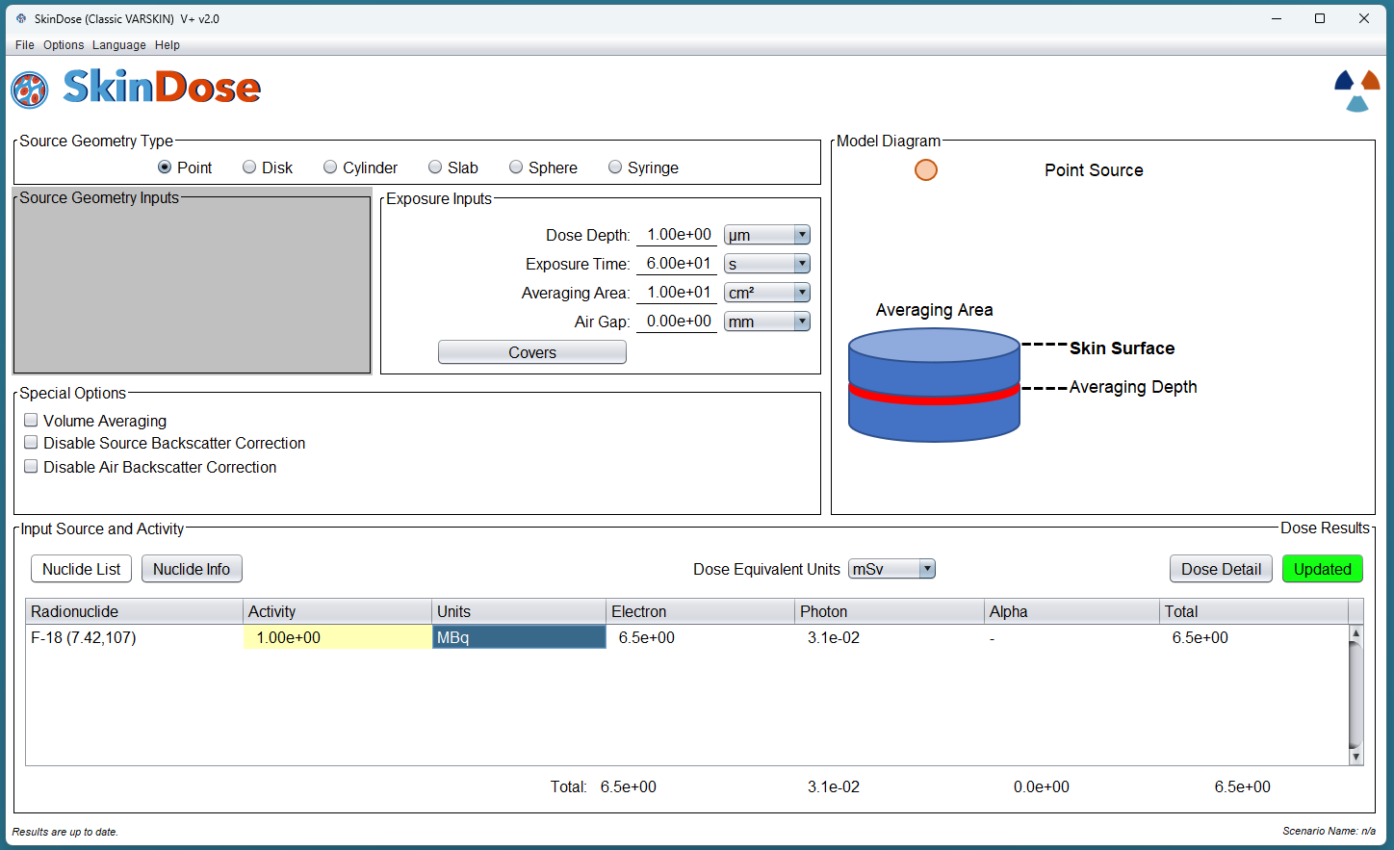
Notes:
Parameters used. Select distances from 1 um to 1 cm.

Slide 5
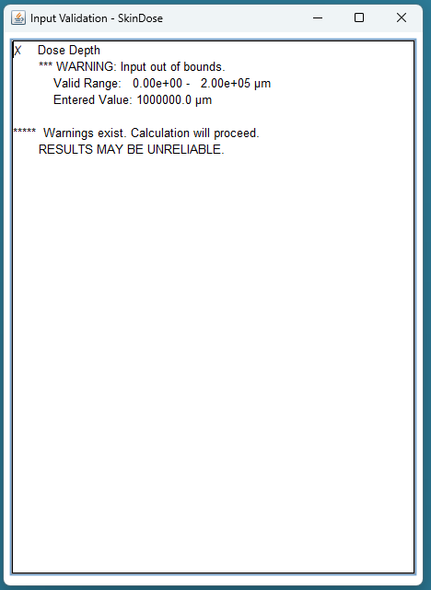
 | Depth (μm) | Electron Dose (mSv) | Photon Dose (mSv) | Total Dose (mSv)
1 μm | 1 | 6.5E01 | 3.10E-02 | 6.5E01
 | 10 | 4.4E01 | 3.70E-02 | 4.5E01
 | 100 | 2.2E01 | 4.80E-02 | 2.3E01
1mm | 1000 | 8.7E01 | 4.20E-02 | 1.30E-01
 | 10000 | 0 | 1.00E-02 | 1.00E-02
 | 100000 | 0 | 9.80E-05 | 9.80E-05
1m | 1000000 | 0 | 1.90E-10 | 1.90E-10

Slide 6
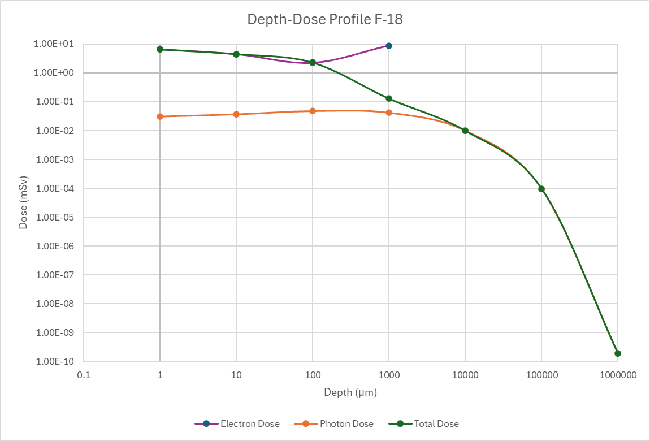

Slide 7
Source Geometry

Slide 8
Liquid Contaminant Spilled on Lab Coat
At a research hospital, a doctor prescribes a 5-milliliter (mL) administration from a stock solution containing 370 kiloBequerels per milliliter (kBq/mL) of rhenium (Re)-186 for a clinical research study at 1 p.m. that day. Around 12:30 p.m., a lab technologist loads the dose under the hood. Subsequently, a fellow employee bumps into her, and the needle slips out of its container. The entire 5 mL of the solution is spilled on the arm of her cloth lab coat in a circular shape with an area of approximately 50 square centimeters (cm2). She is unaware of the accident and continues with her work until the end of the day. Around 5 p.m., a routine survey discovers the contamination.

Slide 9
Variables
Nuclide: rhenium-186 ¹⁸⁶Rh
Activity Concentration: 370 kBq/ml
Source Volume: 5 mL
Source area: 50 cm²
Time 1: 1230
Time 2: 1700
Notes:
The point source geometry is suggested as a starting point to estimate the magnitude of the dose and to collect some other useful information. Run SkinDose and select the “Nuclide List” button. If ¹⁸⁶Re does not appear in the radionuclide library (in the “Available in Database” window), add Re-186 by selecting the database radio button for International Commission on Radiation Protection (ICRP) Publication 107, “Nuclear Decay Data for Dosimetric Calculations”, issued in 2008, confirming the effective Z of 7.42, and double-click on “Re-186”. When “Re-186 (7.42, 107)” appears in the “Selected for Analysis” box, return to the SkinDose window. Confirm the Dose Depth of 7 mg/cm². Enter the Exposure Time as 4.5 followed by the Tab key and change the time unit to hours using the dropdown menu. Confirm that the dose-averaging area is 10 cm² and that there is zero airgap. Also, confirm that the Volume Averaging and Backscatter disable radio buttons are NOT selected and that the Dose Equivalent Units are in “mSv”.

Slide 10
Activity
Activity Concentration: 370 kBq/ml
Source Volume: 5 mL
Activity: 1.85 MBq
Notes:
Because the point source geometry is being used, it is necessary to calculate the source strength by multiplying the concentration of the stock solution (370 kBq/mL) by the size of the administration (5 mL) to get a total source strength of 1.85 MBq.
Use Varskin to find the half life of Rhenium 186. Nuclide info says 3.72 d. What will happen when we use the decay corrected dose? If the prescription is for 370kBq/mL at 1 pm, what will be the activity at 5 pm? 359kBq/mL

Slide 11
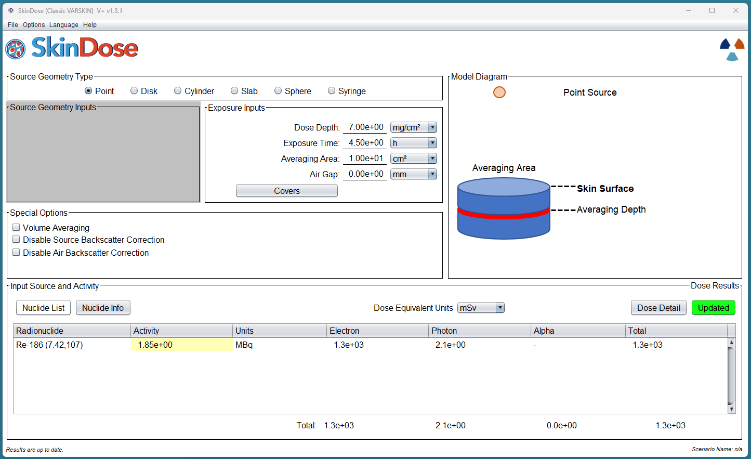
Point Source
1300 mSv (Electron Dose)
2.1 mSv (Photon Dose)
Notes:
For the Re-186 entry in the Radionuclide table at the bottom of the window, select the source strength units of MBq, then enter an activity value of 1.85. Click the red “Calculate” button. After the calculation is performed, the red Calculate button changes to green and indicates “Updated” to inform the user that the results (appearing in the lower third of the SkinDose window) are in fact applicable to the inputs shown.
The results table shows dose equivalent for electrons, photons, and alpha as well as the total equivalent dose for all nuclides and for all radiation types. Examination of the SkinDose results table shows that the total effective dose is 1,300 mSv (1,300 mSv from electrons and 2.1 mSv from photons), a total dose that exceeds regulatory limits.

Slide 12
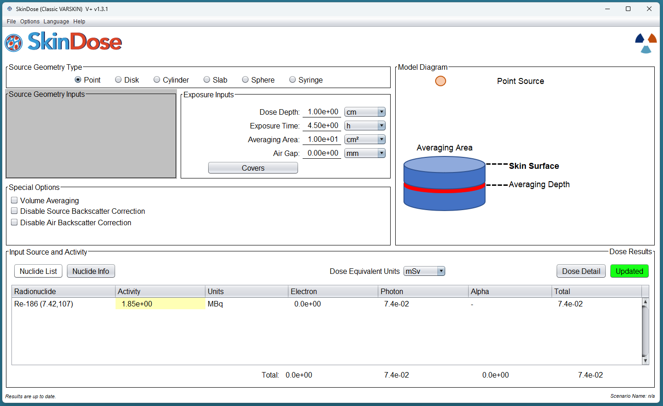
Depth Profile
Notes:
That exposure scenario is obviously very conservative, but also unusable since it is above regulatory limits. Varskin allows you to change parameters so that the dose calculated will more closely resemble the actual exposure scenario. In what ways will the exposure parameters affect the resulting dose. Lets look first at the depth dose.
To calculate the dose at a 1 cm depth, for example, go back to the top of the SkinDose window and change the value of “Dose Depth” to 1,000 milligrams per square centimeter (mg/cm²), and click “Calculate.” The SkinDose results table now displays an electron dose equivalent of 0 (zero) and a photon dose equivalent of 0.074 mSv.
We can see that the resulting dose changed a lot, but is this representative of the exposure scenario?

Slide 13
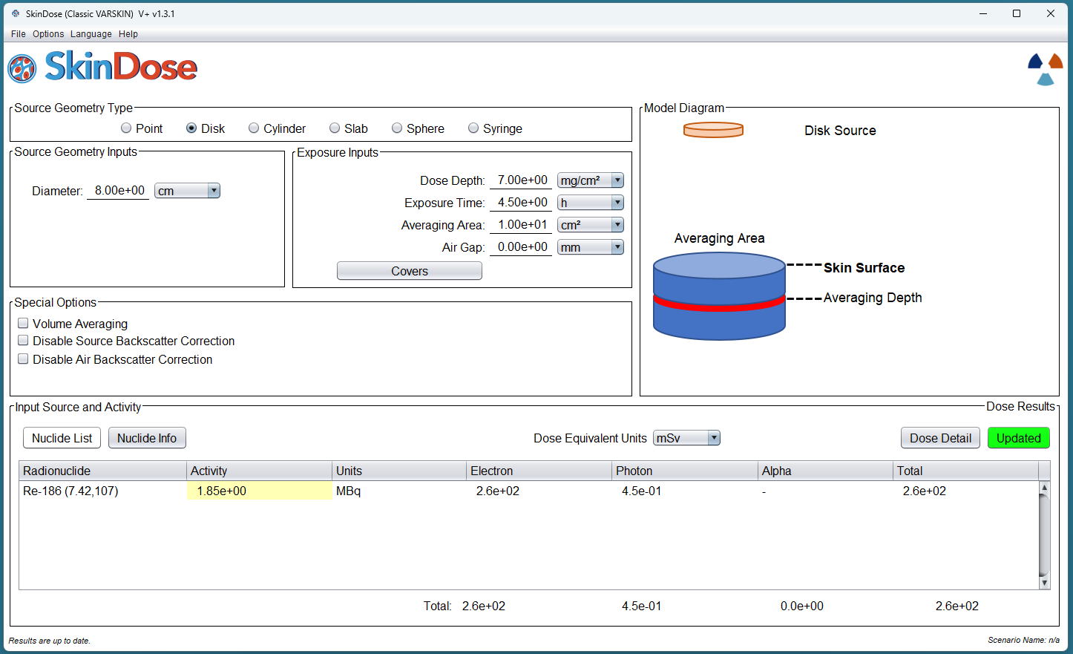
Disk Source
260 mSv
0.45 mSv
Notes:
The total shallow dose calculated using the point geometry was above regulatory limits. However, the situation described in this example will obviously be more accurately modeled using the disk or cylinder geometries. A more realistic, yet conservative approach would be to use the disk geometry and calculate the dose as if all of the contamination were directly on the skin. Return your attention to the top of the SkinDose window and choose the “Disk” radio button in the Source Geometry Type frame. Enter a source Diameter of 8 cm (resulting in a source area of 50 cm²), enter a Dose Depth value of 7 mg/cm², and confirm the Exposure Time of 4.5 hours and an Averaging Area of 10 cm². Select the red “Calculate” button. The Calculate button turns to green and the results table shows an electron dose of 260 mSv and a photon dose of 0.45 mSv.

Slide 14
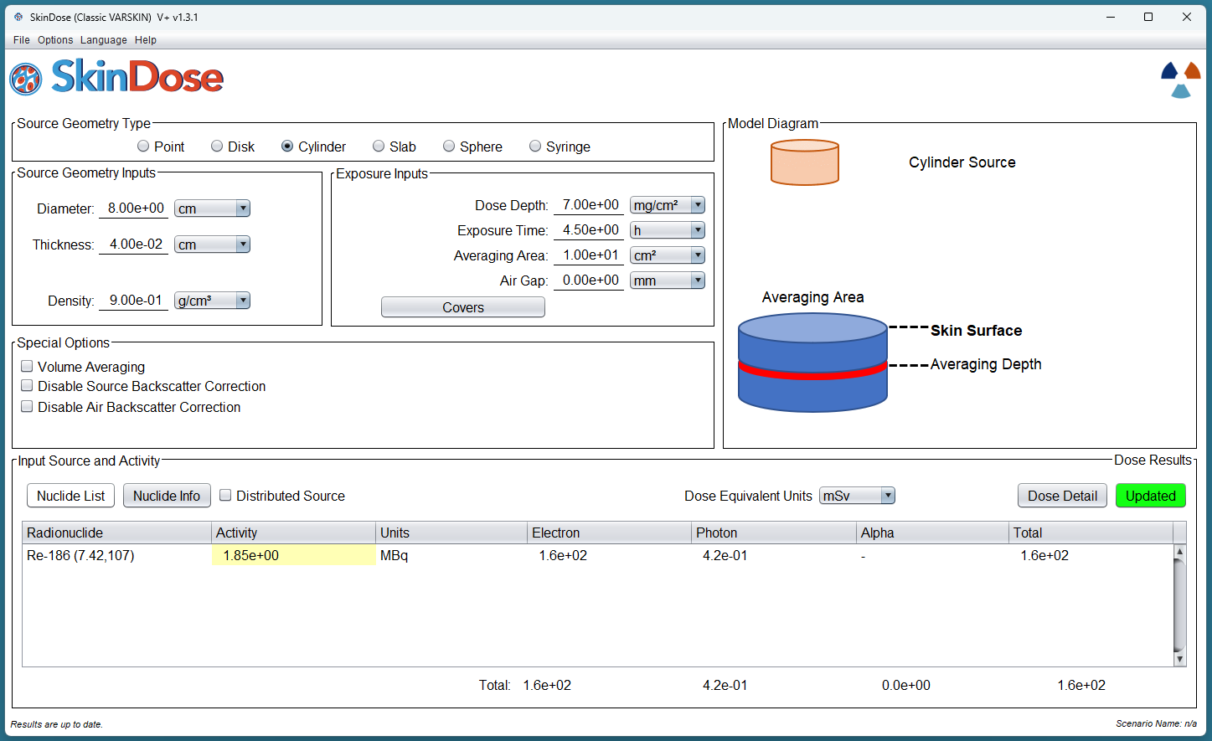
Cylinder Source
160 mSv
0.42 mSv
Notes:
Using the cylinder model to simulate contamination that is uniformly distributed throughout the thickness of the lab coat introduces even more realism. In this case, the lab coat is assumed to soak up the contamination instead of acting as a protective cover material. In Table 2-2 of the main report, the data for a cloth lab coat indicates a thickness of 0.04 centimeters (cm) and a density of 0.9 g/cm³. Select “Cylinder” in the Source Geometry Type frame. Confirm the source Diameter is 8 cm, enter a Thickness of 0.04 cm and a Density of 0.9 g/cm³ (confirm the use of the appropriate units). Confirm the Dose Depth is 7 mg/cm³, the Exposure Time is 4.5 hours, and the Averaging Area is 10 cm². Do not use the Covers function in this example. Click the red “Calculate” button; the SkinDose results will display 160 mSv and 0.42 mSv as the electron and photon dose equivalent, respectively.

Slide 15
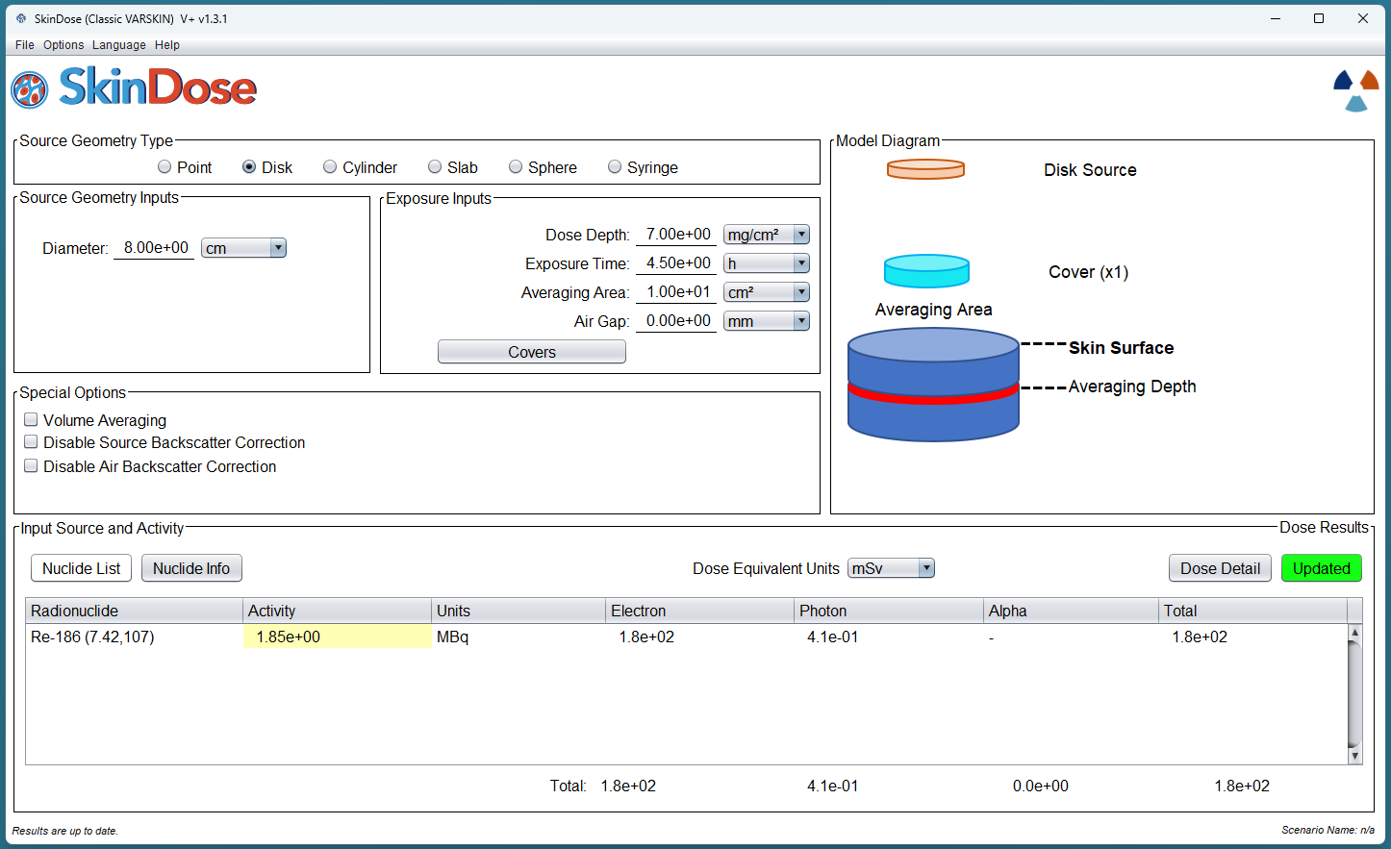
Plastic Lab Coat
Notes:
It is interesting to see what the electron dose would be if the lab coat were impervious to the liquid contamination, and the contamination resided as an infinitely thin layer of contamination on the plastic coat. In this case, the plastic lab coat acts as a cover material instead of defining the size and density of the source. To perform this calculation, return to the top of the SkinDose window and select Disk as the Source Geometry Type. Confirm that the source Diameter is 8 cm, the Dose Depth is 7 mg/cm², the Exposure Time of 4.5 hours, and the dose-averaging Area is 10 cm². Select the “Covers” button to enter a cover Density of 0.36 g/cm³ and a cover Thickness of 0.02 cm. Select the “Apply” button to accept the cover parameters and return to the SkinDose window. You will notice in the Model Diagram frame that a single cover has been added to the picture. Select “Calculate” and the SkinDose results table will display doses of 180 mSv for electrons and 0.41 mSv for photons. It can be concluded from the above calculations, that a thicker, absorbent lab coat will give more protection against electron dose than a thin, impervious material; photon dose is essentially unchanged.

Slide 16
Comparison
SkinDose Configuration | Electron Dose (mSv) | Photon Dose (mSv) | Total Dose (mSv)
Point on skin | 1300 | 2.1 | 1302
Disk on Skin | 270 | 0.45 | 270
Cylinder in Cloth | 160 | 0.42 | 160
Notes:
Put in the other comparisons

Slide 17
Use of Covers

Slide 18
Hot Particle on Gloved Hand
A worker damages his outer glove while working inside containment during an outage at a nuclear reactor. His outer glove is removed, leaving only a surgeon’s glove. The worker proceeds to the step-off pad, which takes about 15 minutes. During the exit survey, contamination is detected on the surgeon’s glove, and the glove is removed and taken to the laboratory for analysis. The laboratory report concludes that the contamination is a stellite hot particle with the following characteristics:
• radioactive contaminant: Co-60
• source strength: 92.5 MBq
• particle thickness and density: 50 μm; 8.3 g/cm3
• particle size: 80 microns x 70 microns
• stellite assumed atomic number (cobalt-chromium alloy): 25.5
• glove thickness: 0.03 cm
• glove density: 0.6 g/cm3

Slide 19
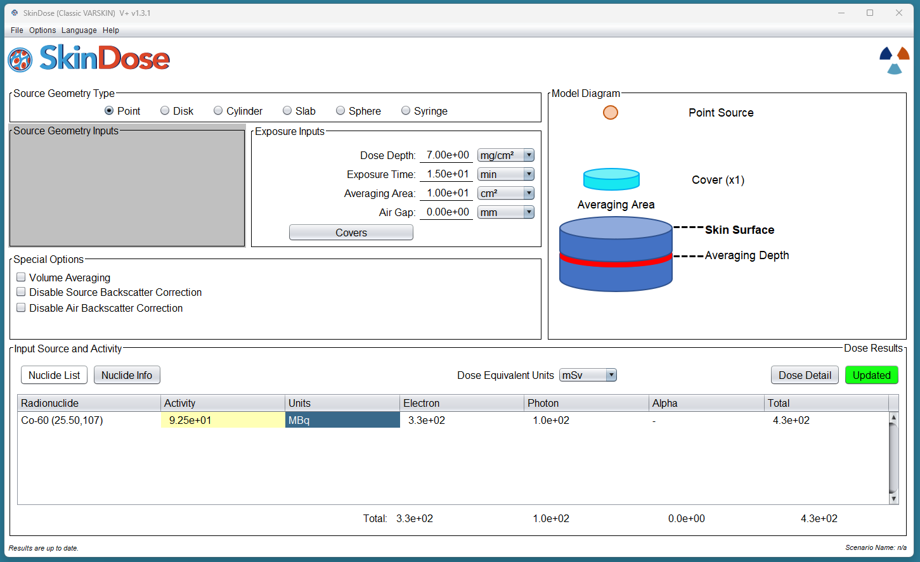
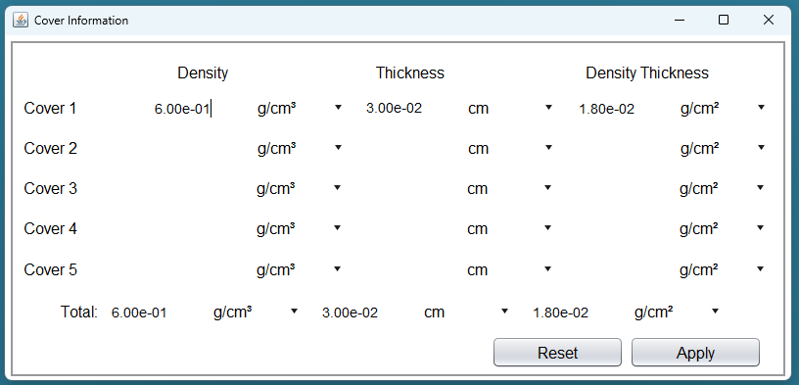
Notes:
The first step is to use the point source geometry to estimate the magnitude of the dose and to collect some other useful information. Start SkinDose or select “Reset Window” from its file dropdown menu. Select the “Nuclide List” button. If Co‑60 does not appear in the ”Available in Database” frame, enter an Effective Z of 25.5, selecting the ICRP 107 radio button and double-click “Co-60” in the radionuclide listing. Once loaded, go the SkinDose main window. For a Point source, confirm a Dose Depth of 7 mg/cm², enter an Exposure Time of 15 minutes, and confirm an Averaging Area of 10 cm². Enter 92.5 MBq for Co-60. Select “Covers” and enter a Density of 0.6 g/cm³ and a Thickness of 0.03 cm; press “Apply”. After you click “Calculate” the SkinDose results table will display an electron dose equivalent of 330 mSv, a photon dose of 100 mSv, and a total dose of 430 mSv, a value approaching the regulatory limit. Thus, a more realistic calculation is desirable. In addition, because there is a photon component to the dose, a dose calculation at 1 cm may be desired.

Slide 20
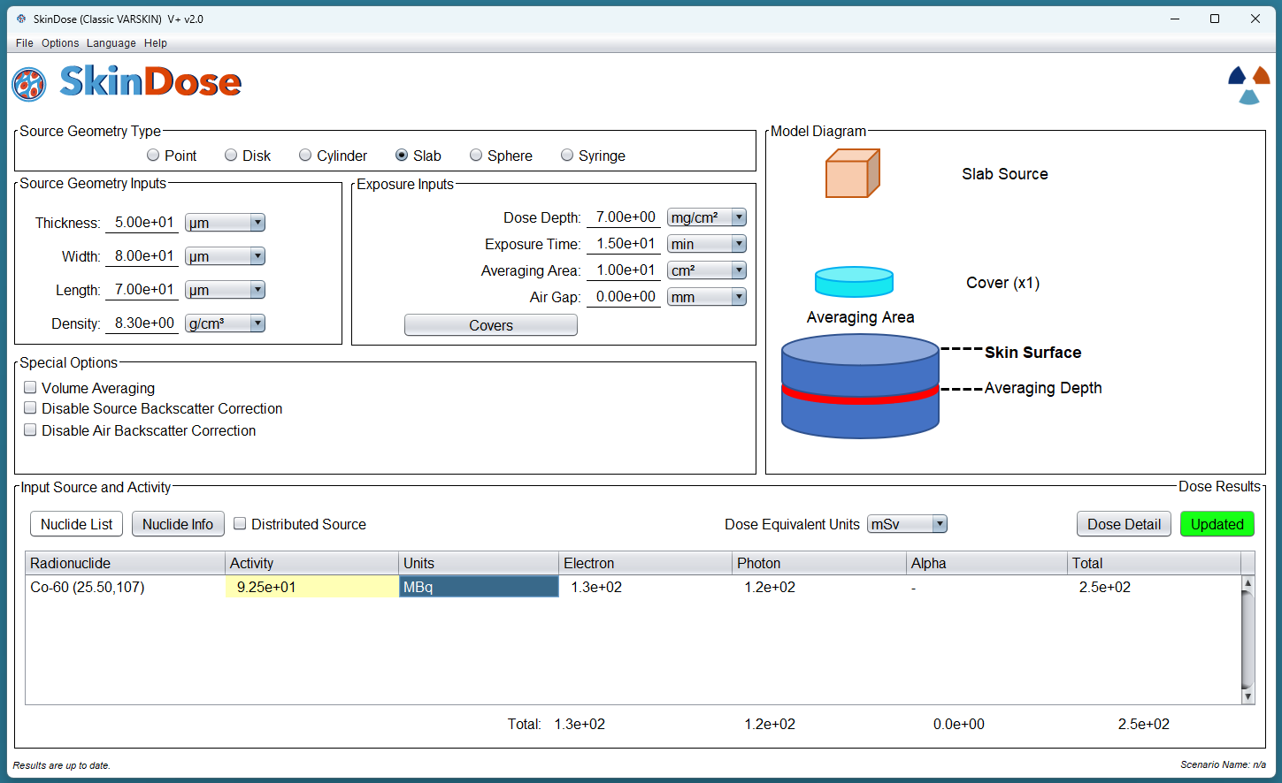
Notes:
Using the cylinder or slab model will result in a more realistic calculation because the effects of self-shielding of the electron particles will be considered. As described previously, the slab and cylinder models can be used for a particle that is known to be rectangular. Return to the top of the SkinDose window and choose the slab as the Source Geometry Type and enter the parameters of the slab source. We know this to be 50 micrometers thick, and 80 by 70 microns with a density of 8.3g/cc.

Slide 21
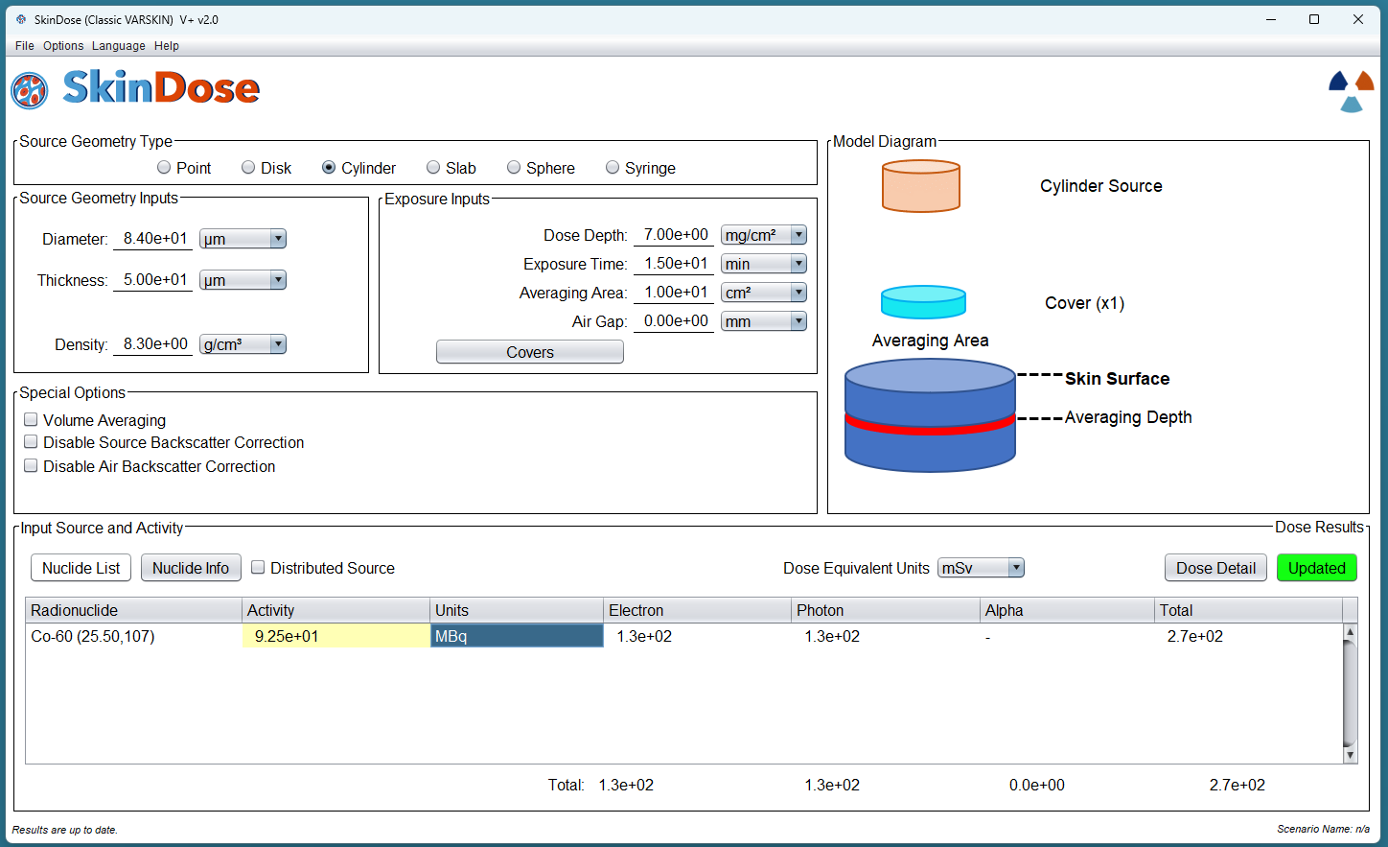
Notes:
To view what the shallow skin dose is when using a slab source, Return to the top of the SkinDose window and choose the cylinder as the Source Geometry Type. The diameter of a disk source, with the same area as the rectangular source, is found by:
$$d=2\sqrt{{X∙Y}/π}=2\sqrt{{80 μm∙70 μm}/π}=84 μm$$
Enter 84 μm for the source Diameter, 50 μm for the source Thickness, and 8.3 g/cm³ for the Source Density. Confirm a 7 mg/cm² Dose Depth, a 15-minute Exposure Time, and an Averaging Area of 10 cm². Select “Covers” and confirm 0.6 g/cm³ as the Density and 0.03 cm as the Thickness. Click “Calculate”. The SkinDose results table displays an electron dose of 120 mSv, a photon dose of 130 mSv, and a total dose of 260 mSv (the total dose appears to be greater than the sum, but this is because of rounding). Including the effects of self-shielding greatly reduced the electron dose and resulted in a dose that is now below regulatory limits.

Slide 22
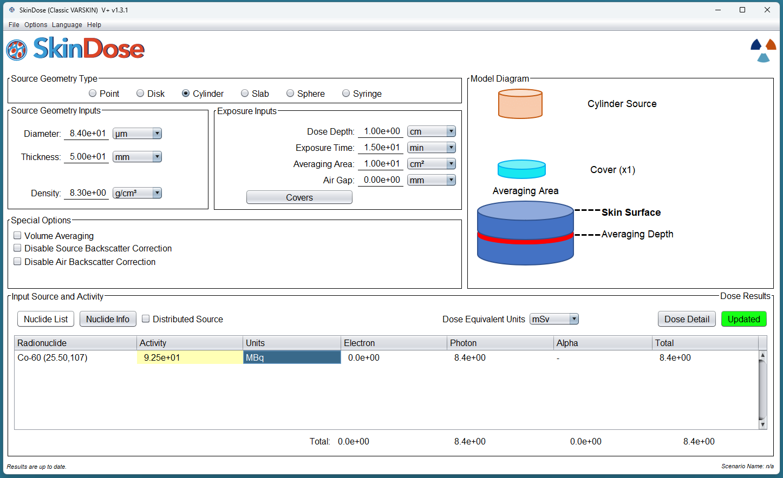
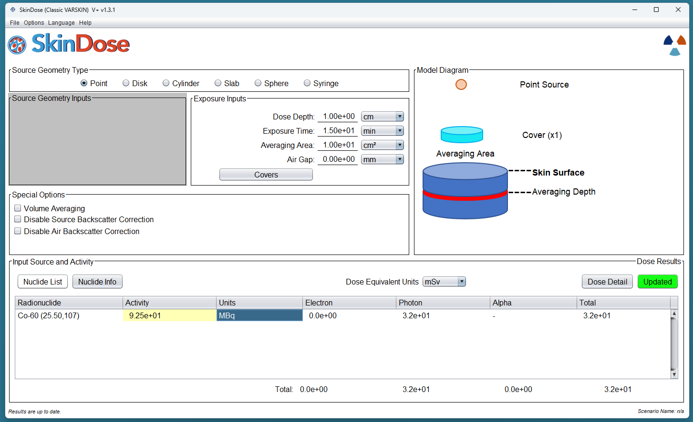
Notes:
To investigate the dosimetric influence of tissue depth, calculate dose at 1 cm by returning to the top of the window, and changing the Dose Depth to 1,000 mg/cm². Click “Calculate”. The SkinDose results table displays a dose at 1 cm of 32 mSv, all from photons if the source is a point, and 8.4 mSv if the source is a cylinder.

Slide 23
Summary
Shallow Dose (7 mg/cm²)
 | Electron (mSv) | Photon (mSv) | Total (mSv)
Point | 330 | 100 | 430
Slab | 130 | 120 | 250
Cylinder | 130 | 130 | 270
Deep Dose (1 cm)
Point | 0 | 32 | 32
Cylinder | 0 | 8.4 | 8.4

Slide 24
Air Gap

Slide 25
Contaminated Metal in a University Laboratory Hood
During a radiation survey of a fume hood, a new radiation safety officer (RSO) at a university discovers a contaminated aluminum plate inside the hood. Further investigation found that the plate was used to hold beakers of solution containing carbon (C)-14 for use in radiobiology experiments. The RSO decides that the plate should be disposed of as low-level radioactive waste and that the activity of C-14 on the plate must be determined. The plate is 15.24 centimeters (cm) by 15.24 cm and is uniformly contaminated over the entire surface. The RSO uses a calibrated circular detector with an area of 50 cm2 and a window thickness of 3 mg/cm2 to measure a dose rate of 1.90 mGy/hr on contact and 0.60 mGy/hr at a distance of 2.54 cm. The RSO uses these dose-rate measurements and SkinDose results to estimate the activity of C-14 on the plate
Notes:
The solution to this example demonstrates a method in which SkinDose might be used for applications other than skin contamination events; users are cautioned not to rely too heavily on such calculations. For this solution, first select “Reset Window” and choose the “Disk” geometry. Select the “Nuclide List” button and add C-14 with an effective Z of 7.42 from the ICRP 107 database. Set the Dose Depth to 3 mg/cm² to correspond to the thickness of the probe window, the Averaging Area to 50 cm² to correspond to the area of the probe, and the source Diameter to 17.2 cm to correspond to the area of the contaminated plate (232 cm²). Dose rate per hour is of interest, so set the exposure Time to 1 hour. An initial source strength of 1 MBq/cm² will be assumed (232 MBq) for the calculation, and the results then scaled to the measurements taken by the RSO; enter an Activity of 232 and set the Units to MBq. Click “Calculate”; the SkinDose results table displays an electron dose of 1,200 mSv in one hour, with no photon or alpha dose. The activity concentration on the plate then can be found using,
$$\frac{\left[A_{act}\right]}{\left[A_{cal}\right]}=\frac{{\dot{D}}_{meas}}{{\dot{D}}_{cal}}$$
Therefore, the activity concentration on the plate is given by:
$$\frac{\left(1{MBq}/{{cm}^{2}}\right)\left(1.90{mGy}/{hr}\right)}{1,200 {mGy}/{hr}}=0.0016 {MBq}/{{cm}^{2}}$$
Multiplying the activity concentration by the area of the plate (232 cm²) results in a total activity of 0.37 MBq. The measurement at a distance of 2.54 cm can be used to verify this result. Return to the top center of the SkinDose window, enter an Air Gap of 2.54 cm (note the Model Diagram frame), and change the activity to 0.37 MBq. Click “Calculate” and the SkinDose results table displays an electron dose of 0.62 mSv in one hour, compared to the measurement of 0.60 mGy/hr with the calibrated detector.

Slide 26
Example 4
Consider a 100 kBq ⁶⁰Co point source skin contaminant separated from the skin by a variable air gap. The source serves as a contaminant for 15 minutes. Fill out the table below, wherein you calculate the effect of an air gap on shallow skin dose from a point source. Use a 0.01 cm² skin dose averaging area to show how interactions in the air gap influence the dose at 7 mg/cm².

Slide 27
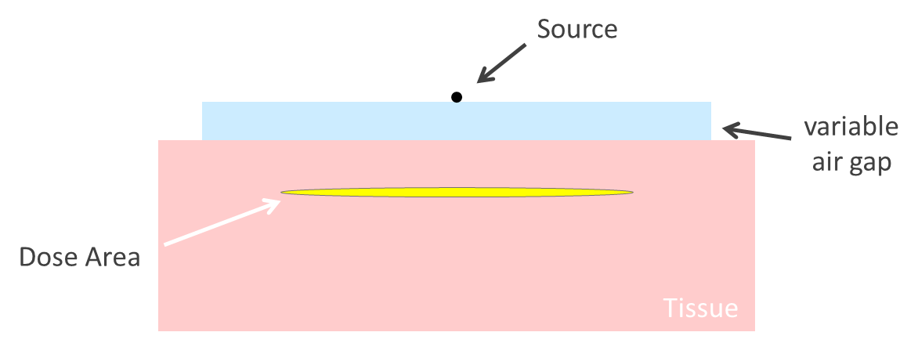
Notes:
Schematic diagram of a point source separated from the surface of skin due to an air gap. (The dose area in this figure is shown much larger than the 0.01 cm² area used for this example.)

Slide 28
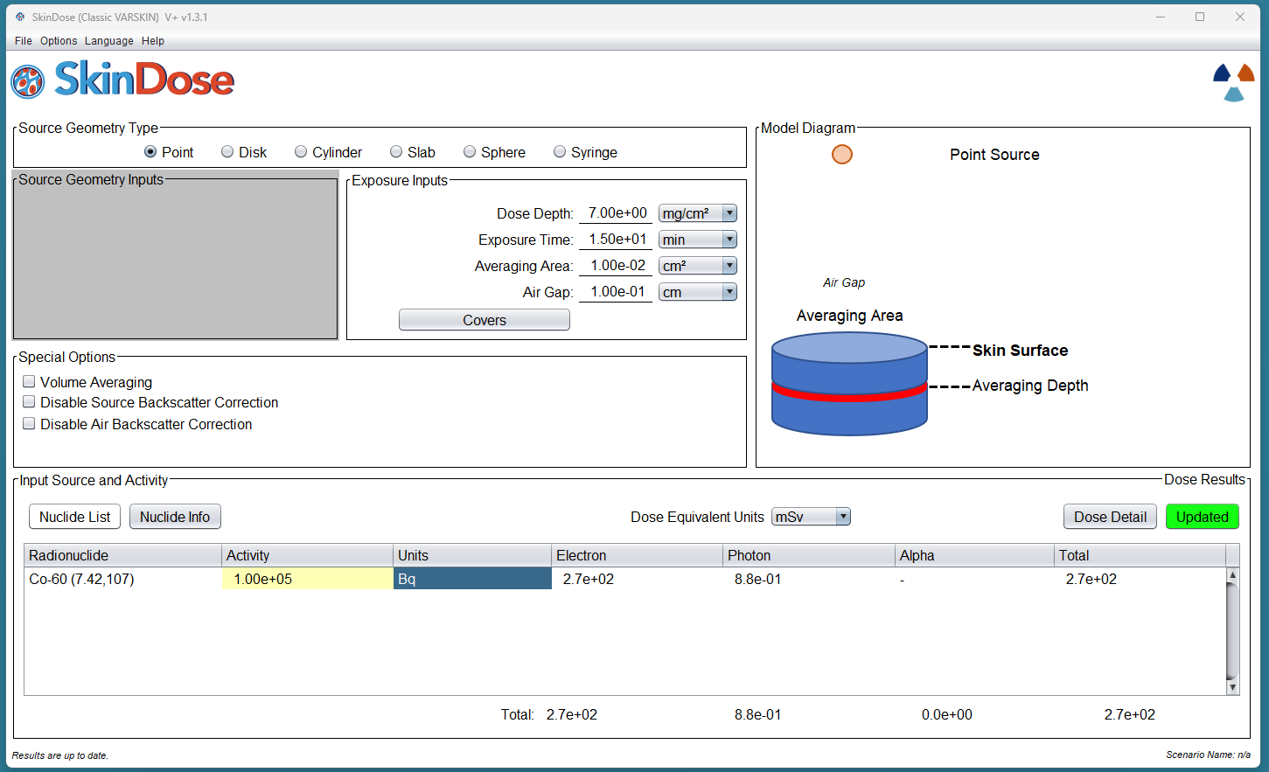

Slide 29
Airgap (cm) | Electron Dose (mGy) | Photon Dose(mGy)
0.1 | 270 | 0.88
0.2 | 80 | 0.26
0.5 | 14 | 0.045
0.7 | 6.9 | 0.023
1 | 3.4 | 0.011
2 | 0.8 | 0.0029
5 | 0.11 | 0.00046
7 | 0.05 | 0.00023
10 | 0.019 | 0.00012
Notes:
Calculate electron and photon dose for each air gap in the table. The values were chosen to support a large range of VARSKIN’s air gap modeling boundaries.
Create a logarithmic plot comparing the air gap length to both electron and photon doses. Is there any part of this plot that could be considered not as expected? What may cause these deviations?

Slide 30
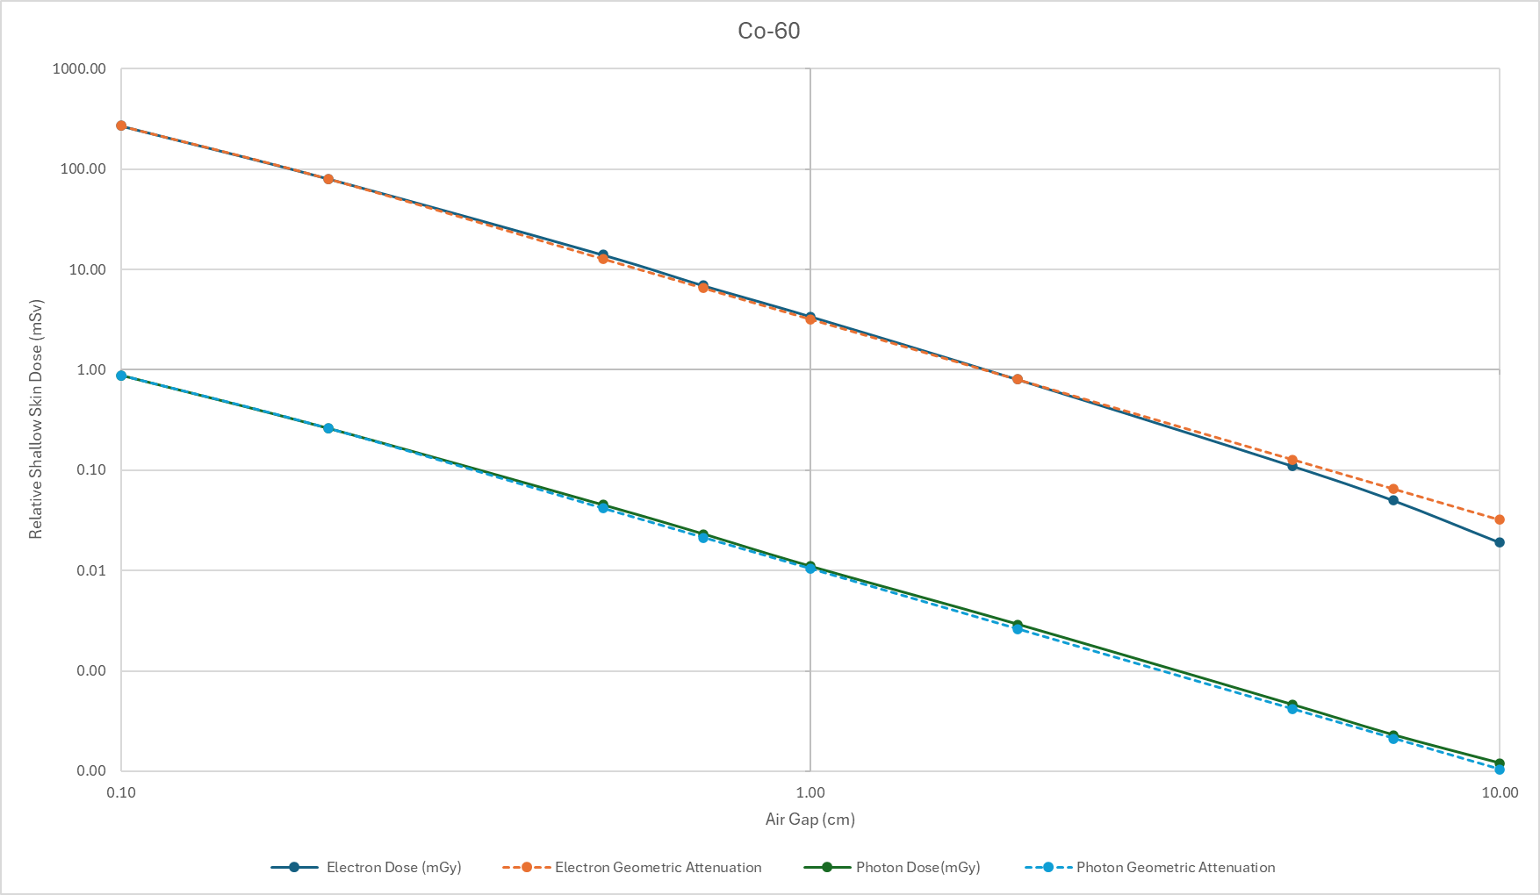
Notes:
If we plot electron and photon dose for the scenario above, we see a similar reduction in dose for the most part, but with a bit of deviation at distances greater than about 5 cm. Photon dose estimates seem to follow the inverse square law, but at larger air gaps, the electron dose decreases faster than expected by inverse square alone. These loses are likely due to significant energy degradation of the electrons at the larger distances. Recall that Co-60 has an average electron energy of 0.5 MeV and photon emissions at 1.17 and 1.33 MeV.
Knowing this can help to see the limits of the VARSKIN code.
What would the plot look like if it were decreasing at 1/cm2? What is the inverse quire law showing the degradation of? Geometric attenuation .. But there is a bit of energy degradation with electrons as well.

Slide 31
Progeny Correction

Slide 32
When the user elects to include decay progeny (using the “D” databases) in the dose calculation, the code’s calculations are more involved, particularly for electron dose. This being the case, dose calculations for parent/progeny electrons may be different from the same dose calculated by summing individual nuclides.

Slide 33
Strontium - 90
Using a basic exposure scenario, we can calculate dose from electrons and photons for 90Sr and 90Y separately, then calculate dose from 90Sr with its progeny intrinsically included (using the D option). Sum the data from the separate nuclides and calculate the difference between this sum and the daughter-included 90Sr dose.

Slide 34
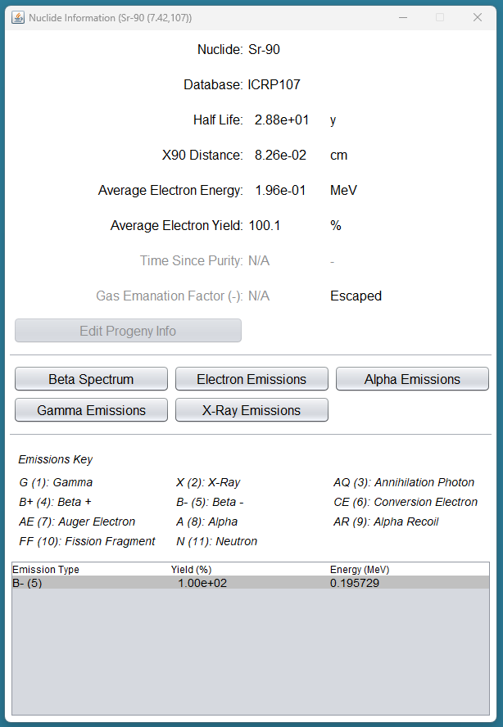
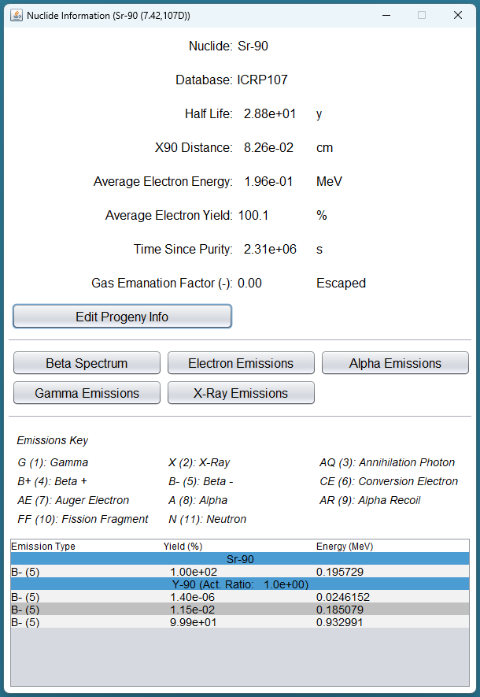
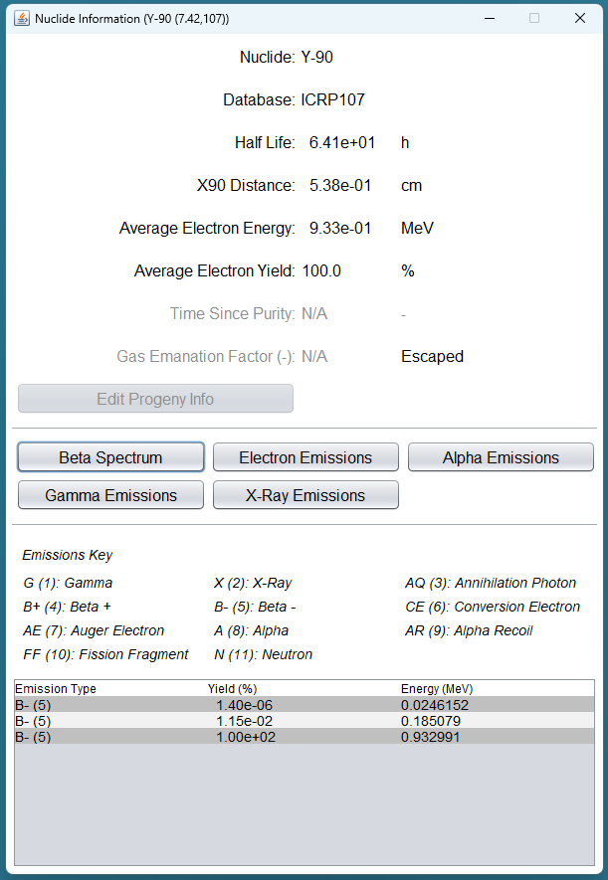
Notes:
Lets first look at the Nuclide info on each of the nuclides. We can see that no progeny has but one beta with a yield of 100%, while looking at the yield information of the 107D database we have the branching ratio of both the parent and the nuclide. There are 3 betas, but the first two are of little consequence; their yields are so llow (0.0000014% and 0.00115%)

Slide 35
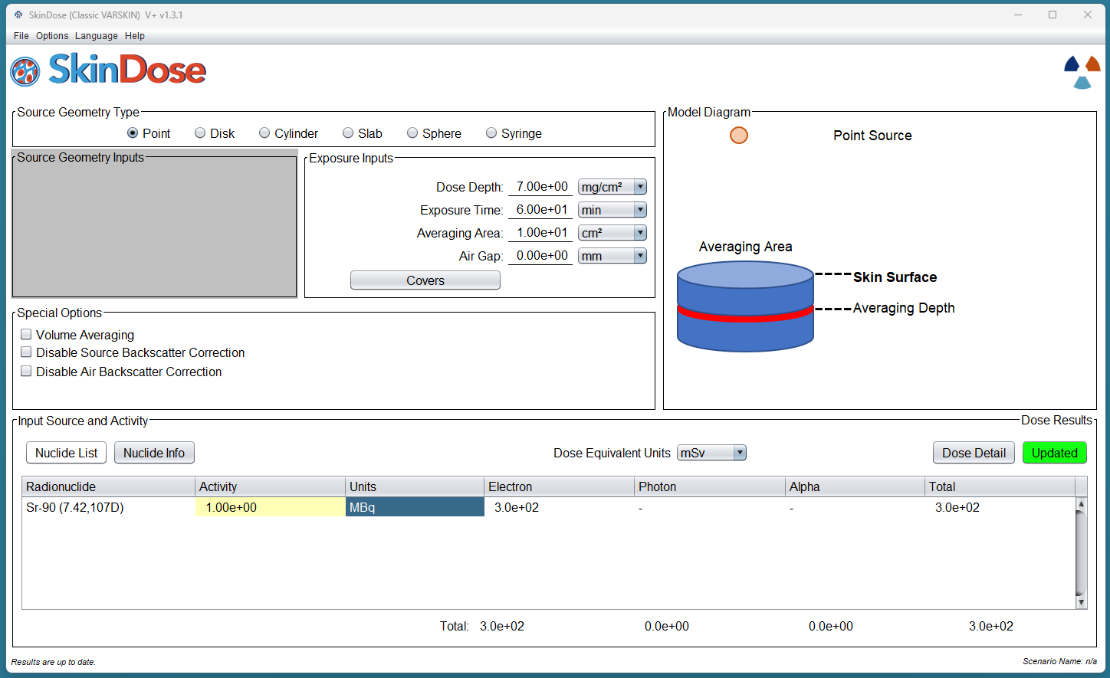
Notes:
Exposure values for 107D

Slide 36
Nuclide Selection | Branching Ratio | Electron Dose | Photon Dose
Sr-90 |  | 140 | -
Y-90 | 1.000 | 160 | -
SUM |  | 300 | -
Notes:
In a table

Slide 37
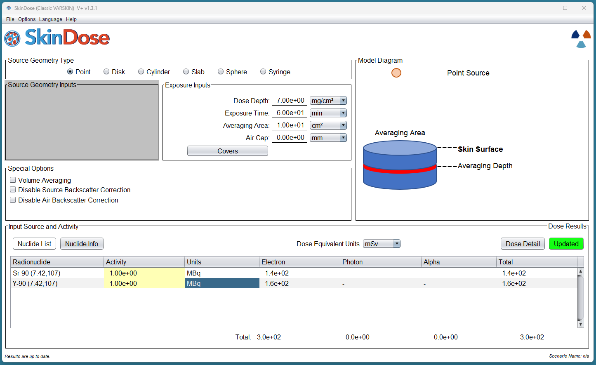
Notes:
Individual nuclides 107 database.

Slide 38
Nuclide Selection | Branching Ratio | Electron Dose | Photon Dose
Sr-90 |  | 140 | -
Y-90 | 1.000 | 160 | -
SUM |  | 300 | -
Sr-90D* |  | 300 | -
Difference |  | 0% | -
Notes:
For such a simple and straight forward example, the difference is 0% between calculations.

Slide 39
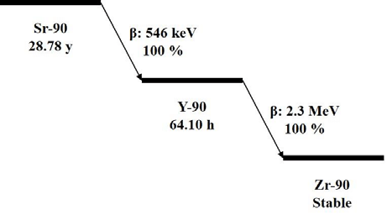
Notes:
Sr 90 is unique in its decay chain in that both it and its daughter has a 100% yield for the beta particle. That particle is also has 100% probability of being a pure beta emitter; so there is no sharing of beta energy with a photon in the decay (ground state 100%)
Lets look at something that has a bit of a different branching ratio.

Slide 40
Examine ⁹⁹Mo, with daughters ^{99m}Tc, and ⁹⁹Tc, and compare with the combined ⁹⁹Mo with its progeny. What do we need to consider when observing between individual and progeny calculations within VARSKIN? How is this different from the previous example with Sr-90 and Y-90?
Notes:
Use mo 99 and tc 99m

Slide 41
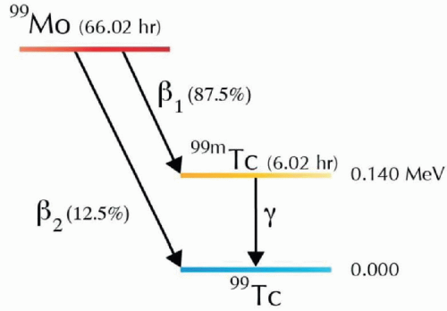
Notes:
Now consider branching ratio

Slide 42
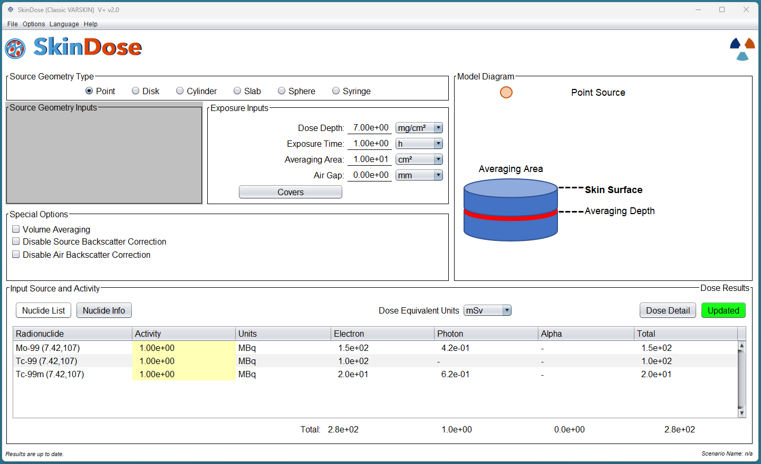
Notes:
Just a plain sum

Slide 43
Nuclide Selection | Electron Dose | Photon Dose | Branching Ratio | Electron Dose | Photon Dose
Mo-99 | 150 | 0.42 | n/a | 150 | 0.42
Tc-99 | 100 | - | 0.125 | 12.5 | -
Tc-99m | 20 | 0.62 | 0.875 | 17.5 | 0.54
SUM | (270)* | (1.04)* |  | 180 | 0.96

Slide 45
Nuclide Selection | Electron Dose | Photon Dose | Branching Ratio | Electron Dose | Photon Dose
Mo-99 | 150 | 0.42 | n/a | 150 | 0.42
Tc-99 | 100 | - | 0.125 | 12.5 | -
Tc-99m | 20 | 0.62 | 0.875 | 17.5 | 0.54
SUM | (270)* | (1.04)* |  | 180 | 0.96
Mo-99D |  |  |  | 170 | 1
Difference |  |  |  | 5.6% | 4%
Notes:
Notice that if we did not use the branching ratio, the sum would be 270 for beta and 1.04 for photon!

Slide 46
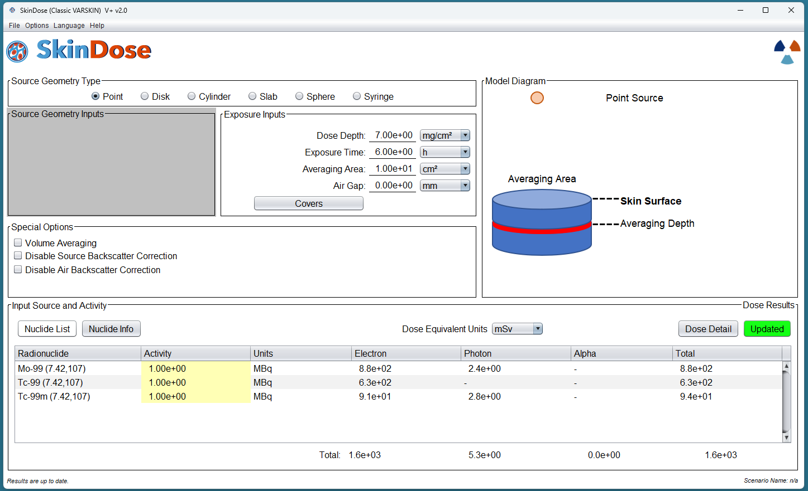
Notes:
Lets look at this if we use a 6 hour exposure time. The answer should be the distributed similarly, right?

Slide 47
Nuclide Selection | Electron Dose | Photon Dose | Branching Ratio | Electron Dose | Photon Dose
Mo-99 | 880 | 2.4 | n/a | 880 | 2.4
Tc-99 | 630 | - | 0.125 | 79 | -
Tc-99m | 91 | 2.8 | 0.875 | 80 | 2.45
SUM |  |  |  | 1039 | 4.85

Slide 48
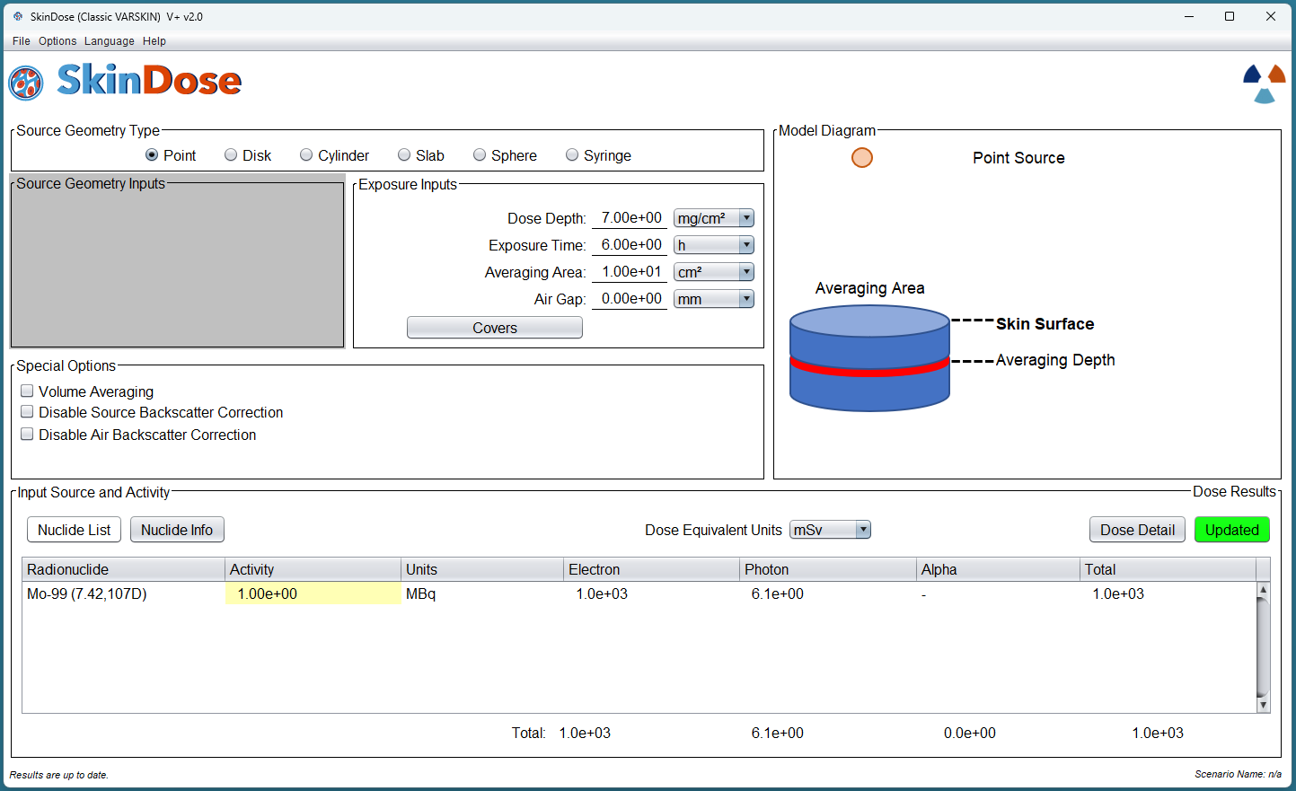

Slide 49
Nuclide Selection | Electron Dose | Photon Dose | Branching Ratio | Electron Dose | Photon Dose
Mo-99 | 880 | 2.4 | n/a | 880 | 2.4
Tc-99 | 630 | - | 0.125 | 79 | -
Tc-99m | 91 | 2.8 | 0.875 | 80 | 2.45
SUM |  |  |  | 1039 | 4.85
Mo-99D |  |  |  | 1000 | 6.1
Difference |  |  |  | 4% | 20%

Slide 50
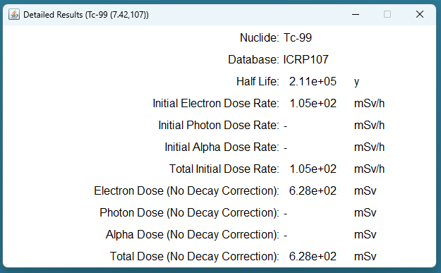
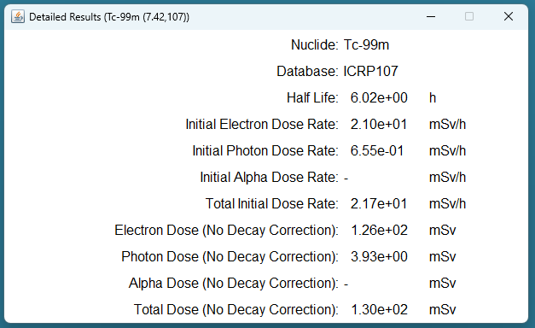
No Decay Correction?

Slide 51
Nuclide Selection | Electron Dose | Photon Dose | Branching Ratio | Electron Dose | Photon Dose
Mo-99 | 880 | 2.4 | n/a | 880 | 2.4
Tc-99 | 630 | - | 0.125 | 79 | -
Tc-99m | 126 | 3.9 | 0.875 | 110.25 | 3.41
SUM |  |  |  | 1069 | 5.81
Mo-99D |  |  |  | 1000 | 6.1
Difference |  |  |  | 4% | 5%
Notes:
No decay correction!
Looking at this why do you think the answer is more accurate when we have no decay correction vs when we have decay correction. Isnt it what we always want?

Slide 52
Decay Correction

Slide 53
Decay Correction
The VARSKIN output window provides three main radiation dose estimates:
initial dose rate;
dose (no decay); and
decay-corrected dose.
At first glance, the user may think that it is odd for a total dose to be calculated that does not consider radioactive decay. VARSKIN, however, has this feature so that decay progeny in secular equilibrium with its parent can receive full consideration in the dose calculation.

Slide 54
Initial Dose Rate
Dose (no decay)
Decay Corrected Dose

Slide 55
Secular Equilibrium
Production rate of daughter nuclide equals its decay rate
When parent nuclide has a much higher half life than the daughter (more than 2 orders of magnitude generally)
Equilibrium occurs around 10 half lives of the daughter
Notes:
At a certain point, every time a Cs atom decays to Ba, that Ba decays “immediately” within the lifespan of the Cs, so the activity is essentially the same.

Slide 56
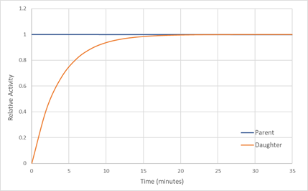
Notes:
This is a graph representing the general pattern of secular equilibrium for a daughter product whose half life is about 2 minutes.

Slide 57
One such example is ¹³⁷Cs (half-life of 30 yrs) and its progeny ^{137m}Ba (half-life of about 2.55 m). Using a 10-half-life rule of thumb, the ^{137m}Ba activity will be fully in-grown from a pure ¹³⁷Cs source within about 25 minutes, after which the activity of both parent and progeny will be equal (secular equilibrium).

Slide 58
The VARSKIN output window provides three main radiation dose estimates: (1) initial dose rate; (2) dose (no decay); and (3) decay-corrected dose. The code first estimates dose rate at the start of exposure and then calculates the other two estimates from that value based on different handlings of exposure time. The dose (no decay) is calculated as simply the product of initial dose rate and exposure time (i.e., assumes that dose rate stays constant during exposure):
$$D(t)=\dot{D}\left(0\right)∙t$$

Slide 59
decay-corrected dose is calculated by time-integrating the changing dose rate:
$$D_{dc}= \int_{0}^{T}{\dot{D}\left(t\right)}dt=\dot{D}\left(0\right)\int_{0}^{T}{e^{−λt}}dt$$

Slide 60
Calculate dose for a ¹³⁷Cs point source of 1 MBq, an exposure time of 1 hour, and a 10 cm² averaging area at a depth of 7 mg/cm².
Notes:
a) Model the scenario in VARSKIN and calculate dose using ICRP 107 parameters. Select the option (D) that will include the decay progeny. What do you observe about the initial dose rate, no-decay dose, and decay-corrected dose?
b) Calculate dose using ICRP 107 parameters where the decay products are not included. You will need to include both nuclides separately. What do you now notice about the initial dose rate, no-decay dose, and decay-corrected dose, compared to part a)? What VARSKIN input causes these differences?
c) How might the branching ratio for 137mBa (94.7%) affect dose calculations?

Slide 61
Notes:
Entering the correct equilibrium type. The half life for Ba 137m is 2.55 min, so 10 half lives is about 25 min. or just click secular equilibrium

Slide 62
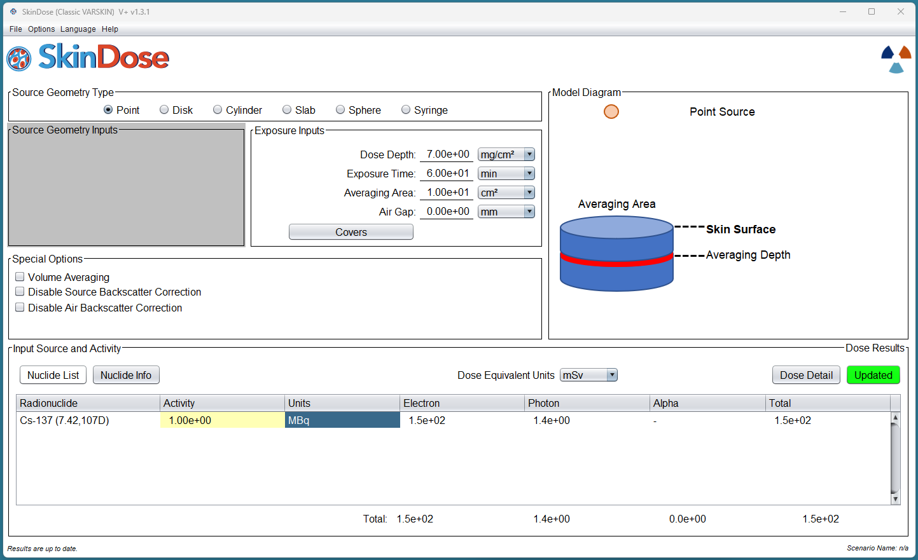
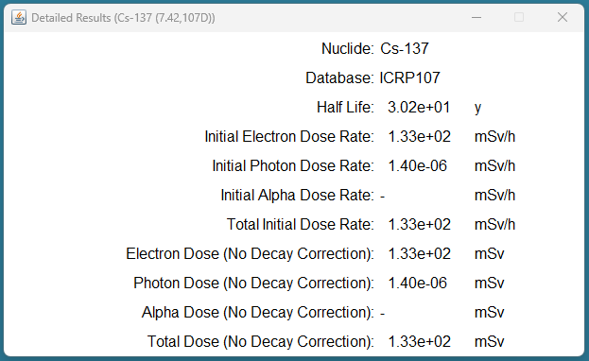
Initial Dose Rate
No Decay Correction
Notes:
a) Model the scenario in VARSKIN and calculate dose using ICRP 107 parameters. Select the option (D) that will include the decay progeny. What do you observe about the initial dose rate, no-decay dose, and decay-corrected dose?
Initial dose rate is equal to no decay corrected dose rate because the half life (30 y) is much longer than the simulation time (60 min), so no significant decay will occur. However, the initial photon dose rate is so low because Cs 137 is a pure beta emitter, so at purity, the decay rate is very low (insignificant) and only has photon dose when Ba 137 grows in. The difference in the no decay correction and decay corrected dose, in this case, is the ingrowth of Ba 137-m
If we use VARSKIN with progeny automatically selected (i.e., using the 38D or 107D database), there will be no issue with no-decay dose and its value will be equal to the decay-corrected dose. However, if the user is looking specifically at dose contribution by nuclide and selects one of the standard databases (i.e., 38 or 107), the no-decay dose values become very important.
In this example, we’re using the ICRP 107D database and selecting ¹³⁷Cs. VARSKIN will automatically include the ^{137m}Ba daughter product and we note below that the Dose (No Decay) is equal to the Decay-Corrected Dose.

Slide 63
In the next step, we run VARSKIN using the ICRP 107 database without automatic inclusion of daughter products. We, therefore, must select both ¹³⁷Cs and ^{137m}Ba from the database. For this VARSKIN execution, we assume that ¹³⁷Cs and ^{137m}Ba are in secular equilibrium (the activities are the same). We examine the output for each nuclide separately (two figures below).

Slide 64
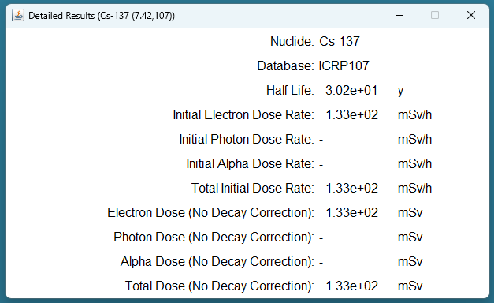
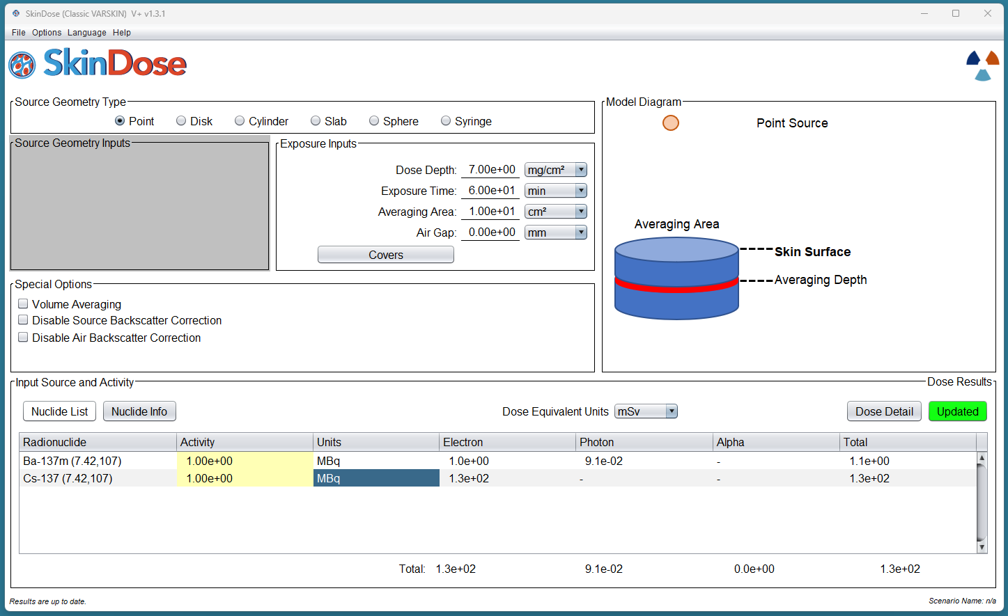
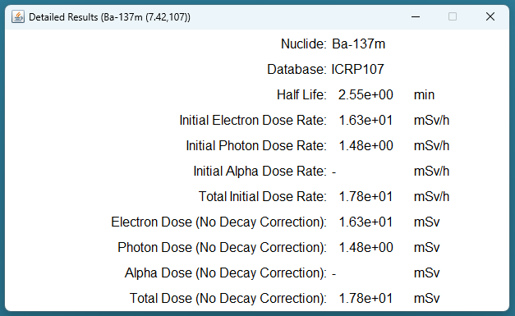
Notes:
b) Calculate dose using ICRP 107 parameters where the decay products are not included. You will need to include both nuclides separately. What do you now notice about the initial dose rate, no-decay dose, and decay-corrected dose, compared to part a)? What VARSKIN input causes these differences?
c) How might the branching ratio for 137mBa (94.7%) affect dose calculations?

Slide 65
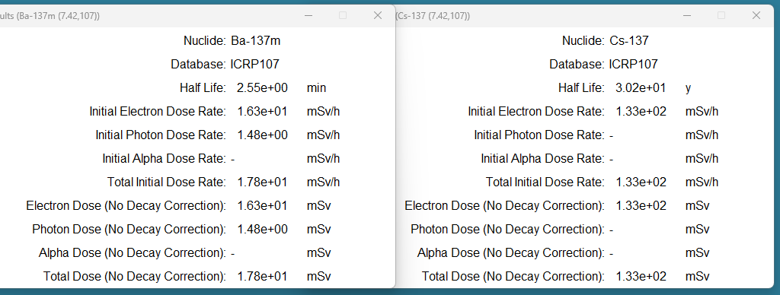

Slide 66
We observe that the dose from 137Cs is purely an electron dose (no contributing photons) and that the no-decay and decayed doses are the same; the 137Cs half-life is very long compared to a 1-hour exposure and decay over that hour is insignificant
Cs-137
 | Initial Dose Rate (mSv/h) | Dose (No Decay Correction) (mSv) | Dose (Decay Correction) (mSv)
Electron | 133 | 133 | 133
Photon | 0 | 0 | 0
Total |  | 133 | 130*
*Rounding on main SkinDose Pane
Notes:
. The second figure, however, indicates a difference of more than an order of magnitude in the no-decay versus decayed doses of 137mBa. Recall the half-life is 2.5 minutes and over the course of an hour, decay is very significant, i.e., the activity is gone in about 25 minutes.

Slide 67
The second detailed dose, however, indicates a difference of more than an order of magnitude in the no-decay versus decayed doses of ^{137m}Ba. Recall the half-life is 2.5 minutes and over the course of an hour, decay is very significant, i.e., the activity is gone in about 25 minutes.
Ba-137m
 | Initial Dose Rate (mSv/h) | Dose (No Decay Correction) (mSv) | Dose (Decay Correction) (mSv)
Electron | 16.3 | 16.3 | 1
Photon | 1.48 | 1.48 | 0.091
Total |  | 17.8 | 1.1

Slide 68
When selecting a nuclide and calculating its dose as we’ve done for ^{137m}Ba in the second example, VARSKIN assumes that the nuclide activity is equal to the input value (1 MBq in this case) at the beginning of the exposure time. Since ¹³⁷Cs constantly replenishes ^{137m}Ba, and the activity remains essentially constant throughout the 1-hour exposure, we want to report the dose value for ^{137m}Ba assuming no decay of that nuclide. Choosing the decay-corrected dose implies that ^{137m}Ba irradiates the skin without replenishment from the decaying ¹³⁷Cs.
Notes:
The trainee should consider the appropriate branching ratio for nuclides. Consider making an example of something with a branching ration that has significance in the digits. This one is 94% so the answers round to the same thing.

Slide 69
If we sum the “No Decay Correction” Ba-137m dose to the Cs-137 dose, we get a more similar value to the Cs-137 (107D) dose:
 | Cs-137 Dose Rate (mSv/h) | Ba-137m Dose Rate (mSv/h) | Cs-137 Dose Rate (107D) (mSv)
Electron | 133 | 16.3 | 150
Photon | 0 | 1.48 | 1.4
Total |  | 17.8 | 150
Differences are in rounding

