Slide 1
VARSKIN+ 2.0
Charlotte Rose
Research Scientist
Corvallis OR
charlotte.rose@rcdsoftware.com

Slide 2
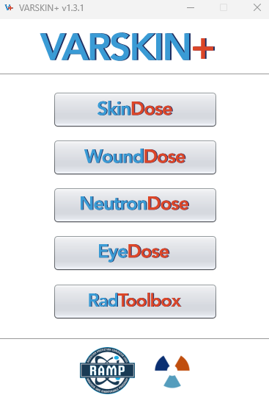
OUTLINE
SkinDose
WoundDose
NeutronDose
EyeDose
RadToolbox

Slide 3
SkinDose
Designed to calculate dose to skin from skin contamination or sources close to the skin surface
Dose equivalent from photon, electron and alpha sources
Applications range from laboratory, medical, therapeutic and industrial contaminations
Flexibility with averaging areas and airgaps
Regulatory utility with shallow dose equivalent, but also versatile enough to estimate doses for up to 2 cm skin depth

Slide 4
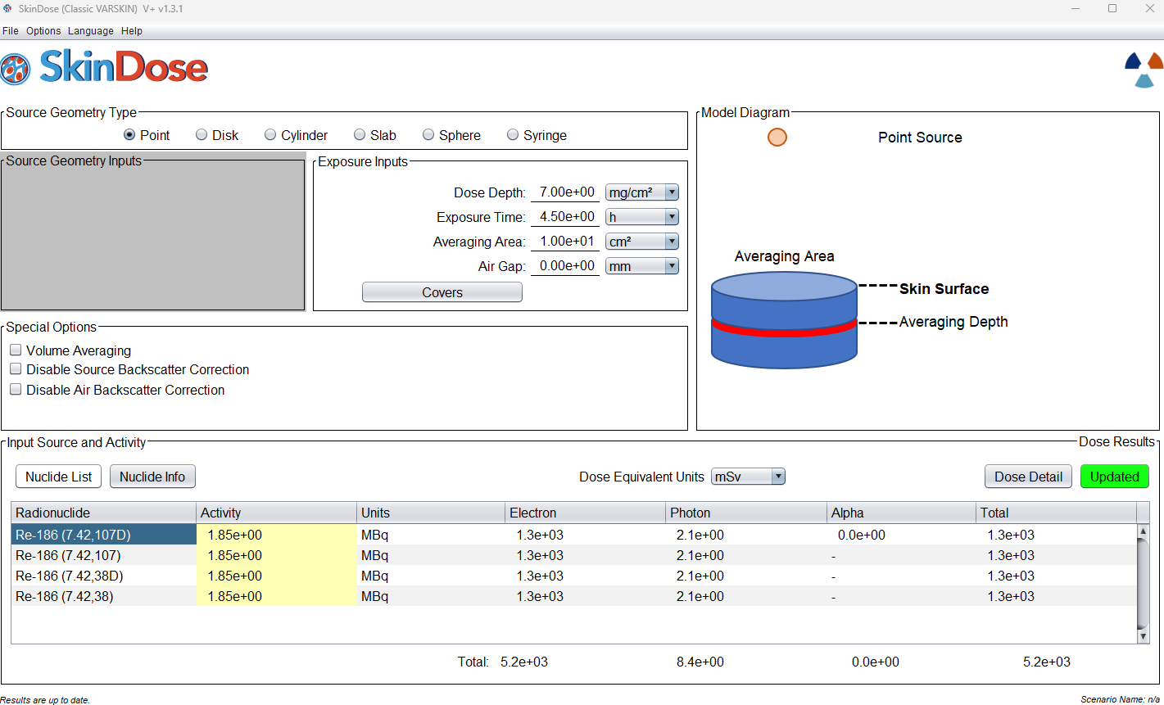
SkinDose

Slide 5
WoundDose
Many of the same features and functions of SkinDose but with added functionality to streamline with NCRP Report 156 (2007)
Primary focus is shallow dose equivalent, local dose equivalent and committed effective dose equivalent from subdermal introduction of radioactivity following skin injury.
Geometries of puncture material are selectable as well as material and radionuclide combinations
Notes:
How is this similar and different than SkinDose? Calculations..
Outline mechanisms of injury and why it is different than skin contamination. How is dose calculated differently for 7mg/cc dose depth (ie where exposure comes from below and above, and scatter etc.. Do a little bit of the physics)
Use example where ED module could overlap to demonstrate utility and potential (?) advantage for future… something for them to look forward to. Also showcase how this is different from wounds.

Slide 6
NeutronDose
Estimation of shallow tissue dose at specified depth following exposure to a source of neutrons with energies ranging from thermal to fast.
The user can select the neutron source, from spontaneous or induced fission, alpha-neutron and photon-neutron reactions, or monoenergetic sources.
The user can select a shield for dose output that is shielded and unshielded.
Notes:
For this training do a little bit of review of neutron dose; charged particle equilibrium, capture vs scatter, radiation weighting factors (?) … so some physics.
When would we worry about a neutron exposure? Is it independent of photon exposure? Should I also show how you would use this to add value to a dose in skin module … ??

Slide 7
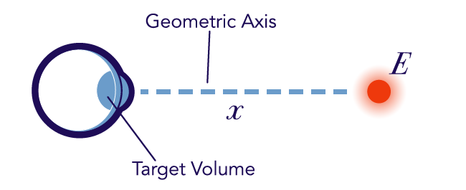
EyeDose
Evaluates photon and electron dose to the lens of the eye.
Chose from a list of nuclides in ICRP 38, ICRP 107 (no progeny) or monoenergetic source.
Shielding is available as standard safety glasses containing 2 mm leaded glass.

Slide 8
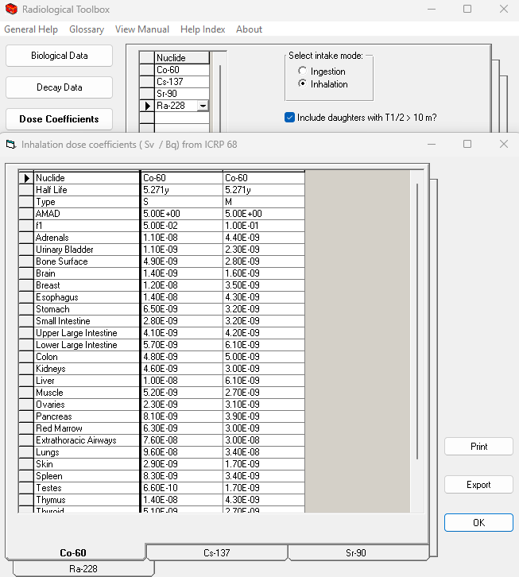
RadToolbox
Repository of physical, biological and radiological data of interest in radiation protection.
View and extract a variety of data to assess radiological conditions
Includes biological data, nuclear decay data, dose and risk coefficients, dose calculations and other material data to be displayed for user calculations or exported to excel for further analysis

Slide 9
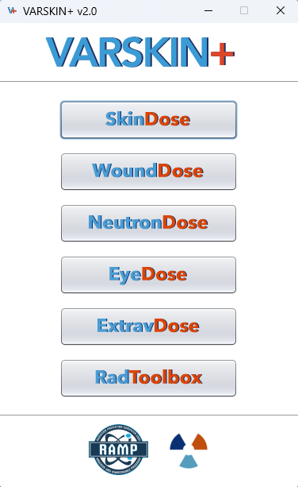
Extravasation
new module now available in VARSKIN+

Slide 10
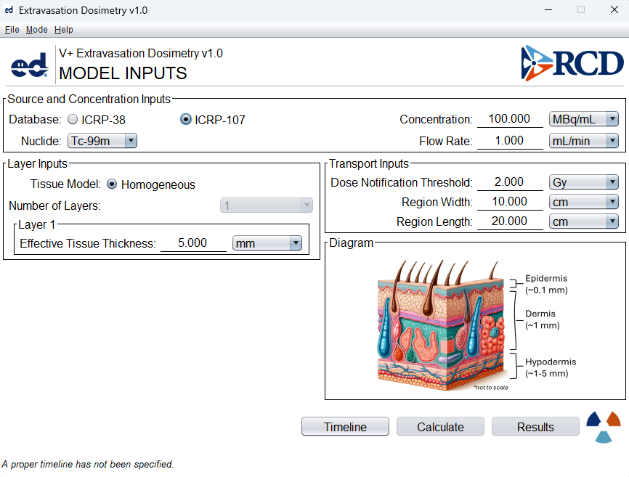
User specifies
Radionuclide
Radiopharmaceutical activity concentration
Extravasation flow rate
Tissue dimensions
Notes:
Main input screen
Hypodermis = subcutaneous: adipose tissue (fat), and areolar connective tissue, blood vessels, nerves
The connective tissue can act as a barrier so that the nuclide is somewhat trapped locally and can contribute to a dose. Extravasation dose calculates the dose as a result of the extravasation wish some factors that include elevation and compression, which can assist the body in absorbing the bolus, and thus reducing the time of exposure. Since treatment can be very different depending on patient factors and local procedures, there are many options to include this variability in exposure time.

Slide 11
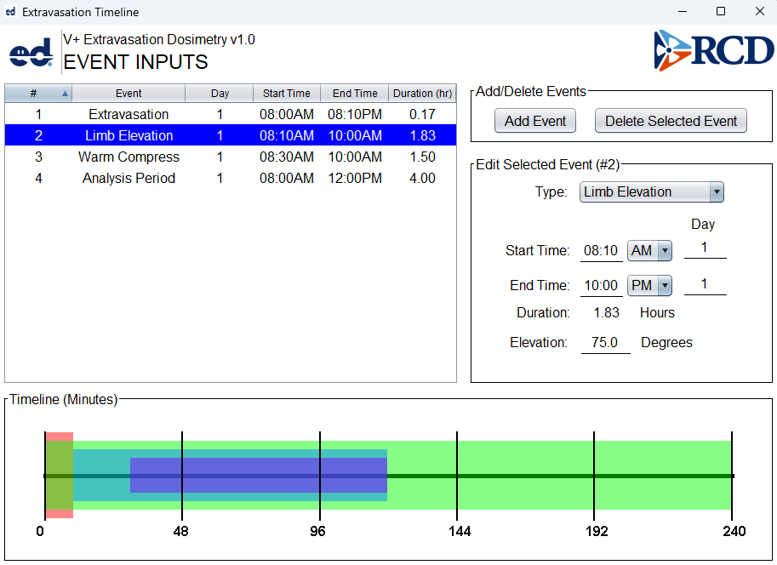
Timeline input screen
User enters times for
Extravasation of radiopharmaceutical during administration
Warm compress (optional)
Limb elevation (optional)
Analysis duration
Notes:
The red bar indicates the time of the extravasation, light blue indicates time of limb elevation, dark blue indicates time of compression and green (lime) indicates time of analysis. For those that are colorblind, and who may not see the colors, there is a slight elevation representing the extravasation event that you can see here: and the analysis extends through the entire timeline.

Slide 12
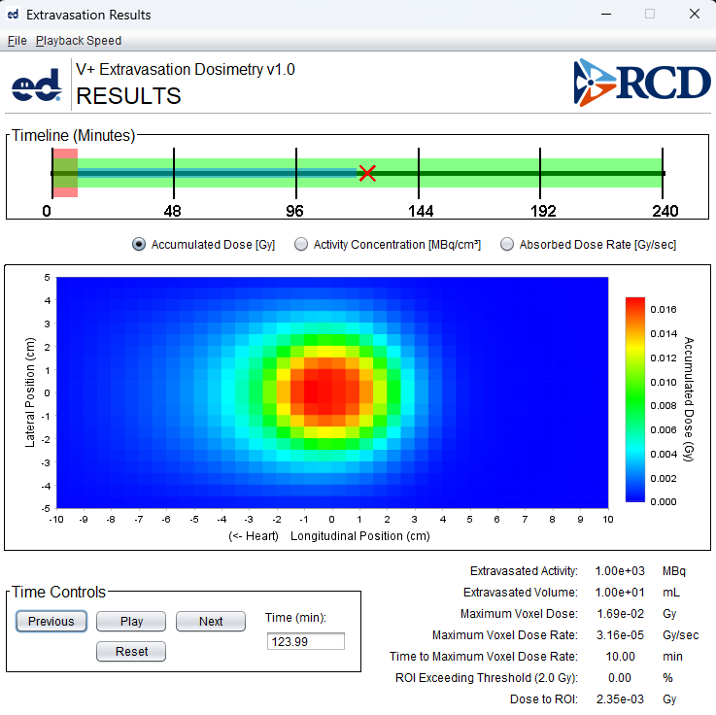
Results screen
Radioactivity in tissue modeled over time
3D results for
Accumulated dose to local tissue
Activity concentration in tissue
Absorbed dose rate
Viewer shows results over time
New module is available today
Training planned later in 2025 includes Fall RAMP User Group meeting
Notes:
Once the results have been calculated (this is not a quick process, so be patient ☺ there are a lot of calculations happening in the application!) you can adjust the playback speed to see the progression of the analysis!

Slide 13
VARSKIN+ 2.0
Charlotte Rose
Research Scientist
Corvallis OR
charlotte.rose@rcdsoftware.com

Slide 14
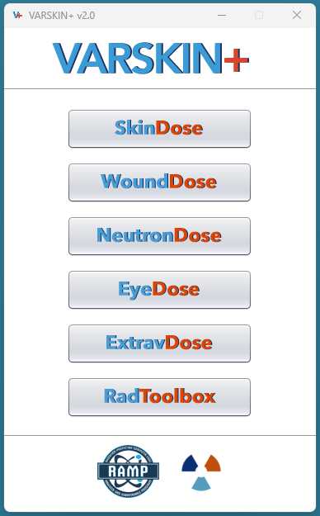
OUTLINE
Main interface
SkinDose GUI

Slide 15
Opening Screen
The first screen you see when you initialize VARSKIN+
Selecting SkinDose will allow the module to appear

Slide 16
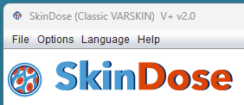
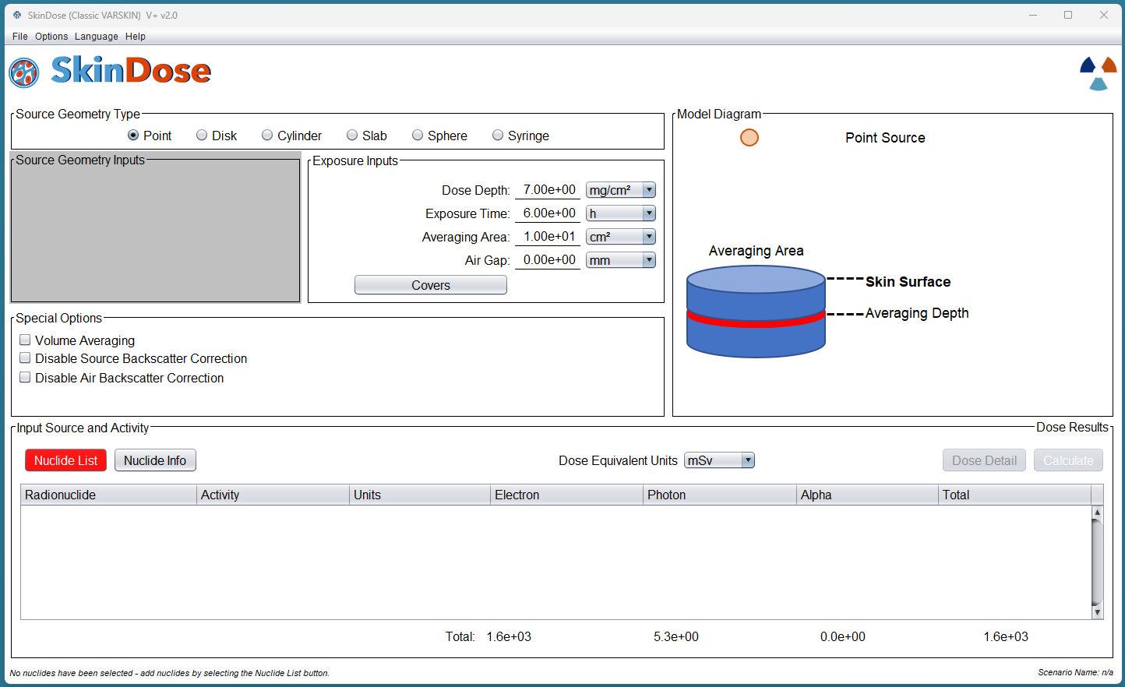
Main Interface
Where the user defines the scenario with data entry fields in the input window
We can start by familiarizing ourselves with the four main menu items.

Slide 17
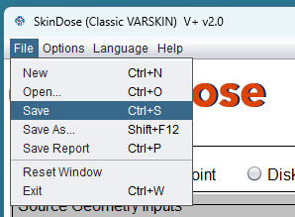
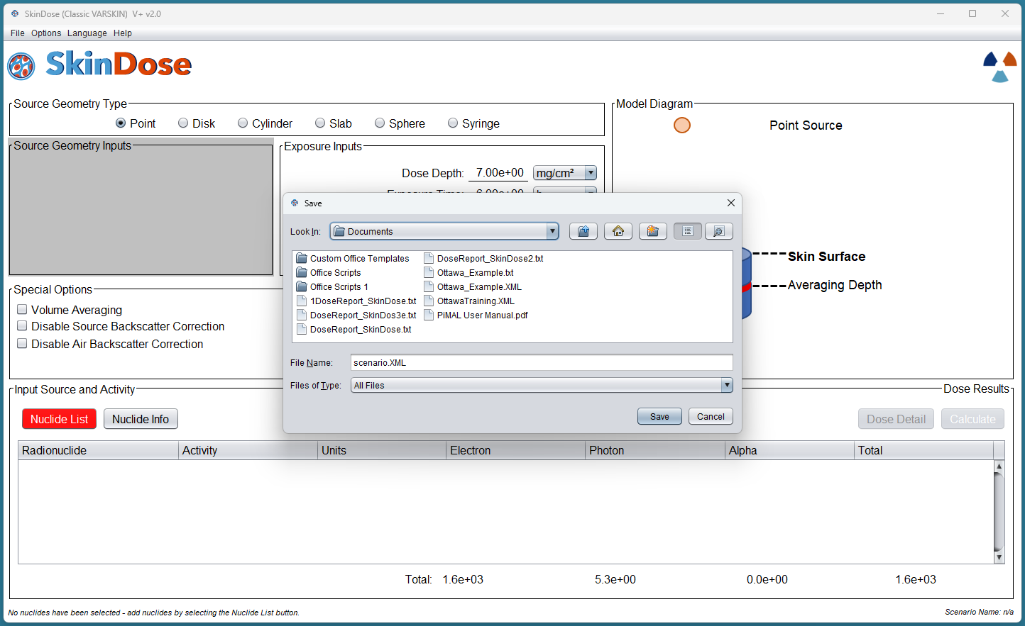
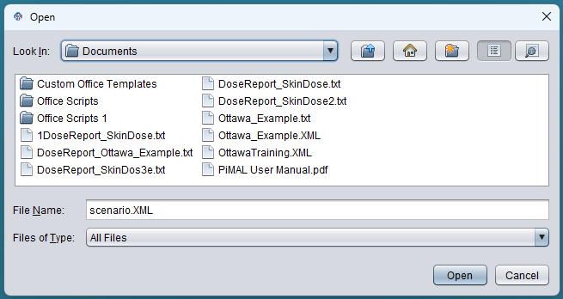
File Menu
Save (As…) allows you to pick up all window parameters in a future SkinDose session
File format is xml – and can be opened again in SkinDose using the “Open…” item in the file dropdown menu
Save Report generates a text summary of parameters and outputs
Reset Window restores to all default values, including language and removes radionuclide list
Exit will cleanly end the session with the VARSKIN+ application still running
Notes:
Save and save as can be useful for error reporting or when evaluating an ongoing dose assessment or investigation
Using reset can be a valuable tool if you are experiencing a freeze of the software or a crash, or some unknown behaviour.

Slide 18
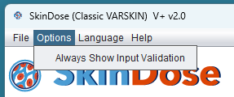
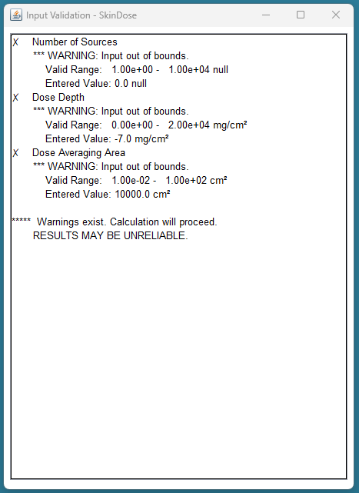
Input Validation
In the menu bar, select
OPTIONS
Select
Always Show Input Validation
An additional screen appears with potential errors or warnings
This provides the user with valuable feedback if parameters are out of range, invalid or unusual.

Slide 19
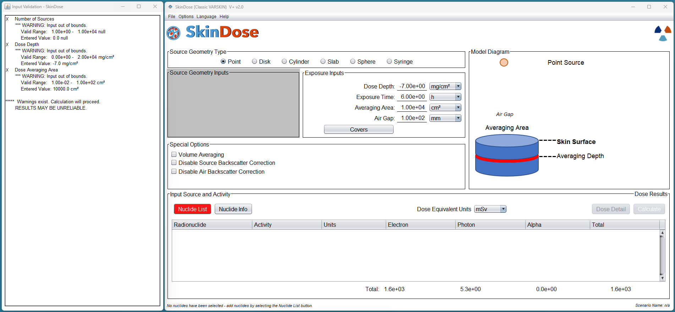

Slide 20
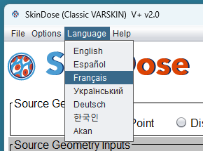
Language Selection
There are currently 5 language options available in the GUI
Selecting a language changes menu items immediately
Option does not carry through for other sessions or modules
Saving a report is generated in English only.

Slide 21
Help – About
Version information
Contract number
Contact information for error reporting and other questions, directing to both:
RAMP website
RCD website

Slide 22
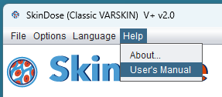
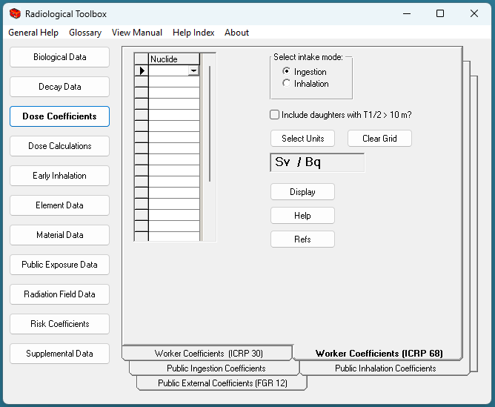
Help – User Manual
Fast access to the user manual
Current version of software
V 2.0 includes user instructions and an appendix with examples and solutions for selected modules.
Note – the user manual for RadToolbox is separate from the current user manual, and can be accessed in the RadToolbox module about menu

Slide 23
Notes:
There is also access to the user guide, technical documents and release notes for the current version of VARSKIN+ available on the RAMP website. User guides and appendices including examples and solutions, technical documents include sensitivity analyses and a list of publications either supporting the methodology incorporated in VARSKIN or research that have used VARSKIN in their analysis. Releasee notes dating back to version 5.3 are also listed.

Slide 24
SkinDose GUI

Slide 25
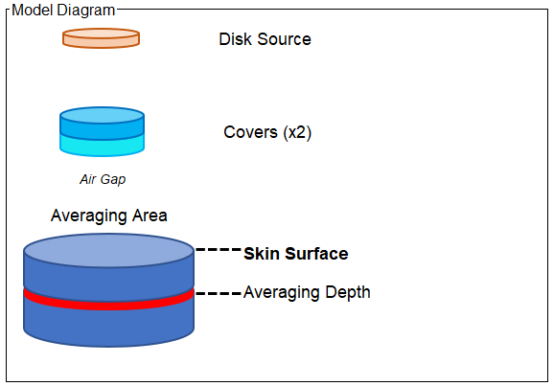
Model Diagram
For all model inputs, a model diagram is immediately updated
This allows the user to see, in real time, what parameters are implemented
A good way to verify your selections are correctly managed.
Notes:
We can see in this image, that we have added an air gap, 2 covers and a disk source. These parameters are seen to be in reference with the skin surface and the averaging depth. For each parameter change, there is the resultant model diagram change. However, there is no change in the diagram if you change the *value* of the air gap, the cover(s) (only the number of covers), the averaging are or the averaging depth. Note that this is not to scale; and does not reflect the thicknesses or other dimensions that are input, just that they have been input to the model.

Slide 26
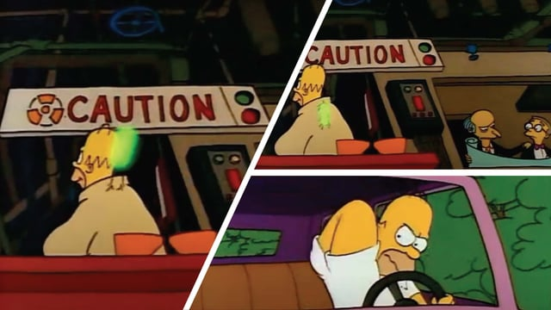
Source Geometry Type
Notes:
Each source geometry type is reflective of a scenario. Disk sources can be used to simulate a spill on a lab coat, for example. Cylinders are reflective of a more dimensional source, like in the introduction to the simpsons, although that would be a fairly large cylinder source! A slab source could be used to demonstrate a foil that has been activated in a research reactor. A sphere source could be a more accurate representation of a larger hot particle, and a syringe source could be used in the instance of a forgotten source in a pocket.

Slide 27
Source Geometry Inputs
For all source geometries except the point source, which is dimensionless we must input the parameters of the shape
For all source geometries except point source and disk source, the user will also input the density of the source. This will account for differences among liquids and solids, for example and is important for self-shielding in the dose calculation
Each geometry will allow the user to edit the relevant dimension.

Slide 28
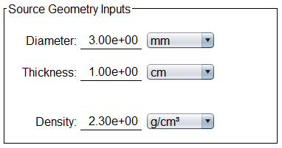
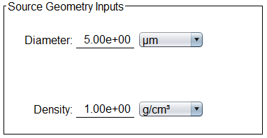
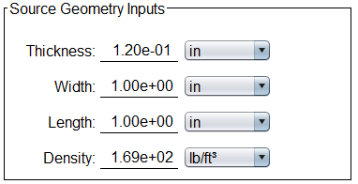
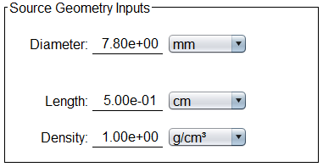
Notes:
Clockwise from top left:
Cylinder source with 3 mm diameter and 1 cm thickness/height and a density of 2.3 g/cc
Hot particle with AMAD 5 micrometres
Slab source is aluminum foild activated, with density of 169 lb/ft3
And a 0.5 mm syringe source with

Slide 29
Syringe Source
Syringes come in varying sizes and shapes, but common volumes generally range from 0.5 mL through 50 mL
Parameters for each volume will be different and some common shapes are in the following table
Dimensions for input are for the *source*, so ensure the length parameter is reflecting liquid volume length, adjusted from maximum barrel length
Syringe Volume | Example Inner Diameter | Example Barrel Length
0.5 mL (cc) | 3.6 mm (0.14 in) | 50 mm (2 in)
1.0 mL (cc) | 3.9 mm (or 0.5 in) | 85 mm (3.35 in)
10 mL (cc) | 38 mm (0. 74 in) | 90 mm (3.55 in)
50 mL (cc) | 64 mm (2.5 in) | 155 mm (6.10 in)

Slide 30
Exposure Inputs
Dose Depth
Exposure Time
Averaging Area
Air Gap
Covers

Slide 31
Dose Depths of Regulatory Importance in the US (USNRC)
Shallow Dose Equivalent applies to the external exposure of the skin at a tissue depth of 0.007 cm (7mg/cm² ) averaged over an area of one square centimeter.
Deep Dose Equivalent applies to external whole-body exposure at a disuse depth of 1 cm (1,000 mg/cm²)
Density of skin is approximated at 1 g/cm²
Density thickness and depth can be solved for mathematically.

Slide 32
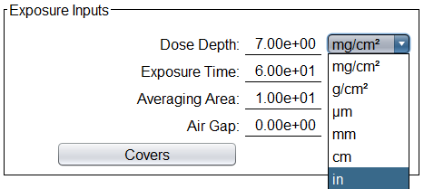
Dose Depth
Selecting units of depth:
mg/cm²
g/cm²
μm
mm
cm
in

Slide 33
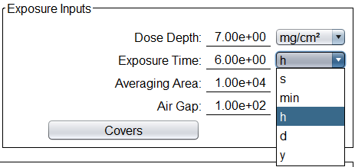
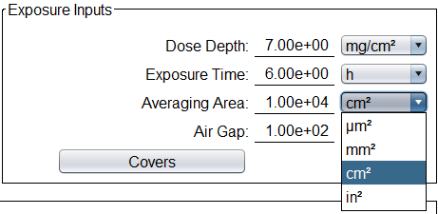
Exposure Inputs
Exposure Time
(s, min, h, d, y)
Averaging Area
(μm², mm², cm², in²)
Acceptable ranges from 0.01 cm² to 100 cm² (scaled to units used)
Air Gap
(μm, mm, cm, in)
Acceptable ranges from 0 cm to 20 cm (scaled to units used)

Slide 34
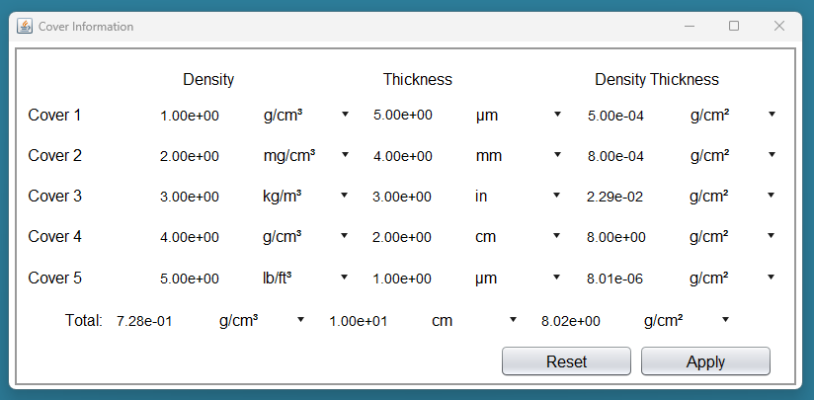
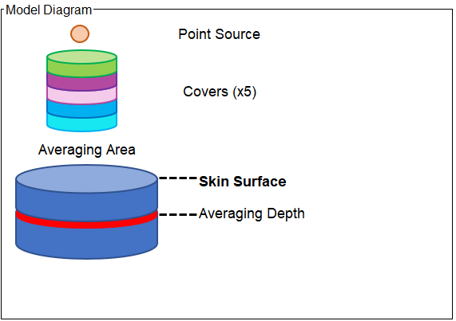
Covers
Notes:
Up to 5 covers can be selected, and two of three parameters can be input; density and thickness, density and density thickness, or thickness and density thickness. For each combination, the third with be computed in SkinDose and filled in automatically. This also eliminates a source of arithmetic error possible by the user.
The total of all the covers thicknesses and densities will be summed and output as the total in the last row of the table. Applying the covers will close the cover selection window, and you will see in the model diagram the selected covers with the number displayed beside it.

Slide 35
Special Options
For advanced use
Not for general use
Will not demonstrate
Should just leave everything unchecked

Slide 36
Input Source and Activity
First thing to do is to select nuclides from the list
ICRP nuclide information
ICPR version with and without progeny (full discussion in intermediate class; for now we will just select ICRP 38 or ICRP 107)
Nuclide(s) of choice
There is an option to change the effective Z; should leave this at 7.42; for advanced users and cases only.

Slide 37
Each time you add a nuclide to the list, it will take a moment to load its unique data.
Once it is in the list, it will not take time to add/remove from active list in this way again.
You can select from the list and leave some out.
If you have nuclides you commonly use, you can always have them in your database; it does not get removed when you close out of VARSKIN+!

Slide 38
Notes:
You can select which database to use; ICRP 38 or ICRP 107. We will not select daughter products for this class. Once a database is selected, chose from the nuclide. If you do not do it in this order, the nuclide list changes when you change the database and it will default back to the top position. Once you have selected a nuclide, click “Add Nuclides” for it to be queued up. The RCD logo (trifoil) will begin to spin, indicating the program is running to add the nuclides to the user database. You can also see the text change at the bottom of the screen, indicating the progress of the calculation. Once it is finished, the nuclide will appear in “selected for Analysis”, you will also see it in the main GUI window which we will see in a moment. You can move it back and forth from the user database to the selected for analysis windows. The selected for analysis window populates in the skindose window for dose calculation, and the available in database nuclides do not need to be retrieved from the main SKINDOSE database again. You can remove a nuclide from the cache/available in database by clicking “delete selected” and it will be removed from both the user database and the main skindose gui window.

Slide 39
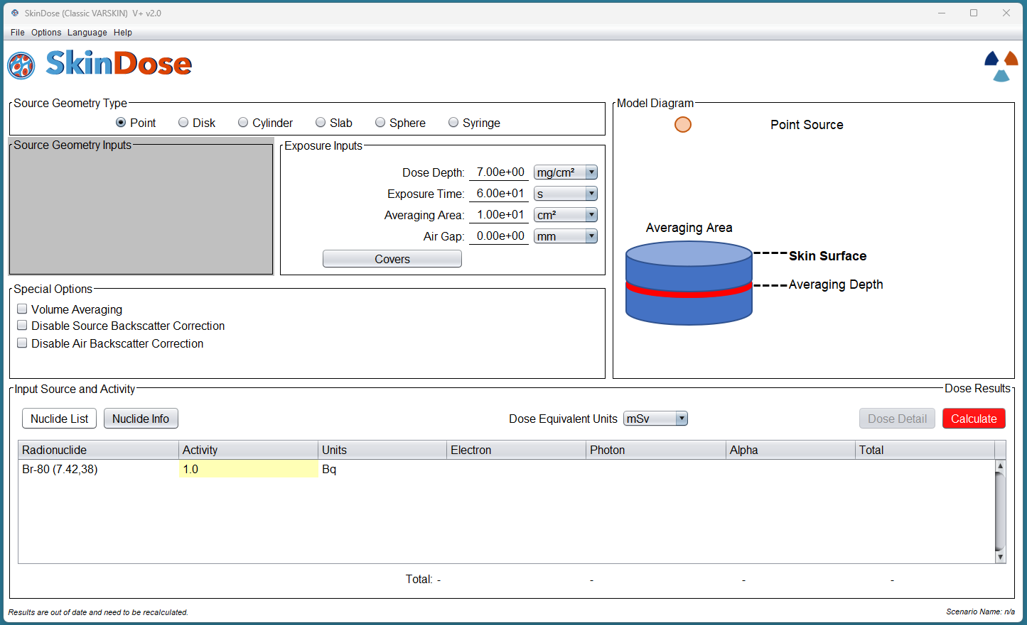
Notes:
You can see here that even though we added Co-60, Cs-137, and Br-80, we removed Co-60 from the analysis list, and removed Cs-137 from our user database, so what remains in the GUI is Br-80.

Slide 40
Nuclide Information
Notes:
By clicking on Nuclide Info, we can see information about the energy and radiation of that nuclide. A listing that includes the nuclide, the half life, beta X90 distance, as well as yield and energy information are all tabulated here. Additionally, we can see the beta sprectra as well as the various emissions in graphical format.

Slide 41
Activity and Units
Once the nuclides are selected, we can input the activity of the nuclides. If there are more than one nuclide, then we input the activity for each.
You can choose up to 6 units of activity
You can choose either rems or Sv, each with 4 prefixes to chose from;
Pico- p 10⁻¹²
Nano- n 10⁻⁹
Micro- μ 10⁻⁶
Mili- m 10⁻³

Slide 42
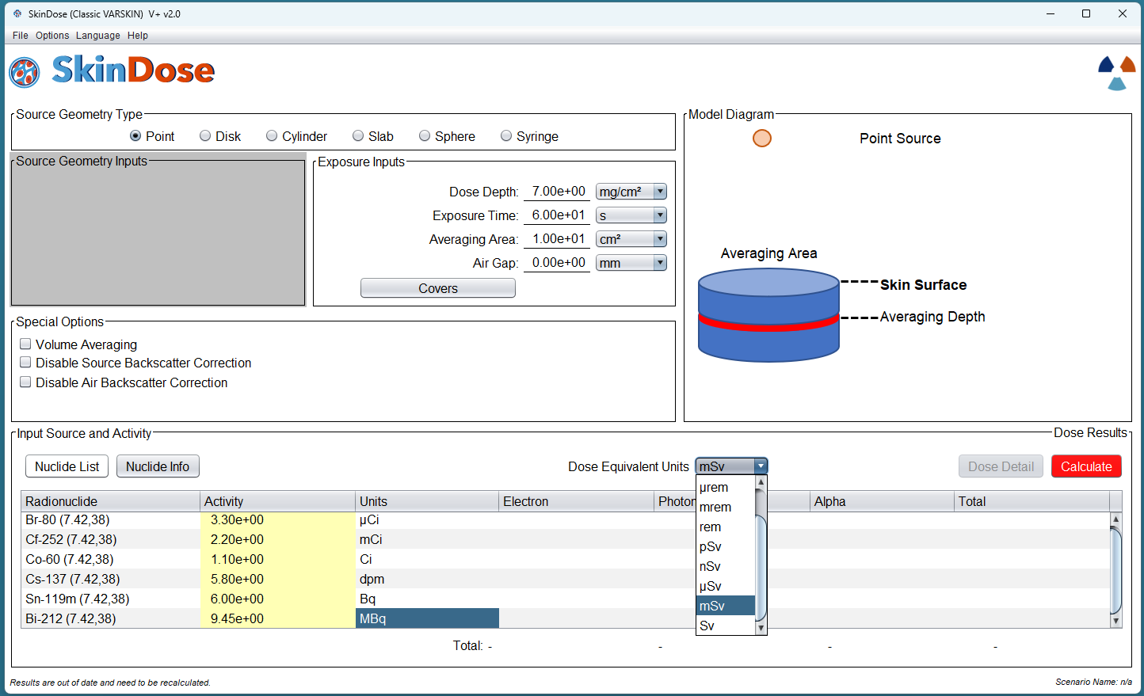

Slide 43
Once you have selected the dose units, the nuclides and the activity, the last step is to calculate dose.
Simply click on the red “Calculate” button, and the dose calculation will be performed.

Slide 44
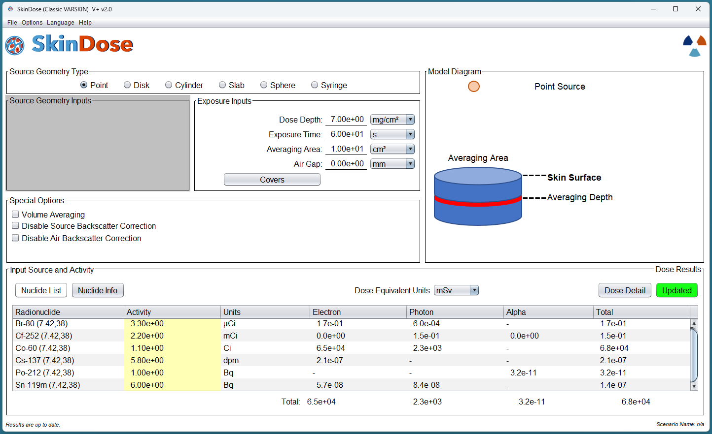
Notes:
You can see here that Once the dose is calculated, until any parameter on the GUI is changed, the “Calculate” button is no longer red, but green, and reads “updated”

Slide 45
Dose Results
Doses are totaled for each nuclide
Doses are totaled for each radiation type

Slide 46
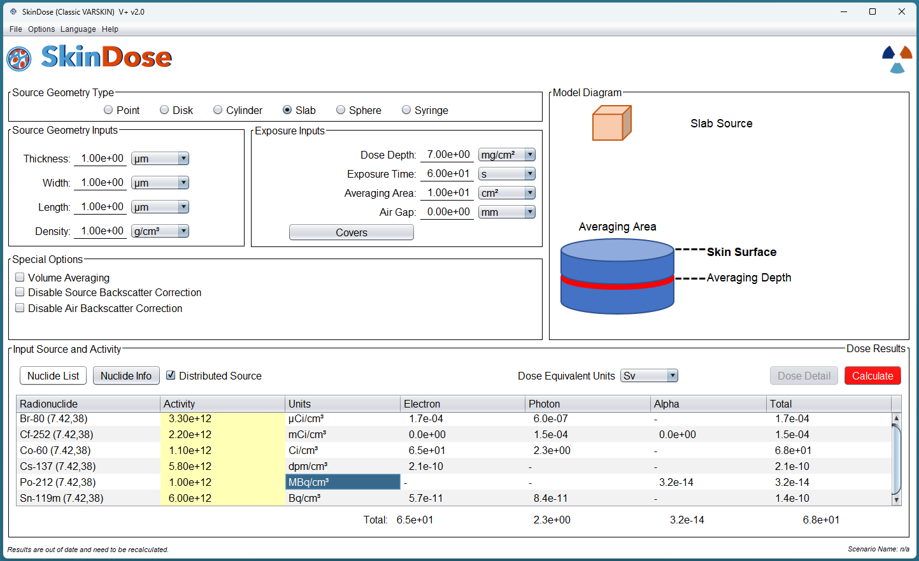
Distributed Source
If we have selected a volume source, we can choose to have it distributed
This will change the units to unit/cm³

Slide 47
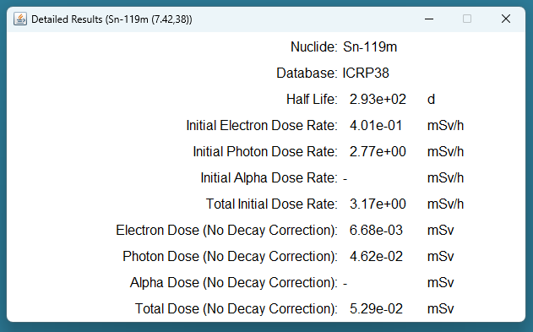
Dose Detail
Once the calculation is done the option to see dose details is available.
Simply click on “Dose Detail” and an additional window will appear
This will show dose detail for the nuclide that is selected.
**when does decay correction occur?***
Notes:
Decay correction happens by default. To see the dose with no decay correction, this information is in dose detail. Some types of radiation exposure replenish such that their decay is matched with ingrowth. There will be more detail on this in later training.

Slide 48
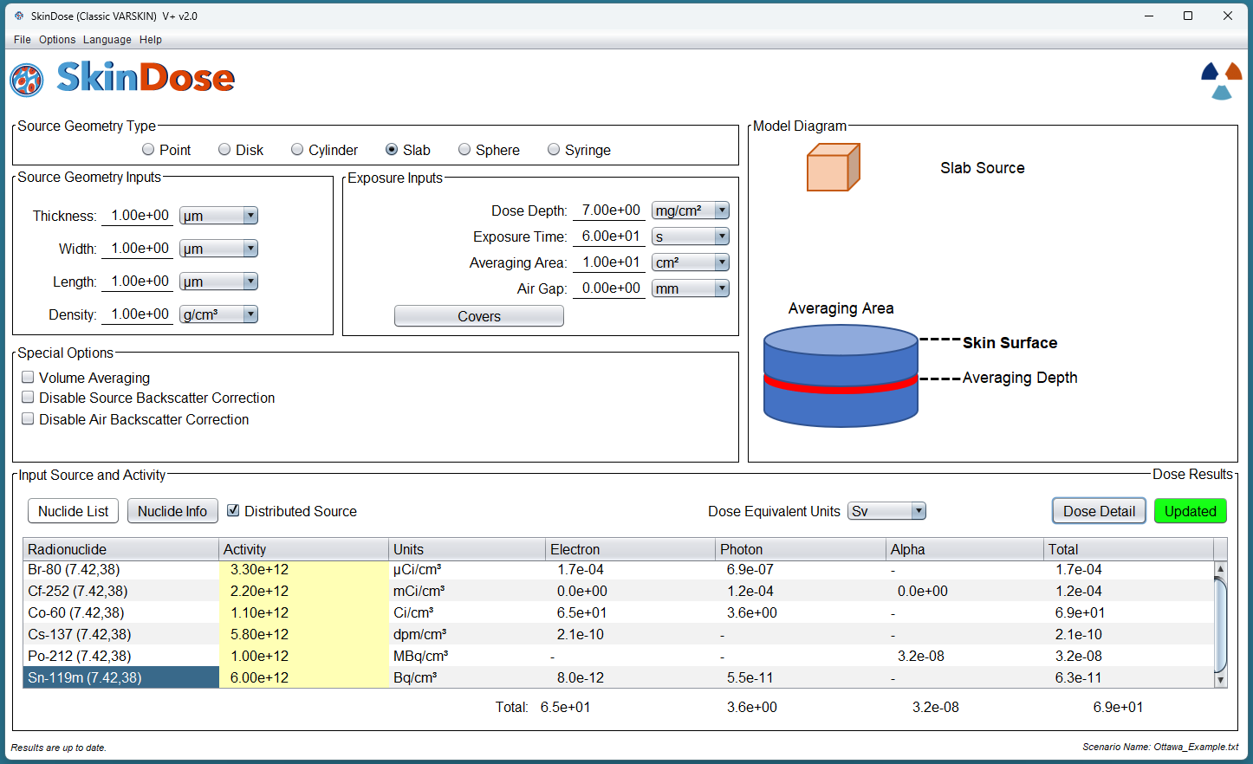
Saving a Scenario
We did so much work for this, we should save it!
Choosing “Save” (or “Save as…”) from the file menu will display the scenario name in the bottom right corner. The text here will be what you input as the save name.
Now, if SkinDose is closed and re-initialized, then you can load this configuration as it was left!

Slide 49
Save Report
This would also be a great time to save a report!
Detailed information will be output as a text file for further review or records.

Slide 50
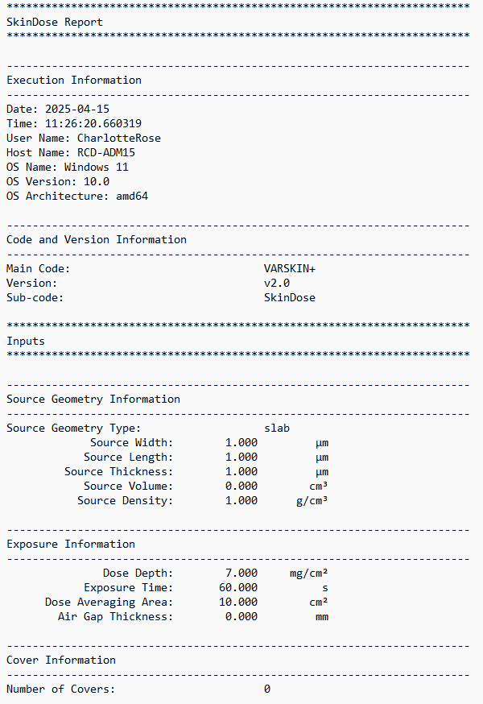
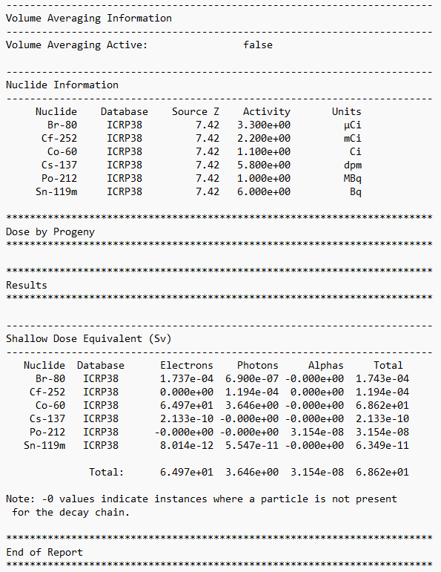

Slide 51
Thank You!
Questions?

