Slide 1
Use of RASCAL in the CNSC’s Emergency Operations Centre – Lessons Learned
Gaétan Latouche, Verena Sesin & Mohamed Shawkat
CNSC EOC Reactor Safety Group & Protective Actions Group
May 14, 2025
E-Doc # 7487391
Notes:
VERENA
Good morning everyone. My co-presenters and I are pleased to present on the Use of RASCAL in the CNSC’s Emergency Operations Centre, and lessons learned from a recent emergency exercise.
Myself and Gaetan, we are part of the EOC’s Protective Actions Group, and Mohamed is part of the Reactor Safety Group. Both of our groups work closely together, as we will illustrate in the following slides.

Slide 2
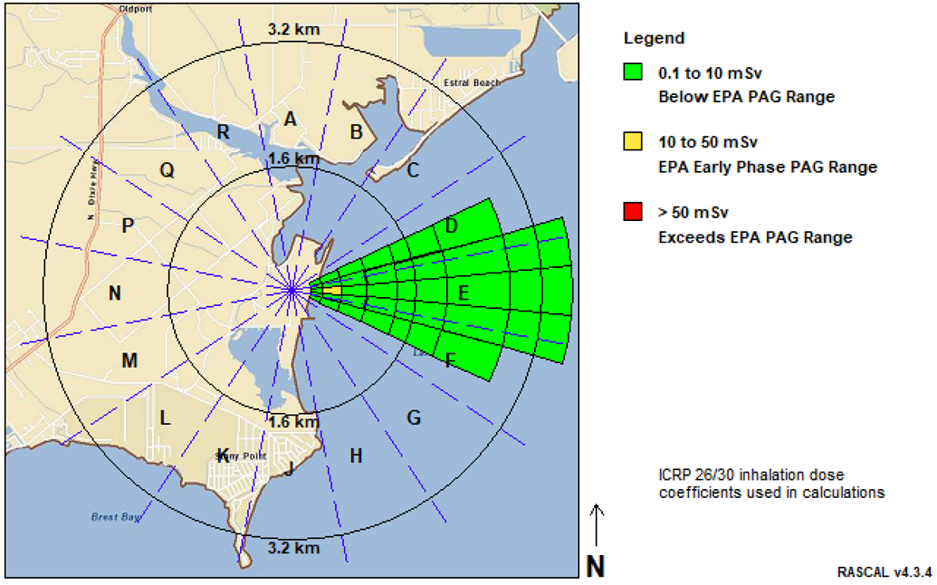
Presentation outline
What is RASCAL?
How RASCAL fits within the CNSC’s Emergency Operations Centre
Tools to estimate the source term
CNSC staff participation in Cobalt Magnet 2025
Lessons learned from Reactor Safety Group and Protective Actions Group
Summary of areas for improvement
Notes:
VERENA
Here is a brief overview of our presentation. We will start with sharing more about the RAMP code RASCAL and how it fits within the CNSC’s EOC.
I will then pass it over to Mohamed to share about the tools that the Reactor Safety Group uses to estimate the source term, and Gaetan will be going over the CNSC’s participation in the Cobalt Magnet 2025 exercise. Following, Mohamed and I will present lessons learned from their respective groups, and finally we will summarize opportunities for improvement.

Slide 3
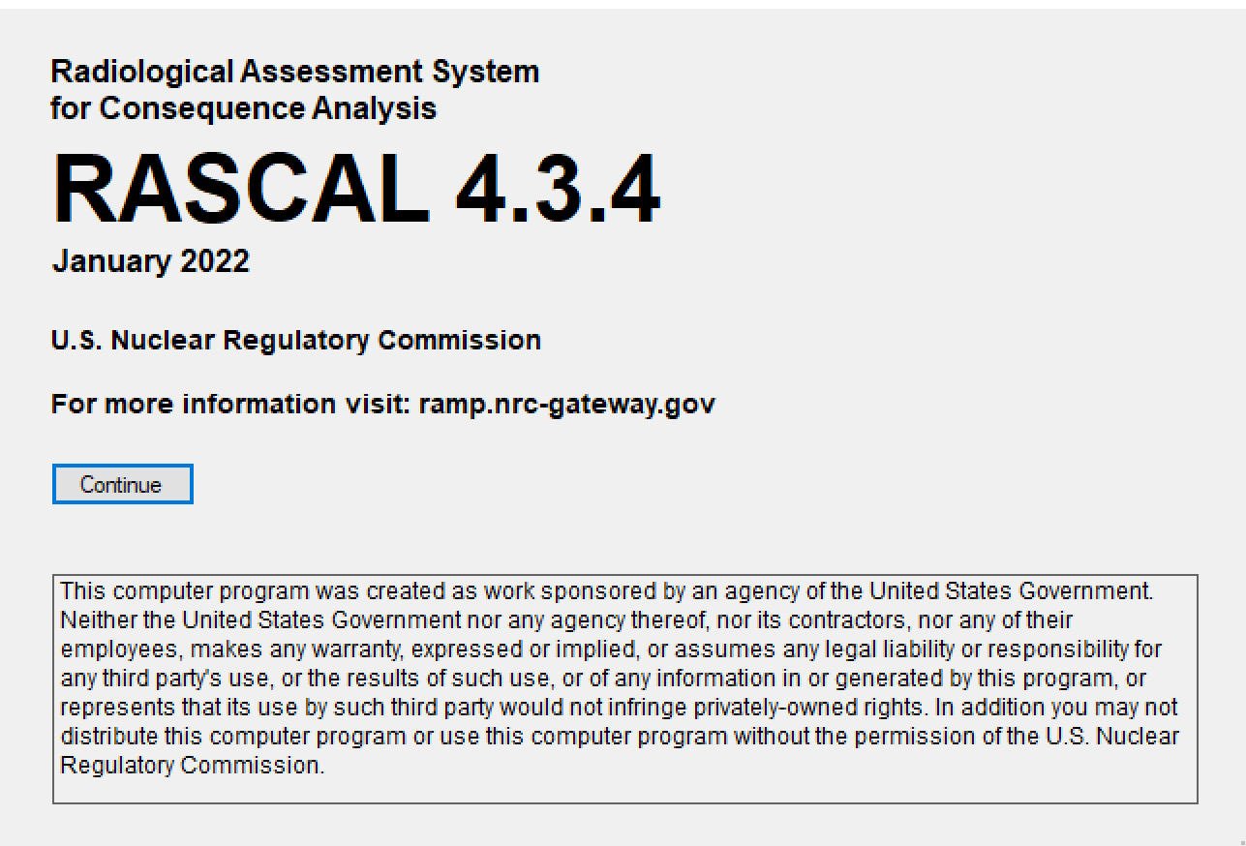
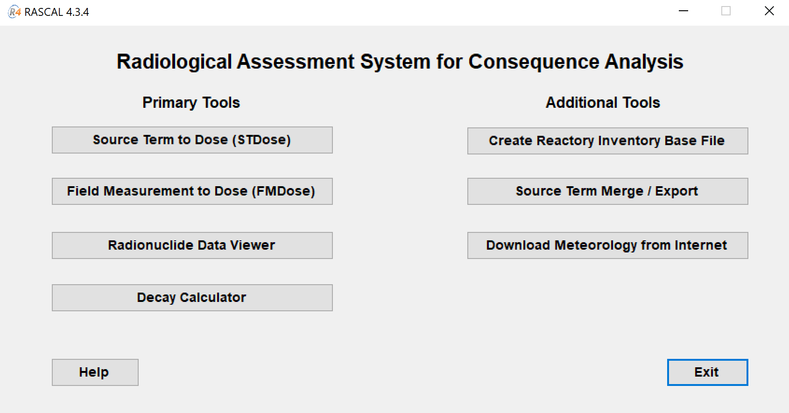
What is RASCAL?
Radiological Assessment System for Consequence AnaLysis
Tool for rapid dose assessment and consequence projections during radiological incidents
Source Term to Dose (STDose) function:
Predicts the source term (concentrations of radionuclides released) based on the reactor or Spent Fuel Pool technical data, current conditions, and release path
Uses atmospheric dispersion and transport models to estimate radionuclide doses
Version 4.3.4 includes select international reactor sites, such as CANDU in Canada
For Canadian sites, RASCAL 4.3.4 can estimate the radionuclide doses only
Notes:
VERENA
What is RASCAL? RASCAL stands for Radiological Assessment System for Consequence AnaLysis.
It is a tool for rapid dose assessment and consequence projections during radiological incidents.
Commonly, the Source Term to Dose (STDose) function is used. This function predicts the source term (concentrations of radionuclides released) based on the reactor or Spent Fuel Pool technical data, current conditions, and release path. It uses atmospheric dispersion and transport models to estimate radionuclide doses.
The current RASCAL version 4.3.4 includes select international reactor sites, such as CANDU in Canada. However, for Canadian sites, RASCAL 4.3.4 can estimate the radionuclide doses only.

Slide 4
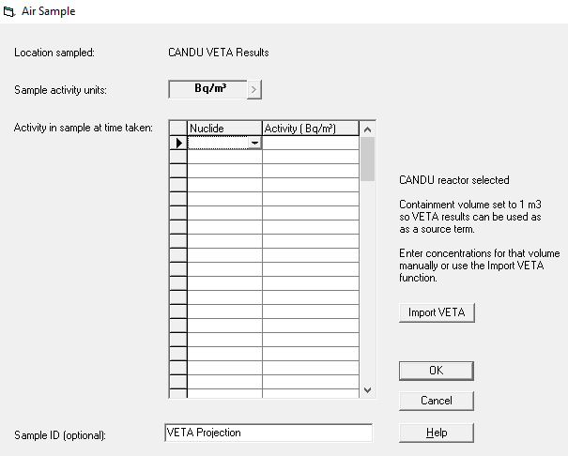
How RASCAL fits within the CNSC’s EOC
During a nuclear emergency, the Protective Actions Group (PAG) is responsible for modelling the dispersion of the radioactive plume and estimating the dose to the public and potential consequences
RASCAL is used by the PAG Dispersion Specialist to model dispersion and calculate doses
Source term is estimated by the Reactor Safety Group (RSG)
For CANDU reactors, PAG staff import the source term into RASCAL using the STDose Containment Air Sample function
Notes:
VERENA
How does RASCAL fit within the CNSC’s EOC?
During a nuclear emergency, the Protective Actions Group (PAG) is responsible for modelling the dispersion of the radioactive plume and estimating the dose to the public and potential consequences. RASCAL is used by the PAG Dispersion Specialist to model dispersion and calculate doses.
The Source term is estimated by the Reactor Safety Group (RSG). As you can see, both of our groups work closely together to eventually inform protective actions decisions.
As one example, you can see on the right-hand side of this slide a screenshot of RASCAL showing the case of a CANDU reactor, where PAG staff import the RSG-generated source term into RASCAL as part of the STDose Containment Air Sample function.

Slide 5
RSG Tools to Estimate the Source Term (ST)
The process of estimating the ST is governed by the diagnosis and prognosis of the accident, which is performed via the 4D/4P (for CANDU reactors) or the 3D/3P (for LWRs) approaches.
For CANDU Reactors:
VETA estimates the ST from Darlington, Pickering, Bruce, and Point Lepreau nuclear power plants (NPPs)
Source Term Database (STDB) contains STs predicted by MAAP-CANDU for several mitigated and unmitigated beyond design basis accidents (BDBAs):
The ST from the database may be modified based on the actual accident progression
In some cases, new MAAP-CANDU runs may need to be performed if modifications are not possible
BAYLOCA estimates the ST from a CANDU reactor Spent Fuel Pool
Estimated ST is transferred to PAG using an EXCEL template
For Light Water Reactors (LWRs):
RASCAL V4.3.4
Estimated ST is transferred to PAG using an EXCEL template OR the RASCAL CASE file is shared to add meteorological data
Notes:
MOHAMED
This slide goes into more details on how the RSG estimates the source term and which tools are being used.
There is an important distinction between CANDU reactors and LWRs. The process of estimating the ST is governed by the diagnosis and prognosis of the accident, which is performed via the 4D/4P (for CANDU reactors) or the 3D/3P (for LWRs) approaches.
In more detail: for CANDU Reactors:
VETA estimates the ST from Darlington, Pickering, Bruce, and Point Lepreau nuclear power plants (NPPs)
Source Term Database (STDB) contains STs predicted by MAAP-CANDU for several mitigated and unmitigated beyond design basis accidents (BDBAs):
The ST from the database may be modified based on the actual accident progression
In some cases, new MAAP-CANDU runs may need to be performed if modifications are not possible
BAYLOCA estimates the ST from a CANDU reactor Spent Fuel Pool
Estimated ST is transferred to PAG using an EXCEL template
In contrast, for LWRs:
RSG staff use RASCAL V4.3.4
Estimated ST is transferred to PAG using an EXCEL template OR the RASCAL CASE file is shared to add meteorological data

Slide 6
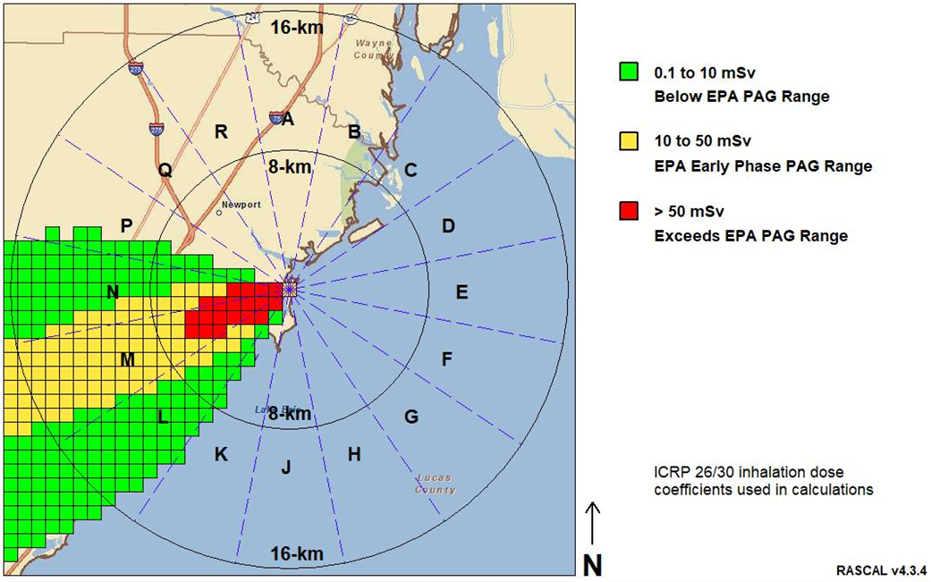
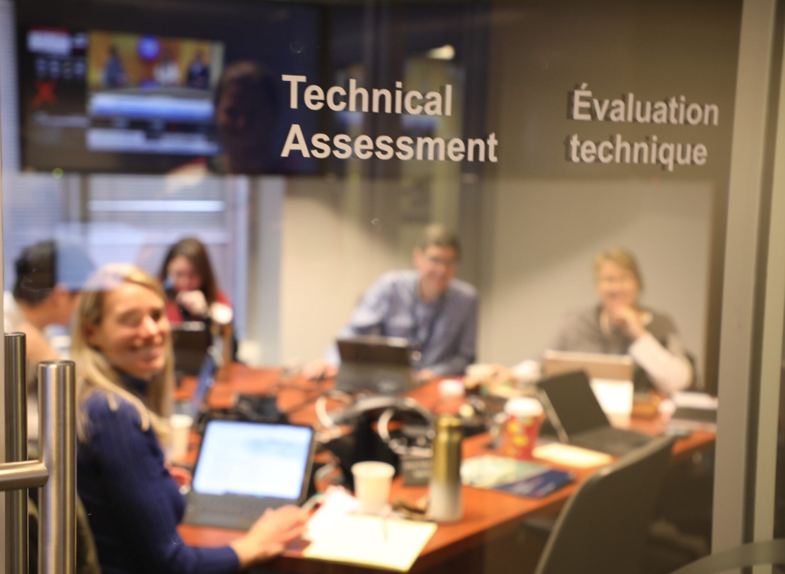
CNSC staff participation in Cobalt Magnet 2025
Exercise scenario of a radiological release at the fictional Erie Nuclear Power Plant in Michigan, U.S., with consequences in Canada
Due to the non-CANDU reactor design, RSG relied on RASCAL source term capabilities
RSG and PAG staff used RASCAL as a shared tool to prepare the simulation – a new challenge!
Notes:
GAETAN
Recently, CNSC staff participated in an emergency exercise called Cobalt Magnet 2025, or in short, CM25. This was a great opportunity to put our tools into practice.
The CM25 provided an exercise scenario of a radiological release at the fictional Erie Nuclear Power Plant in Michigan, U.S., with consequences in Canada.
One key aspect for our RSG and PAG teams was the fact that the scenario featured a non-CANDU reactor design. Therefore, RSG relied on RASCAL source term capabilities, as Mohamed had described earlier. To address this scenario, RSG and PAG staff used RASCAL as a shared tool to prepare the simulation – a new joint challenge for our teams.

Slide 7
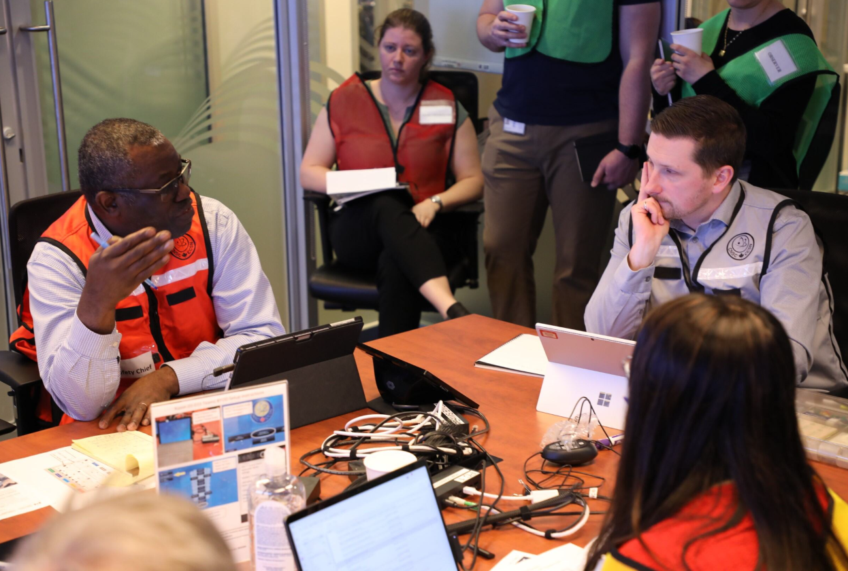
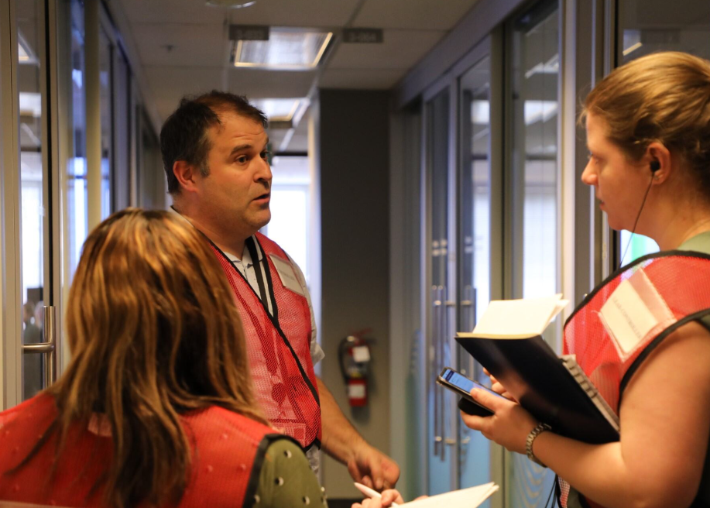
CM25 Accident Scenario Overview
Day 1
Leakage in Spent Fuel Pool (SFP) led to loss of water inventory followed by fuel damage and breach in the reactor building wall, creating a release path to the atmosphere
SFP leak was fixed, and pool was filled which stopped the release
Fixed leak was compromised and SFP water inventory was lost again, causing a 2nd release
2nd release was eventually stopped by fixing the leakage again, refilling the pool, and closing the reactor building wall opening
Field measurements for the source term from the two releases were provided to the CNSC
Night
Day 2
Notes:
GAETAN
Before we present our lessons learned, here is a brief overview of the CM25 accident scenario.
On Day 1, leakage in the Spent Fuel Pool (SFP) led to loss of water inventory followed by fuel damage and breach in the reactor building wall, creating a release path to the atmosphere. The SFP leak was fixed, and the pool was filled which stopped the release.
Overnight, the fixed leak was compromised and SFP water inventory was lost again, causing a 2nd release.
On Day 2, the 2nd release was eventually stopped by fixing the leakage again, refilling the pool, and closing the reactor building wall opening. Field measurements for the source term from the two releases were provided to the CNSC.
I will now pass it over to Mohamed to talk about the RSG’s lessons learned.

Slide 8
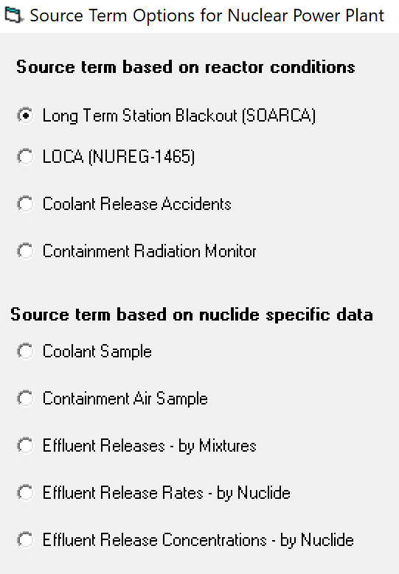
RSG: Lessons Learned – Real-World Relevance
Lesson #1:
RASCAL 4.3.4 capability of handling multiple releases
RASCAL is not designed to handle multiple releases
A work-around was implemented by simulating one long release and then manually altering the *.CSV ST output file to account for the no release period
The work-around approach needs to be further investigated by simulating several cases to better understand its limitations
Notes:
MOHAMED
I will now present the lessons learned for the Reactor Safety Group, starting with our first lesson on the capability of RASCAL 4.3.4 to handle multiple releases.
We learned that RASCAL is not designed to handle multiple releases. The options would be to run multiple STDose calculations for each time period, however, this would create a situation in which RASCAL would be overestimating the source term.
A work-around was implemented by simulating one long release and then manually altering the *.CSV ST output file to account for the no release period. But this work-around approach needs to be further investigated by simulating several cases to better understand its limitations. Moreover, it would be helpful to have an option to import or copy/paste ST data from external files for all options under the “source term based on nuclide specific data” as shown on the screenshot on the right.

Slide 9
RSG: Lessons Learned – Real-World Relevance
Lesson #2:
Transfer of source term (ST) to PAG
With the work-around for multiple release, the RASCAL CASE file could not be shared to specify the addition data for dose estimates
The template used to communicate the ST to PAG did not work when uploaded to RASCAL as it did not follow the pre-programmed format
This problem was not observed when RASCAL is used for CANDU sites
New EXCEL template or communication protocol is needed for LWRs
Lesson #3:
Verification/Validation of the source term provided by other organizations
CNSC can verify a ST estimated by other organizations by comparing it to CNSC predictions
For the case of a measured ST, it was not clear how the measurements were verified to qualitatively estimate the level of confidence or uncertainty
Same applies to CNSC predicted or estimated ST that is shared with others
CNSC to establish a process to ensure the quality of the ST from external organizations
Notes:
MOHAMED
Our second lesson relates to the transfer of the source term to the PAG. With the work-around for multiple release, the RASCAL CASE file could not be shared to specify the addition data for dose estimates. The template used to communicate the ST to PAG did not work when uploaded to RASCAL as it did not follow the pre-programmed format. Notably, this problem was not observed when RASCAL is used for CANDU sites. We concluded that a new EXCEL template or communication protocol is needed for LWRs and we have started initial discussions among RSG and PAG staff.
Our third lesson is on the verification and/or validation of the source term provided by other organizations. CNSC can verify or validate a ST estimated by other organizations by comparing to CNSC predictions and assess the differences. For the case of a measured ST, it was not clear how the measurements were verified to qualitatively estimate the level of confidence or uncertainty. The same applies to CNSC predicted or estimated ST that is shared with others. A guideline or protocol needs to be established to ensure the quality of the ST coming from or going to external organizations.
With that, I will now pass it over to Verena to cover the PAG lessons learned.

Slide 10
PAG: Lessons Learned – Exercise Design
Lesson #4:
Weather data for dispersion modelling
Clarity on source of scripted weather data to be used in RASCAL
Issues with interpretation of additional sources of weather data with information provided in STARTEX package regarding the wind direction
Capability of comparing modelling results among staff and external parties
Success: Meeting to resolve different interpretations among players
Lesson #5:
Implementation of PAUSEX in RASCAL
RASCAL did not allow for input of an artificial pause in time into the model
Definition of the timing of the release required manual adjustment of time to remove pause
Difficulty matching up release time with meteorological data.
Notes:
VERENA
I will now present the lessons learned for the Protective Actions Group, starting with two lessons that relate to the design of the emergency exercise.
Our first lesion, or lesson #4 overall, is about the weather data for dispersion modelling. We learned that clarity on the source of scripted weather data to be used in RASCAL is important. During the exercise, there were a few issues with the interpretation of additional sources of weather data with information provided in the STARTEX package regarding the wind direction. The STARTEX package noted that wind is blowing toward Northeast, but other meteorological parameters available indicated wind toward the East (i.e., wind blowing from 270 degrees). Different interpretations and uses of weather sources hindered our capability to compare modelling results both internally among staff covering different shifts in the EOC, and external parties, such as between CNSC and Health Canada staff. But there was success: CNSC and HC staff had a productive meeting to resolve different interpretations.
Next, lesson #5 relates to the implementation of PAUSEX in RASCAL. The exercise was designed in a way that there was an artificial pause between Friday 5 pm and Monday 8 am, where no time had passed for the exercise scenario, so the exercise did not progress while in real life, we all had a weekend. This created complications for the modelling, because RASCAL did not allow for input of an artificial pause in time into the model. RASCAL of course assumes that following a release, the radioactive plume keeps dispersing – it does not get to pause for the weekend. To adjust for this, CNSC staff had to manually adjust the time of release forward based on the Monday 8 am re-start of the exercise, to remove the artificial pause. This also created difficulty in matching up the release time with changing weather data, as Friday’s weather had to be pushed forward as well and manually aligned over the release duration.
These two lessons would be great to consider in future exercise designs.

Slide 11
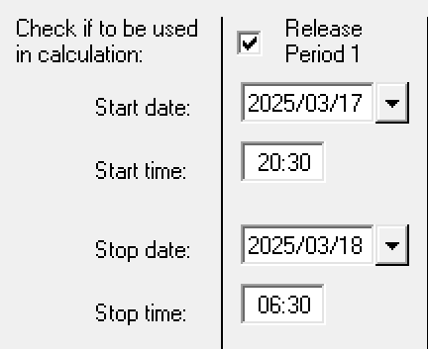
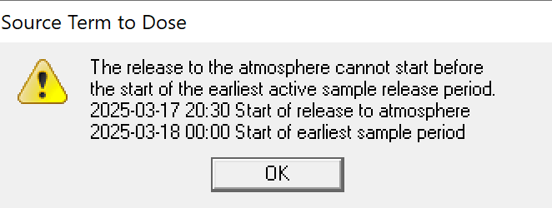
PAG: Lessons Learned – Real-World Relevance
Lesson #6:
Training on RASCAL functions
CNSC’s Dispersion Specialist training focusses on “nuclear power plant” event type and does not cover “spent fuel” event type
Staff required time to become familiar with “spent fuel” function and encountered error messages
Additional training would be helpful, as well as a new source term template that contains all required input information for the LWR spent fuel pool scenario
Notes:
VERENA
Lastly, the PAG had one more lesson learned that has real-world relevance: staff’s familiarity with diverse RASCAL functions and troubleshooting error messages.
For example, our Dispersion Specialist training and work instructions focus on CANDU reactors and the NPP function. The event type ‘spent fuel’ was new to at least some staff and we had to spend time understanding this function and required input to RASCAL during the exercise. A few error messages were encountered, for example, relating to modelling a release that spanned two days. To enter atmospheric releases into RASCAL, PAG staff needed to set the start time for 00:00 am on the day of, and the 10 hrs of release that followed, not the actual start time of the release at 20:30 pm on the previous day. Staff reported that RASCAL would not run with the release occurring over two days. However, manually adjusting the modelling of the entire plume to occur in one day meant that the plume release did not overlap with inputted meteorological data. This could impact the plume modelling results because meteorology such as wind direction, speed, and precipitation drives the dispersion.
Moreover, this event type required different information and a different input template than the standard one that staff typically use for the CANDU reactor, as Mohamed had discussed earlier.
With that, I will now pass it back to Gaetan to provide a summary of all the identified areas of improvement based on our lessons learned.

Slide 12
Summary of Opportunities for Improvement
Capability of RASCAL to model multiple releases and import of external source term data
New template or communication protocol to transfer LWR source term between RSG and PAG for RASCAL use
Clarification of approach to verify or validate source term predictions with external organizations
Clarity of weather data to be used in exercise scenario
Consideration of RASCAL functionality in exercise design
Additional staff training on different RASCAL functions
Notes:
GAETAN
This slide summarizes the opportunities for improvement that we have collectively identified:
Capability of RASCAL to model multiple releases and import of external source term data
New template or communication protocol to transfer LWR source term between RSG and PAG for RASCAL use
Clarification of approach to verify or validate source term predictions with external organizations
Clarity of weather data to be used in exercise scenario
Consideration of RASCAL functionality in exercise design
Additional staff training on different RASCAL functions

Slide 13
Next steps
CNSC is gathering all lessons learned from the Cobalt Magnet 2025 exercise
Lessons learned highlighted in this presentation will be used to identify opportunities for improvement internally
Lessons learned with respect to RASCAL will be shared with the US NRC’s RAMP team for further discussion and consideration
Notes:
GAETAN
In terms of next steps:
The CNSC is gathering all lessons learned from the Cobalt Magnet 2025 exercise
The lessons learned highlighted in this presentation will be used to identify opportunities for improvement internally
Lessons learned with respect to RASCAL will be shared with the US NRC’s RAMP team for further discussion and consideration

Slide 14
Thank you
Notes:
GAETAN
Thank you and we look forward to further discussion.

