Slide 1
NRC Emergency Preparedness for SMRs and ONTs
Eric Schrader
Emergency Preparedness Specialist
May 14, 2025

Slide 2
Major Provisions of 10 CFR 50.160 EP Regulations
This framework provides small modular reactors (SMR) and other new technologies (ONT):
regulatory framework proportional to facility risk profile
technology inclusive, performance based
scalable EPZ according to spectrum of accident risk
hazard analysis for contiguous facilities
ingestion planning capabilities

Slide 3
Still a Graded Approach to EP
Still risk-informed however the process balances the regulatory burden with the facility risk
Existing NRC regulations that use a similar graded approach to EP include:
Power reactors
low-power testing and decommissioning
Research and test reactors
Fuel Fabrication Facilities
Independent Spent Fuel Storage Installations
Monitored Retrievable Storage

Slide 4
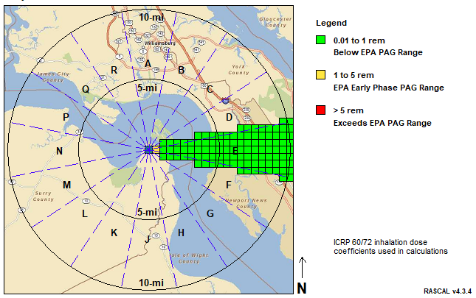
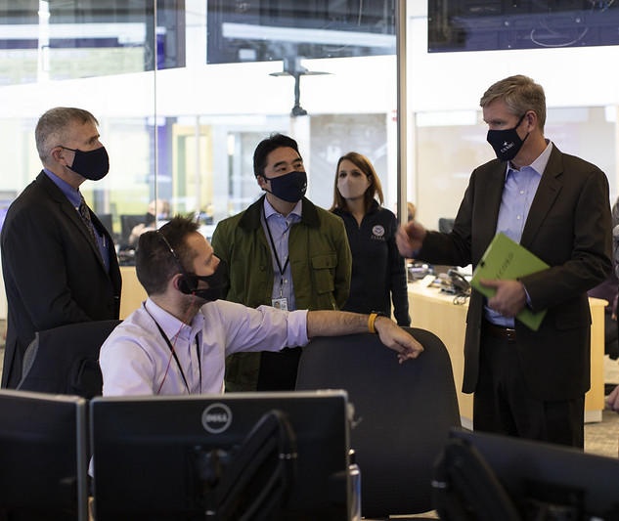
Emergency Response Functions
Event classification and mitigation
Protective actions
Communications
Command and control
Staffing and operations
Radiological assessment
Re-entry
Critiques and corrective actions
Recommend protective actions to offsite authorities as conditions warrant.

Slide 5
Planning Activities Ensure Readiness
Prepare and issue public information during emergencies
Implement the emergency plan in conjunction with safeguards contingency plan
Voice and data communications with the NRC
Emergency response facilities where effective direction and control can be exercised
Site familiarization training for offsite support
Maintain the emergency plan

Slide 6
Additional Planning Activities for EPZ > Site Boundary
Protective actions within the EPZ
Contacts and arrangements
Evacuation time estimate within the EPZ
Primary and backup offsite response facilities
Making and communicating dose projections
Periodic emergency planning information for public
General re-entry plans after an emergency
Drill and exercise programs with offsite response

Slide 7
A Scalable EPZ Supports Planning Needs
The EPZ is a planning tool:
The EPZ determination considers form and function
The area within which public dose is projected to exceed 10 mSv TEDE over 96 hours considering:
accident likelihood
source term
meteorology
The area within which predetermined, prompt protective measures are warranted
timing of the accident sequence

Slide 8
Hazard Analysis - Adverse Impact of Contiguous Facilities
Address the impact on emergency plan implementation from:
contiguous or nearby facilities and other credible hazards
potential impacts of industrial plants, other reactors, transportation systems, or combination of factors
site-specific, credible hazards from other facilities that may require additional EP considerations

Slide 9
Ingestion Pathway Planning
Emphasizes capabilities and readiness to respond
Identification of major exposure pathways for ingestion
Identify resources available at all levels of government to sample, assess, and implement a quarantine or embargo of food and water to prevent ingestion

Slide 10
Emergency Preparedness is and Always Will Be
to assure protective actions can and will be taken
to provide a dose savings
risk-informed
an independent layer of defense in depth

Slide 11
So… What’s Different?
Regulations define the required outcomes
Applicant describes and justifies methods to meet regulations
Allows an applicant to determine the best method for them to meet the regulations
Size of the EPZ is based on risk of individual facility

Slide 12
Pre-Application Engagement = Max Success
Early Issue Identification
Improved Licensing Strategy
Identify and address potential regulatory challenges before formal submission. Clarify applicable regulations, guidance, and licensing pathways.
Align licensing approach with NRC regulations. Establish appropriate scope and level of detail needed in the application.
Efficient Resource Use
Reduce likelihood of significant rework or delays. Optimize technical and financial resources by focusing on key regulatory concerns early.

Slide 13
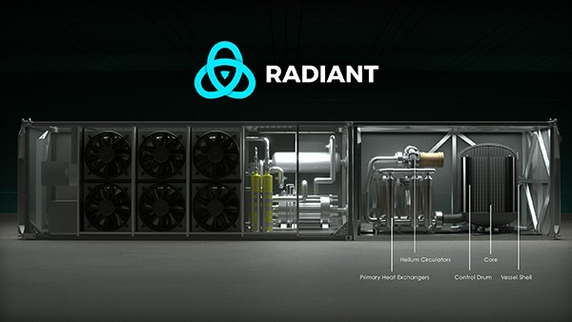
Engaging with Applicants and Vendors
Construction Permit Application Issued
Fuel Fabrication Review
License Review in Progress
Ongoing Preapplication Activities/Potential Applications

Slide 14
Thank You

