Slide 1
Potassium Iodide Policy Implementation
Todd Smith, PhD
Senior Level Advisor
May 13, 2025

Slide 2
Potassium Iodide policy in the U.S.
NRC regulations require consideration of KI as a supplemental protective action
regulations and guidance are specific to large light water reactors
“Federal Policy on Use of Potassium Iodide (KI),” 67 FR 1355, 2002
KI should be stockpiled and distributed for emergency workers, institutionalized persons, and considered for the public within the 10-mile emergency planning zone
Bioterrorism Act of 2002
requirement to distribute KI out to 20 miles around nuclear power plants; waived because more effective protective measures exist

Slide 3
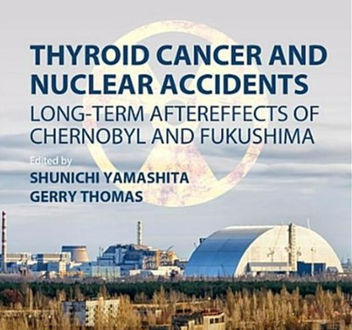
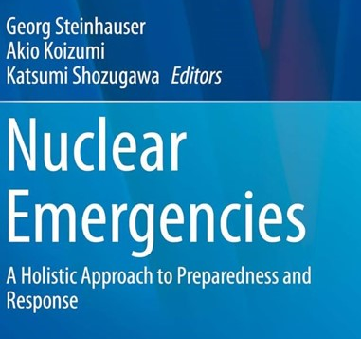
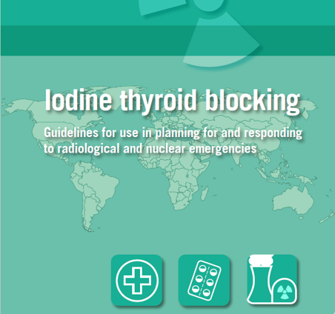
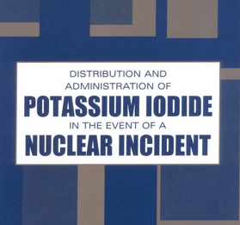
Real events provide insight on KI use and best practices
Regarding radioiodine:
children are most at-risk
ingestion pathway is important
thyroid screening resulted in overdiagnosis and anxiety
Nonradiological health effects can outweigh radiological risks

Slide 4
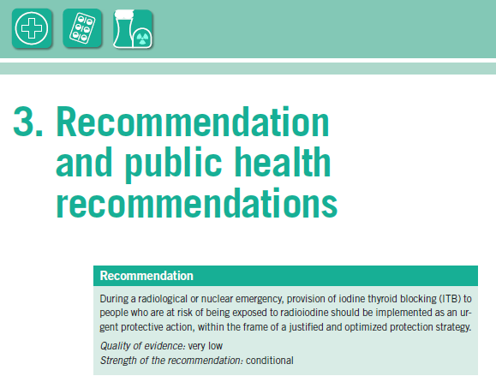
WHO recommends further KI research:
radioiodine biokinetics
optimal timing of intake
feasibility and acceptability
best practices for stockpiling or pre-distribution
World Health Organization, “Iodine thyroid blocking: Guidelines for use in planning and responding to radiological and nuclear emergencies,” WHO 2017.
https://www.who.int/publications/i/item/9789241550185

Slide 5
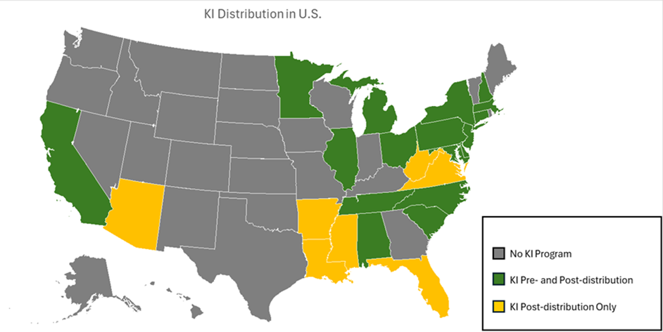
U.S. KI policy is evidence-based
Efficacy and efficiency of KI implementation could benefit from modernization
KI Subcommittee within the Federal Radiological Preparedness Coordinating Committee (FRPCC) has been reinstated to assess need for guidance
KI guidance can benefit from:
insights on radioiodine release from state-of-the-art consequence analyses
lessons from Chernobyl, Fukushima and Ukraine
adequacy of dietary iodine sufficiency and daily iodine intake
understanding of advances in nuclear technologies
best practices
US NRC. Literature Review: Evaluation of Implementation Strategies for Potassium Iodide; 2025. ADAMS Accession No. ML25077A036.

Slide 6
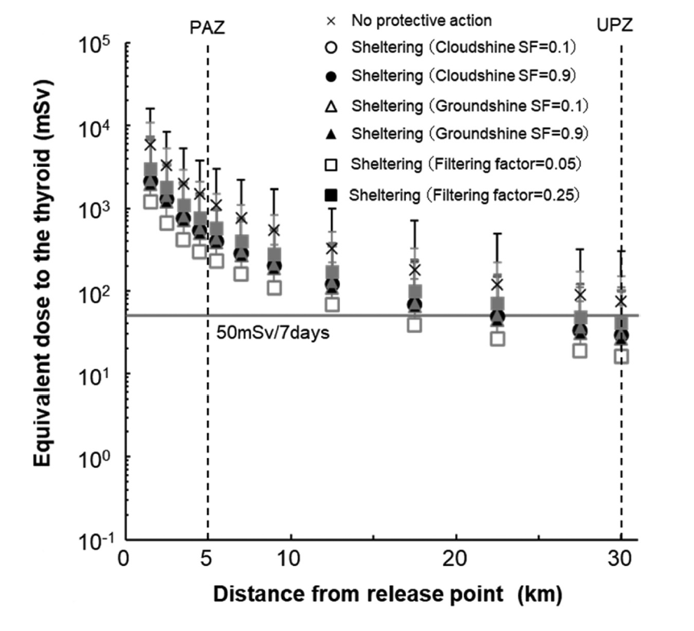
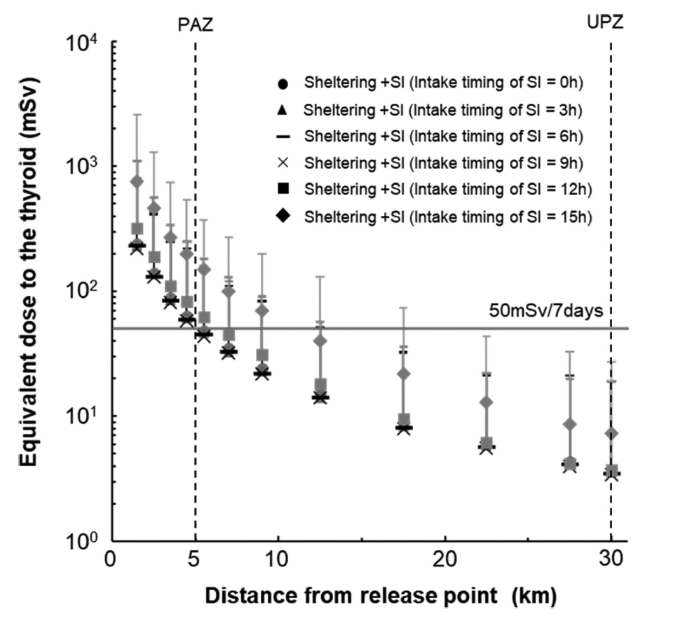
KI effectiveness can be modeled
Kimura, M., Oguri, T., Ishikawa, J., & Munakata, M. (2020). Development of an evaluation method for planning of urgent protection strategies in a nuclear emergency using a level 3 probabilistic risk assessment. Journal of Nuclear Science and Technology, 58(3), 278–291. https://doi.org/10.1080/00223131.2020.1820914

Slide 7
MACCS can inform KI strategies
NRC is using MACCS to assess effectiveness of KI implementation
KIMODL determines whether to consider KI or NOKI
Linear no threshold (LNT) dose-response model applied
Dose to a population is reduced by a factor
$$\left(1−EFFACY\right)×POPFRAC$$
where,
EFFACY reduces the dose to the thyroid from inhalation
POPFRAC is the fraction of a cohort that ingests KI

Slide 8
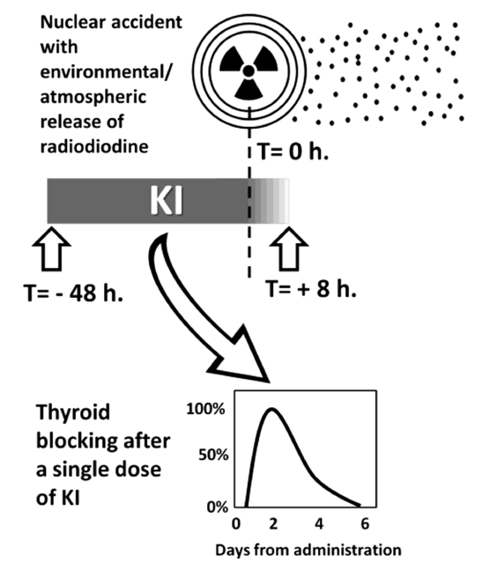
KI effectiveness is factor dependent
To be effective against inhalation exposure, KI must be administered within a specific window of opportunity
< 12-24 hours before exposure ~90% to 70% effective
< 1-3 hours after exposure ~85% to 50% effective
> 6 hour after exposure has negligible protective effect
Modeling can provide useful insights for informing KI implementation. Factors include:
source term (optimal timing and radioiodine form)
KI time dependency (biokinetics)
iodine sufficiency (biokinetics)
distribution strategy (feasibility)
human factors (acceptability)
state of practice (best practice)
Ioannis Ilias, Manfredi Rizzo, Georgios Meristoudis. Potassium Iodide in Nuclear Accidents: Give it Timely, Swiftly and Judiciously, Endocrine, Metabolic & Immune Disorders - Drug Targets; Volume 23, Issue 6, Year 2023, e141022210042. DOI: 10.2174/1871530323666221014150729

Slide 9
Data can inform MACCS parameters
The rate of distribution was 94.9%, but the intake rate was only 63.5%. Intake was lower in those aged 0 to 2 years compared with those aged ≥3 years (OR, 0.21; 95% CI, 0.11 to 0.36). Parents’ intake was positively associated with their children’s intake (OR, 61.0; 95% CI, 37.9 to 102.9). The variance partition coefficient for regions was 0.021, suggesting that the intake of stable iodine was more likely affected by individual than by regional factors. Closed-ended questions showed that the main reason for avoiding intake was concern about safety. Open-ended questions for other reasons revealed issues related to the distribution method, information about the effects and adverse effects of iodine, and instructions for iodine intake. There were no symptomatic adverse effects claimed to the town.

Slide 10
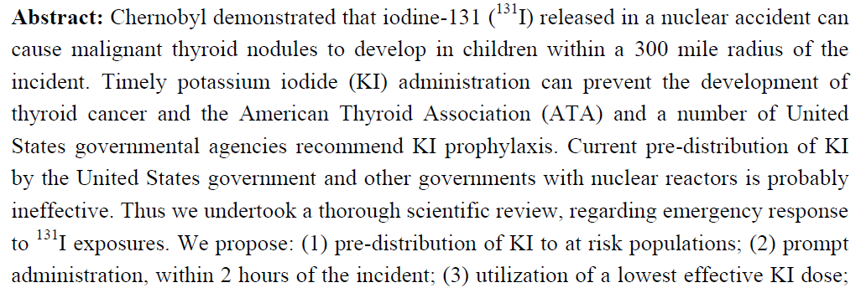
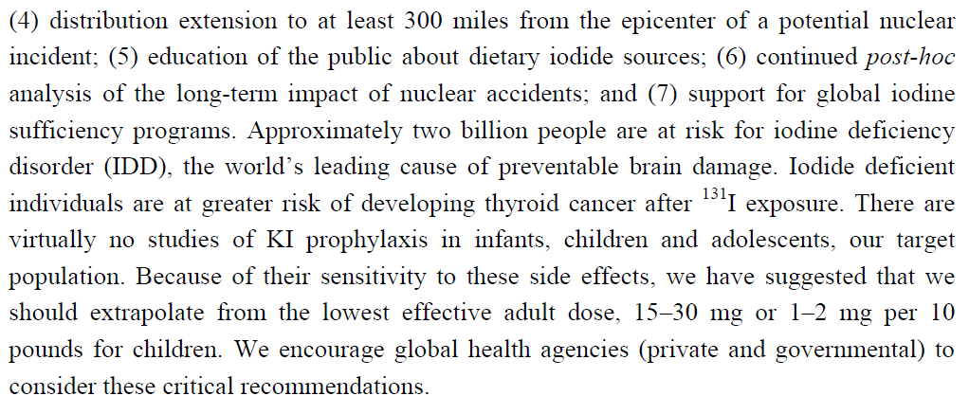
Good science supports data driven decisions

Slide 11
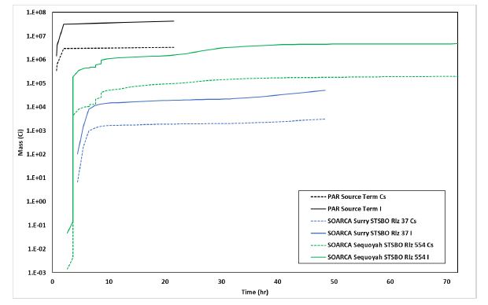
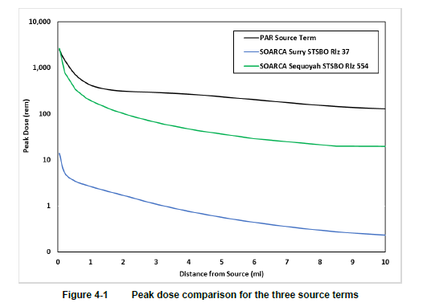
Source term is a key driver of radiation risk
NRC protective action recommendation (PAR) study used rapidly progressing scenarios, but realistic accident scenarios progress more slowly
Release timing and characteristics have large impact on potential consequence estimates
Sandia National Laboratories. Scoping Analysis of MACCS Modeling Improvements for the Study of Protective Action Recommendations, SAND2022-3706, March 2022.

Slide 12
Potential scenarios to model in MACCS
No KI
KI pre-distributed
KI picked up at distribution centers/shelters
KI stockpiled – delivered when and where needed

Slide 13
RAMP informs use of other measures

Slide 14
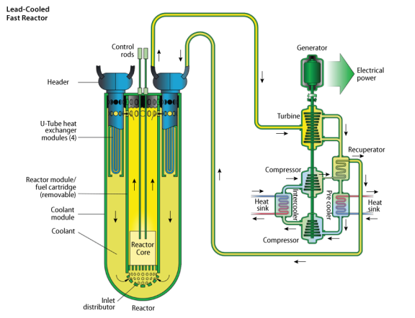
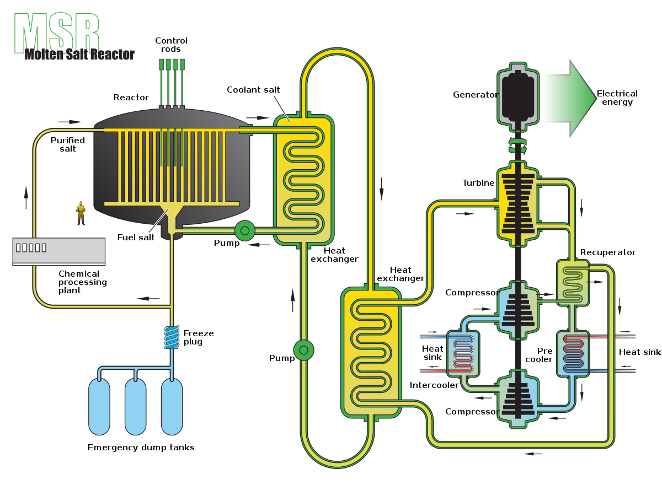
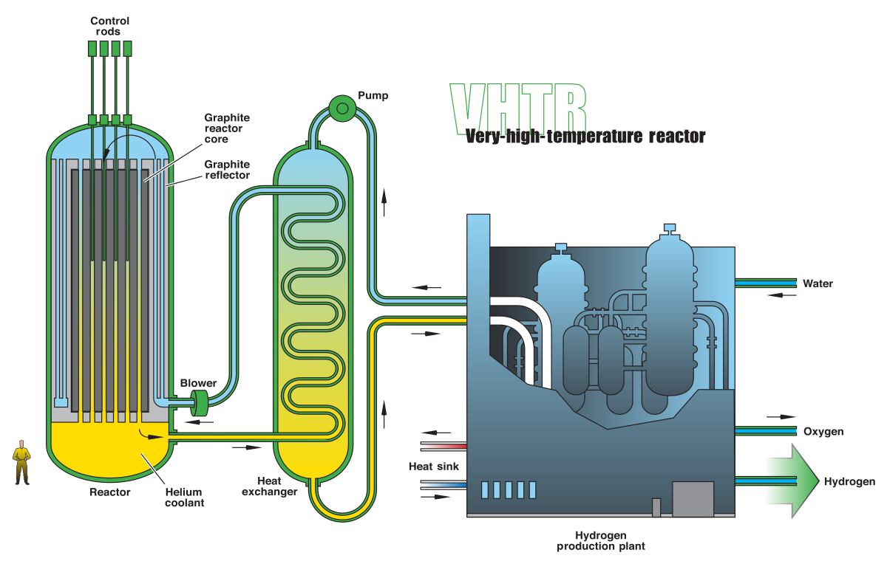
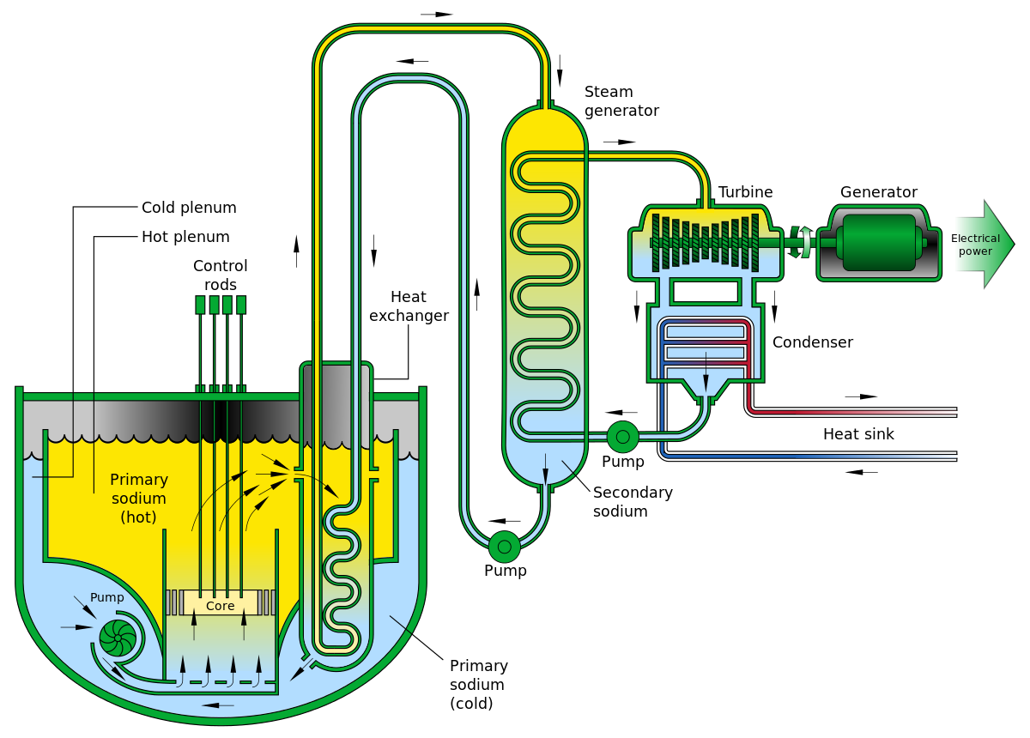
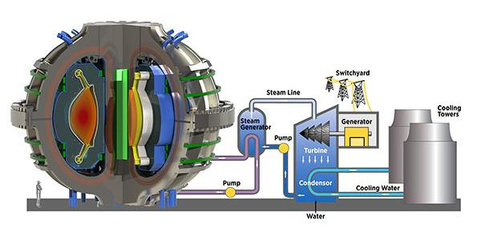
KI decisions for advanced nuclear are technology dependent

Slide 15
NRC is actively supporting effective KI policy
Frequently Asked Questions About Potassium Iodide
https://www.nrc.gov/about-nrc/emerg-preparedness/about-emerg-preparedness/potassium-iodide/ki-faq.html
Use of Potassium Iodide
https://www.nrc.gov/about-nrc/emerg-preparedness/about-emerg-preparedness/potassium-iodide-use.html
Contact
Todd Smith, PhD
todd.smith@nrc.gov
Jonathan Fiske
jonathan.fiske@nrc.gov

Slide 16
Thank you

