Slide 1
Applicability of Current Atmospheric Dispersion Models for Extreme, Persistent Cold Locations
Michael D. Mazaika.
U.S. NRC, Physical Scientist (Meteorologist)
May 13, 2025

Slide 2
Acronyms
ANS – American Nuclear Society
COL – Combined Construction / Operating License
CP – Construction Permit
DC – Design Certification
D/Q – Relative Deposition
EAB – Exclusion Area Boundary
EPA – U.S. Environmental Protection Agency
EPZ – Emergency Planning Zone
ESP – Early Site Permit
LPZ – Low Population Zone
ML – Manufacturing License
NASA – National Aeronautics & Space Admin
NCEI – National Centers for Environmental Information
NEI – Nuclear Energy Institute
NOAA – National Oceanic & Atmospheric Administration
NRC – U.S. Nuclear Regulatory Commission
OL – Operating License
QA/QC – Quality Assurance / Quality Control
RAWS – Remote Automated Weather Station
SDA – Standard Design Approval
WRCC – Western Regional Climate Center
X/Q – Relative Concentration
2

Slide 3
Aims of NRC’s Cold Regions Future Focused Research Project
Support development of comprehensive, discipline-specific regulatory guidance for advanced reactor designs
Provide strategic information that can be used in decision making
Minimize need for customized analyses by licensees and applicants, and for customized NRC staff reviews
Begin to identify and understand limitations of current NRC dispersion models and meteorological (Met) inputs if advanced reactors are deployed where subject to extreme and/or persistent cold conditions (e.g., as in Alaska)
3

Slide 4
Next Generation of Advanced Reactor Designs
Small Modular Reactors (SMRs)
Liquid Metal-Cooled Fast Reactors (LMFRs)
High Temperature Gas-Cooled Reactors (HTGRs)
Molten Salt Reactors (MSRs)
Micro-Reactors (Stationary)
4

Slide 5
A Process for Deciding If Atmos. Dispersion Modeling and Met Monitoring Is Needed
(These positions on when Met monitoring and dispersion modeling is needed is based a future focused research project and do not reflect an NRC established position)
No Accident or Routine Releases
Applicant’s dose analysts demonstrate no airborne radiological releases
NRC staff agrees technically and per regulations / guidance
Dispersion modeling and Met monitoring doesn’t appear to be necessary
However, some modeling with screening Met data may be valuable for community relations purposes
Accident / Routine Releases Not Minimal
Applicant’s dose analysts show airborne radiological releases / dose impacts are significant or can’t show them to be minimal
NRC staff agrees on significance or shows releases / dose impacts are significant technically and per regulations / guidance
Dispersion modeling and Met monitoring needed
Accident / Routine Releases Minimal
Applicant’s dose analysts show airborne radiological releases / dose impacts will be minimal
NRC staff agrees technically and per regulations / guidance
Dispersion modeling using screening Met data rather than monitoring may be appropriate
Some modeling with screening Met data may also be valuable for community relations purposes
5

Slide 6
Who, What, and When ?
Who --- Applicant’s dose analysts as confirmed by NRC dose analysts with support, as needed, from respective Met staffs. Applications may be for CPs, OLs, ESPs, COLs, DCs, SDAs, MLs.
What --- If needed, Met monitoring > dispersion modeling > dose analyses
Met monitoring includes siting, installation, operation and maintenance, QA/QC, data processing and validation, developing model inputs (does not apply to DCs, SDAs, and MLs)
Accident dispersion modeling estimates offsite X/Qs at EAB and LPZ and onsite X/Qs for specific accident release scenarios at numerous source–receptor pairs
Routine release dispersion modeling estimates X/Qs and D/Qs typically at specific offsite receptors and distances, and for distance segments. Supports population and other dose calculations, radiological monitor siting, operations.
Dose analyses use, in part, dispersion modeling results as direct inputs to calculations
When --- Long-lead item. Per Reg Guide 1.23 (regulatory approach), one consecutive year for CP, two consecutive years for OL, ESP, or COL applications. Three or more years preferred with data not older than 10 years. Long-lead duration recognized by industry (ANS-3.11 and NEI). DC, SDA, and ML applicants would use Met data representative of where their designs might be deployed.
6

Slide 7
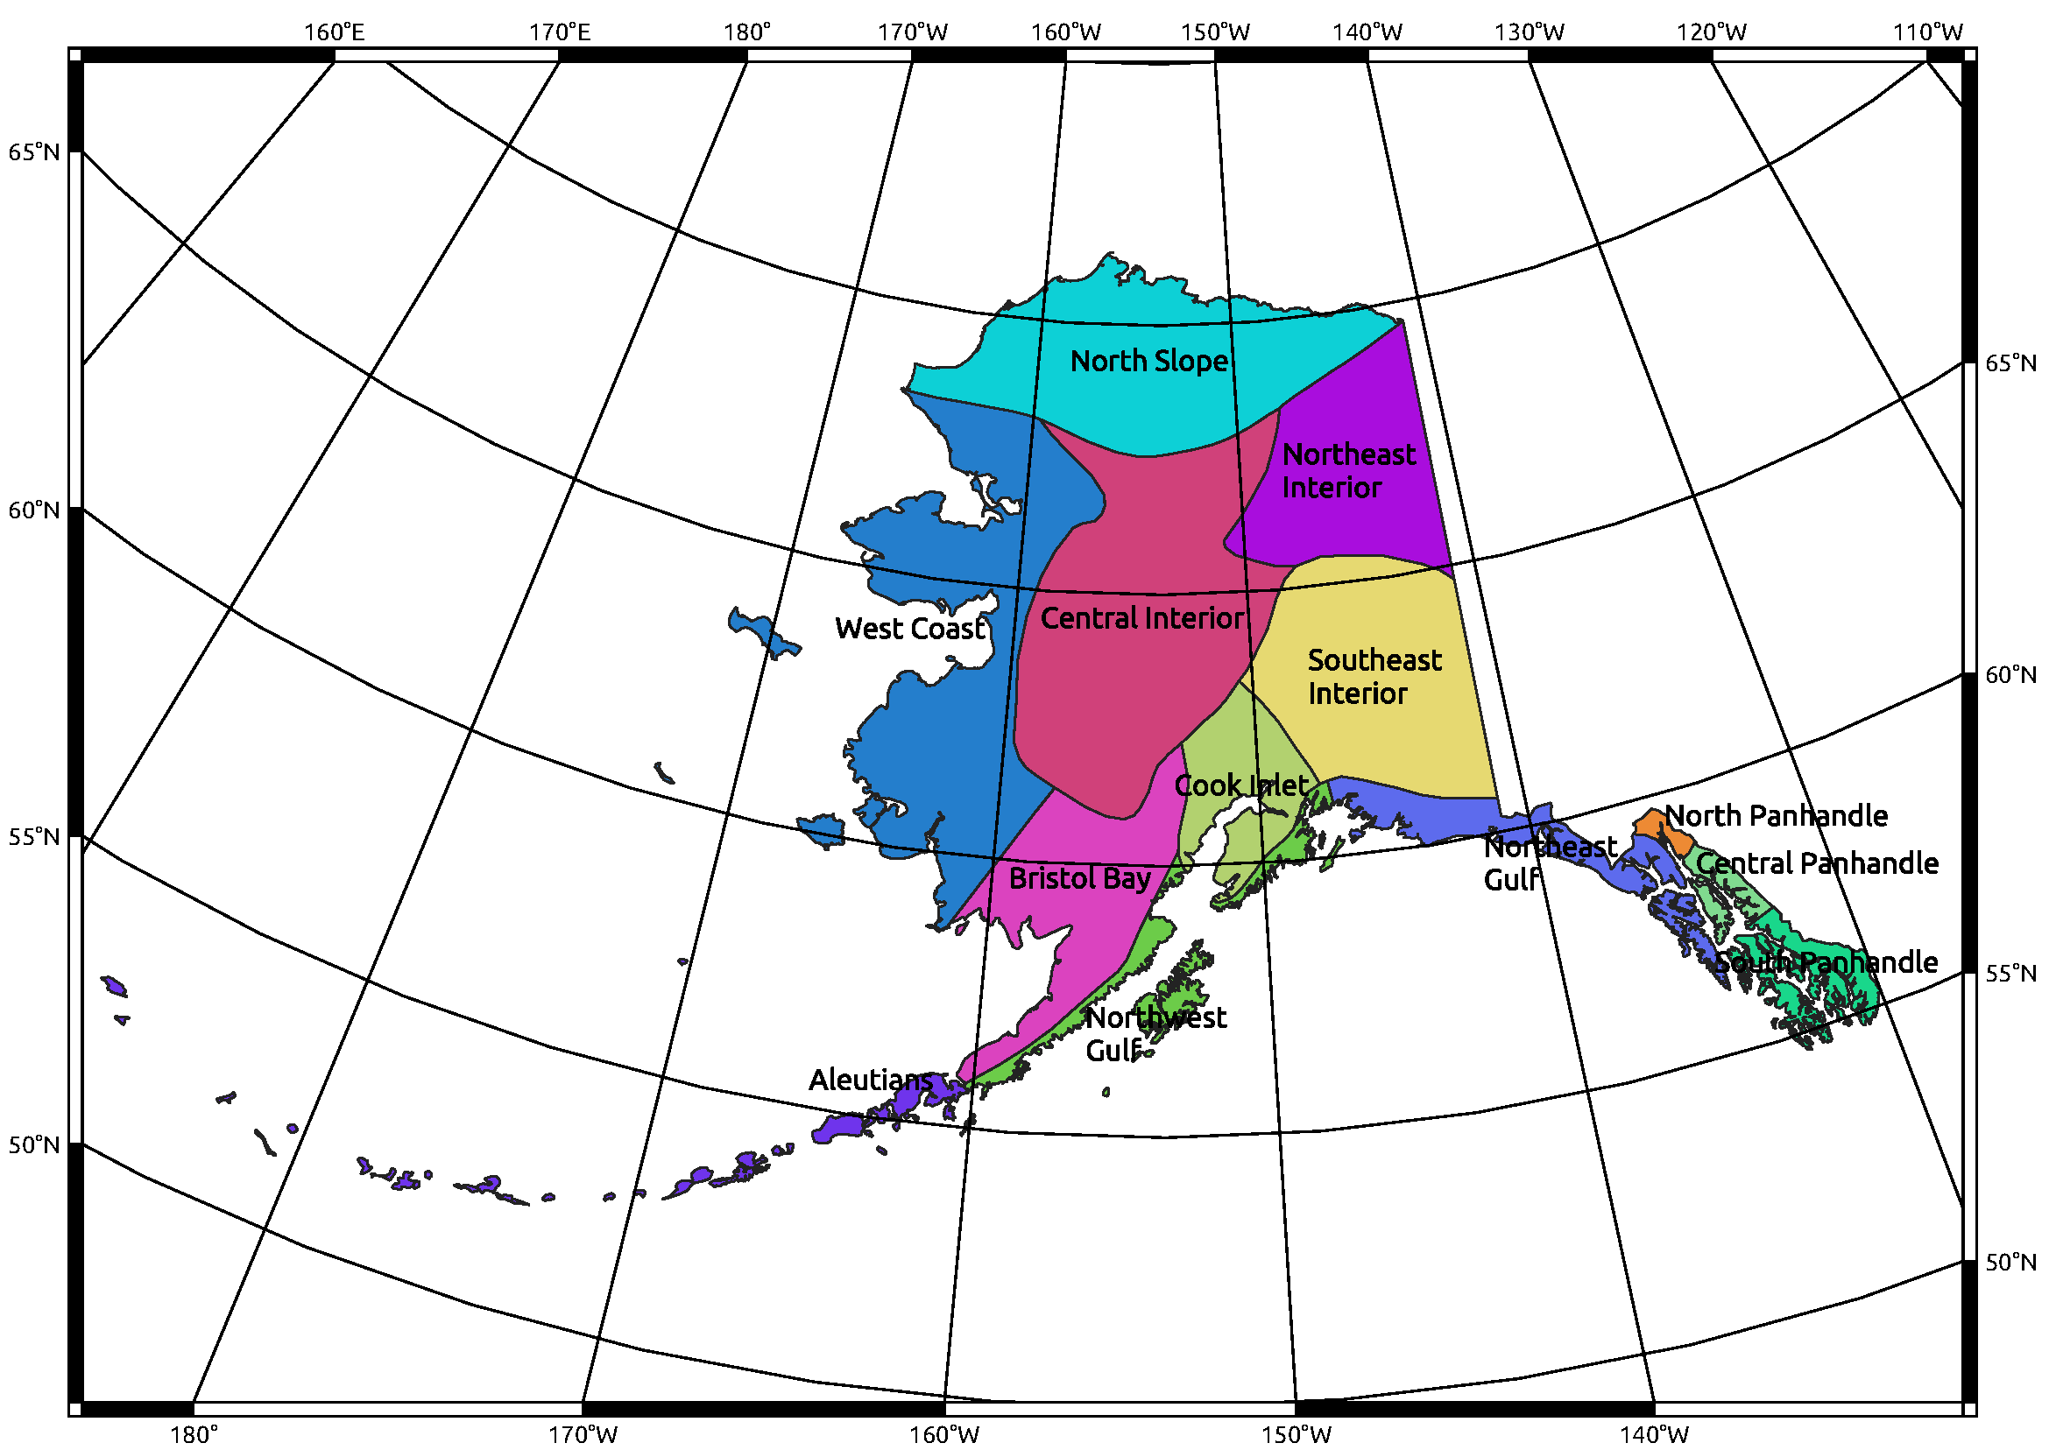
Where ?
Fast Facts
Lat (~ 71 to 52 deg N), ~1100 mi (N-S)
Lon (~ -130 to -177 deg W), ~2000 mi (E-W)
Coastline (~ 33000 mi, Beaufort Sea, Chukchi Sea, Bering Strait, Gulf of Alaska)
Mtn. Ranges – Brooks, Alaska-Aleutian, Chugach, Wrangell, St. Elias (Coast Range)
12 Major Rivers, 3 Major Tributaries - Yukon
13 Climate Divisions (NOAA-NCEI)
5 Climate Zones (WRCC) – Maritime, Maritime-Continental, Transition, Continental, Arctic
Temps – Annual Avg (40° to 10°) S to N, Seasonal range generally increases S to N, and from Maritime to Continental
Precip (Rain, Snow) – Significant decreases S/SW to N, and from Maritime to Continental
7

Slide 8
Why ?
Existing commercial LWR fleet in U.S. deployed in Lower 48 states
Some advanced reactor designs may be deployed in Alaska (and other cold regions)
Current NRC dispersion models old, based on limited field studies in Lower 48 conducted many years ago, model results generally conservative per defense-in-depth
Current regulatory guidance developed based on above but with caveats on model use
Other models (e.g., EPA, National Labs), Met data, and other model inputs are alternate approaches = custom analyses by applicants + custom reviews by Staff
Atmos. dispersion may be different in cold regions (e.g., longer persistence of poor dispersion conditions = potentially higher doses)
Dispersion conditions vary by location, may need different seasonal modeling approaches
Logistical issues for Met monitoring (weather, remote sites, maintenance, QA/QC, wildlife)
8

Slide 9
A Deeper Look at Why We May Not Even Know What We Don’t Know!
Duration of sunlight and intensity of solar radiation
Frequency of calm winds and low wind speeds
Boundary layer, mixing height, and temperature inversions
Persistence of restrictive dispersion conditions
Presence of thermal internal boundary layers (TIBLs)
Precipitation frequency and intensity
Length of growing season
Topography (including presence of sea & river ice)
9

Slide 10
Atmospheric Dispersion Conditions
Atmospheric dispersion has two parts:
Transport – where does a release go and how fast does it get there
Diffusion – how much does a release spread in the horizontal and vertical as it travels
Transport:
Where depends on wind direction(s) at plume height
Plume height depends on release temperature, exit velocity, and ambient temperature
How fast (or slow) depends on wind speed
Diffusion or plume spread:
Plume spread defines volume of air that release mixes into
Volume controls dilution and dilution depends on physical and mechanical turbulence
NRC defines turbulence (physical by stability class, mechanical by structural wake)
10

Slide 11
Example 1 (1 of 2) – Duration of Sunlight (Hrs:Min) Source: NASA, Goddard Institute for Space Studies, “ModelEAR5 Simulations”
 | Utqiagvik (Barrow) | Fairbanks | Anchorage | Annette
Jan | 0:00 | 4:03 | 5:40 | 7:17
Feb | 4:16 | 6:59 | 7:48 | 8:47
Mar | 9:25 | 10:10 | 10:26 | 10:47
Apr | 14:17 | 13:39 | 13:25 | 13:07
May | 19:50 | 17:05 | 16:15 | 15:18
Jun | 24:00 | 20:37 | 18:45 | 17:02
Jul | 24:00 | 21:26 | 19:11 | 17:18
Aug | 23:33 | 18:10 | 17:05 | 15:54
Sep | 15:40 | 14:37 | 14:14 | 13:46
Oct | 10:59 | 11:17 | 11:24 | 11:33
Nov | 5:49 | 7:49 | 8:30 | 9:17
Dec | 0:00 | 4:40 | 6:05 | 7:34
11

Slide 12
Example 1 (2 of 2) – Avg. Solar Intensity (Watts/M**2) Source: NASA, Goddard Institute for Space Studies, “ModelEAR5 Simulations”
 | Utqiagvik (Barrow) | Fairbanks | Anchorage | Annette
Jan | 1.67 | 20.02 | 39.19 | 77.30
Feb | 34.11 | 73.40 | 97.81 | 139.95
Mar | 130.47 | 174.24 | 198.58 | 237.80
Apr | 269.97 | 301.19 | 318.91 | 346.97
May | 409.45 | 413.11 | 420.47 | 433.88
Jun | 483.29 | 467.83 | 468.44 | 473.25
Jul | 440.78 | 436.88 | 441.08 | 450.58
Aug | 313.81 | 337.10 | 351.37 | 374.67
Sep | 171.29 | 212.73 | 235.20 | 271.40
Oct | 59.13 | 101.44 | 126.14 | 167.92
Nov | 7.13 | 30.86 | 51.63 | 91.06
Dec | 0:00 | 7.01 | 23.47 | 59.22
12

Slide 13
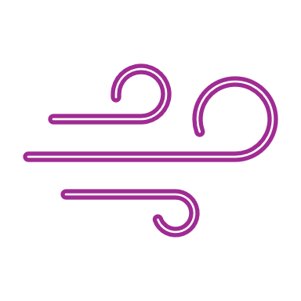
Example 2 (1 of 4) January Frequency of Nighttime Calm Winds
13

Slide 14
Example 2 (2 of 4) June Frequency of Nighttime Calm Winds
14

Slide 15
Example 2 (3 of 4) January Frequency of Daytime Calm Winds
15

Slide 16
Example 2 (4 of 4) June Frequency of Daytime Calm Winds
16

Slide 17
Example 3 – Mixing Height & Temperature Inversions
Boundary Layer:
Lowest 1 to 2 kilometers above Earth’s surface
Mixing Height:
Depth above earth’s surface through which relatively vigorous mixing of air (and pollutants within it) takes place
Varies seasonally and from day-to-day depending on cloud cover, wind speed, weather patterns, etc.
Temperature Inversions:
Ambient temperature usually decreases with height
An inversion is an increase of temperature with height that acts like a lid
Usually at high altitudes during the day, starts at or closer to the ground at night due to radiational cooling
Photo of Salem Power Plant in Massachusetts by Ralph Turcotte, Beverly Times
17

Slide 18
Some Takeaways – Getting There From Here
Size of advanced reactor and site footprint doesn’t affect all disciplines and technical reviews the same.
Design development is a business decision and should consider range of climate and Met conditions to account for potential site locations.
Met monitoring is generally a long lead-time item; even more so in remote locations subject to extreme and/or persistent cold.
NRC modeling and Met monitoring guidance preferred. Alternate approaches allowed if justified but customized analyses by applicants and reviews by NRC staff needed.
Maximum dispersion impacts, locations, doses, and sizing of EPZ may be affected by location, persistence, and/or time of year.
Multiple long- and/or short-term modeling analyses or modeling approaches may be needed for licensing if conditions vary significantly.
Community relations may be important as consent-based siting approaches for nuclear facilities continues to develop.
18

Slide 19
Contact michael.mazaika@nrc.gov for additional info
19

