Slide 1
Draft New Reactor Generic Environmental Impact Statement and Proposed Rule
Stacey Imboden
Senior Project Manager
NRC Office of Nuclear Material Safety and Safeguards

Slide 2
Agenda
NEPA Overview
Purpose of the Generic Environmental Impact Statement for Licensing of New Nuclear Reactors (NR GEIS)
Background
Process and Methodology
Preliminary Findings of the NR GEIS
Proposed Amendments to 10 CFR Part 51
Schedule

Slide 3
NEPA and the NRC
National Environmental Policy Act (NEPA) of 1969
Requires Federal agencies to assess environmental impacts of their proposed actions
Informs Federal decision making
Involves public disclosure of environmental impacts and other considerations
NRC’s Environmental Regulations are in 10 CFR Part 51
Issuance of a construction permit, operating license, or early site permit for a new reactor requires an environmental impact statement (EIS) under 10 CFR 51.20

Slide 4
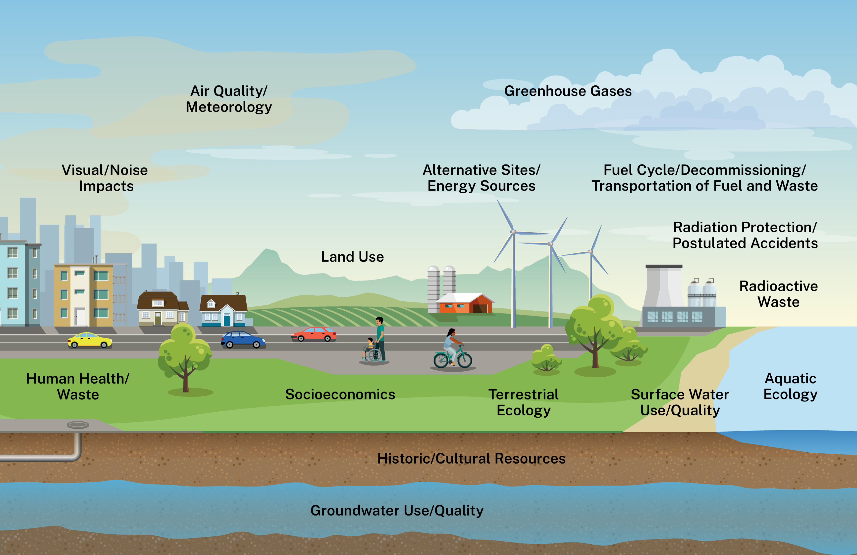
Resource Areas Considered in NRC NEPA Reviews

Slide 5
Purpose of the NR GEIS
Present impact analyses for environmental issues common to many new nuclear reactors that can be addressed generically, and improve licensing efficiency, by:
Eliminating the need to reproduce the same analyses during licensing reviews
Allowing NRC staff to focus environmental review efforts on issues that can only be resolved once a site is identified
Identifying the possible types of environmental impacts of constructing, operating and decommissioning a nuclear reactor
Assessing impacts that are expected to be generic (the same or similar) for many nuclear reactors
Defining the environmental issues that will need to be addressed in project-specific supplemental environmental impact statements (SEISs)

Slide 6
Background
Nov. 15, 2019 | NRC initiates an exploratory process to determine the possible utility of developing a GEIS for licensing advanced nuclear reactors (84 FR 62559)
Feb. 28, 2020 | NRC staff informs the Commission that it has concluded that developing a GEIS is viable and would generically resolve many environmental issues, reduce licensing review time and costs, and increase regulatory stability and predictability for applicants (SECY-20-0020)
Apr. 30, 2020 | NRC issues a Notice of Intent to prepare the GEIS (85 FR 24040)
Sept. 21, 2020 | Commission approves the development of the GEIS, and directs staff to codify the results of the GEIS (SRM-SECY-20-0020)
Nov. 29, 2021 | Proposed rule and draft GEIS sent to the Commission (SECY-21-0098)
Apr. 18, 2024 | Commission approves proposed rule and draft GEIS for publication subject to edits and comments (SRM-SECY-21-0098)
Oct. 4, 2024 | NRC issues Notice of Availability for proposed rule and draft GEIS for public comment (89 FR 80797)

Slide 7
SRM-SECY-21-0098 (April 18, 2024)
NRC Commission approved publication of the proposed rule subject to the following:
Change the limited applicability of the GEIS from solely “advanced nuclear reactors” to any new nuclear reactor application
Provided the application meets the values and assumptions of the plant parameter envelope (PPE) and site parameter envelope (SPE) used to develop the GEIS
Clarify that any applicable site-specific and conditionally site-specific issues identified in the Decommissioning GEIS will need to be addressed in project-specific environmental reviews
Remove references to fusion reactors
Include a provision requiring a review of the GEIS every 10 years

Slide 8
Process and Methodology
Technology-neutral, performance-based approach using a plant parameter envelope (PPE) and a site parameter envelope (SPE)
PPE – consists of parameters for specific reactor design features regardless of the site
For example: reactor footprint, building height, water use, air emissions, employment levels, noise generation levels
SPE – consists of parameters specific to the location where the reactor may be sited
For example: site size, size of water bodies supplying water to the reactor, demographics

Slide 9
Process and Methodology (continued)
For each PPE and SPE parameter, the NRC developed a set of bounding values and assumptions based upon:
Regulatory limits and permitting requirements relevant to the resource as established by Federal, State, or local agencies
Relevant information obtained from other NRC GEISs
Empirical knowledge gained from conducting evaluations and analyses for past new reactor EISs and operating reactor SEISs
Values and assumptions derived from other documents applying a PPE/SPE approach
Subject matter expertise and/or development of calculations and formulas based upon education and experience with the resource

Slide 10
Process and Methodology (continued)
Each issue was assigned a category as follows:
Category 1 issues – environmental issues for which a generic analysis concluding SMALL adverse environmental impacts is possible, provided that relevant values and assumptions in the PPE and SPE are met, or beneficial impacts
Category 2 issues – environmental issues for which a meaningful generic analysis of environmental impacts is not possible because the issue requires consideration of project-specific information
N/A (Uncertain) issues – environmental impacts of these issues are uncertain

Slide 11
Preliminary Findings
122 total issues in 16 environmental resource areas:
100 Category 1 issues
20 Category 2 issues
2 N/A (Uncertain) issues
Table 4-1 of the NR GEIS includes a list of all issues and relevant PPE/SPE values and assumptions, as applicable:
The bases for these values and assumptions are included in Appendix G of the NR GEIS
NRC proposes to codify these generic findings (Category 1 issues) in 10 CFR Part 51

Slide 12
Category 1 Issue Example
ISSUE | FINDING | PPE/SPE VALUES AND ASSUMPTIONS
Onsite Land Use | Small | The proposed project, including any associated land uses, complies with NRC siting regulations in 10 CFR Part 100. The site size is 100 ac or less. The permanent footprint of disturbance includes 30 ac or less of vegetated lands, and the temporary footprint of disturbance includes no more than an additional 20 ac or less of vegetated lands. The proposed project complies with the site’s zoning and is consistent with any relevant land use plans or comprehensive plans. The site would not be situated closer than 0.5 mi to existing residential areas or 1.0 mi to sensitive land uses such as Federal, State, or local parks; wildlife refuges; conservation lands; Wild and Scenic Rivers; or Natural Heritage Rivers. The site does not have a history of past industrial use capable of leaving a legacy of contamination requiring cleanup to protect human health and the environment. The total wetland loss from use of the site, including use of any offsite rights-of-way, would be no more than 0.5 ac. Best management practices for erosion, sediment control, and stormwater management would be used. Compliance with any mitigation measures established through zoning ordinances, local building permits, site use permits, or other land use authorizations.

Slide 13
Category 2 Issue Example
ISSUE | FINDING | PPE/SPE VALUES AND ASSUMPTIONS
Surface Water Quality Degradation Due to Chemical and Thermal Discharges | Undetermined | The staff determined that a generic analysis to determine operational impacts on surface water quality due to chemical and thermal discharges was not possible because (1) some States may impose effluent constituent limitations more stringent that those required by the EPA, (2) limitations imposed on effluent constituents may vary among States, and (3) the establishment of a mixing zone may be required. Because all of these issues related to degradation of surface water quality from chemical and thermal discharges require consideration of project-specific information, a project-specific assessment should be performed in the SEIS.

Slide 14
Implementation of the NR GEIS
Applicants may rely on Category 1 NR GEIS findings in their environmental report without further analysis, provided that:
They demonstrate that the relevant values and assumptions of the PPE and SPE used in the resource analysis are met
There is no new and significant information that would require project-specific analysis
NRC Staff would:
Verify the PPE/SPE demonstration for Category 1 issues
Audit the applicant’s new and significant process
Produce a SEIS that focuses on Category 2 issues and Category 1 issues that do not meet the PPE/SPE values

Slide 15
Proposed Amendments to 10 CFR Part 51
Add a new appendix C to subpart A of 10 CFR Part 51 to codify the NR GEIS generic findings
Require that on a 10-year cycle, the Commission intends to review the material in appendix C and update if necessary
Revise § 51.50 to provide applicants with the option to use the NR GEIS when preparing environmental reports for new reactors
Revise § 51.75 to require the NRC staff to use the NR GEIS in preparing its draft EIS if an applicant referenced the NR GEIS in its application
Add a new section (§ 51.96) to provide the NRC staff with directions on preparing its final EIS referencing the NR GEIS

Slide 16
Key Supporting Documents
DOCUMENT NAME | ACCESSION #
Draft Generic Environmental Impact Statement for Licensing of New Nuclear Reactors, NUREG-2249 (NR GEIS) | ML24176A220
Federal Register Notice for the Generic Environmental Impact Statement for Licensing of New Nuclear Reactors (proposed rule) | ML24176A216
Draft Regulatory Analysis for the 10 CFR Part 51, Generic Environmental Impact Statement for Licensing of New Nuclear Reactors | ML24176A218
Draft Regulatory Guide - Preparation of Environmental Reports for Nuclear Power Stations (Draft Regulatory Guide DG-4032/Proposed Revision 4 to Regulatory Guide 4.2) | ML24176A228
Draft Interim Staff Guidance – Environmental Considerations for New Nuclear Reactor Applications that Reference the Generic Environmental Impact Statement for Licensing of New Nuclear Reactors (NUREG-2249) | ML24176A231
Recommendations for an Applicant to Calculate Activity Data for Greenhouse Gases Estimates (GHG White Paper) | ML21225A768
Energy and System Design Mitigation Alternatives White Paper | ML21225A754

Slide 17
NR GEIS Rulemaking Schedule
Proposed Rule to the Commission
November 29, 2021
Proposed Rule Published (89 FR 80797)
October 4, 2024
Public Comment Period Ends
December 18, 2024
Final Rule to the Commission
December 1, 2025
Final Rule Published*
June 1, 2026
*The publication date is an estimate.

Slide 18
Questions/Comments Received on the Draft NR GEIS and Proposed Rule
Limited Work Authorizations – should the GEIS and rule be expanded to include NRC approval of LWAs?
Postulated Accidents – should this be a Category 1 issue?
Non-Resource Related Issues – should Purpose and Need, Need for Power, and Alternatives be Category 1 issues and/or are these issues at all?
EIS requirements – should Rule allow new reactor impacts to be addressed in environmental assessments or categorical exclusions instead of EISs?
Research and Test Reactors – is the GEIS applicable to these reactors?
Fiscal Responsibility Act and ADVANCE Act – what is the relationship between this GEIS and these laws?

Slide 19
Next Steps for the NRC Staff
Review and respond to substantive comments received on the NR GEIS
Update the NR GEIS, the rule, and supporting documents as appropriate
Send the revised rule to the Commission for review and approval by December 1, 2025

Slide 20
Thank you

