Slide 1
Canada-US Collaboration under the Memorandum of Cooperation (MOC)
Matthew Naraine
Advanced Reactor Licensing Division, CNSC
May 13, 2025

Slide 2
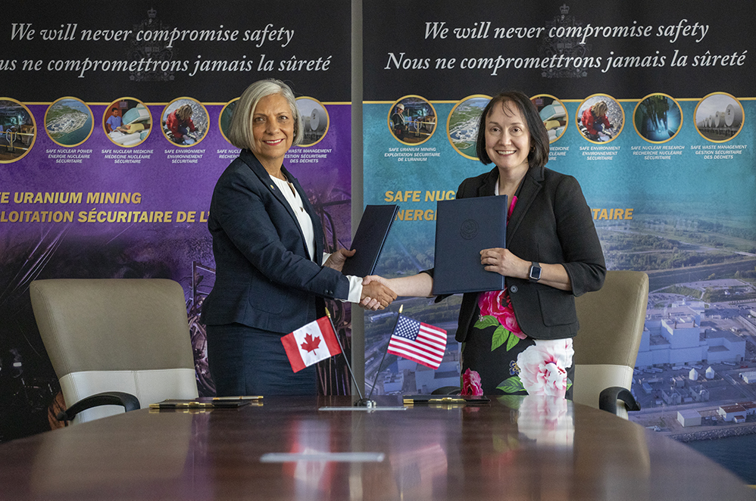
Background on Memorandum of Cooperation (MOC)
Trilateral MOC between CNSC, US NRC, and UK ONR
Signed in March 2024
Builds on the success of previous MOUs/MOCs since 2017
Mandate to share experiences in:
Pre-licensing, licensing and construction oversight for new builds
Computer codes, training and research
Joint reviews published online
Collaboration to enhance safety and agility in each country maintaining regulatory independence and sovereignty
2019

Slide 3
Benefits to the US and Canada
Perform joint review and verification activities of novel safety features
Share expertise and leverage analysis performed by each regulator
Align regulatory review approaches to extent practical
Expedited technical reviews with timely and informed conclusions

Slide 4
MOC Strategic Goals
Collaborate on technical reviews such as generic design of BWRX-300 to optimize schedule and resources for each country
Explore lifecycle collaboration (siting, construction, operation, etc.)
Demonstrate a model for successful international collaboration that other countries may adopt
Establish joint regulatory positions/conclusions that may serve as a foundation for regulatory approval by other regulators worldwide
Prepare for other vendors/applicants engaged in two or more countries (Westinghouse, etc.)
Strategic international collaboration yields mutual benefit by putting domestic priorities first

Slide 5
MOC Leadership
CNSC | US NRC | UK ONR
Director General, Directorate of Advanced Reactor Technologies (DART), Co-Chair | Director, Division of Advanced Reactors and Non-Power Production and Utilization Facilities (DANU), Co-Chair | Head of Regulation, Advanced Nuclear Technologies (ANT), Co-Chair
Director General, Directorate of Assessment & Analysis (DAA) | Director, Division of New and Renewed Licenses | Head of Regulation, Generic Design Assessment (GDA)
The Advanced Reactor Technologies and Small Modular Reactor Committee is supported by international experts acting as a single staff body

Slide 6
Collaboration on Siting and Environmental Topics
CNSC and Health Canada input to NRC Office of Nuclear Regulator Research
“Applicability of Current Atmospheric Dispersion Models for Extreme, Persistent Cold Locations” (ML25069A620)
NRC processes considered in development of CNSC fleet licensing approach
“Generic Environmental Impact Statement for Licensing New Nuclear Reactors” (NUREG-2249)
“Industry Guideline for Developing a Plant Parameter Envelope in Support of an Early Site Permit” (NEI 10-01)
Early engagement on regulatory approach to Brownfield Sites and Coal to Nuclear transitions with DOE, NRC, CNSC, CNL, NRCan, and more.
Lifecycle collaboration prioritizes the right activities at the right time for mutual benefit

Slide 7
Conclusions
International cooperation and implementing agreements enable exchange of scientific, technical and regulatory information that is relevant for computer codes like RAMP
The MOC is the blueprint for international regulatory collaboration on reviewing advanced reactors and small modular reactors (SMR)
CNSC and NRC staff are exploring siting and environmental topics under a lifecycle collaboration model
The strategic approach to international collaboration continues to realize mutual benefit to the US and Canada

Slide 8
Thank you

