Slide 1
RAMP OVERVIEW
Stephanie Bush-Goddard, Ph. D.
Senior Researcher
May 13th, 2025

Slide 2
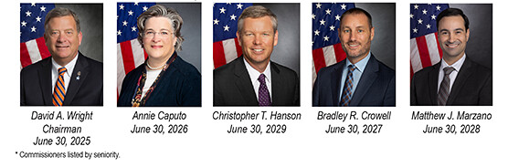
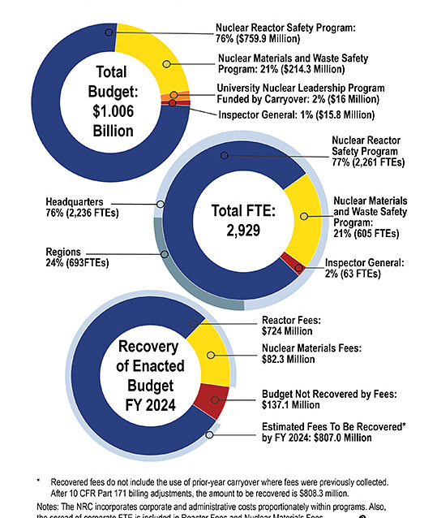
US NRC: Who we are.
2024-2025 Information Digest (ML25051A094)
NRC-licensed reactor generate 18.5% of U.S. gross electricity
94 commercial nuclear power reactors operating in 28 States
29 licensed research and test reactors operate in 21 States
~ 5,960 total inspection and assessment hours at each reactor
17,000 medical, academic, industrial and general use licensees
10 regional low-level compacts/4 disposal facilities
3 Reactor Fuel Vendors
3 Uranium Recovery Sites
9 Active Fuel Cycle Facilities
Track 80,000 sources, mostly Co-60

Slide 3
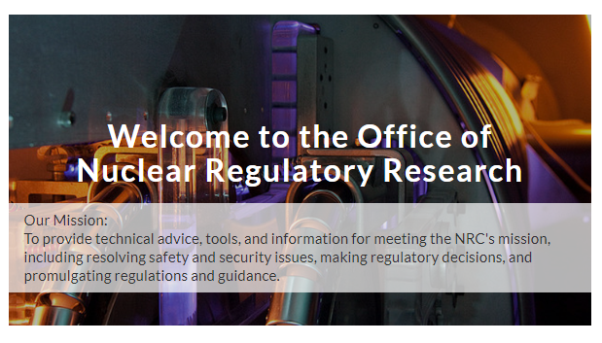
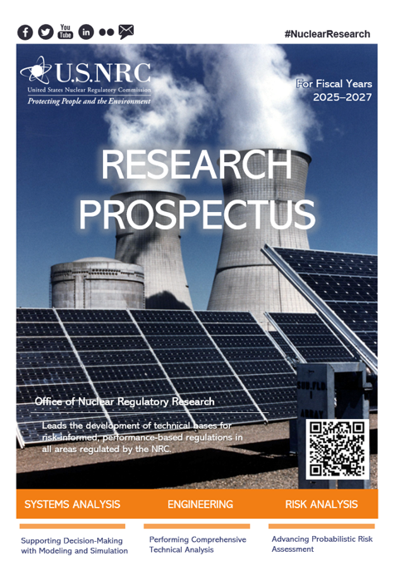
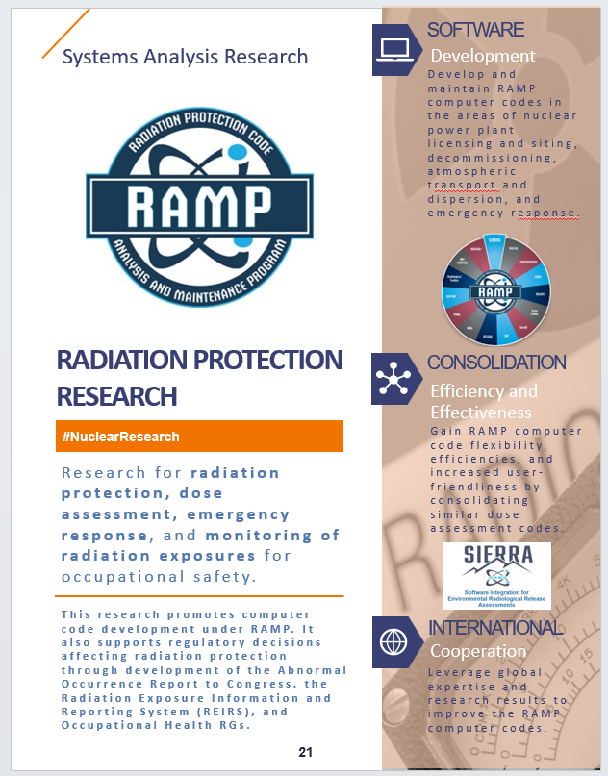
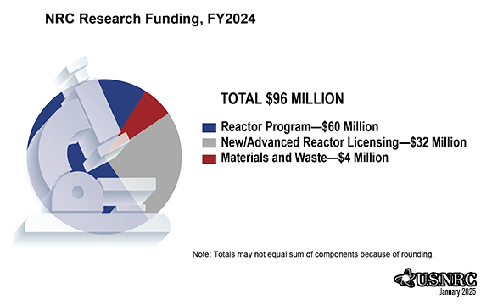
Office of Research: Who we are.

Slide 4
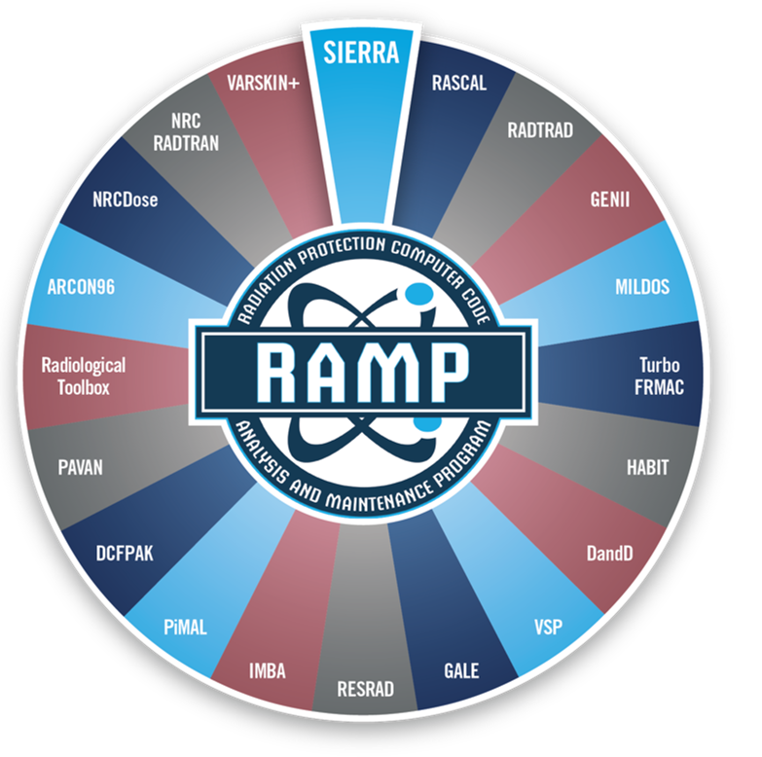
RAMP: Who we are:
Develop, maintain, improve, distribute, and provide training on NRC-sponsored radiation protection and dose assessment computer codes to be used for:
  Licensing
  Inspection
  Emergency Response
  Environmental Remediation
  Medical Activities, etc.

Slide 5
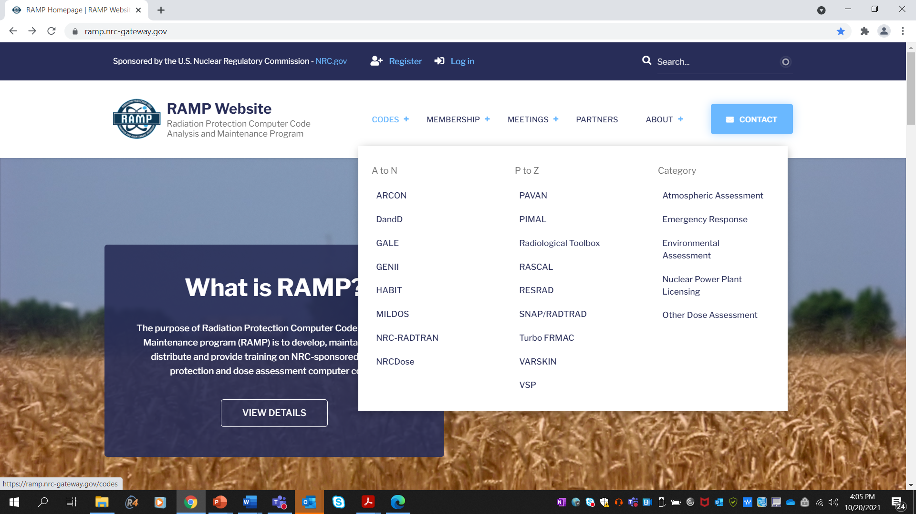
RAMP Website https://ramp.nrc-gateway.gov/
Major communication tool for RAMP
  Download most codes
  Documentation
  Training/webinar recordings
  Support
Current Activities
  More targeted communication
    Surveys
    Support
  Forums
  University Corner
  International pages

Slide 6
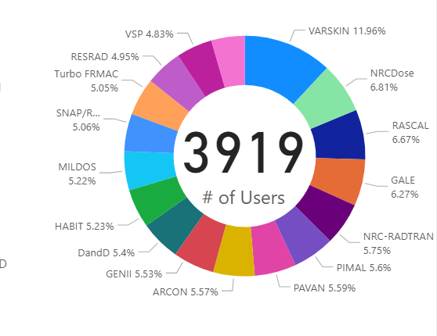
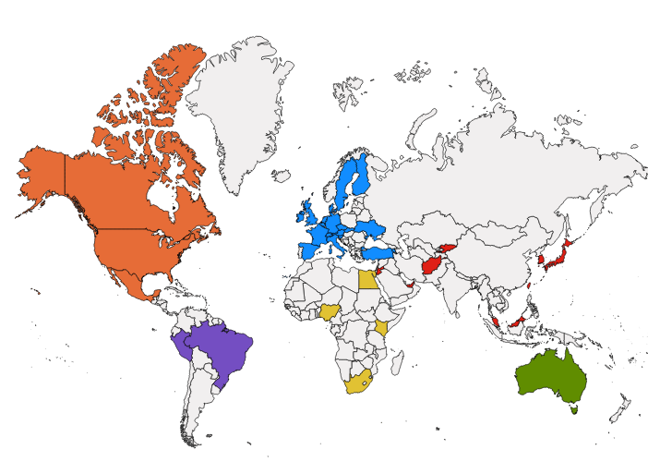
Users:
International Collaboration
100+ bilateral or multilateral agreements with over 20 countries :15 Agreements for RAMP
~3900 Members, including ~180 Canadian Members
Major Canadian RAMP Members
  CNSC
  Canadian National Lab
  Emergency Management Ontario
  Nuclear Waste Management Organization
Codes mostly used:
  RASCAL
  V+ (formally VARSKIN)
  NRC RADTRAN
Over 60 participants at this RAMP Meeting
  Representatives from 5 Countries
    Canada, Ghana, South Korea, US, Belgium

Slide 7
Codes in RAMP at this meeting.

Slide 8
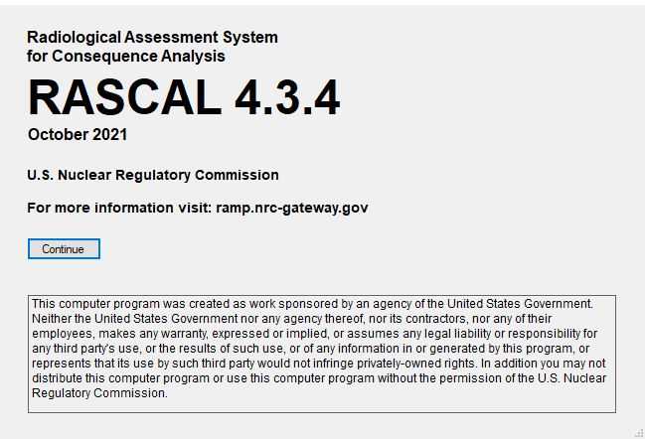

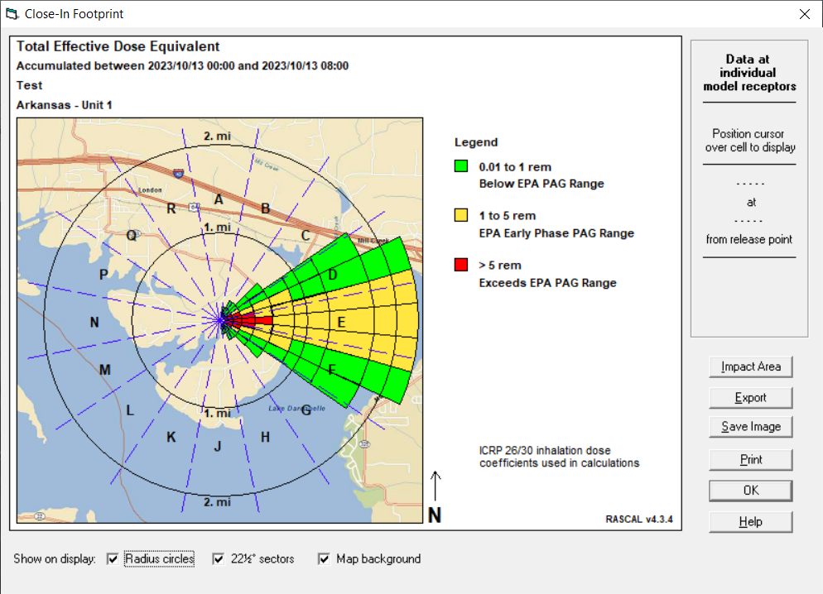
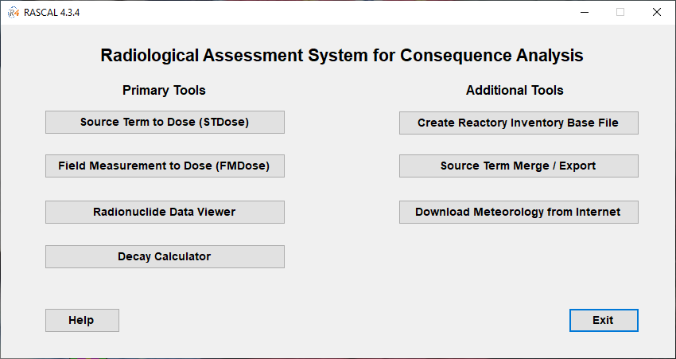
Emergency Response Codes
RASCAL
Radiological Assessment System for Consequence Analysis
Fast-running software used for beyond-design-basis radiological incidents to assess off-site dose consequences and to help inform or evaluate protective actions.
Current Activities:
  RASCAL v4.3.5 release date in early 2024.
  Beginning RASCAL 5.0 Development.
Mr. Rigel Flora,
US NRC
RASCAL Trainer

Slide 9
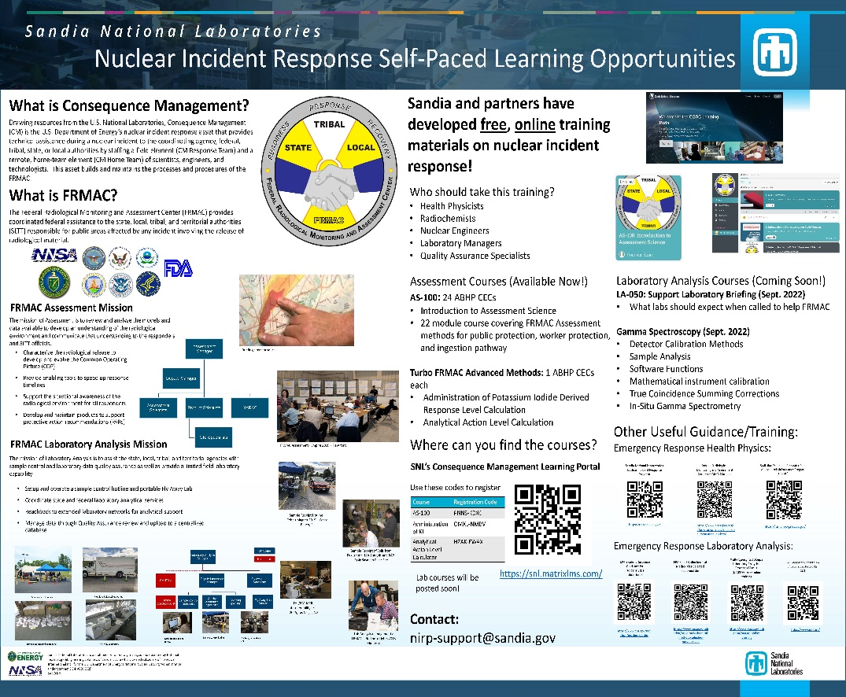
Emergency Response Codes
Turbo FRMAC
Performs complex calculations to quickly evaluate radiological hazards during an emergency response by assessing impacts to the public, workers, and the food supply.
Sandia National Laboratories maintains distribution of Turbo FRMAC, but RAMP users have access to code discussions, training, and technical support.
If you need technical support for Turbo FRMAC please email: nirp-support-fogbugs@sandia.gov
Autumn Kalinowski,
Sandia National Lab
Turbo FRMAC Trainer
https://nirp.sandia.gov/Software/TurboFRMAC/TurboFRMAC.aspx

Slide 10
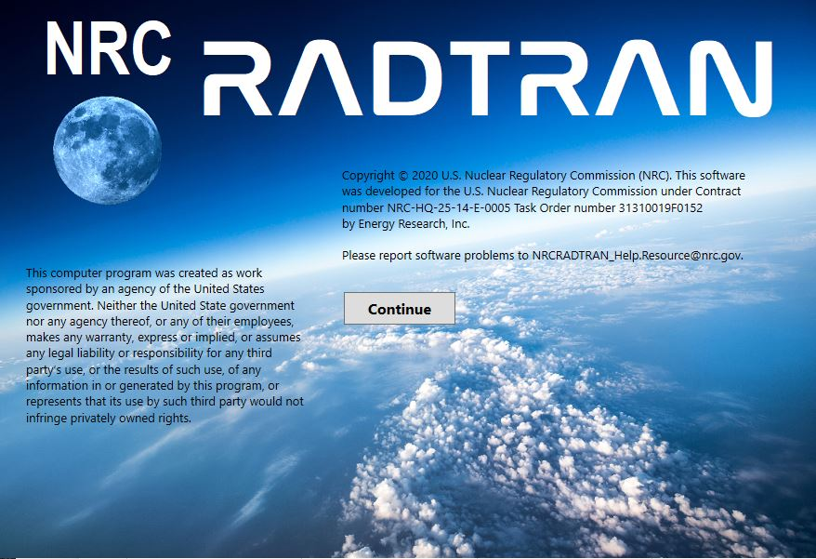
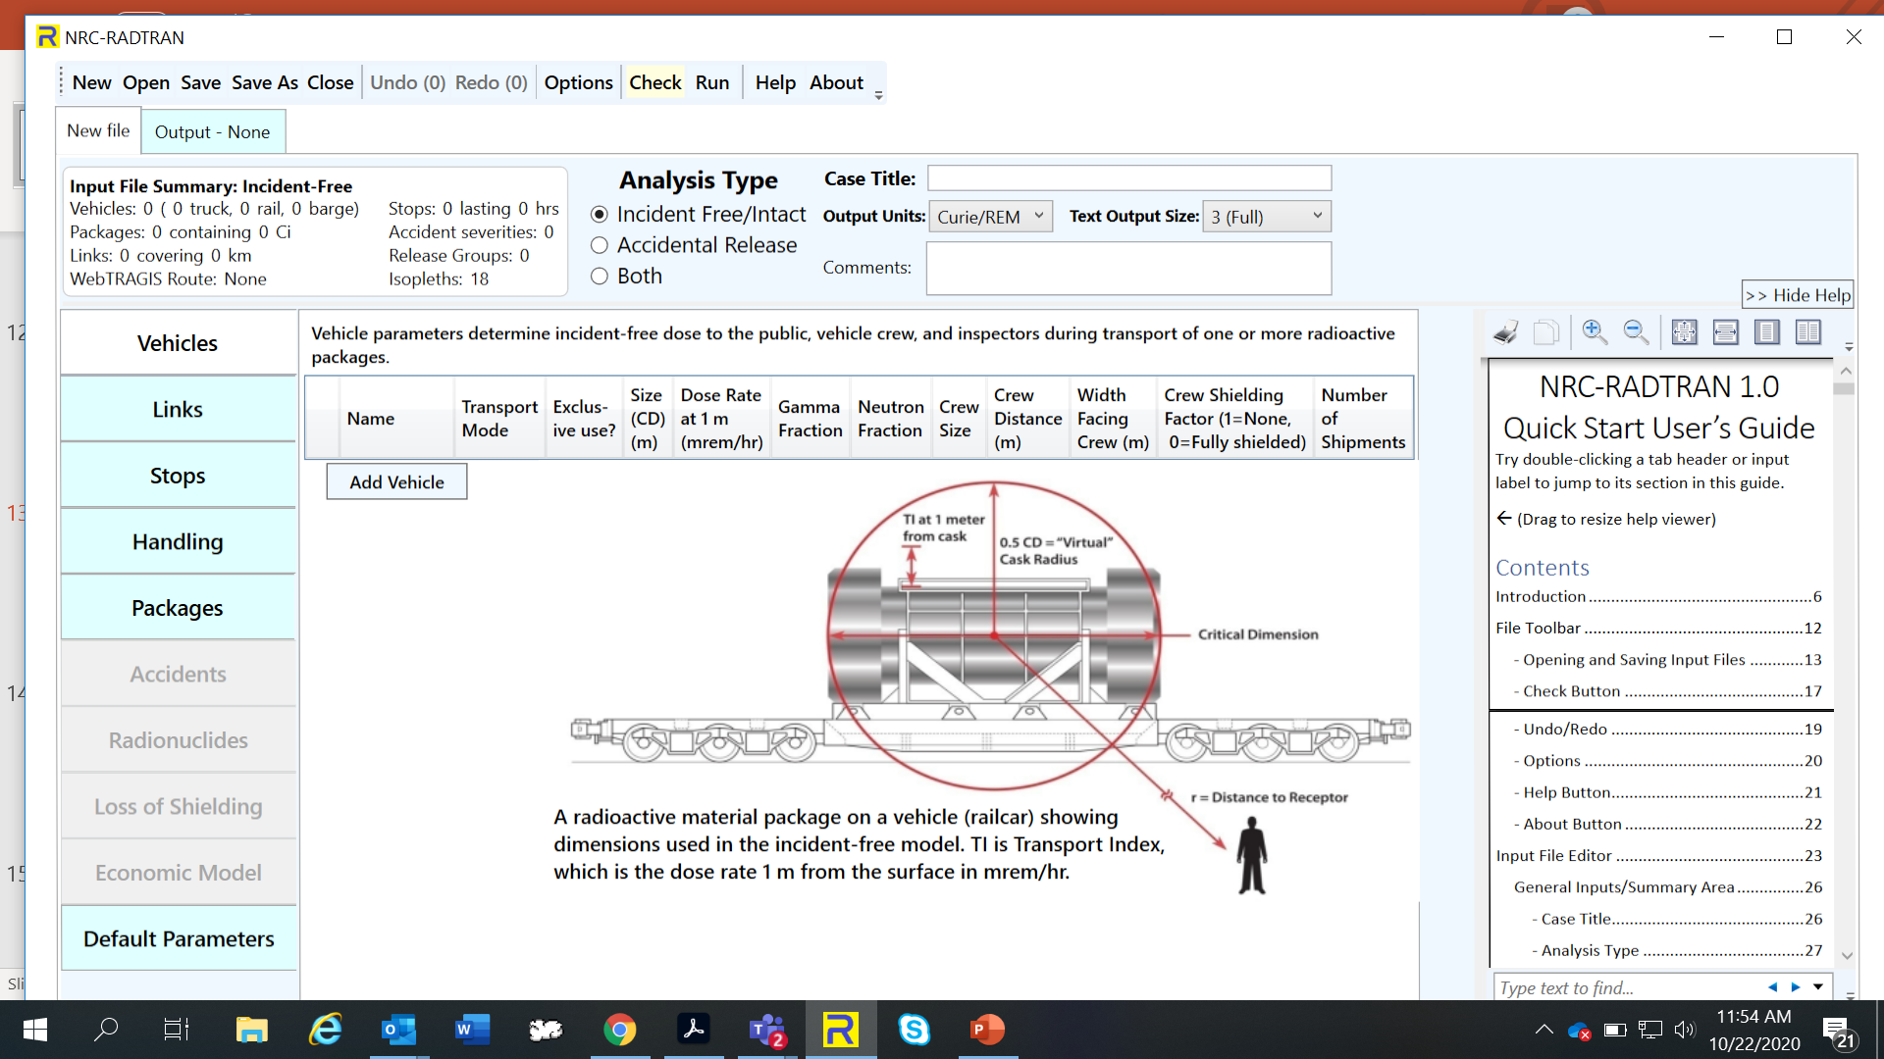

Licensing Support Codes
NRC-RADTRAN
Radioactive Material Transport
Code for risk and consequence analysis of radioactive material transportation.
Current Activities:
  Updated Code ‒ NRC-RADTRAN 1.1 to include:
    Develop WebTRAGIS alternatives.
    Sum population risk across all transportation links and fix errors while using >9 links.
    Implement coding changes to display default values in NRC-RADTRAN.,
    Implement GUI changes to include air cargo, air passenger, and other rail options.
Dr. Jon Napier,
Pacific Northwest Lab
NRC-RADTRAN Trainer
Notes:
Fix KML file errors for speed and population densities.
Develop WebTRAGIS alternatives.
Sum population risk across all transportation links and fix errors while using >9 links.
Implement coding changes to display default values in NRC-RADTRAN.,
Implement GUI changes to include air cargo, air passenger, and other rail options, and
Investigate and correct hard coded conversion factors.

Slide 11
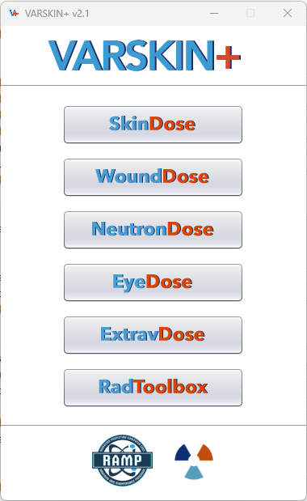
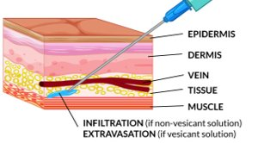

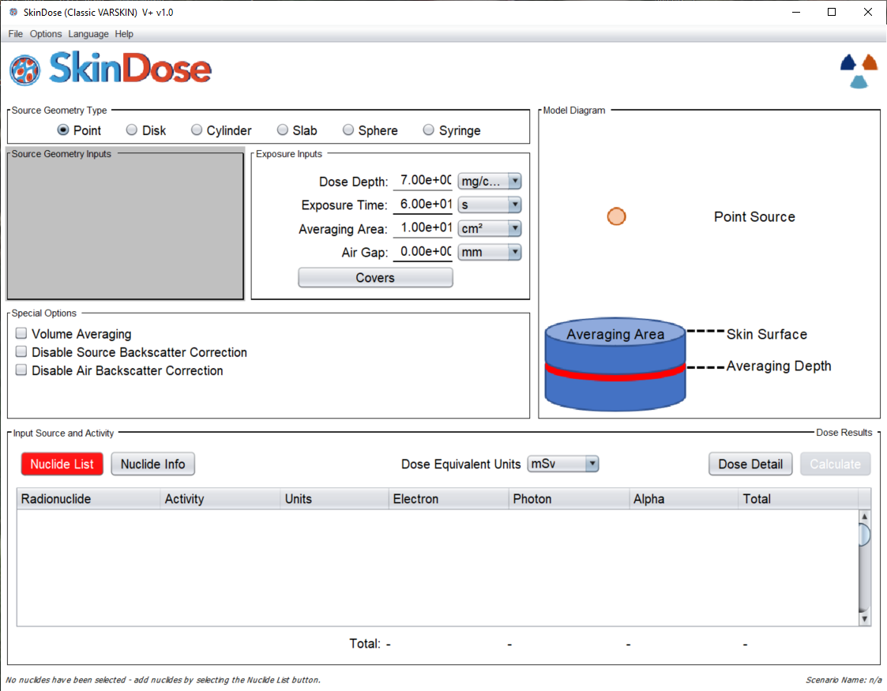
V+ (formally VARSKIN+)
Used to calculate occupational dose to the skin resulting from exposure to radiation emitted from contamination on or near skin.
Current Activities:
  Release of VARSKIN+ v1.2
    Improved Alpha Dosimetry.
    Improved Ingrown Decay Progeny Calculation
    Neutron Energy Degradation Model.
  Integrated the Radiological Toolbox
  Release of Extravasation Dose Module in FY24/25
Charlotte Rose,
Renaissance Code Development
V+ Trainer

Slide 12
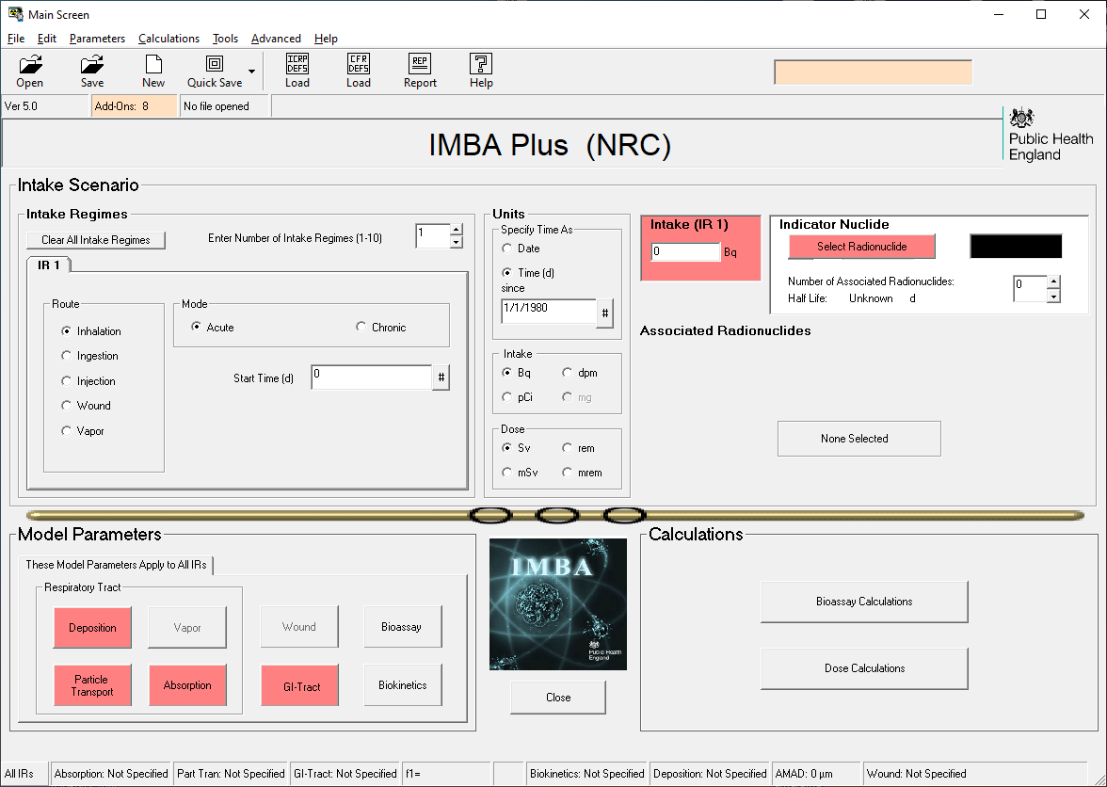
IMBA
Integrated Modules for Bioassay Analysis
A suite of modules for internal dosimetry that implements respiratory tract, GI-tract, tissue dosimetry, biokinetic, and bioassay models as recommended by the International Commission on Radiological Protection.
IMBA modules can estimate single or multiple intakes of different radionuclides and calculate resulting doses based on ICRP 68 and US 10 CFR 835.
Charlotte Rose,
Renaissance Code Development
V+ Trainer
Dr. Jon Napier,
NRC-RADTRAN Trainer

Slide 13
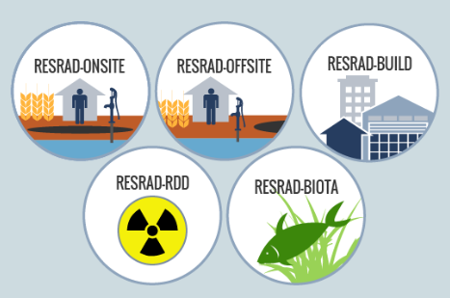
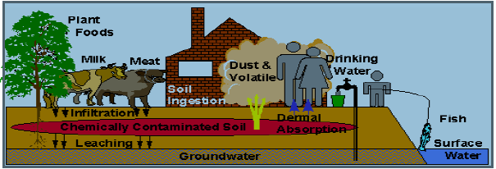
RESRAD- BIOTA
Residual Radioactivity
Family of codes used to analyze human and biota radiation exposures from environmental contamination of residual radioactive materials.
Uses pathway analysis to evaluate exposure and associated risks, which then informs cleanup criteria and authorized limits.
Current Activities:
  RESRAD ONSITE v8.0 FGR-15 DCFs.
Dr. Charlie Yu,
Argonne National Lab
Principle Investor

Slide 14
Are RAMP codes, such as RASCAL, fit-for-purpose to be used/applied for the new reactor technologies being proposed?
Answer: It depends/maybe.

Slide 15
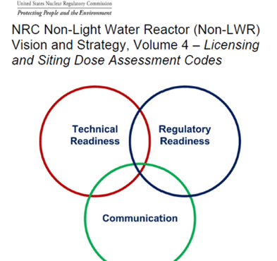
Volume 4:
Licensing and Siting Dose Assessment Codes
Tasks
  Consolidate/Modernize Codes
  Improve Source Terms
  Improve Atmospheric Transport & Dispersion Models
  Update Dose Coefficients
  Develop Environmental Pathway Models
RAMP Code Non-LWR Vision and Strategy

Slide 16
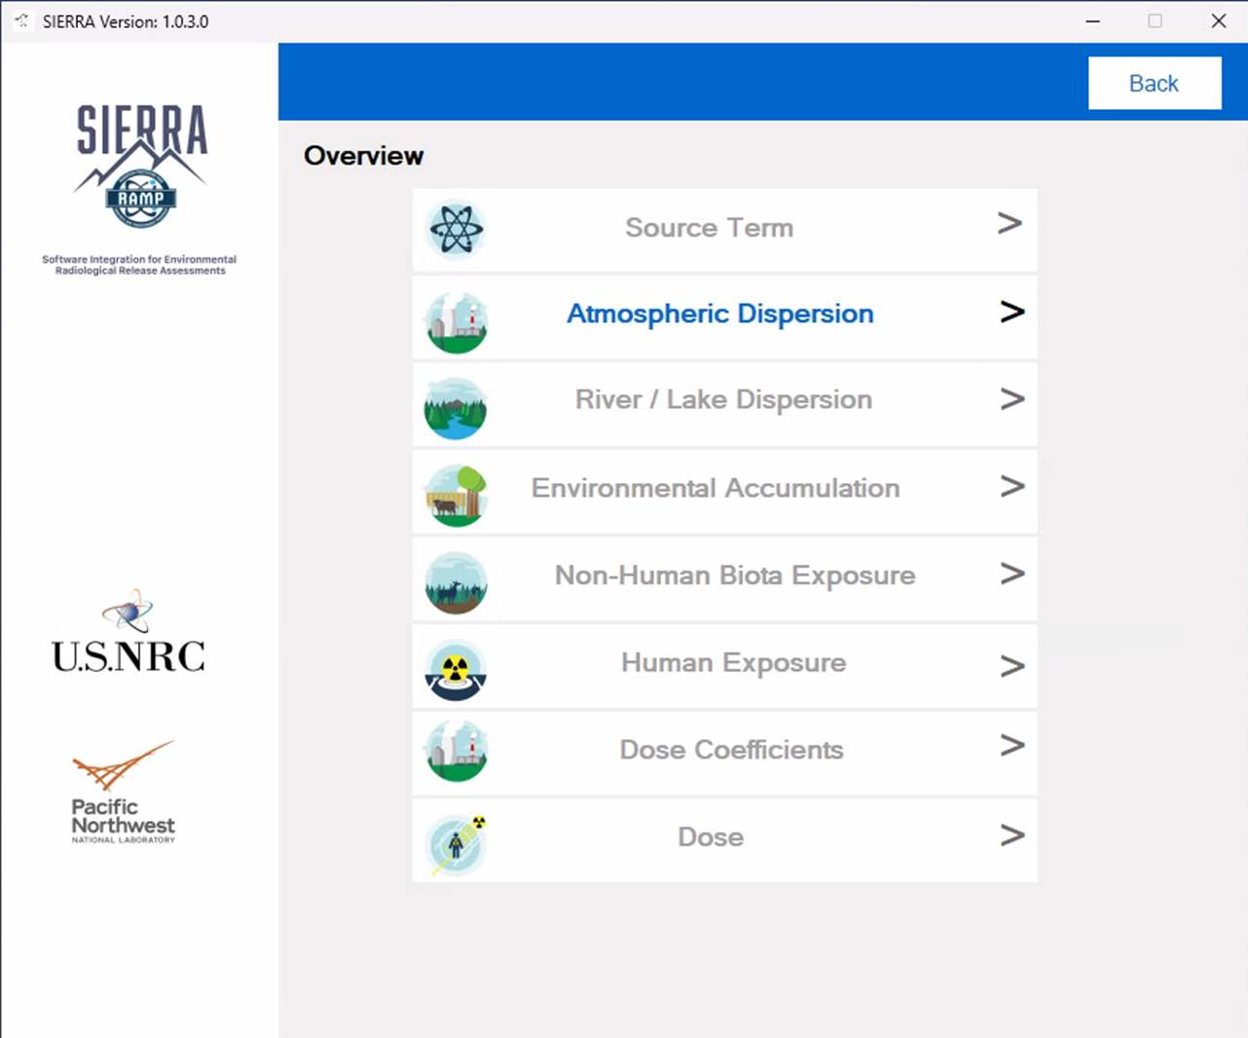

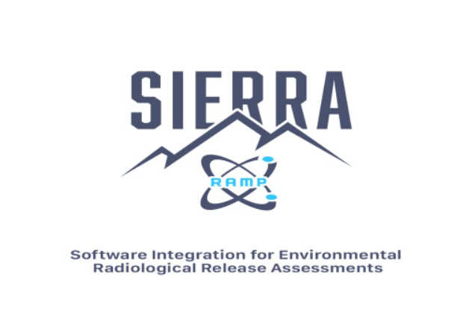
NPP Licensing: SIERRA
Software Integration for Environmental Radiological Release Assessments
Software under active development which aims to combine multiple RAMP codes into one easy to use package.
SIERRA- ATD is live!!!!
Current efforts underway for SIERRA.
  Source Term
  Environmental
  Dose Coefficients
  Modification for Advanced reactors
Mr. Sam Edwards,
Computer Scientist

Slide 17
Next:
Overview of the Week

