Slide 1
Welcome and Housekeeping
Courtney MacDonald & Verena Sesin
CNSC RAMP Organizing Team
May 13
Notes:
VERENA

Slide 2
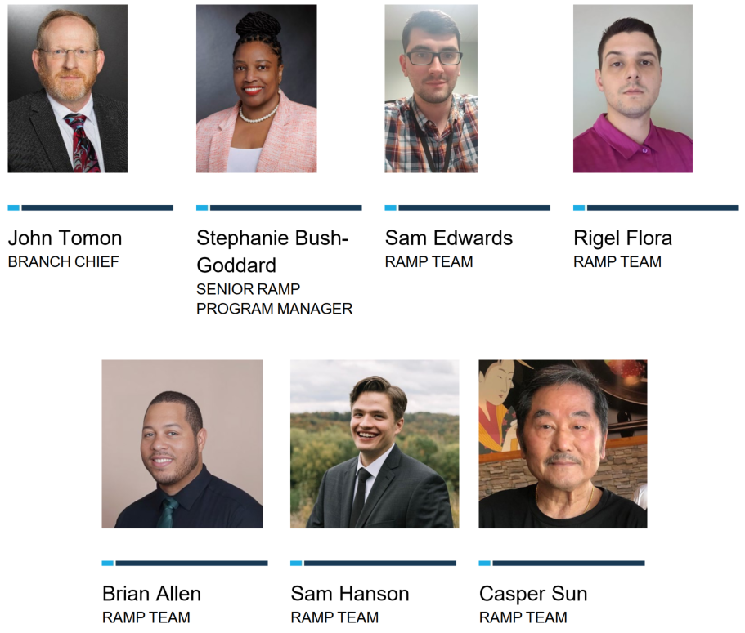
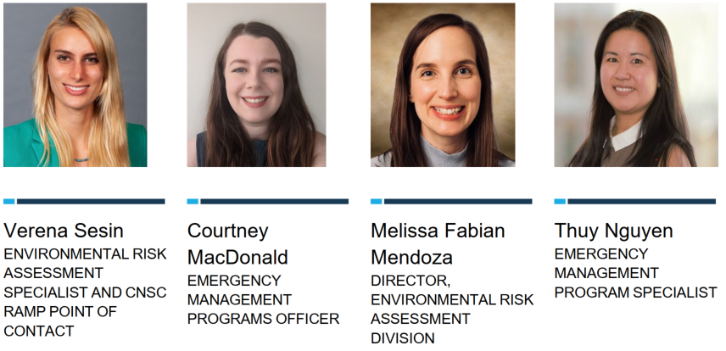
A Warm Welcome
From the CNSC and US NRC Organizing Teams
Notes:
VERENA

Slide 3
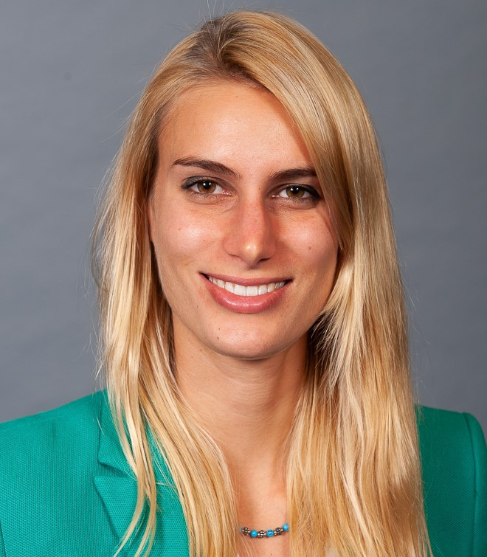

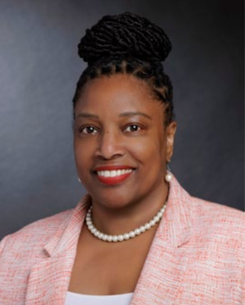
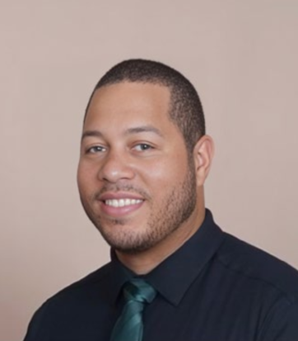
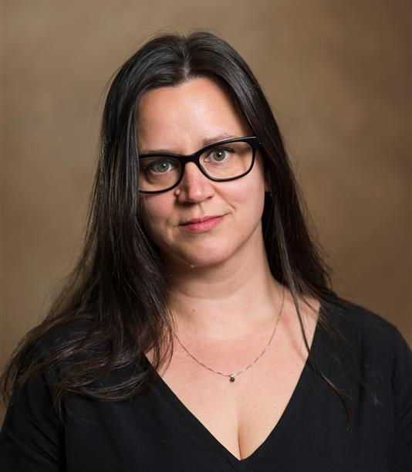
A Warm Welcome
Keep an eye out for our in-person RAMP team if you have any questions
Verena
Courtney
Stephanie
Brian
Charlotte
Notes:
VERENA

Slide 4
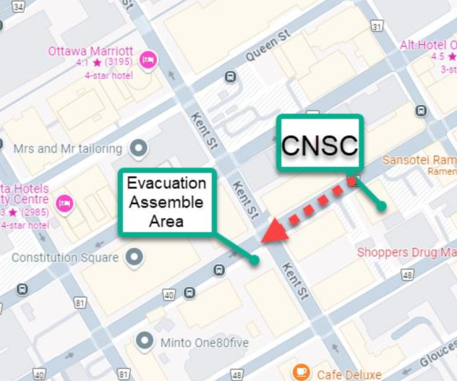
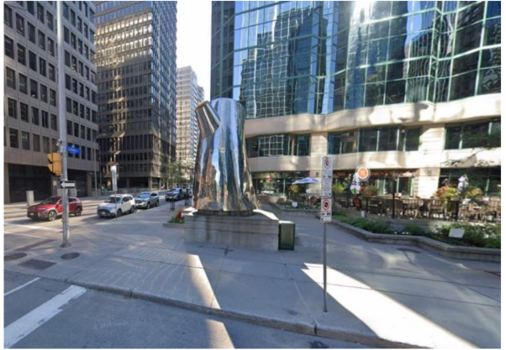
Safety First! In Case of an Emergency:
Evacuation Assembly Area (large tea kettle)
Notes:
COURTNEY
Before we begin this week, I’d like to take a few moments for a quick safety briefing. In the event of an alarm or evacuation order, please remain calm and listen closely.
Look for the CNSC staff; as they will direct you to the nearest stairwell to exit the building. During an evacuation, only the stairwells can be used. Although if you do have accessibility needs, please see me (or Courtney) and I (she) can have alternate arrangement made. Staff and visitors should descend quickly, exiting either at the parking lot or on Slater Street, moving to the evacuation assembly area at the corner of Kent and Slater. When crossing the street, only do so at the traffic lights.
Once you have evacuated the building, please proceed directly to the designated assembly point. You’ll know you are there when you see the large tea kettle. Remain at the assembly area until further instructions are given. A headcount will be conducted to ensure everyone has safety evacuated.

Slide 5
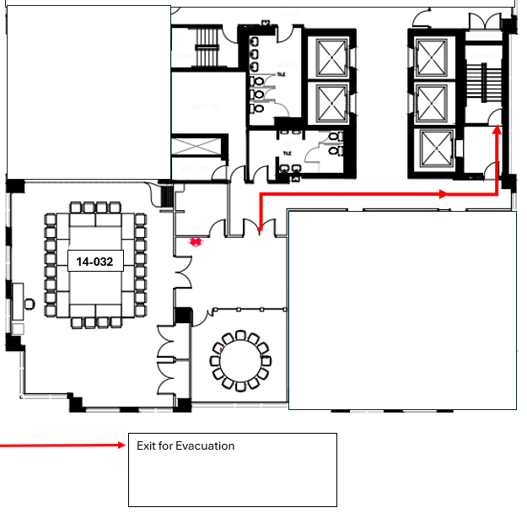
If you are on the 14th Floor during an Emergency:
Notes:
COURTNEY
If you are on the 14th floor during an emergency, please head towards the stairwell and descend quickly but safely. And as previously mentioned follow CNSC staff to the designed assembly point, at Slater and Kent.

Slide 6
Housekeeping –
We welcome you to:
Actively listen and participate
Share ideas and ask questions
Provide feedback that is respectful and focused on the issue, not the person
Identify action items to be followed-up on after the meeting
Speak to the RAMP team anytime in case of questions or concerns, such as:
If you’d like to switch sessions
A private room to take a call
Any health and safety concerns
Notes:
VERENA

Slide 7
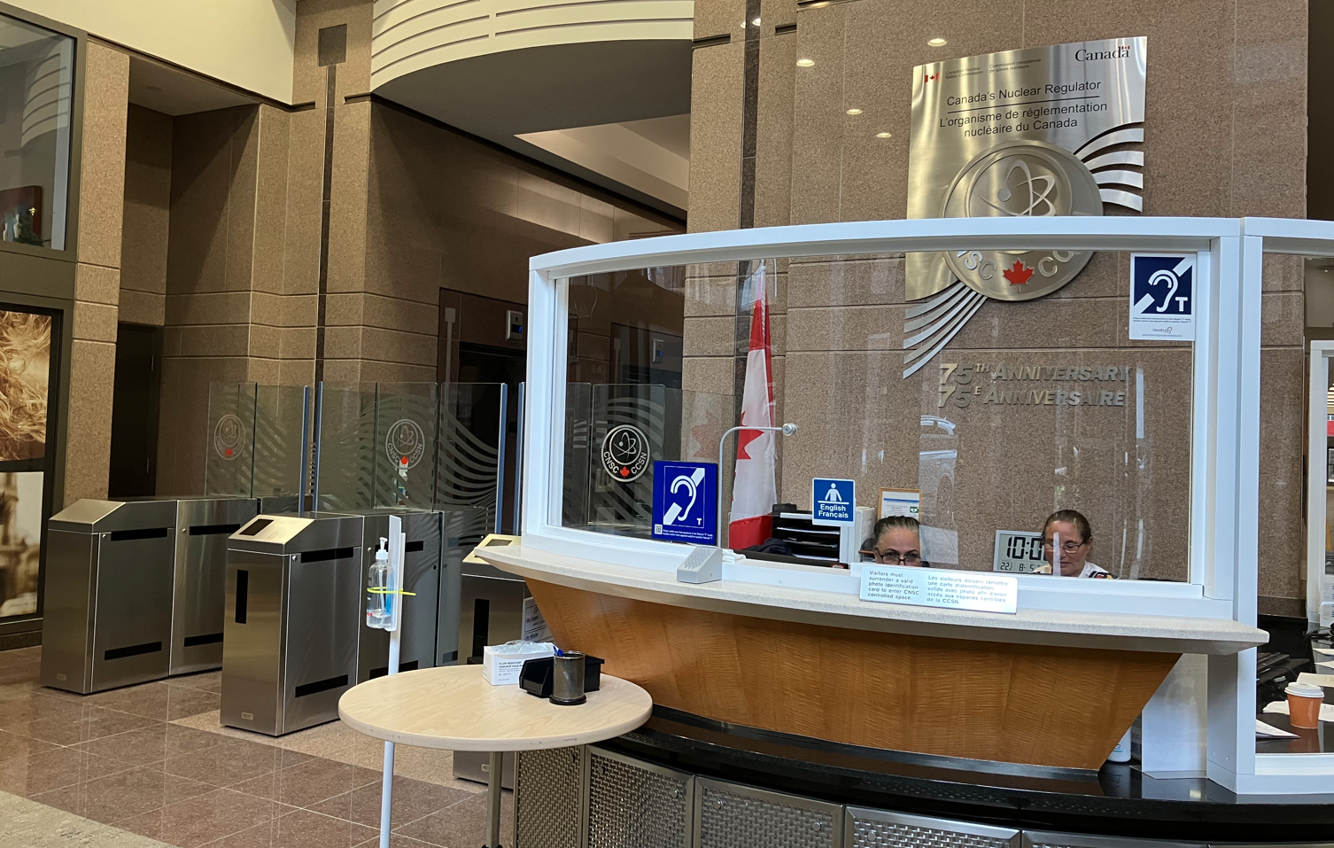

Housekeeping – Reminder for External Visitors
Arrival: Please arrive at the CNSC lobby at least 15 minutes before your session begins to sign in at the Commissionaires Desk.
14th Floor Access: For meetings on the 14th floor, a Commissionaire or CNSC staff member will escort you up.
Escorting Requirement: External visitors must always be accompanied by CNSC staff within secure areas (including the 14th floor).
Stepping Away: If you need to step away while in the secured area, please inform the organizing team to be escorted.
Visitor Pass: Ensure your visitor pass is always clearly visible while inside the CNSC building.
Commissionaires Desk
Secure areas (behind gates)
Notes:
VERENA

Slide 8

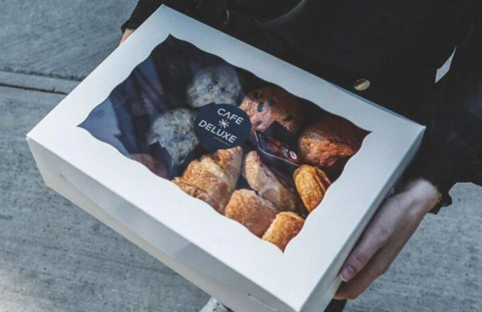
Housekeeping – Hospitality
Coffee Breaks: Enjoy morning and afternoon coffee breaks served in the foyer of this room (SL 01-010).
Lunch - On Your Own: Please refer to your program booklet for walkable lunch choices.
Social Hour/ Dinner: Details regarding the social hour and no-host dinner will be shared later today.
Stay Hydrated: Water stations can be found in the foyer of SL 01-010, and down the hall, just after the café tables.
Notes:
VERENA

Slide 9
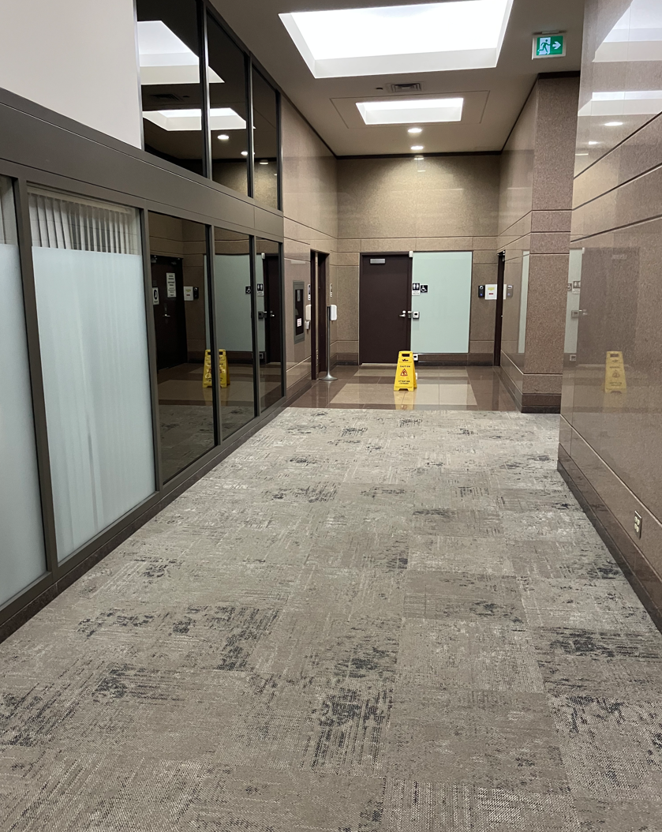
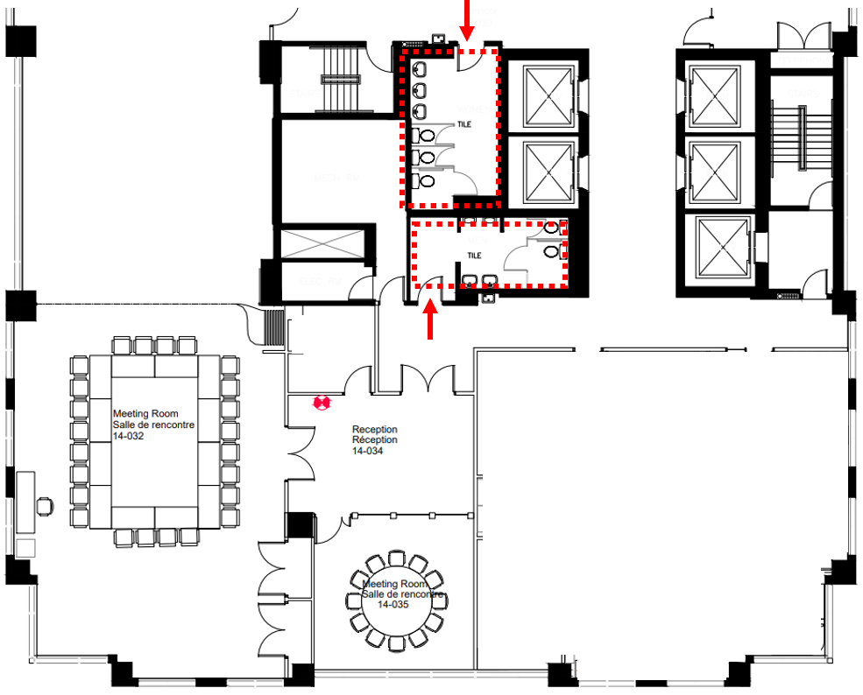
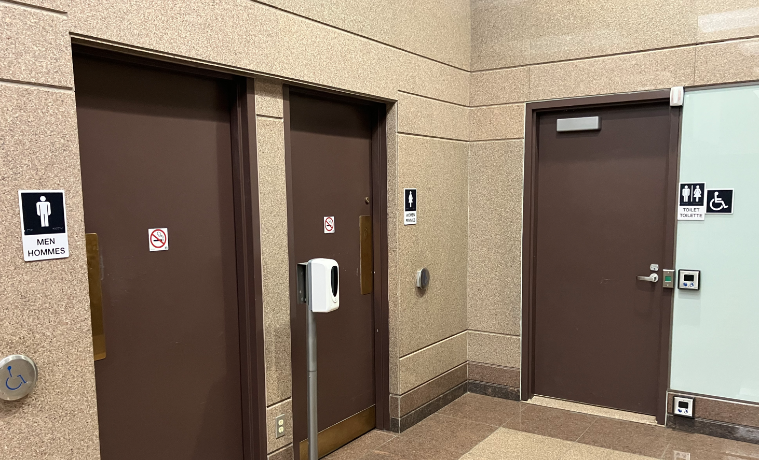
Housekeeping – Washrooms
1st Floor Washrooms
14th Floor Washrooms require escorting
Down the hallway and turn left
Notes:
VERENA

Slide 10
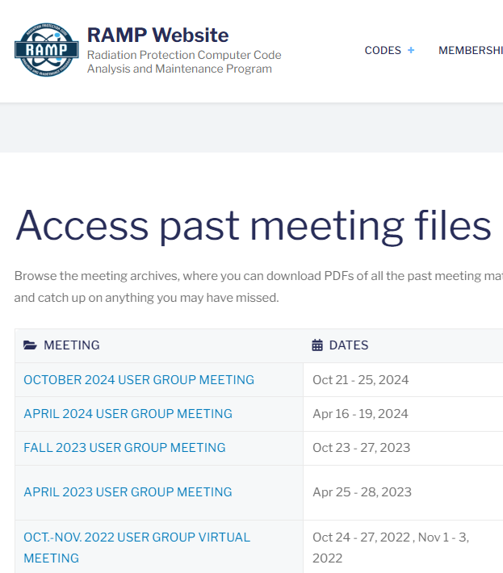

Housekeeping – Recordings
All symposium and training sessions will be recorded for later viewing via the RAMP website
  Some speakers have opted out
Access past meeting files | RAMP Website
Login your account → Past Meetings
Notes:
VERENA

Slide 11

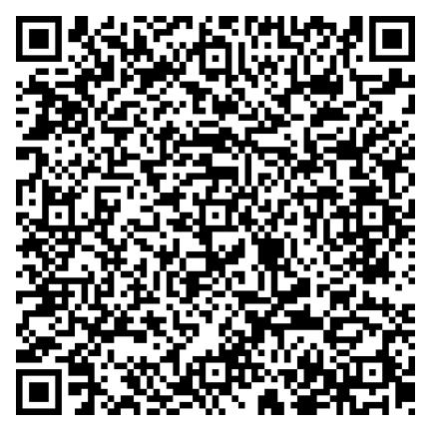
Scan to download
Stay Informed with our App
Symposium schedule
Training schedule
Venue information
Lunch, dinner, café, bakery options
Nearby grocery stores, pharmacies
Transportation
Tips for exploring Ottawa
Health & safety
Emergency contacts
… and more at your fingertips!
Notes:
COURTNEY

Slide 12
Land Acknowledgment
Courtney MacDonald & Verena Sesin
CNSC RAMP Organizing Team
May 13
Notes:
VERENA
Slide as background for oral remarks

Slide 13
Welcome and
Opening Remarks
Dean S. Haslip, Ph.D.
Vice-President Technical Support Branch and Chief Science Officer
Canadian Nuclear Safety Commission
May 13
Notes:
VERENA to introduce Dean
Slide as background for oral remarks

Slide 14
Introduction to RAMP
Stephanie Bush-Goddard, Ph. D.
Senior Researcher
May 13

Slide 15
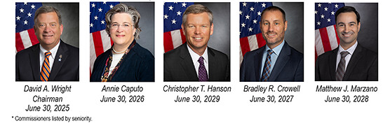
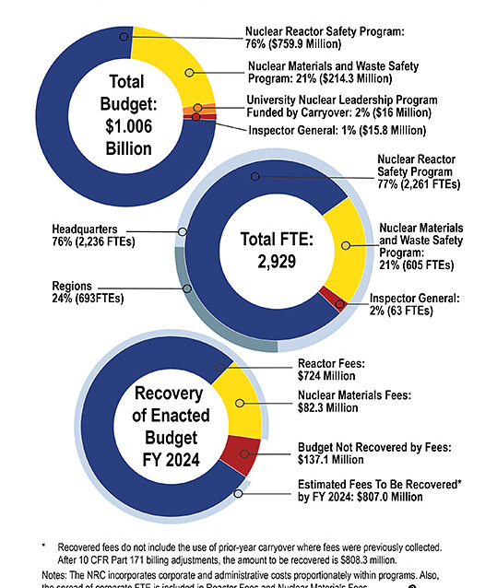
US NRC: Who we are.
2024-2025 Information Digest (ML25051A094)
NRC-licensed reactor generate 18.5% of U.S. gross electricity
94 commercial nuclear power reactors operating in 28 States
29 licensed research and test reactors operate in 21 States
~ 5,960 total inspection and assessment hours at each reactor
17,000 medical, academic, industrial and general use licensees
10 regional low-level compacts/4 disposal facilities
3 Reactor Fuel Vendors
3 Uranium Recovery Sites
9 Active Fuel Cycle Facilities
Track 80,000 sources, mostly Co-60

Slide 16
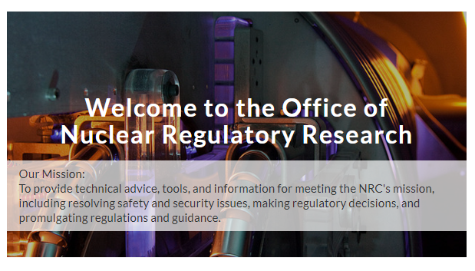


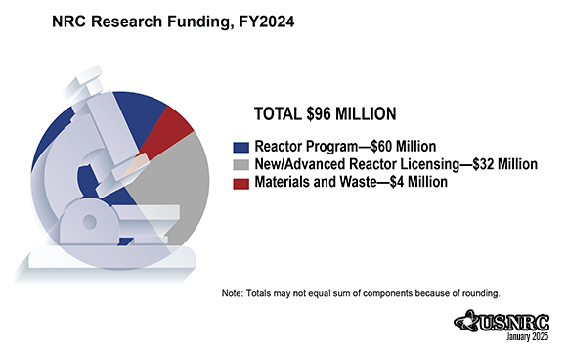
Office of Research: Who we are.

Slide 17
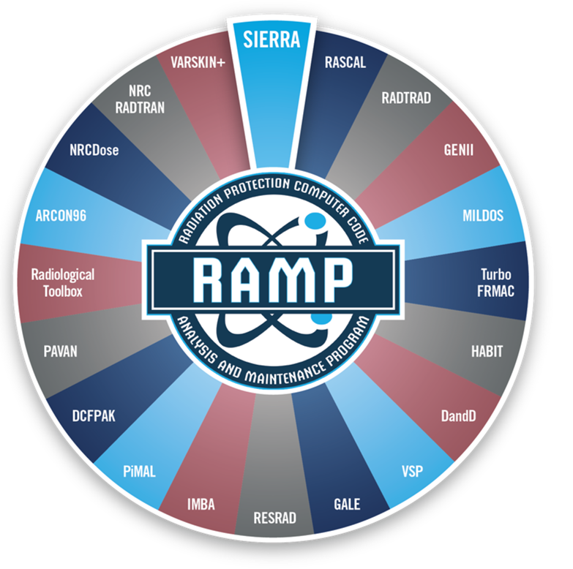
RAMP: Who we are:
Develop, maintain, improve, distribute, and provide training on NRC-sponsored radiation protection and dose assessment computer codes to be used for:
  Licensing
  Inspection
  Emergency Response
  Environmental Remediation
  Medical Activities, etc.

Slide 18
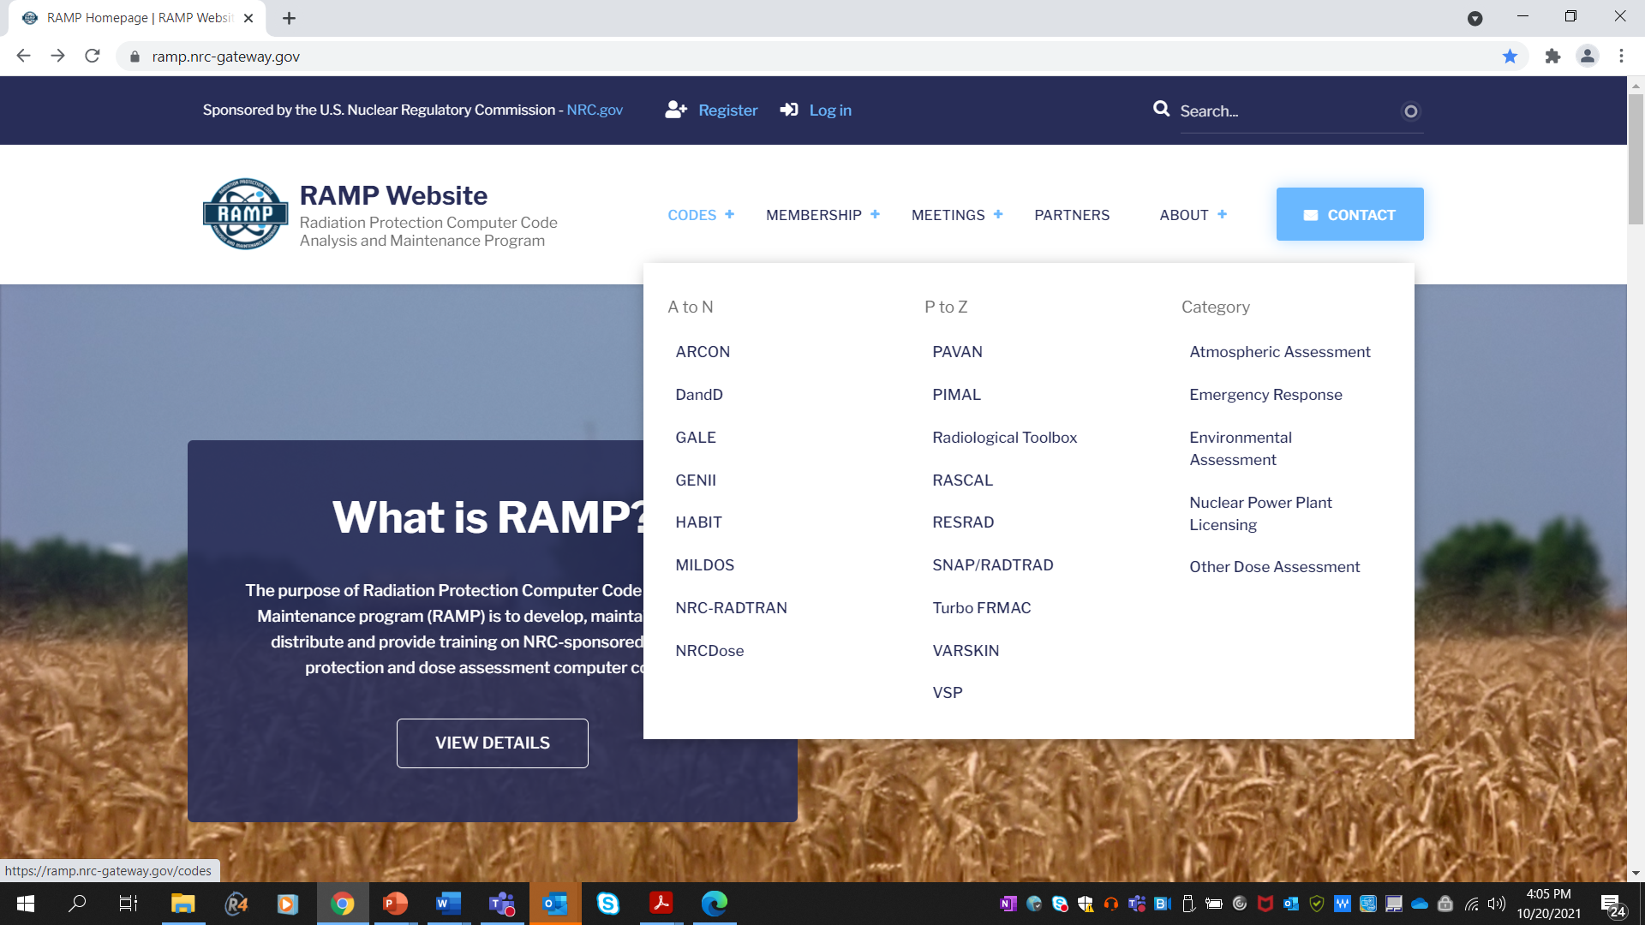
RAMP Website https://ramp.nrc-gateway.gov/
Major communication tool for RAMP
  Download most codes
  Documentation
  Training/webinar recordings
  Support
Current Activities
  More targeted communication
    Surveys
    Support
  Forums
  University Corner
  International pages

Slide 19
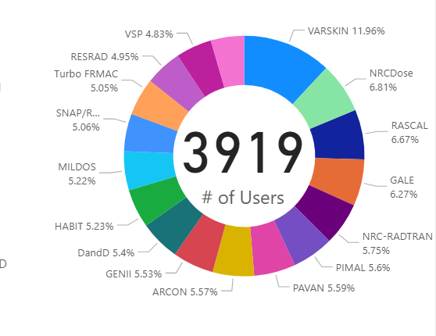
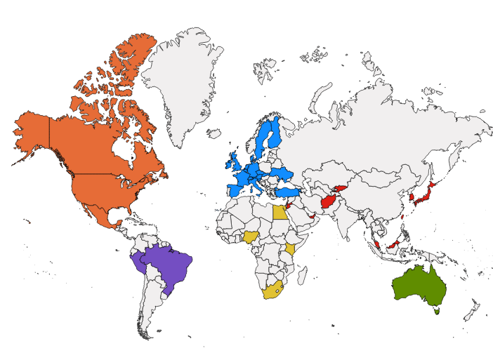
Users:
International Collaboration
100+ bilateral or multilateral agreements with over 20 countries: 15 Agreements for RAMP
~3900 Members, including ~180 Canadian Members
Major Canadian RAMP Members
  CNSC
  Canadian Nuclear Laboratories
  Emergency Management Ontario
  Nuclear Waste Management Organization
Codes mostly used:
  RASCAL
  V+ (formerly VARSKIN)
  NRC RADTRAN
Over 60 participants at this RAMP Meeting
  Representatives from 5 Countries
    Canada, Ghana, South Korea, US, Belgium

Slide 20
Codes in RAMP at this meeting.

Slide 21
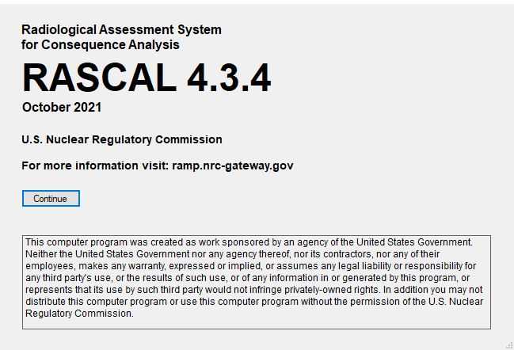
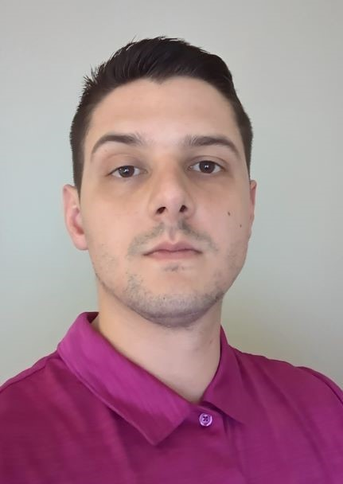
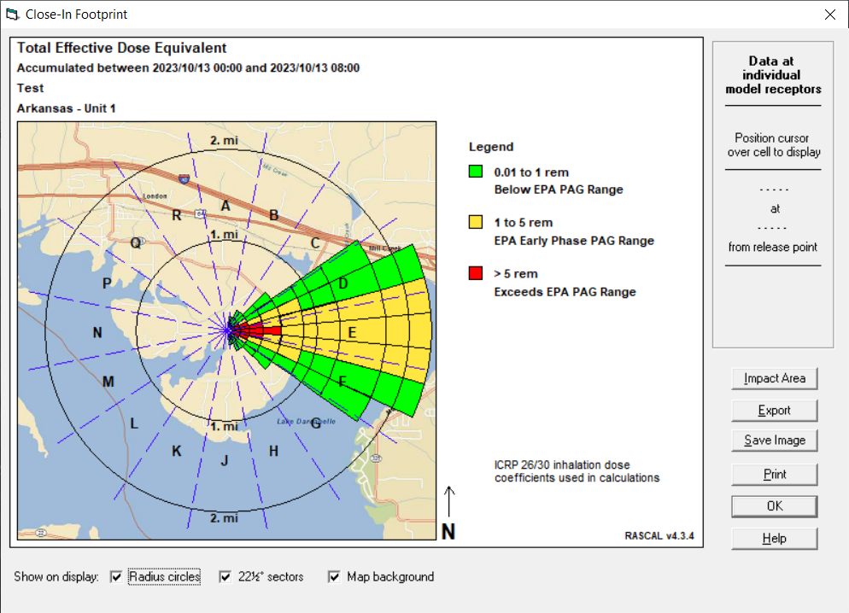
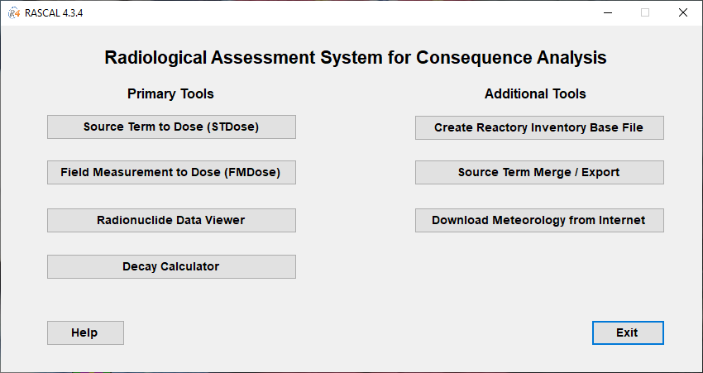
Emergency Response Codes
RASCAL
Radiological Assessment System for Consequence Analysis
Fast-running software used for beyond-design-basis radiological incidents to assess off-site dose consequences and to help inform or evaluate protective actions.
Current Activities:
  RASCAL v4.3.4 release date in early 2024.
  Beginning RASCAL 5.0 Development.
Mr. Rigel Flora,
US NRC
RASCAL Trainer

Slide 22
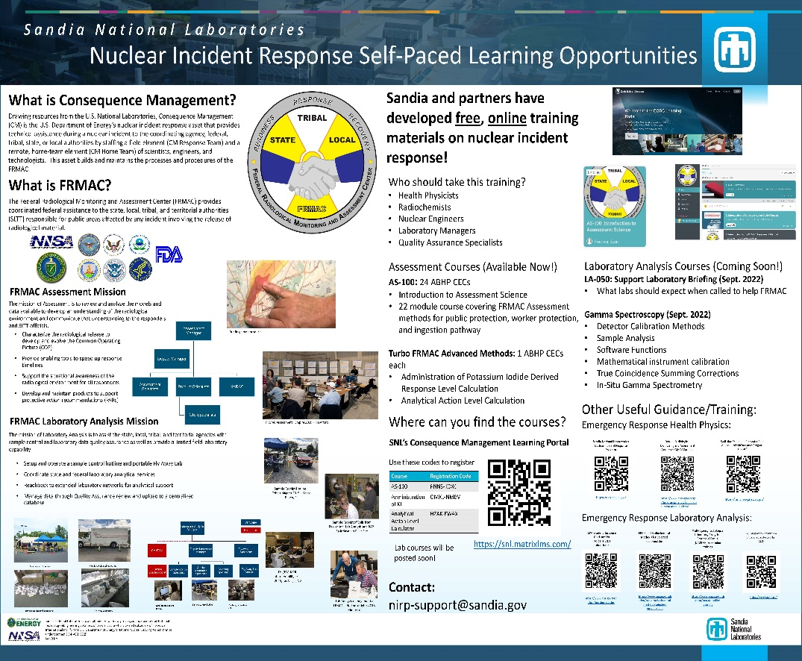
Emergency Response Codes
Turbo FRMAC
Performs complex calculations to quickly evaluate radiological hazards during an emergency response by assessing impacts to the public, workers, and the food supply.
Sandia National Laboratories maintains distribution of Turbo FRMAC, but RAMP users have access to code discussions, training, and technical support.
If you need technical support for Turbo FRMAC please email: nirp-support-fogbugs@sandia.gov
Autumn Kalinowski,
Sandia National Lab
Turbo FRMAC Trainer
https://nirp.sandia.gov/Software/TurboFRMAC/TurboFRMAC.aspx

Slide 23
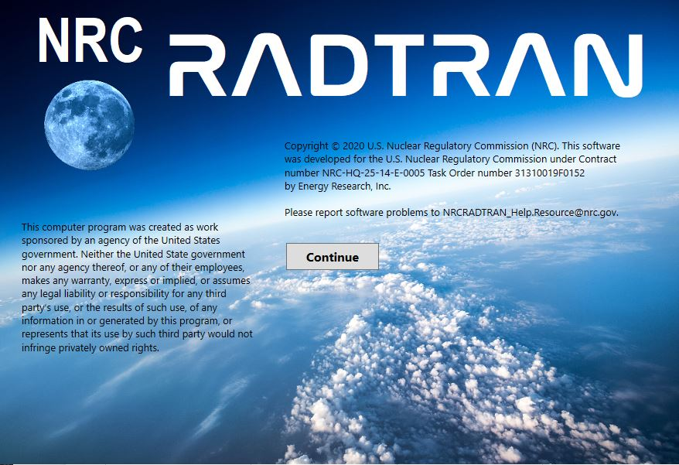
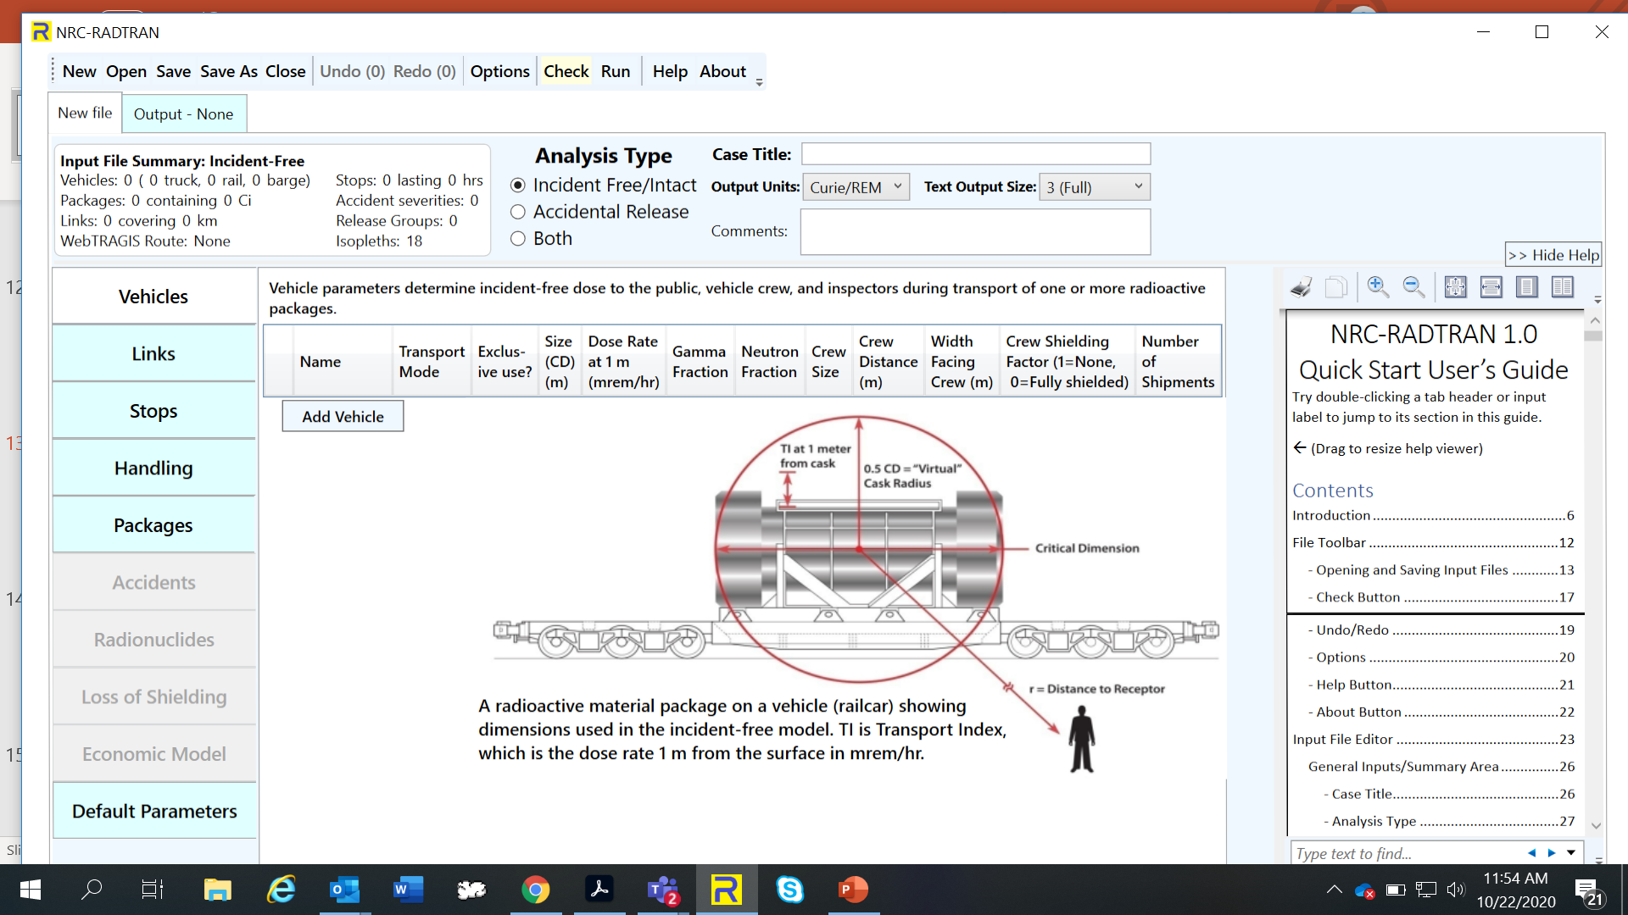
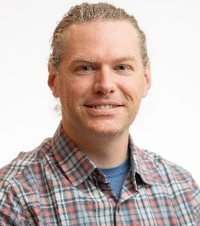
Licensing Support Codes
NRC-RADTRAN
Radioactive Material Transport
Code for risk and consequence analysis of radioactive material transportation.
Current Activities:
  Updated Code ‒ NRC-RADTRAN 1.1 to include:
    Develop WebTRAGIS alternatives.
    Sum population risk across all transportation links and fix errors while using >9 links.
    Implement coding changes to display default values in NRC-RADTRAN.,
    Implement GUI changes to include air cargo, air passenger, and other rail options.
Dr. Jon Napier,
Pacific Northwest Lab
NRC-RADTRAN Trainer
Notes:
Fix KML file errors for speed and population densities.
Develop WebTRAGIS alternatives.
Sum population risk across all transportation links and fix errors while using >9 links.
Implement coding changes to display default values in NRC-RADTRAN.,
Implement GUI changes to include air cargo, air passenger, and other rail options, and
Investigate and correct hard coded conversion factors.

Slide 24
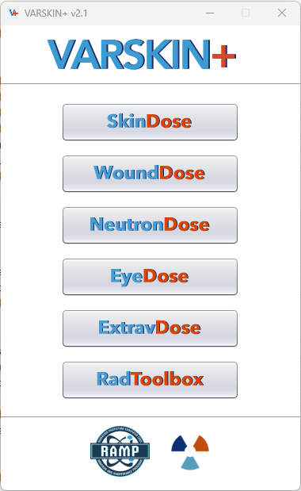
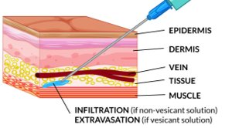
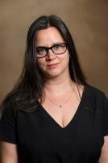
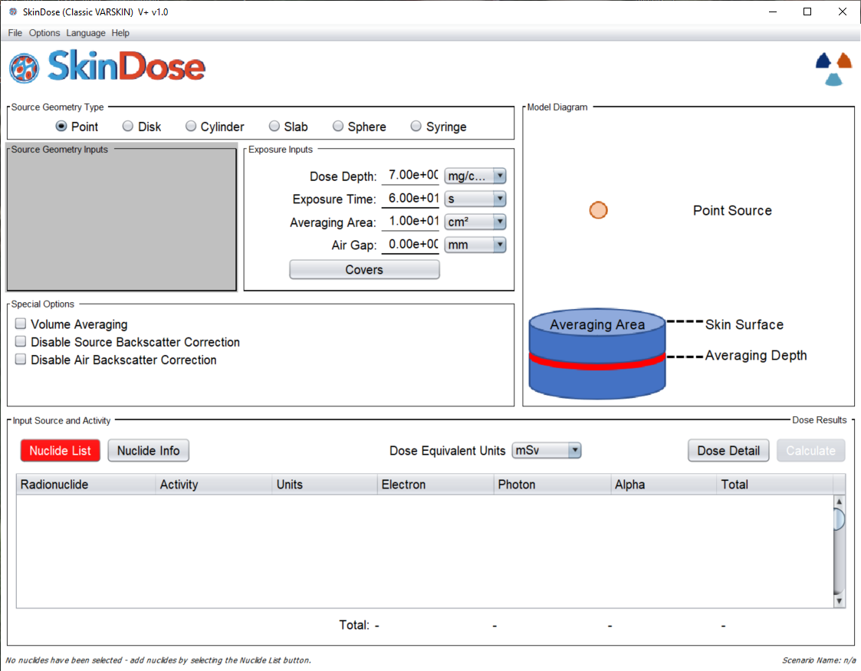
V+ (formerly VARSKIN+)
Used to calculate occupational dose to the skin resulting from exposure to radiation emitted from contamination on or near skin.
Current Activities:
  Release of VARSKIN+ v.2.1
    Improved Alpha Dosimetry.
    Improved Ingrown Decay Progeny Calculation
    Neutron Energy Degradation Model.
  Integrated the Radiological Toolbox
  Release of Extravasation Dose Module in FY25/26
Charlotte Rose,
Renaissance Code Development
V+ Trainer

Slide 25
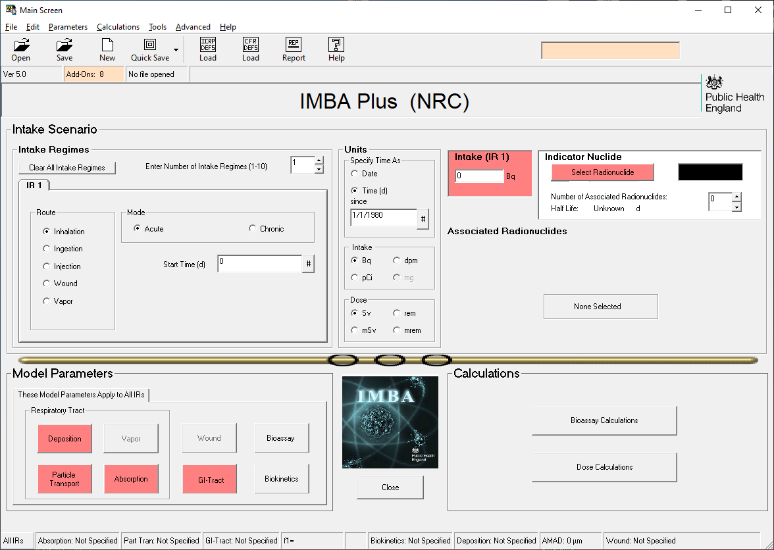
IMBA
Integrated Modules for Bioassay Analysis
A suite of modules for internal dosimetry that implements respiratory tract, GI-tract, tissue dosimetry, biokinetic, and bioassay models as recommended by the International Commission on Radiological Protection.
IMBA modules can estimate single or multiple intakes of different radionuclides and calculate resulting doses based on ICRP 68 and US 10 CFR 835.
Charlotte Rose,
Renaissance Code Development
V+ Trainer
Dr. Jon Napier,
NRC-RADTRAN Trainer

Slide 26
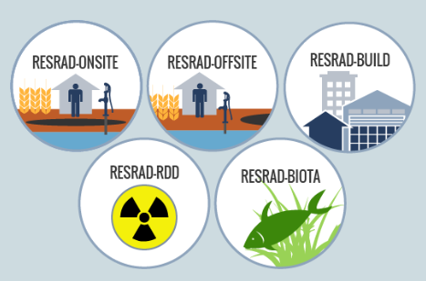
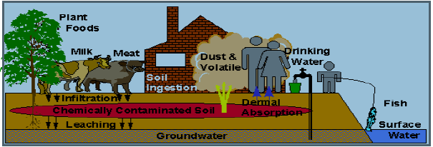
RESRAD-BIOTA
Residual Radioactivity
Family of codes used to analyze human and biota radiation exposures from environmental contamination of residual radioactive materials.
Uses pathway analysis to evaluate exposure and associated risks, which then informs cleanup criteria and authorized limits.
Current Activities:
  RESRAD ONSITE v8.0 FGR-15 DCFs.
Dr. Charley Yu,
Argonne National Lab
Principle Investigator

Slide 27
Are RAMP codes, such as RASCAL, fit-for-purpose to be used/applied for the new reactor technologies being proposed?
Answer: It depends/maybe.

Slide 28
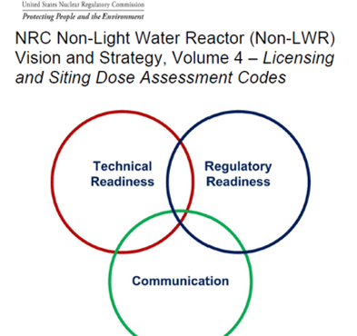
Volume 4:
Licensing and Siting Dose Assessment Codes
Tasks
  Consolidate/Modernize Codes
  Improve Source Terms
  Improve Atmospheric Transport & Dispersion Models
  Update Dose Coefficients
  Develop Environmental Pathway Models
RAMP Code Non-LWR Vision and Strategy

Slide 29
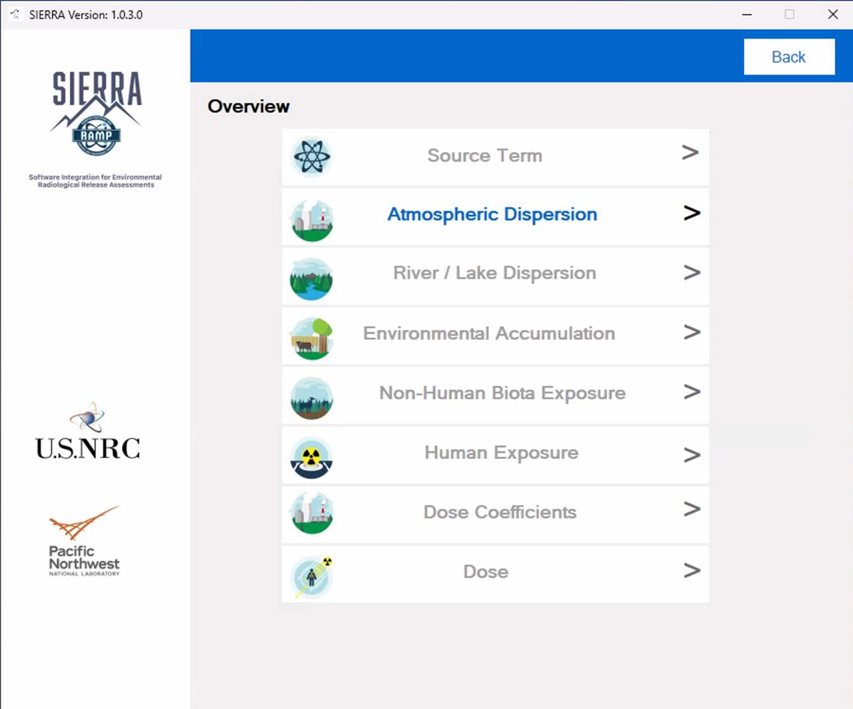
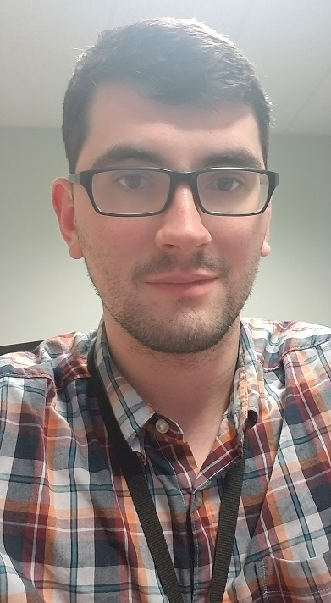
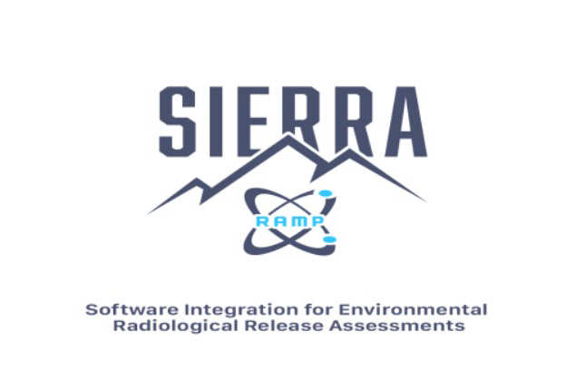
NPP Licensing: SIERRA
Software Integration for Environmental Radiological Release Assessments
Software under active development which aims to combine multiple RAMP codes into one easy to use package.
SIERRA-ATD is live!!!!
Current efforts underway for SIERRA.
  Source Term
  Environmental
  Dose Coefficients
  Modification for Advanced reactors
Mr. Sam Edwards,
Computer Scientist

Slide 30
NRC Advanced Reactor Readiness:
Morning session:
  Overview of Advanced Reactor Readiness Activities
Environmental Session:
  Draft New Reactor Generic EIS and Proposed Rule
Radiation Protection Session:
  KI Pills, Nanoparticles and MACCS Code Development for Advanced Reactors
Emergency Planning:
  EP for Small Modular Reactors

Slide 31
Next:
Overview of the Week

Slide 32
Overview of the Week / Symposium
Courtney MacDonald & Verena Sesin
CNSC RAMP Organizing Team
May 13
Notes:
VERENA

Slide 33
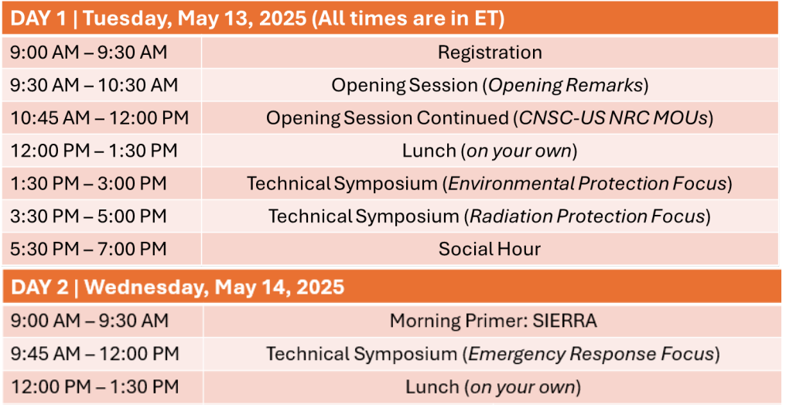

Technical Symposium: Schedule at a Glance
1st Floor
Notes:
VERENA

Slide 34
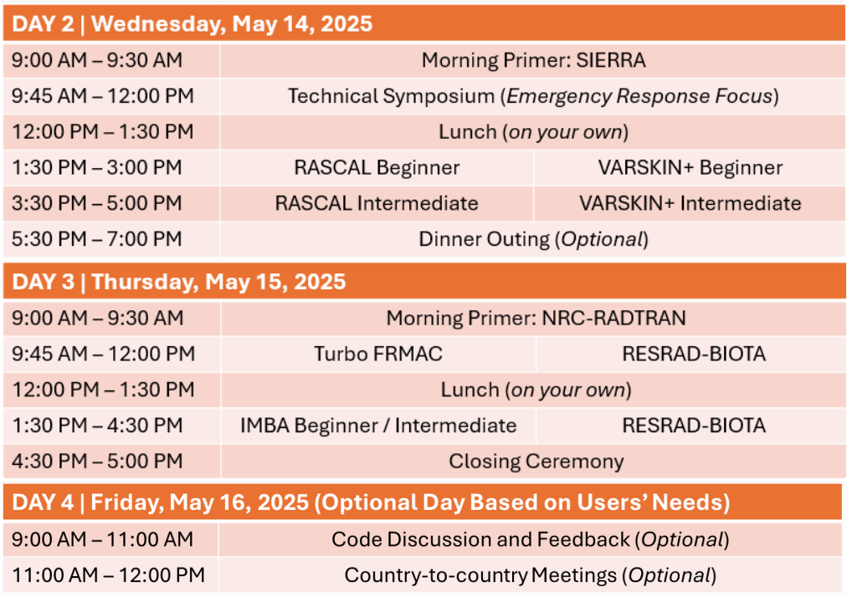

Training: Schedule at a Glance
1st Floor
14th Floor
Notes:
VERENA

Slide 35


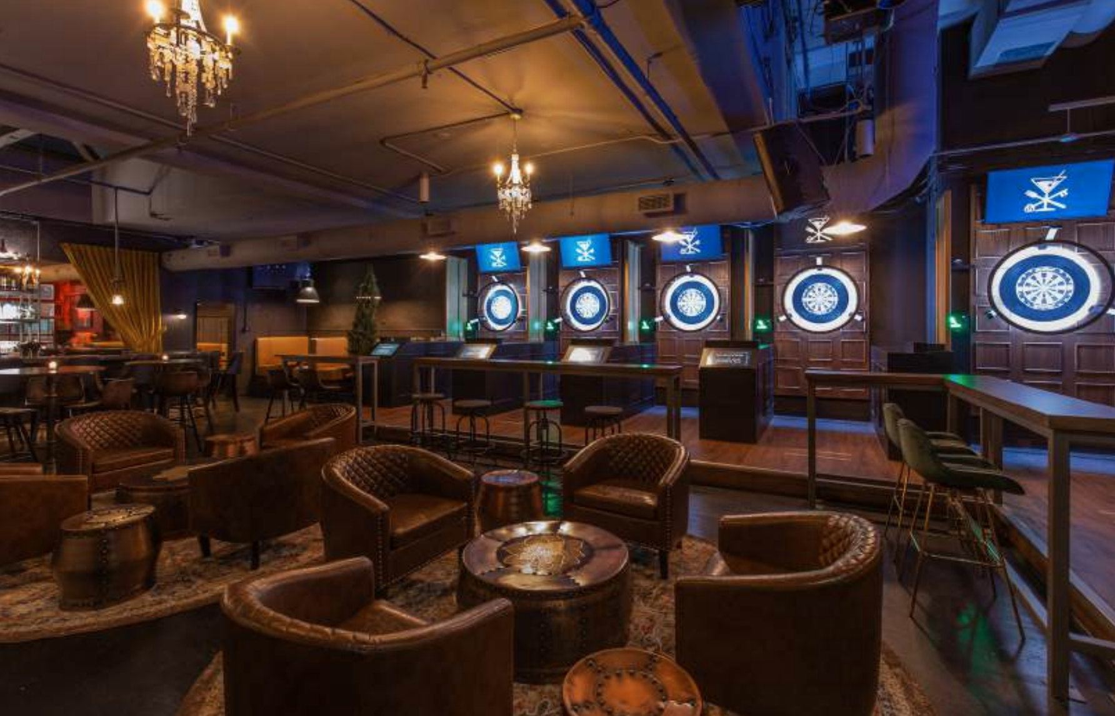
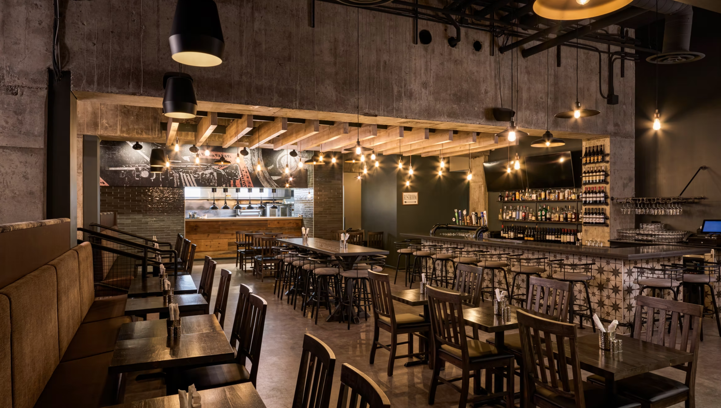
Social Events (Optional)
Social Hour
May 13, 5:30 - 7:00 PM
Manor Lounge
No-host Dinner Outing
May 14, 5:30 - 7:00 PM
OCCO Kitchen & Bar
Please check the program booklet or App for more information
Notes:
COURTNEY

Slide 36

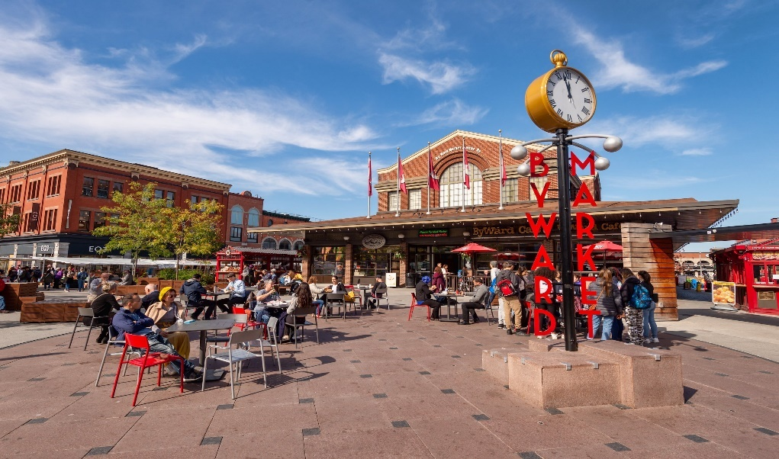
Beyond the RAMP Meeting
Check the program booklet and App for advice on:
Things to do in Ottawa
Events happening this week
Cafés, bakeries, restaurants
Looking for anything else?
Please feel free to ask the CNSC Organizing Team for recommendations!
Notes:
COURTNEY

Slide 37
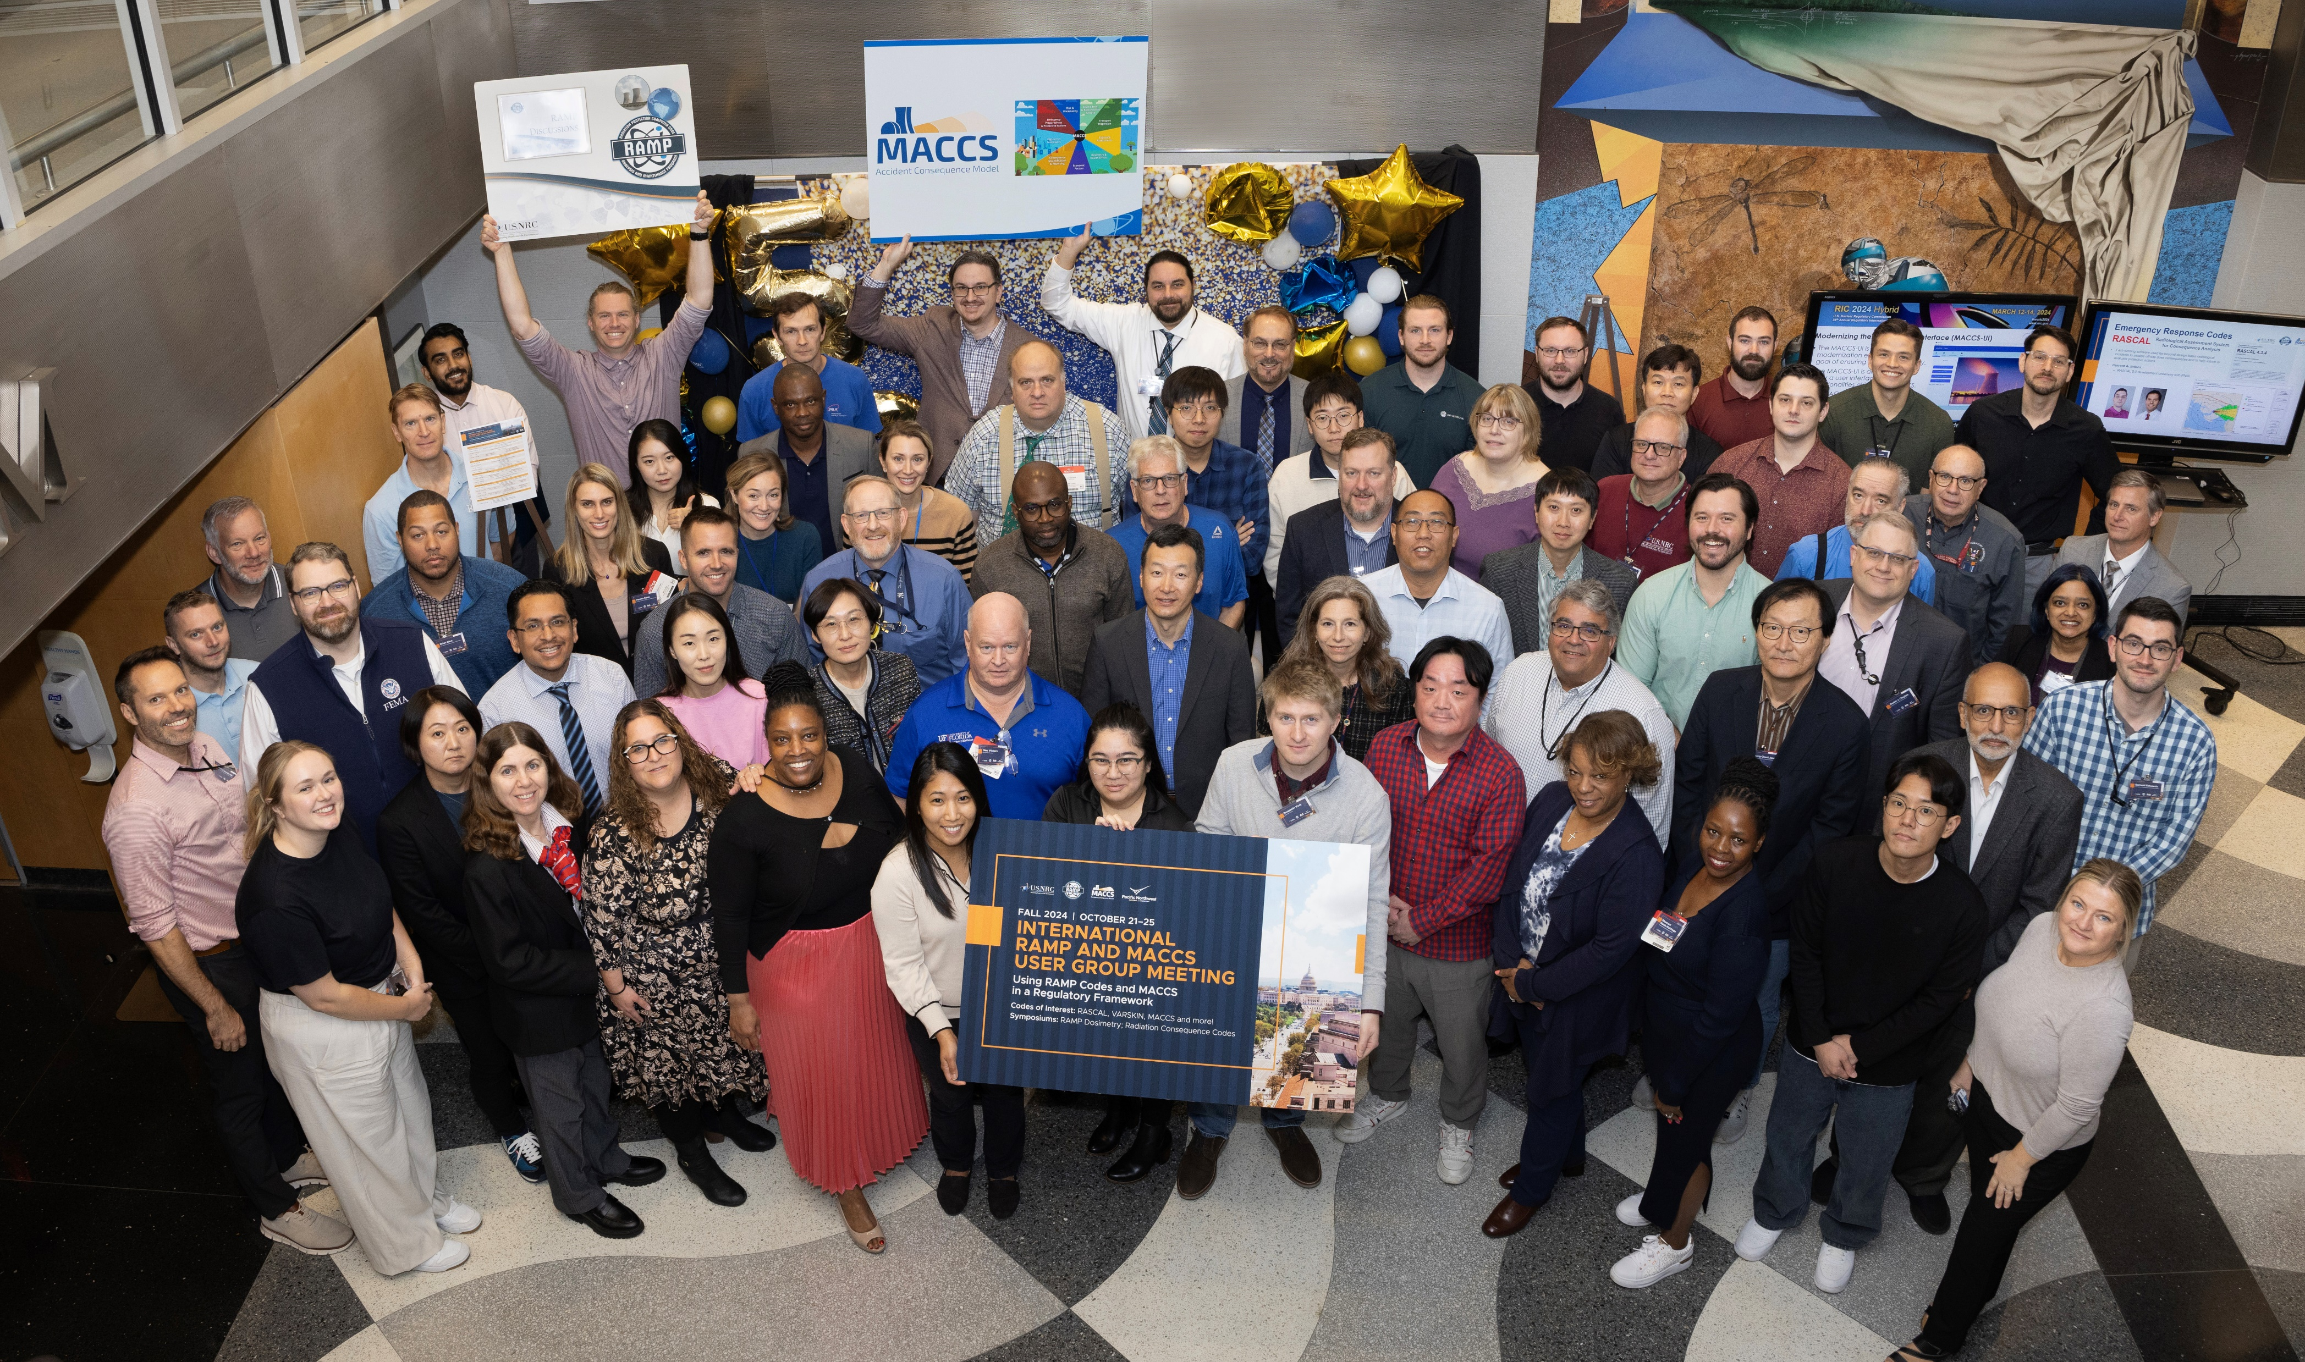

Don’t miss the group photo at 11:40 am today!
Group photo at the 2024 Fall RAMP Users’ Group Meeting
Notes:
COURTNEY

Slide 38
Thank you

