Slide 1
MACCS Code Development Activities for Advanced Reactors
AJ Nosek, PhD
Accident Consequence Analyst
US Nuclear Regulatory Commission

Slide 2
Purpose of MACCS Code
The purpose of MACCS is to simulate and understand the public consequences of severe nuclear accidents.
Created by Sandia National Laboratories to support US Nuclear Regulatory Commission (NRC) research and regulatory applications
Origins go back to the mid-1970s
MACCS is typically used for prospective analyses
MACCS is very versatile with a large set of user inputs
MACCS can quickly run thousands of Monte Carlo simulations for PRA applications
Large set of weather trials (hundreds or thousands)

Slide 3
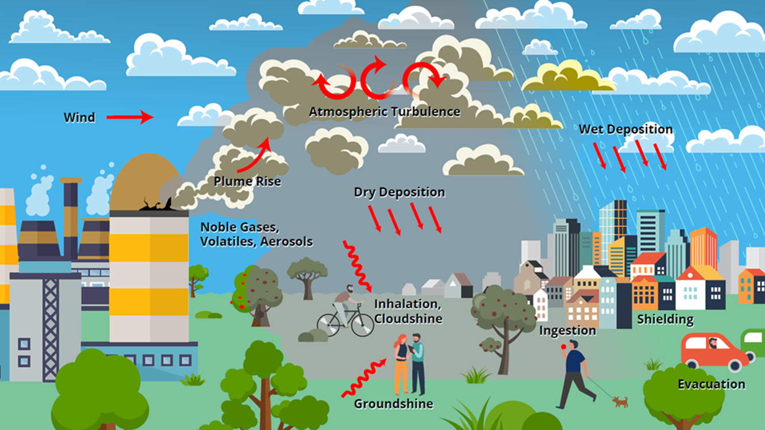
Phenomena Treated by MACCS
Representation of source term
Atmospheric dispersion
Statistical sampling of archived weather data
Wet and dry deposition
Dose exposure pathways
Inhalation
Cloudshine
Groundshine
Resuspension
Ingestion
Skin deposition
Emergency response
Sheltering
Evacuation
Potassium iodide (KI) ingestion
Relocation
Long-term protective actions
Decontamination
Temporary or permanent interdiction of property
Crop disposal
Economic losses
Evacuation and relocation per diem costs
Long-term relocation cost
Decontamination costs
Loss of property use
Depreciation during interdiction
Property value for permanent interdiction
Radiogenic health effects
Early health effects
Cancer incidence / fatalities
Notes:
Source term – imported as a file from MELCOR or similar application, or input directly into MACCS itself by specifying the release characteristics. Magnitude and timing, to include buoyancy (heat), height, initial timing, release rate by radionuclide by chemical group, particle size distribution by chemical group…items like that to characterize your release.
Models Atmospheric transport and dispersion – weather is a key part of that – options for statistical sampling of your weather data
(120 hour, bin sampling)
Deposition – deposited on the ground, or washed out by interactions with clouds or rain.
Exposure pathways – and ultimately the biological impacts and resulting risks
Broken down into multiple time domains:
Emergency – sheltering, biological impacts and potential shielding effects
Evacuation – speed and timing of evacuation for example. You can also modify this for certain groups of people, or modify speeds (weather)
Potassium Iodine Ingestion –
Relocation
Long Term effects:
Impacts on the land – work associated with decontaminating land, possible interdition, and crop disposal
Economic Losses:
Mentioned biological impacts, but a key part of MACCS is also calculating economic impacts to have a full picture of the risk.

Slide 4
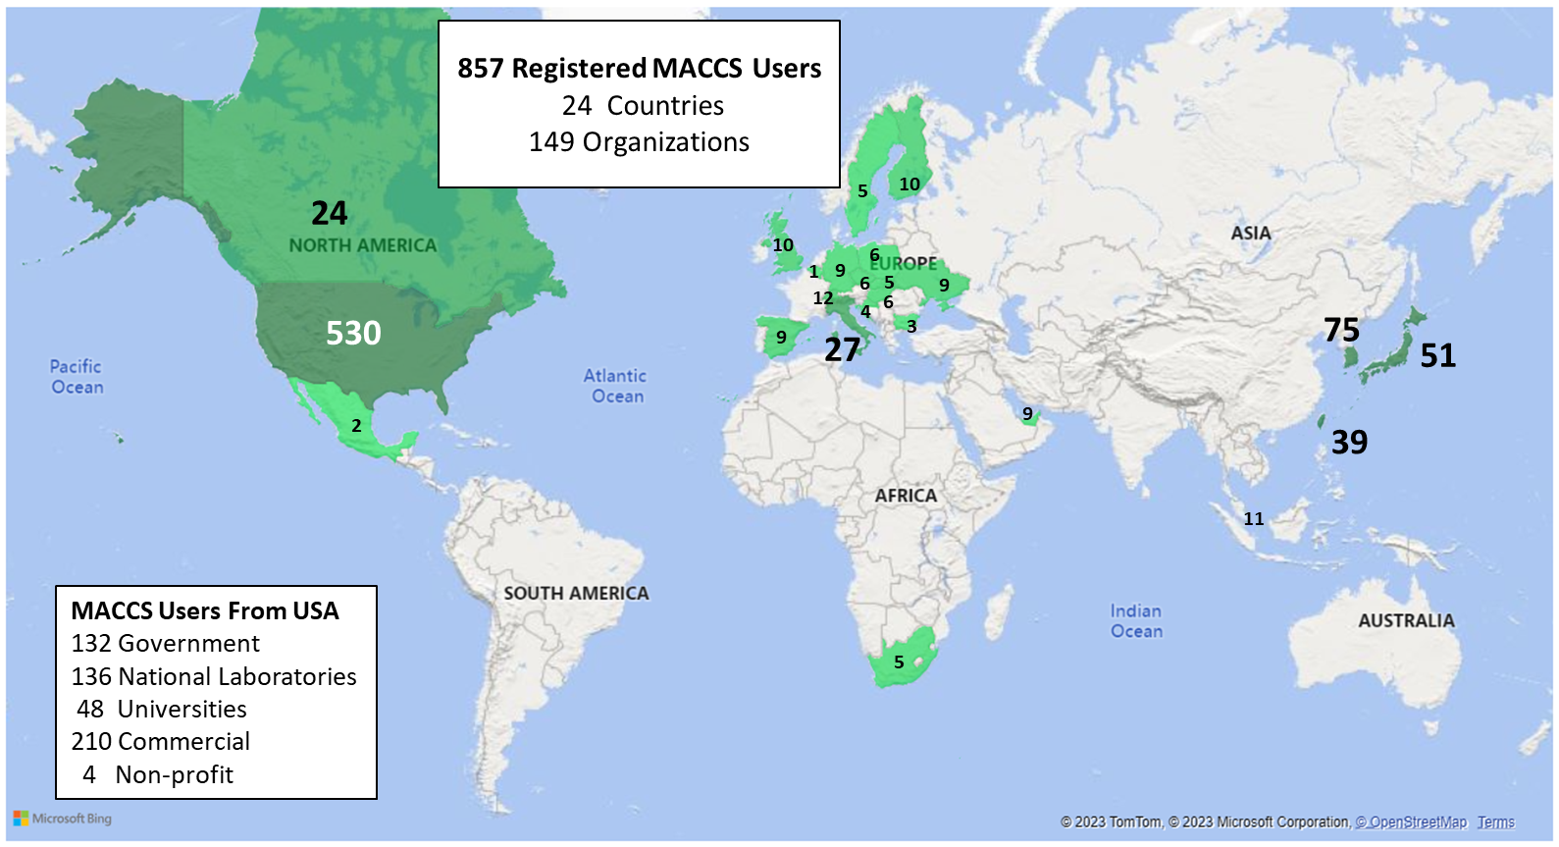
MACCS Code Distribution
NRC Cooperative Programs | Research Areas
Code Applications and Maintenance Program (CAMP) | Thermal Hydraulics
Cooperative Severe Accident Research Program (CSARP) | Severe Accidents
Radiation Protection Computer Code Analysis and Maintenance Program (RAMP) | Radiation Protection
MACCS belongs to the Cooperative Severe Accident Research Program (CSARP)
MACCS support codes include:
MACCS-UI / WinMACCS
MelMACCS
SecPop (U.S. only)
MACCS-HYSPLIT Tools
AniMACCS
Instructions for requesting the MACCS Code Suite and MACCS-related documents can be found at: https://maccs.sandia.gov/
MACCS Users by Country
Notes:
MelMACCS: Special for MELCOR! Working with MELCOR team to enhance integration.
New Maccs website! IMUG registration, code distribution, bug reporting.

Slide 5
International MACCS User Group (IMUG)
Save the Date!
October 20 – 23, 2025
This year, IMUG will be fully online
4-hour sessions
~8 AM to 12 PM (EDT)
If you would like to join:
Send me your email (MACCSCodes@nrc.gov), or
Check our MACCS events webpage as we get closer to the date (https://maccs.sandia.gov/events)

Slide 6
MACCS Code Development Activities for Advanced Reactors – Summary
In January 2020, the NRC issued the report titled, “NRC Non-LWR Vision and Strategy, Volume 3 – Computer Code Development Plans for Severe Accident Progression, Source Term, and Consequence Analysis Revision 1”
The plan provided 7 topical areas of consideration pertaining to consequence analysis for the MACCS computer code.
In FY24, staff completed the MACCS code development plan. Staff completed most of these tasks with the use of code updates or by identifying and adopting state-of-practice methods commonly used in the relevant topical areas.
Currently, staff is evaluating future candidate research activities to further enhance the code readiness of MACCS for advanced reactors.

Slide 7
MACCS Code Development Activities Status
Phenomenological Areas​ | Fiscal Year |  |  |  |  |  | Reports​ | Notes
 | 2019​ | 2020​ | 2021​ | 2022​ | 2023​ | 2024​
Nearfield Modeling​ | X​ | X ​ | X​ | ​ | ​ | ​ | SAND2020-2609 SAND2021-6924​ | MACCS 4.1 has implemented upgraded nearfield models.
Radionuclide Release Screening ​ | ​ | ​ | X​ | X ​ | ​ | ​ | SAND2021-11703 SAND2022-12018​ | MACCS 4.2 has increased the radionuclide limit to 999. Report provided methodology for creating a list of radionuclides for MACCS dosimetry.
Radionuclide Size, Shape, and Chemical Form | ​ | ​ | ​ | X​ | ​ | ​ | SAND2022-12766​ | MACCS deposition and dosimetry capabilities are state-of-practice. Report identified use of resistance model as potential enhancement. Report also identified use of multiple radiochemical forms as a potential enhancement.
Tritium Modeling​ | ​ | ​ | ​ | X​ | X ​ | X ​ | SAND2022-12016​ SAND2023-10896 | MACCS provides tritium inhalation dose coefficients assuming tritiated water vapor. In MACCS v5.0, staff adjusted these values by x1.5 to account for intake through skin absorption. Modeling of tritium ingestion requires alternative codes.
Radionuclide Evolution in Atmosphere​ | ​ | ​ | ​ | ​ | X​ | X​ | SAND2024-12069 | State-of-practice models for generic reactive atmospheric transport are limited in availability.
Decontamination Modeling | ​ | ​ | ​ | ​ | ​ |  | None | MACCS decontamination modeling shows no specific nexus to non-LWR technologies.
Chemical Hazards​ | ​ | ​ | ​ | ​ |  |  | None​ | Chemical hazards may be out of scope for severe accident probabilistic consequence analysis.

Slide 8
Demonstration Calculations
Activity Summary:
Staff conducted MACCS demonstration calculations for an example heat pipe reactor (HPR) source term (ADAMS Accession No. ML23045A044).
The MACCS analysis used the radionuclide core inventory from a SCALE evaluation and the source term from a MELCOR code demonstration using a publicly available HPR reference design.
Results confirm MACCS is flexible in analyzing offsite consequences from postulated HPR accident release.
Path Forward:
Continue additional demonstrations for advanced reactor source terms (e.g., high temperature gas reactor) for training and knowledge management

Slide 9
MACCS Code Development Activities Path Forward (1/2)
Several tasks identified potential follow-on work that may benefit both non-LWR and LWR technologies. Candidate research activities include:
Source Term:
Continue evaluating radionuclide importance to dose for non-LWR inventories and expand these evaluations to include ingestion doses
Examine methods to account for reactivity transients that produce fission products during the accident.
Update codes to address new MELCOR outputs (e.g., new radionuclide classes, new time-dependent release activities).
Continue to engage with MELCOR and ORIGEN teams to simplify workflows and information sharing.
Certain types of releases (e.g., significant tritium releases, chemical hazards) may require MACCS model enhancements or alternative methods to analyze.

Slide 10
MACCS Code Development Activities Path Forward (1/2)
Candidate research activities include (continued):
Atmospheric transport:
Benchmark and stress-test MACCS wake effect and downwash models
Incorporate EPA PRIME model plume rise/downwash algorithms
Upgrade MACCS deposition model to incorporate state-of-practice resistance model for deposition
Benchmark MACCS regression-based deposition model against AERMOD/HYSPLIT resistance-based model
Dosimetry:
Examine sensitivity of dose coefficients to alternate chemical forms
Upgrade MACCS dose coefficient file to allow user-specified chemical forms
Update guidance for modeling consequences of tritium releases when using MACCS
Decontamination:
Practice the development of site-specific MACCS decontamination inputs
Create decontamination models using GIS data

Slide 11
MACCS v5.1 Development
MACCS version 5.1 has a planned release for Fall 2025.
Most MACCS v 5.1 enhancements are focused on modernization of MACCS-UI and the MACCS engine.
A few enhancements that are potentially important for advanced reactors are also being added. This includes new outputs for dose-distance plots and for ambient dose projections

Slide 12
International Collaboration with Canadian Nuclear Labs (CNL) for Cold Weather Climates
Activity Summary
Forward looking initiative for potential advanced reactor deployment in arctic climates
Ensure MACCS is ready for cold climates
Evaluating cold weather impacts on modeling (e.g., persistent stable conditions, extreme ambient temperatures, plume buoyancy calculations)
MACCS demonstration and code comparison exercises
Path Forward
Continued engagement with CNL to model advanced reactor source term with real weather data
Comparison with MACCS against state of practice modeling techniques for cold weather (CNL ADDAM code)

Slide 13
Conclusions
MACCS was originally designed with flexibilities to accommodate various types of facilities.
Staff considers MACCS code readiness adequate for assessing consequences associated with non-LWR technologies.
Staff is currently planning activities to further enhance our MACCS code readiness.
Staff is open to other ideas to enhance MACCS from the advanced reactor stakeholder community.

Slide 14
Contact Information
MACCS Advanced Reactor Tasks
NRC Lead: AJ Nosek, AJ.Nosek@nrc.gov
Sandia National Lab Lead: Kyle Clavier, kaclavi@sandia.gov
MACCS Resources
Homepage: https://maccs.sandia.gov/
Request MACCS code: https://maccs.sandia.gov/getcode.aspx
Code suggestions and bugs: https://maccs.sandia.gov/fogbugz.aspx

Slide 15
Questions?

