Slide 1
Use of National Centers for Environmental Prediction (NCEP) Data to Support Severe Accident Consequence Analysis at Locations Without Onsite Meteorological Data
Kate Weiksnar, Mariah Garcia,
Audrey Nguyen, Dan Clayton
Sandia National Laboratories
International MACCS User Group Meeting
October 21-25, 2024

Slide 2
Motivation/Objective
Certain regulatory actions require the assessment of potential off-site consequence risks to public safety and the environment from a hypothetical severe accident
The analysis of the off-site consequences begins with atmospheric dispersion modeling utilizing onsite meteorological data
These assessments may be for locations where onsite meteorological data does not currently exist
Determine feasibility of using weather files derived from synthetic weather data in MACCS consequence analyses
Not replace site-specific weather data, but to supplement weather data for sites without
Compare analyses for multiple sites with site-specific meteorological conditions measured onsite and using synthetic weather data

Slide 3
Weather Data sources
Site-specific meteorological data – ASOS¹
Automated Surface Observing Systems (ASOS) program
  Joint effort of the National Weather Service, the Federal Aviation Administration, and the Department of Defense
  Designed to support aviation operations at both large and small airports and support the needs of the meteorological, hydrological, and climatological research communities
  Archives provide a potential source of meteorological data where onsite data does not currently exist
Synthetic weather data – NAM12²
North American Mesoscale 12 km (NAM12) data
  NOAA ARL archiving NAM hybrid sigma pressure coordinate data since 2010
  Extracted data and concatenated the initial fields and forecasts into daily files
  40 sigma pressure levels
  Every hour
  12 km lambert conformal grid
¹https://www.ncei.noaa.gov/access/search/data-search/automated-surface-weather-observing-systems
²https://www.ready.noaa.gov/archives.php

Slide 4
MACCS Meteorological Needs
Gaussian plume segment model
  Wind speed
  Wind direction
  Pasquill-Gifford stability class
  Precipitation
HYSPLIT model
  Extensive compatible data sets with time-dependent, three dimensional information
Need meteorological data over the course of a year or more
  Sampling weather sequence
  Calculate mean values and percentile values of consequence metrics
ASOS
  Wind speed
  Wind direction
  Cloud coverage
    Can use Turner’s method to get stability class
  Precipitation
  Multi-year archives
NAM12
  Wind speed
  Wind direction
  Cloud coverage
    Can use Turner’s method to get stability class
  Precipitation
  Multi-year archives

Slide 5
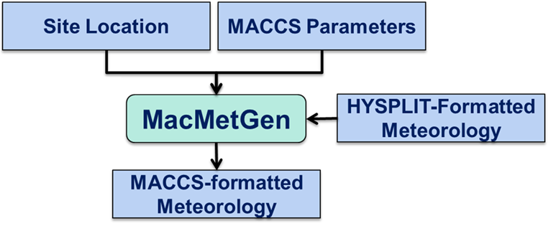
Data extraction and conversion
MacMetGen
  Developed by Sandia to ensure consistency between meteorological data used with Gaussian plume segment and HYSPLIT models
  Extracts meteorological data from HYSPLIT data sets and generates MACCS-formatted file
Process used in this analysis
  Extract from ASOS data and NAM12 data for the year 2022 for each site
  Convert ASOS to same format that MacMetGen extracts from NAM12 data sets
  Run MacMetGen to determine stability class and generate MACCS-formatted meteorology for both data sets
  Analyze wind roses and stability class distributions
  Ensure MACCS execution
  Multiple sites to check for robustness

Slide 6
Analysis Setup
Source term
  #1 - NUREG-1150 historic (puff release followed by a longer duration tail)
  #2 - SOARCA Short-Term Station Blackout (more delayed and prolonged)
Four sites
  Alaskan coastal orography
  Large river valley
  Flat terrain
  Gulf coast
MACCS grid of 29 radial intervals (out to 1,000 mi) and 16 compass sectors
General evacuation scheme
  Modeled with multiple evacuating cohorts
Uniform weather bin sampling (40 samples per bin)

Slide 7
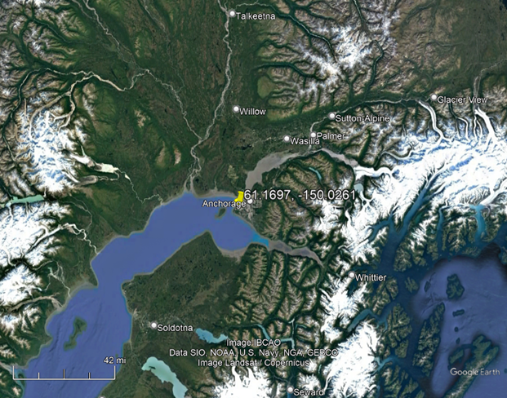
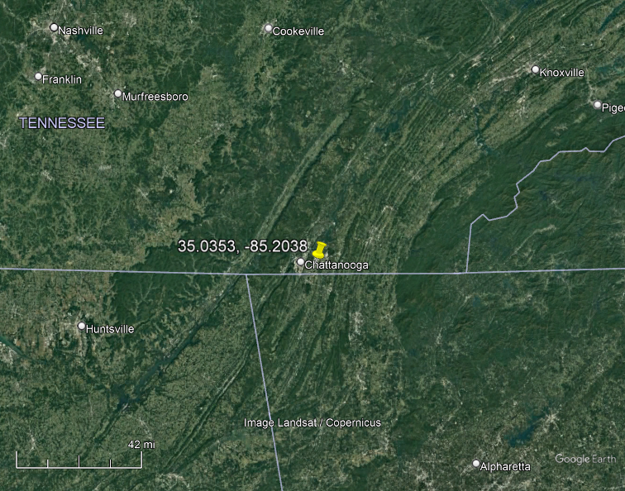
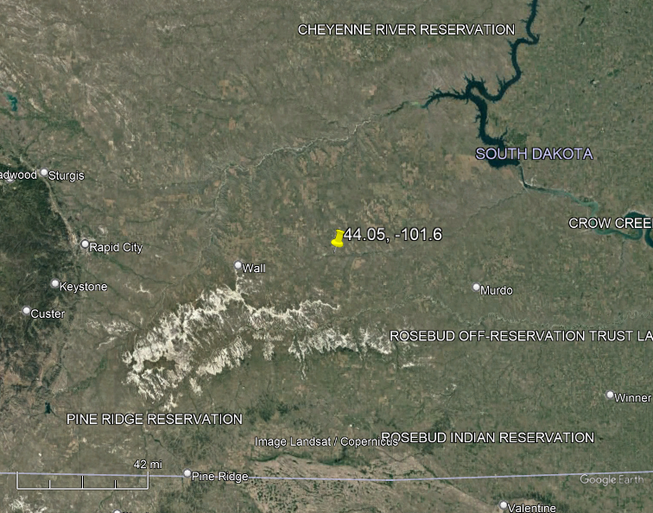
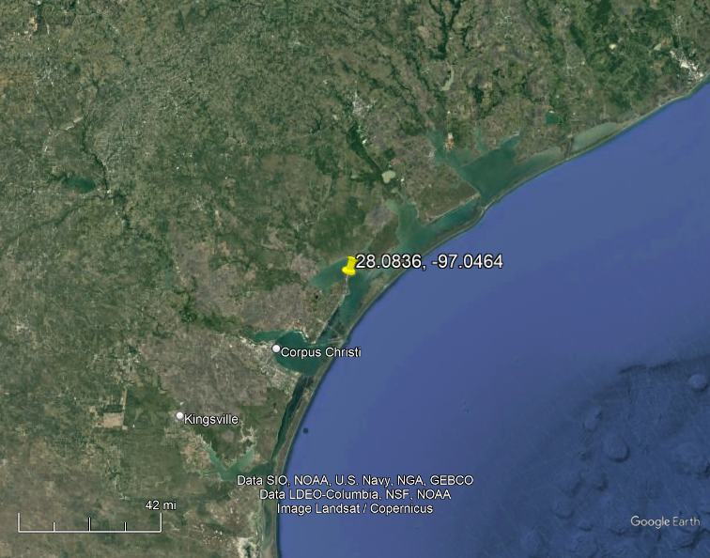
Sites
Alaskan coastal orography
  Anchorage, AL
  PANC ASOS station
Large river valley
  Chattanooga, TN
  KCHA ASOS station
Flat terrain
  Phillips, SD
  KPHP ASOS station
Gulf coast
  Rockport, TX
  KRKP ASOS station
PANC
KCHA
KPHP
KRKP

Slide 8
ASOS versus NAM12 Weather Data Comparisons
ASOS
NAM12
Difference between ASOS and NAM12
ANC
PHP

Slide 9
Output Metrics
Mean, 95th and 5th percentiles
Atmospheric Model Outputs
  Peak (around the compass) normalized, time-integrated, ground-level, air concentration (χ/Q, s/m³) as a function of distance from the site (Peak Air)
  Peak (around the compass) normalized ground concentration (D/Q, 1/m²) as a function of distance from the site (Peak Ground)
  Normalized land areas that exceed various levels of contamination (unitless) (Land Area)
Consequence Outputs
  Normalized peak ionizing radiation dose (unitless) as a function of distance (Peak Dose)
  Early fatality risk (unitless) within a circular area near the point of release (EF Risk)
  Normalized regional population doses (unitless) (Pop Dose)
  Latent cancer fatality risk (unitless) over region (LCF Risk)
  Normalized, regional economic loss (unitless) (Econ Loss)

Slide 10
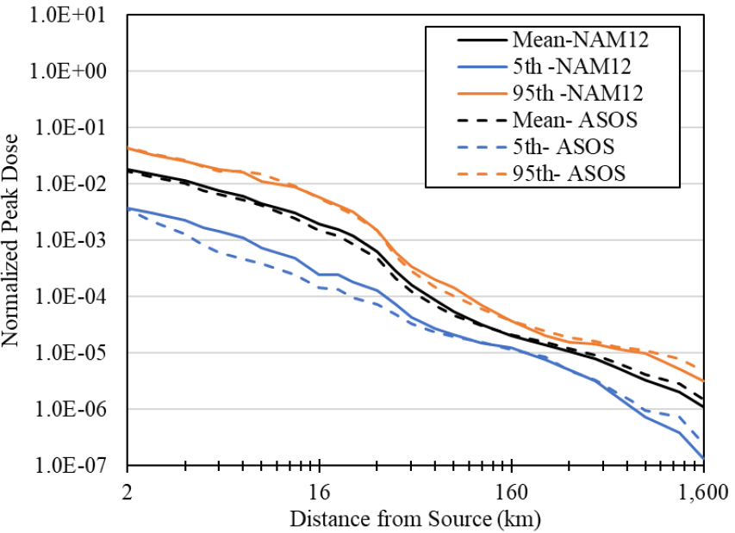
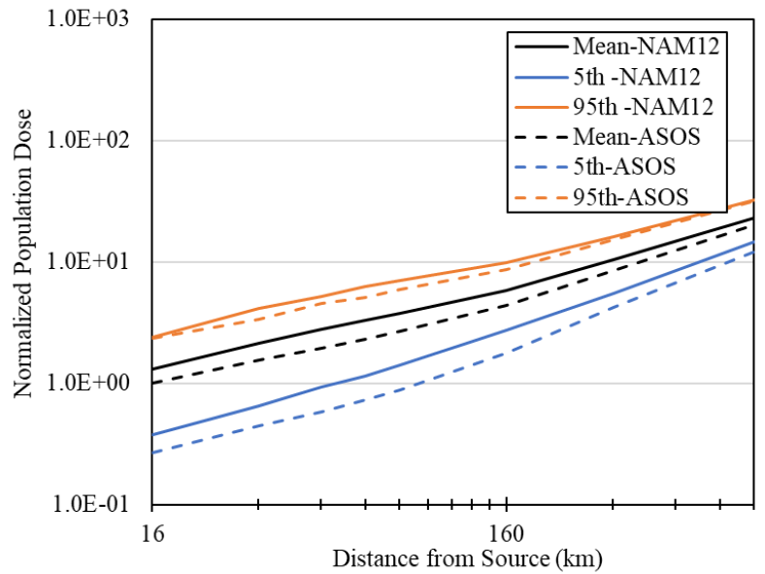
Typical Comparisons
Compare mean, 5th, and 95th values over distance and over all weather trials
Peak Quantities
Integrated Quantities
Site ANC, ST #1
Site ANC, ST #1

Slide 11
Comparison Results
Ratio of mean NAM12 model results to mean ASOS model results
  Shown as Average
  (Minimum | Maximum)
  >1 indicates NAM12 larger
  <1 indicates ASOS larger
All within a factor of two
NAM12 generally higher
Similar across all four sites and both source terms

Slide 12
Summary
Evaluate the feasibility of using weather files derived from synthetic weather data in MACCS consequence analyses
Compared extracted ASOS and NAM12 weather data for four sites
Performed MACCS analyses over wide set of metrics and distances for each site
Strong level of agreement between annual average results from ASOS and NAM12 analyses and generally within a factor of two
Using weather files derived from synthetic weather data in MACCS consequence analyses appears to be a valid alternative

