Slide 1
RASCAL Training
Unit 3 – Evolving Scenario
RAMP 2024 Users Meeting

Slide 2

Unit 3 Outline
We’ll provide an evolving scenario and use that to guide several RASCAL runs, each including:
  Scenario introduction
  Model discussion
  Run RASCAL on your computer
  Results discussion
Each section is a continuation of the changing scenario to show how RASCAL can be used throughout the course of a real-world event
Break in the middle of the session

Slide 3
Scenario
For today, the overall scenario will include:
Plant has Small Break LOCA
  MODEL: Containment Radiation Monitor
Small Leak into Aux Building
  MODEL: Coolant Release
Conditions Worsen
  MODEL: Containment Radiation Monitor
  MODEL: LOCA
Field measurement Comparison

Slide 4


RASCAL Slide
Every time we ask you to use RASCAL, you’ll see one of these blue slides.
It will include information needed to complete the steps.
If you have multiple screens, put the presentation in one screen and use RASCAL in the other. Otherwise, you will have to switch back and forth.
If you don’t have RASCAL installed, you can just watch us use it.
We will do a short step-by-step after each slide, followed by some questions.

Slide 5
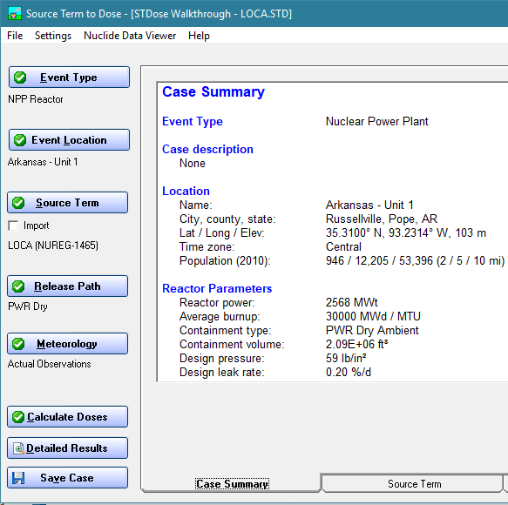
Source Term Reminder
Source Terms available depend on Event Type/Location
Source Term & Release Pathway combine to generate atmospheric source term
One of the hardest parts of using RASCAL outside training is obtaining information and knowing what models can be used, sometimes even multiple per scenario

Slide 6
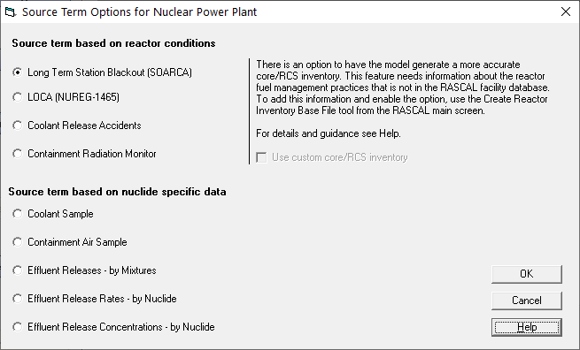
Source Terms for Today
When Nuclear Power Plant is selected as the Event Type, you will see this screen for Source Term options (models)
Today, we will be using the highlighted 3 models

Slide 7
Scenario
Palo Verde Unit 1 trips automatically at 08:35
  Operators suggest that a LOCA may be in progress, but the size is unknown
  Very little information is available; but operators do have containment radiation monitor readings
Strategy
  Too early to have any useful details for a dose assessment
    We don’t know if LOCA model would apply (assumes core damage)
    No release path to environment
  We can use the Containment Radiation Monitor model to estimate core conditions

Slide 8
Containment Rad Monitor - Background
One or more instruments inside containment used to continuously survey the containment volume for radiation.
Generally reads out in units of R/h.
Readings will be shown in the control room and will likely be available from plant data systems.

Slide 9
Containment Rad Monitor - How This Works in RASCAL
The model uses tables such as this one to convert the reading into a damage amount.
Two factors in addition to the R/h reading are considered:
Time since reactor shutdown, and whether sprays are on or off.

Slide 10
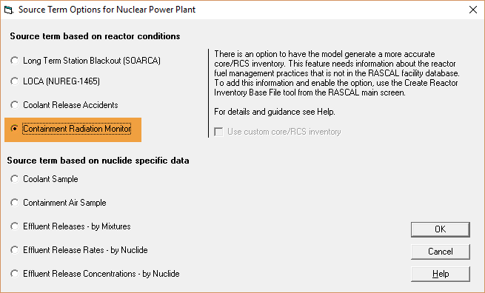
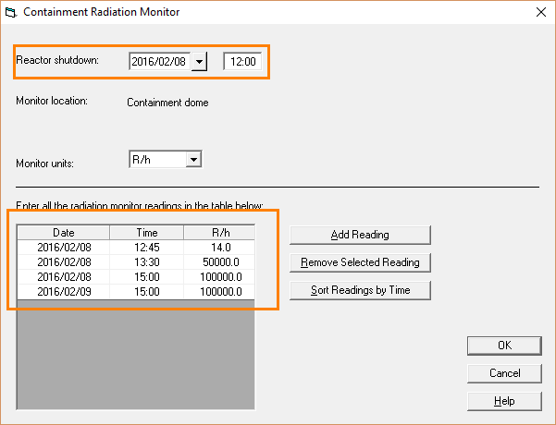
Containment Rad Monitor - How This Works in RASCAL
The only entries required are the shutdown time and the actual rad monitor readings.
This model is not predictive and persists damage amounts until it reaches a new entry.

Slide 11

Your Turn to Use RASCAL
Given the scenario excerpt below, run the entire case in RASCAL.
Palo Verde Unit 1. Shutdown at 08:35.
Sprays are off and readings are shown below:
Since we are running this model only to determine core damage state and not doses downwind, the release pathway and weather details are not important at this time. Use default (design) containment leakage, predefined standard meteorology and default calc distance/duration.
Time | Containment Radiation Monitor Reading (R/h)
08:40 | 2.4
08:55 | 5.1
Notes:
Give 5-10 min to complete problem. Next slide is walkthrough to catch up anyone who may need help.

Slide 12

Let’s walk through the problem together

Slide 13

Knowledge Check
The 5.1 R/h reading translates into how much core damage?
  8.47E-03% cladding failure
  1.09E-02% cladding failure
  1.72E-02% cladding failure
  None of the above values
Notes:
The 5.1 R/h reading translates into how much core damage?
8.47E-03% cladding failure (correct value)
1.09E-02% cladding failure (SD = 00)
1.72E-02% cladding failure (SD yesterday)
None of the above values

Slide 14
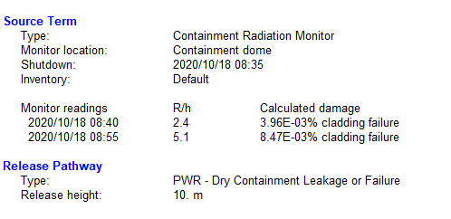
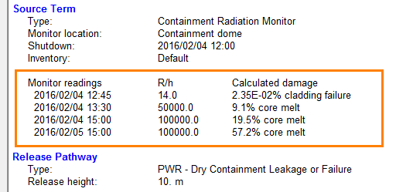
Conclusion
From the case summary, we can see the calculated core damage:
Time | Containment Radiation Monitor Reading (R/h) | RASCAL Calculated Core Damage
08:40 | 2.4 | 3.96E-03% cladding failure
08:55 | 5.1 | 8.47E-03% cladding failure
After completion, save your case!

Slide 15
Is the core really damaged?
Our RASCAL results show small amounts of clad failure. The table shows spiked coolant. Since RASCAL only calculates clad failure and core melt states with this model, our results show as extrapolated clad failure.
We can translate this as no clad failure.
5.1
Notes:
GFA update

Slide 16
Scenario
At 09:30, there are indications that a valve in the ECCS (Emergency Core Cooling System), which is providing make-up water, has failed resulting in some reactor coolant flowing into the auxiliary building.
Strategy
  Previously
    Containment radiation run suggested no core damage
    Had no release path, but now have a pathway to environment through aux building
  We can use the Coolant Release model to estimate RCS inventory leaking to environment

Slide 17
Coolant Release - How This Works in RASCAL
All reactor system pipe breaks can be modeled 2 ways depending on volume of coolant leak:
  LOCA (large or unrecoverable break, core melt)
  Coolant Release (smaller break, no core melt)
For coolant release models (simple SGTRs or small bypass LOCAs with no degrading conditions):
  Database has information about nuclides that would be in normal coolant
  Coolant spiking

Slide 18
Your Turn to Use RASCAL
Given the scenario excerpt below, run the entire case in RASCAL
Palo Verde Unit 1. Shutdown (same as before) at 08:35. Containment rad monitor run suggested spiked coolant (leave at default 30). Coolant release starts when ECCS valve failed at 09:30.
Release is through aux building (bypass) and operators estimate backflow rate at 100 gal/min. Filters remain on.
Weather data is as follows:
Since we expect this to be a small release and are estimating approximate dose values early on, we will start with an 8-hour calculation duration.
Type | Date | Time | Wind Dir (deg) | Wind spd (mph) | Stability | Precip | Air Temp ( F)
Obs | Today | 08:00 | 20 | 7 | C | None | 75
Fcst | Today | 10:00 | 30 | 6 | Unknown | None | 80
Notes:
Give 5-10 min to complete problem. Next slide is walkthrough to catch up anyone who may need help.

Slide 19
Let’s walk through the problem together
Notes:
Show RASCAL window on top of slide.

Slide 20
Knowledge Check
What is the TEDE at 0.1 miles?
  ***
  0.0E+00 rem
  2.0E-03 rem
  None of the above values
Would this source term (coolant release) be usable later if the fuel became damaged?
  No
  Yes
(less than 1 mrem)
Notes:
What is the adult thyroid CDE at 0.1 miles?
*** or less than 1 mrem (correct value)
0 (reading stars incorrectly)
2.0E-03 rem (using 4.3.3)
None of the above values
Would this source term (coolant release) be usable later if the fuel became damaged?
No (correct value)
Yes

Slide 21
Questions
Our Answers
Additional Thoughts
  Doses are low – coolant release; no core damage
  Improved fuel quality reduces spiking factor
 | Dose at 0.1 miles from the site
TEDE (rem) | ***
Adult Thyroid CDE (rem) | ***

Slide 22
Scenario
An additional containment radiation monitor reading of 105,000 R/h now becomes available
Strategy
  This reading seems high enough to warrant a second containment radiation monitor run to find core damage state
  Although we have a release path to environment, we still only want to use this run as core damage confirmation, not as a dose projection

Slide 23
Your Turn to Use RASCAL
Given the scenario excerpt below, run the entire case in RASCAL.
Load previous Containment Rad Monitor case and add new reading.
Palo Verde Unit 1. Shutdown at 08:35. Sprays are off and readings are shown below:
Since we are running this model only to determine core damage state and not doses downwind, the release pathway and weather details are not important at this time. Use default (design) containment leakage, predefined standard meteorology and default calc distance/duration.
Time | Containment Radiation Monitor Reading (R/h)
08:40 | 2.4
08:55 | 5.1
09:45 | 105,000
Notes:
Give 5-10 min to complete problem. Next slide is walkthrough to catch up anyone who may need help.

Slide 24
Let’s walk through the problem together
Notes:
Show RASCAL window on top of slide.

Slide 25
Knowledge Check
The 105,000 R/h reading translates into how much core damage?
  1.9% core melt
  18.9% core melt
  27.7% core melt
  None of the above values
Are the offsite doses shown in the Maximum Dose Values table useable?
  No. The release pathway and weather data were not matched to real conditions.
  Yes, but there are uncertainties in the values.
Notes:
The 105,000 R/h reading translates into how much core damage?
1.9% core melt (missing 0)
18.9% core melt (correct value)
27.7% core melt (SD = 00)
None of the above values
Are the offsite doses shown in the Maximum Dose Values table useable?
No. The release pathway and weather data were not matched to real conditions.
Yes, but there are uncertainties in the values.

Slide 26
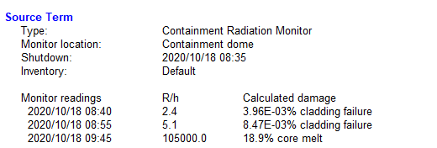
Conclusion
From the case summary, we can see the calculated core damage:
Time | Containment Radiation Monitor Reading (R/h) | RASCAL Calculated Core Damage
08:40 | 2.4 | 3.96E-03% cladding failure
08:55 | 5.1 | 8.47E-03% cladding failure
09:45 | 105,000 | 18.9% core melt

Slide 27
Conclusion
Reminder, this is not an ideal model to be your first choice for modeling a severe accident; however, it can be a good secondary, confirmatory calculation
Model assumptions:
  Readings represent the full amount of damage; may lag significantly or the release may bypass the containment
  Uniform mixing of fission products in the containment atmosphere
  Monitors are unshielded and see a large fraction of the containment volume

Slide 28
Scenario
The licensee confirms the leak to the auxiliary building is larger than their attempts to make up level to the core. They estimate the core will become uncovered shortly.
Strategy
  Now we have enough information to run a complete dose assessment with a significant release and a release pathway.
  The information we have (suggesting core uncovery) aligns with the RASCAL LOCA model.

Slide 29
LOCA - How This Works in RASCAL
The source term model for Loss-of-Coolant Accidents (LOCA) in RASCAL is based on NUREG-1465.
It assumes that a core not covered by water is unable to remove enough heat and starts to heat to the point of fuel melt. After the reactor is uncovered, the model will release fractions of the core inventory based on these phases:
30 minutes of cladding failure/gap release
80-90 minutes of core melt
2-3 hours of vessel melt-through
The shutdown time in the model is used to decay correct all the isotopes in the core. The reactor recovery time is used to stop additional nuclides from contributing to the source term. The core damage processes after heat-up are very similar to the LTSBO timeline.

Slide 30
Your Turn to Use RASCAL
Given the scenario excerpt below, run the entire case in RASCAL.
Run a LOCA model case using the following information.
Palo Verde Unit 1. Shutdown at 08:35. The licensee estimates the core will become uncovered at 09:45. There is currently no estimated time of recovery. The licensee estimates that given their makeup attempts and sump fill rates, the leak into the aux building is approximately 100 gal/min. They believe their aux building filters are intact and operating. Use the previously
entered observation/forecast for weather.
Additionally, protective actions are being considered for 12 hours from now. Run your assessment using 12-hour calculation duration to estimate potential doses until that time.
Notes:
Give 5-10 min to complete problem. Next slide is walkthrough to catch up anyone who may need help.

Slide 31
Let’s walk through the problem together

Slide 32
Knowledge Check
What is the projected TEDE (rem) at 5.0 miles?
  6.9E-01
  1.5E+00
  3.3E+01
  None of the above values
Notes:
What is the projected TEDE (rem) at 5.0 miles?
6.9E-01 (SD = 00)
1.5E+00 (correct answer)
3.3E+01 (filters off)
None of the above values

Slide 33
Scenario
Field teams have been dispatched to several locations.
Strategy
  Field measurements will always provide better data than RASCAL projections; however, it may be useful to align projections to field team data before lots of field data is available.
  This alignment can help inform future field team operations or interpolate field team data points.

Slide 34
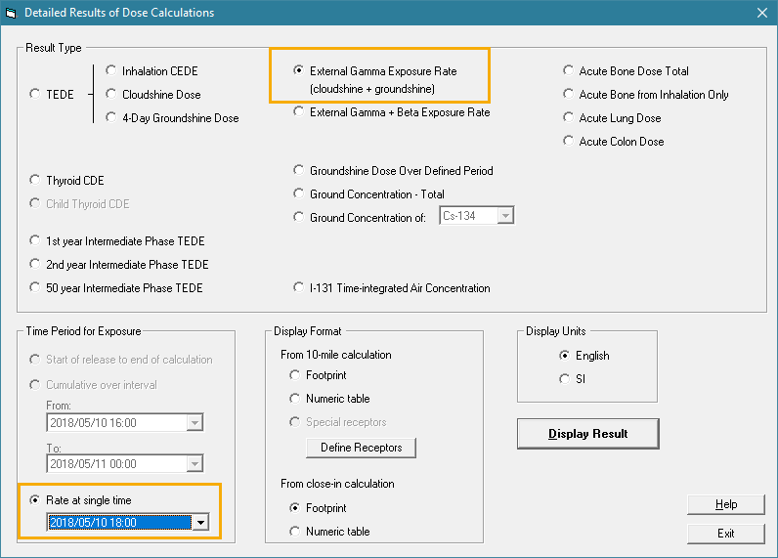
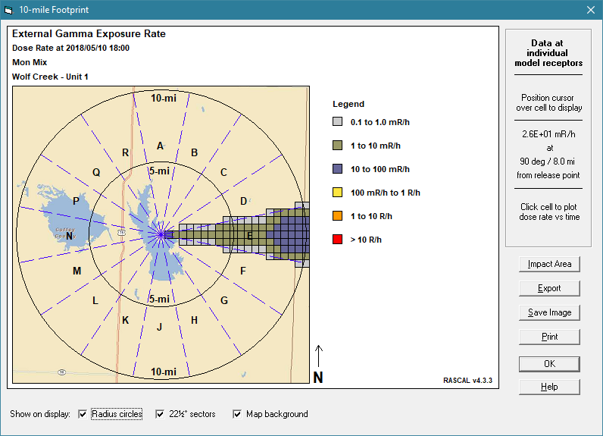
Field Team Comparison - How This Works in RASCAL
One of the detailed results options is to
view the gamma dose rate.
Set the time to the time of the field measurement
Mouse over the cells to see the data values. More information can be seen if you click on the cell.

Slide 35
Your Turn to Use RASCAL
Use the previous RASCAL run and compare the results to below
Field teams have been dispatched and reported measurements at 14:00 local time. Do these readings confirm that your dose projections are representative of the actual release?
Field Team & Location | Gamma Reading | RASCAL Projected Value
Team 1 202° - 2.7 miles | 162 mR/h | ?
Team 2 193° - 9.2 miles | 4.9 mR/h | ?
Team 3 90° (east) – 2 miles | 0.06 mR/h | ?
Notes:
Give 5-10 min to complete problem. Next slide is walkthrough to catch up anyone who may need help.

Slide 36
Let’s walk through the problem together
*We can also show you useful result types like direct reading dosimeter conversions and at preset locations.

Slide 37
Knowledge Check
For Field Team 1 (202 deg at 2.7 miles), what is the projected gamma reading (mR/h) at 14:00?
  7.8E+01 mR/h
  1.4E+02 mR/h
  2.1E+02 mR/h
  None of the above values
Field team 3 reports a gamma value of 0.06 mR/h at a point 2 miles east of the plant. Does your RASCAL projection align with that?
  No, the field team must be measuring wrong
  No, my RASCAL results are probably wrong
  Yes, my RASCAL run reported 0.06 at that location
  Yes, my run projected 0.0 but field team numbers reflect background and noise
Notes:
For Field Team 1 (202 deg at 2.7 miles), what is the projected gamma reading (mR/h) at 14:00?
7.8E+01 mR/h (reading at end of period)
1.4E+02 mR/h (correct value)
2.1E+02 mR/h (gamma + beta)
None of the above values
Field team 3 reports a gamma value of 0.06 mR/h at a point 2 miles east of the plant. Does your RASCAL projection align with that?
No, the field team must be measuring wrong
No, my RASCAL results are probably wrong
Yes, my RASCAL run reported 0.06 at that location
Yes, my run projected 0.0 but field team numbers reflect background and noise (correct answer)

Slide 38
Field Team Comparison - Conclusion
Our Answers
Field Team & Location | Gamma Reading | RASCAL Projection
Team 1 202° - 2.7 miles | 162 mR/h | 140 mR/h
Team 2 193° - 9.2 miles | 4.9 mR/h | 5.4 mR/h
Team 3 90° (east) – 2 miles | 0.06 mR/h | 0

Slide 39
Review
Today, we covered a more realistic scenario that used multiple RASCAL runs and models
It is likely that during a real event, more than 1 run will be needed
Sometimes information changes and becomes more available throughout the event

Slide 40
This concludes our Evolving Scenario unit
Remember that resources & training can be found at:
https://ramp.nrc-gateway.gov/

