Slide 1
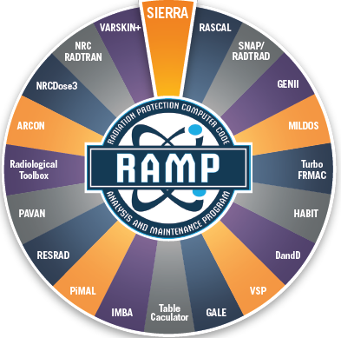
Thursday Primer: Status of NRC Vet Activities
Rigel Flora
Health Physicist
2023 Fall RAMP Users’ Group Meeting October 23–27, 2023 Rockville, MD
Notes:
Hello, my name is Rigel Flora
I am a Health Physicist and the RAMP Program Manger.
This presentation is to give each of you a snap shot of the rest of the User Meeting.
Next slide please.
20s

Slide 2
Agenda
What is Future-Focused Research
Why Vet Activities
Guidance Documents
What is PiMAL
Proposed Vet Phantoms
Notes:
You should have both this booklet and the RAMP newsletter in your folder if you are in house.
If you are virtual, you should have received the RAMP Program Booklet via email.
Everything you need to know if contained in this booklet.
However, if you did not, I am here to tell you about the full five days of presentations, training, code discussions and tours.
As John said earlier, we manage about 18 codes and its not possible to give attention to each code each year.
As such, we alternate what we present, but it is based on the popularity of the code, if a new version was developed during that year and other factors.
As Kim said in her opening talk, this year we concentrate on RASCAL and RESRAD
.and an Internal and External Dosimetry Meeting.
Make sure you mention the CHP credit
Next slide please.

Slide 3
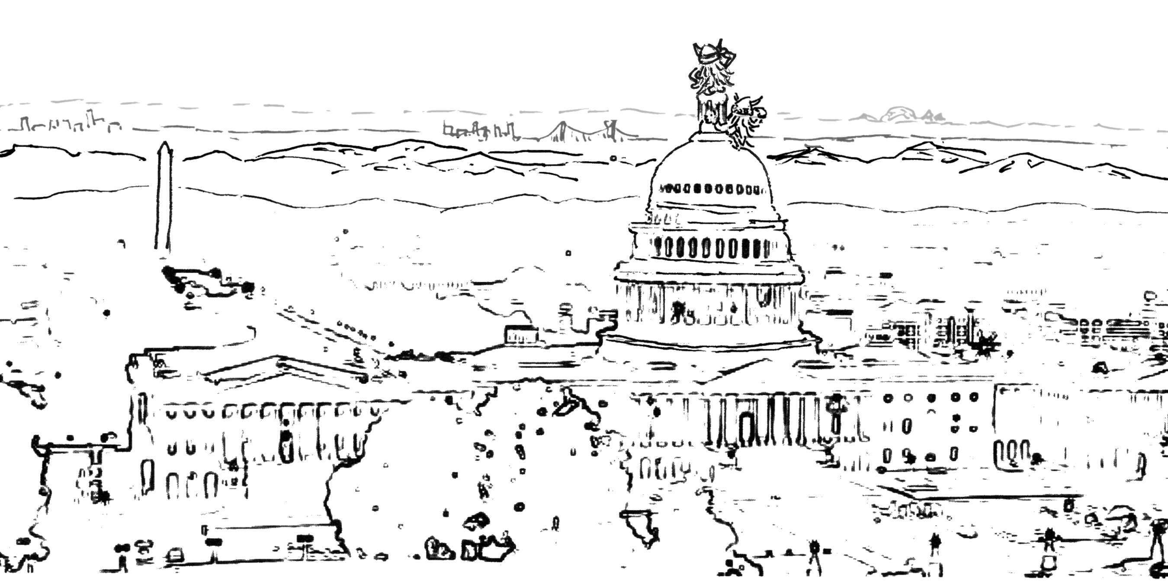
NRC’s Future-Focused Research Program
Notes:
You should have both this booklet and the RAMP newsletter in your folder if you are in house.
If you are virtual, you should have received the RAMP Program Booklet via email.
Everything you need to know if contained in this booklet.
However, if you did not, I am here to tell you about the full five days of presentations, training, code discussions and tours.
As John said earlier, we manage about 18 codes and its not possible to give attention to each code each year.
As such, we alternate what we present, but it is based on the popularity of the code, if a new version was developed during that year and other factors.
As Kim said in her opening talk, this year we concentrate on RASCAL and RESRAD
.and an Internal and External Dosimetry Meeting.
Make sure you mention the CHP credit
Next slide please.

Slide 4
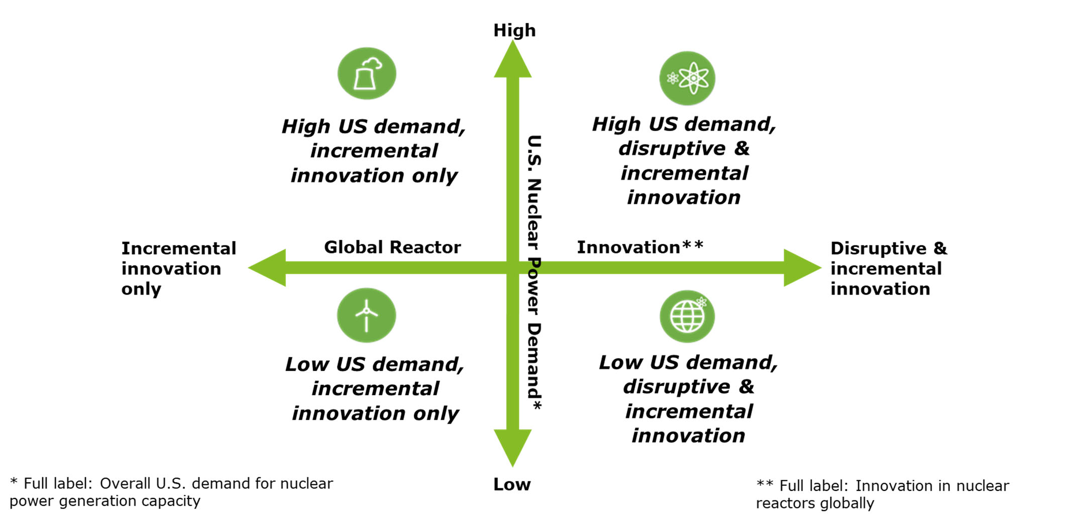
Why Do We Need the FFR Program?
Changing reactor technologies, concepts of operation
Increasing knowledge base (and means to use)
Increasing computational capabilities (hardware, software, modeling approaches)
Changing staff and other stakeholders
Increasing and more challenging regulatory applications
0
U.S. Nuclear Regulatory Commission, “The Dynamic Futures for NRC Mission Areas,” 2019. (ML19022A178)
RES goal: help ensure that NRC is prepared
Notes:
You should have both this booklet and the RAMP newsletter in your folder if you are in house.
If you are virtual, you should have received the RAMP Program Booklet via email.
Everything you need to know if contained in this booklet.
However, if you did not, I am here to tell you about the full five days of presentations, training, code discussions and tours.
As John said earlier, we manage about 18 codes and its not possible to give attention to each code each year.
As such, we alternate what we present, but it is based on the popularity of the code, if a new version was developed during that year and other factors.
As Kim said in her opening talk, this year we concentrate on RASCAL and RESRAD
.and an Internal and External Dosimetry Meeting.
Make sure you mention the CHP credit
Next slide please.

Slide 5
Goals of the FFR Program
Support NRC’s need for longer-term (≥ 3 years) R&D activities
Funding
Dedicated
Fully loaded at beginning of project
Exploring opportunities to leverage with University R&D Grant Program
Program management and administration
Streamlined submission and review process
Low-burden, low-resource implementation
Start small, grow with success
Initiated current program in FY-20
Mixed project portfolio
Time horizons
Project risk: emphasizing riskier, less-applied ideas for FY-22 and beyond
Notes:
The NRC authorizes the release of animals to owners following veterinary procedures involving byproduct material when the exposure to members of the public from the animal is expected to be below the public dose limits in 10 CFR Part 20. In recent years, new uses of byproduct material are emerging for use in veterinary medicine and comprehensive guidance is needed to determine acceptable criteria and procedures for release of the animals following the procedures.
NUREG-1556, Volume 7, Revision 1, "Consolidated Guidance About Materials Licenses: Program-Specific Guidance About Academic, Research and Development, and Other Licenses of Limited Scope, Including Electron Capture Devices and X-Ray Fluorescence Analyzers"
Appendix D provides high level guidance for release of animals following veterinary procedures using byproduct material. However, this guidance only provides specific criteria for sodium iodine-131 treatment for cats and more uses of byproduct material in animals are emerging. In addition, the current guidance states that veterinary licensees should provide the released animal's owner with written instructions to reduce the dose to the public after treatment. NUREG-1556, Volume 7 further states the instructions should provide a margin for dose reduction and should not be relied upon as the primary way of keeping the dose to members of the public below the 10 CFR Part 20 dose limits. However, the industry and license reviewers have asked for more specific guidance for instructions as part of procedures to allow for release.

Slide 6
Where FFR Fits in Research
FFR Program
Idea Generation
Idea Refinement and Selection
Portfolio Monitoring and Reporting
Follow-On Projects (User Needs)
Notes:
The NRC authorizes the release of animals to owners following veterinary procedures involving byproduct material when the exposure to members of the public from the animal is expected to be below the public dose limits in 10 CFR Part 20. In recent years, new uses of byproduct material are emerging for use in veterinary medicine and comprehensive guidance is needed to determine acceptable criteria and procedures for release of the animals following the procedures.
NUREG-1556, Volume 7, Revision 1, "Consolidated Guidance About Materials Licenses: Program-Specific Guidance About Academic, Research and Development, and Other Licenses of Limited Scope, Including Electron Capture Devices and X-Ray Fluorescence Analyzers"
Appendix D provides high level guidance for release of animals following veterinary procedures using byproduct material. However, this guidance only provides specific criteria for sodium iodine-131 treatment for cats and more uses of byproduct material in animals are emerging. In addition, the current guidance states that veterinary licensees should provide the released animal's owner with written instructions to reduce the dose to the public after treatment. NUREG-1556, Volume 7 further states the instructions should provide a margin for dose reduction and should not be relied upon as the primary way of keeping the dose to members of the public below the 10 CFR Part 20 dose limits. However, the industry and license reviewers have asked for more specific guidance for instructions as part of procedures to allow for release.

Slide 7
Why Vet Activities/Regulatory Driver
The NRC authorizes the release of animals to owners following veterinary procedures.
NUREG-1556, "Consolidated Guidance About Materials Licenses: Program-Specific Guidance About Academic, Research and Development, and Other Licenses of Limited Scope, Including Electron Capture Devices and X-Ray Fluorescence Analyzers“.
Appendix D provides high level guidance for release of animals following veterinary procedures using byproduct material. However, this guidance only provides specific criteria for sodium iodine-131 treatment for cats and more uses of byproduct material in animals are emerging.
The industry and license reviewers have asked for more specific guidance for instructions as part of procedures to allow for release.
Notes:
The NRC authorizes the release of animals to owners following veterinary procedures involving byproduct material when the exposure to members of the public from the animal is expected to be below the public dose limits in 10 CFR Part 20. In recent years, new uses of byproduct material are emerging for use in veterinary medicine and comprehensive guidance is needed to determine acceptable criteria and procedures for release of the animals following the procedures.
NUREG-1556, Volume 7, Revision 1, "Consolidated Guidance About Materials Licenses: Program-Specific Guidance About Academic, Research and Development, and Other Licenses of Limited Scope, Including Electron Capture Devices and X-Ray Fluorescence Analyzers"
Appendix D provides high level guidance for release of animals following veterinary procedures using byproduct material. However, this guidance only provides specific criteria for sodium iodine-131 treatment for cats and more uses of byproduct material in animals are emerging. In addition, the current guidance states that veterinary licensees should provide the released animal's owner with written instructions to reduce the dose to the public after treatment. NUREG-1556, Volume 7 further states the instructions should provide a margin for dose reduction and should not be relied upon as the primary way of keeping the dose to members of the public below the 10 CFR Part 20 dose limits. However, the industry and license reviewers have asked for more specific guidance for instructions as part of procedures to allow for release.

Slide 8
Developing NRC Guidance
Regulatory Guide Development Support
While the NRC has authorized release of animals containing byproduct material when exposure to the public is expected to be below public dose limits in 10 CFR Part 20 for over 20 years, the NRC does not have a specific regulatory framework for the release.
Therefore, the NRC is developing a rule-making plan to propose to codify the authorization of veterinary licensees to release animals containing byproduct material in 10 CFR Part 30 with appropriate instruction under certain circumstances.
The regulatory guidance would be developed in parallel with the rule-making if the NRC pursues it, but is still necessary if rule-making activities are stopped.
Notes:
While the NRC has authorized release of animals containing byproduct material when exposure to the public is expected to be below public dose limits in 10 CFR Part 20 for over 20 years, the NRC does not have a specific regulatory framework for the release. Therefore, the NRC is developing a rule-making plan to propose to codify the authorization of veterinary licensees to release animals containing byproduct material in 10 CFR Part 30 with appropriate instruction under certain circumstances. The rule would be appropriately risk-informed and performance-based, while providing the needed clarity to veterinary licensees and license applicants that are regulated by the NRC or Agreement States. The regulatory guidance would be developed in parallel with the rule-making if the NRC pursues it, but is still necessary if rule-making activities are stopped.

Slide 9
“Can I Pet my Pets”
An FFR project undertaken by RPB aiming to identify potential risk to pet owners.
Focused on three animal groups for this analysis
Canine
Feline
Equine
Treatments were chosen based upon frequency and level of potential hazard to the public.
Considered both external and internal pathways
Notes:
You should have both this booklet and the RAMP newsletter in your folder if you are in house.
If you are virtual, you should have received the RAMP Program Booklet via email.
Everything you need to know if contained in this booklet.
However, if you did not, I am here to tell you about the full five days of presentations, training, code discussions and tours.
As John said earlier, we manage about 18 codes and its not possible to give attention to each code each year.
As such, we alternate what we present, but it is based on the popularity of the code, if a new version was developed during that year and other factors.
As Kim said in her opening talk, this year we concentrate on RASCAL and RESRAD
.and an Internal and External Dosimetry Meeting.
Make sure you mention the CHP credit
Next slide please.

Slide 10
Internal Pathways
There are several pathways for radionuclides used in veterinary procedures to become internalized in the human body.
Saliva – animal licking the owner’s hands or face.
Inhalation – primarily a concern for cat owners, particulates from cat litter can become airborne during use.
Direct transfer from animal surface – due to grooming habits of certain animals’ radionuclides are transferred from saliva to the exterior of the animal. This opens several different routes for internalization, primarily through hand to mouth contact after petting the animal.
For each pathway, the maximum initial administration activity was assumed as well as the largest removeable fraction which could be found in literature.
Both assumptions were made to increase conservatism and assure that if a pathway did present a dosimetry risk it would become apparent.

Slide 11
Geometry for MCNP Simulations
Six different geometries were simulated to evaluate maximum potential external dose.
Canine/Feline
Sleeping near the owner’s head.
Laying across the owner’s lap while the human is seated.
Animal laying/standing at the owner’s feet.
Equine
Owner standing and facing the animal within arms reach, designed to simulate activities such as grooming.
Owner leading the horse using a standard lead rope distance of one meter.
Owner riding the horse.
Notes:
You should have both this booklet and the RAMP newsletter in your folder if you are in house.
If you are virtual, you should have received the RAMP Program Booklet via email.
Everything you need to know if contained in this booklet.
However, if you did not, I am here to tell you about the full five days of presentations, training, code discussions and tours.
As John said earlier, we manage about 18 codes and its not possible to give attention to each code each year.
As such, we alternate what we present, but it is based on the popularity of the code, if a new version was developed during that year and other factors.
As Kim said in her opening talk, this year we concentrate on RASCAL and RESRAD
.and an Internal and External Dosimetry Meeting.
Make sure you mention the CHP credit
Next slide please.

Slide 12
Codes and Methods
Scenarios in this investigation were created using MCNP and the PIMAL human phantom.
PIMAL was selected to aid in the creation and positioning of the human because it allows for manipulation of the human phantom and contains 24 organs which serve to increase the accuracy of the simulations.
The animals were created independently within MCNP primarily using macrobodies.
Depending on the distribution of the source nuclide, internal structures such as a skeletal system were also included.
Standard tissue distribution and animal size was incorporated to assure an anatomically accurate model was created.
Notes:
You should have both this booklet and the RAMP newsletter in your folder if you are in house.
If you are virtual, you should have received the RAMP Program Booklet via email.
Everything you need to know if contained in this booklet.
However, if you did not, I am here to tell you about the full five days of presentations, training, code discussions and tours.
As John said earlier, we manage about 18 codes and its not possible to give attention to each code each year.
As such, we alternate what we present, but it is based on the popularity of the code, if a new version was developed during that year and other factors.
As Kim said in her opening talk, this year we concentrate on RASCAL and RESRAD
.and an Internal and External Dosimetry Meeting.
Make sure you mention the CHP credit
Next slide please.

Slide 13
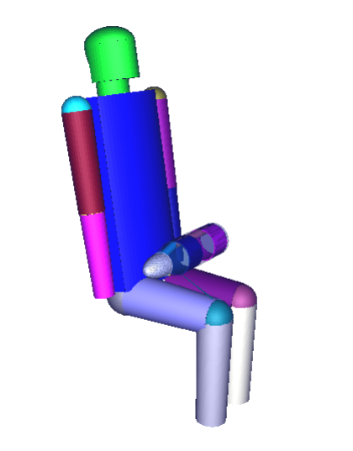
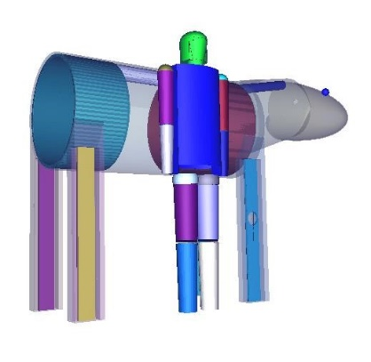
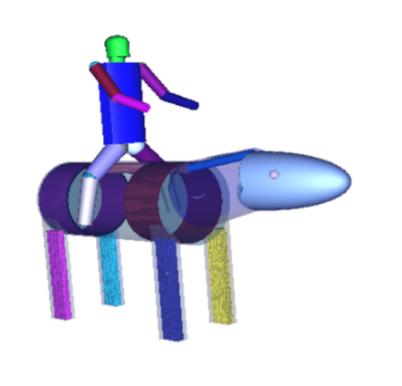
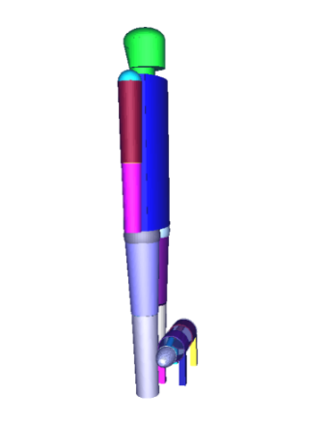
Images Taken from Vis-Ed
Feline in lap
Standing at horse shoulder
Feline at feet
Riding the horse

Slide 14
Feline Results
Procedure | Tc-99m Full Body | I-131 Hyperthyroidism | I-131 Thyroid Cancer
Administration (MBq) | 1,110 | 148 | 1,480
Feline at Owner’s Head
Dose Rate (mSv/h) | 0.11 | 0.031 | 0.31
Total Dose (mSv) | 0.75 | 2.7 | 27
Feline in Owner’s Lap
Dose Rate (mSv/h) | 0.15 | 0.041 | 0.42
Total Dose (mSv) | 1.1 | 3.6 | 36
Feline at Owner’s Feet
Dose Rate (mSv/h) | 0.0083 | 0.0019 | 0.019
Total Dose (mSv) | 0.058 | 0.17 | 1.7
Red indicates values in excess of 0.02 mSv/h or 1 mSv.
Assuming 100% occupancy factor and a maximum administered activity.
Hold period was not accounted for in the table results.
It is common for some procedures to require a hold period at the veterinary office to allow the radionuclide to decay
In this case the I-131 treatments require a 4-8 day hold depending on amount administered.
Assumptions make it very easy to scale the results utilizing occupancy factor or radiological decay.

Slide 15
Canine Results
Procedure | Tc-99m Full Body | Tc-99m Bone Distribution | Sn-117m Synovectomy | I-131 Hyperthyroidism |  | I-131 Cancer
Administration (MBq) | 1,110 | 1,110 | 222 | 148 |  | 4,440
Canine at Owner’s Head
Dose Rate (mSv/h) | 0.089 | 0.090 | 0.088 | 0.038 |  | 1.1
Total Dose (mSv) | 0.77 | 0.78 | 43 | 3.3 |  | 99
Canine in Owner’s Lap
Dose Rate (mSv/h) | 0.11 | 0.11 | 0.017 | 0.021 |  | 0.62
Total Dose (mSv) | 0.93 | 0.94 | 8.7 | 1.8 |  | 53
Canine at Owner’s Feet
Dose Rate (mSv/h) | 0.0092 | 0.011 | 0.00030 | 0.0018 |  | 0.053
Total Dose (mSv) | 0.080 | 0.092 | 0.15 | 0.15 |  | 4.6

Slide 16
Equine Results
Procedure | Tc-99m Full Body | Tc-99m Bone Distribution | Sn-117m Synovectomy | Ir-192 (sealed) Eyelid | I-125 (sealed) Eyelid
Administration (MBq) | 1,110 | 8,880 | 222 | 45,000 | 1,665
Standing at Horse’s Shoulder
Dose Rate (mSv/h) | 0.014 | 0.063 | 0.00085 | 0.16 | 0.0015
Total Dose (mSv) | 0.097 | 0.44 | 0.41
Riding Horse
Dose Rate (mSv/h) | 0.0034 | 0.069 | 5.1E-7 | 0.43 | 0.0016
Total Dose (mSv) | 0.023 | 0.48 | 0.00025
Leading the Horse
Dose Rate (mSv/h) | 0.0014 | 0.0074 | 0.00028 | 0.65 | 0.0019
Total Dose (mSv) | 0.010 | 0.051 | 0.14

Slide 17
Internal Pathway Results
Despite the high level of conservatism, all pathways analyzed returned CEDE values below 1 mSv.
The standard range was between factors of seven to several hundred times lower.
A singular pathway did return results which could become significant when combined with external dose.
Direct saliva transfer following treatment with I-131 can potentially result in a CEDE of 0.42 mSv.
This would require the human to ingest 1 mL of saliva immediately upon the return of the animal.
Because of the conservative approach and low associated dose values, it can be determined that there is very little concern for an internal radiation risk.

Slide 18
Current Activities
In the first year of its application the FFR program was a success.
Due to the findings from the project follow on research and guidance development has been planned.
For RAMP, that means an update to PiMAL has been planned in order to support further research requests as guidance is prepared.

Slide 19
PiMAL
Graphical User Interface which assists users in developing Monte Carlo N-Particle (MCNP) geometry input decks.
PiMAL allows for manipulation of the phantom within the GUI and will then provide the input deck to be utilized in MCNP.

Slide 20
Planned Updates
Build three domestic animal phantoms in PiMAL
Canine, Feline, and Equine
The phantoms will allow radioactive material to be placed in various organs of those animals (including knee joints)
Used to estimate dose to an exposed individual (also available in PiMAL) to demonstrate regulatory compliance

Slide 21
Questions?

