Slide 1
Visual Sample Plan
Case Study
SPRING 2022 RAMP INT’L USERS GROUP MEETING
April 5-8, 2022
Deborah Fagan and Lisa Newburn
Pacific Northwest National Laboratory
PNNL-SA-171826

Slide 2
Agenda
Introductions (5 min)
Visual Sample Plan Overview(15 min)
Systematic Planning Basics (20 min)
Case Study Scenario Introduction (10 min)
Example 1: Unity Rule (25 min)
Break (5 min)
Example 2: Stratified Mean (25 min)
Example 3: Spatial Analysis (25 min)
Coming Developments in VSP (10 min)
Questions (15 min)

Slide 3
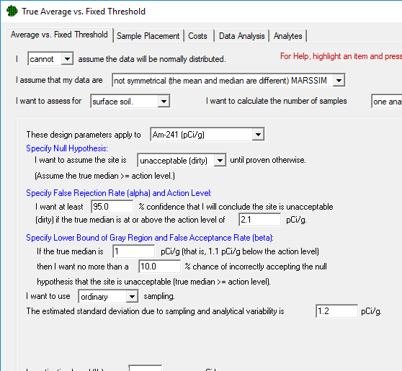
What is Visual Sample Plan (VSP)?
VSP is a software tool to…
  Design a statistically-based sampling strategy
    How many samples should be collected, and where?
    Based on the Data Quality Objectives (DQO) process

Slide 4
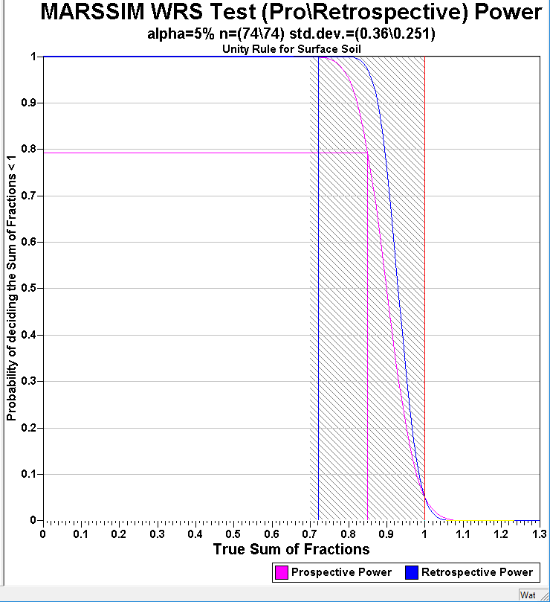
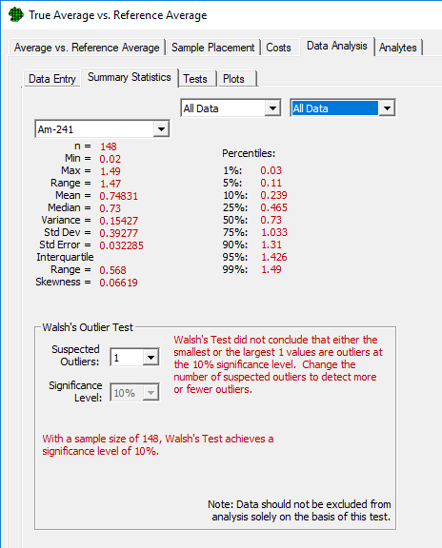
What is Visual Sample Plan (VSP)?
VSP is a software tool to…
  Design
  Analyze data to support decisions
    Statistical tests
    Graphs, plots and summary statistics

Slide 5
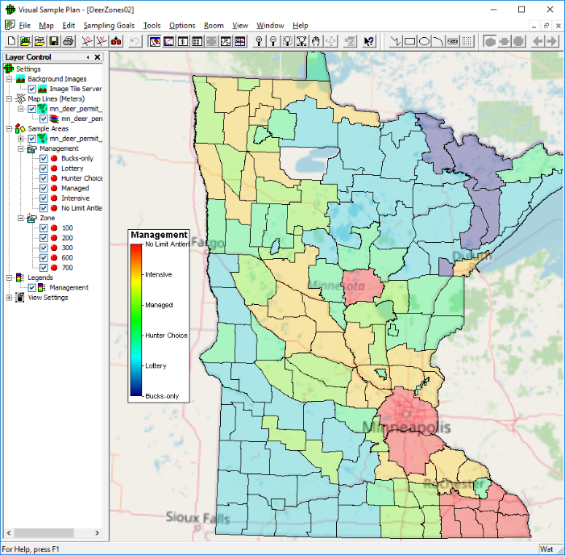
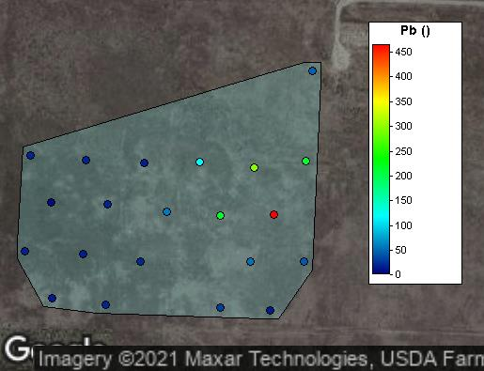
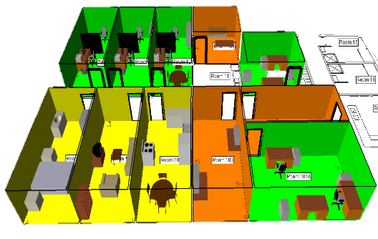
What is Visual Sample Plan (VSP)?
VSP is a software tool to…
  Design
  Analyze
  Visualize maps, buildings, planned sample locations, and results
    CAD and GIS file import
    Map imagery download
    3D room and equipment modeling and visualization

Slide 6
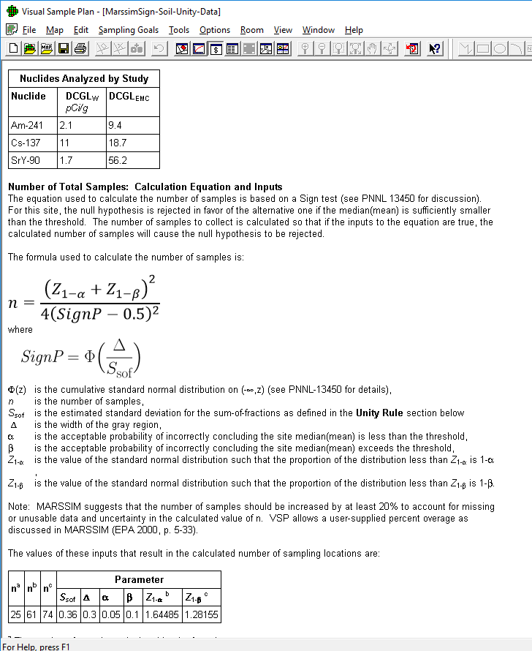
What is Visual Sample Plan (VSP)?
VSP is a software tool to…
  Design
  Analyze
  Visualize
  Guide users who don’t have statistical expertise
    Decision-driven and plain (jargon-free) language
    Automatically generated reports documenting steps and assumptions
    Thorough documentation and references

Slide 7
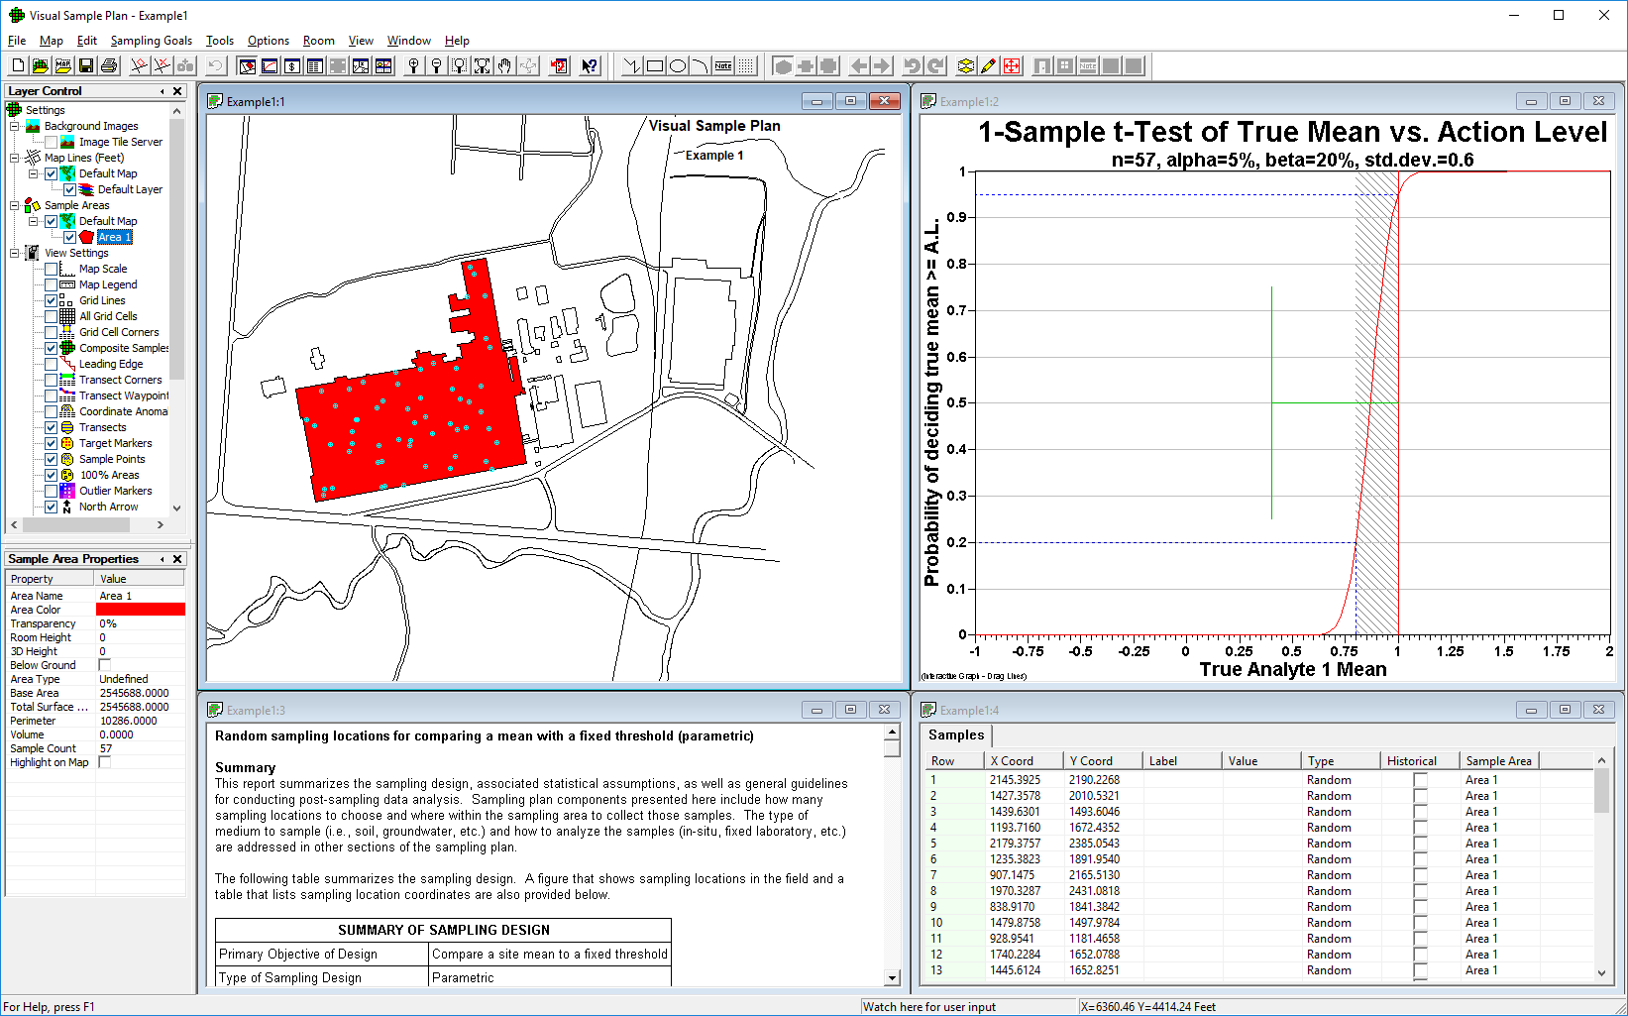
Visual Sample Plan in Use
Maps can be imported/exported with sample areas defined and samples displayed

Slide 8
Visual Sample Plan in Use
Diagnostic interactive graphics can be manipulated to quickly see effects on design of changing Data Quality Objective inputs

Slide 9
Visual Sample Plan in Use
Detailed 3-15 page report automatically generated documenting design, assumptions, maps, equations, Data Quality Objectives, Analyses

Slide 10
Visual Sample Plan in Use
Sample location coordinates listed and available for output for use in the field (w/GPS)

Slide 11
Downloads and Users
Over 12,000 total downloads from around 5,000 unique users
Approximately 2,000 downloads each year
*year to date through 5/6/2020

Slide 12
VSP Sponsoring Agencies
U.S. Nuclear Regulatory Commission (NRC)
  MARSSIM Updates & Training
U.S. Dept. of Defense (DoD)
  Transect sampling designs, geostatistics, composite sampling
U.S. Dept. of Homeland Security (DHS)
  Chemical/Biological applications and building mapping
U.S. Dept. of Energy (DOE)
  Long term monitoring, geostatistics, & non-parametric models, composite sampling, hot-spot sampling
U.S. Centers for Disease Control (CDC/NIOSH)
  Combined judgment and random sampling
U.S. Environmental Protection Agency (EPA)
  Traditional Environmental Sampling Designs
UK Atomic Weapons Establishment
  Expert mentor and enhancements
UK Government Decontamination Services
  Enhancements
UK Department for Environment, Food and Rural Affairs
  Building visualization and sampling improvements

Slide 13
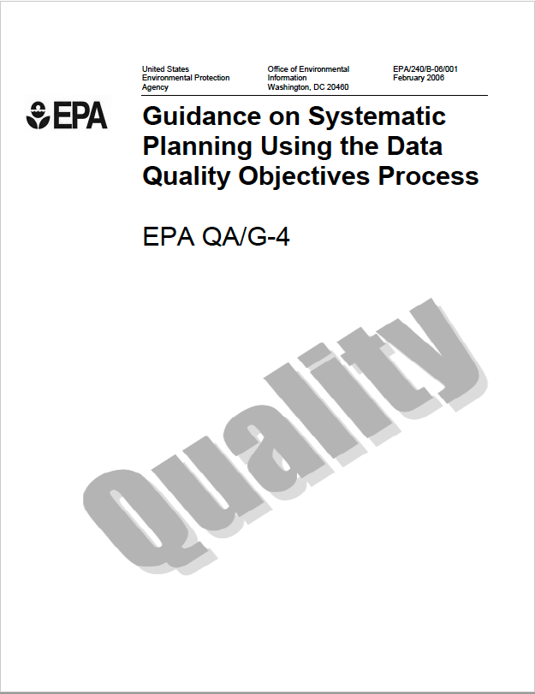
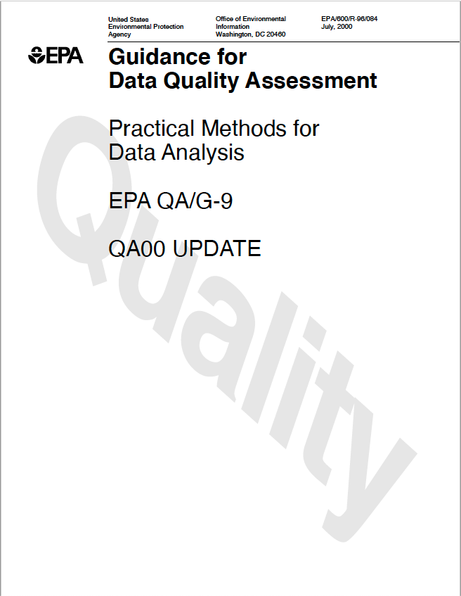
EPA Data Life Cycle
PLANNING
Data Quality Objectives Process
Quality Assurance Project Plan Development
IMPLEMENTATION
Field Data Collection and Associated
Quality Assurance / Quality Control Activities
ASSESSMENT
Data Validation / Verification
Data Quality Assessment
https://www.epa.gov/sites/default/files/2015-06/documents/g4-final.pdf
https://www.epa.gov/sites/default/files/2015-06/documents/g9-final.pdf

Slide 14




Steps in DQO Process
State the problem
Identify the goal of the study
Identify information inputs
Define the boundaries of the study
Develop the analytic approach
Specify performance or acceptance criteria
Develop the plan for obtaining data
VSP

Slide 15
Step 1: State the problem
Identify project team, stakeholders
Identify project schedule, resources, milestones, budget
Develop the conceptual site model (CSM)
  Sources of potential contaminants
  Current understanding of site conditions
    Known or expected locations of contaminants
    Media that are or may become contaminated
    Exposure scenarios
  Identify the intended use for study data
    Estimation: advance the state of knowledge, identify regulatory alternatives, characterize level of exposure without existing regulations
    Decision-making: determine alternative action, comparison to risk-based thresholds or regulatory limits

Slide 16
Step 2: Identify the goal of the study
Identify principal study question(s)
Identify actions that can occur by answering study question
Develop estimation or decision statements
  Estimation statements:
    State what needs to be estimated
    State key assumptions
  Decision-making:
    Organize multiple decisions (prioritize or sequence)
    State alternative actions for each decision statement

Slide 17
Step 3: Identify the information inputs
Informational Inputs
VSP Inputs
Contaminants of potential concern (COPCs)
Regulatory limits or action levels
Site characteristics
Decision criteria and alternative actions
Physical, logistical, cost constraints
Applicable data collection and analytical methods
Historical data
Site map
Sampling objective
Expected total and analytical variability
Expected distribution (spatial and probabilistic) of the data
Tolerable probabilities of data-driven decision errors
Costs
17

Slide 18
Step 4: Define the study boundaries
Can the site be divided into geographical “decision units” based on proximity, usage, natural boundaries?
Does the CSM lead to a natural identification of study areas, media, time frames?
Is the contamination expected to be present in “hot spots”?
What are the technological considerations for sampling and/or alternative actions for an area or medium?
What is a sampling unit?
  The collection of sampling units is the population of interest
Each decision or estimation statement should be evaluated for each decision unit

Slide 19
Step 5: Develop the analytic approach
Specify the population parameter of interest (e.g., the mean concentration of radionuclide A in the top 6 inches of soil)
For decision problems, choose a workable action level (e.g., dose-based for radionuclides)
For estimation problems, choose the estimator (e.g., sample mean)
Develop the decision rule for each medium, decision unit, time frame
  Decision problems: “If…, then…, else”
  Estimation problems: ”This study will estimate the true…”

Slide 20
Step 6: Specify performance or acceptance criteria – Decision statement
Types of incorrect decisions
  Falsely concluding a site mean is below an action limit
  Falsely concluding a site mean exceeds a regulatory threshold
Determine the consequences of decision errors
  Failing to (remediate, restrict) an unacceptable area
  Taking (remedial, restrictive) action for an acceptable area
Specify the decision statement as a statistical hypothesis based on the more dire decision error consequences
  Usually falsely concluding an area is acceptable has the more dire consequences
  The alternative hypothesis is then that the area is acceptable
  The null (working) hypothesis is that the area is unacceptable

Slide 21
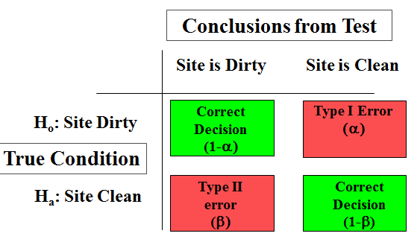
Step 6: Specify performance or acceptance criteria – Decision statement
Determine the ”acceptable” decision error rates
  Type I error: I am willing to accept a 1/10 chance of failing to (remediate, restrict) an unacceptable area
  Type II error: I am willing to accept a 1/5 chance of unnecessarily (remediating, restricting) an acceptable area

Slide 22
Step 6: Specify performance or acceptance criteria – Estimation statement
Develop performance criteria for new data being collected or acceptable criteria for existing data being considered for use.
  Time frame over which data are usable
Specify the interval requirements
  Confidence or tolerance level
  Interval width

Slide 23
Step 6: Specify performance or acceptance criteria – Estimation statement
Specify the acceptable limits on estimation uncertainty
  The population mean should be estimated with 90% confidence
  And the width of the interval should be +/- 10%

Slide 24
Step 7: Develop the plan for obtaining data
Compile the information from Steps 1-6
Identify alternative sampling and analysis designs (location and number of samples) that are appropriate for your decision statements and decision units
  Sample collection alternatives
  Sample analysis alternatives
  Sample placement alternatives
Select the design that will yield data that will best achieve your performance or acceptance criteria
  Balance sample collection and analysis cost with acceptable decision uncertainty
  Balance worker safety with sample collection strategy
  Balance ability to make a timely decision with sample analysis strategy
Document the sampling and analysis approach

Slide 25
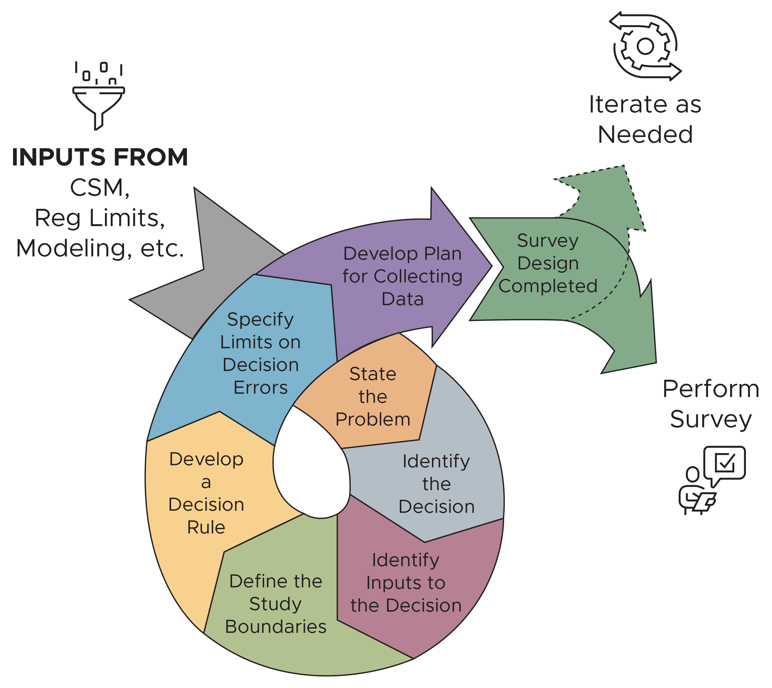
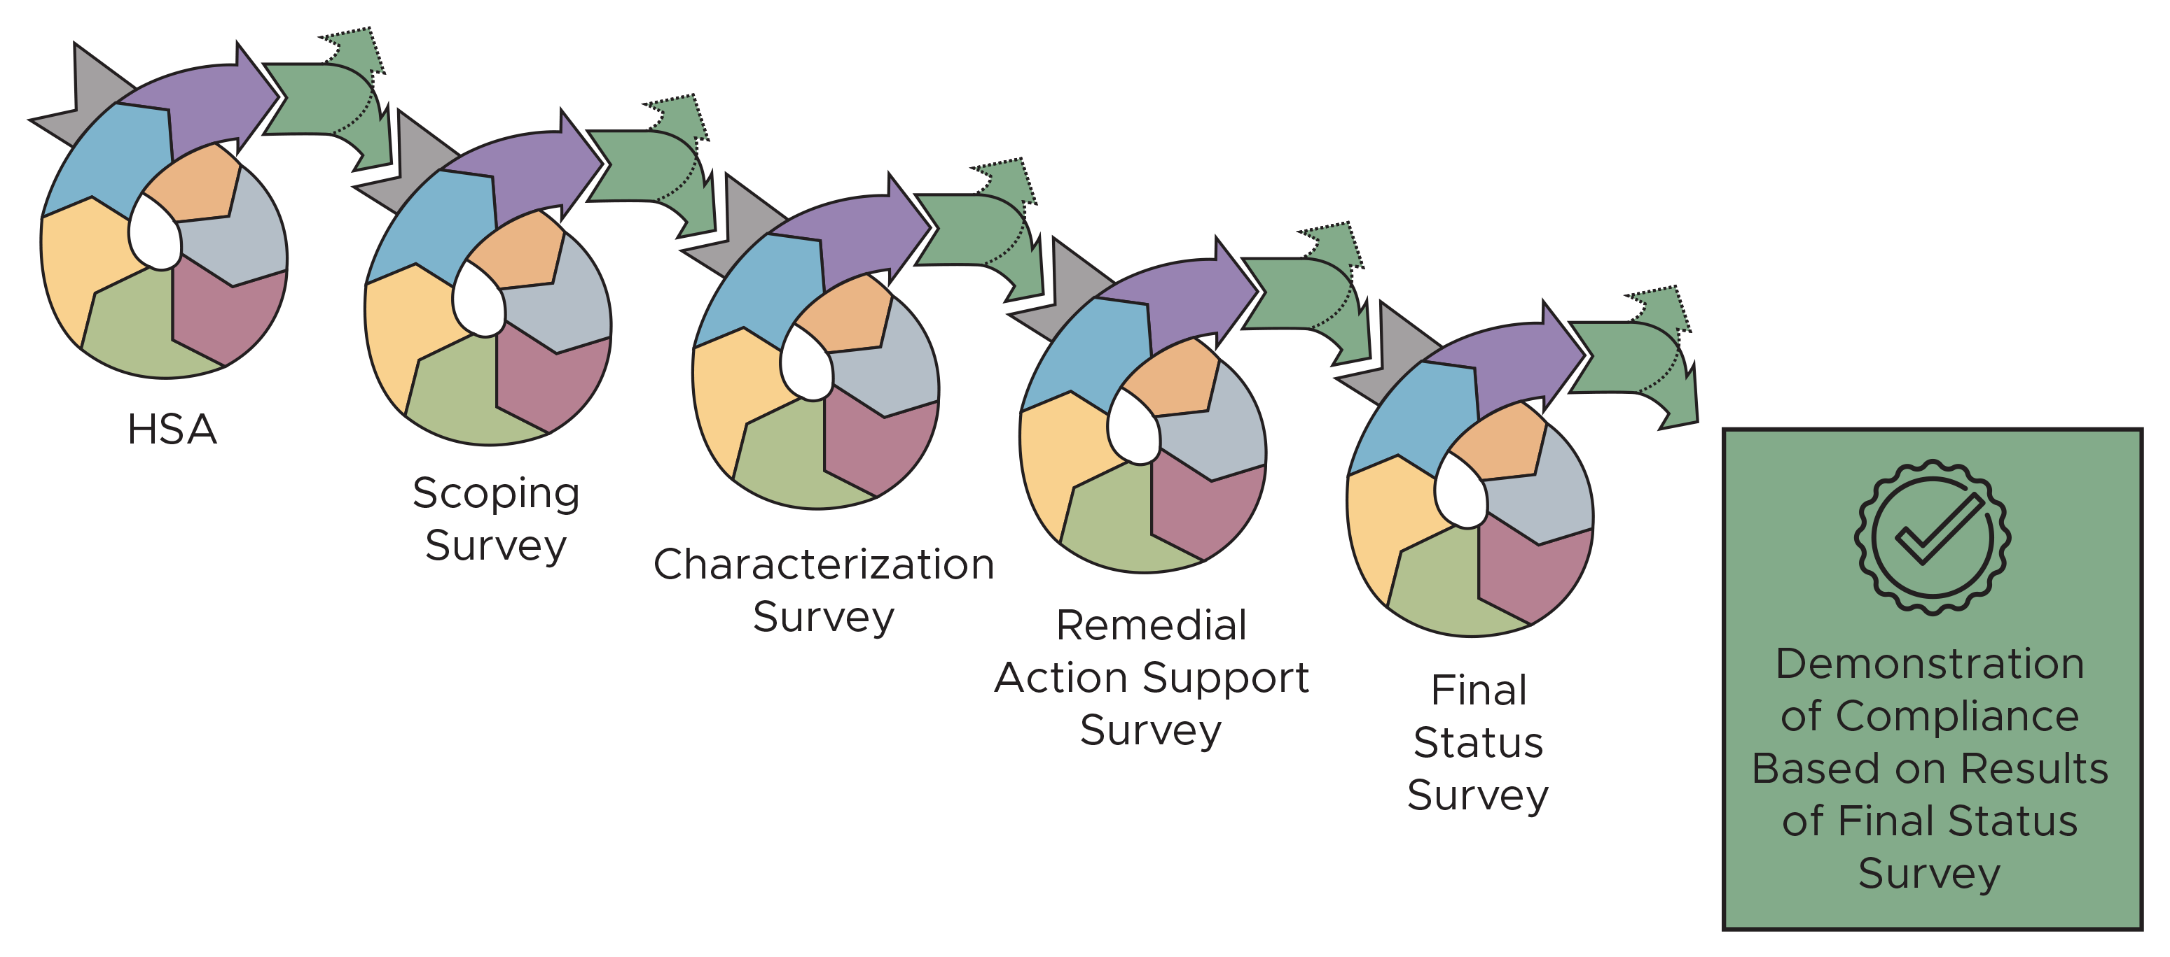
Implementation of DQO process through project life cycle

Slide 26
Legacy Site Scenario
(continuing scenario from preceding GENII training…)
Hanford BC Controlled Area
In the mid-1950s, Hanford retrieved uranium from the oldest tanks of high-level waste remaining from the original Bismuth Phosphate reprocessing process
The uranium recovery worked, but generated nearly twice as much waste as originally produced
The wastes were processed to “scavenge” Cs137 and Sr90 to reduce the activities, and then the supernatant liquids were discharged to surface soils in a series of covered “specific retention trenches”
  155,000,000 liters (40,000,000 gallons)
Historical Site Assessment of the Surface Radioactive Contamination of the BC Controlled Area; WMP-18647

Slide 27
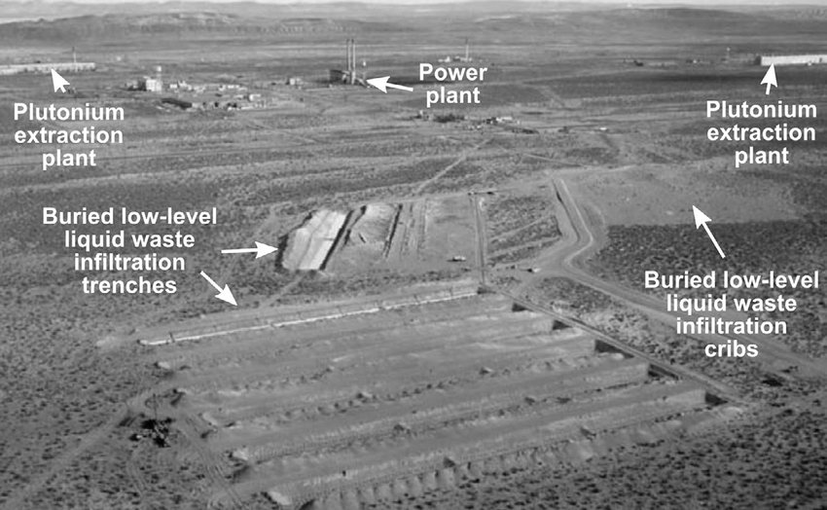
The Specific Retention Trenches

Slide 28
Contamination Events
The trenches were covered with soil, but initially, burrowing native animals intruded into the trenches and used the waste as a “salt lick”
  Badgers, rodents, primarily jackrabbits
  The animals defecated and urinated in the vicinity
  Predators (coyotes) also ate the rabbits and further spread scat and urine
  Also, deep-rooted tumbleweeds and subsequent grasses added to the distribution
This was discovered in 1958-1960; the holes were filled in 1965 and the trenches covered with asphalt. Additional gravel was added in 1969
A total of ~10 km² (4 square miles) was directly impacted
Historical Site Assessment of the Surface Radioactive Contamination of the BC Controlled Area; WMP-18647

Slide 29
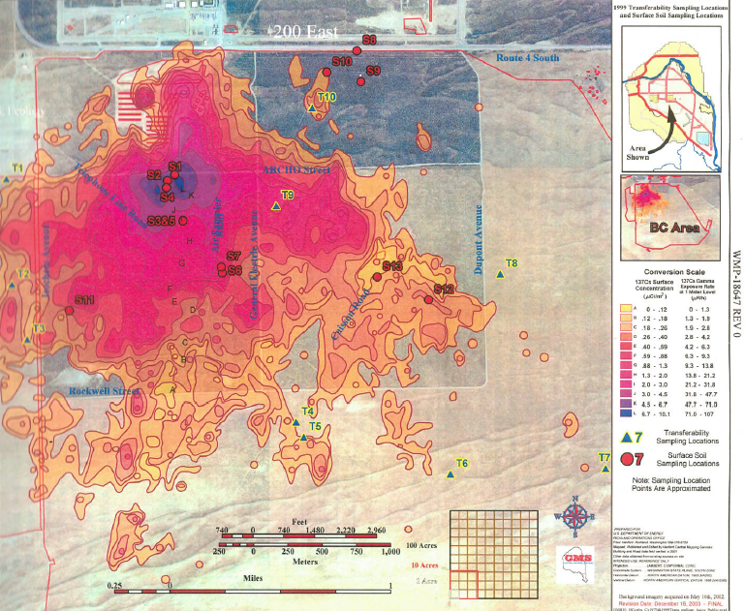
The Extent of the Contamination
Historical Site Assessment of the Surface Radioactive Contamination of the BC Controlled Area;
WMP-18647

Slide 30
Remediation
The following examples show several possible sampling objectives immediately before and after remediation via soil removal
Specific details, contamination values and the sampling plans created are for illustrative purposes and have been simplified / modified
On Scene Coordinator Report FY2010 and FY2011;
DOE/RL-2011-101

Slide 31
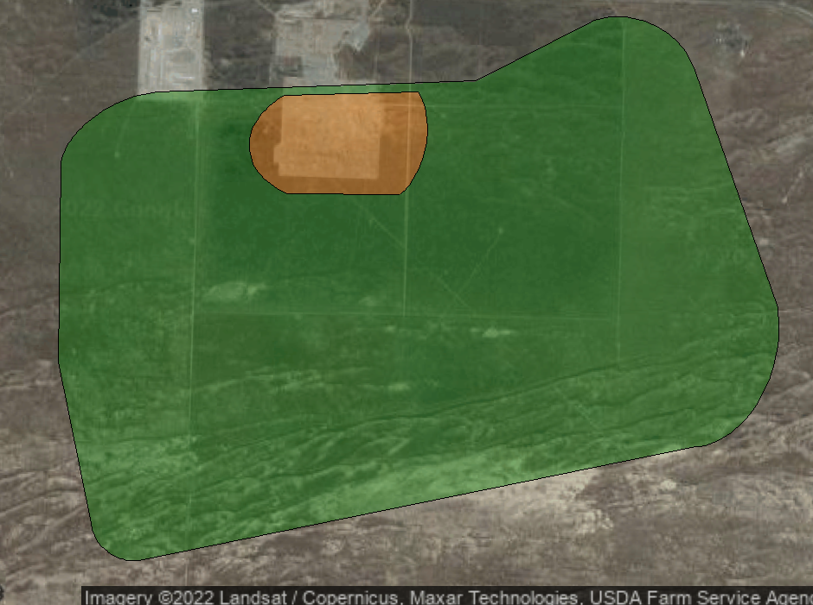
Decision Units
Zone A (orange): Region of elevated contamination prior to remediation
Zone B (green): Some areas of elevated contamination but lower risk

Slide 32
Example 1: Unbiased Mean Estimation for Differing Strata
Suppose that prior to remediation, stakeholders want estimate the overall Cs-137 average for both Zone A and Zone B
  Planning for handling and disposal of removed soil
The two zones differ in
  Average concentration
  Standard deviation of concentration
  Size
 | Zone A | Zone B
Area | 230 acres | 3,970 acres
Average concentration | 950 pCi/g | 200 pCi/g
Standard deviation | 475 pCi/g | 100 pCi/g

Slide 33
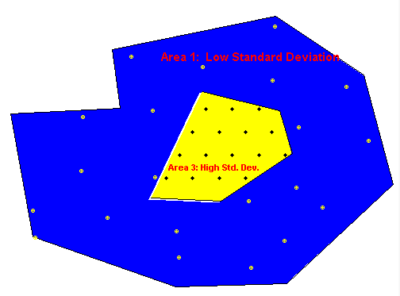
Stratified Sampling
What is Stratified Sampling?
  Divide a heterogeneous population into non-overlapping groups (strata) that are internally more homogeneous
  Use random or systematic sampling in each stratum
Advantages
  Provides more accurate estimates of the mean or percentiles of the heterogeneous population than if simple random sampling is used over the entire site without stratification
  Better allocation of samples

Slide 34
Stratified Sampling: Mean Estimation
Objective is to obtain an unbiased, sufficiently precise estimate of the mean
Allocates samples by size of area and standard deviations
Provides weighted estimate of mean and standard error

Slide 35
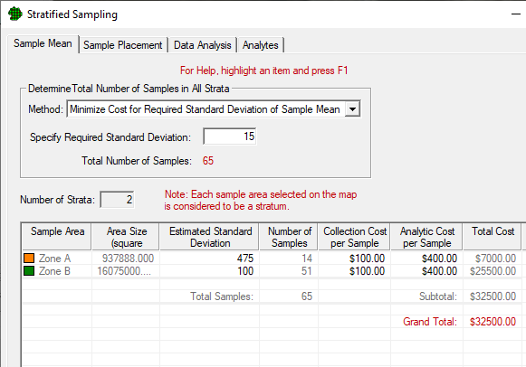
Stratified Sampling Design Dialog
Enter strata parameters
Select optimization method
Sample size, distribution and total cost calculated
65 samples total
  14 in Zone A
  51 in Zone B

Slide 36
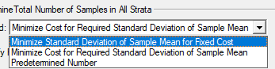
Optimization Methods
Minimize Standard Deviation of Sample Mean for Fixed Cost
  Fixed budget, minimize uncertainty on mean estimate
Minimize Cost for Required Standard Deviation of Sample Mean
  Fixed required uncertainty on mean, minimize overall cost
Predetermined Number
  Fixed number of samples, optimize allocation across strata

Slide 37
Cost Information
Cost per sample and per analysis can be specified for each stratum
Example: Suppose collection costs were greater for Zone A (due to radiological controls, PPE, etc.)
  If optimizing cost, total sample size and sample allocation will be adjusted (shown on next slide)

Slide 38
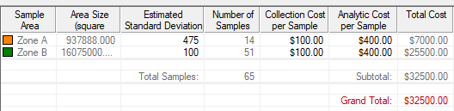
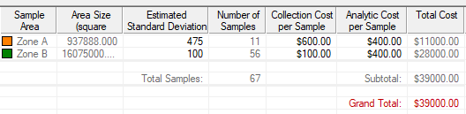
Cost Information

Slide 39
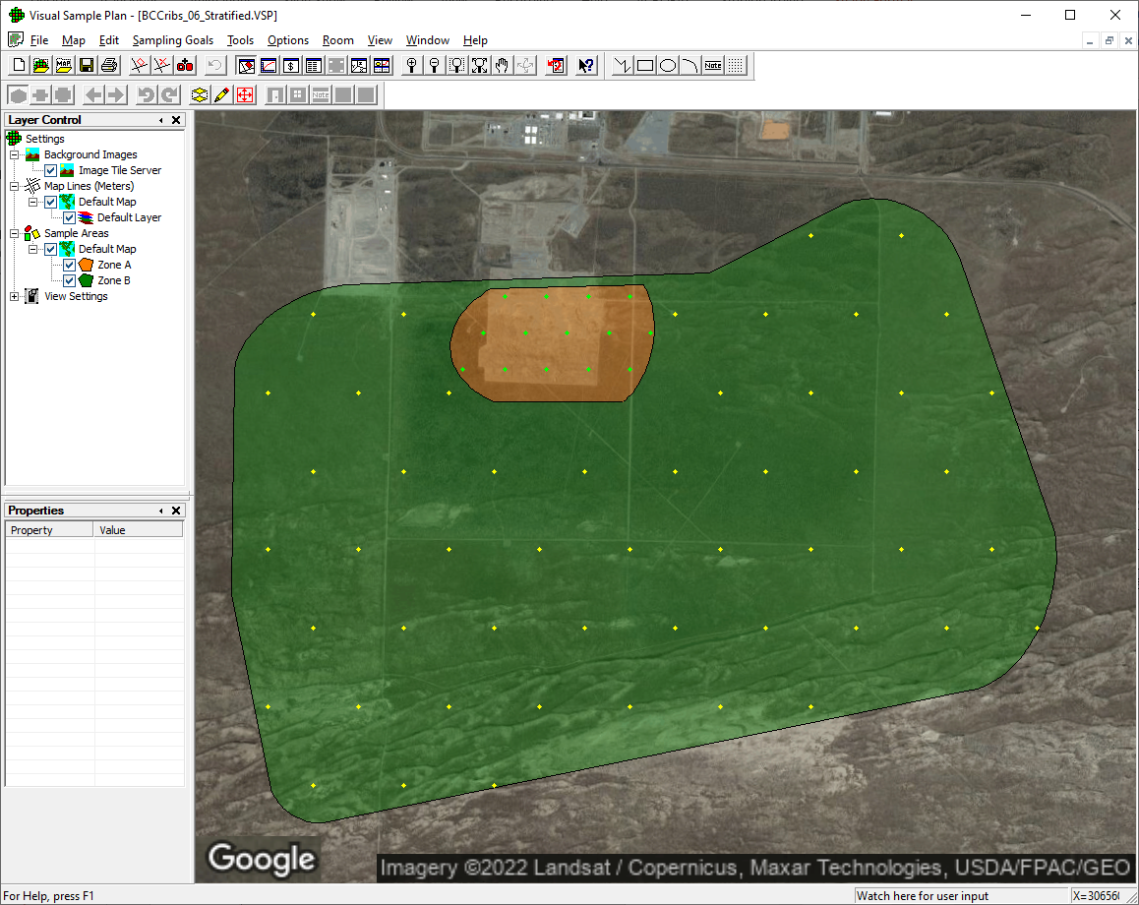
Sampling Plan

Slide 40
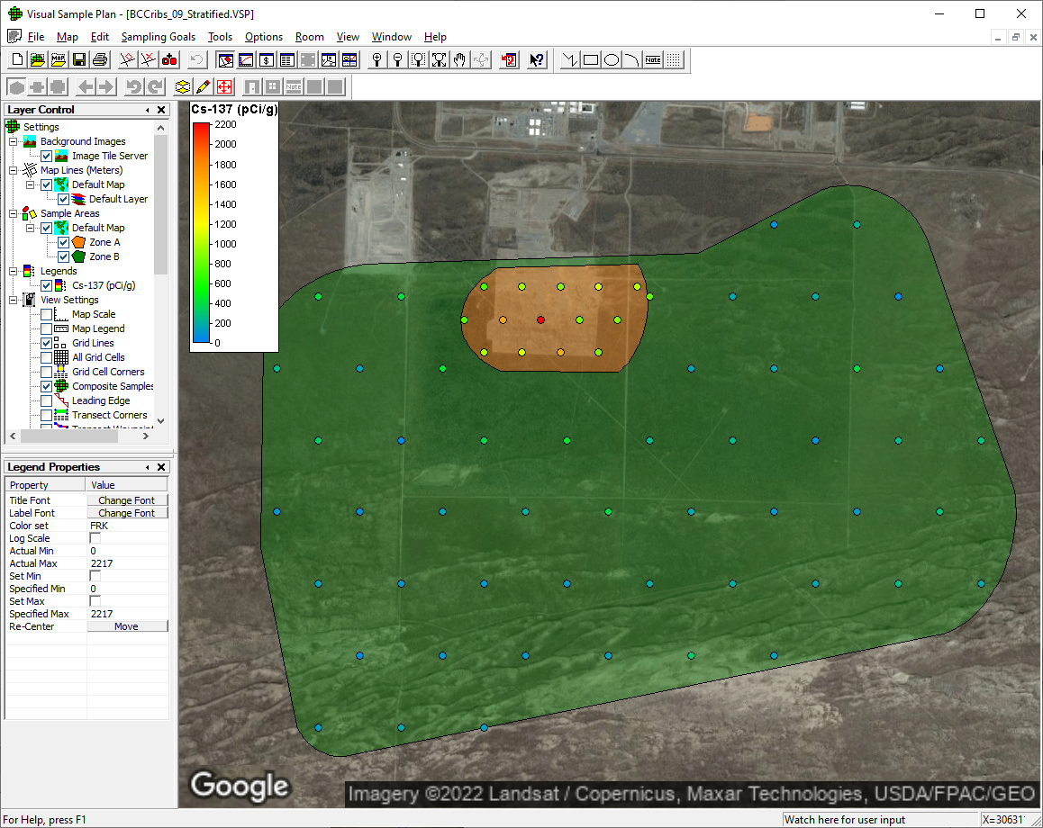
Data Results (notional)

Slide 41
Data Analysis: Calculating Estimated Mean
Estimated site mean (all strata combined)
where
= estimated mean of data in stratum h
= proportion of site in stratum h
Standard error (standard deviation of estimated site mean)

Slide 42
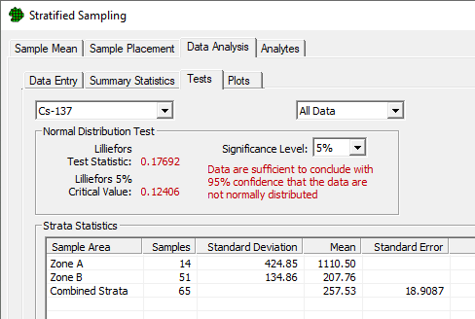
Data Analysis: Calculating Estimated Mean
Unbiased estimate of mean: 257.53 pCi/g
  Simple average of all values: 402.2 pCi/g

Slide 43
Example 2: Spatial Analysis
Analysis Objective: Create a spatial estimate of radiological contamination across both areas
Use geostatistical analysis (kriging) to create an estimate map and delineate contours

Slide 44
Geostatistical Analysis
In environmental settings, often observe spatially correlated data; samples obtained close to each other are more correlated than samples farther apart.
  Classical test of hypothesis approaches ignore spatial correlations.
  Geospatial methods estimate and account for those spatial correlations.

Slide 45
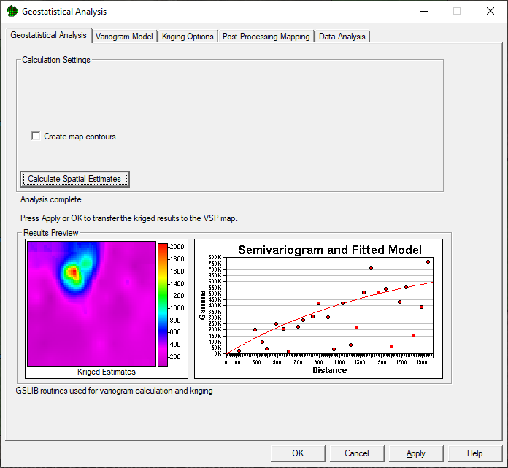
Geostatistical Analysis in VSP
“Easy Button” one-click analysis
Many options for refining and improving estimates

Slide 46
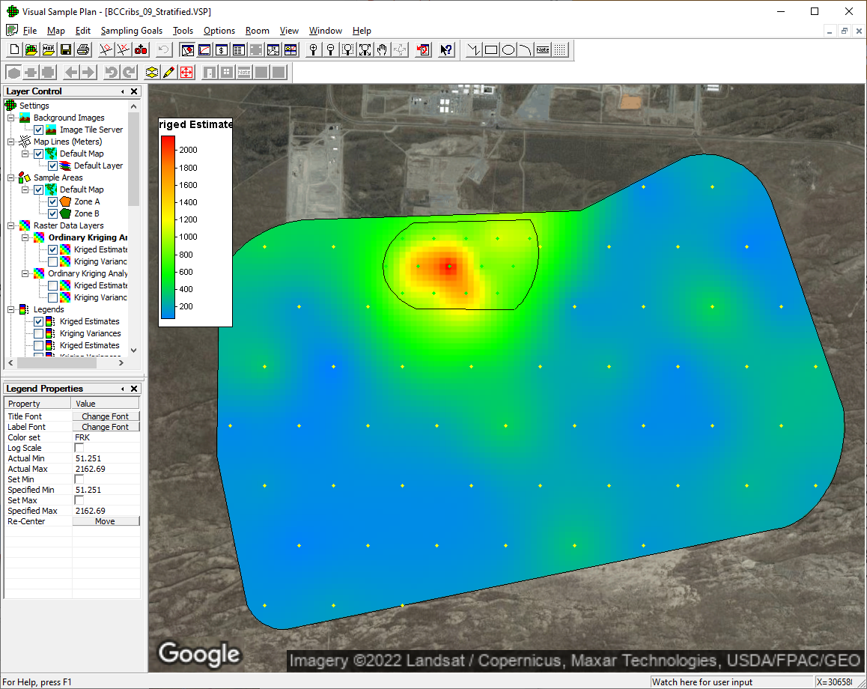
Viewing Estimate on Map

Slide 47
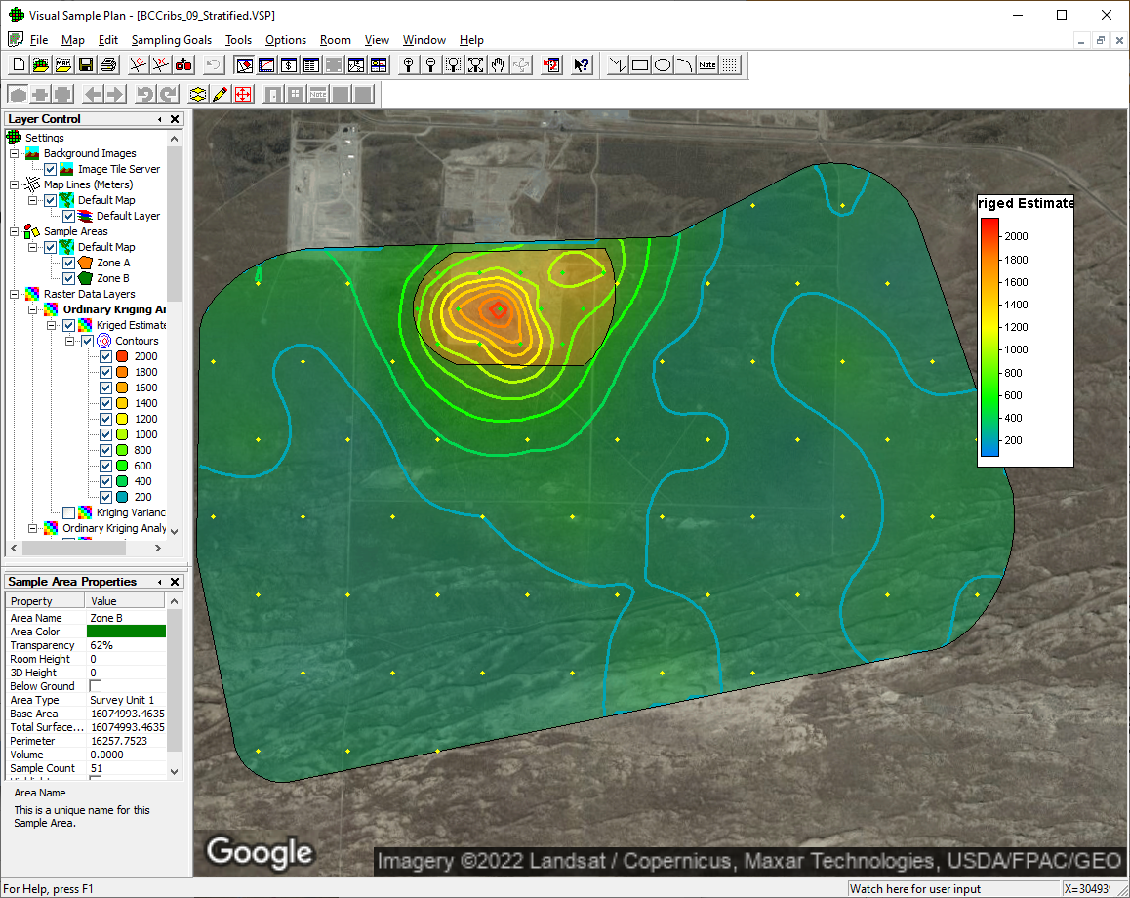
Delineating contours

Slide 48
Example 3: Mean Comparison Against A Threshold
Scenario: Remediation has been completed, and a Final Status Survey will be conducted to verify remediation effectiveness
Decision Objective: Compare the average residual radioactivity in the surface soil within a survey unit to a threshold
Requires inputs of:
  Threshold (often comes from regulatory limit or cleanup levels)
  Decision error tolerances
  Estimated population characteristics (e.g. distribution, standard deviation)

Slide 49
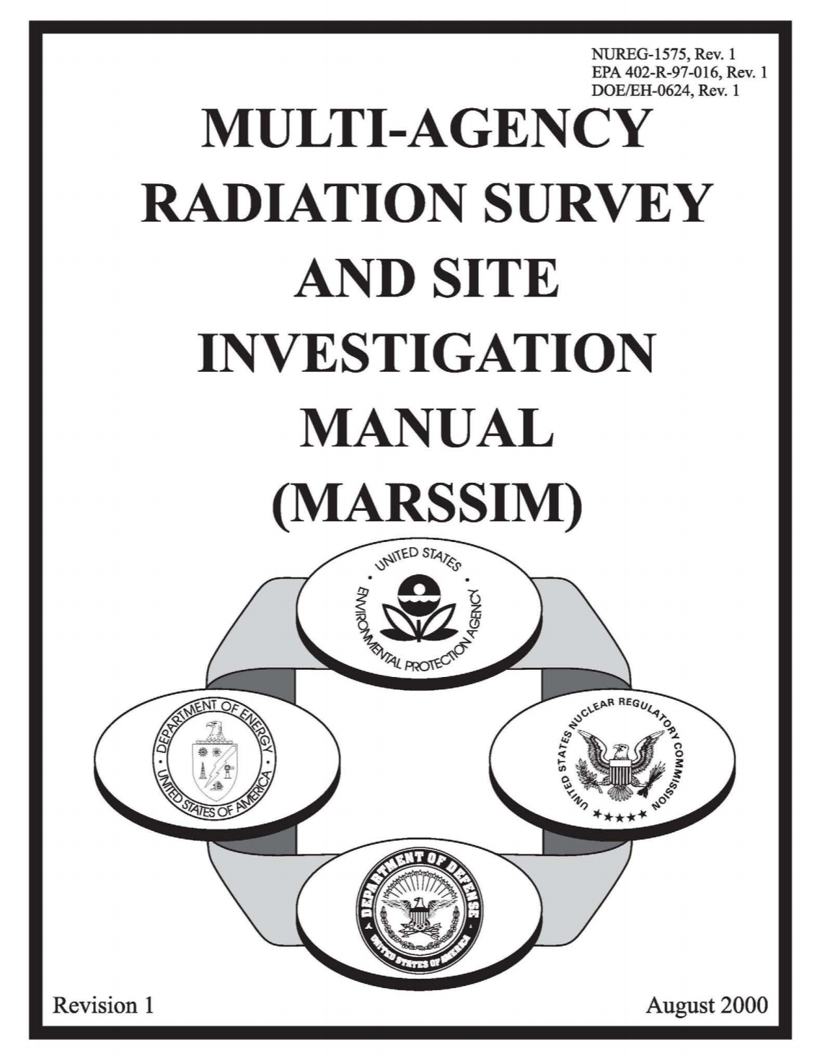
MARSSIM Approach
Problem: How to demonstrate that residual radioactivity on a site complies with radiological release criteria?
  Many stakeholders and agencies
  Wide variety of possible statistical methods and techniques
Solution: Develop a consistent approach
  Collaboration between EPA, DOE, NRC and DOD
  Establish clear processes and recommendations

Slide 50
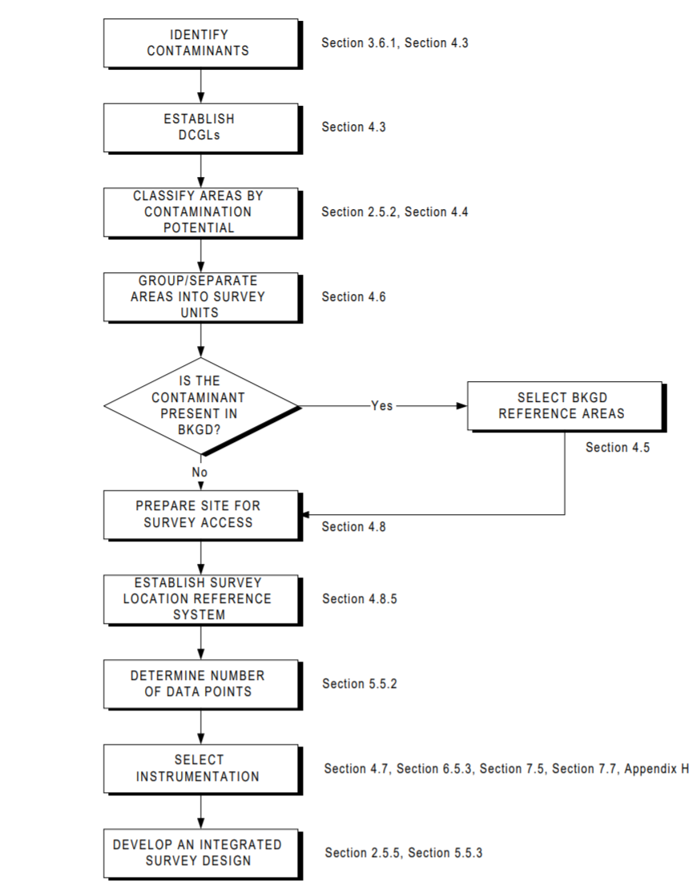
MARSSIM Advantages
Established and widely accepted
Optimize the number of samples or measurements
Uses non-parametric statistics
  Don’t have to know underlying distribution
Based on Data Quality Objective (DQO) process
Source: https://www.epa.gov/sites/production/files/2015-06/documents/marssim_roadmap.pdf

Slide 51
Unity Rule
Method for making an overall statistical decision with multiple radionuclides or multiple types of measurements
Used if elevated areas of residual radioactivity are discovered within an isolated area of a site to ensure that site wide dose criteria are met
Can be used as a sum of fractions or to determine dose based action limits for individual radionuclides with known ratios
Notes:
Could use more here

Slide 52
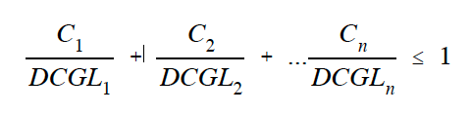
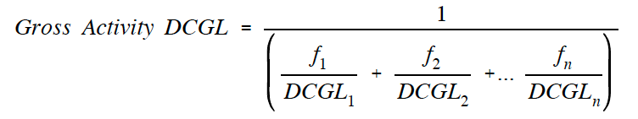
Unity Rule
Sum of fractions:
Unity rule is satisfied when the following relation holds:
Gross activity:
$fi$is the relative fraction for the $ith$ radionuclide

Slide 53
Example 1: Unity Rule Design Parameters
Objective: Design a sampling plan to evaluate whether the total residual radioactivity from Cs-137 and SrY90 exceed the cleanup levels
Radionuclide | DCGLw (pCi/g) | Estimated Background Mean (pCi/g) | Estimated Std. Dev (pCi/g)
Cs-137 | 12.4 | 1.05 | 1.10
SrY-90 | 9 | 0.178 | 0.1

Slide 54
Example 1: Unity Rule Design Parameters
Overall objective is to Compare Average to Fixed Threshold
For a MARSSIM approach, no assumption of normal distribution
Regulator is requiring 95% confidence
  No more than a 5% chance of mistakenly releasing the area if the mean actually exceeds the release limit
  Type I error rate

Slide 55
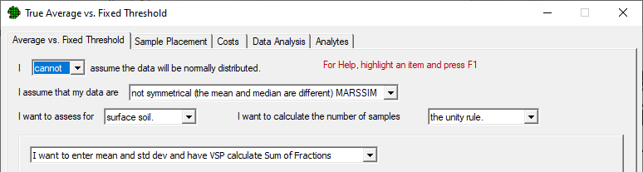
Design Dialog
First selections establish the type of design used

Slide 56
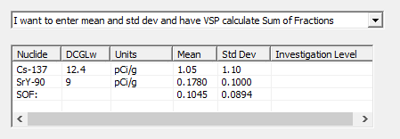
Entering Radionuclide Information
After adding nuclides on the Analytes tab, we enter mean and std dev so VSP can do the Sum of Fractions calculations
Converts to overall estimated SOF mean and std dev
Here, the estimated mean is expected to be 10.45% of the SOF DCGL

Slide 57
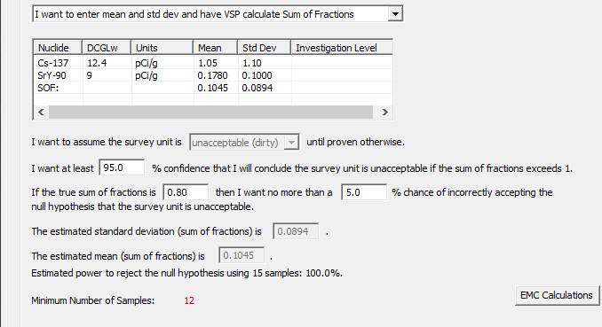
Enter Remaining Parameters
Notes:
Talk through parameters – confidence, LBGR

Slide 58
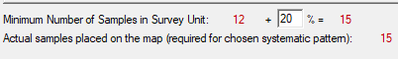
Sample Size and Placement
MARSSIM recommends taking 20% more samples than the minimum
Makes sure that desired confidence is still achieved even if:
  Some samples are lost or unusable
  Estimated standard deviation is slightly incorrect
Actual samples may vary due to systematic pattern random start

Slide 59
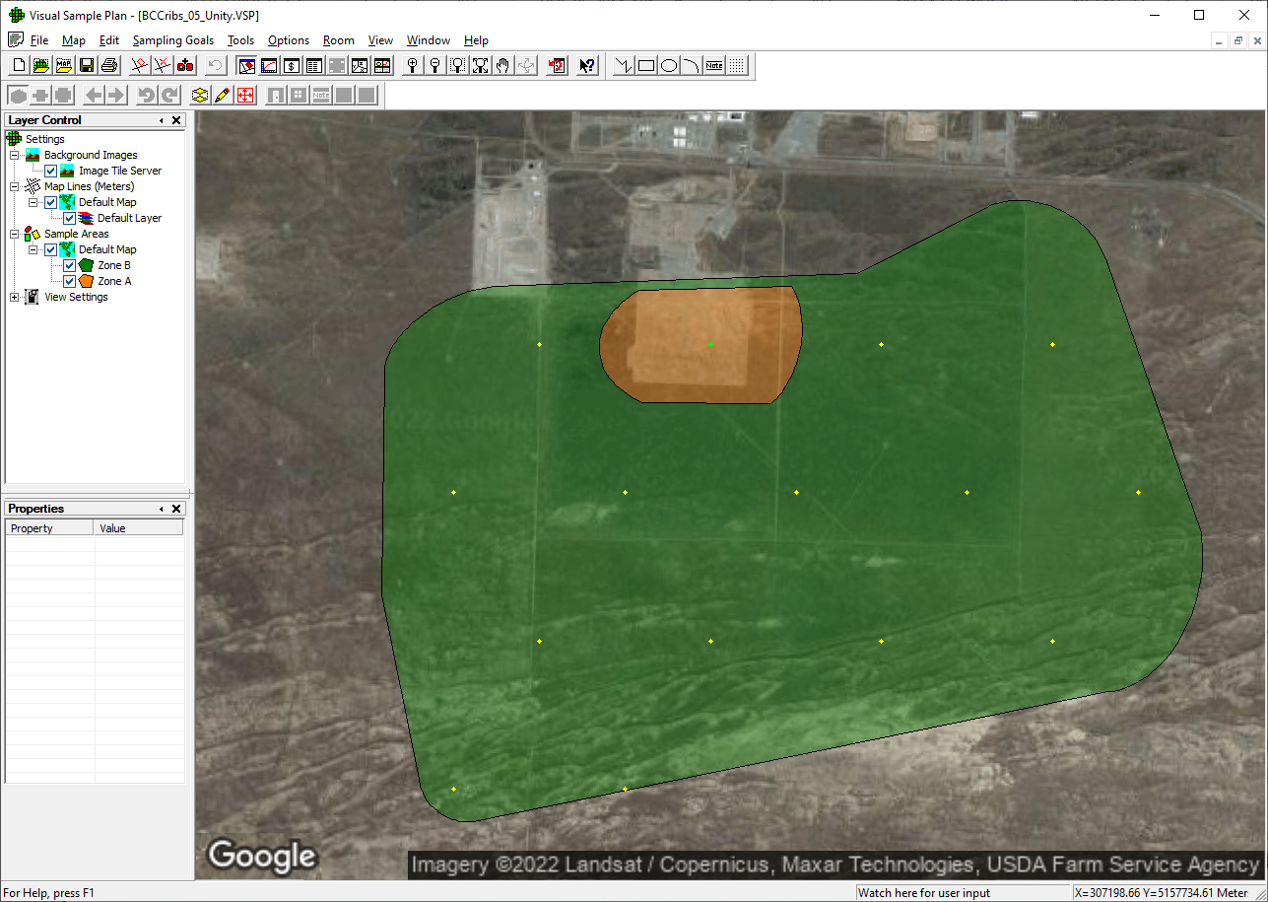
Sample Placement Applied

Slide 60
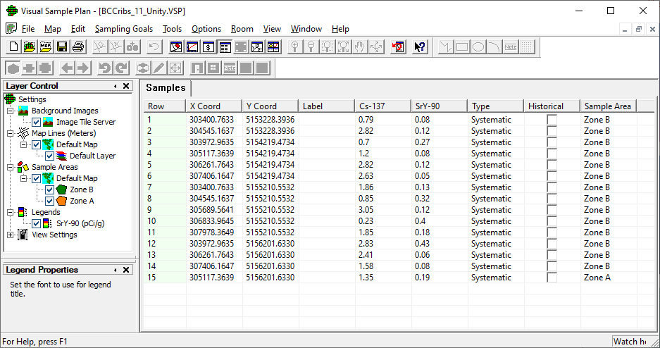
Sample Results (notional)

Slide 61
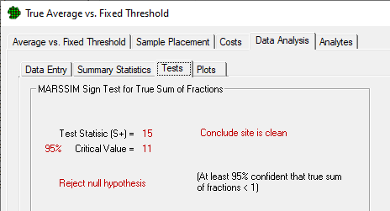
Sign Test Results
If Test Statistic exceeds Critical Value, reject the null hypothesis
  In this case: conclude with 95% confidence that the true sum of fractions is less than 1

Slide 62
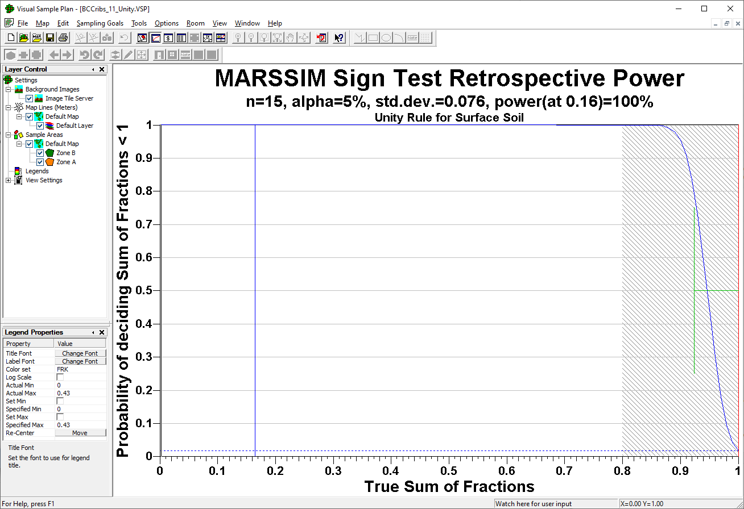
Retrospective Power Curve
Notes:
Observed mean and std dev in SOF is slightly higher than estimated mean and SOF, but still achieve very good retrospective power since levels are well below cleanup levels

Slide 63
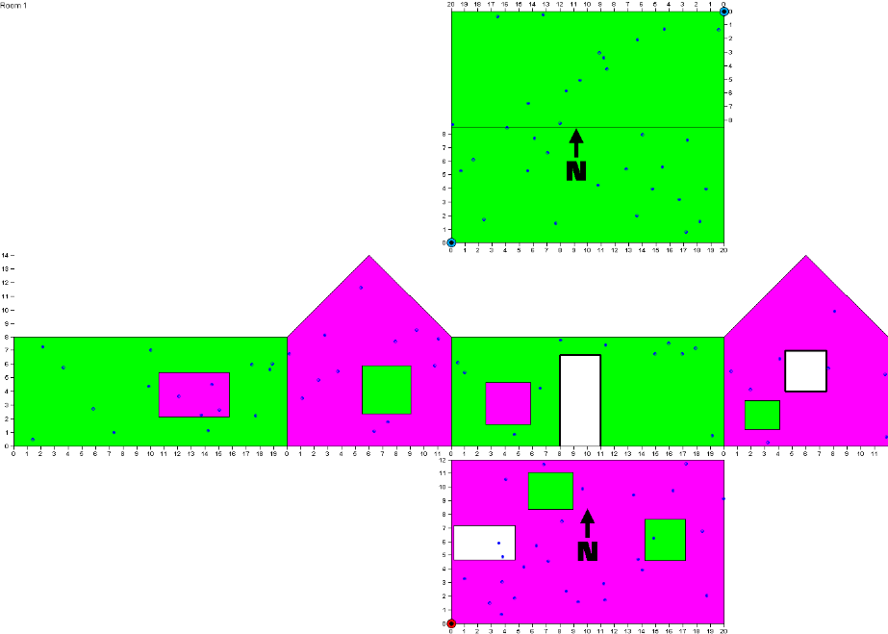
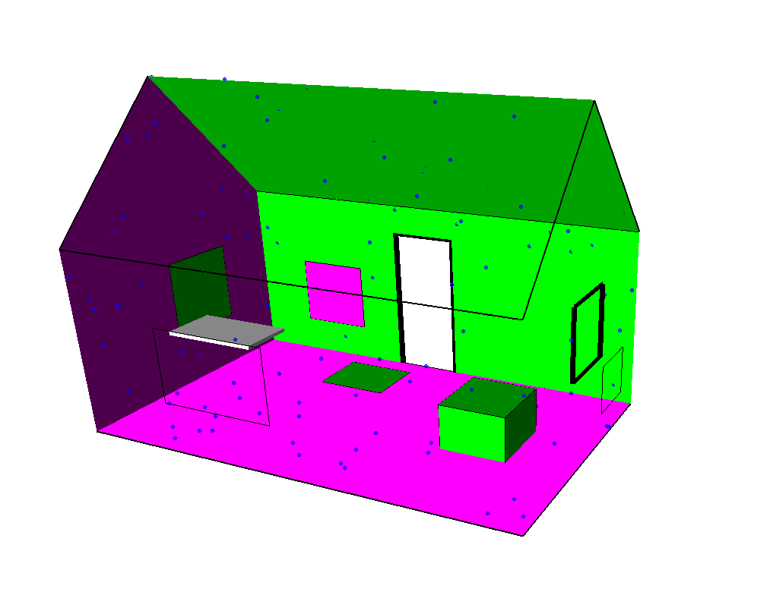
Coming Soon in VSP
Building improvements
  Uneven ceilings
  Room scale
  Improved furniture modeling and visualization
Fixed Rank Kriging (FRK) for combined ground and aerial kriging
Subsurface soil analysis methods

Slide 64
Questions?
More information on RAMP website and at http://vsp.pnnl.gov
Search “Visual Sample Plan” on YouTube for instructional videos
  https://www.youtube.com/channel/UCZvWo01liuzX_hzpqXY8KkQ
Email vsp@pnnl.gov for general VSP help and questions
Contact us directly at lisa.newburn@pnnl.gov or deborah.fagan@pnnl.gov

