Slide 1
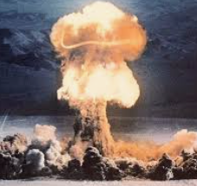
First-in-Human Trial of Oral Drug to Remove Radioactive Contamination
David R. Cassatt, PhD
NIAID Radiation and Nuclear Countermeasures Program
Fall 2023 RAMP Users’ Group Meeting
Thursday, October 26, 2023
Rockville, MD

Slide 2
NIAID Radiation and Nuclear Countermeasures Program

Slide 3

NIAID RNCP Background
Established in 2004, to accelerate development of
medical countermeasures (MCMs) and biodosimetry devices
for use during a radiation public health emergency
Mission
Support early through advanced research and development
Fund studies via grants, cooperative agreements, contracts & inter-agency agreements

Slide 4
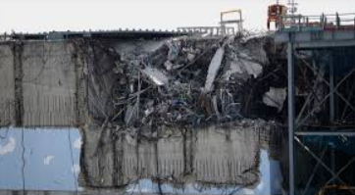
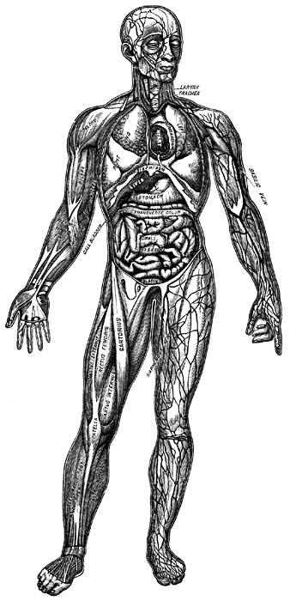
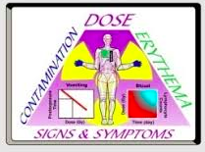
Scenarios, Targets & Research Priorities
Nuclear detonation
Nuclear power plant accident or attack
Dirty bomb or other dispersal device
Other radionuclide release
Dosimetry Guidance
CNS
Internal
radionuclide contamination
Lung
Kidney
Cardiovascular
Gastrointestinal (GI)
Cutaneous
Combined
injuries
Biodosimetry
Hematopoietic (H)
MCMs for Acute (ARS)
and Delayed (DEARE)
Radiation Syndromes
Decorporation MCMs
AFRRI, USUHS, 2013
Notes:
RNCP small group of 7

Slide 5
RNCP Radiation Research Continuum
Regulatory Affairs
NDA
BLA
IND
Basic
Research
Nonclinical
Development
Advanced Development
Mechanisms
Targets
Efficacy
Models
Lead candidate
Optimization
Formulation
Safety
Pivotal animal studies
Phase I safety
FDA interactions
NIAID Partners
NIH/DoD/Academics Companies/Contractors BARDA & FDA

Slide 6


U.S. Food and Drug Administration (FDA) Animal Rule to License Radiation MCMs
21 CFR 314.600-650 drugs; 21 CFR 601.90-95 biologics
When clinical trials are not ethical or feasible
Must address:
Mechanism
Primary Endpoint
Selection of
Human Dose
Pivotal Studies
Clipart courtesy FCIT: http://etc.usf.edu/clipart
Biodosimetry devices do not use the Animal Rule
6

Slide 7
NIH Strategic Plan (2005)
“The development of medical countermeasures capable of preventing or treating radiation injury is the major component of this NIH strategic plan.”
“This class [of medical countermeasures] includes agents that can eliminate radioactive material that has been incorporated into the body and thereby minimize internal radionuclide exposure…”
“CA- and Zn-DTPA are currently in the SNS, but must be administered intravenously…”
→ Need for decorporation agents suitable for a mass casualty situation

Slide 8

NIAID Product Development Contract (2005-Present)
“[To] provide support services to facilitate and accelerate product development research conducted by academia, industry, and Federal laboratories.”
Contract includes:
  Animal model development
  MCM testing:
    Safety/PK/PD
    Efficacy
  Manufacturing
  Phase 1 clinical

Slide 9
RNCP MCM Product Evaluations
Area Addressed | # Studies
Hematopoietic-ARS | >475
Gastrointestinal-ARS | 96
Lung DEARE | 80
Skin, cardiovascular, CNS, kidney, combined injuries | <120
Radionuclide decorporation | 12
Biodosimetry | 65

Slide 10
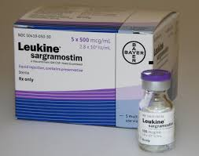
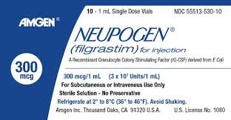


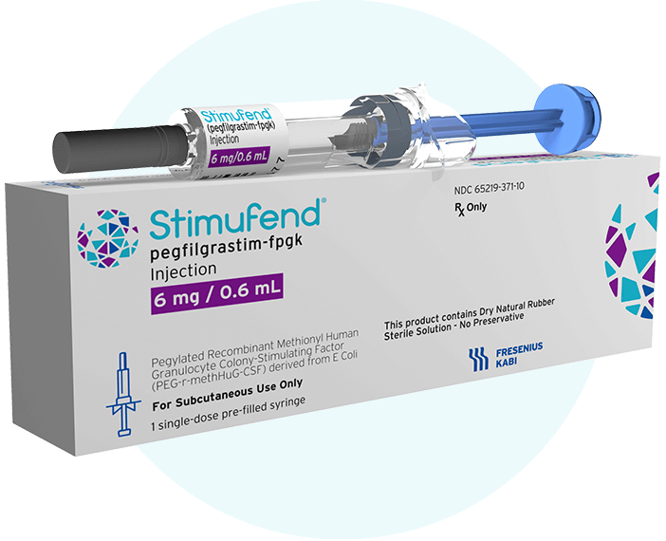

Animal Rule Approvals and Strategic National Stockpile Acquisition
2015
2018
2021
2023

Slide 11
Radionuclide Decorporation Program

Slide 12
Clinical Manifestations of Internal Radionuclide Contamination
Acute Radiation Syndrome for ¹³⁷Cs and ²¹⁰Po
Metal toxicity (uranium)
Late cancer development
Treatment is to remove contaminant

Slide 13
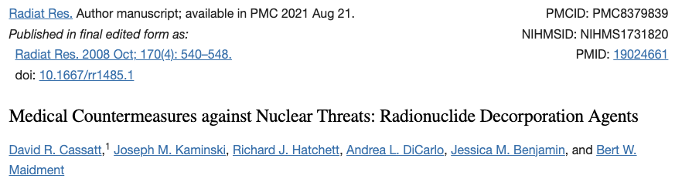
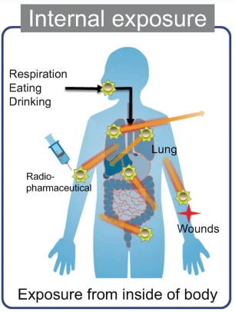
Radionuclide Decorporation & Blocking Agents
  Chelators bind isotopes & help excretion
  Licensed US products
    Potassium iodide
    Prussian blue
    Ca- and Zn-DTPA
  Novel oral agent under study (HOPO)
Hashimoto et al. Forest Radioecology in Fukushima. 2022

Slide 14
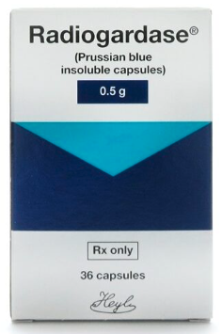
Approved Radionuclide Chelators: Radiogardase® (Prussian Blue)
Approved in September 2003
For adults: PO
Increase excretion of Cs
For adults: 3 g tid
Approval based on use in 1987 accident in Goiânia, Brazil

Slide 15
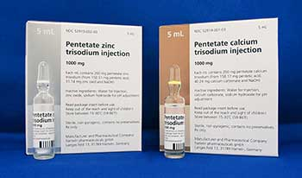
Approved Radionuclide Chelators: Ca- and Zn-DTPA
Approved in September 2004
For adults: IV or by nebulizer
Increase excretion of Am, Pu, Cm
For adults: 1 g qd
Approval based on data from nuclear power plant accidents (REAC/TS Registry)

Slide 16
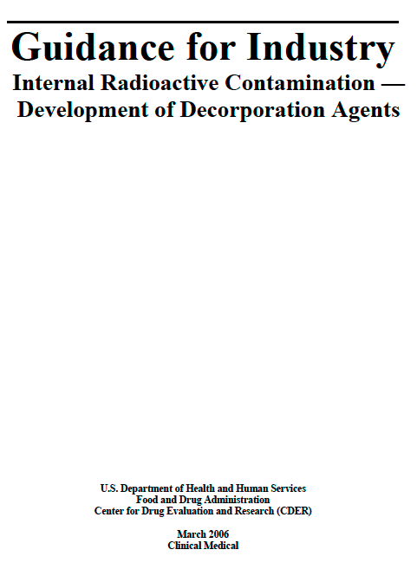
FDA Guidance for Development of Decorporation Agents (2006)
Animal Rule could be appropriate mechanism
“Efficacy can be based on direct measurement of the elimination of the radioactive contaminant through feces or urine…”
“Clinically meaningful reduction in whole-body committed radiation dose…following administration of a decorporation agent in the animal efficacy study…is ‘clearly related to the desired benefit in humans…’”

Slide 17
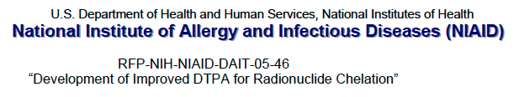
NIAID Contract Activities
2005: RFP for oral forms of DTPA
Awards:
SRI International (absorption enhancers)
University of Kentucky (prodrug)
Nanotherapeutics (nanoparticles)

Slide 18
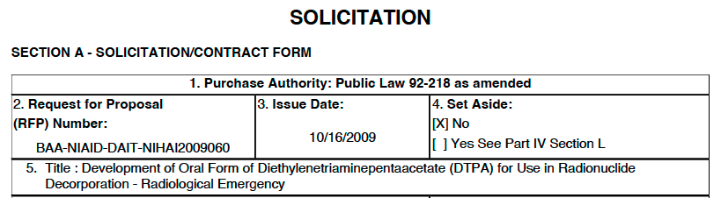
NIAID Contract Activities
2005: RFP for oral forms of DTPA
2010: BAA for oral forms of DTPA
Awards:
SRI International (absorption enhancers)
University of North Carolina (prodrug)
→ IND
→ IND (Captura)

Slide 19
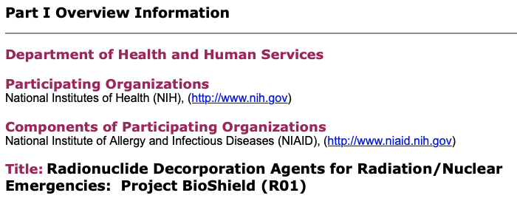
NIAID Grant Activities
2006: RFA for novel oral decorporation agents
Awards:
Pacific Northwest National Laboratory (SAMMS)
University of Utah (amphipathic forms of DTPA)
Pacific Northwest National Laboratory (biomaterials)
University of Florida (desferrithiocin analogs)
Lawrence Berkeley National Laboratory/University of California, Berkeley (HOPO compounds)

Slide 20
Development of HOPO-14-1

Slide 21
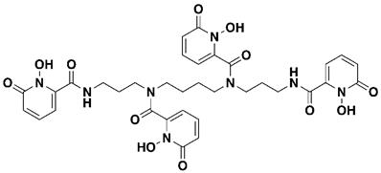
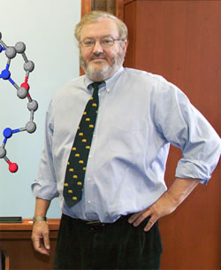



Development of 3,4,3-LI(1,2-HOPO)
Orally available
Decorporation of actinides
Can decorporate other metals
Does not bind to essential metals
Ken Raymond
Pat Durbin
Rebecca Abergel

Slide 22
Support of HOPO Project Through NIAID Funding
2006: NIAID Bioshield R01 for efficacy studies
2009: NIH/RAID for API manufacturing (HOPO-101)
2009: GO Grant for further testing
2011: First FDA meeting
2012: PDS Contract (UMSOM) for IND-enabling studies
2012: BARDA interagency agreement for efficacy testing
2014: IND submitted
2016: PDS Contract (SRI) for formulation (HOPO 14-1)
2022: PDS Contract (SRI) for clinical study
2022: P01 for efficacy testing and modeling

Slide 23
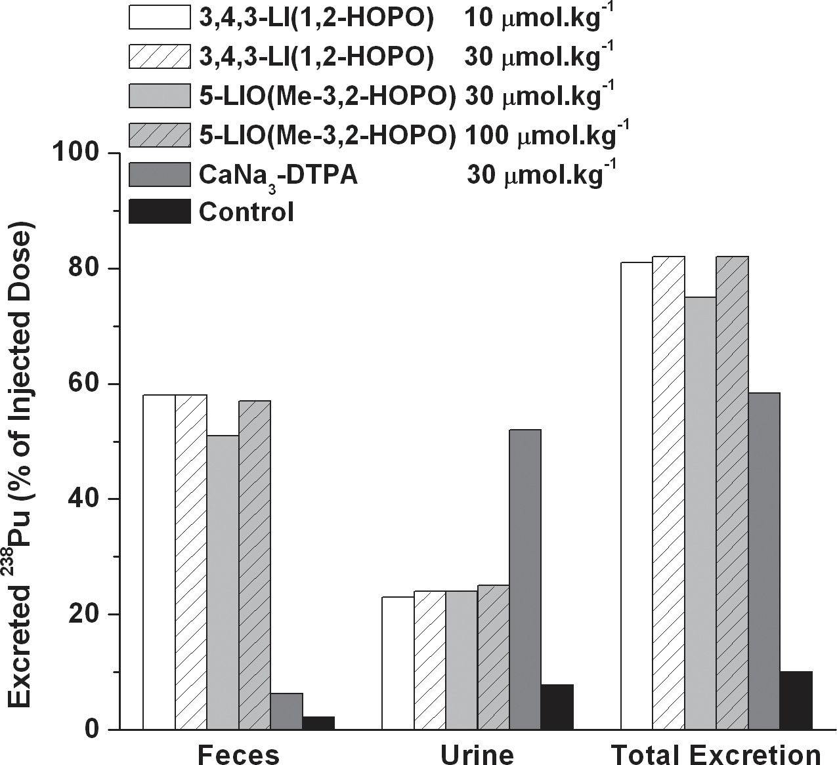
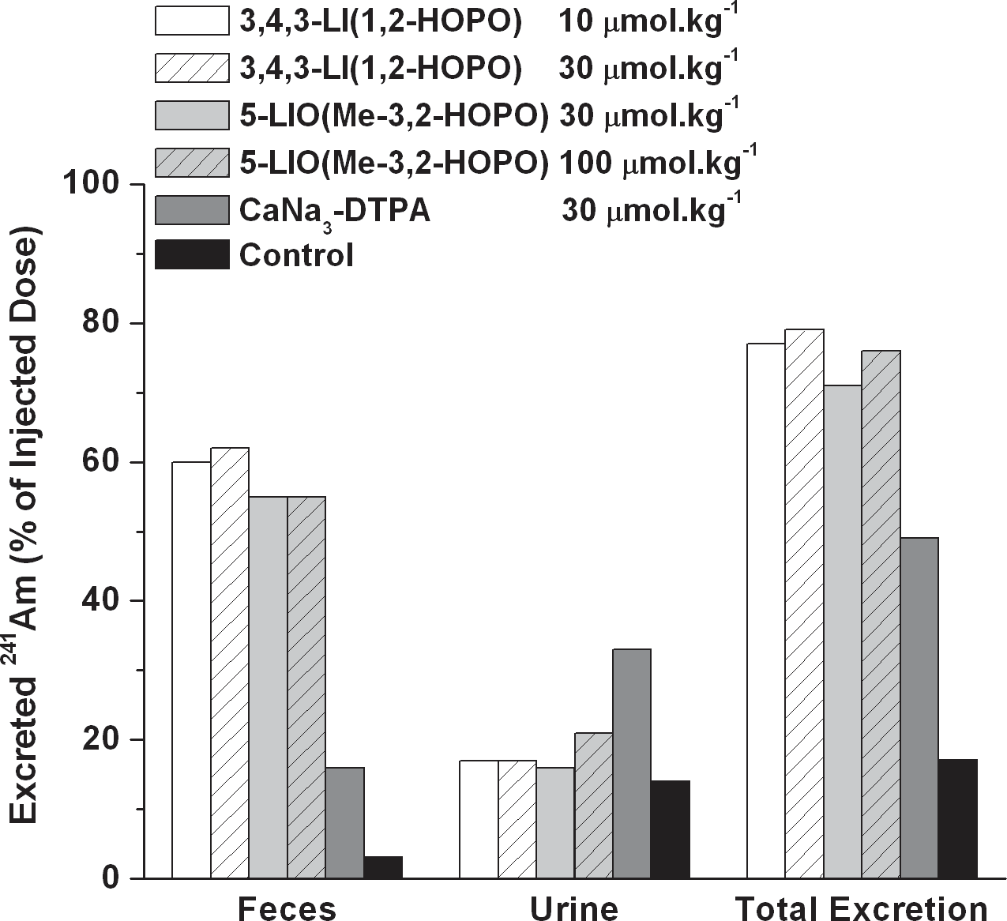
Efficacy Against Transuranics
Plutonium
Americium
Abergel R.J. and Raymond, K.N., Hemoglobin 2011, 35:276

Slide 24
Dosage-Effectiveness of HOPO Ligands
Chelators injected IP into mice 1 hour after IV Pu injection
Mice harvested 24 hours after injection
3,4,3-LI-(1,2-HOPO) has superior chelation activity
5-LIO(Me-3,2-HOPO)
CaNa₃-DTPA
TREN-(Me-3,2-HOPO)
3,4,3-LI-(1,2-HOPO)
Durbin R.J. et al., Health Phys. 2008, 95:465

Slide 25
Comparison of Route of Administration of HOPO and DTPA
Chelators injected into mice 1 hour IP or 3 min PO after IV Pu injection
Mice harvested 24 hours after injection
Oral 3,4,3-LI-(1,2-Me-3,2-HOPO) has superior chelation activity
CaNa₃-DTPA, ip
3,4,3-LI-(1,2-Me-3,2-HOPO)
ip
oral
3,4,3-LI-(1,2-HOPO), ip
Durbin R.J. et al., Health Phys. 2008, 95:465

Slide 26
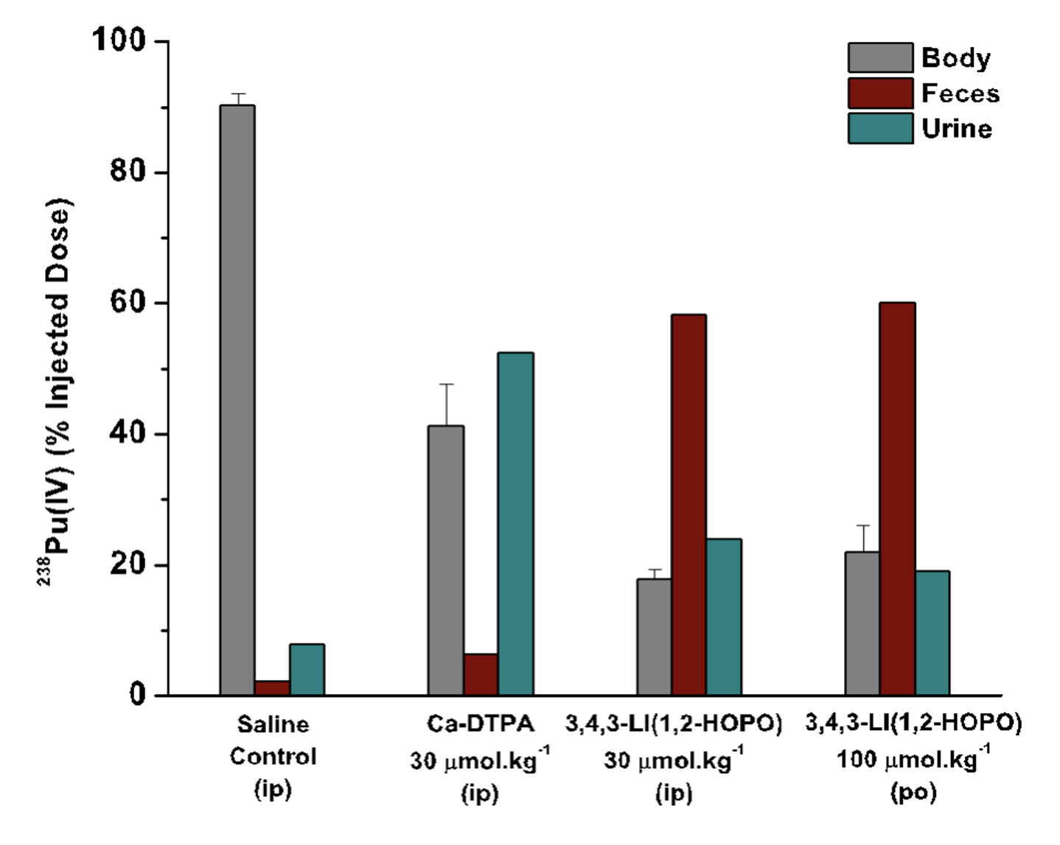
Plutonium Decorporation by 3,4,3-LI(1,2-HOPO)
Chelators injected into mice 1 hour IP or PO after IP Pu injection
Urine and feces collected and mice harvested 24 hours after injection
Oral 3,4,3-LI-(1,2-Me-3,2-HOPO) has retains chelation activity
Abergel R.J. et al., Health Phys. 2010, 99:401

Slide 27
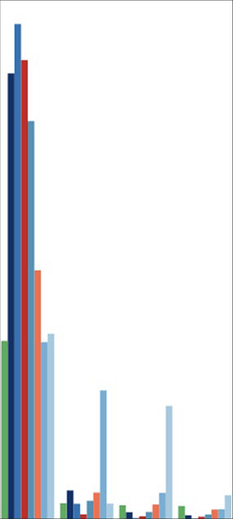

Decorporation of Gadolinium by HOPO
100
Chelators injected into mice at various times IP after IV Gd injection
Urine and feces collected at various times after injection
3,4,3-LI-(1,2-Me-3,2-HOPO) has superior chelation activity
75
¹⁵³Gd Content (% RD)
50
25
0
1
2
3
4
Study Day
Rees J.A. et al., Sci Rep. 2018, 8:4419

Slide 28
Non-Clinical Safety Studies
Pharmacokinetics: t_{1/2} in rat IV: 2.33 ± 0.44 hr; PO: 1.13 ± 0.66 hr
Elimination generally by biliary route
Oral absorption improved by proprietary absorption enhancers
7-day maximum tolerated dose in rat: 400 mg/kg/day or 3840 mg/kg/day equivalent in human: 8x anticipated single human dose
Other safety tests demonstrate acceptable toxicity
Based on safety studies, FDA granted approval to proceed in 2014
Choi T.A. et al., Drug Dev Res. 2015, 76:107
Bunin D.I. et al., Radiat Res 2013, 179:171

Slide 29
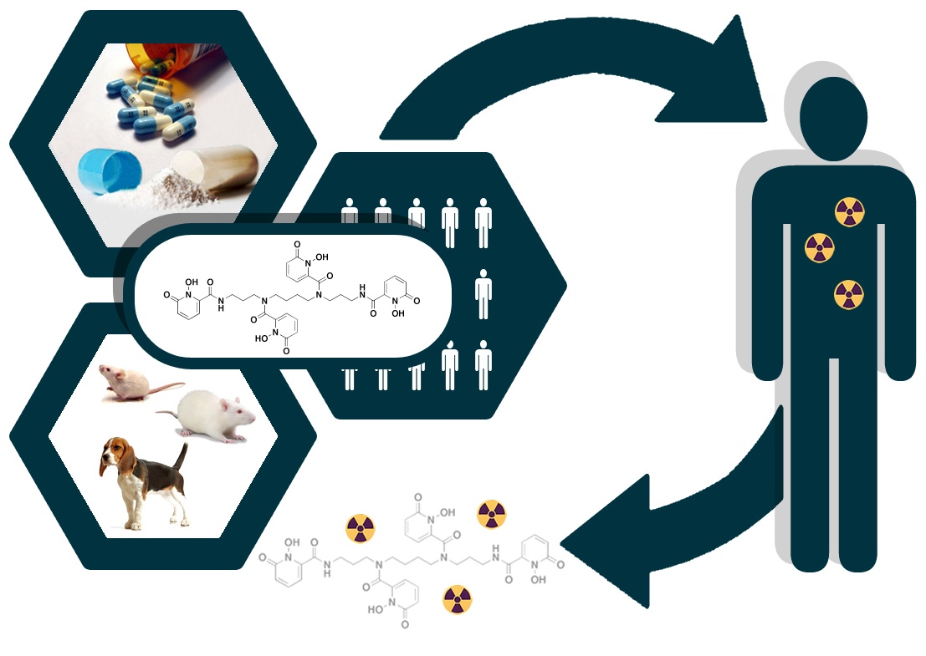
HOPO-14-1 Clinical Trial Now Recruiting
Pharm/tox data support clinical development of HOPO 14-1 for decorporation of radionuclides
Study of Single Oral Doses of HOPO 14-1 Evaluating Safety, Tolerability, Pharmacokinetics
NCT05628961
  Seven cohorts (six healthy volunteers each)
  Single ascending dose (100-7500 mg)

Slide 30
Summary and Future Plans
With US government support, HOPO 14-1 has shown promise as a radionuclide decorporation agent
Initial Phase 1 clinical trial underway
Future plans include adequate and well-controlled studies in animals to show efficacy, additional clinical trials
Promising use to decorporate gadolinium

Slide 31
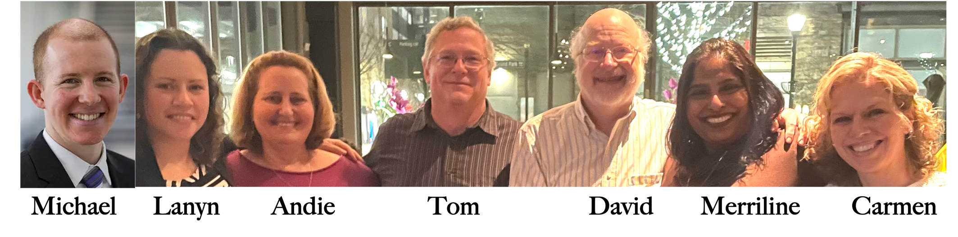
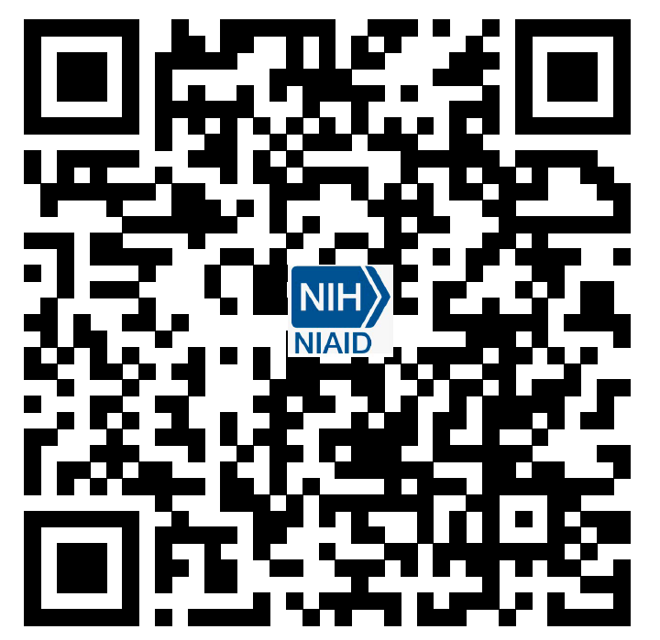
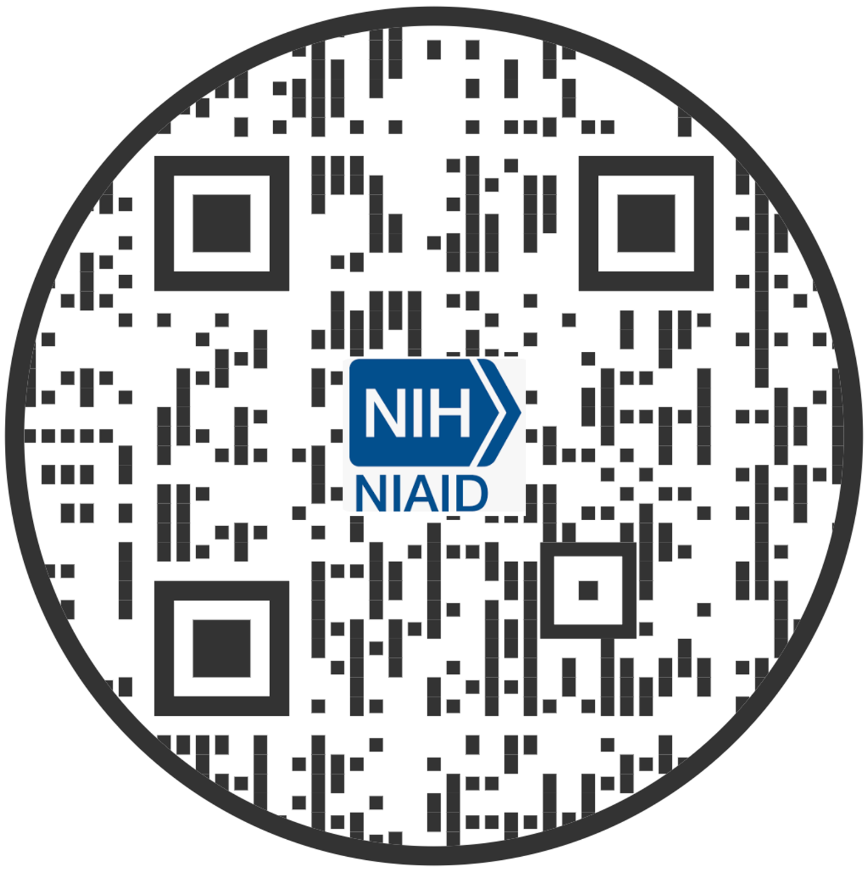
Thank You for Your Attention!
RNCP
Website
RNCP
Fact Sheet
Questions? cassattd@niaid.nih.gov

Slide 32

Thank you
Notes:
Back to 3/16/20:
Instead of morning commute, daily walks
Took pictures to use as Zoom backgrounds
Still adjusting

