Slide 1
Office of Nuclear Material Safety and Safeguards
John Lubinski
Director
2023 Fall RAMP Users’ Group Meeting
October 23–27, 2023
Rockville, MD

Slide 2
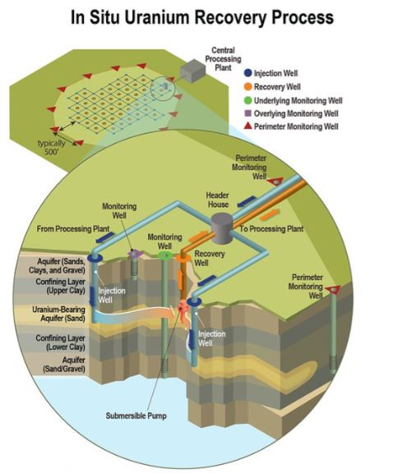
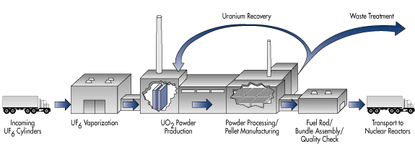
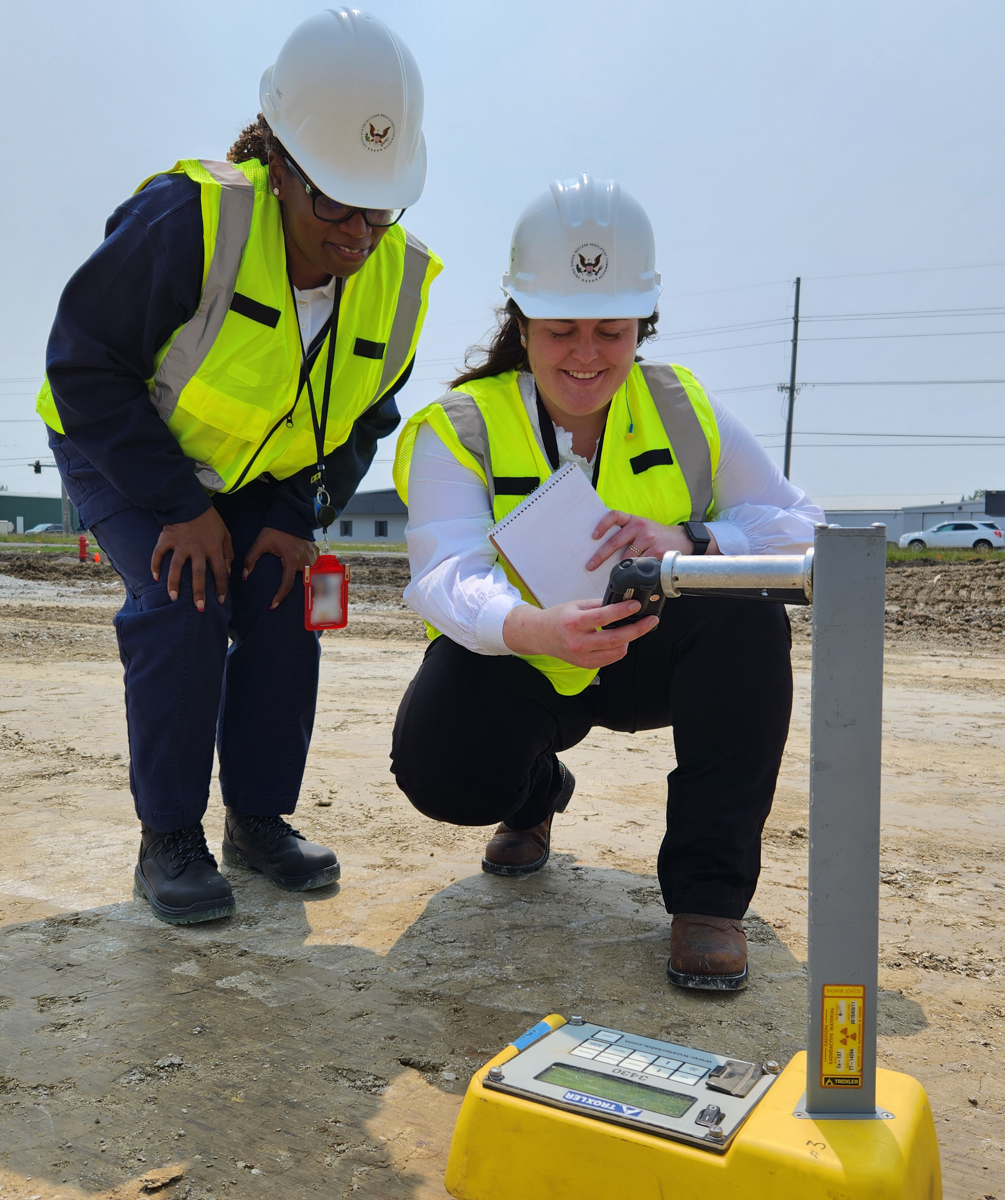
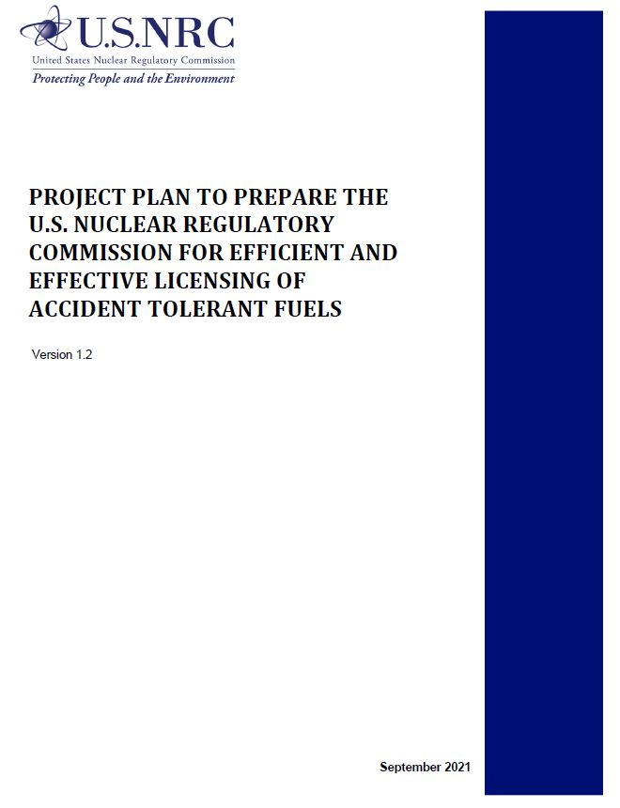
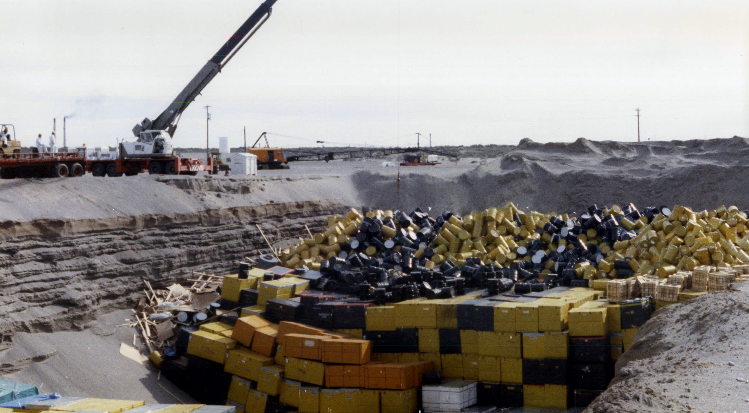
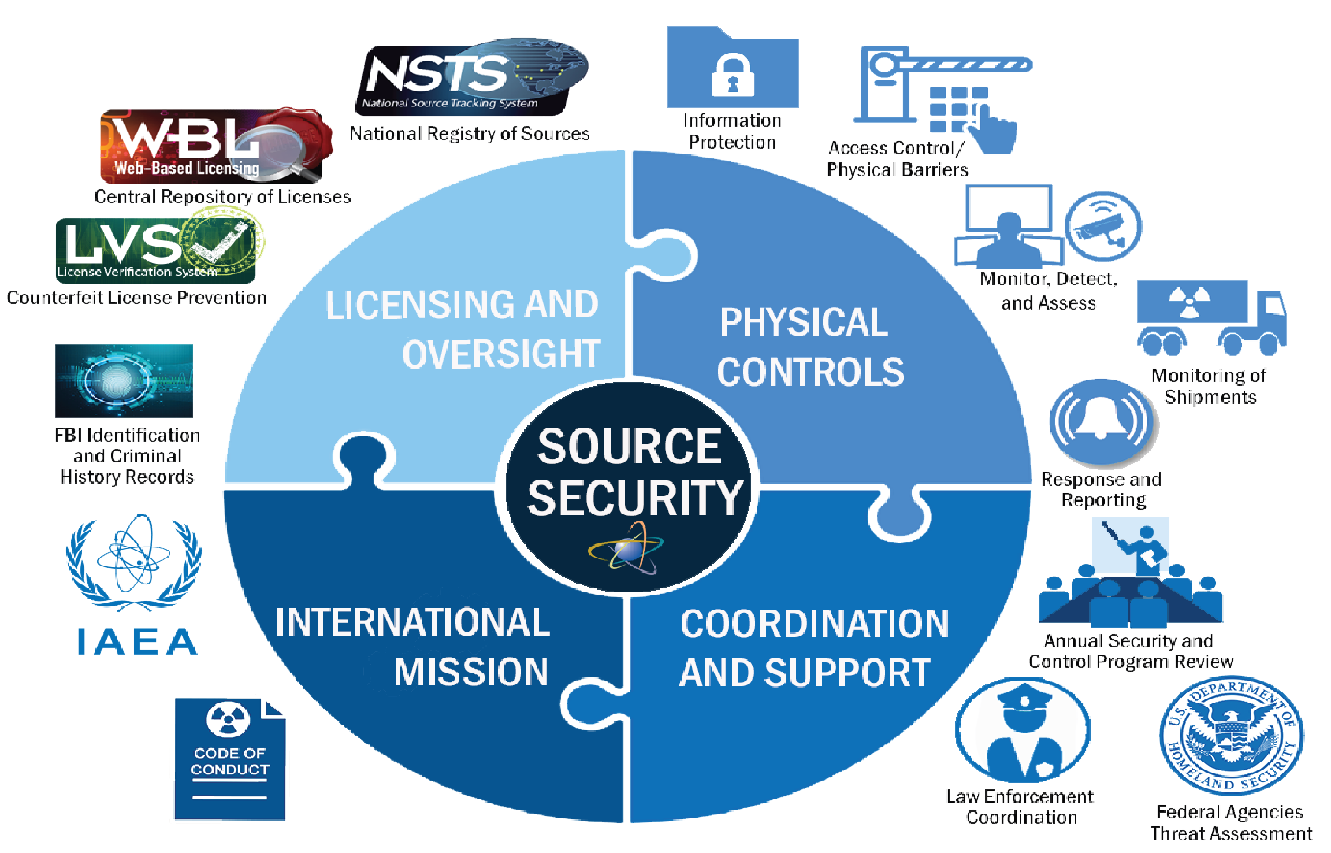
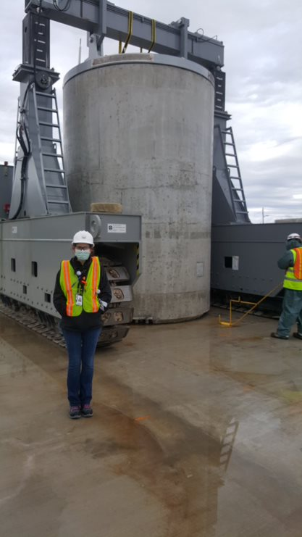
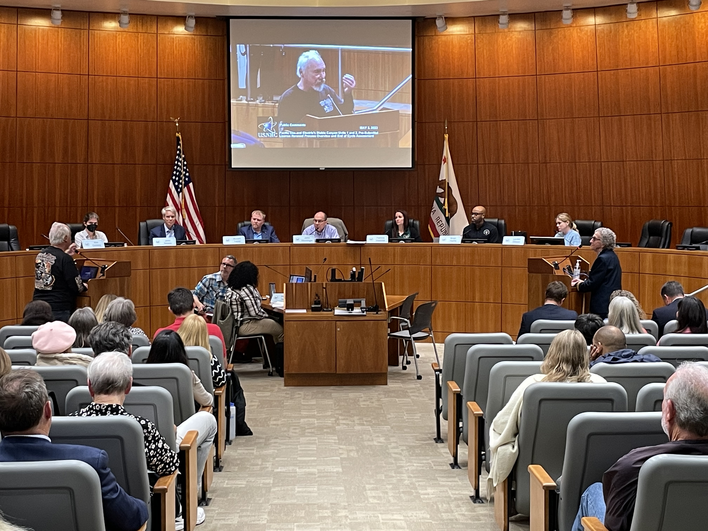
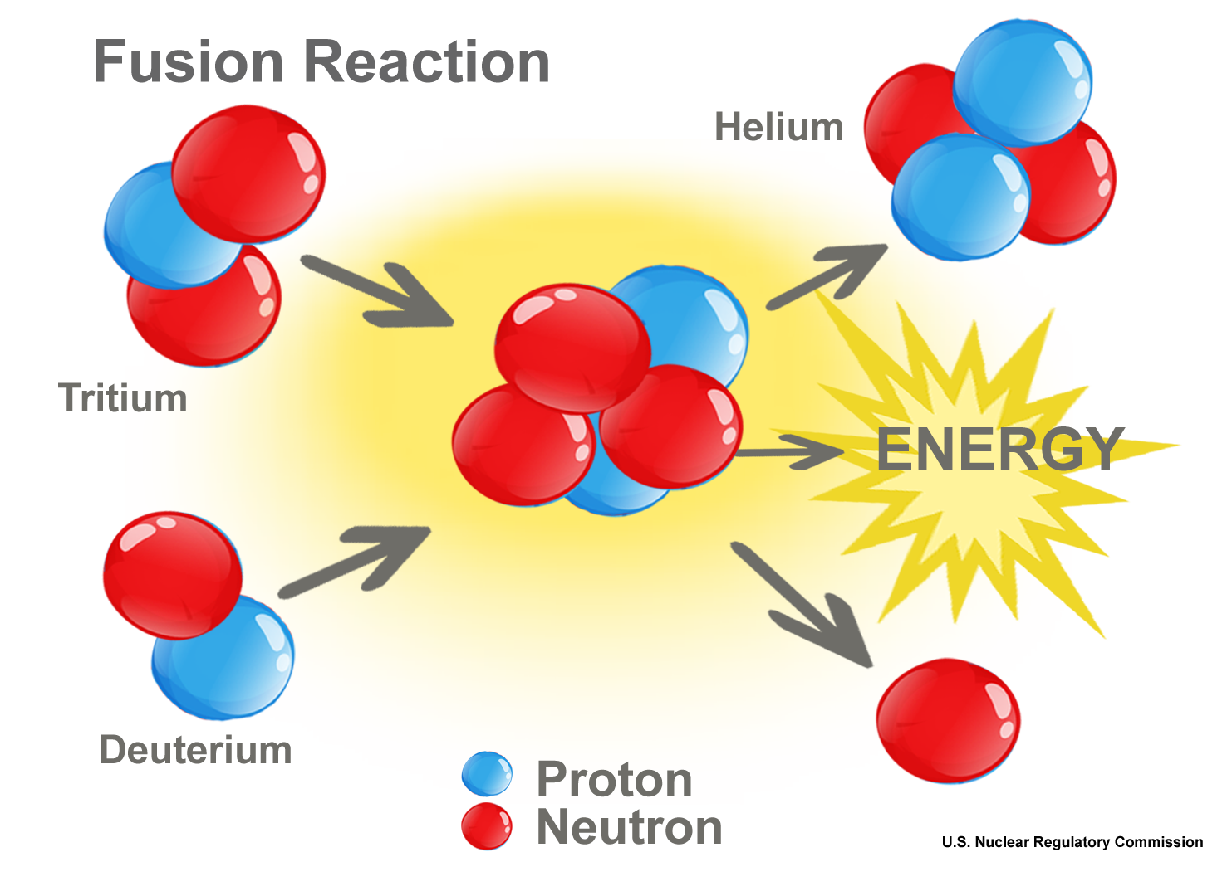
NMSS: who we are and what we do
Regulating uranium recovery and licensing fuel cycle facilities
Working together to assure the safe, secure, and environmentally responsible use of radioactive materials and nuclear facilities.
Regulating low-level waste
Working the Agreement States to regulate commercial, academic and medical use of materials
Regulating increased enrichment, higher burnup, and accident tolerant fuels
Ensuring Radioactive
Material Security
with the Agreement States and the international community
Engaging Tribal nations, States, the public, and other stakeholders
Developing regulatory framework for fusion
Regulating high-level waste & spent fuel storage and transportation

Slide 3
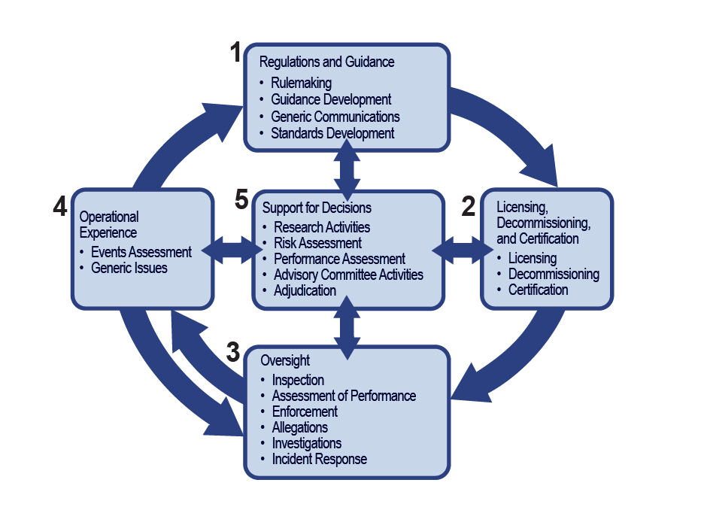
How the NRC Regulates

Slide 4
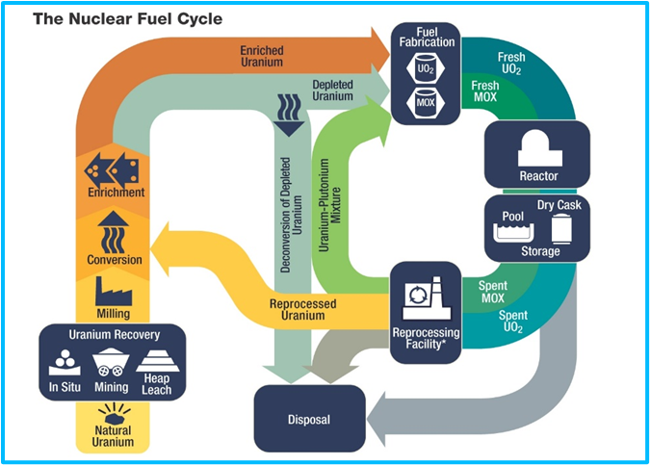
NMSS regulates the “front end” of the nuclear fuel cycle
Three uranium recovery sites located in NE, NM, and SD
Fuel cycle facilities
    One uranium hexafluoride conversion facility (“ready-idle” status)
    Six uranium fuel fabrication facilities
    Two gas centrifuge uranium enrichment facilities (one operating and one construction pending)
    One depleted uranium deconversion facility (construction decision pending)

Slide 5
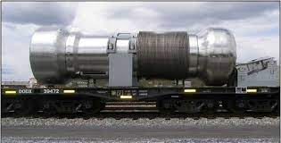
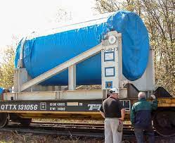
NMSS assures safe transportation of radioactive materials and storage of spent fuel.
More than 3 million packages of radioactive material shipped each year
Harmonization of Transportation Safety Requirements with International Atomic Energy Agency (IAEA) Standards rulemaking
  The NRC, in consultation with the U.S. Department of Transportation, is proposing to amend its regulations for the packaging and transportation of radioactive material to make them compatible with those of the IAEA.
  These changes are necessary to maintain a consistent regulatory framework for the packaging and transportation of radioactive material.

Slide 6
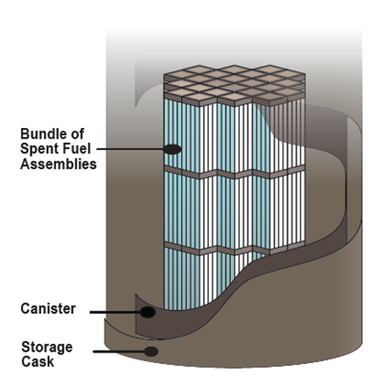
NMSS approves cask designs and leads licensing of on-site dry fuel storage (“back end” of the fuel cycle).
Loaded vertical HI-STORM 100 casks are storing
spent fuel at the Diablo Canyon Power Plant
85 licenses for independent spent fuel storage installations in 37 states including two consolidated interim storage facilities (CISFs).
The ISP/WCS facility CISF, located in Andrews County, Texas was licensed on 9/13/2021.
The Holtec HI-STORE facility CISF, to be located in Lea County, New Mexico was licensed on 5/9/2023.

Slide 7
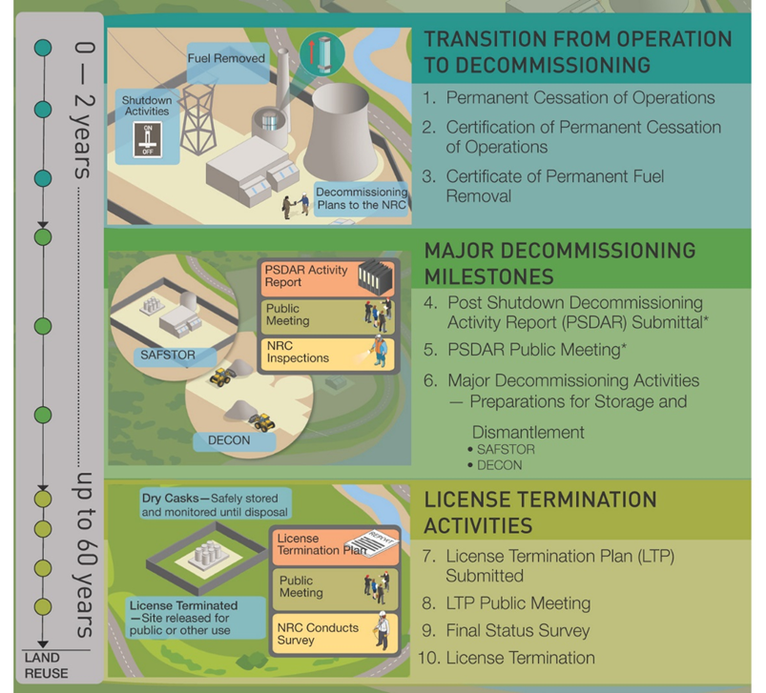
NMSS leads the reactor and materials facility decommissioning program
Verify licensees’ financial ability to decommission
Oversee decontamination and decommissioning
Terminate approximately 100 licenses per year
  11 power reactors have terminated their licenses after meeting the NRC’s criteria for unrestricted release. ​
  25 power reactors are in decommissioning​.
  7 present and anticipated license termination plans

Slide 8
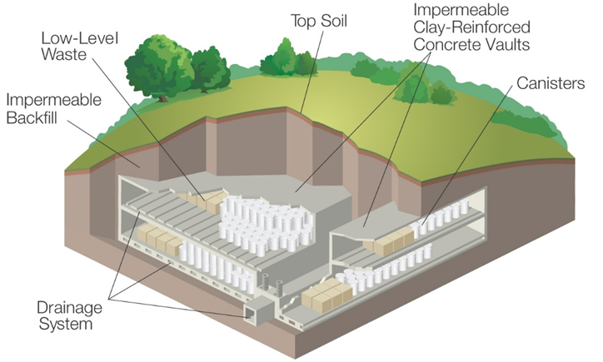
NMSS assures safe disposal of low-level radioactive waste.
Broad definition
Medical and academic waste, industrial gauges, etc.
    Categorized by hazard
A, B, C and “greater than class C”
Rulemaking examples: low level waste disposal and GTCC
    Four licensed facilities
    (all licensed by agreement states)
Washington
Utah
Texas
South Carolina

Slide 9
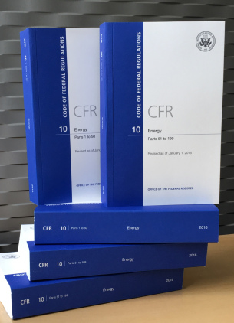
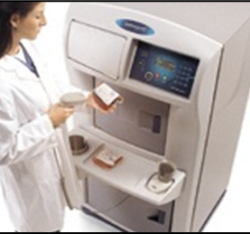
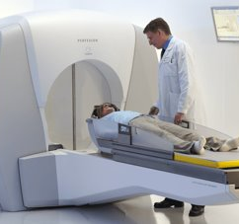
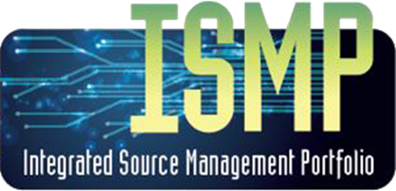
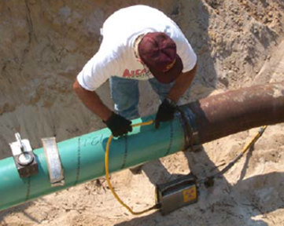
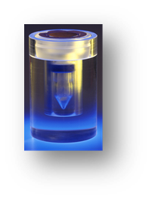
NMSS regulates medical, industrial, and academic uses of radioactive materials.
Materials licensees have the primary responsibility to maintain the security and accountability of the radioactive material in their possession.
Academic & Research Uses
Use of nuclear materials in universities, colleges, and other academic institutions for coursework, lab demonstrations, and research.
Source Security & Accountability
10 CFR Part 37 Physical security requirements for Category 1 and Category 2 radioactive materials
10 CFR Part 20, security, control and accounting control requirements.
National tracking of high-risk radioactive sources.
Industrial Uses
Industrial radiography
Irradiators
Gauges
Well logging
Consumer products
Medical Uses
Diagnostic uses
Therapeutic Uses
Research or in vitro testing

Slide 10
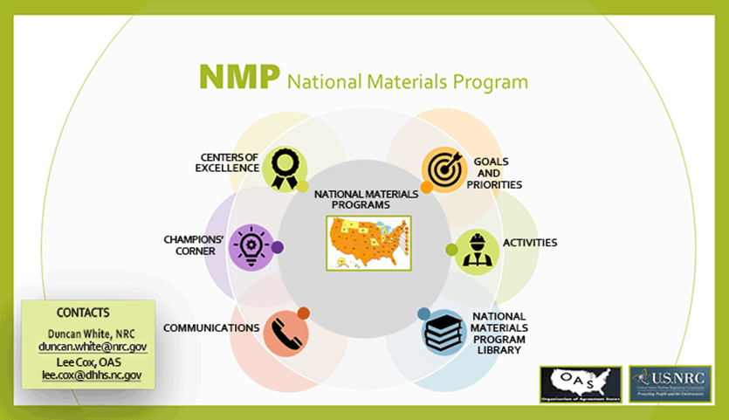
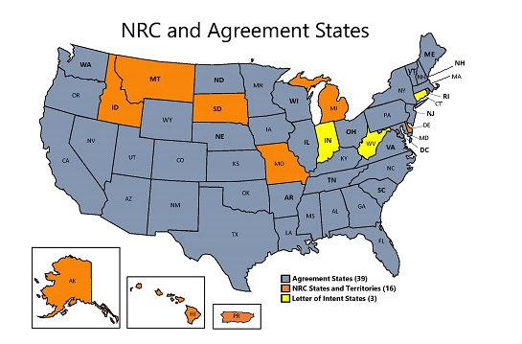
NMSS establishes the framework for safe and secure use of radioactive materials to protect people and the environment
The NRC and the Agreement States regulate activities associated with diverse uses of radioactive materials through the National Materials Program.
The NRC has oversight of over 2,100 licenses and the 39 Agreement States have oversight of over 16,000 licenses.
The National Source Tracking System tracks more than 80,000 higher-risk sources held by approximately 1,100 NRC and Agreement State licensees.

Slide 11
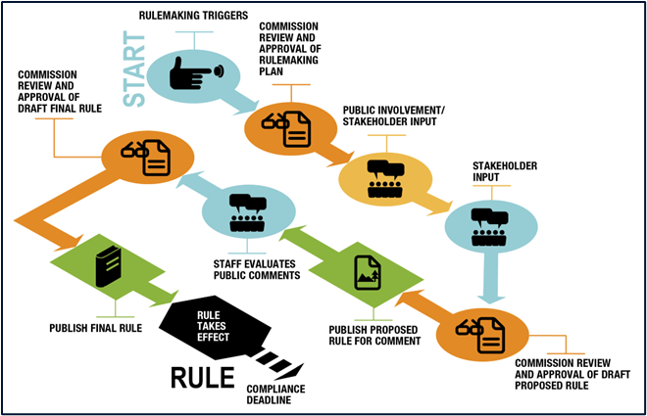
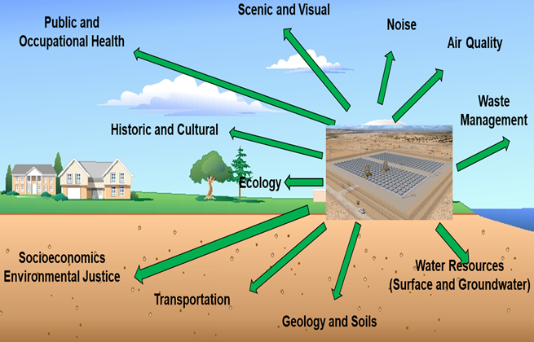
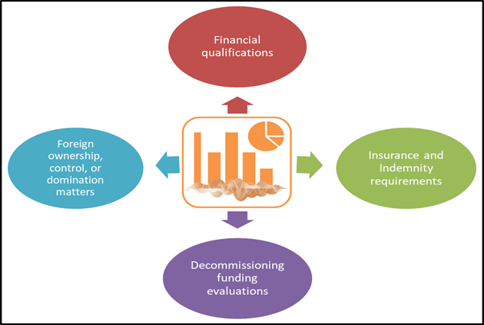
NMSS facilitates rulemaking, environmental, and
financial assessment activities
Rulemakings
Environmental Reviews
Financial Assurance
Develops and implements policies, procedures, and program management for the NRC’s rulemaking and petition for rulemaking activities.
Performs environmental reviews for licensing actions as required by National Environmental Policy Act, the Endangered Species Act, the National Historic Preservation Act, and other related acts.
Develops and implements policies and procedures for performing financial reviews for reactor and material licensees.
Prepares evaluations in support of individual licensing actions, topical reports, license renewal, combined license applications, or early site permits.

Slide 12

NMSS efforts are centered on meeting our mission, focusing on our people and our future, and optimizing our work
People
Trust
Workload

