Slide 1


Welcome from the RAMP Team
Edward Harvey
Radiation Protection Branch
Division of Systems Analysis
Office of Nuclear Regulatory Research
United States Nuclear Regulatory Commission

Slide 2


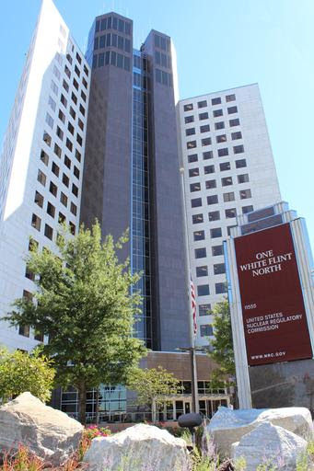
Nuclear Regulatory Research
Mandated by US Congress
Three technical divisions
  Division of Engineering
  Division of Risk Analysis
  Division of Systems Analysis
About 200 engineers, scientists, analysts, and support staff
  ~ 30% M.S. and 30% Ph.D.
Approximately $40M funding
2
2
Notes:
Mission of RES from public website

Slide 3
The Role of RAMP
RAMP is a computer code management program for development, maintenance and distribution of radiation/dose assessment codes:
Streamline updates/recognized code issues
Incorporating the latest accepted state of the art models
Incorporate new models as the need arises in current codes: i.e., VARSKIN and wound modeling
Fiscally responsible by leveraging group dynamics
Leverage the NRC expertise in member country activities; share international codes
Consolidation efforts to gain efficiencies

Slide 4
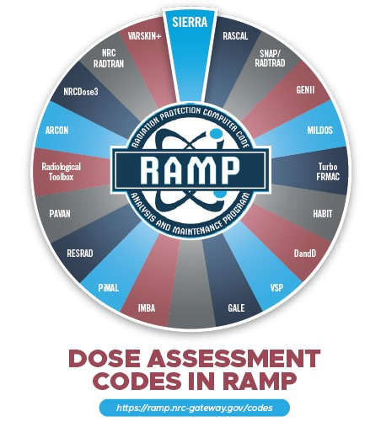
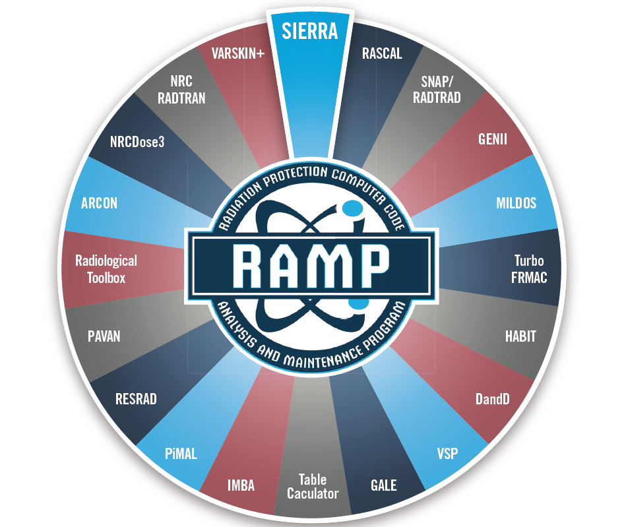
RAMP Computer Codes
Notes:
Here we have a display of all the codes available in RAMP. We currently maintain and distribute 16 computer codes and coordinate user support for an additional 3 (RESRAD, Turbo FRMAC, and VSP)
For additional information on our codes, you can always visit the RAMP website using the web address on this slide.

Slide 5

Welcome Italy!
Joining RAMP effective January 2023
Partnership with the Italian National Inspectorate for Nuclear Safety and Radiation Protection (ISIN)

Slide 6


International Agreements
  We currently have 15 RAMP Agreements with these partners:
  South Africa
  Ghana
  Singapore
  Canada
  Taiwan
  Spain
  Nigeria
  South Korea
  Australia
  Poland
  Ukraine
  Mexico
  Armenia
  United Arab Emirates
Italy

Slide 7
RAMP Code Updates

Slide 8
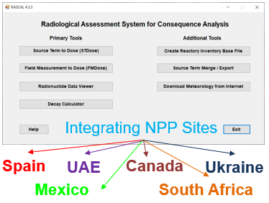
RASCAL
Fast-running software used for beyond-design-basis radiological incidents to assess off-site dose consequences and to help inform or evaluate protective actions.
Updates
  RASCAL 4.3.4 (1/2022)
    Additional Country Sites
    MetFetch issue resolved
    New settings options
    Various bug fixes
Notes:
Added international sites to the database for Spain and Ukraine and incorporated available power uprates.
Resolved MetFetch Issue
Added additional options on the settings screen (default calculation duration and default results units)
Various bug fixes

Slide 9
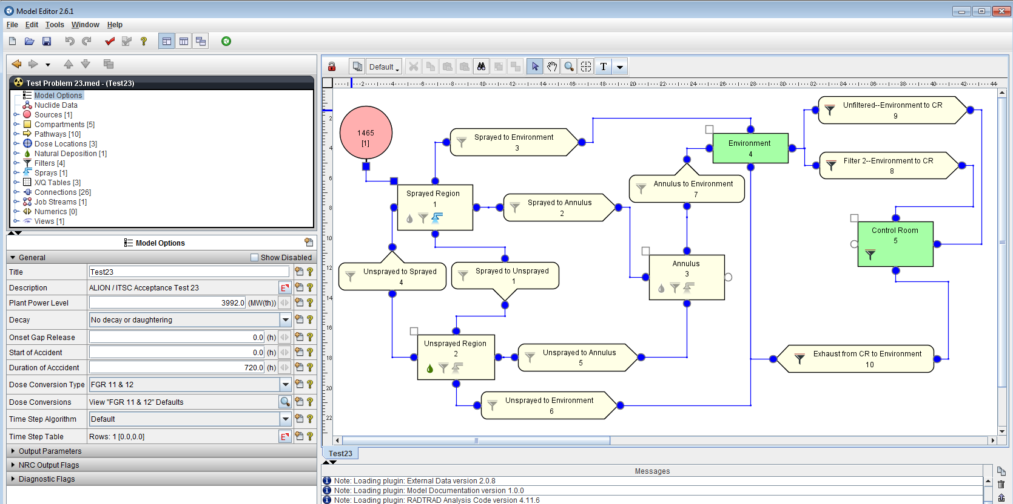
SNAP/RADTRAD
Used to perform dose calculations for design-basis accidents at the exclusion area boundary, low population zone, and control room.
Current Activities
RADTRAD-AC v5.0.3 – June 2022
RG 1.183 Rev. 1 Updates
Training November 1-3, 2022
Notes:
NRC staff performs licensing confirmatory analyses of the plant’s design and the licensee’s offsite and control room dose calculations following a design basis accidents.
RADTRAD Version 5.0.3 Released June 2022
Updates:- Modified the plots in the output plot file. There are now three options for generating output plot data. The plots are selected using the command line options identified below:
o--addTransPlots – Gives the transport group atom count per compartment and compartment location (atmosphere, surface, sump, or filtered).
o--addNucliPlots – Gives the set of nuclide plots per compartment and compartment location.
o--addActivityPlots – Compartment decay activity in Curies or MBq per compartment.

Slide 10
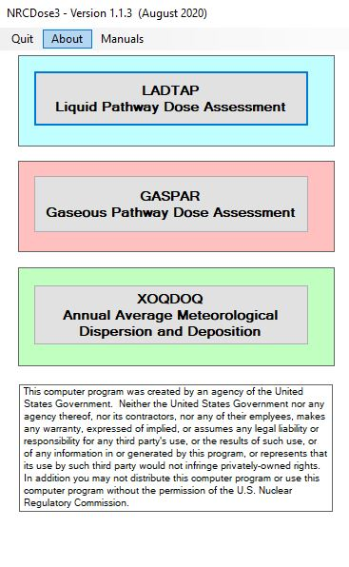
NRCDose3
GUI for the LADTAP II, GASPAR II, and XOQDOQ Fortran codes that implement NRC’s current requirements for As Low As Reasonably Achievable for radioactive effluents from NPP.
Current Activities
NRCDose3 v1.1.4 – November 2022
Publish NUREG: User Guide and Technical Manual
Code consolidation
Notes:
Code & Graphical User Interface (GUI) Changes:
GASPAR – On GUI screen input, included a check on the number of Special Locations, limiting the entry to 5 or less.
GASPAR – Added an “Info” pop-up message for Humidity, clarifying that absolute humidity (g/m³) should be entered in the temperature is entered as zero (0); otherwise, humidity should be entered as relative humidity as a percentage.
GASPAR – Changed the format used for entries on “Options” tab to store entered values as decimal numbers. This corrected calculations when entries were incorrectly recognized as integer values.
GASPAR – Included a pop-up message on the “Release time for purges” on the Source Term tab identifying that value must be less than 4380 hours. Use of a value greater than 4380 results in incorrect calculations of doses from C-14 releases.
LADTAP – Corrected the “Max Individual Hold-up Time and “Avg Individual Hold-up Time” (in the “Usage/Consumption” tab) to be consistent with Regulatory Guide 1.109 specified values as used for individual and population dose calculations for irrigated foods.
XOQDOQ – corrected issue when reading XOQDOQ legacy files.

Slide 11
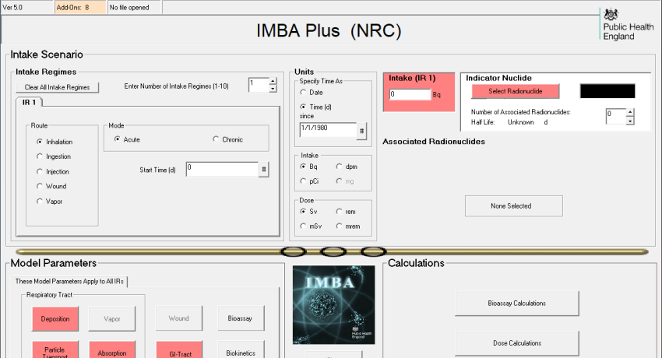
IMBA
The Integrated Modules for Bioassay (IMBA) software suite became available via RAMP in Spring of 2022!
Notes:
The Integrated Modules for Bioassay (IMBA) software suite is now live on RAMP! IMBA is a suite of software modules for internal dosimetry that implements respiratory tract, gastro-intestinal tract, tissue dosimetry, biokinetic and bioassay models as recommended by the International Commission on Radiological Protection (ICRP). Originally designed by the United Kingdom's Health Security Agency, the IMBA modules can estimate single or multiple intakes of different radionuclides and calculate resulting doses in the body and/or excrement for workers based on ICRP Publication 68 and US 10 CFR 835. IMBA provides a platform for conducting customized dose calculations with different user set parameters. The code has launched on the RAMP website and can be downloaded now, along with supporting documentation.

Slide 12
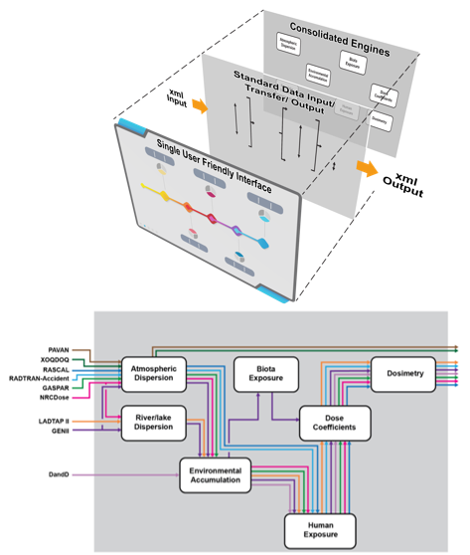

SIERRA
Notes:
Some of you may recall that the RAMP team has undergone and effort to consolidate many of our codes into a single user interface that will maintain the functionality of the individually codes. We are happy to announce that we have officially named this consolidated code SIERRA, which stands for Software Integration for Environmental Radiological Release Assessments.
Atmospheric dispersion module, which consolidates ARCON, PAVAN, and XOQDOQ, is in testing phase; official release next year

Slide 13

Feature Presentation
Jonathan Gill, PhD
Nuclear Incident Response Team and Nuclear Radiological Incident Task Force Program Manager
Notes:
I now have the pleasure and the privilege of introducing our next speaker.
Dr. Jonathan Gill is currently the Nuclear Incident Response Team and Nuclear Radiological Incident Response Task Force program manager in FEMA’s Chemical, Biological, Radiological and Nuclear office (CBRN) . Prior to this, Jon spent two and a half years at DOE/NNSA headquarters in the Office of Nuclear Incident Response as a fellow and lab detailee, where he advised and assisted in the management of various interagency projects involving radiological consequence management. Before his time at DOE, Jon conducted research at the University of Tennessee on optically stimulated luminescence applications for nuclear forensics, manufacture of surrogate nuclear debris, and dissolution and fusion methods for mass spectral analysis of surrogate and actual nuclear debris. In Jon’s previous life, he served eight years in the US Army as a unit leader and staff leader. His military experience spanned leading units up to 100 Soldiers and contractors in combat operations, managing large ground operations and logistics activities in austere conditions of over 3500 personnel covering approximately 100,000 square miles, and project managing construction projects.
Without further ado, I will turn it over to Dr. Gill to discuss his feature topic: FEMA Emergency Response. The floor is yours Dr. Gill!

Slide 14

Your Role
For this virtual meeting, I Challenge You…
To learn​
To participate​
To question ​
To think outside of the box​
To bring forward suggestions
for improvements​
To have fun​

Slide 15
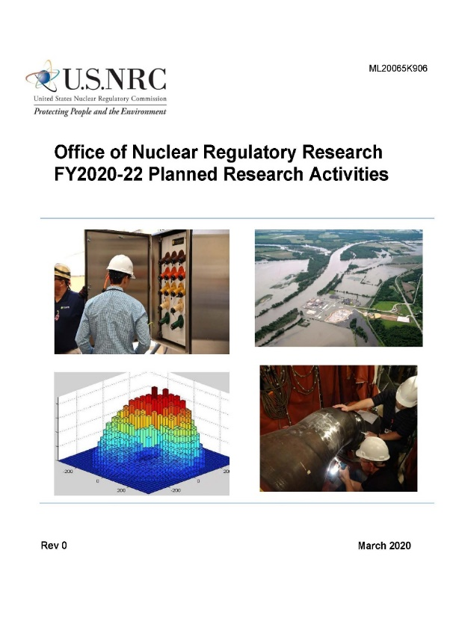
Key Research Areas
Thermal-Hydraulics
Fuel and Core
Risk Analysis
Human Reliability and Human Factors
Fire Safety
External Hazards
Materials Performance
Structural Performance
Domestic and International Collaboration
Digital Instrumentation & Control and Electrical
Severe Accident and Accident Consequences
Radiation and Environmental Protection

