Slide 1
Bremsstrahlung Emissions from Internal Beta Emitters 10 CFR 35.75 (Patient Release); RG 8.39, Rev 2 NRC Contract No: 31310019C0027
D. L. Boozer, PhD, CHP
D. M. Hamby, PhD

Slide 2
Introduction
Dose-Rate Kernel: a mathematical function for dose rate determination at a point $r$ due to photon emissions from point $r_{s}$
Bremsstrahlung photons are created because of acceleration of electric charge
energy spectrum is continuous from 0 to kinetic energy of the slowing charge
generally, bremsstrahlung is only significant for low mass, relativistic particles
two types of bremsstrahlung:
outer – resulting from deceleration of particles as they traverse a medium
bremsstrahlung as we usually think about it
inner – resulting from the acceleration of charged particles as they are produced
usually insignificant and we’ve ignored it in this model

Slide 3
Energy Spectrum from an X-Ray Tube
Bremsstrahlung energy spectra are complex
electron source spectrum
initial photon creation
attenuation due to shielding material
attenuation due to distance
usually includes characteristic X rays

Slide 4
Motivation
Provide a mathematical and scientific basis for estimating dose due to bremsstrahlung radiation emitted from:
an embedded electron/beta source
a diagnostic X-ray tube
Practical applications:
bystander dosimetry following radiopharmaceutical administration
developing photon energy spectrum for diagnostic-procedure dosimetry
input for Monte Carlo simulation

Slide 5
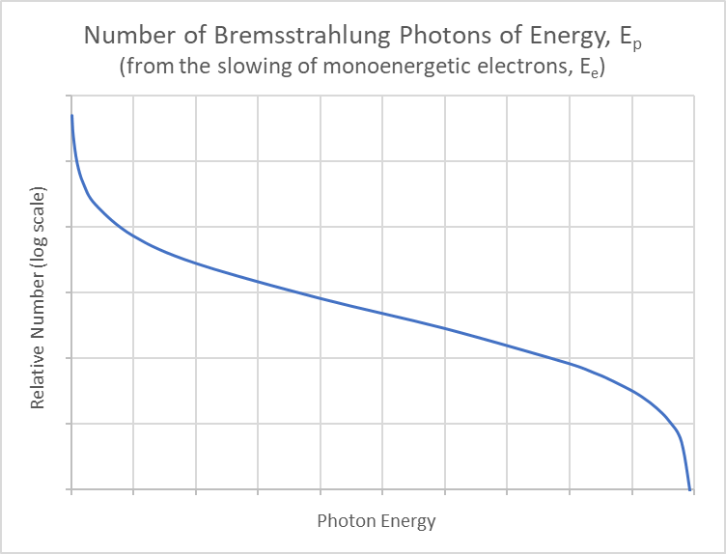
Bremsstrahlung Energy Spectrum Estimates*
Bremsstrahlung emission intensity
$$I\left(E_{p}\right)=4 E_{p}\left[\left(\frac{E_{e}}{E_{p}}−1\right)−\frac{3}{4}\ln\left(\frac{E_{e}}{E_{p}}\right)\right]$$
$I\left(E_{p}\right)$ can be normalized to estimate the number distribution of bremsstrahlung photons of energy $E_{p}$ emitted given monoenergetic electrons of energy $E_{e}$
$$N_{br}\left(E_{e},E_{p}\right)=\frac{16∙Y\left(E_{e}\right)}{5{ E}_{e}}\left[\left(\frac{E_{e}}{E_{p}}−1\right)−\frac{3}{4}\ln\left(\frac{E_{e}}{E_{p}}\right)\right]$$
$E_{p}$ = energy of emerging photon
$E_{e}$ = initial energy of slowing electron
$Y\left(E_{e}\right)$ = fraction of incident electron energy $E_{e}$ subsequently emitted as bremsstrahlung
(*Bethe and Heitler 1934; Wyard 1952; Shultis and Faw 2000; Heitler 2003)

Slide 6
Bremsstrahlung Dose-Rate Kernel
Then, the differential bremsstrahlung photon fluence at distance $r$ from the source is:
$$\frac{dψ}{dE_{p}}=N_{br}\left(E_{e},E_{p}\right) \left(\frac{B∙e^{−μx}}{4πr^{2}}\right)$$
Allowing calculation of a bremsstrahlung dose-rate kernel from the slowing of monoenergetic electrons of energy $E_{e}$ [mSv m² GBq⁻¹ h⁻¹]:
$$Δ_{e}=k\sum_{i}{f_{i}\int_{E_{min}}^{E_{e_{i}}}{E_{p}\frac{μ_{en_{i}}}{ρ}N_{br}\left(E_{e_{i}},E_{p}\right)∙B_{i}∙e^{−μ_{i}x} dE_{p}}}$$

Slide 7
Bremsstrahlung Dose-Rate Kernel
For beta emissions:
$$N_{br}\left(E_{p}\right)=\int_{E_{p}}^{E_{max}}{N_{β}\left(E_{e}\right)∙N_{br}\left(E_{e},E_{p}\right) dE_{e}}$$
Plot generated assuming electrons are traveling through 20 mm of tissue to create the bremsstrahlung photons
However, photons are assumed emitted isotropically from a point
$$∆_{b}\left({}_{}^{32}P\right)=4.73x{10}^{−4} \left[\frac{mSv m^{2}}{GBq h}\right]$$
E_{max} (³²P) = 1.71 MeV

Slide 8
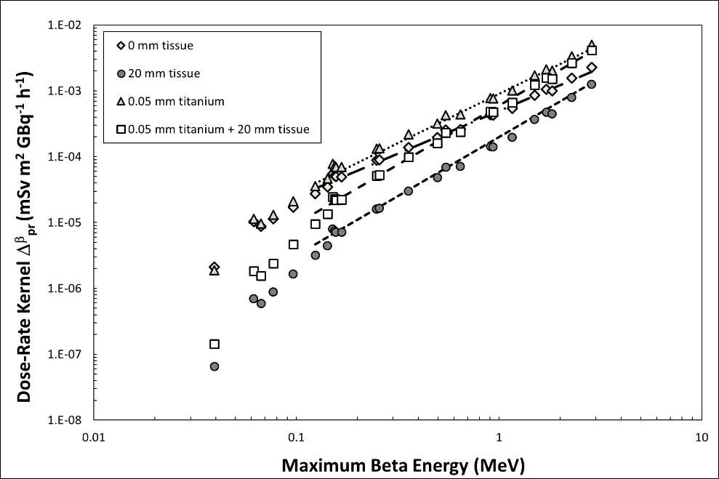
Dose-Rate Kernel as a Function of Max Energy
For scenarios of four encasement materials (see legend)
Dashed lines represent power function relationship of bremsstrahlung dose kernels based on maximum beta energy
Dose kernel for 20 mm tissue:
$$∆_{β} ≈0.0002{\left(E_{max}^{β}\right)}^{1.8}$$

Slide 9
Comparisons with MCNP (monoenergetic)

Slide 10
Comparisons with MCNP (continuous energy)

Slide 11
Comparison with Real World Data
Yttrium-90 microspheres are used for cancer treatment by direct tumor implantation
Sirtex (a manufacturer of the SIR-Sphere® Y-90 resin microsphere) studied the average bremsstrahlung dose rate from an injected patient
In their study:
2.1 GBq implanted into patient's abdomen
approximately 6 hours post implantation, exposure rate was 1.5 $μ$Sv/hr at 1 m
Results of this work:
2.1 GBq implanted into 2 cm of tissue
decay-corrected dose rate = 1.6 $μ$Sv/hr at 1 m

Slide 12
Components of Calculated Photon Emissions
Radionuclide | Gamma/X | MonoE electrons | Continuous beta | Total
³²P | - | - | 4.74E-04 | 4.74E-04
⁹⁰Y | 5.94E-07 | 2.26E-07 | 7.97E-04 | 7.98E-04
¹⁰⁶Ru | - | - | 6.54E-08 | 6.54E-08
¹⁰⁶Ru implant | - | - | 1.44E-07 | 1.44E-07
¹¹¹Ag | 4.00E-03 | 2.19E-07 | 1.69E-04 | 4.17E-03
¹⁶⁶Ho | 4.79E-03 | 4.30E-06 | 4.65E-04 | 5.26E-03
¹⁶⁹Er | 6.03E-07 | 2.98E-10 | 2.53E-05 | 2.59E-05
¹⁷⁷Lu | 5.44E-03 | 2.74E-06 | 4.05E-05 | 5.48E-03
¹⁸⁶Re | 3.42E-03 | 3.17E-06 | 1.41E-04 | 3.57E-03
¹⁸⁸Re | 8.90e-03 | 3.96E-06 | 5.77E-04 | 9.48E-03

Slide 13
Questions?

Slide 14
References
Bethe, H.A.; Heitler, W. On the stopping of fast particles and on the creation of positive electrons. Proceedings of the Royal Society of London. Series A, Containing Papers of a Mathematical and Physical Character. 146(856); 83-112: 1934.
Heitler, W. The quantum theory of radiation. 3rd ed. Dover Publications. Mineola, NY. 2003.
Shultis, J.K.; Faw, R.E. Radiation Shielding. American Nuclear Society. La Grange Park, IL. 2000.
Wyard, S.J. Intensity distributions of bremsstrahlung from beta rays. Proceedings of the Physical Society of London. A65, 377, 1952.

